Slide 1

Online Toxicity Analysis: Comparative Evaluation of Text Classification and Topic Modeling Techniques
Text Mining and Search
A.Y. 2025/2026
Garofalo Kevin 930804
Lonati Giulio 924924
Siano Vincenzo 934168

Slide 2

Introduction
Text Mining
Project
  Online platforms face increasing challenges in moderating toxic and abusive user-generated content at scale
  Toxicity detection goes beyond sentiment analysis, requiring understanding of context, sarcasm, and identity-based hate
  Manual moderation is not scalable, motivating automated Text Mining and NLP-based solutions
  This project compares classical machine learning and deep learning approaches for:
    Text Classification (multi-label, supervised learning)
    Topic Modeling (unsupervised learning)
01
Introduction

Slide 3

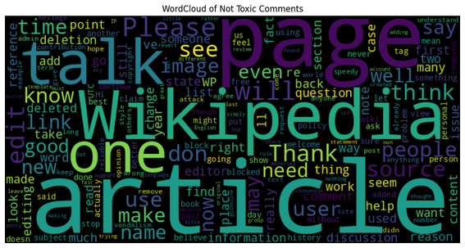
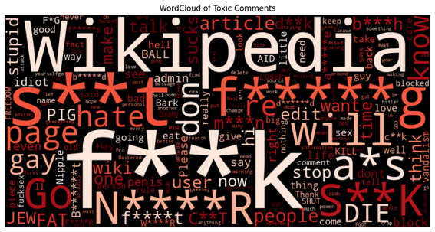
Dataset and EDA
Label | Count | Percentage
Toxic | 15,294 | 9.58%
Severe Toxic | 1,595 | 1.00%
Obscene | 8,449 | 5.29%
Threat | 478 | 0.30%
Insult | 7,877 | 4.94%
Identity Hate | 1,405 | 0.88%
Clean (non-toxic) | 143,346 | 89.83%
Text Mining
Project
  Dataset: Wikipedia talk pages’ comments (Train: 159,571, Test: 153,164)
  Labels: toxic, severe_toxic, obscene, threat, insult, identity_hate
  Severe class imbalance: e.g. threat, identity_hate
  Data Cleaning:
    Classification: Removed ambiguous labels (-1) from test set (63,978 samples)
    Topic Modeling: Combined train and test sets (22,468 samples for toxic-only subset, while 2,117 for identity_hate)
Dataset and EDA
02
  Distinct vocabularies for toxic vs. clean comments
  Overlapping length distributions for both toxic and non-toxic
  Some labels (e.g. threat, identity_hate) are extremely rare

Slide 4
Preprocessing
Text Mining
Project
General cleaning:
  HTML tags and URLs
  User mentions
  IP addresses
  Repeated characters
  Redundant whitespace
Statistical models:
  Tokenization
  Stop-word removal
  Lemmatization
Deep Learning models: no further cleaning to preserve context
Preprocessing
03

Slide 5



Text Classification
Text Mining
Project
Methods
  Text Representation
    Bag-of-Words for statistical classifiers
    Contextual word embeddings for Transformer-based models
  Machine Learning classifiers
    Naive Bayes, Logistic Regression, LinearSVM, SGD
    One-vs-Rest strategy
  Deep Learning
    Fine-tuned DistilBERT for multi-label prediction
    Binary Cross-Entropy loss and AdamW optimizer
    Dynamic padding (max length = 256)
Text Classification: Methods
04

Slide 6
Results
Text Mining
Project
Evaluation
Test set
Model | ROC-AUC
Naive Bayes (TF) | 0.8720
Logistic Regression (TF-IDF) | 0.9806
LinearSVC (TF-IDF) | 0.9688
SGD (Log Loss, TF-IDF) | 0.9769
SGD (Hinge Loss, TF-IDF) | 0.9797
DistilBERT | 0.9922
Model | ROC-AUC | F1 Macro
Logistic Regression | 0.9618 | 0.50
DistilBERT | 0.9865 | 0.61
Text Classification: Results
05

Slide 7
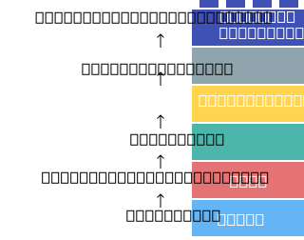
Topic Modeling
Text Mining
Project
Methods
  Bag-of-Words approaches
    Latent Dirichlet Allocation (LDA): term-frequency (TF) representation
    Non-negative Matrix Factorization (NMF): TF-IDF representation
  Contextual embeddings (BERTopic)
    Neural topic modeling via sentence embeddings
    Clustering-based topic discovery
      Density-based (HDBSCAN)
      Centroid-based (k-means)
Topic Modeling: Methods
06

Slide 8

Topic Modeling
Text Mining
Project
Results: Toxic-only
Model | Coherence | Lexical Diversity | Perplexity | Reconstruction Error | Semantic Diversity
LDA (k = 5) | 0.514 | 0.96 | 0,0010 | - | -
LDA (k = 10) | 0.515 | 0.97 | 0,0011 | - | -
NMF (k = 5) | 0.490 | 0.92 | - | 147.1227 | -
NMF (k = 10) | 0.457 | 0.69 | - | 145.6265 | -
BERTopic with HDBSCAN | 0.367 | - | - | - | 0.528
BERTopic with k-means (k = 5) | 0.454 | - | - | - | 0.276
BERTopic with k-means (k = 10) | 0.455 | - | - | - | 0.329
Topic Modeling: Toxic-only Results
07

Slide 9
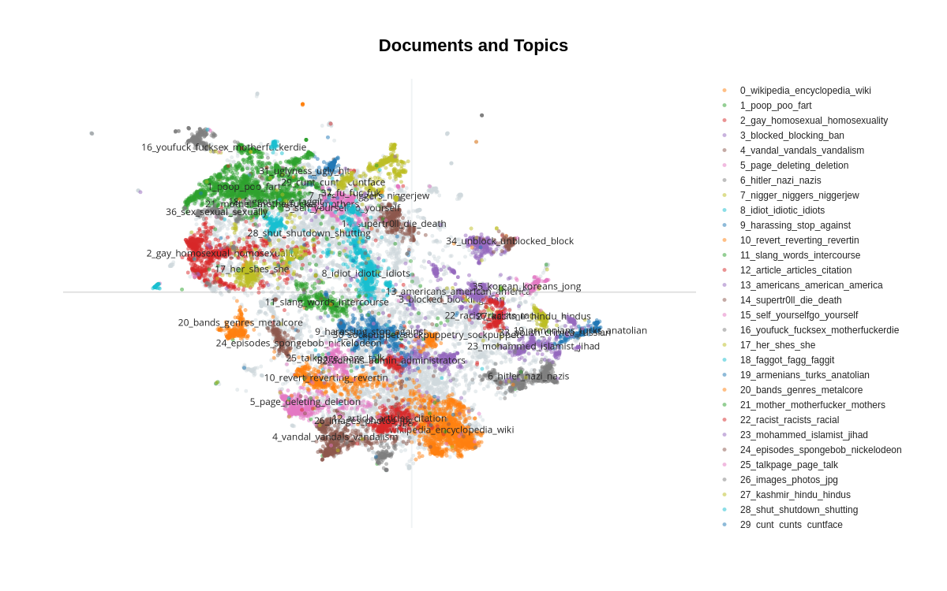
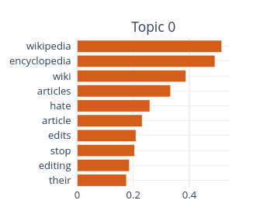
Topic Modeling
Text Mining
Project
BERTopic with HDBSCAN
Topic Modeling: Toxic-only Results
08

Slide 10


Topic Modeling
Text Mining
Project
Results: Identity Hate
Model | Coherence | Semantic Diversity
HDBSCAN | 0.3399 | 0.4352
k-means (k = 10) | 0.3778 | 0.3913
k-means (k = 5) | 0.3670 | 0.3341
Topic Modeling: Identity Hate Results
09

Slide 11
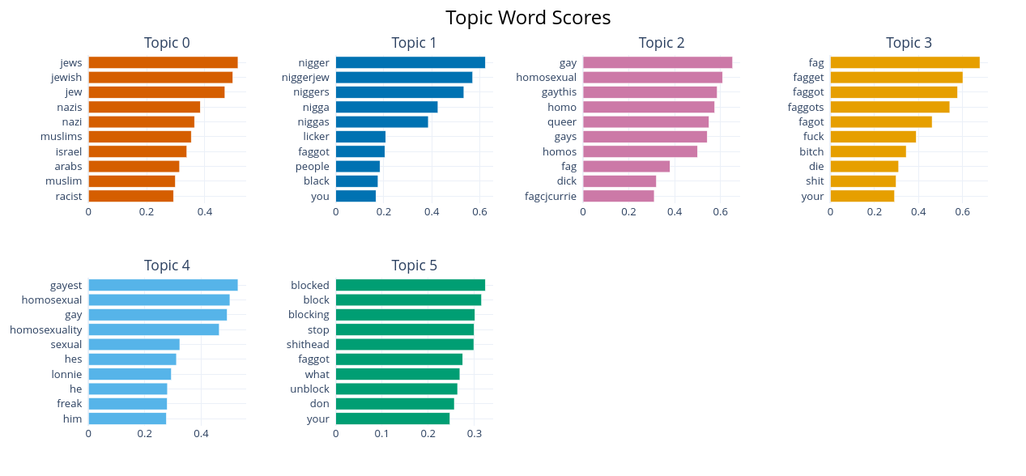
Topic Modeling
Text Mining
Project
BERTopic with HDBSCAN (Identity Hate)
Topic Modeling: Identity Hate Results
10

Slide 12
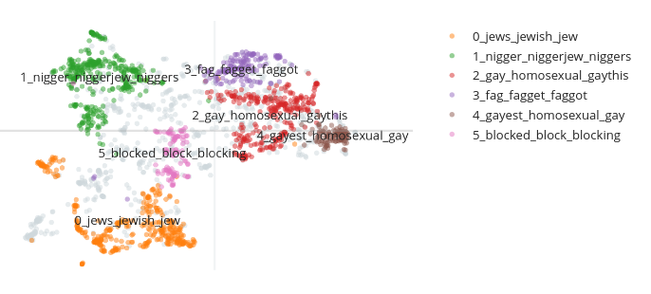
Topic Modeling
Text Mining
Project
BERTopic with HDBSCAN (Identity Hate)
Topic Modeling: Identity Hate Results
11

Slide 13


Strengths and Limitations
Text Mining
Project
Text Classification:
  Tuned Logistic Regression and SGD emerged as the strongest statistical models
    SGD offered faster training, while Logistic Regression achieved the best overall performance
  DistilBERT consistently outperformed classical models, especially on context-dependent and rare toxicity labels
  Limitation: single-model approaches were used
Topic Modeling:
  LDA and NMF produced relatively decent topics but struggled with semantic overlap
  BERTopic better captured nuanced, diverse forms of toxic language
  Limitation: embedding-based models are more sensitive to noise and produce many outliers
Strengths and Limitations
12

Slide 14



Conclusions
Text Mining
Project
Classification:
  Deep Learning vs. Traditional: contextual embeddings consistently outperformed lexical representations
  Addressed Challenges: successfully managed multi-label structure and severe class imbalance
Topic Modeling:
  Revealed recurring themes and nuanced patterns in toxic comments beyond classification
Future Developments:
  Optimization: ensemble methods and model stacking
  Hybrid approaches: combine classification with topic modeling
  Scaling: extension to multilingual datasets
Conclusions
13

Slide 15
  Thank you

