Slide 1
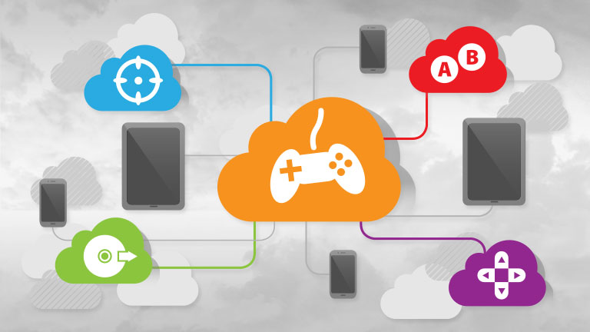

Slide 2
Gaming as a Service
SaaS
Vortex, PlayKey, Jump
PaaS
GaaS
LiquidSky, Snoot, GeForce Now
IaaS
Parsec

Slide 3
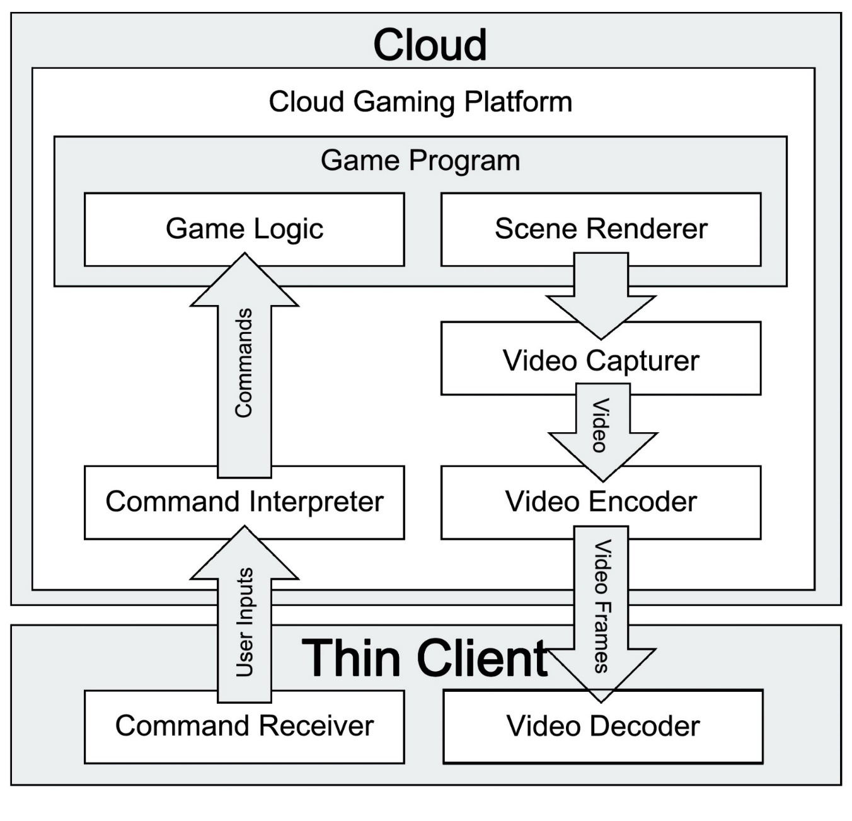
GaaS Architecture
System integration:
Simplicity VS
Optimization

Slide 4
Why Cloud Gaming?
Pro
No high hardware requirements
Game everywhere
No space requirements
No hacking
No cracking
Cons
Latency
Security issues
Notes:
Underline = game developer Pros

Slide 5
QoS & QoE
QoS: We can measure it, depends on technology we use and it changes from service to service. Es: bitrate, framerate, latency.
QoE: We can feel it, depends on our perception and changes from person to person. Es: quality of video and latency treshold.

Slide 6
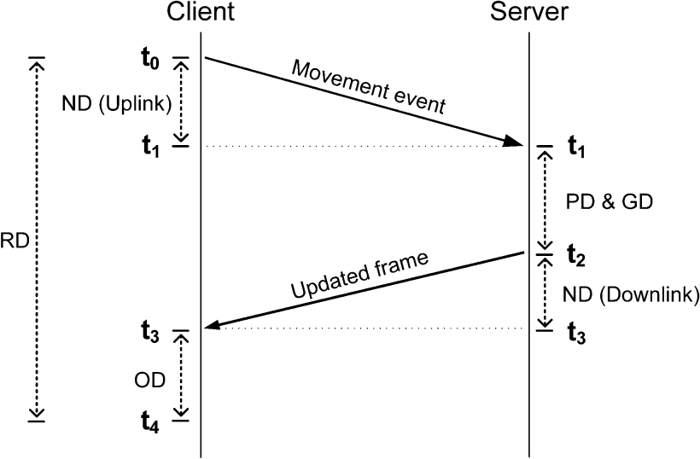
The latency problem
ND = Network delay PD = Processing delay GD = Game delay
OD = Playout delay

Slide 7
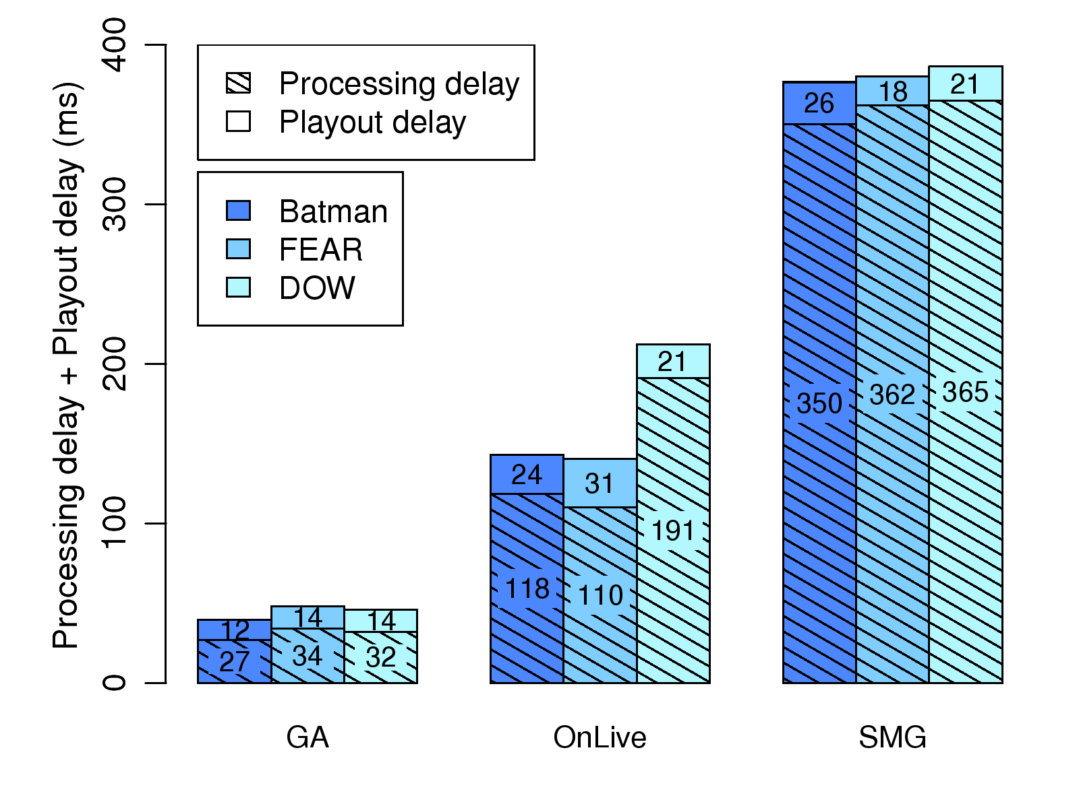
Latency comparison
NO NETWORK DELAY

Slide 8
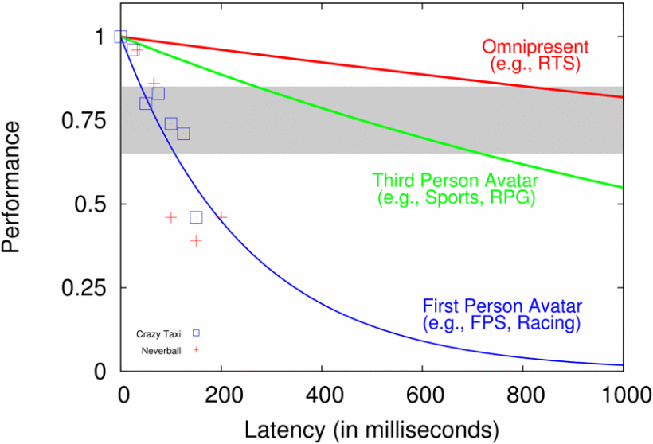
QoE

Slide 9
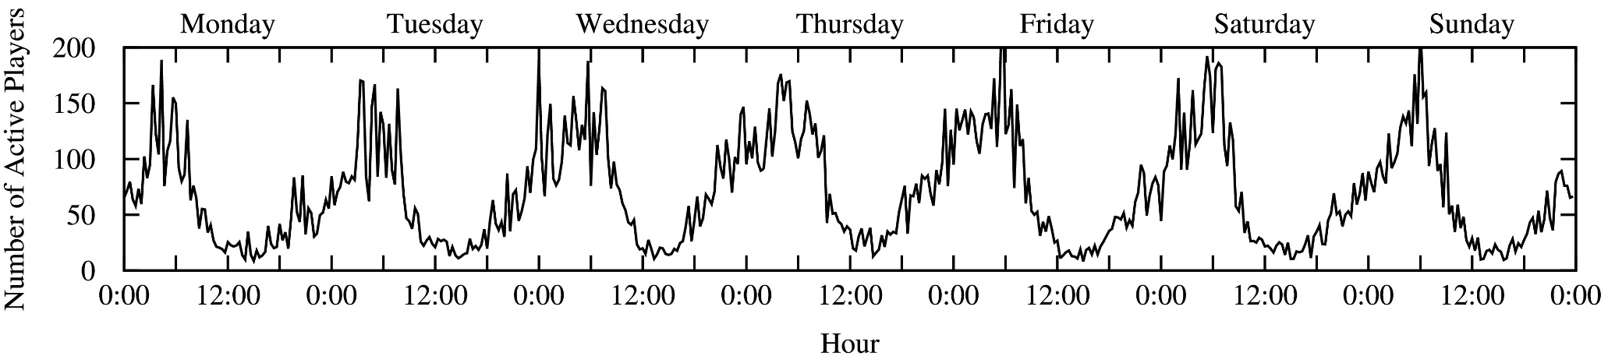
Infrastuctures optimization
vGPU: One GPU, more virtual instances.
Distributed architectures: The nodes are geographically distributed to ensure a good QoS for all the client. P2P protocol can be exploit to improve performace.
Minumum resource consumption: Dynamic allocation of the nodes (DBP).

Slide 10
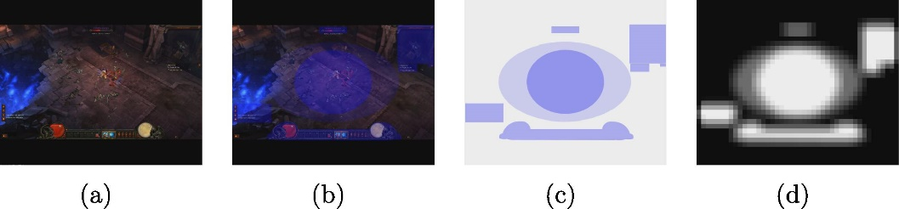
Data compression
Video compression: Simple 2D video compression. Some optimization could be done exploiting ROI and 3D warping.
Graphics compression: Compress 3D structures and 2D textures. Local scene rendering.
Hybrid compression: Use a layered approach through the compression of some 3D primitives and the video compression.

Slide 11
Adaptive Trasmission
Change framerate and bitrate accordly with network delay.
LAG
CLIENT
SERVER
DATA
FEEDBACK

Slide 12
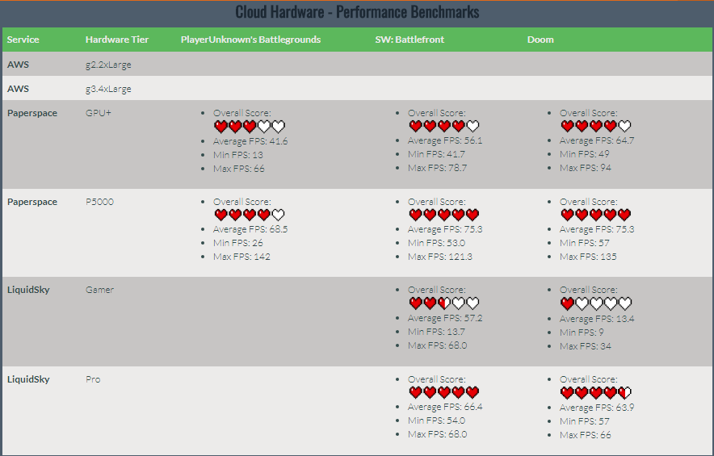

Slide 13


Slide 14
References
W. Cai, R. Shea, C. Huang, K. Chen, J. Liu, V. Leung, C. Hsu, "A survey on cloud gaming: future of computer games", IEEE Access, vol. 4, pp. 7605-7620, 2016.
K.-T. Chen, Y.-C. Chang, H.-J. Hsu, D.-Y. Chen, C.-Y. Huang, C.-H. Hsu, "On the quality of service of cloud gaming systems", IEEE Trans. Multimedia, vol. 16, no. 2, pp. 480-495, Feb. 2014.
M. Claypool, D. Finkel, "The effects of latency on player performance in cloud-based games", Proc. 13th Annu. Workshop Netw. Syst. Support Games (NetGames), pp. 1-6, Dec. 2014.
Y. Li, X. Tang, W. Cai, "Play request dispatching for efficient virtual machine usage in cloud gaming", IEEE Trans. Circuits Syst. Video Technol., vol. 25, no. 12, pp. 2052-2063, Dec. 2015.
K. Sun, D. Wu, "Video rate control strategies for cloud gaming", J. Vis. Commun. Image Represent., vol. 30, pp. 234-241, Jul. 2015.
http://gaminganywhere.org/gaming_anywhere.html
http://www.droidviews.com/play-pc-console-games-on-android-without-emulator-with-cloud-gaming/
http://gameunoia.com/best-game-streaming-provider-september-comparison/
http://thoughtprovokingtech.com/TPT-CGF17.html

