Slide 1



K-Means Algorithm for the Hadoop MapReduce Framework
CLOUD COMPUTING project
Academic year 2022/2023
Giulio Capecchi
Federico Frati
Stefano Micheloni

Slide 2

Introduction
K-means algorithm is a widely used clustering technique
Aim of this project is to implement the K-means algorithm using the Hadoop framework
Specifically, by creating a MapReduce model, for:
Scalability
Efficiency

Slide 3

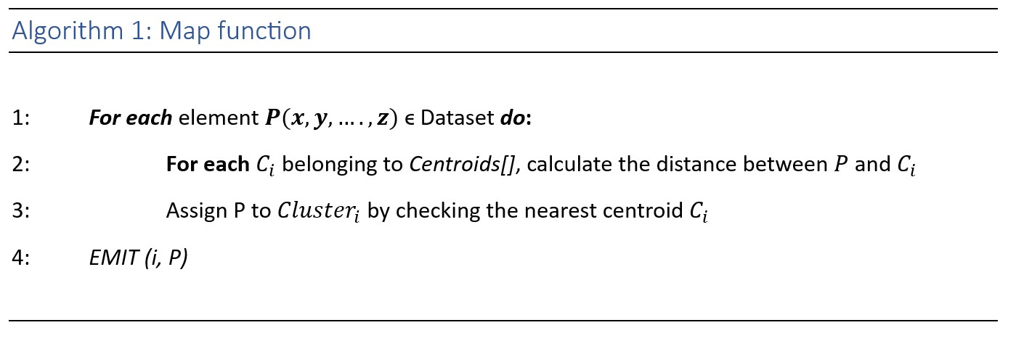
Pseudocode (1)

Slide 4
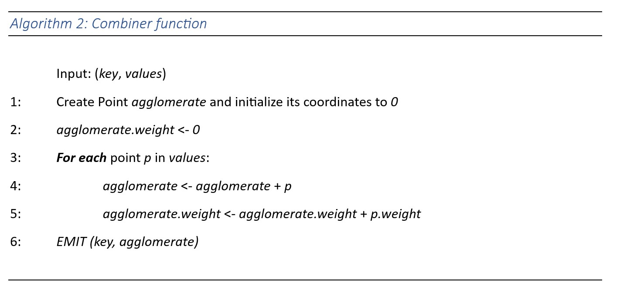
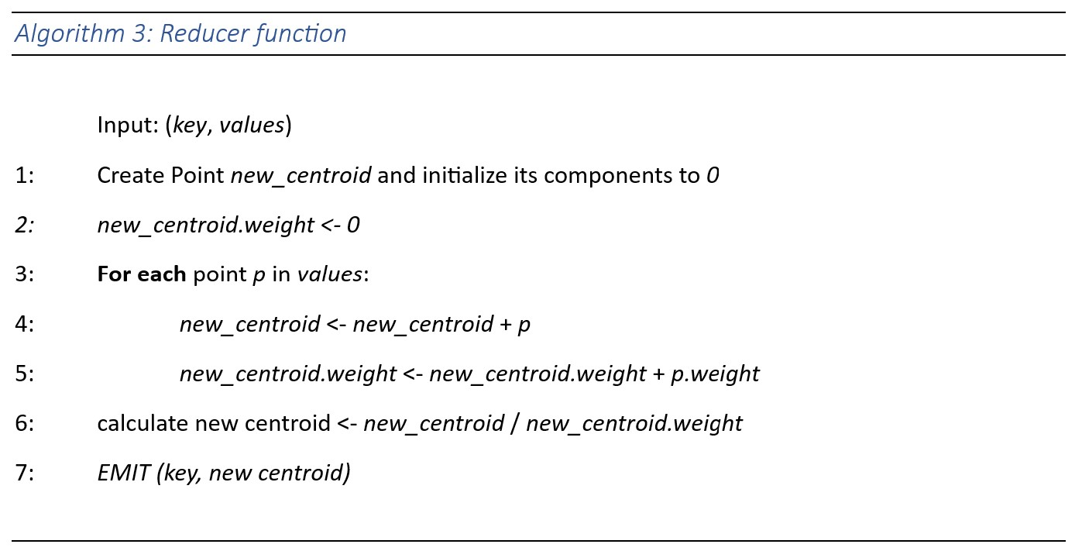
Pseudocode (2)

Slide 5
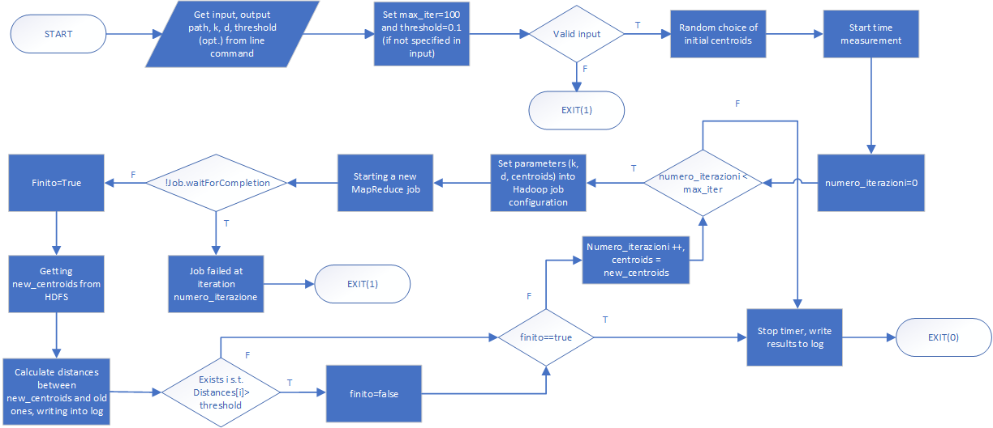
FLOWCHART

Slide 6
MAPREDUCE IMPLEMENTATION
Split
<Key, Row>
Mapper
Shuffle and Sort
Coordinates.txt
<ID_cluster, Point>
<ID_cluster, list of Points>
<ID_cluster, list of Points>
Reducer
Combiner
<ID_Cluster, New_Centroid>
<ID_cluster,
Partial_sum>

Slide 7
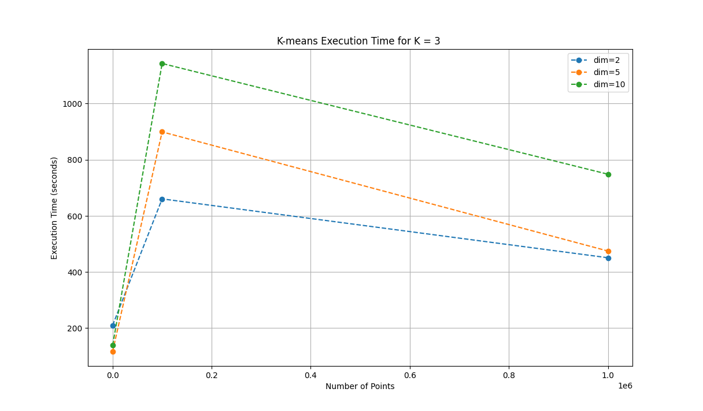
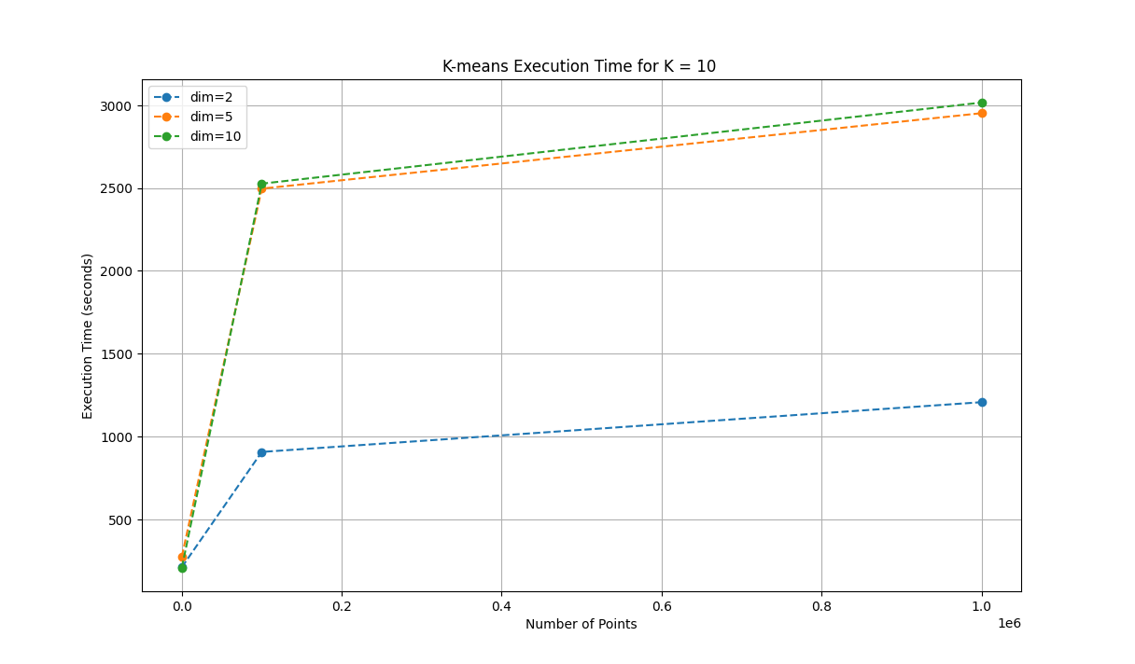
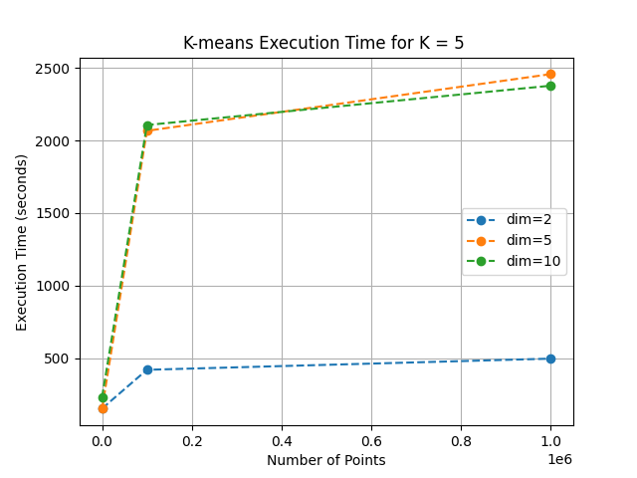
RESULTS OBTAINED with max_iter=100, threshold=0.1

Slide 8

CONCLUSIONS
Execution times influenced by:
Size of the dataset
Number of points (n)
Points’ dimension (d)
Stop criteria
Non-linear correlation between execution time and dataset size
Suitability for Big Data!
Possible improvements:
Smart choice of initial position of centroids
Clusterized dataset

Slide 9


Thanks for your attention!
We hope you found interesting this presentation.

