Slide 1

Transit Anomaly Detection for Airport and Border Control Data
Machine Learning (LUISS 2025-2026)
Georges-Alexis Mitracos, Giulio D'Amico

Slide 2

Agenda
01
CONTEXT & DATA
Business Context & Relevance, Data Overview & Key Insights
02
CLASSICAL ML APPROACH
Feature Engineering & Detection Strategy, Results & Performance
03
MULTI-AGENT APPROACH
LangGraph Architecture, Agent Performance & Report Quality
04
COMPARISON & NEXT STEPS
Head-to-Head Comparison, Limitations & Risks, Take-Home Message

Slide 3

Act 01
CONTEXT & DATA
Business Context & Relevance, Data Overview & Key Insights

Slide 4
Reactive border control detection leaves security gaps that a data-driven system can close
Context, Mission, Objectives and Outcomes
"When dangerous items appear only 1% of the time, human error rates reach 30%" Bazerman & Chugh, Harvard Business Review, 2006
CONTEXT & MISSION
Border control authorities process thousands of transits daily with rich metadata, but anomaly detection today is largely manual and reactive
A proactive system flags suspicious patterns before they escalate
OBJECTIVES
Implement the same anomaly detection system twice : classical ML pipeline and multi-agent architecture
Compare both approaches to determine which is more suitable under different conditions
Produce an actionable anomaly report ranked by priority score and confidence interval
OUTCOMES
A ranked list of anomalous routes with risk level (CRITICAL / HIGH / MEDIUM / LOW) and Wilson 95% CI
A comparative analysis of two paradigms to guide future deployment decisions
A natural-language report generated by a local LLM
4

Slide 5
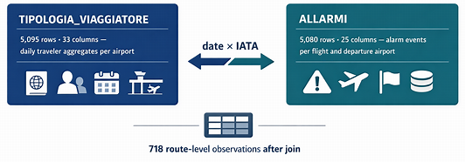
Two messy Italian datasets required systematic quality engineering before any modelling
Data Overview and Quality Challenge
Key Insights
Hidden Data Issues: A cardinality audit revealed that columns officially showing 0% missing values were actually full of dirty inputs: strings instead of numbers ("1 pax", "~5"), mixed IATA casings ("TIA", "Tia"), and 6 mixed date formats.
Standardization > Imputation: Only three columns had true missing values (e.g., OPERATOR_NOTES at 99%). The real challenge was fixing the inconsistent Italian raw text.
The Resolution: We built 5 reference dictionaries and applied targeted cleaning to output 718 pristine route-level observations, perfectly formatted for modelling.
5

Slide 6
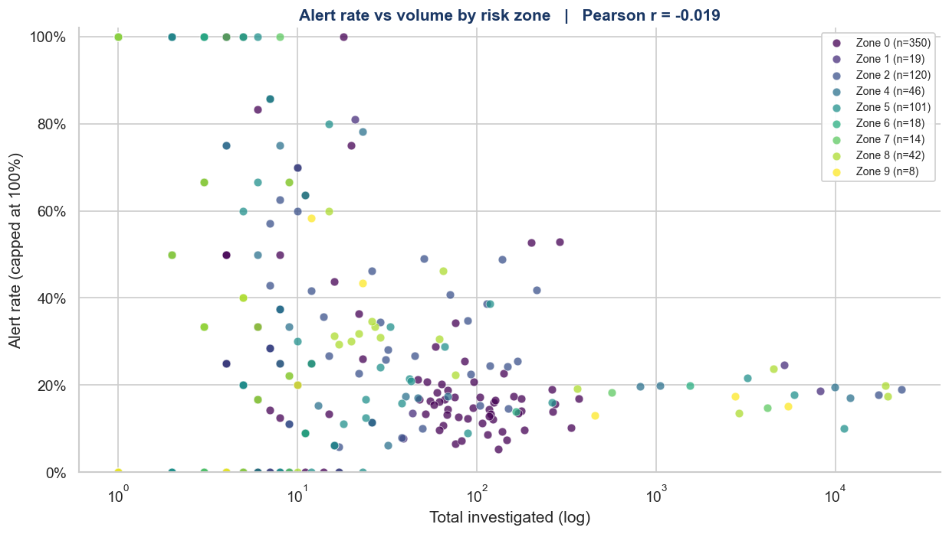
Volume does not equal risk, separating true threats from statistical noise requires a data-driven model
Route-level analysis: Why traditional volume-based profiling fails.
Key Insights
Alert Rate vs. Passenger Volume by Risk Zone
(Pearson r = -0.019)
Volume ≠ Risk: A Pearson correlation of -0.019 proves that larger flights do not proportionally generate more alerts. Security risk is mathematically decoupled from traffic size.
The Small-Sample Trap: Manual detection relying on "highest alert rates" is flawed. Tiny flights (< 10 passengers) hit a 100% alert rate from a single incident, creating operational noise rather than revealing systemic threats.
The Data-Driven Imperative: Static rules fail in this variance. To move from reactive sorting to proactive detection, we must deploy algorithmic models capable of identifying hidden behavioral anomalies regardless of flight size.
Note:Alert rate = total alarms / total investigated, capped at 100%. Pearson r computed on 718 route-level observations. Zones represent geographic risk classifications assigned by border control authorities.
6

Slide 7
Act 02
CLASSICAL ML APPROACH
Feature Engineering & Detection Strategy, Results & Performance

Slide 8
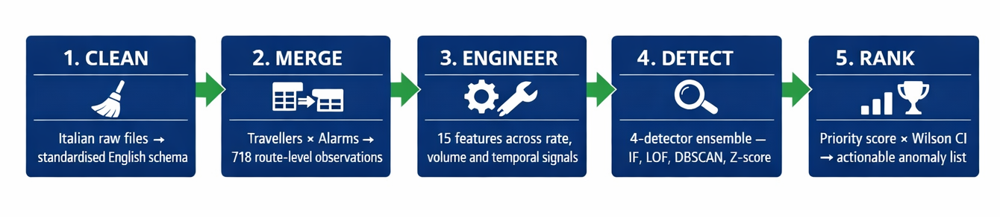
A 5-stage pipeline transforms 10,000 raw records into 15 leak-free features ready for detection
Classical ML Pipeline and Feature Engineering
Rate Signals | Volume Signals | Temporal Signals
Features: alarm_rate, rate_deviation, investigation_rate, alert_rate_ALB/AFG | Features: entries, tot_alarms, traffic_multiplier, n_high_risk | Features: alarm_rate_yesterday, rolling_7d_avg_rate, is_weekend, month
Why: Isolates true risk from flight size and flags historically dangerous corridors. | Why: Ensures algorithms contextualize the sheer scale and raw exposure of the route. | Why: Captures seasonal trends and sudden behavioral shifts against local baselines.
8

Slide 9
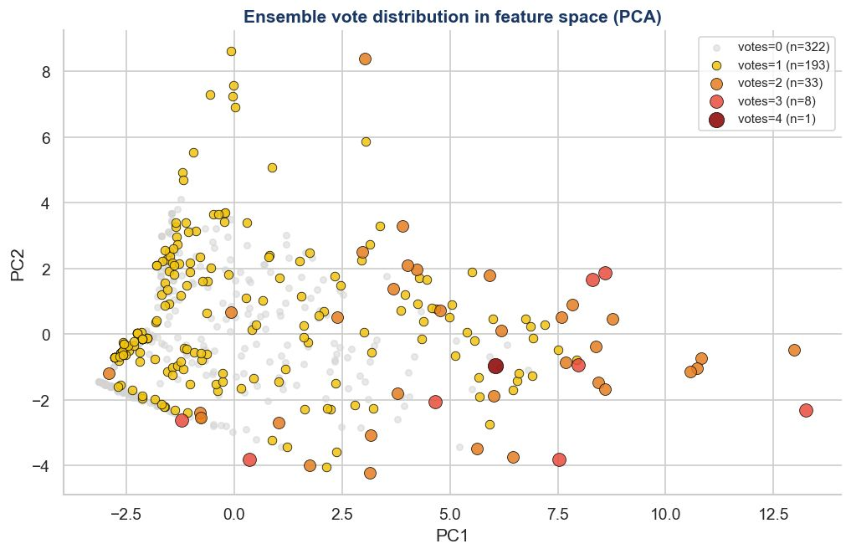
Four detectors vote independently, only routes isolated by multiple algorithms are confirmed anomalies
Outlier Detection — Ensemble Consensus Strategy
Ensemble Vote Distribution in Feature Space (PCA Projection)
Key Insights
Geometric Consensus: PCA visually isolates structural anomalies. Routes with 2+ votes clearly separate from the dense "normal" baseline.
Noise Filtering: 193 single-vote alerts discarded. One algorithm's flag is noise; multi-algorithm agreement is a verified signal.
High-Confidence Threats: 9 extreme anomalies (3-4 votes) flagged by almost all detectors, neutralizing individual model biases.
Controlled Yield: The 2+ threshold isolates 42 anomalies (5.8%). This aligns perfectly with our 5% contamination prior, proving zero over-flagging.
Note: 718 route-level observations projected onto 2 principal components. Colour and size reflect detector consensus from votes=0 (grey) to votes=4 (dark red). Consensus threshold ≥2/4. Contamination = 0.05.
9

Slide 10
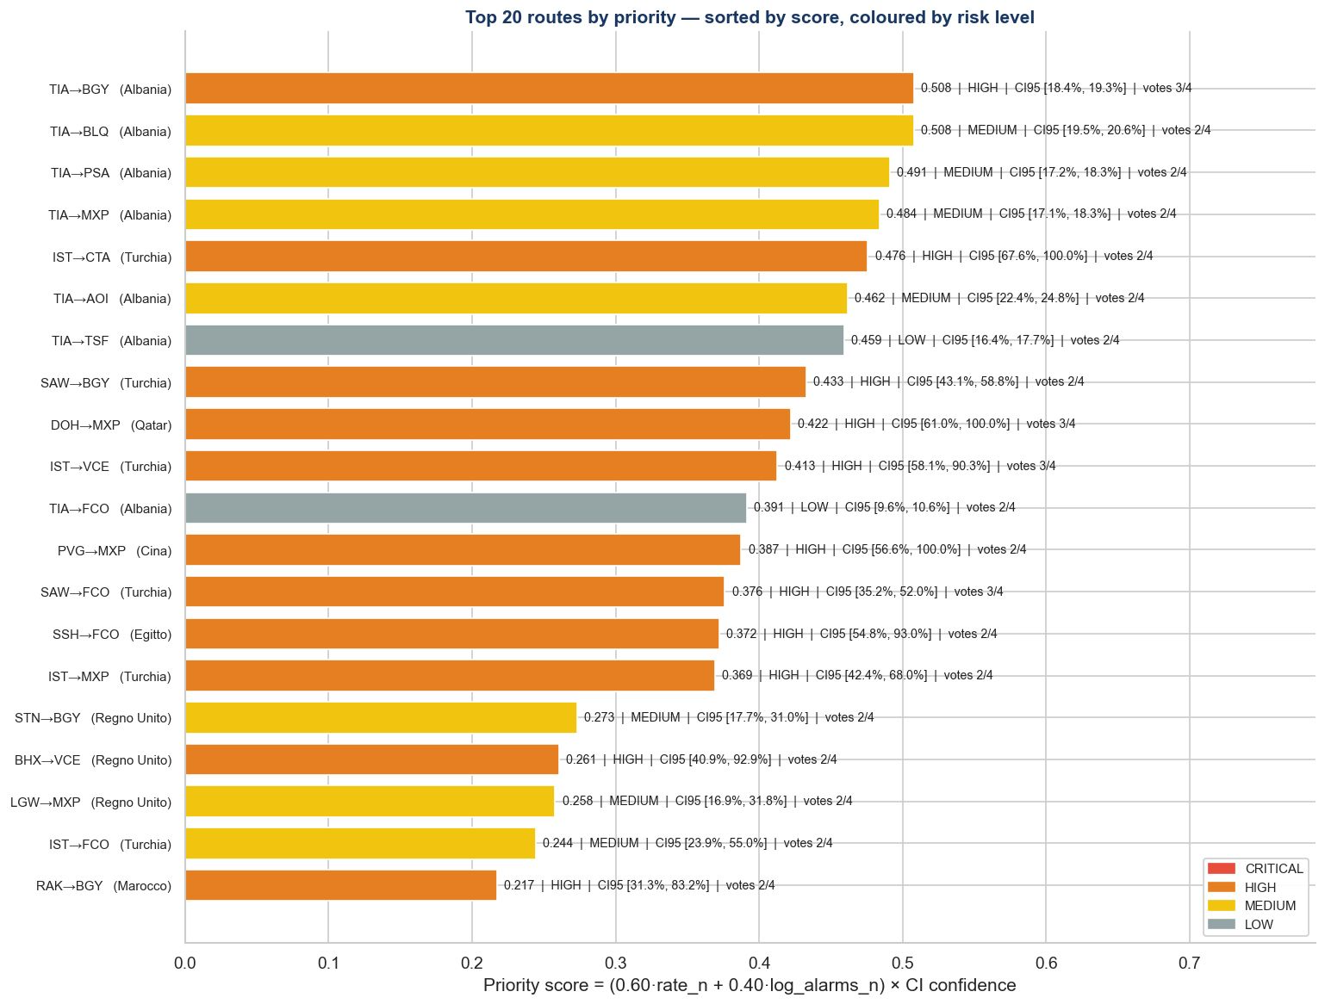
Explaination
Albanian and Turkish corridors dominate the top 20 anomalies, led by TIA→BGY (Score: 0.508)
Classical Pipeline Results
Top 20 Routes by Priority Score (coloured by risk level)
Key Insights
Albanian Dominance: 7 of the top 10 anomalous routes originate from Tirana (TIA). These routes exhibit high priority scores with statistically tight confidence intervals.
The Wilson CI Safeguard: Turkish routes (e.g., IST→CTA) show extreme raw alert rates but are mathematically downweighted by wider confidence intervals due to lower volume. This successfully prevents small-sample false positives.
Beyond the Top 2: The model captures diverse, non-obvious corridors in the tail (Qatar, China, Egypt, Morocco). This proves the ensemble detects underlying structural anomalies, not just regional biases.
Note: Priority score = (0.60 × alert_rate_norm + 0.40 × log_alarms_norm) × Wilson CI confidence. CI 95 computed on alert rate per route. Routes with insufficient sample size are downweighted automatically by the CI factor.
10

Slide 11
Act 03
MULTI-AGENT APPROACH
LangGraph Architecture, Agent Performance & Report Quality

Slide 12
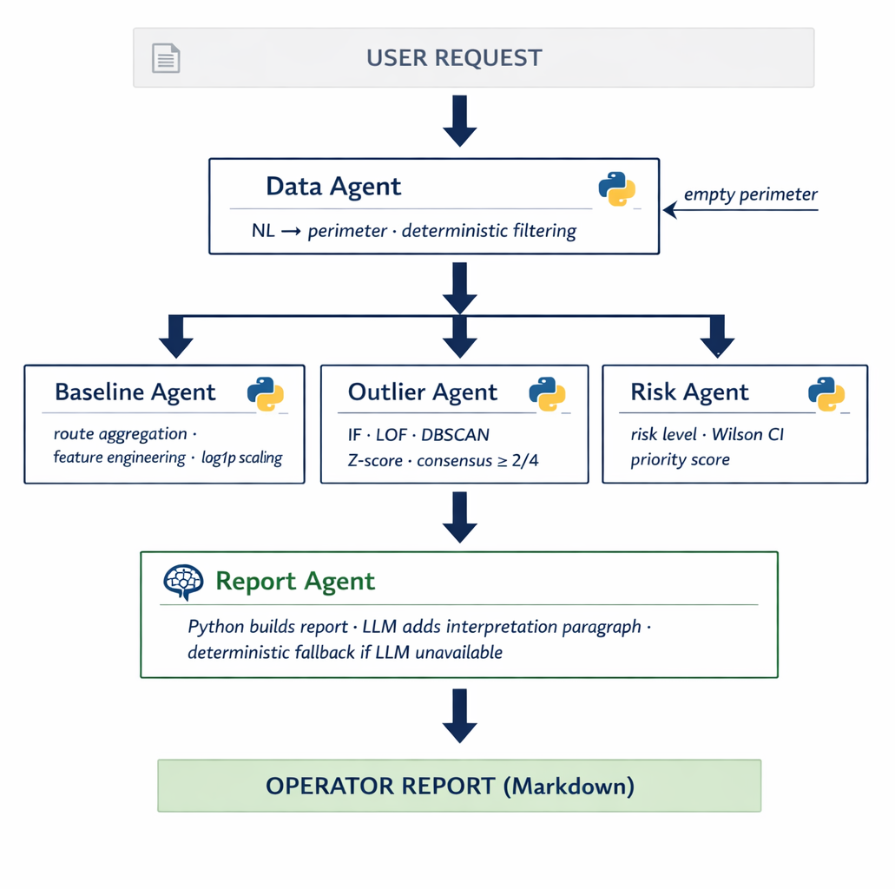
A LangGraph orchestrator coordinates 5 specialist agents, strictly separating deterministic math from LLM reasoning
Multi-Agent Architecture — System Flow & Design Choices
Key Insights
LangGraph Orchestrator (Shared State)
Delegated Computation: The Data Agent and Core Agents strictly use deterministic Python for numerical tasks (filtering, statistics, ML). Zero LLM hallucination risk on raw data.
Targeted LLM Usage: Large Language Models are reserved exclusively for human-centric tasks: parsing the initial user perimeter and formatting the final natural-language output (Report Agent).
Auditable State: The LangGraph orchestrator securely passes minimal, structured summaries between nodes, completely avoiding the "context stuffing" trap of sending full CSV files to an AI.
1
2
3
12

Slide 13
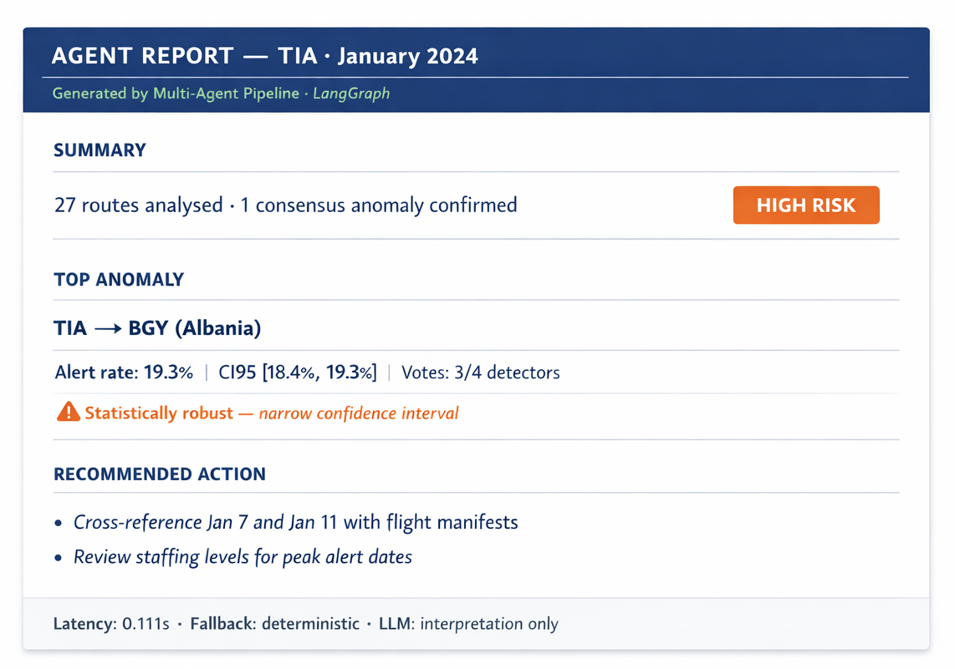
A single natural-language query delivers an operator-ready report in a moment
Multi-Agent Delivery — From Raw Query to Actionable Intelligence
Key Insights
Free-text input: "flights from TIA" parsed in Italian and English via deterministic fallback + LLM safety net.
Graceful on all inputs: 5 perimeter types tested, yielding 100% graceful outputs (including on invalid queries).
Jaccard 100%: Identical anomaly sets compared to the classical pipeline, confirming strict mathematical equivalence.
Note: Report generated by Report Agent on perimeter "flights from TIA". All numbers computed deterministically in Python, LLM adds interpretation paragraph only. Latency measured on local hardware, LLM excluded.
13

Slide 14
Act 04
COMPARISON & NEXT STEPS
Head-to-Head Comparison, Limitations & Risks, Take-Home Message

Slide 15
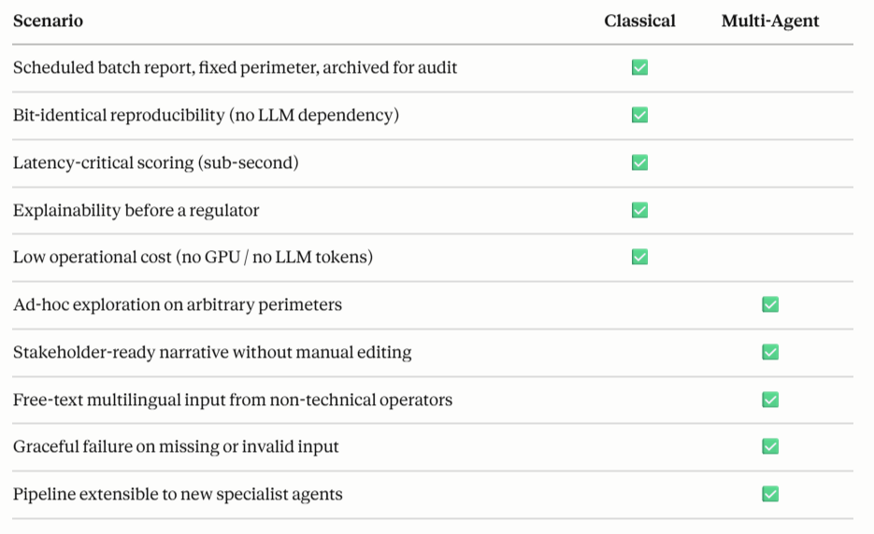
The choice is not algorithmic; it is a deployment decision driven by operational constraints
Comparative Analysis & Final Recommendation
Key Insights
The Final Recommendation: Deploy both.
The Classical pipeline serves as the nightly, deterministic system-of-record.
The Multi-Agent pipeline sits on top as an on-demand, interactive exploration interface for non-technical operators.
15

Slide 16
A robust proof of concept, Six strategic priorities to transition from prototype to production
Limitations, Risks and Next Steps
06
01
6. Static Learning Loop
1. Ground Truth Absence
Risk : The system does not currently learn from human triage (e.g., confirmed false positives). Mitigation : Build a "Feedback Agent" to dynamically ingest operator decisions back into the priority weights.
Limitation : Jaccard proves consistency, not accuracy. Precision/recall needs labelled data. Next Step : Establish a labelled validation set with the client to evaluate true model performance.
05
02
5. Missing Spatial Context
Roadmap to Production
2. Temporal Blindspot
Limitation : The current model scores routes independently, ignoring broader regional threat clusters.
Limitation : A 2-month dataset prevents true seasonal decomposition (rolling means are only proxies). Next Step : Ingest 12+ months for robust 7d/28d rolling baselines.
Next Step : Deploy a specialist "Geo-Agent" to cluster anomalies by origin country/region.
04
03
4. LLM Non-Determinism
3. Feature Instability
Risk : Even at temperature=0, the semantic interpretation varies slightly across runs. Mitigation : Strictly confine the LLM to the final narrative; keep all numerical ranking strictly deterministic.
Risk : Auto-detected categorical features (top nationalities, documents) will shift unpredictably with new data. Mitigation : Freeze and version segmentation features per model release to guarantee scoring consistency.
16

Slide 17
The End
Take-Home Message
“Agentic AI doesn't make classical pipelines obsolete; it makes them accessible. The math stays deterministic, but the barrier to entry vanishes. We didn’t replace the model, we simply connected it to the operators who need it, in plain English and under a minute.”
Authors & Contact:
Georges-Alexis Mitracos, Giulio D’Amico
LUISS Guido Carli University

