Slide 1
GIT per il progetto PCTO
G.Falco A.S. 2021-22
GIT
Distributed Revision Control
A version control system is simply software that lets you effectively manage application versions.

Slide 2
Requirements
Taking tracks of all changes of the codebase
and be able to return easly to previous versions
Share modifications with other collaborators
every member of the work team, could work indipendently on a particular task.
Merge all contributions at the right time

Slide 3
How we’ll use it
On local computer (home or at school lab)
starting with the same directory
Sharing every change with a remote central repository:
www.github.com
Sending our change to remote repository PUSH operation
and receiving update bt PULL operation

Slide 4
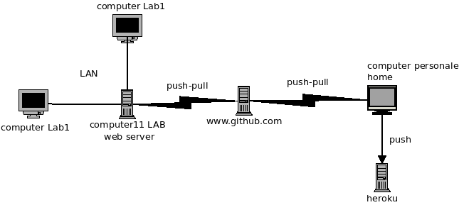
Organizational structure

Slide 5
Detail Explanation
http://mapelli.selfip.org/pcto
mantain the working copy of the system published on Internet. I only have credentials for connect by terminal with the server and run a PULL request
A project on github.com mantain the complete history of development and can be share with some collaborators
They can run push or pull operation and update system from their local directory
From local server in lab1 (10.0.0.11 on the LAN) we can run pull o push operation target in github project
Every work team member can use lab computer, and update via LAN (ssh connection) the lab1 server.

Slide 6
Using Git – installation configuration
GIT installation on Ubuntu
sudo apt-get install git
Configuration for the first time
git config –global user.name “Mario Rossi”
git config –global user.email “mario.rossi@blabla.com”
git config –global color.ui true

Slide 7
Clone command
git clone https://github.com/giuliofalco/pcto.git
create a working copy of directory project on your own local computer.
You’ll be able to pull future updating and if you are a collaborator, run a push operation in order to update the system with your changes
git init initialize the system in existing directory from scratch

Slide 8
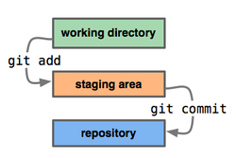
Main Git flow operation
git status command display files that need to be tracked (new or modified)
Repository is the local place, where every version of the file system is stored

Slide 9
Git main operations
git status
display the current status of the system: files to be tracked
git add <filename>
All files of the current directory
git add .
All files of current and subdirectories
git add –all

Slide 10
Git Commit
git commit -m “comment”
git commit -am “comment”
automatically add files updated, but not new files
git log –oneline
display the history of commitments

Slide 11
Git Push an Pull
git push origin main
origin is the rempte address where we cloned the system
main is the current branch
A branch is a lable connected to a particuar path in the development history
git pull origin main
update our current directory with remote changes

Slide 12
Test your skill
How could be useful a version control system ?
How can I start using git ?
Which are the main step in using git, what is the staging area ?
Which is the command to start tracing a file ?
By which command I copy of a directory from a remote host ?
By which command I can update a remote copy of my repository

