Slide 1
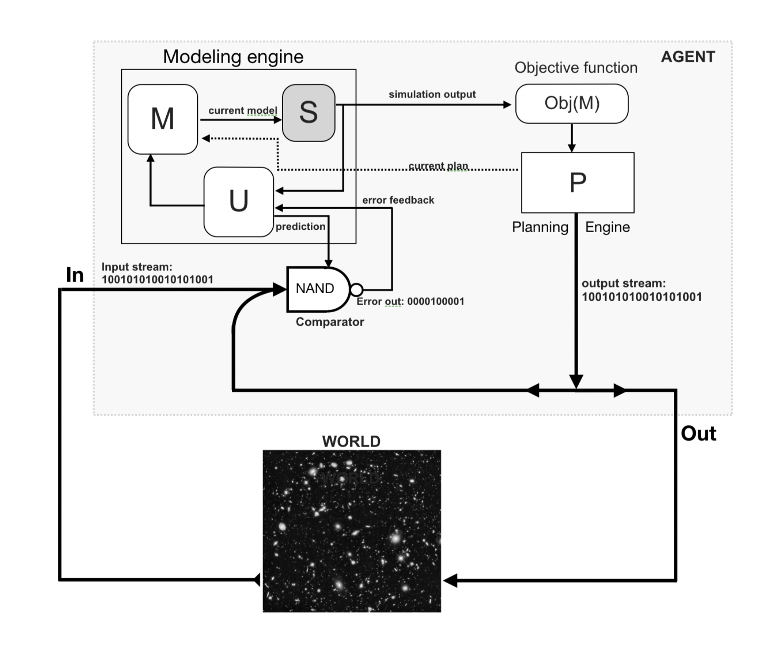
AGENT
Modeling Engine
Compression
Model
Model
Objective
Function
Structure, symmetry
Simulator
Updater
Valence
prediction
error
Comparator
Plan
Planning
Engine
World Tracking
constraints
Coarse
graining
Compositional Actions
WORLD
Structured, compositional data, symmetry
Input
Output

Slide 2





AGENT
Modeling Engine
Model
Model
Objective
Function
Simulator
Updater
precision
Valence
prediction
error
Comparator
Plan
Planning
Engine
Input
WORLD
Output

