Slide 1

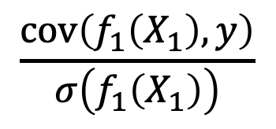






$$\frac{cov\left(f_{1}\left(X_{1}\right), y\right)}{σ\left(f_{1}\left(X_{1}\right)\right)}$$
$$X_{1}$$
$$∂$$
$$⋮$$
$$max$$
$$\frac{cov\left(f_{p}\left(X_{p}\right), y\right)}{σ\left(f_{p}\left(X_{p}\right)\right)}$$
$$X_{p}$$
$$∂$$

Slide 2
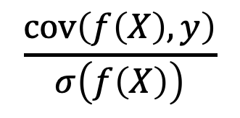




$$X_{1}$$
$$\frac{cov\left(f\left(X\right), y\right)}{σ\left(f\left(X\right)\right)}$$
$$⋮$$
$$X_{p}$$
$$∂$$

Slide 3
Independent Groups
Black = A ∪ B ∪ C ∪ D, White = E ∪ F ∪ G ∪ H,
Female = A ∪ B ∪ E ∪ F, Male = C ∪ D ∪ G ∪ H,
Old = A ∪ C ∪ E ∪ G, Young = B ∪ D ∪ F ∪ H
G
E | F
C | H
Intersectional Groups
A | B
C | D
A, B, C, D, E, F, G, H
Female
Gerrymandering Groups
A, B, C, D, E, F, G, H,
Black & Female = A ∪ B, White & Female = E ∪ F,
Black & Male = C ∪ D, White & Male = G ∪ H,
Black & Old = A ∪ C, White & Old = E ∪ G,
Black & Young = B ∪ D, White & Young = F ∪ H,
Female & Old = A ∪ E, Male & Old = C ∪ G,
Female & Young = B ∪ F, Male & Young = D ∪ H,
Black, White, Female, Male, Old, Young
White
Male
Black
Old
Young

