Slide 1

Finding a home
for
Nicole

Slide 2
Nicole Johnson
Main Characteristics
central neighborhood
middle price range
Lively
Analysis base:
Area
Distance from neighbors
Prince Range

Slide 3
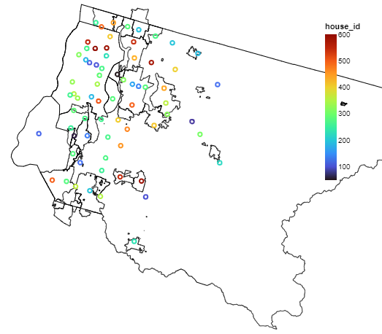
Central Area
Map shows the distribution of houses to sell considering their zip code number.

Slide 4
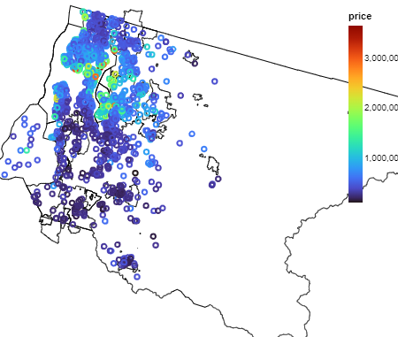
Price distribution
Map shows the distribution of houses to sell considering their prices

Slide 5
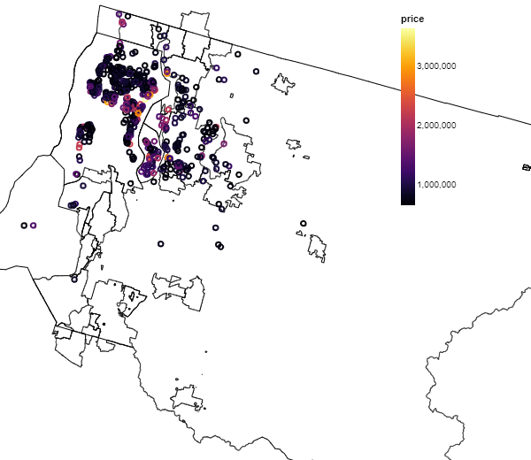
Noble areas
Map shows the distribution of houses to sell that are more expensive than the general average price considering their prices.

Slide 6
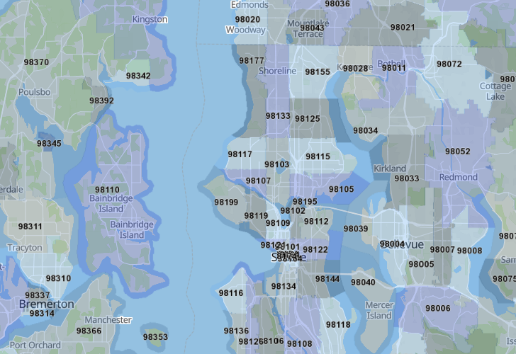
Real zip code map of King County

Slide 7
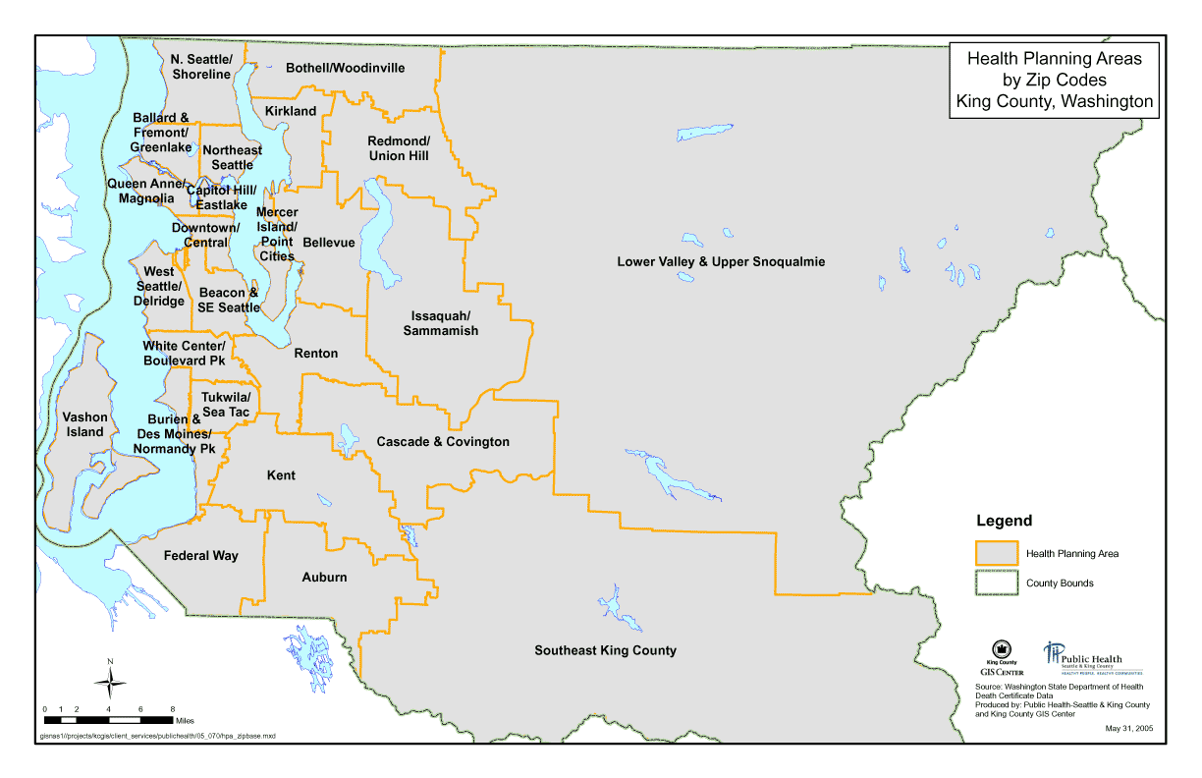
Real area of King County

Slide 8
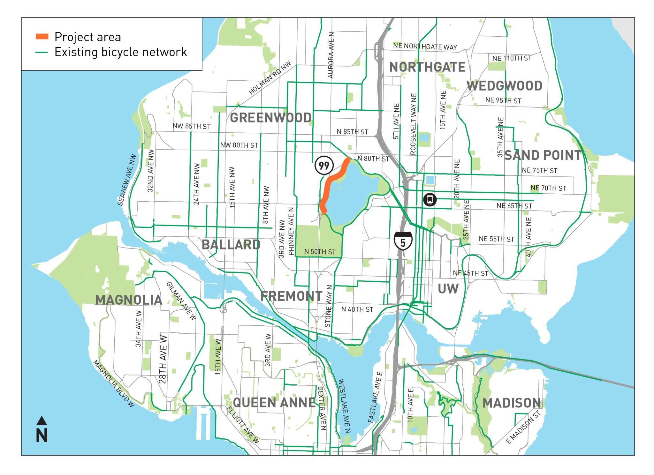
Green Lake
ZIP code: 98103, 98115
Average price to buy a house: 602,216$
Median price of a house: 560,00$
Minimum price to buy a house: 200,00$
Maximum price to buy a house: 2300,00$.

Slide 9
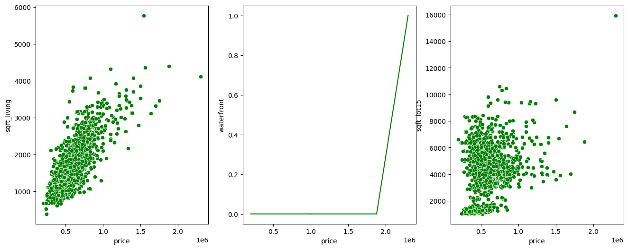
Price increase as the size of the lot gets bigger
Houses at waterfront are small and when possible has a enormous increase in the price
Neighbors tend to have smaller lots which can indicate a less isolate area
Lower prices in more crowded areas

Slide 10
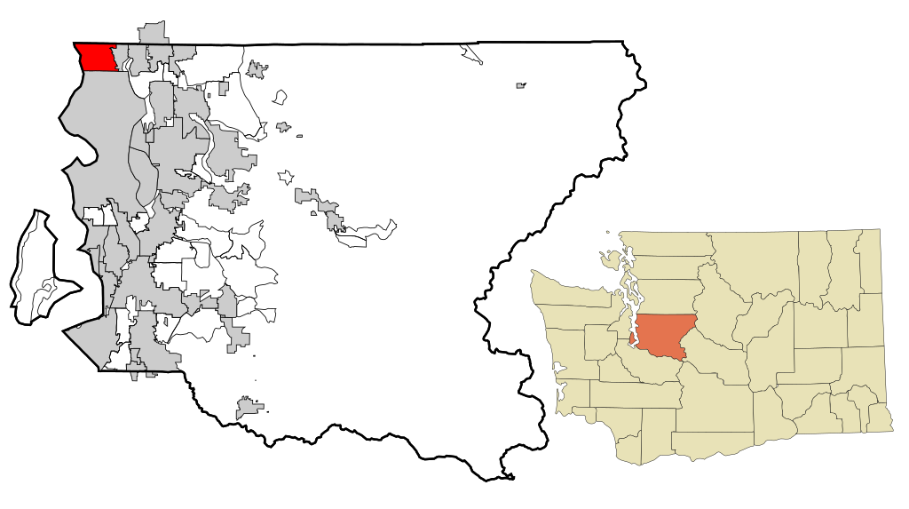
Shoreline
ZIP code: 98133, 98155, 98177
Average price to buy a house: 462,53$
Median price of a house: 400,00$
Minimum price to buy a house: 130,00$
Maximum price to buy a house: 4500,00$.

Slide 11
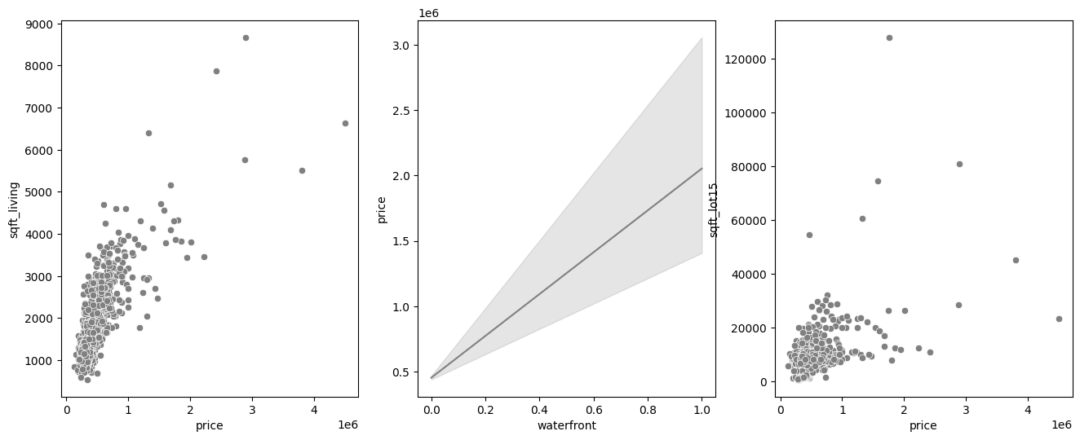
Price increase as the size of the lot gets bigger but most have same size and price.
Houses at waterfront are more possible but also with a increase in the price
More neighbors with large lots can indicate a more isolate area than Green Lake
Lower prices in more crowded areas

Slide 12

Kirkland
ZIP code: 98033, 98034, 98083
Average price to buy a house: 646,54$
Median price of a house: 510,00$
Minimum price to buy a house: 90,00$
Maximum price to buy a house: 5110,00$.

Slide 13
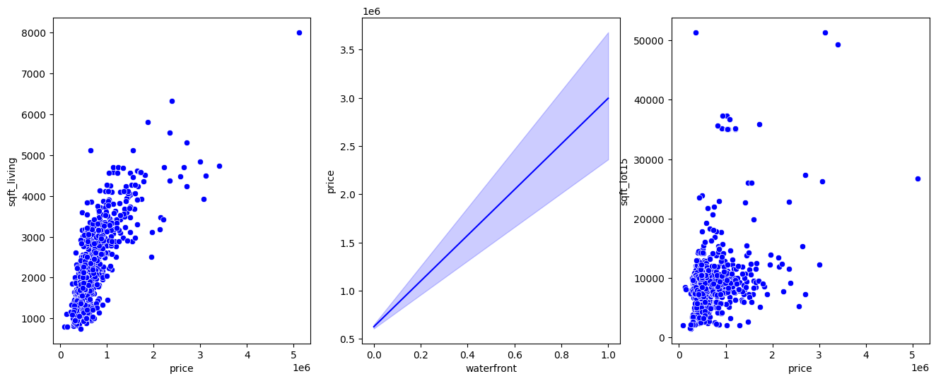
In general has smaller houses than Green Lake and Shoreline.
Houses at waterfront are also possible but also with a increase in the price
Similar to Green Lake it’s less isolated in general but also has more isolated areas
Isolated areas have a considerable increase in the price range

Slide 14
Comparing
the
areas
– .. – S2 – .. –

Slide 15
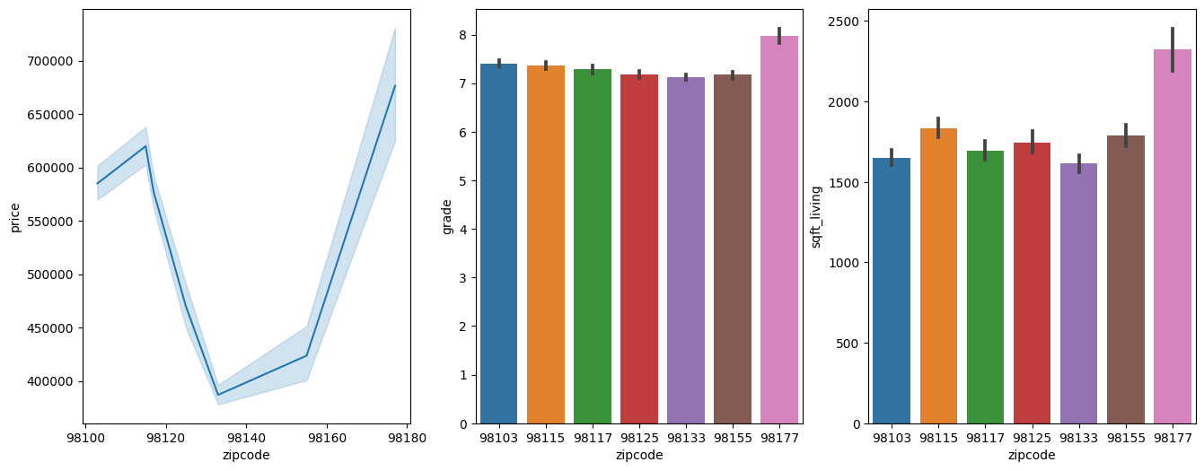
price per zip code
highlighting the more and less noble areas
grades per zip code
highlighting the areas with better house grades
Can indicate a better general condition of the houses for sell
Size of the houses per zip code
Highlight the most distant from the center

Slide 16
Shoreline
Less central
Lower median price
Low population density
Includes poorer and richer zip codes
Noble areas are further from the center
6 specific addresses satisfied the price range for the area
Green Lake
More Central Area in general
Higher median price
Big population density
Better life conditions
More noble are
2 specific addresses satisfied the price range for the area
Kirkland
As central as Green Lake
Middle median price in comparison
Less crowded than Green Lake
Less isolated than Shoreline
Includes more isolated areas
Less noble area in general
3 specific addresses satisfied the price range for the area

Slide 17
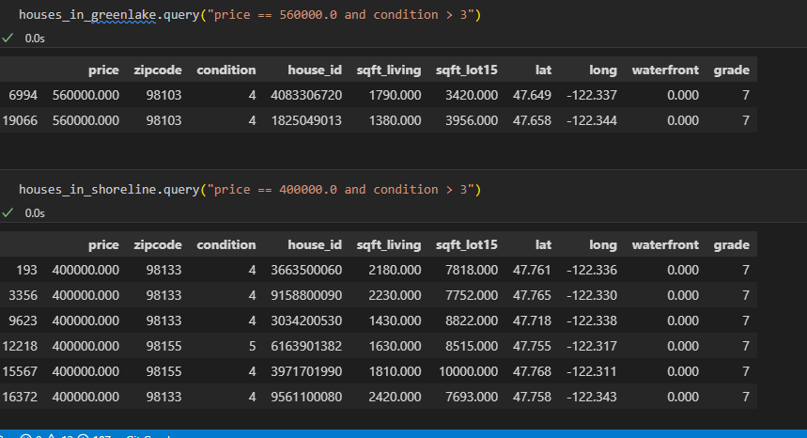
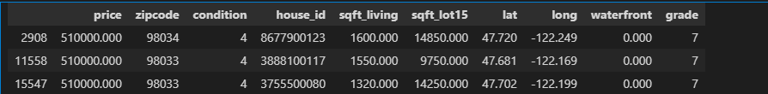
Green Lake
Shoreline
Kirkland

