Slide 1
SQLite Database
with DataGrip

Slide 2
part of 3 5 7 assignemet

Slide 3
3 - SQLite
work on a DataBase in SQLite in week 3 from 19-23 Oct.
with at least 3 tables
with at least 3 queries
show in week from 19-23 Oct.
3 pts. your work and 1 from me

Slide 4
5 - MySQL
work on a DataBase in MySQL in week 5
with at least 5 tables
with at least 5 queries
show in next week
5 pts. your work and 1 from me

Slide 5
7 – SQL Server
work on a DataBase in SQL Server in week 5
with at least 7 tables
with at least 7 queries
show in week 7
7 pts. your work and 1 from me

Slide 6
Grade you work out of 20 pts.

Slide 7
DataBase
Data
Relationship
Constraint

Slide 8
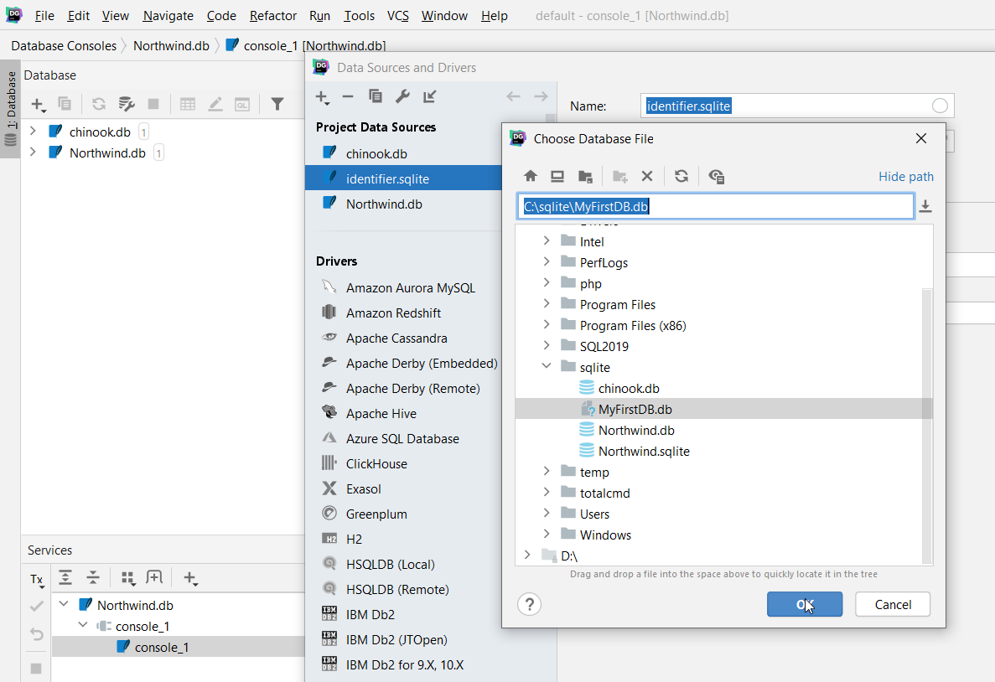
Create Blank Database - Create Blank File

Slide 9
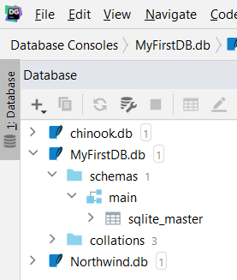
one database schema (main)
one (system) table sqlite_master

Slide 10
Create Table
Object tables - record holds information that relates to real world object
customer is real world object
fields reflect characteristics of object they represent - that make it unique or that are important
Transaction tables - record holds information about event
place order for product is example of event
almost always have Date/Time field because when event happened is usually important piece of information to record
another common type of field is field that refers to object table, such as reference to customer

Slide 11
Create Table
Join tables - when many to many relationship exists join table sits in middle of tables
usually has name that reflects association
generally has only three fields: unique field to identify each record, reference to one side of association, and a reference to other side of association

Slide 12
Design Table
create new table.
enter field names, data types, properties, and (optionally) descriptions
set table’s Primary Key
create indexes for appropriate fields
save table's design.

Slide 13
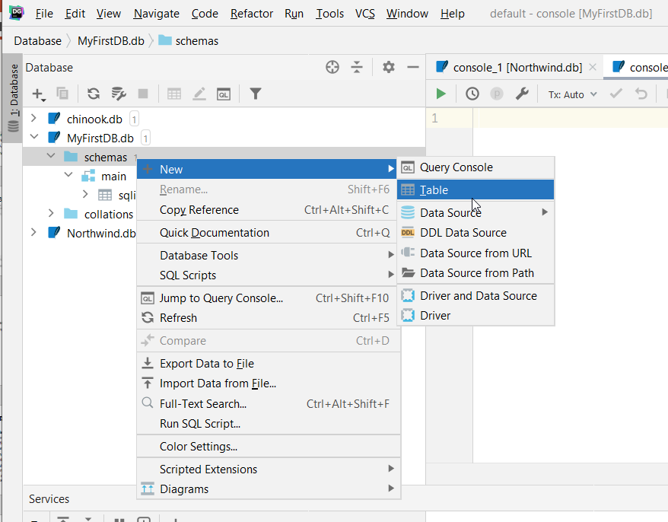

Slide 14
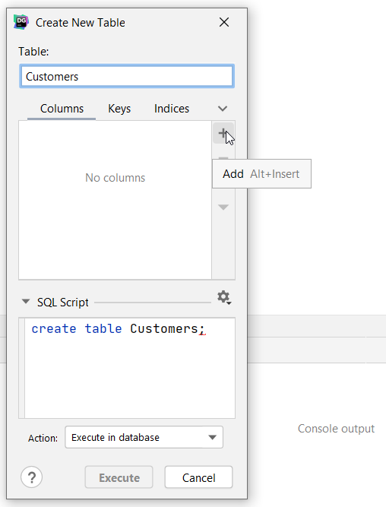
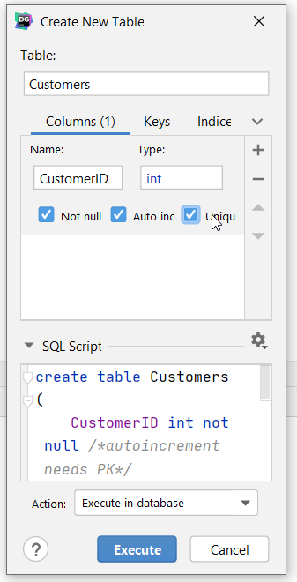
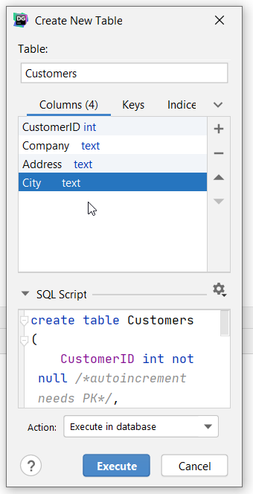

Slide 15
CREATE TABLE – SQL command
create table Customers
(
CustomerID int not null /*autoincrement needs PK*/,
Company text,
Address text,
City text
);
create unique index Customers_CustomerID_uindex
on Customers (CustomerID);

Slide 16
each value stored in (SQLite) database has one of following storage classes:
NULL - value is NULL value
INTEGER - value is signed integer, stored in 1, 2, 3, 4, 6, or 8 bytes depending on magnitude of value
REAL - value is floating point value, stored as 8-byte IEEE floating point number
TEXT - value is text string, stored using database encoding (UTF-8, UTF-16BE or UTF-16LE)
BLOB - value is Binary Large OBject data, stored exactly as it was input

Slide 17
(SQLite) Date & Time
(SQLite) does not support built-in date and/or time storage class
leverages some built-in date and time functions to use other storage classes such as TEXT, REAL, or INTEGER for storing (calendar) date and time values
can freely choose any data types to store date and time values and use built-in dates and times function to convert between formats

Slide 18
Using TEXT storage class for storing SQLite date and time (like MySQL TimeStamps)
use string format: YYYY-MM-DD HH:MM:SS.SSS
CREATE TABLE datetime_text(d1 text, d2 text);
to insert date and time values use DATETIME function; for example, to get current UTC date and time value, you pass now literal string to function as follows:
INSERT INTO datetime_text (d1, d2)
VALUES(datetime('now'),datetime('now', 'localtime'));
SELECT d1, typeof(d1), d2, typeof(d2) FROM datetime_text

Slide 19
Using REAL storage class to store SQLite date and time values (like Date & Time in SQL Server)
use real number to store date and/or time values as Julian day numbers, which is number of days since noon in Greenwich on November 24, 4714 B.C.
CREATE TABLE datetime_real(d1 real);
INSERT INTO datetime_real (d1)
VALUES(julianday('now'));
SELECT date(d1), time(d1) FROM datetime_real;

Slide 20
Using INTEGER to store SQLite date and time values (like Date & Time in MySQL)
use integer values to store UNIX time which is number of seconds since 1970-01-01 00:00:00 UTC
CREATE TABLE datetime_int (d1 int);
INSERT INTO datetime_int (d1)
VALUES(strftime('%s','now'));
SELECT datetime(d1,'unixepoch’) FROM datetime_int;

Slide 21
ALTER TABLE
SQLite supports only limited subset of ALTER TABLE
rename table
rename column
add new column to existing table

Slide 22
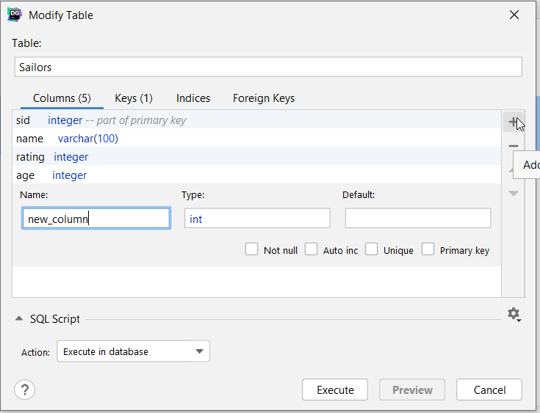

Slide 23
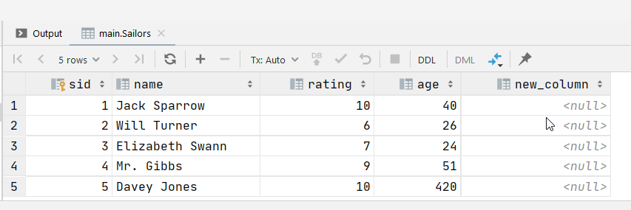
select * FROM Sailors

Slide 24
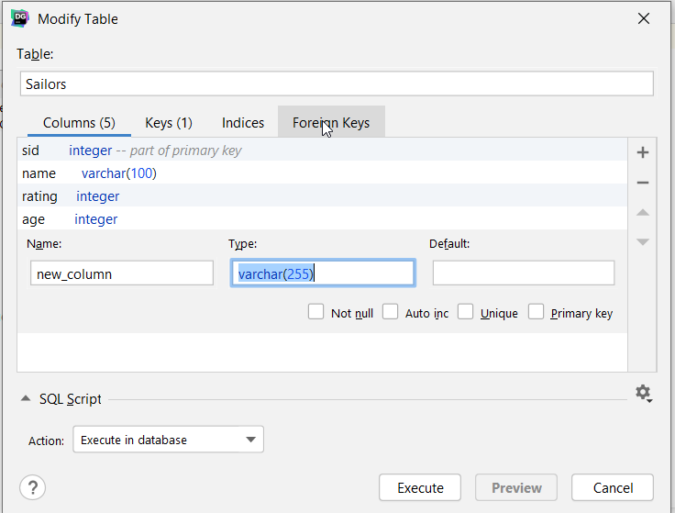

Slide 25
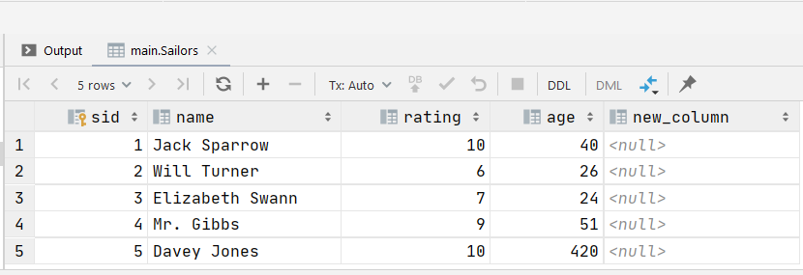

Slide 26
?

Slide 27
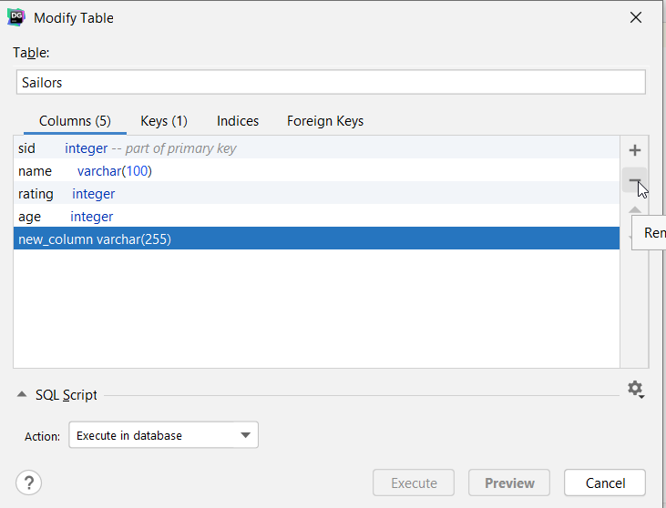

Slide 28
Create
Read
Update
Delete

Slide 29
INSERT
to insert data into table, single row / multiple rows, and default values
can insert rows using data provided by SELECT statement

Slide 30
INSERT
INSERT INTO table (column1,column2 ,..)
VALUES( value1, value2 ,...);
specify name of table
comma-separated list of columns; column list is optional
comma-separated list of values after VALUES keyword; if omit column list, you have to specify values for all columns in table
number of values in value list must be same as number of columns
data types

Slide 31
INSERT
INSERT INTO Sailors (name, rating, age)
VALUES ('James BOND', 007, 'immortal')
INSERT INTO Sailors (name, rating, age)
VALUES ('James BOND', 7, 10, 'immortal')
INSERT INTO Sailors (name, rating, age)
VALUES ('James BOND', 7, 10)

Slide 32
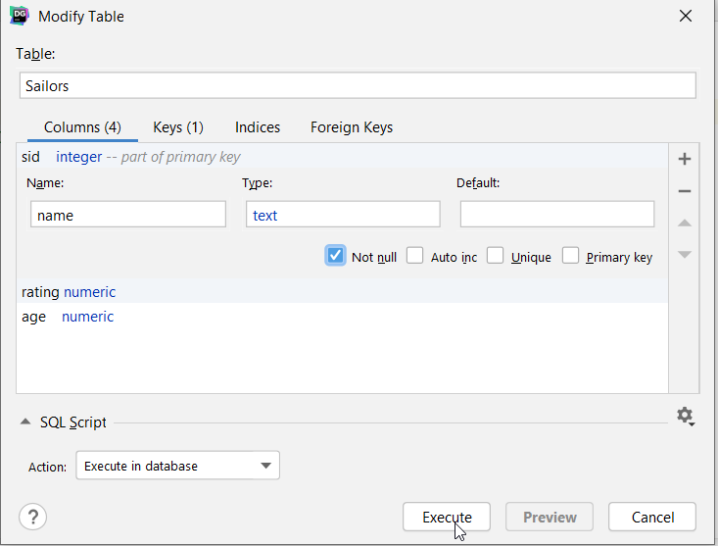
Name will allow NULL values

Slide 33
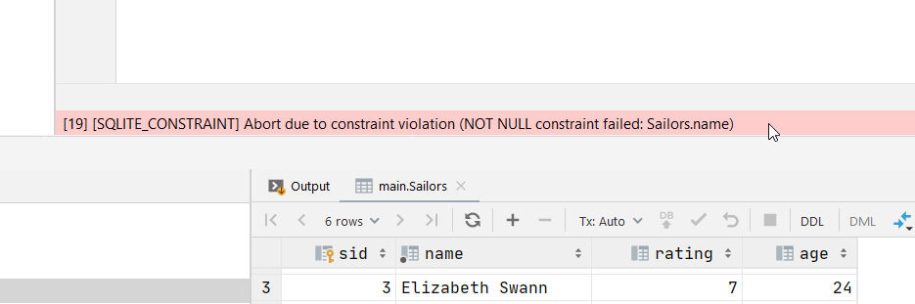
INSERT INTO Sailors (rating, age)
VALUES (4, 5)

Slide 34
SELECT …

Slide 35
UPDATE
UPDATE table
SET column_1 = new_value_1,
column_2 = new_value_2
…
WHERE
search_condition
UPDATE Sailors SET Name = 'Ian FLEMING', rating = 10
WHERE sid = 6

Slide 36
DELETE
DELETE FROM table
WHERE search_condition;

Slide 37
DataBase
Data
Relationship
Constraint

Slide 38
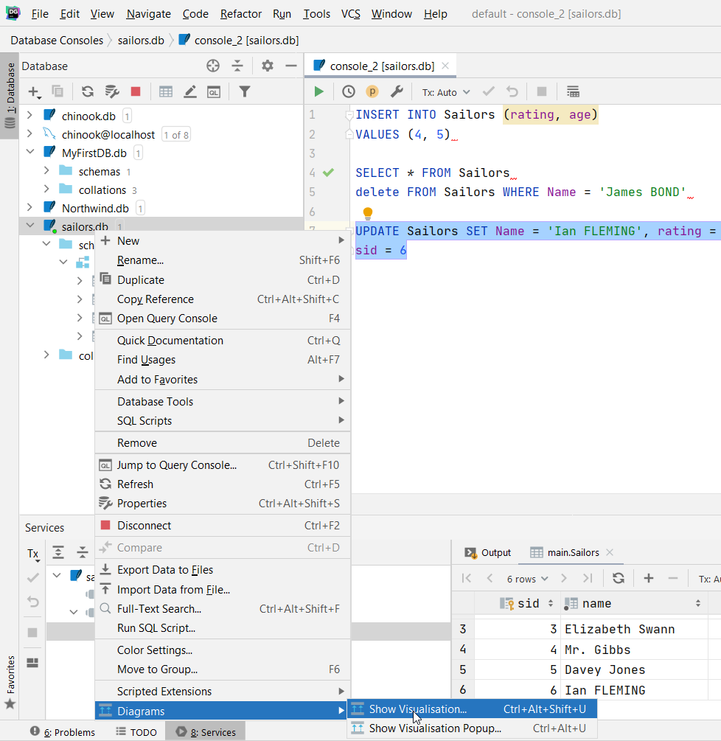

Slide 39
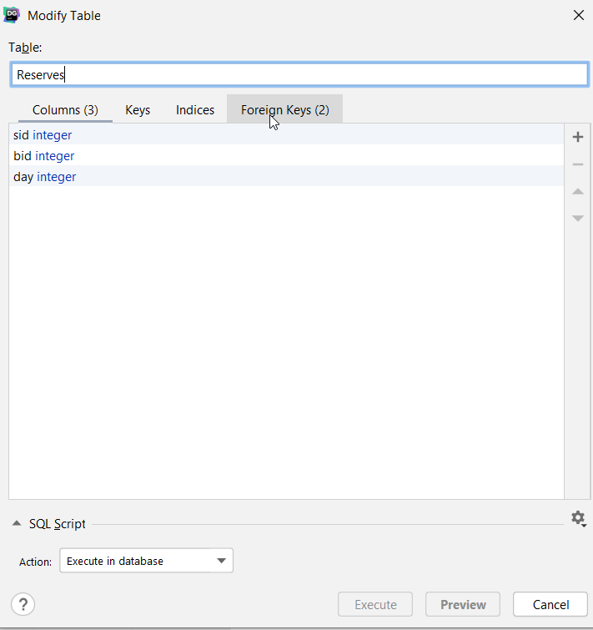

Slide 40
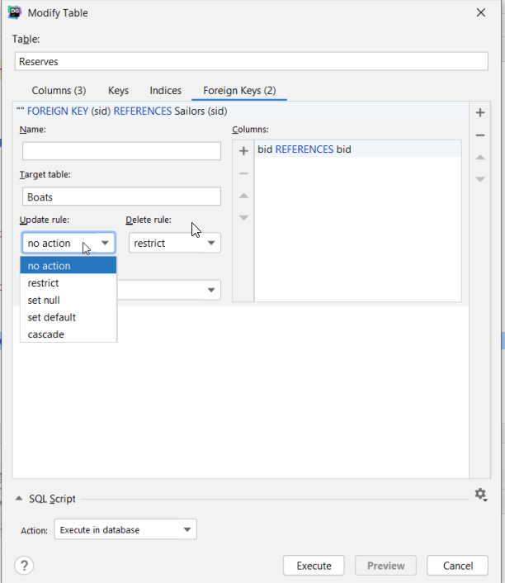
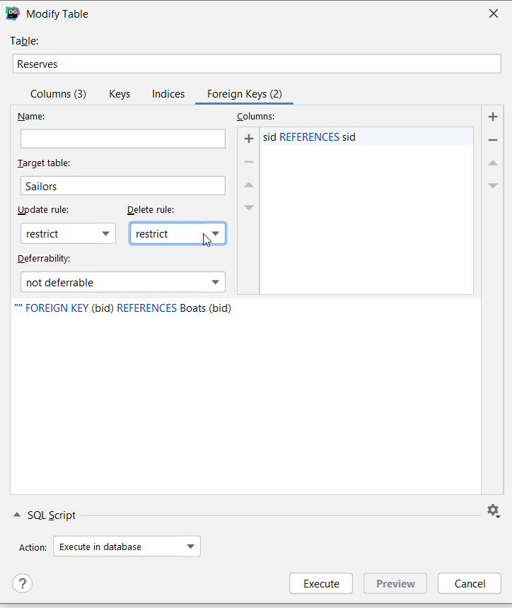

Slide 41
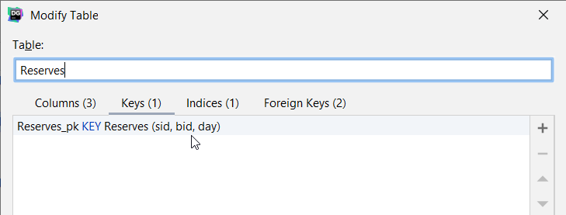

Slide 42
INSERT INTO Reserves VALUES(3,4,5)
INSERT INTO Reserves VALUES(3,4,5)
[19] [SQLITE_CONSTRAINT] Abort due to constraint violation (UNIQUE constraint failed: Reserves.sid, Reserves.bid, Reserves.day)

Slide 43
PRAGMA foreign_keys = ON;
UPDATE Reserves
SET sid = 33, bid = 44, day = 55
WHERE sid = 3 AND bid = 4 AND day = 5
INSERT INTO Reserves VALUES(33, 44, 55)
[19] [SQLITE_CONSTRAINT] Abort due to constraint violation (FOREIGN KEY constraint failed)

Slide 44
CREATE TABLE Sailors2 …
age numeric CHECK(age > 0)
INSERT INTO Sailors2 SELECT * FROM Sailors
UPDATE Sailors SET age = -123
WHERE sid = 6
UPDATE Sailors2 SET age = -123
WHERE sid = 6

Slide 45
column_name data_type CHECK(expression),
[19] [SQLITE_CONSTRAINT] Abort due to constraint violation (CHECK constraint failed: Sailors2)

Slide 46
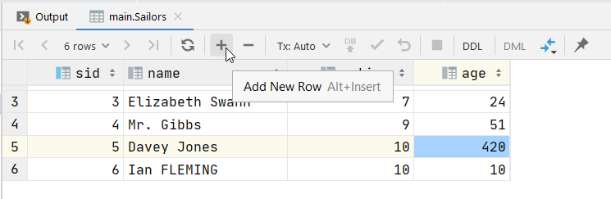
select * from Sailors - INSERT

Slide 47
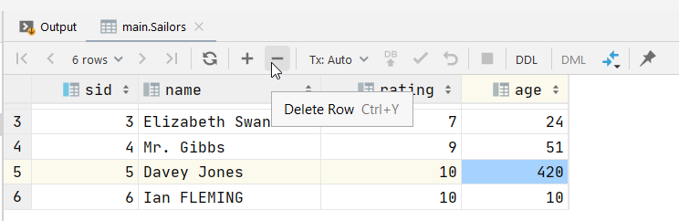
select * from Sailors - DELETE

Slide 48
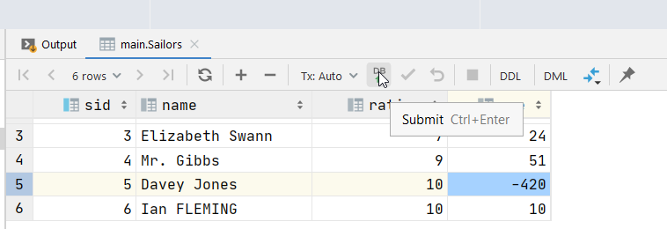
select * from Sailors - UPDATE

Slide 49
select * from Sailors - UPDATE
main> UPDATE Sailors SET age = -420 WHERE sid = 5 AND name = 'Davey Jones' AND rating = 10 AND age = 420
[2020-10-20] [19] [SQLITE_CONSTRAINT] Abort due to constraint violation (CHECK constraint failed: Sailors)

Slide 50
Queries

Slide 51
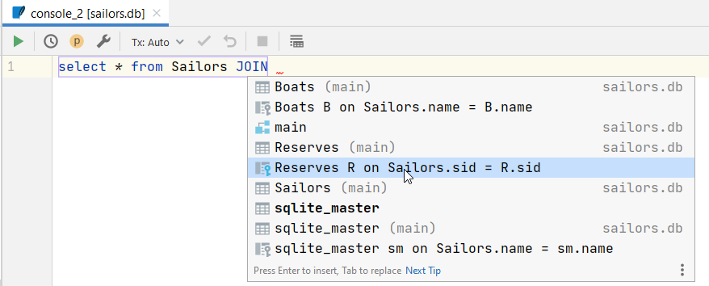

Slide 52
SELECT
Boats.bid, Boats.name as BoatName, [color],
Sailors.sid, Sailors.name as SailorName, rating, age,
day
FROM Boats
JOIN Reserves on Boats.bid = Reserves.bid
JOIN Sailors on Sailors.sid = Reserves.sid

