Slide 1
Fundamental Algorithms Lecture #8
Cluj-Napoca

Slide 2
Agenda
Disjoint Sets
Concept & list representation (brief review)
Tree representation
Binomial Heaps & Binomial Trees
Def
Basic operations
Fibonacci Heaps
B trees
Def
Basic operations

Slide 3
Disjoint Sets
Collection of dynamic DS S={S₁, …, S_{k}}
∃n elements (objects) in all k sets (n≥k)
each set S_{i} is identified by its representative element, x∈ S_{i};
Basic operations:
MAKE-SET (x)
Generates a new set, with a single element => n sets initially, each object has its own set, and it is its own representative el.
UNION (x, y)
joins 2 disjoint sets, represented by x and y; builds S_{x} U S_{y} (and destroys S_{x} and S_{y} ); the representative becomes any of the 2 representatives;
FIND-SET (x)
Returns a pointer to the representative element of the set containing element x.

Slide 4
Disjoint Sets – contd.
n = nb. of objects in the whole S
m = total nb. of operations (MAKE-SET, UNION, FIND-SET)
m>=n (as we have n MAKE-SET operations)
Utility/Applications:
speeds up execution when we need to find/group items with similar features
graphs (connected components; MST)
many other

Slide 5
Disjoint Sets - implementation
Linked List
A set = a linked list
representative= the first element (head) of the list
An object in such a list contains
The element from the set;
The pointer to the next element in the list (LL)
Pointer to the representative (ex: blackboard)
MAKE-SET(x) – builds a list with a single element O(1)
FIND-SET(x) – returns the representative O(1)
UNION(x, y) – adds x’s list at the end of y’s list;
representative = former y’s representative
all x’s elements have to update representative pointer (ex: blackboard)

Slide 6
Disjoint Sets – implementation – contd.
Worst case: O(m²) for all operations
n MAKE-SET (1 for each element)
UNION
n times (to get to a single set)
1 + 2 + 3 + … +2 = O(n²) (show on the blackboard)
n~m (actually m>n, yet n is linear in m)
On average, O(m) for a call of UNION, m calls => O(m²)

Slide 7
Disjoint Sets – implementation increase efficiency
Update pointers for the shorter lists
Keep as knowledge their length (similar to Order Statistic Trees)
Theorem: For n objects in LL with weighted union, for m MAKE-SET, FIND-SET and UNION takes O(m + nlgn)
Proof: (check the textbook – identify an informal justification)

Slide 8
Forest of Disjoint Sets
Set = tree with root; keep parent pointer
1 node = 1 element (=1 obj) from the set
1 tree = a set
The root = representative el.
Basic Implem. ~ to lists (no improvement)
MAKE-SET (x) build the tree with root only
FIND-SET (x) goes up and return the representative
UNION (x, y) Ex: (blackboard)

Slide 9
Forest of Disjoint Sets – Heuristics (to increase performance)
UNION by rank
Similar to weighted unify on lists
The tree with less nodes will point to the tree with many nodes
Info kept at root level = rank = max height of the tree
rank ≅ lg (dim) (is an approximation, not an exact value; a guarantee that value is never exceeded)
PATH compression
Within the Find-Set, each node on the search path will update the parent node to the representative (instead of parent), and leave the rank unchanged!
Shrink does NOT change rank! Why? Ex: blackboard
rank ≅ lg (dim) It is an approximation, ONLY

Slide 10
Forest of Disjoint Sets – Heuristics
Rank[x]
= max height of the subtree rooted by x
= nb. of edges on the longest path from x to a leaf
rank[leaf] = 0
Find-Set leave ranks unchanged

Slide 11
Forest of Disjoint Sets - Implementation
MAKE-SET(x)
p[x] <- x
rank[x]<-0
UNION(x, y)
LINK(FIND-SET(x), FIND-SET(y))
LINK(x, y)
if rank [x] > rank [y]
then p[y] <-x
else p[x] <-y
if rank [x] = rank [y]
then rank [y]= rank [y]+1

Slide 12
Forest of Disjoint Sets - Implementation
FIND-SET(x)
if x!=p[x]
then p[x] <- FIND-SET(p[x])
return p[x]

Slide 13
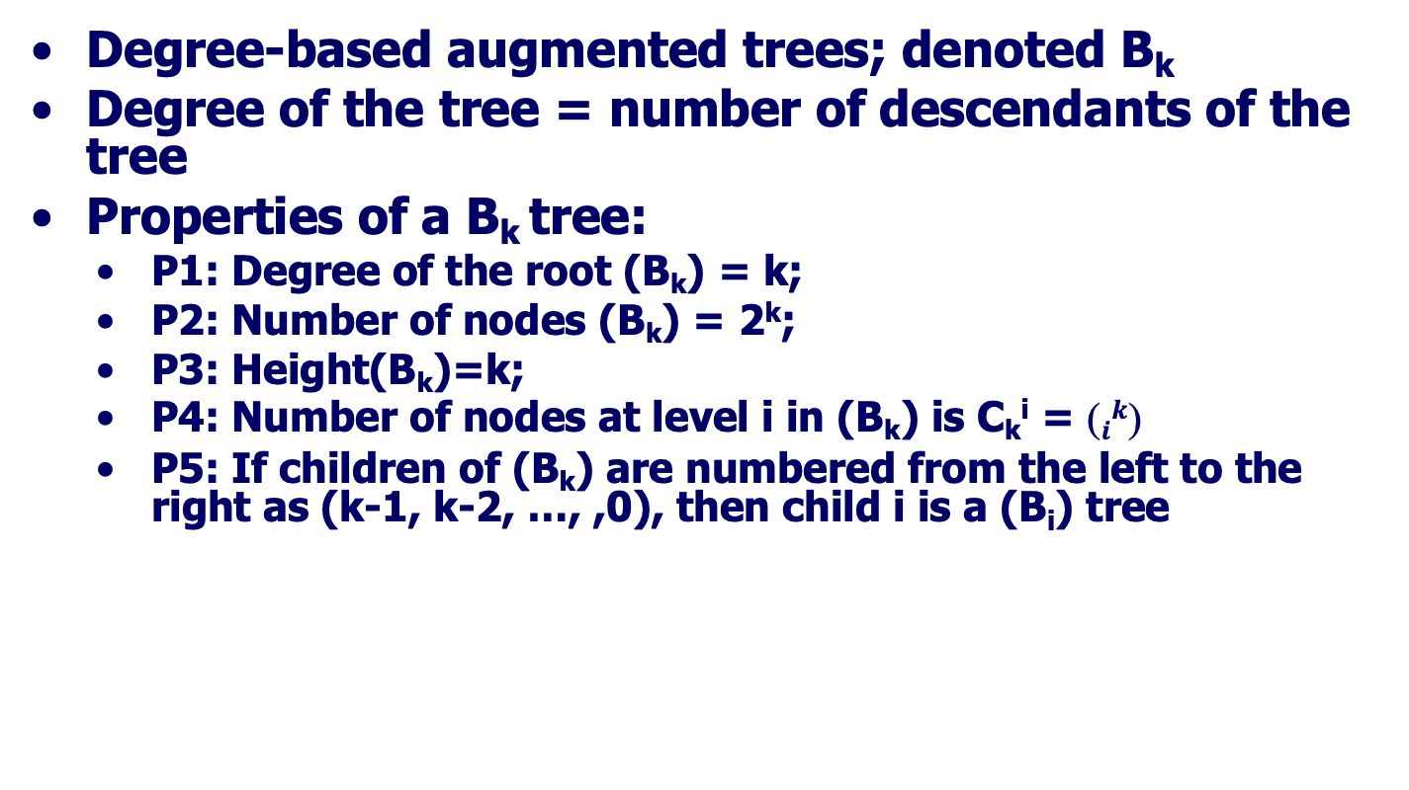
Binomial Trees
Degree-based augmented trees; denoted B_{k}
Degree of the tree = number of descendants of the tree
Properties of a B_{k} tree:
P1: Degree of the root (B_{k}) = k;
P2: Number of nodes (B_{k}) = 2^{k};
P3: Height(B_{k})=k;
P4: Number of nodes at level i in (B_{k}) is C_{k}^{i} = $ik$
P5: If children of (B_{k}) are numbered from the left to the right as (k-1, k-2, …, ,0), then child i is a (B_{i}) tree

Slide 14
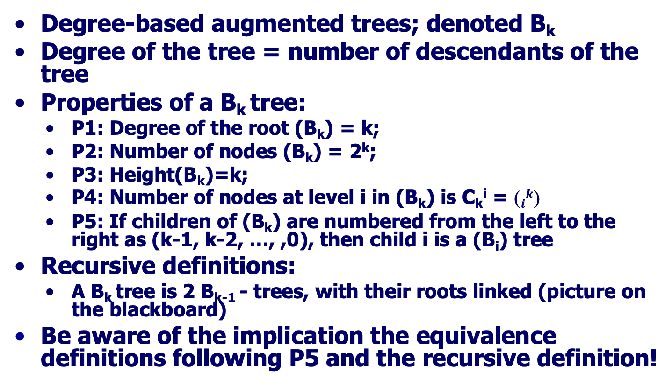
Binomial Trees
Degree-based augmented trees; denoted B_{k}
Degree of the tree = number of descendants of the tree
Properties of a B_{k} tree:
P1: Degree of the root (B_{k}) = k;
P2: Number of nodes (B_{k}) = 2^{k};
P3: Height(B_{k})=k;
P4: Number of nodes at level i in (B_{k}) is C_{k}^{i} = $ik$
P5: If children of (B_{k}) are numbered from the left to the right as (k-1, k-2, …, ,0), then child i is a (B_{i}) tree
Recursive definitions:
A B_{k} tree is 2 B_{k-1} - trees, with their roots linked (picture on the blackboard)
Be aware of the implication the equivalence definitions following P5 and the recursive definition!

Slide 15
Binomial Trees
Recursive definitions:
A B_{k} tree is 2 B_{k-1} - trees, with their roots linked (see picture and follow discussion)
A B_{k} tree is collection of k trees: B_{k-1}, B_{k-2}, …, B₁, B₀ – trees (see picture and follow discussion)
Proof of P4: Number of nodes at level i of (B_{k}) is C_{k}^{i}

Slide 16
Binomial Trees
Recursive definitions:
A B_{k} tree is 2 B_{k-1} - trees, with their roots linked (see picture and follow discussion)
A B_{k} tree is collection of k trees: B_{k-1}, B_{k-2}, …, B₁, B₀ – trees (see picture and follow discussion)
Proof of P4: Number of nodes at level i of (B_{k}) is C_{k}^{i}
Goes by induction
On level i we have nodes from 2 B_{k-1}trees
From the first tree (containing the root of B_{k}) #nodes at level i = C_{k-1}^{i}
From the second one #nodes at level i-1 (one level less; level measured from the root) = C_{k-1}^{i-1}
So there are C_{k-1}^{i} + C_{k-1}^{i-1}= C_{k}^{i} nodes at level i in B_{k}

Slide 17
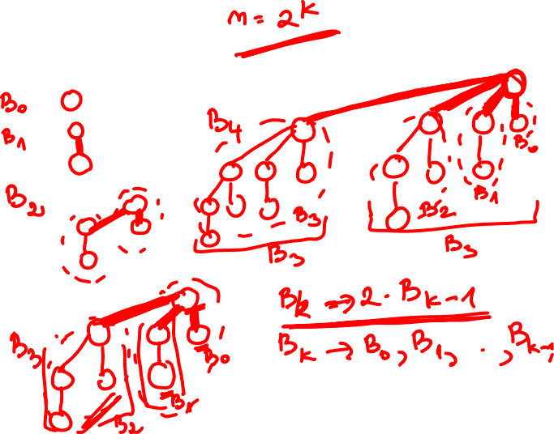

Example

Slide 18
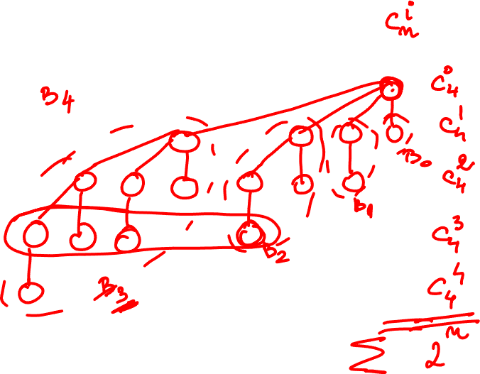
Exemplu 2

Slide 19
Binomial Heaps
Binomial Heap (H) = A set of Binomial trees with the following properties:
P1: each node has a key;
P2: each binomial tree in H is heap-ordered (min on top);
P3: for any k, there is at most one B_{k} tree in H.
Consequence: if H has n nodes, it has at most ? binomial trees.

Slide 20
Binomial Heaps
Binomial Heap (H) = A set of Binomial trees with the following properties:
P1: each node has a key;
P2: each binomial tree in H is heap-ordered (min on top);
P3: for any k, there is at most one B_{k} tree in H.
Consequence: if H has n nodes, it has at most ⎣lgn⎦ +1 binomial trees.

Slide 21
Binomial Heaps
Binomial Heap (H) = A set of Binomial trees with the following properties:
P1: each node has a key;
P2: each binomial tree in H is heap-ordered (min on top);
P3: for any k, there is at most one B_{k} tree in H.
Consequence: if H has n nodes, it has at most ⎣lgn⎦ +1 binomial trees.
Justification:
Max number of trees a H may have = one of each type
If each type of tree is present, the number of nodes for
B_{k-1}, B_{k-2}, …, B₁, B₀ is 2^{k-1}, 2^{k-2}, …, 2⁰ respectively
Nb of nodes of H is their sum = 2^{k-1}+ 2^{k-2}+…+2⁰ = 2^{k} -1
Denote 2^{k} = n. H has n nodes, and k trees (⎣lgn⎦ +1)

Slide 22
Binomial Heaps – Operations (|H|=n) (for all, examples on the blackboard)
Make-Heap
Builds an empty Binomial Heap
Notes:
Check Unite in delete!
http://staff.ustc.edu.cn/~csli/graduate/algorithms/book6/chap20.htm

Slide 23
Binomial Heaps – Operations (|H|=n) (for all, examples on the blackboard)
Make-Heap O(1)
Builds an empty Binomial Heap
Binomial-Heap-findMinimum(H)
Returns the pointer to the root of the B with the min key (NOT removed);
Notes:
Check Unite in delete!
http://staff.ustc.edu.cn/~csli/graduate/algorithms/book6/chap20.htm

Slide 24
Binomial Heaps – Operations (|H|=n) (for all, examples on the blackboard)
Make-Heap O(1)
Builds an empty Binomial Heap
Binomial-Heap-findMinimum(H) O(lgn)
Returns the pointer to the root of the B with the min key (NOT removed);
Binomial-Heap-Unite(H1, H2) =
merge + links O(lgn)
merge – merges 2 rooted lists (H1, H2) into a single one sorted by degree (increasing order)
link – changes a pair of B_{k-1} trees into a B_{k} tree
Unite = merge + links from left to right
Notes:
Check Unite in delete!
http://staff.ustc.edu.cn/~csli/graduate/algorithms/book6/chap20.htm

Slide 25
Binomial Heaps – Operations (|H|=n) (for all, examples on the blackboard)
Make-Heap O(1)
Builds an empty Binomial Heap
Binomial-Heap-findMinimum(H) O(lgn)
Returns the pointer to the root of the B with the min key (NOT removed);
Binomial-Heap-Unite(H1, H2) =
merge + links O(lgn)
merge – merges 2 rooted lists (H1, H2) into a single one sorted by degree (increasing order) O(lgn)
link – changes a pair of B_{k-1} trees into a B_{k} tree O(1)
Unite = merge + links from left to right O(lgn)+lgnO(1)
Notes:
Check Unite in delete!
http://staff.ustc.edu.cn/~csli/graduate/algorithms/book6/chap20.htm

Slide 26
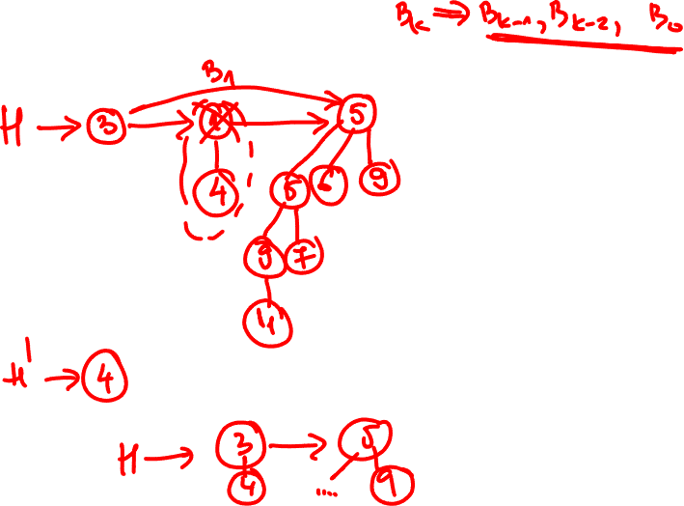

Slide 27
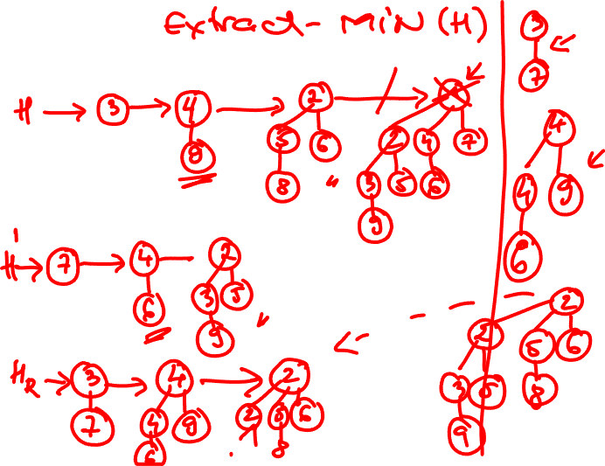

Slide 28
Binomial Heaps – Operations (|H|=n) (for all, examples on the blackboard)
Binomial-Heap-extractMinimum(H)
Binomial-Heap-findMinimum(H)
removes that tree from H
Make a heap out of the binomial tree containing the min key =>H1in
Binomial-Heap-Unite(H, H1)
Notes:
Check Unite in delete!
http://staff.ustc.edu.cn/~csli/graduate/algorithms/book6/chap20.htm
When merge and occur 3 of size S keep the one that results from uniting 2 of size S-1 and unite further the 2 of size S.

Slide 29
Binomial Heaps – Operations (|H|=n) (for all, examples on the blackboard)
Binomial-Heap-extractMinimum(H) O(lgn)
Binomial-Heap-findMinimum(H) O(lgn)
removes that tree from H O(1)
Make a heap out of the binomial tree containing the min key =>H1in O(lgn)
Binomial-Heap-Unite(H, H1) O(lgn)
Binomial-Heap-keyDelete(H1, H2)
As if we were to extract min.
How?
Decrease the key to delete to -∞+
restore the heap property of the Binomial tree +
Extractmin
Notes:
Check Unite in delete!
http://staff.ustc.edu.cn/~csli/graduate/algorithms/book6/chap20.htm
When merge and occur 3 of size S keep the one that results from uniting 2 of size S-1 and unite further the 2 of size S.

Slide 30
Binomial Heaps – Operations (|H|=n) (for all, examples on the blackboard)
Binomial-Heap-extractMinimum(H) O(lgn)
Binomial-Heap-findMinimum(H) O(lgn)
removes that tree from H O(1)
Make a heap out of the binomial tree containing the min key =>H1in O(lgn)
Binomial-Heap-Unite(H, H1) O(lgn)
Binomial-Heap-keyDelete(H1, H2) O(lgn)
As if we were to extract min.
How?
Decrease the key to delete to -∞+ O(1)
restore the heap property of the Binomial tree + O(lgn)
Extractmin O(lgn)
Notes:
Check Unite in delete!
http://staff.ustc.edu.cn/~csli/graduate/algorithms/book6/chap20.htm
When merge and occur 3 of size S keep the one that results from uniting 2 of size S-1 and unite further the 2 of size S.

Slide 31
Fibonacci Heaps
Collection of ordered trees
Properties: like Binomial Heaps with some constraints added/removed.
Relaxed constraints:
May contain several trees of the same degree
Rooted, yet unordered
Added constraints:
Children at a given level in a tree are linked to each other (left/right) in a circular, doubly linked list (child list)
Node augmentation: degree[x] = number of children in the child list of x
The heap maintain a pointer (min[H]) to the root of the tree containing the min key.
Operations:
Like for Binomial Heaps (Hw)
Obs: due to relaxations, operations faster:
Insert node – a node which is a tree, at the top level
Find min – has a pointer
Union – simpler, since they are not ordered

Slide 32
Binomial/Fibonacci Heaps Comparative analysis
Operation | Binomial | Fibonacci
Make heap | O(1) | O(1)
Insert | O(lgn) | O(1)
Find min | O(lgn) | O(1)
Extract min | O(lgn) | O(lgn)
Union | O(lgn) | O(1)
Decrease key | O(lgn) | O(1)
delete | O(lgn) | O(lgn)

Slide 33
B-trees
Previous DS reside in the primary memory
Trees on secondary storage devices (disk)
A node may have many children
Goal: decrease the number of pages accessed when search for a node
Store a very large number of keys
Maintain the height of the tree under control (h very small)

Slide 34
B-trees – contd.
Typical pattern while working with B-trees:
x<-pointer to some object
Disk-Read(x)
Operations that access/modify some fields of x
Disk-Write(x)
Once in memory, operations are performed fast
Objective: as few pages read/write operations

Slide 35
B-trees – contd.
Generalization of BST (with ordered lists)
P1: n[x] keys in node x
P2: keys are ordered
key₁[x]<= key₂[x]<=… <=key_{n[x]}[x]
P3: An internal node contains n[x]+1 pointers to the children c_{i}[x]
P4: is a search tree:
key[c₁[x]]<= key₁[x]<=keyc[₂[x]] <=
P5: All leaves are at the same level = height of the tree = h
P6: t = degree of the tree; min(t)=2. Every node (except for the root) has at least t-1 keys, and t children
P7: Every node (except for the root) has at most 2t-1 keys, and 2t children

Slide 36
B-trees – Search
One pass procedures (top-down ONLY, NO back up; as opposed to PBT, AVL, RB trees)
For ALL operations, the process is JUST
top->down!!!
Search
Straightforward generalization of BST search
Combined with ordered list search
#pages accessed (worst) O(h)
Access time in a page (worst) O(t)
Overall O(th)

Slide 37
B-trees – Insert
One pass procedures (top-down ONLY, NO back up updates; as opposed to PBT, AVL, RB trees)
Insert
Search for a LEAF position to insert
Insertion is performed in an EXISTING leaf
Along the path while searching (top-down), ensure there is space for a safe insert (split full nodes on the path down to avoid overflowing, so that the insertion is successful in an existing node!!!)
A key added to a full node (leaf included) will induce:
the migration of the median key to the parent node,
and the split of the given node into 2 nodes (leaf into 2 leaves)
Time: O(th)
O(h) disk accesses,
O(t) CPU time in one page

Slide 38
B Trees - insert
Like in any BST tree insert in a leaf (in a leaf, NOT as leaf; the node is NOT now created!)
Stages:
Search the path for the position (leaf) to insert
Ensure the search path is safe
Insert the key in the corresponding leaf
Types of nodes to store a key:
Leaf (key to be inserted )
Non-leaf (the “safe path” step = in the attempt to make room = in the split stage with median migration up)
Possible issues
Attempt to store in a full node, with (2t-1) keys – issue – node overflows! Not allowed.
Cases to analyze
Not overflowing node – no issue
Overflowing node – issue – needs a strategy to handle it
Notes:
Check cases in insert/delete

Slide 39
B Trees -insert
Strategy
Along the searched path, ANY full node along the path (with already (2t-1) keys) is “fixed” (allowing for a potential full node to accept a new key to be added):
Divide the full node in 2 nodes with (t-1) keys
The median key in the full node is promoted to the parent node (there is room, as we proceed top-down, and an upper node was “fixed”, is not overflowing)
if root is full, increase the height (by adding 1 more node = new root); the ONLY case of height increase.
Insert procedure
Top-down approach (descendent)
There is NO operation performed on return (bottom up)
Notes:
Check cases in insert/delete

Slide 40
B-trees – Delete
One pass procedures (top-down, NO back up update; as opposed to AVL, RB trees)
Delete
Search for the node to contain the key to be removed and identify its type (leaf/no leaf – all nodes are either internal, or leaves; the tree is complete) (z from BST)
Physical removal of one object which belongs to a leaf (y in BST)
Q: Why y, a node with one successor only in a BST is in a leaf in a B-tree?
Along the path while searching (top-down), ensure the constraints for a safe delete are met (merge nodes with degree t on the path down to avoid underflowing, so that the deletion is possible)
Time: O(th)
O(h) disk accesses
O(t) CPU time in one page =>

Slide 41
B Trees – delete
Like in ANY other BST tree
Search for the key to remove (pointed by z)
If in leaf, delete it
If not in the leaf, remove (physically) a node (pointed by y; its content is moved in the node pointed by z) with one-single child (pointed by x) - the predecessor/successor – (in B-trees y is in a leaf, hence x points to nil)
Types of nodes containing the key to be deleted
Leaf
Non-leaf (i.e. internal)
Possible issues
Attempt to delete from a node with only (t-1) keys – issue – node underflows! Not allowed
Cases to analyze
Node type | Capacity
Leaf | Does not underflow
Non-leaf | Underflows
Notes:
Check cases in insert/delete

Slide 42
B Trees – delete
Cases to analyze
Issue: attempt to delete from a node
with only (t-1) keys –
node underflows! Not allowed
Solution
Similar strategy as in case of insert: prevent, rather than repair
In the search stage (for the key to delete), ensures that each node (along the searched path) has the ability to allow for delete (does not underflow)
Along the searched path, any node with only (t-1) keys is “fixed”
If any of the sibling nodes has at least t keys, “borrow” a key from it (promote the last/first key from the left/right brother node to the parent node, and move down the appropriate key from parent to the almost underflowing node). (see examples for case 3.1 – next slide)
If both sibling neighbors have only (t-1) keys, merge the underflowing node with one of the 2 siblings, and put the key from the parent node in between them in the new generated (by merge) node. (see examples for case 3.2.1 next slide). Maybe a height shrink occurs (see examples for case 3.2.2 next slide).
Delete procedure
Top-down approach (descendent)
There is no operation performed on return (bottom up)
Node type | Capacity
Leaf | Does not underflow
Non-leaf | Underflows
Notes:
Check cases in insert/delete

Slide 43
B Trees –delete contd.
Node type | Capacity
Leaf | Does not underflow
Non-leaf | Underflows
Cases – only 3 to be considered (not 4): non-leaf/underflow is not considered (since along the path, the underflow situation is solved, anyway).
Cases: (follow the examples – blackboard)
Case1 – key in leaf, node does not underflow
Simply delete the key
Case2 – key not in leaf, node does not underflow
Remove pred/succ (from a leaf for a BT) like in BST. The case reduces to case 1 or 3.
Case3 – key in leaf, node underflows
3.1 sibling consistent (at least one sibling neighbor has at least t keys) sol: “borrow” from sibling
Promote the last/first key in consistent neighbor to parent
Move down the key in parent node in between the leaf and consistent sibling to the underflowing leaf
3.2 neighbor siblings both with just (t-1) keys
Merge the underflowing leaf with one sibling neighbor by adding in the middle the key in the parent in between the leaf and sibling
3.2.1 keep the height of the tree
3.2.2 decrease the height of the tree (if the parent is the root and has just one single key)
Notes:
Check cases in insert/delete
Quiz2_Balance

Slide 44
Required Bibliography
From the Bible – Chapter 21 (Data Structures for Disjoint Sets), Chapter 18 (B-Trees), Chapter 19 (Fibonacci Heaps)
From the Bible, second edition – Chapter 19 (Binomial Heaps)

