Slide 1
Fundamental Algorithms
Course 1, 2020
Cluj-Napoca

Slide 2
Agenda
Administrative stuff
What this course is/is NOT about
Computational complexity
Basics
What and why
What NOT and why NOT

Slide 3
Administrative stuff
English track + Romanian track A
Rodica Potolea
Professor, Computer Science Department
Room C09
Rodica.Potolea@cs.utcluj.ro
Romanian B track
Camelia Lemnaru – part 1
Camelia.Lemnaru@cs.utcluj.ro
Ciprian Oprisa – part 2
Ciprian.Oprisa@cs.utcluj.ro

Slide 4
Structure of the course
Lectures (MS Teams + moodle)
https://moodle.cs.utcluj.ro/course/view.php?id=292
Slides + discussions + pseudocode
Open course with Q&As sessions.
Stop us and ask questions whenever you have. If you have a question, most probably other students have the same question!
Tutorials (MS Teams + moodle)
Problem solving – analysis and design, evaluation, comparisons
Pseudocode
Labs same content, every group a different faculty member or (former) PhD student, graduate/master
Each group – separate channel + moodle
Problem solving (algorithms implementation, testing and evaluation)
C/C++

Slide 5
Lab sessions info
Group | Enrollment key (moodle) | TA | URL Lab session
30221 | Group@30221_2020 | Richard Ardelean
30222 | Group@30222_2020 | Paul Helmer
30223 | Group@30223_2020 | Robert Vacareanu
30224_1 | Group@30224_1_2020 | Olariu Eliza
30224_2 | Group@30224_2_2020 | Chira Codrin
30225 | Group@30225_2020 | Voichita Iancu
30226 | Group@30226_2020 | Vasile Suciu | See Teams
30227 | Group@30227_2020 | Ramona Tolas | See Teams
30228 | Group@30228_2020 | Cristian Militaru | See Teams
30229 | Group@30229_2020 | Raluca Portase | See Teams
302210 | Group@302210_2020 | Dan Toderici | See Teams
30421 | Group@30421_2020 | Csongor Varady
30422 | Group@30422_2020 | Ciprian Oprisa
30423 | Group@30423_2020 | Anda Stoica
30424 | Group@30424_2020 | Tibor Kadar
CSC | Group@CSC_2020 | Camelia Lemnaru | See Teams

Slide 6
Textbook
Bible:
Cormen, Leiserson, Rivest, (Stern)
Introduction to Algorithms, first edition 1990 (second/third edition 2001) MIT Press
Have it on moodle (url) – e-copy
CS Department Library, Baritiu 26-28, Room M04 – hard copy

Slide 7
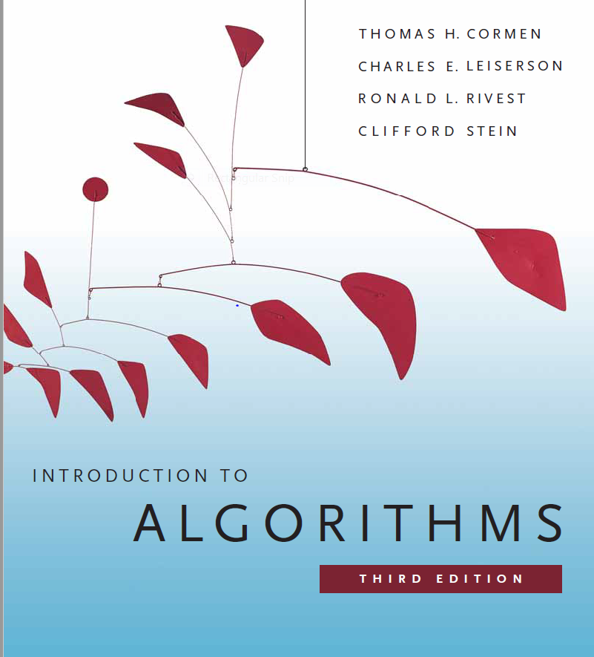
go immediately to check the library!!!

Slide 8
Evaluation
Course quizzes
Between 3 and 7 quizzes, during the course, un-announced
Target info in the current course and ALL the things discussed up to that point
Delivered on Moodle
20% of the Final Grade; CANNOT retake the quizzes
Hands on evaluation (laboratory assignments)
Stay in your group
10 assignments
Every (other) lab deadline on an assignment (various thresholds; we encourage evolution & knowledge/skills increase)
Late assignments policy:
Some assignments can be submitted 1 week late: 80% of max grade
More than 1 week, no grade (0) on the given assignment
Plagiarism policy – 0 tolerance!!! Don’t even try!
30% in the Final Grade (need grade of 5 or more to be allowed to take the final exam)
FE
2-3h examination (moodle): algorithm traces, questions, algorithm design for specific problems, complexity analysis; open books

Slide 9
What is this course about?
NOT a programming course
NOT a Data Structures course
Course on Fundamental Algorithms
How to:
evaluate algorithms performance
compare performance of different algorithms
design efficient and optimal algorithms
identify a solution to a problem
specific efficient algorithms on fundamental problems

Slide 10
What is an algorithm?
An algorithm is

Slide 11
What is an algorithm?
An algorithm is
“Word used by programmers when they do not want to explain what they did”

Slide 12
What is an algorithm?
An algorithm is
“Word used by programmers when they do not want to explain what they did”
“Something that made something do something in some amount of time”

Slide 13
What is an algorithm?
An algorithm is
“Word used by programmers when they do not want to explain what they did”
“Something that made something do something in some amount of time”
“When a piece of code from stackoverflow works but you don't know why and how!”

Slide 14
What is an algorithm?
An algorithm is
“Word used by programmers when they do not want to explain what they did”
“Something that made something do something in some amount of time”
“When a piece of code from stackoverflow works but you don't know why and how!”
A sequence of computational steps that transform the input into the output.
specific computational procedure for achieving the desired input/output relationship.

Slide 15
What is an algorithm?
An algorithm is
“Word used by programmers when they do not want to explain what they did”
“Something that made something do something in some amount of time”
“When a piece of code from stackoverflow works but you don't know why and how!”
A sequence of computational steps that transform the input into the output.
specific computational procedure for achieving the desired input/output relationship.

Slide 16
An algorithm ...
…has to be

Slide 17
An algorithm ...
…has to be
correct
“Program testing can be used to show the presence of bugs, but never to show their absence” (Dijkstra, 1970, "Notes On Structured Programming")

Slide 18
An algorithm ...
…has to be
correct
efficient
main goal of this course
more on this soon…

Slide 19
An algorithm ...
…has to be
correct
efficient
easy to implement
see https://en.wikipedia.org/wiki/Galactic_algorithm

Slide 20
Complexity
Algorithm Complexity vs Problem Complexity!
Highly related (details soon)
Algorithm complexity question: What is the amount of resources required to run THE algorithm?
Parameters to be evaluated
Time
Memory
Other (secondary memory accesses, network traffic, etc.)
Time (components – in parallel execution)
Computation time
As the number of processors increases, computation time decreases
Communication time (data transfer, partial results transfer, information communication)
The opposite

Slide 21
Algorithm Complexity– cont.
Overall execution time
T
N

Slide 22
Algorithm Complexity – cont.
Denote the efficiency of an algorithm by the <time> required to solve the problem.
<time> can be replaced with any other resource, but it is the most important
How to actually evaluate efficiency?
Measure ACTUAL time
time = f(sec)? Why? Why not?
Estimate time t=f(n), n=input data size
Cases to be considered (as executions do not always behave the same)
Best
Worst
Average
Cases relate to?
the algorithm implementing the given problem (method/strategy – TBD) so every algorithm could have a different (distinct from other algorithms) best/worst case
the implementation of the algorithm (specific structures employed, the way they are manipulated)
Handled by the Analysis of Algorithms field

Slide 23
Problem Complexity
Handled by Computational Complexity Theory field
The question: What is the least amount of resources necessary by any of the possible (known/unknown) algorithms that could solve a given problem?
Mathematical models of computation
Establish the practical limits on what computers (and algorithms) can/cannot do
In practice, when discussing about the complexity (of a problem), we evaluate the efficiency of the solution (that is, a particular implementation of a given algorithm)
Relative
Absolute

Slide 24
Complexity – cont. (Efficiency)
Comparison between algorithms (relative comparison)
t(n) represents functions expressing execution time
Just asymptotic behavior matters (i.e. the term with the fastest growth is considered only)
Ex: given t₁(n)= 3n²+300n+50
t₂(n)= 2n³ + 10n² +2n+10
we count just as t₁(n) ≅ 3n² and t₂(n) ≅ 2n³
… more on this will follow
Relative complexity evaluation
between various algorithms
efficiency has degrees of comparison
Alg1 is more / less efficient than Alg2

Slide 25
Complexity – cont. (Optimality)
Absolute comparison?
compare with some absolute measure?
reference value = problem complexity
Provides info about the optimality of an algorithm
Optimality does NOT have degrees of comparison
An algorithm is either optimal or NOT optimal
How to operationalize this
What do you compare on the algorithm side?
What does problem complexity even mean, from a practical standpoint?

Slide 26
Complexity – cont. (Optimality)
O – notation (big Oh function)
Expresses the upper bound of a function
O(g(n))={f(n)|∃c, n₀>0, 0<=f(n)<=c·g(n), ∀n>=n₀}
f(n)=O(g(n))
O specifies the asymptotic upper bound
It is related to the algorithm (expresses the execution time of the algorithm implementing a problem as a number of execution steps)

Slide 27
Complexity – cont. (Optimality)
Ω - notation
Expresses the lower bound of a function
Ω(g(n))={f(n)|∃c, n₀>0, 0<=c·g(n) <=f(n), ∀n>=n₀}
f(n)= Ω(g(n))
Ω specifies the asymptotic lower bound
It is related to the problem (expresses the theoretical number of steps required by the problem to be solved)

Slide 28
Complexity – cont. (Optimality)
Optimality is related to the lower bound absolute (Ω)
Optimality is a superlative
Has NO DEGREE OF COMPARISON!!!
i.e. an algorithm is either
OPTIMAL,
or is NOT optimal;
there is no MORE/LESS optimal!

Slide 29
Complexity – cont. (Optimality)
Absolute comparison defines a relation between O and Ω (estimation of the performance of an algorithm solving a given problem in relation to lower bound of the problem!)
So, compare O (big Oh function) with Ω
Which O?
Worst case. Why?
Asymptotic behavior (what happens when execution is the slowest?)
O() <= Ω () in the best or even average case
Ex: The sorting problem has its lower bound
Ω(n lgn), and many sorting algorithms have O(1) best case and O(n) average case!!!

Slide 30
Complexity – cont. (Optimality)
An algorithm is optimal if the running time of the algorithm to solve the problem in the worst case scenario equals the lower bound of the given problem and uses just constant additional memory:
O = Ω
Generally, we are interested in
EITHER developing algorithms with t(n) such that
Ω <= t(n) <= O
where O = running time of the best known algorithm for the given problem
OR identifying the best known algorithms
The good news
This is what we are doing in this course
The bad news
many of the real-world problems do not have good algorithms
Even worst
No such algorithms will exist (soon? EVER!). NPC problems (TBD …but … this is beyond the scope of this class. It’s the master course!)

Slide 31
Complexity – cont.
Rules for estimating O (Big Oh function)
1. O(c·f(n))= O(f(n))
2. O(f₁(n)·f₂(n))= O(f₁(n))·O(f₂(n))
in nested loops
3. O(f₁(n)+f₂(n))= O(f₁(n))+O(f₂(n))
in consecutive loops
4. When expressing O, only leading term is considered

Slide 32
Complexity – cont.
leading (lim)
f1(n) leads f2(n)
n^{n} n!
n! a^{n}, a>1
a^{n} b^{n}, a>b
a^{n} n^{b}, a>1
log_{a}n log_{b}n, b>a>1
log_{a}n 1, a>1
Vals of Ω() for some problems
Searching Ω(logn)
Selection Ω(n)
Sorting Ω(n·logn)
The base of the log in CS is 2

Slide 33
Complexity – cont.
Interpretation O(1): constant time (i.e. regardless the dimension of the input data, the algorithm has always the same running time)
Asymptotic behavior:
For t₁(n)= 3n²+3n+5 =>O(n²)
For t₂(n)= 2n³ + 100n² +25n+1000 =>O(n³)
For “real” values (i.e. small sizes of data, small n) it could be that the leading term is not leading:
100n² > 2n³ !
100n² = 2n³ :2n²
100/2=n
So for n< 50, the second term in t2 grows faster!!!

Slide 34
Complexity – cont.
Ω characterizes the problem, lower bound
O characterizes the algorithm that solves that problem, upper bound
if Ω = O in the worst case + no additional memory is used by the algorithm (sometimes, logarithmic space allowed – to be discussed later – then optimal algorithm)
If no optimal algorithm is known, what solutions are acceptable?
Q: How fast the max dim (of the problem that can be solved on a computer) grows in case we increase the speed of the computer?
How different classes of algorithms affect performance?

Slide 35
Complexity – cont.
What classes are interesting (to be considered)?
Experiment: let’s consider 2 classes of algorithms:
Alg1: polynomial
Alg2: exponential
Assume a new hardware system is built, and its speed increases V times (compared to our former system)
Q? How does this increase the max size of the problem to be solved on the new system?
That is: estimate n₂=f(V,n) given
V=increase of speed of the new machine
n=max size on the former (let’s call it old) machine

Slide 36
Complexity – cont.
Alg1: O(n^{k})
Oper. Time
M1(old): n^{k} T
M2(new): n^{k} T/V
Vn^{k} T
(n₂)^{k}= Vn^{k}=(V^{1/k} n)^{k}
So, n₂= V^{1/k} n
Favorable consequence:
If the speed of the machine increases V times,
Then the max dimension of the problem increases v^{1/k} times.
Notes:
v^{1/k} is small value
But the degree of the polynomial (k) is small for most problems
AND, it is a multiplicative increase

Slide 37
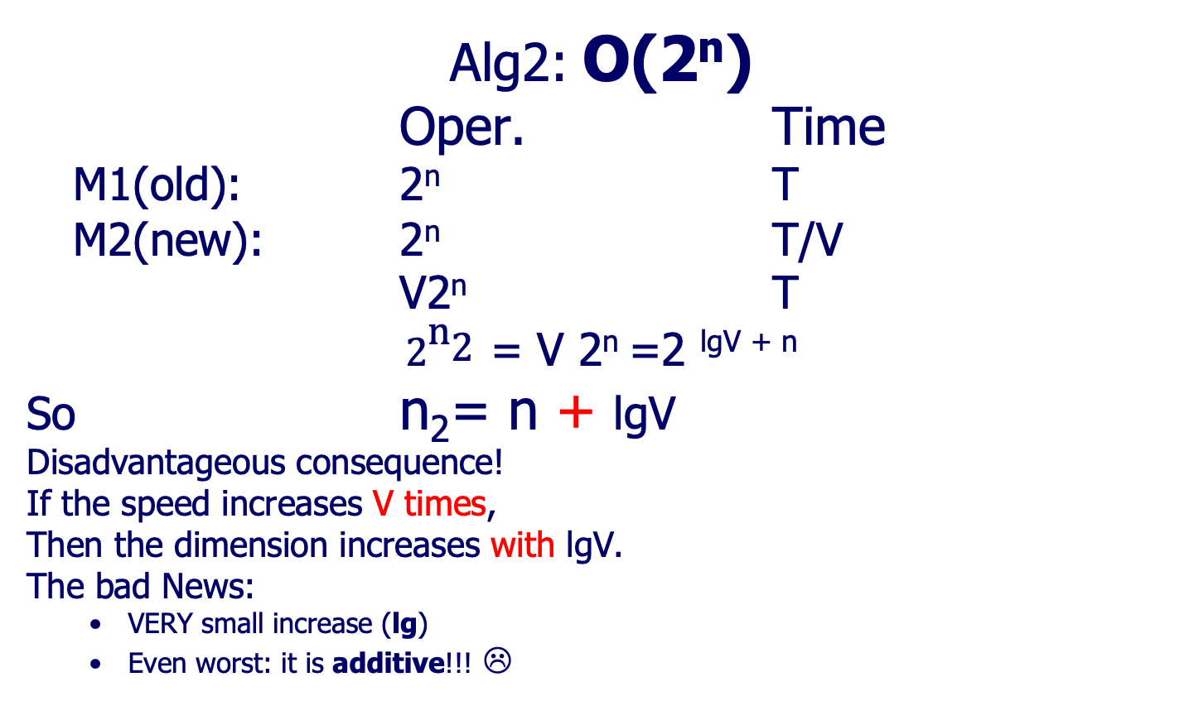
Complexity – cont.
Alg2: O(2^{n})
Oper. Time
M1(old): 2^{n} T
M2(new): 2^{n} T/V
V2^{n} T
${\text{2}}^{{\text{n}}_{\text{2}}}$ = V 2^{n} =2 ^{lgV + n}
So n₂= n + lgV
Disadvantageous consequence!
If the speed increases V times,
Then the dimension increases with lgV.
The bad News:
VERY small increase (lg)
Even worst: it is additive!!! ☹

Slide 38
Complexity – cont.
Speed of the new computer in terms of the old one: V₂=V ·V₁
Alg1: O(n^{k}): n₂= v^{1/k} ·n
Alg2: O(2^{n}): n₂= n + lgV
CL: For exp algs, no matter how many times we increase the speed of the system, the size increases with an additive constant!!!
Sol:
avoid designing exponential solutions! NEVER EVER write exponential algorithms!!!
are there any problems with unknown polynomial sols?
P=NP ? 1 million USD problem (since 1971, Stephen Cook)

Slide 39
Complexity – cont.
Evaluating the complexity for Divide et Impera algorithms
divide_et_impera(n, I, O)
if n<=n0
then direct_solution(n, I, O)
else divide(n, I1,I2,…,Ia)
divide_et_impera(n/b,I1,O1) //a rec. calls
divide_et_impera(n/b,I2,O2)
…
divide_et_impera(n/b,Ia,Oa)
combine(O1,O2,…,Oa,O)

Slide 40
Complexity – cont.
Assumption f(n) = time (complexity) of the alg – sequence except for the recursive calls (div&comb)
f(n)= n^{c}
⎛t₀ if n<n₀
t(n)= ⎨
⎝at(n/b)+f(n) if n>=n₀
This is something to remember:
t(n)= at(n/b)+n^{c} a = number of recursive calls
b= division factor of the input
c = degree of the polynomial describing the run time of the sequence outside the recursive calls

Slide 41
Complexity – cont.
Calling tree
n^{c} => n^{c}
(n/b)^{c} (n/b)^{c} … (n/b)^{c} => a (n/b)^{c}
(n/b²)^{c} (n/b²)^{c. ….} (n/b²)^{c} … => a²(n/b²)^{c}
…
How many levels?

Slide 42
Complexity – cont.
Level Calling tree # Ops
0 n^{c} => n^{c}
1 (n/b)^{c} (n/b)^{c} … (n/b)^{c} => a (n/b)^{c}
2 … (n/b²)^{c} (n/b²)^{c} …. (n/b²)^{c} … => a²(n/b²)^{c}
… … …
log_{b}n => a ^{log}_{b}^{n} (n/b ^{log}_{b}^{n})^{c}
t(n) = n^{c}+ a (n/b)^{c}+ a²(n/b²)^{c}+…
= n^{c}[1+a/b^{c}+(a/b^{c})²+…(a/b^{c})^{log}_{b}^{n}]
Geometric progression:
first_term =1
ratio (q) = a/b^{c}
number of terms = log_{b}n+1

Slide 43
Complexity – cont.
t(n)=n^{c}[1+a/b^{c}+(a/b^{c})²+…(a/b^{c})^{log}_{b}^{n}]
Cases:
q<1; a<b^{c} => O(n^{c}) – 1st term matters
q=1; a=b^{c} => O(n^{c}·log_{b}n )
q>1; a>b^{c} => O(?)
t=first_term·(q^{n}-1)/q-1
t(n)= n^{c}[ (a/b^{c})^{log}_{b}^{n} -1]/[a/b^{c}-1]
3. Take the asymptotic term: n^{c} (a/b^{c})^{log}_{b}^{n}

Slide 44
Complexity – cont.
Case 3: q>1, a>b^{c}
t(n)= n^{c}[ (a/b^{c})^{log}_{b}^{n} -1]/[a/b^{c}-1]
the asymptotic term n^{c} (a/b^{c})^{log}_{b}^{n}
Q?: O(n^{c} (a/b^{c})^{log}_{b}^{n})=O(n^{α})
if yes, α=?
n^{α} =n^{c} (a/b^{c})^{log}_{b}^{n} divide by n^{c}
n^{α-c} =(a/b^{c})^{log}_{b}^{n} apply log_{b}
(α-c) log_{b} n = log_{b} n ·log_{b} (a/b^{c}) divide by log_{b}n
(α-c) = log_{b} a-c add c
α = log_{b} a

Slide 45
Complexity – cont.
Cl: if f(n)= n^{c}
a<b^{c} => O(n^{c})
a=b^{c} => O(n^{c}·log_{b}n )
a>b^{c} => O(n^{log}_{b} ª) !! Independent of c
Obs: b should be scaler (b>1)
composition should comply the partition rule!
In most cases, either divide, or combine is some (almost) default operation (or it takes just O(1))
Ex: quick sort combine is default (sort insitu)
merge sort divide is almost default - computes the middle index O(1)

Slide 46
Complexity– cont.
Particular cases:
c=1 => f(n)=n
⎛O(n) if a<b
t(n)= ⎨O(n·log_{b}n ) if a=b
⎝ O(n^{log}_{b} ª) if a>b
Q? Algorithm examples?
Ex: qsort a=b=2=>O(n·log₂n)=O(n·logn)
IS qsort optimal? Justify!

Slide 47
Complexity – cont.
Particular cases:
2. c=0 => f(n)=ct
⎛N/A if a<bº ⬄ a<1!
t(n)= ⎨O(log_{b}n ) if a<bº ⬄ a=1
⎝ O(n^{log}_{b} ª) if a<bº ⬄ a>1
Q? Algorithm examples?
Ex: a=1, b=2 search in BST => O(logn)
a=2, b=2 tree traversal=> O(n)

Slide 48
Sorting algorithms
What is all about?
Direct strategies – tutorial
Advanced strategies – course

Slide 49
Required Bibliography
From the Bible – Chapters 2, 3 and 4.6 -> 4.6 (inclusive)

