Slide 1
Fundamental Algorithms Lecture #2
Cluj-Napoca, 2020

Slide 2
Agenda
Review – conclusions
Divide et impera evaluation
Particular cases
Master Theorem
Sorting
Heap Sort

Slide 3
Review – conclusions
Correctness
How do we know an algorithm is correct?
Testing never shows an algorithm is correct. It can only show it is INCORRECT (by finding bugs)
Absence of evidence ≠ Evidence of absence
Dijkstra: “Testing shows the presence, not the absence of bugs. ”
So, how can we know an algorithm is correct?
Proof!
if the pre-conditions are satisfied, the post-conditions will be true when the algorithm terminates;
partial correctness = whenever preconditions are satisfied, the post-conditions are true;
total correctness = partial correctness + termination condition

Slide 4
Review – conclusions
Complexity
Evaluate time and space requirements
Time as an estimation of the amount of work done
As an expression of # of atomic operations
Identify the operations done, count their number and estimate their growths
Depends on the size of the input data (n)
Depends on case (best, worst, average to be evaluated)
Space requirements as an expression of supplementary memory
Need algorithms using constant extra space
Some times, algs with lgn extra space are accepted

Slide 5
Review – conclusions
Complexity
Time = amount of work = as a function of n (size of input data)
We need its asymptotic growth
Lower bound Ω depends on the problem
Upper bound O depends on the algorithm
Efficiency compare algorithms (their corresponding O function) among each other – one is more/less efficient
Optimality Ω = O in the worst case scenario - compare an algorithm with the problem lower bound

Slide 6
Review – conclusions
Stability
The property of an algorithm to preserve the relative order of equal elements from the input (initial/original data) in the output (final data/result)
Desired property
Choose stable algorithms, if possible
When and why?

Slide 7
Review – conclusions
Correctness
Efficiency
Stability

Slide 8
Divide et impera evaluation
divide_et_impera(n, I, O)
if n<=n0
then direct_solution(n, I, O)
else divide(n, I1,I2,…,Ia)
divide_et_impera(n/b,I1,O1) //a rec. calls
divide_et_impera(n/b,I2,O2) //b division factor
…
divide_et_impera(n/b,Ia,Oa)
combine(O1,O2,…,Oa,O)

Slide 9
Divide et impera evaluation – contd.
f(n)= n^{c}
⎛t₀ if n<n0
t(n)= ⎨
⎝at(n/b)+f(n) if n>=n0
a = number of recursive calls
b = the ratio to which the original domain is divided
c = degree of the polynomial expressing the execution time of the divide et impera sequence except for the recursive calls
It is reasonable to assume f(n) is polynomial as we are seeking for overall polynomial running time algorithms

Slide 10
Divide et impera evaluation – contd.
t(n)=n^{c}[1+a/b^{c}+(a/b^{c})²+…(a/b^{c})^{log}_{b}^{n-1}]
Cases: 1. q<1; a<b^{c} => O(n^{c})
2. q=1; a=b^{c} => O(n^{c}·log_{b}n )
3. q>1; a>b^{c} => O(n^{log}_{b} ª) !!
It’s polynomial
Small power Independent of c
Obs: b should be scaler (b>1)
composition should comply to the partition rule!
In most cases, either divide, or combine is O(1)
Ex: quick sort combine = done by default (sort in situ) – no time at all
merge sort divide O(1): compute the middle index

Slide 11
Particular cases
c=1 => f(n)=n
⎛O(n) if a<b
t(n)= ⎨O(n·log_{b}n ) if a=b
⎝ O(n^{log}_{b} ª) if a>b
Ex: qsort a=b=2=>O(n·log₂n)=O(n·logn)
Is qsort optimal? Justify!
It (a=b=2) is NOT the worst case!
Are there means of avoiding worst case?
See the following courses/seminars

Slide 12
Particular cases – cont.
2. c=0 => f(n)=ct
Q? Is this possible ? Does such algs exist?
⎛N/A if a<bº ⬄ a<1 not possible!
t(n)= ⎨O(log_{b}n ) if a=bº ⬄ a=1
⎝ O(n^{log}_{b} ª) if a>bº ⬄ a>1
Ex: a=1, b=2 search in BST => O(logn)
a=2, b=2 tree traversal => O(n)

Slide 13
Master Theorem to remember/to keep close
f(n)= n^{c}
⎛t₀ if n<n₀
t(n)= ⎨
⎝at(n/b)+f(n) if n>=n₀
q<1; a<b^{c} => O(n^{c})
q=1; a=b^{c} => O(n^{c}*log_{b}n )
q>1; a>b^{c} => O(n^{logba})

Slide 14
Homework
Consider your personal computer/notebook. Check the number of instructions/second it can execute, then compute which is the maximum problem size (i.e. n) that a (1) polynomial and (2) exponential algorithm can solve in:
1 day 1 year
1 week 1.000 years
1 month 1.000.000 years

Slide 15
Sorting algorithms
Sorting problem Ω(nlgn)
What is all about?
Direct strategies – seminary
Advanced strategies – course

Slide 16











Sorting problem Ω
Lemma: Any comparison-based sorting alg. performs Ω(nlgn) comparisons in the worst case to sort n objects
e.g.
y
a₁$≤$a₂ $≤$a₃
a₂ $≤$a₃
y
a₁$≤$a₃ $≤$a₂
y
a₁ $≤$a₃
n
a₁ $≤$a₂
n
a₃$≤$a₁ $≤$a₂
y
a₂$≤$a₁ $≤$a₃
n
a₁ $≤$a₃
y
a₂$≤$a₃ $≤$a₁
n
a₂ $≤$a₃
n
a₃$≤$a₂ $≤$a₁

Slide 17






Sorting problem Ω
Lemma: Any comparison-based sorting alg. performs Ω(nlgn) comparisons in the worst case to sort n objects
e.g.
y
a₁$≤$a₂ $≤$a₃
a₂ $≤$a₃
y
a₁$≤$a₃ $≤$a₂
y
a₁ $≤$a₃
n
a₁ $≤$a₂
n
a₃$≤$a₁ $≤$a₂
y
a₂$≤$a₁ $≤$a₃
n
a₁ $≤$a₃
y
a₂$≤$a₃ $≤$a₁
n
a₂ $≤$a₃
n
a₃$≤$a₂ $≤$a₁
leaves = each possible answer for any given input
How many leaves? (l )

Slide 18

Sorting problem Ω
Lemma: Any comparison-based sorting alg. performs Ω(nlgn) comparisons in the worst case to sort n objects
l = n! leaves in the tree
Worst-case running time $≡$? (related to what from the tree)

Slide 19
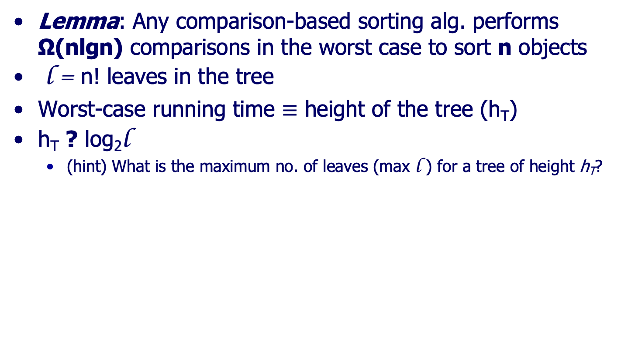
Sorting problem Ω
Lemma: Any comparison-based sorting alg. performs Ω(nlgn) comparisons in the worst case to sort n objects
l = n! leaves in the tree
Worst-case running time $≡$ height of the tree (h_{T})
h_{T} ? log₂l
(hint) What is the maximum no. of leaves (max l ) for a tree of height h_{T}?

Slide 20

Sorting problem Ω
Lemma: Any comparison-based sorting alg. performs Ω(nlgn) comparisons in the worst case to sort n objects
l = n! leaves in the tree
Worst-case running time $≡$ height of the tree (h_{T})
h_{T} > log₂l (motivate!)

Slide 21
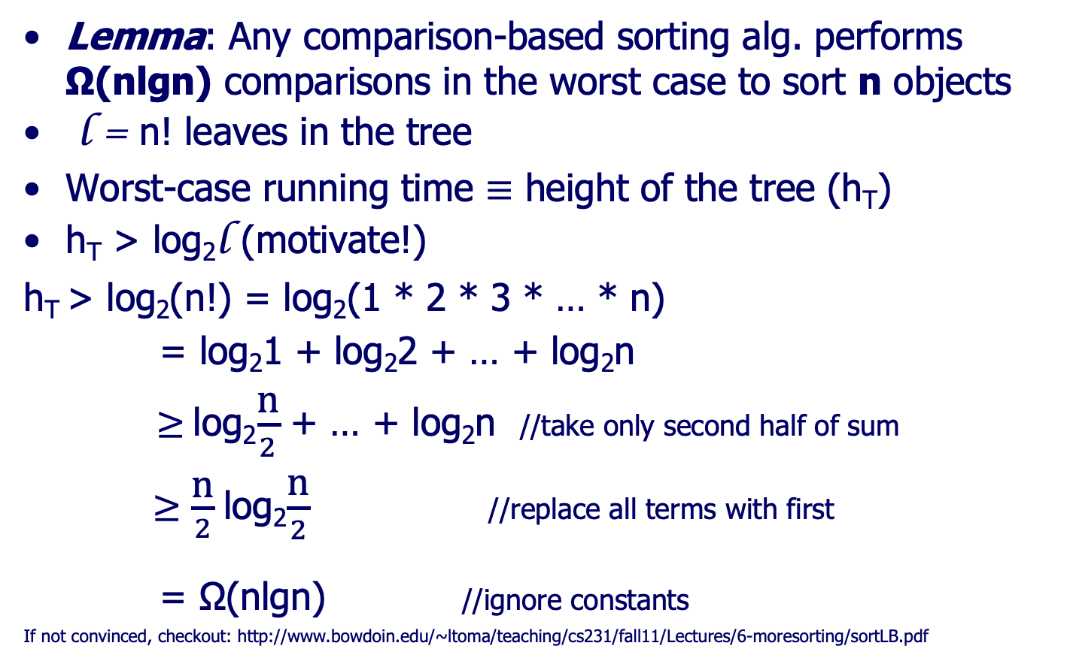
Sorting problem Ω
Lemma: Any comparison-based sorting alg. performs Ω(nlgn) comparisons in the worst case to sort n objects
l = n! leaves in the tree
Worst-case running time $≡$ height of the tree (h_{T})
h_{T} > log₂l (motivate!)
h_{T} > log₂(n!) = log₂(1 * 2 * 3 * … * n)
= log₂1 + log₂2 + … + log₂n
$≥$log₂$\frac{\text{n}}{2}$ + … + log₂n //take only second half of sum
$≥\frac{\text{n}}{2}$log₂$\frac{\text{n}}{2}$ //replace all terms with first
= Ω(nlgn) //ignore constants
If not convinced, checkout: http://www.bowdoin.edu/~ltoma/teaching/cs231/fall11/Lectures/6-moresorting/sortLB.pdf

Slide 22
Heap sort
Sorting with the aid of a heap structure
Heap = array viewed (logical perspective) as a BT
Representation (logical persp.) based on the index
i = parent
2·i 2·i+1 = children
Property: A[parent(i)]>=A[i]
Parent/child property => implies a partial order relation
Q? What is a partial order relation?
There is NO property between siblings
Example - blackboard
Other properties may be defined

Slide 23
Heap sort – cont.
Q1: identify a maximal subset on which the partial order relation becomes a total order relation.
A branch.
Q2: based on the heap property, what consequence (post condition) follows?
The root contains the max value;
Max value in case the property based on which the heap is built is >=.
The root would have some other particularity in case another property is the choice.

Slide 24
Heap sort – Heap procedures
Heapify – Reconstituie heap
“Adds ” the root to 2 left and right children rooted heaps
Build-Heap
Constructs the whole heap structure (on the entire array), by repeatedly applying heapify
Heapsort
Reorganizes the array by repeatedly extracting the root of the heap and placing it in the “right” position of the sorted array

Slide 25
Heapify (Reconstituie heap)
Pre-condition – 2 heaps (H1, H2)
Goal: add a single element El s.t. the triple (El and H1, H2) represents a larger heap: H
Post-condition – 1 single heap H (Root+H1+H2)
The strategy: top-down = sink the root to its correct place in the heap
2!
7
3
6
5
1
2
3
1

Slide 26
Heapify
heapify (A,i)//i-index of the root (= El to be added on top of the heap)
largest<- //root, left or right child index
index_of_max_bet(A[i],A[left(i)],A[right(i)])
if largest <> i //one of the children larger than root
then A[i]<->A[largest] //swap root with largest child
heapify(A, largest) //continue the process on the heap //branch of the largest child. The other branch (i.e. heap) //is not affected at all
it applies a top-down strategy

Slide 27
Heapify - example
2!
7
7
3
2
3
6
5
1
2
6
5
1
2
3
1
3
1
7
7
6
3
6
3
3
5
1
2
2
5
1
2
2
1
3
1

Slide 28
Heapify – running time
Running time:
O(1) running time at one level
Recursive calls (how many times?)
Best: none => O(1)
Worst: every time => repeated down to the level of the leaves
Intuitive: height of a full BT=lgn; you have to “sink” the root down to the level of a leaf (O(h), h=lgn for a complete tree)
Exact evaluation:
The last row of the tree is exactly half full, and we go on that branch
If full BT, half of the nodes are leaves
t(n)=t(2n/3)+O(1) : a=1, b=3/2, c=0
=> Apply Master (case #2) and get O(log_{b}n )= O(log_{3/2}n) =
= O(lgn/lg(3/2)) = O(lgn/(lg3-1))=O(c·lgn)= O(lgn)
Why b=3/2? Explained later (next 2 slides)

Slide 29
Heapify – running time
Why t(n)=t(2n/3)+O(1)?
Why 2n/3 nodes on the rec call (b=3/2)?
Picture 3*n/6 (internal) and 3n/6 (leaves)
All other levels – multiple levels
Leaves’ parents (on the left) and leaves (on the right) – 1 level
Leaves (on the left half only) – 1 level
n/6
n/6
n/6
n/6
2n/6

Slide 30
Heapify - Justification of # of nodes
Half of the nb. of nodes are leaves (2/3 on the left, 1/3 on the right)
Nb. of parents of leaves from left= half the number of those leaves (and at the same time = nb. of leaves from right)
The rest of the elements (= n-2n/6-n/6-n/6) are equal split (left/right) on the rest levels up to the root
n/6
n/6
n/6
2n/6
n/6
n/6
n/6
n/6
2n/6
2n/6

Slide 31
Heapify - Justification of # of nodes
Nb. Of nodes on the worst case: nodes on the largest branch (left one)
=n/6+n/6+2n/6=4n/6=2n/3
So t(n)=t(2n/3)+O(1) (claimed 3 slides before) is justified

Slide 32
Build-Heap
Heapify starts from the assumption we already have 2 heaps. Where are they from?
1 single node is a (very basic) heap.
So, half of the # of nodes are already heaps; we get the strategy
Start with 2 heaps each of dimension 1
Add their common parent node to build a heap of dimension 3
Adopt a bottom-up strategy:
½ out of all nodes are heaps from the very beginning (leaves in a complete binary tree)
Apply heapify to the first non-leaf node (the node in the tree with the largest index, having at least one child)
Go to the “next” indexed node (sibling to the left of the first processed element)
Continue the process until reach the root

Slide 33
Build-Heap – code
Build-Heap(A)
for i<-|A|/2 downto 1 //from the non-leave nodes to the root
do heapify(A,i) // build the heap out of 2 already built // heaps and 1 node
It applies a bottom-up strategy
Running time:
it seems to be n/2 ·lg n
We apply n/2 times (on all non-leaf nodes) heapify
heapify in worst case is O(lgn)
Means n/2 times O(lgn) goes to n/2 ·lg n
CL: only building the heap takes n/2 ·lg n
So we cannot sort on n/2 ·lg n!!!

Slide 34
Build-Heap – running time
Running time – a first evaluation:
n/2 times heapify => nlgn. Not good ☹
Running time – a closer look:
For all leaves, heapify does not apply
Half of the nodes are leaves – no operation applied
For all the parents of all the leaves it only takes O(1)
nb. of leaves’ parents = half of the nb. of leaves
time require to heapify all of them (=nb*time): ½² ·n · 1
For half of the remaining elements, it takes 2 steps to “heapify” them:
half of the rest is ½ · ½ · ½ ·n = 1/8 ·n
time require to heapify them: 1/8 ·n ·2
At each of the next steps, the nb. of elements halves, while the nb. of steps required to heapify each increases by 1

Slide 35
Build-Heap – running time
t(n) =
// #· individual time
n/2·0+ //(leaves)
n/2²·1+ // (leaves’parents) ….
n/2³ ·2+
n/2⁴ ·3+…
[lgn]
= ∑[n/2^{h+1}] ·O(h)
0

Slide 36
Build-Heap – running time
To evaluate the sum on the prev slide, start from:
∑x^{k} = (1-x^{n+1})/(1-x) (geom prog., first =1, q=x)
∑ x^{k} =1/(1-x) For x<1, n->∞ we get:
(∑ x^{k} )’ = [1/(1-x)]’ (derive)
∑k·x^{k-1} = 1/(1-x)² (multiply by x)
∑k·x^{k} = x/(1-x)² (1)
Use the result (for a particular value of x) to calculate the desired sum from before

Slide 37
Build-Heap – running time
[lgn]
t(n)= ∑[n/2^{h+1}] ·O(h)
0
[lgn]
= ∑ n[1/2^{h+1}] ·h
0
[lgn]
= n/2· ∑ [1/2^{h}] ·h =n/2·∑ h · (1/2)^{h}
0
But since ∑k·x^{k} = x/(1-x)² (from (1) previous slide),
for x=1/2 we get
∑k·x^{k} =(1/2)/(1-1/2)²=(1/2)/(1/2)² =2
So ∑ h · (1/2)^{h} = 2, therefore t(n)= O(n)

Slide 38
Build-Heap Complete Example
1
1
5
2
5
2
1
3
7
2
4
3
7
2
4
3
1
3

Slide 39
Build-Heap Complete Example
1
1
5
2
5
7
4
3
7
2
4
3
2
2
1
3
1
3
7
7
1
5
1
5
2
5
7
4
3
2
2
4
3
1
2
4
3
2
2
1
3
1
3
1
3

Slide 40
Heapsort
Heapsort – the complete technique
Build Heap which selects the max on the top of the heap
swap the top element (root) with the bottom one (last leaf) (i.e. move the max element in the last position of the array, where it belongs in the ordered array)
At this point, we destroyed both the heap structure, and we don’t have an ordered one!

Slide 41
Heapsort cont.
Heapsort – the technique –cont.
except for the first and last elements, we have a heap
from the second A[2] to the one before the last A[|A|-1] we have a heap
BUT the last element is in its right place in the ordered array already; consider it not more in the heap (thus, heap_size should decrement by 1)
apply heapify again on the new, smaller heap (without the last), for A[1] to sink that element in the right position
repeat the process until the dim of the heap becomes 1
while the heap’s dimension decreases (by 1 each step, from the right), the already ordered array’s dimension increases (with 1 each step, on the left)

Slide 42
Heapsort - code
HeapSort(A)
Build-Heap(A) //generate the initial heap structure
heap_size[A]<-|A|
for i<-|A|downto 2//from the non-leave nodes do A[1]<->A[i] //swap the root of the heap //with the bottom element in the current heap; //array A[1..i-1] is a heap, array A[1..|A|] is //an ordered structure
heap_size[A]<-heap_size[A]-1
heapify(A,1)// rebuild the heap struct. rom 1 to i

Slide 43
Heapsort - evaluation
Build-Heap(A) takes O(n)
for i<-|A|downto 2 repeats n times
heapify(A,1) takes O(h) where h goes down from lgn to 1, so loop<=n·lgn
O(n)+O(n·lgn) = O(n·lgn)
t_{HeapSort} = O(n·lgn) = Ω(n·lgn)
Eval in worst case => optimal algorithm

Slide 44
Heapsort – complete example (after the heap was built – the for loop)
Swap 7 (top) with 3 (bottom)
Heapify from index 1 (sink 3 to the right place)
7
3
5
2
5
2
4
3
1
2
4
3
1
2
5
1
3
5
1
7
4
2
3
2
3
3
1
2
4
3
1
2
1
7
1
7

Slide 45
Heapsort – complete example (green=sorted part; blue =heap part)
Swap 5 (top) with 1 (bottom)
Heapify from index 1 (sink 1to the right place)
1
5
4
2
4
2
3
3
1
2
3
3
1
2
4
4
5
7
1
7
1
2
3
2
3
3
1
2
1
3
1
2
5
7
5
7

Slide 46
Heapsort – complete example (green=sorted part; blue =heap part)
Swap 4 (top) with 2 (bottom)
Heapify from index 1 (sink 2 to the right place)
4
2
3
2
3
2
1
3
1
2
1
3
1
4
3
5
7
3
5
7
2
2
3
2
1
3
1
4
1
2
1
4
5
7
5
7

Slide 47
Heapsort – complete example (green=sorted part; blue =heap part)
Swap 3 (top) with 1 (bottom)
Heapify from index 1 (sink 1 to the right place)
3
1
3
2
3
2
1
2
1
4
1
2
3
4
3
5
7
3
5
7
1
2
2
2
1
2
3
4
1
1
3
4
5
7
5
7

Slide 48
Heapsort – complete example (green=sorted part; blue =heap part)
Swap 3 (top) with 1 (bottom)
Heapify from index 1 (sink 1 to the right place)
3
1
2
2
2
2
1
1
3
4
1
3
3
4
2
5
7
5
7
1
2
1
3
3
4
5
7

Slide 49
Heapsort – complete example (green=sorted part; blue =heap part)
Swap 2 (top) with 1 (bottom)
Heapify from index 1 (sink 1 to the right place)
2
1
1
2
1
2
1
3
3
4
2
3
3
4
2
5
7
1
1
5
7
2
3
3
4
5
7

Slide 50
Heapsort – complete example (green=sorted part; blue =heap part)
Swap 2 (top) with 1 (bottom)
Heapify from index 1 (sink 1 to the right place)
2
1
1
1
1
2
2
3
3
4
2
3
3
4
5
7
5
7

Slide 51
Heapsort – complete example (green=sorted part; blue =heap part)
Swap 1 (top) with 1 (bottom)
Only 1 element in the heap =>smallest=>all is array
Blue = elements in the heap
Green = elements in the ordered array
http://www.eecs.wsu.edu/~cook/aa/lectures/applets/sort1/heapsort.html
1
1
1
2
1
2
2
3
3
4
2
3
3
4
5
7
5
7

Slide 52
Heap – as a data structure
Build heap strategy applies in case the dimension of the array is known in advance and has a constant value
If not, define and use a heap as a data-structure => add dimension associated with the structure (size of the heap)
Operations:
pop_heap extract the top from the heap
push_heap add one item to the heap

Slide 53
Heap – as a data structure – cont.
pop_heap Extracts the top element
Move bottom element on top (swaps last with top, similar to 1 step of heapsort)
Decrements the heap size
Heapify the whole (from 1 to the new size), to update the heap structure =>O(lgn)
push_heap
Adds a new element at the bottom
Rebuild heap, a bottom-up approach (bubble the bottom element upper in the heap, until it finds a larger-value parent) => O(h)=O(lgn)
Examples on the blackboard

Slide 54
Heap – as a data structure – cont.
build_heap
Repeats push_heap procedure
It takes 1+2·1+4·2+…+n/2·lgn=O(nlgn)
heap_sort
Build the heap (build_heap takes O(nlgn))
pop_heap (takes O(lgn))
add the poped element at bottom+1 (i.e. out of the heap, in the array)
It takes O(nlgn) (to build the heap)+ O(nlgn) (n times a pop operation)

Slide 55
Heap – comparison in building the heap
Approach Sol 1 (heapify) Sol2(pop/push)
1 el approach sinks the top (root) bubbles a leaf
O(h) O(h)
all els(build heap)bottom-up top-down
approach (starts with the last nonleaf el) (adds a new leaf)
Time to build O(n) O(nlgn)
advantage faster variable dim
drawback fixed dim slower
usage sorting priority queues

Slide 56
Heap-Sort - Conclusions
Optimal sorting algorithm
In practice, quicksort, even not optimal by initial design (with its default/classic approach) behaves better
Good quicksort implementations (avoid worst case OR ensure best case always) ARE optimal

Slide 57
Recap
Review
Divide et impera evaluation
Particular cases
Master Theorem
Sorting
Heap Sort

Slide 58
Required Bibliography
From the Bible – Chapter 6 (Heapsort), 8.1 (sorting lower bound)

