Slide 1
Fundamental Algorithms Lecture #3

Slide 2
Agenda
Master Theorem – to be remembered
Features to evaluate – review
Heap structure - review
QuickSort
i^{th} Selection
QuickSort - updated

Slide 3
Master Theorem to remember/to keep close
a = number of recursive calls
b = division factor = ratio between original size over recursive size
c = degree of polynomial of the execution time of the sequence outside recursive calls: f(n)= n^{c}
⎛t₀ if n<n₀
t(n)= ⎨
⎝at(n/b)+f(n) if n>=n₀
q<1; a<b^{c} => O(n^{c})
q=1; a=b^{c} => O(n^{c}*log_{b}n )
q>1; a>b^{c} => O(n^{logba})

Slide 4
Features to evaluate - review
Correctness
Partial and total
Efficiency vs. optimality
Cases – what do they depend on
The problem to be solved
The algorithm solving the problem
The implementation of the algorithm
Stability:
Stable vs unstable algorithm
Determinism:
Deterministic vs nondeterministic behavior

Slide 5
Heap – as a data structure
Static data structure (an array)
Heap utilization when its size changes
Heap_size – a data field
Operations:
pop_heap extract the top from the heap
push_heap add one item to the heap

Slide 6
Heap – as a data structure – cont.
pop_heap Extracts the top element O(1)
To restore the heap property (after the pop_heap):
Move bottom (last) element on top
Decrements the heap size
Heapify the whole (from 1 to the new size), to update the heap structure => O(lgn) time to RESTORE the heap property
push_heap
Increase the heap_size
Adds a new element at the bottom
Rebuild heap, a bottom-up approach (bubble the bottom element upper in the heap, until it finds a larger-value parent) => O(h)=O(lgn)

Slide 7
Heap – as a data structure – cont.
build_heap
Repeats push_heap procedure
It takes 1+2·1+4·2+…+n/2·lgn=O(nlgn)
heap_sort
Build the heap (build_heap takes O(nlgn))
pop_heap (takes O(lgn))
add the poped element at bottom+1 (i.e. out of the heap, in the array)
It takes O(nlgn) (to build the heap)+ O(nlgn) (n times a pop operation)

Slide 8
Heap – comparison in building the heap
Approach Sol 1 (heapify) Sol2(pop/push)
1 el approach sinks the root bubbles a leaf
O(h) O(h)
all els(build heap)bottom-up top-down
approach (starts with the last non-leaf el) (adds a new leaf)
Time to build O(n) O(nlgn)
advantage faster variable dim
drawback fixed dim slower
usage sorting priority queues

Slide 9
Sorting – optimal strategies
Optimal sorting = algorithm to sort in place (constant additional space) in O(nlgn) time
In practice, quicksort, even if not optimal (the original solution), behaves better than heapsort
A good implementation of quicksort (by injecting various enhancements – see later) IS optimal

Slide 10
QuickSort
QuickSort(A,p,r) //p, r -index of first, last el in //the array A to order
if p<r //if proper array (=nonempty)
then q<-partition(A,p,r)//q index returned // at the boundary of the 2 partitions
QuickSort(A,p,q) QuickSort(A,q+1,r)
t(n): Master theorem: f(n)=n => c=1 (partition, next slide)
a=2 (2 rec calls)
b=?

Slide 11
Partition (as Hoare originally proposed the algorithm; in the original textbook – first edition)
Partition(A,p,r) //p, r -index of the first, last el in the array
x<-A[p] i<-p-1 j<-r+1 //pivot is the first element in the array
while i<=j do //as long as left index to the left of right index
begin
repeat j<-j-1
until A[j]<=x //stop at the first smaller or equal element to pivot
repeat i<-i+1
until A[i]>=x //stop at the first greater or equal element to pivot
if i<j
then swap (A[i],A[j])
else return j
end

Slide 12
Partition (Hoare original)
Partition(A,p,r)
x<-A[p] i<-p-1 j<-r+1
while i<=j do
begin
repeat j<-j-1
until A[j]<=x
repeat i<-i+1
until A[i]>=x
if i<j
then swap (A[i],A[j])
else return j
end
x=9
1
2
3
4
5
6
7
8
A
9 | 3 | 12 | 5 | 7 | 2 | 9 | 5
i=0
j=9

Slide 13
Partition (Hoare original)
Partition(A,p,r)
x<-A[p] i<-p-1 j<-r+1
while i<=j do
begin
repeat j<-j-1
until A[j]<=x
repeat i<-i+1
until A[i]>=x
if i<j
then swap (A[i],A[j])
else return j
end
x=9
1
2
3
4
5
6
7
8
A
9 | 3 | 12 | 5 | 7 | 2 | 9 | 5
i=0
j=8

Slide 14
Partition (Hoare original)
Partition(A,p,r)
x<-A[p] i<-p-1 j<-r+1
while i<=j do
begin
repeat j<-j-1
until A[j]<=x
repeat i<-i+1
until A[i]>=x
if i<j
then swap (A[i],A[j])
else return j
end
x=9
1
2
3
4
5
6
7
8
A
9 | 3 | 12 | 5 | 7 | 2 | 9 | 5
i=1
j=8

Slide 15
Partition (Hoare original)
Partition(A,p,r)
x<-A[p] i<-p-1 j<-r+1
while i<=j do
begin
repeat j<-j-1
until A[j]<=x
repeat i<-i+1
until A[i]>=x
if i<j
then swap (A[i],A[j])
else return j
end
x=9
1
2
3
4
5
6
7
8
A
5 | 3 | 12 | 5 | 7 | 2 | 9 | 9
i=1
j=8

Slide 16
Partition (Hoare original)
Partition(A,p,r)
x<-A[p] i<-p-1 j<-r+1
while i<=j do
begin
repeat j<-j-1
until A[j]<=x
repeat i<-i+1
until A[i]>=x
if i<j
then swap (A[i],A[j])
else return j
end
x=9
1
2
3
4
5
6
7
8
A
5 | 3 | 12 | 5 | 7 | 2 | 9 | 9
i=1
j=7

Slide 17
Partition (Hoare original)
Partition(A,p,r)
x<-A[p] i<-p-1 j<-r+1
while i<=j do
begin
repeat j<-j-1
until A[j]<=x
repeat i<-i+1
until A[i]>=x
if i<j
then swap (A[i],A[j])
else return j
end
x=9
1
2
3
4
5
6
7
8
A
5 | 3 | 12 | 5 | 7 | 2 | 9 | 9
i=3
j=7

Slide 18
Partition (Hoare original)
Partition(A,p,r)
x<-A[p] i<-p-1 j<-r+1
while i<=j do
begin
repeat j<-j-1
until A[j]<=x
repeat i<-i+1
until A[i]>=x
if i<j
then swap (A[i],A[j])
else return j
end
x=9
1
2
3
4
5
6
7
8
A
5 | 3 | 9 | 5 | 7 | 2 | 12 | 9
i=3
j=7

Slide 19
Partition (Hoare original)
Partition(A,p,r)
x<-A[p] i<-p-1 j<-r+1
while i<=j do
begin
repeat j<-j-1
until A[j]<=x
repeat i<-i+1
until A[i]>=x
if i<j
then swap (A[i],A[j])
else return j
end
x=9
1
2
3
4
5
6
7
8
A
5 | 3 | 9 | 5 | 7 | 2 | 12 | 9
i=3
j=6

Slide 20
Partition (Hoare original)
Partition(A,p,r)
x<-A[p] i<-p-1 j<-r+1
while i<=j do
begin
repeat j<-j-1
until A[j]<=x
repeat i<-i+1
until A[i]>=x
if i<j
then swap (A[i],A[j])
else return j
end
x=9
1
2
3
4
5
6
7
8
A
5 | 3 | 9 | 5 | 7 | 2 | 12 | 9
j=6
i=7

Slide 21
Partition (Hoare original)
Partition(A,p,r)
x<-A[p] i<-p-1 j<-r+1
while i<=j do
begin
repeat j<-j-1
until A[j]<=x
repeat i<-i+1
until A[i]>=x
if i<j
then swap (A[i],A[j])
else return j
end
x=9
1
2
3
4
5
6
7
8
A
5 | 3 | 9 | 5 | 7 | 2 | 12 | 9
j=6
i=7
…returns 6

Slide 22
Partition (Hoare original)
Partition(A,p,r) //p, r -index of the first, last el in the array
x<-A[p] i<-p-1 j<-r+1 //pivot is the first element in the array
while i<=j do //as long as left index to the left of right index
begin
repeat j<-j-1
until A[j]<=x //stop at the first smaller or equal element to pivot
repeat i<-i+1
until A[i]>=x //stop at the first greater or equal element to pivot
if i<j
then swap (A[i],A[j])
else return j
end
Qs: (individual analysis! Hw!)
the repeat-until loops stop on equal elements and swaps them. Why?
the indexes i and j never go beyond the array boundaries. Why?
First element pivot has an undesired worst case (leads O(n²) quicksort). Which is it? Why is it undesired?
using A[p] as pivot is essential in this implementation. Why? Homework!
using A[r] as pivot would cause error execution. Why? How can it be avoided? Homework!

Slide 23
Partition (Hoare’s update)
Partition(A,p,r) //p, r -index of first, last el in the array
x<-A[(p+r)/2] //or p, or r; doesn’t matter
i<-p
j<-r
repeat
while A[i]<x do i=i+1
while A[j]>x do j=j-1
if i<=j then
begin swap(A[i],A[j])
i=i+1 j=j-1
end
until (j<i)
Qs:
symmetric method. Works the same, whatever (middle, first, last) pivot is chosen.
the while loops stop on equal elements and swap them. Why? Why not allowing them in the partition they already belong and change the loops conditions to non-strict inequalities?
In case i=j elements are swapped. It is redundant! Why to swap them? So can we change if i<=j into if i<j? Any trap?
Notes:
Q2: if the pivot is the min/max value, and the inequality is nonstrict, the first/second while loop goes out of the array bounds.
Q3: if i=j and not swap, how do we exit the loop? A[i] =x=A[j] and i=j no condition to advance in any while or repeat loop

Slide 24
QuickSort – evaluation
b=? It depends on the case.
Cases DEPEND on the pivot choice, hence on the implementation!
Best: each partition divides the array into 2 equal parts => b=2 (in the Master theorem)=> O(nlgn)
Average: it can be shown it is close to the best case
Worst: each partition divides the array into arrays containing 1 element only and the rest of the elements => rec. calls each time on (1) and (n-1) elements respectively => n+(n-1)+(n-2)+… = O(n²)
(for the first/last element chosen as pivot, ordered array is the worst case!!!!) TO BE AVOIDED!

Slide 25
QuickSort – evaluation – contd.
Not an optimal algorithm: O(n²)>Ω(n·lgn)
O(nlgn) for best and average case
Worst case occurs seldom
How seldom?
Property of data to enter worst case?
How does it depend on the implementation?
What factor(s) impact the case?
pivot (for Partition) first element worst case?
pivot middle element worst case?
How can ensure we NEVER enter the worst case?
Always enter the best case
Do Partition based on the median (ensuring 2 equal halves)
Does this affect f(n) (we should stay within O(n))
Randomization (TBD)

Slide 26
Median selection
Put QS on hold for now…
Selection problem = given an unordered array, find the element which in the ordered array would occur in the i^{th} position (obviously, without ordering the array)
Median selection = selection when i=n/2

Slide 27
i^{th} Selection
Selects the i^{th} smallest element from an unordered array
TBD on trees as well (dynamic structures)
Hoare’s algorithm – QuickSelect
Resembles the QuickSort algorithm, but with just one recursive call

Slide 28
i^{th} Selection – code
QuickSelect(A,p,r,i)//p=first, r=last, i=desired rank
if p=r //got the i^{th} element in the right place
then return A[p]
q<-partition(A,p,r) // q =index of the position //where the partition stops
k<-q-p+1 //k=length of the left partition, rank of the pivot
if i=k
then return A[q]
else if i<k
then return QuickSelect(A,p,q-1,i)
else return QuickSelect(A,q+1,r,i-k)

Slide 29
QuickSelect – evaluation
Problem lower bound: Ω(n)¹
Cases are similar to QuickSort, yet just a single recursive call
Worst
t(n)=n+(n-1)+(n-2)+…=O(n²) => NOT optimal
Average
t(n)=n+n/2+…=O(n)
Best
Element found after a single partition pass (no recursive call) =>O(n)
¹https://jeffe.cs.illinois.edu/teaching/497/02-selection.pdf

Slide 30
Optimal Selection
The same situation as for QuickSort: need to avoid worst case!
Akl’s algorithm = derived from parallel processing
Splits the input data into a sub-arrays such that the selection is optimal

Slide 31
AklSelection
AklSelection (A[1,n],i)
Split the array into sub-arrays of dim a each A_{i}, i=1,n/a.
Direct sort each A_{i}, and find its median, m_{i}.
Generate the array of medians, and call the AklSelection(m[1,n/a],n/a) on the new array, to select the median of medians (i.e. M=m[n/a]).
Partition the input array into elements <= and >= M respectively. Assume there are k elements <=M.
if i<=k
then AklSelection(A[1,k],i)
else AklSelection(A[k+1,n],i-k)

Slide 32
AklSelection – algorithm evaluation
Determine a such that the alg. is optimal
Ω(n) => it should be O(n)
Assume t(n) the running time
The steps:
(split) a=constant => c₁·n
(sort) O(1) for one seq, n/a seqs=>c₂·n
(rec. call on n/a elements) => t(n/a)
(partition) =>c₄·n
(rec. call on one partition) => at most t(3n/4) (justification follows in 2 slides)

Slide 33
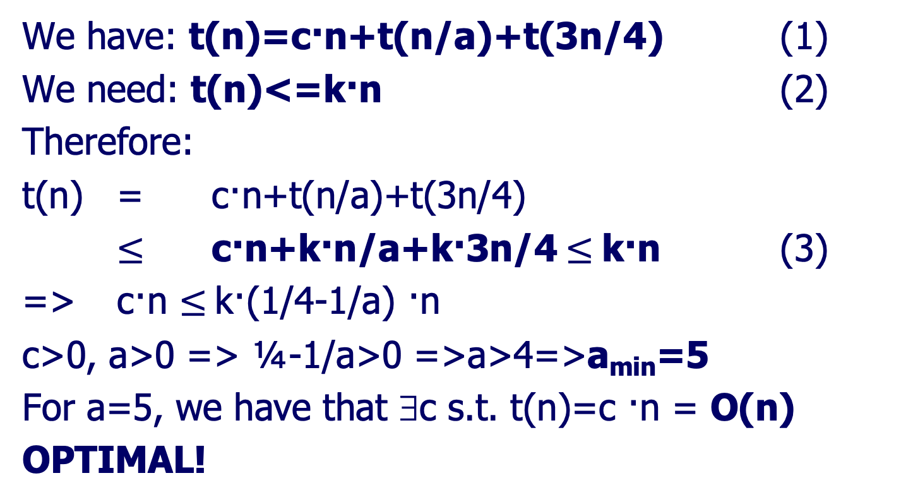
AklSelection – alg. eval. – contd.
We have: t(n)=c·n+t(n/a)+t(3n/4) (1)
We need: t(n)<=k·n (2)
Therefore:
t(n) = c·n+t(n/a)+t(3n/4)
$≤$ c·n+k·n/a+k·3n/4$≤$k·n (3)
=> c·n $≤$k·(1/4-1/a) ·n
c>0, a>0 => ¼-1/a>0 =>a>4=>a_{min}=5
For a=5, we have that ∃c s.t. t(n)=c ·n = O(n)
OPTIMAL!

Slide 34
AklSelection – alg. eval. – contd.
Why is step #5 t(3n/4) at most?
M<= half of m_{i}’s =>∃n/2a m_{i}’s such that
m_{i}>=M (1)
Each median m_{i} is >= and <= than exactly half of the nb. of elements in A_{i}, hence ∃a/2 Ai’s such that
m_{i}<=A_{i} (2)
(1)=>M is <=than n/2a medians m_{i}
(2)=>Each such median <= a/2 elements
Overall: M<= than at least n/2a· a/2=n/4 elements

Slide 35
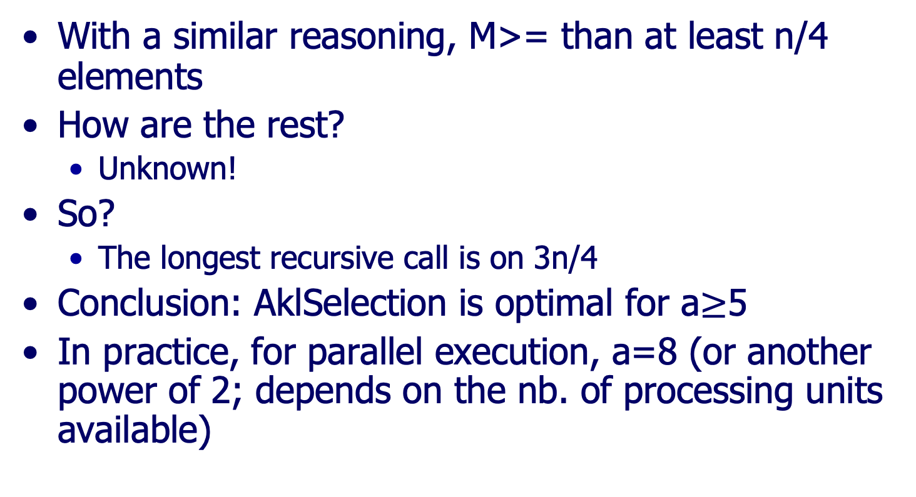
AklSelection – alg. eval. – contd.
With a similar reasoning, M>= than at least n/4 elements
How are the rest?
Unknown!
So?
The longest recursive call is on 3n/4
Conclusion: AklSelection is optimal for a$≥$5
In practice, for parallel execution, a=8 (or another power of 2; depends on the nb. of processing units available)

Slide 36
Median selection
May use it in QS
its optimal version has O(n)
by median partition, QS enters best case always
Resume QS

Slide 37
QuickSort revised (rv1)
QuickSort(A,p,r)
if p<r
then q<-partition(A,p,r)
QuickSort(A,p,q) QuickSort(A,q+1,r)
Worst case running time: O(n²) due to uneven partitioning
Avoid worst case: use the “right” partitioning sequence (i.e. split input data into 2 equal subsets)
Notes:
http://grail.sourceforge.net/demo/quicksort/algorithm.html
http://www.scribd.com/doc/12755420/Cormen-Algolec4

Slide 38
QuickSort revised (rv1) – cont.
Element to split the input data = median
(i.e. element which in the ordered array would occur in the middle)
Use a Median Selection before partitioning (we’ll see shortly that’s actually instead of partitioning)
Selection – revised
Hoare’s alg.
kind of QS with only 1 recursive call
inefficient O(n²) worst case running time; no improvement
Akl’s alg (the one described before)
Optimal for a>=5 => O(n)
Multiplicative ct. very large (i.e. in the average case, Hoare’s alg. is much better!)

Slide 39
QuickSort revised (rv1) - transformation with selection
QuickSort(A,p,r)
if p<r
then
AklSelect(A,p,r,|A|/2)
q<-partition(A,p,r)//use the element returned by Select
QuickSort(A,p,q)
QuickSort(A,p,|A|/2)
QuickSort(A,q+1,r)
QuickSort(A,|A|/2+1,r)
Q: what is the effect of partition?
Is it required any more?
Note: partitioning and the blue QS calls get out

Slide 40
QuickSort rv1
QuickSort(A,p,r)
if p<r
then
AklSelect(A,p,r,|A|/2) //determines the median, and //partitions based on the median
QuickSort(A,p,|A|/2)
QuickSort(A,|A|/2+1,r)
How many rec. calls?
Half done on leaves (i.e. empty data structures, thus call and return – takes time for doing nothing)
What is the efficiency of rec. calls on small data structures?
Avoid rec. calls on small data.

Slide 41
QuickSort rv1 enhanced
QuickSort(A,p,r)
if (r-p)<δ
then direct_sort(A,p,r)//which one?
else
AklSelect(A,p,r,|A|/2)
QuickSort(A,p,|A|/2)
QuickSort(A,|A|/2+1,r)
Enhancements
p-r<δ saves time (secs, overhead of calls/restores from calls),
Select ensures the optimality (always falling into the best case) of the alg

Slide 42
QuickSort revised (rv2)
In rv1, AklSelect guarantees best case always
QuickSort is O(nlgn) in the average case
It’s enough to avoid the worst case
A random partition ensures this!
Before partitioning, at each step pick a random element to make the partitioning based on that element (so swap the random chosen element with the element placed in the position of the pivot – first/middle/last)

Slide 43
QuickSort rv2 – cont.
random_partition(A,p,r)
i<-random(p,r) //choose a random element
A[i]<->A[p] //put it in the first position
return partition(A,p,r) //here we have the
// regular one
QuickSort-Random(A,p,r)
if p<r
then q<-random_partition(A,p,r)
QuickSort(A,p,q) QuickSort(A,q+1,r)

Slide 44
QuickSort rv2 enhanced
QuickSort-Random(A,p,r)
if (r-p)<δ
then direct_sort(A,p,r)
else q<-random_partition(A,p,r)
QuickSort(A,p,q) QuickSort(A,q+1,r)

Slide 45
Merge Sort
Divide et impera
Attempts (and succeeds) to always enter the best case
Approach (see blackboard)
Divides the input into 2 equal partitions (chooses the middle)
Apply 2 recursions
Merge the resulting ordered halves
Master Theorem: a= 2; b=2; c=1 => O(nlgn). Is it optimal? Why/why not?
Where does it apply?

Slide 46
Sorting – conclusions
No direct method is optimal; all are O(n²), even if some behave well in best/average cases
Heapsort – is optimal
Heaps often used in Priority Queues
QuickSort
classic version not optimal
Improved versions optimal:
Choose a random element to make the split
Use an optimal selection alg. (Akl’s) to find the “split” point
Augment the alg with a direct method for small arrays, s.t. improve time (in secs, not t(n))
Notes:
http://www.cs.ubbcluj.ro/~arthur/Fundamentals%20of%20Programming/Lecture%20Notes/Lecture_13.pdf
http://www.cs.ubbcluj.ro/~arthur/Fundamentals%20of%20Programming/Lecture%20Notes/
Search (#12)

Slide 47
Required Bibliography
From the Bible – Chapter 7 (QuickSort), Sections 9.2 and 9.3 (Selection problem algorithms)

