Slide 1
Molecular dynamics simulations of
PNA-RNA hybrids for sensors design
Giuseppe Sacco
Supervisors: Riccardo Nifosì, Valentina Tozzini

Slide 2
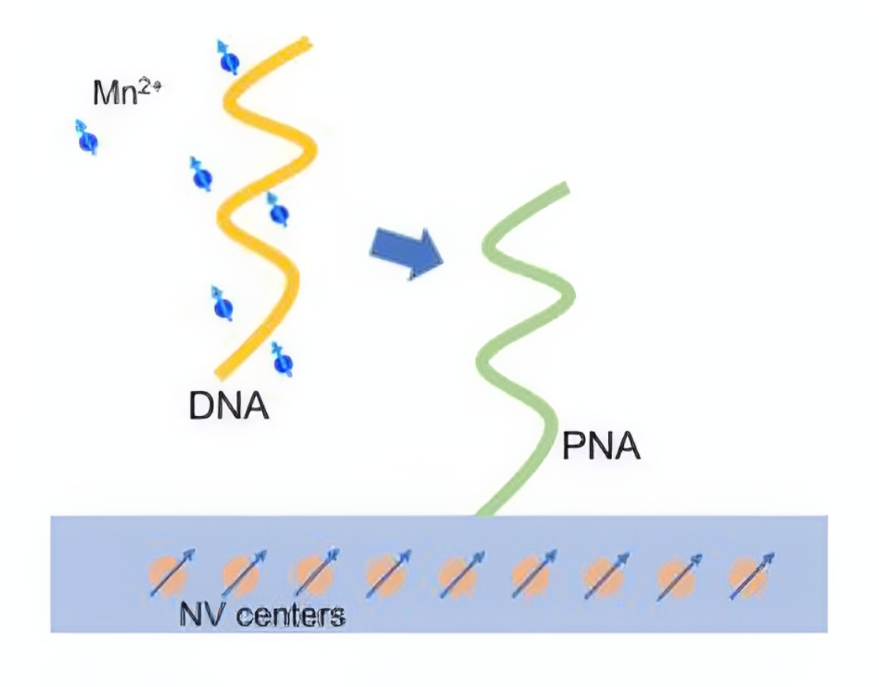
The Setup
Device for micro-RNA/DNA sensing
Hybridization result in accumulation of cations in the proximity of the substrate.
Fluorescence of NV centers is sensible to the local concentrations of paramagnetic species, such as Mn2+
No chemical reactions or labeling
We are addressing the computational modeling of the system through MD simulations and subsequent data analysis

Slide 3
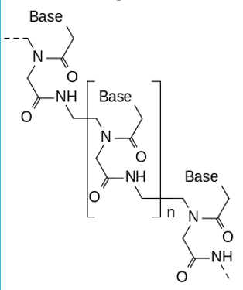
Peptide Nucleic Acids
PNAs are artificial polymers analog to nucleic acids, in which the main chain contains peptide bonds
Great variability and ease of functionalization
No charged phosphate group
PNA-NA binding is stronger than NA-NA
Greater specificity to target sequences
Stability of hybridization complexes
Most relevant applications include gene editing, nucleic acid sensing, antisensing, and crosslinking

Slide 4
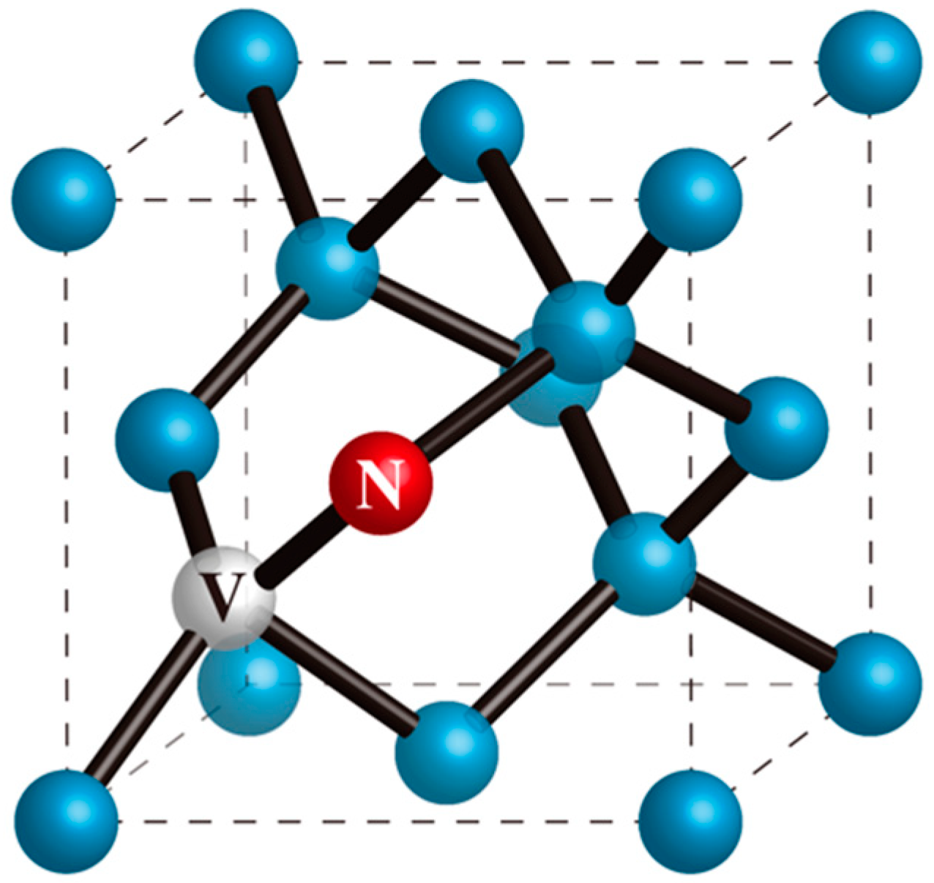
Nitrogen-Vacancy Centers (NV)
NV centers are point defects in diamond where two nearest neighbors carbon atoms are substituted by one nitrogen atom and a vacancy
Moreover, diamond substrate is well-studied, simple, easy to manipulate and well-suited to applications in life sciences.
Submicrometer space resolution
High sensitivity
Compatible with life-sustaining conditions
*Florestan C Ziem et al. “Highly sensitive detection of physiological spins in a microfluidic device”. In: Nano letters 13.9 (2013), pp. 4093–4098

Slide 5
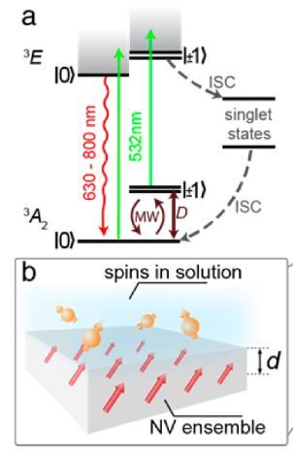
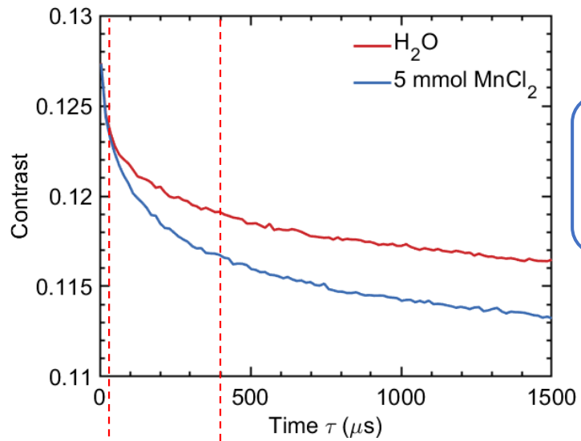
External spin detection
Detection of the external spins by monitoring the relaxation of the polarized NV spin state due to magnetic dipole−dipole interaction between the fluctuating external spins and the NVs
Coupling to external spins is measured as deviation from the intrinsic mean relaxation time T1 = 1.1 ms of the ensemble.
Florestan C Ziem et al. “Highly sensitive detection of physiological spins in a microfluidic device”. In: Nano letters 13.9 (2013), pp. 4093–4098.

Slide 6

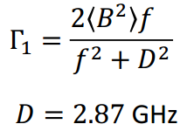
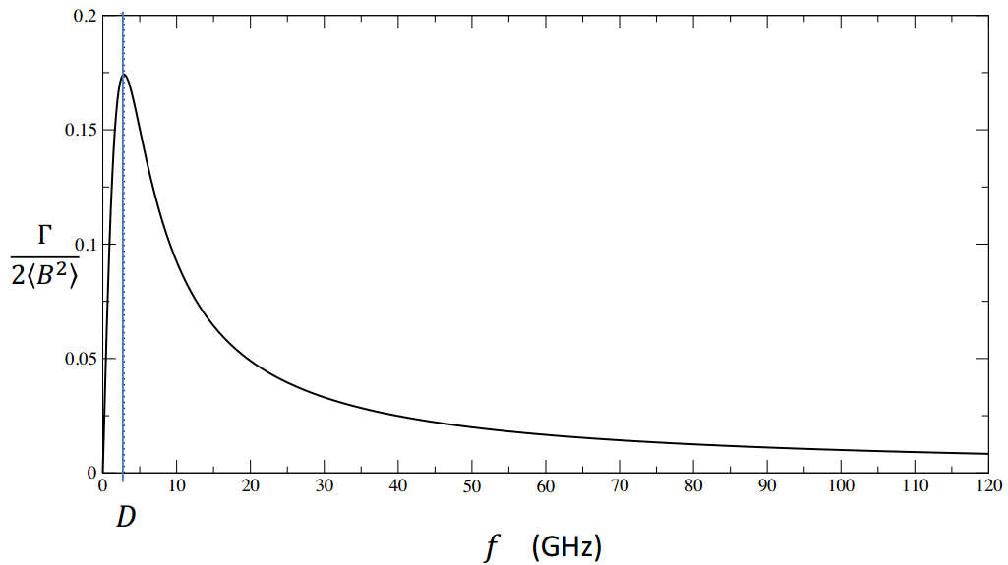
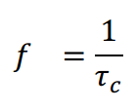

Fluorescence Relaxation
NV fluorescence decay is sensitive to the magnetic noise of paramagnetic spins
Fourier Transform of yields
for weak external B omega_0 = 0
Fluorescence relaxation rate is given by

Slide 7
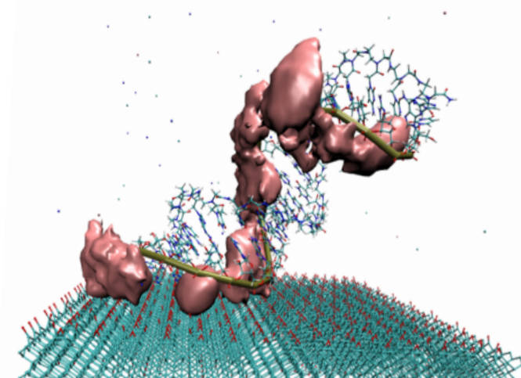
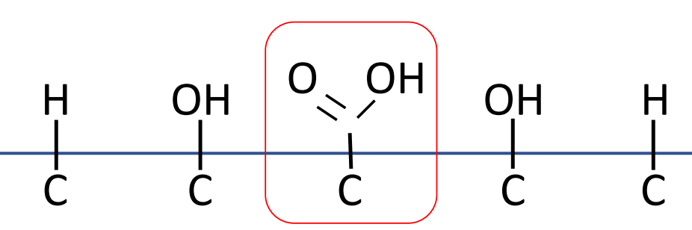
Analysis
Configurational landscape of a single-strand PNA, duplex and their interaction with a model of the actual functionalised surface of diamond
Ion coordination and dynamics

Slide 8
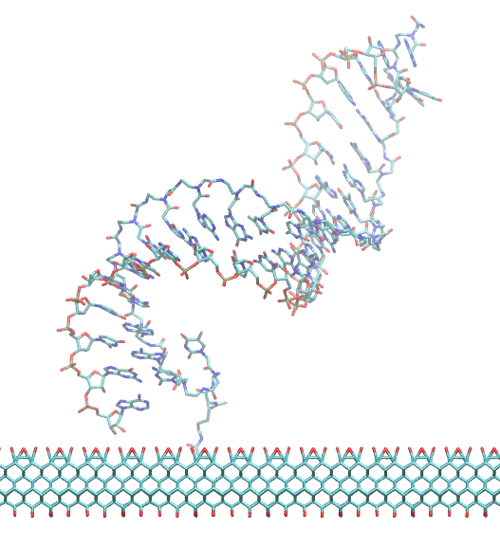
Force Field
Empirical force-field-based Molecular Dynamics simulations
We adopted an optimized version* of AMBER, obtained by fitting torsion angles of the PNA backbone to high-level QM reference energy maps yielding better results both in the stability of duplexes and in the agreement with experimental data.
GROMACS: Simulations, Data Analysis
Further ad hoc analysis is carried through self-made Python scripts
*Maciej Jasinski, Michael Feig, and Joanna Trylska. “Improved force fields for peptide nucleic acids with optimized backbone torsion parameters”. In: Journal of Chemical Theory and Computation 14.7 (2018), pp. 3603– 3620.

Slide 9
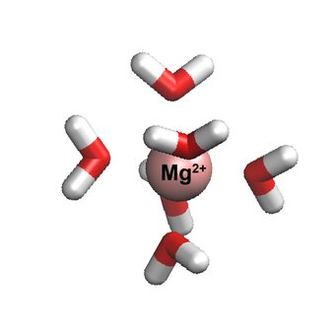
Ion coordination
Spin dynamics can be inferred from the simulation from the dynamics of the solvation shell since reorientational motion and the spin dynamics become strongly correlated
From ion trajectory and shell rotation we calculate the magnetic field produced
Westlund 2010

Slide 10
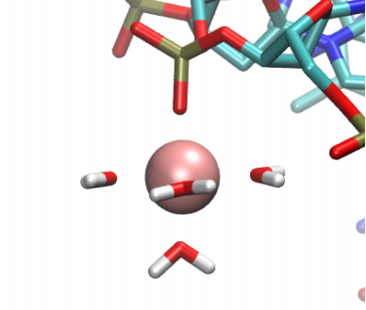
Future developments
Mn2+ can interact with RNA directly or indirectly (i.e. mediated by water)
2D map of magnetic field
Plenty of space for optimization!
AM Polyanichko et al. “The effect of manganese (II)[1] on DNA structure:electronic and vibrational circular dichroism studies”. In: Nucleic acidsresearch 32.3 (2004), pp. 989–996.

Slide 11
Thank you for the attention!

