Slide 1


Markov-Dubins Problem: an Optimal Control Approach
Giuseppe Sensolini Arrà

Slide 2
Background
Markov-Dubins Problem
find the shortest planar curve joining two points with prescribed tangents, with a specific bound on the curvature
Markov-Dubins Problem:
an Optimal Control Approach
Pagina 1

Slide 3
Background
Markov-Dubins Problem
find the shortest planar curve joining two points with prescribed tangents, with a specific bound on the curvature
The problem was originally posed by A. A. Markov in 1889 in the context of railway design.
It was solved solved in 1957 by L. Dubins with an elegant paper based on geometric arguments.
In the 70’s the problem was reformulated in the optimal control framework.
In 1990 J. A. Reeds and L. A. Sheep solved the problem for a car that goes both forward and backward.
In recent years the problem has been reformulated in order to find 3D optimal paths for unmanned aerial vehicles.
Nowadays Dubins paths are widely used for path planning in many engineering fields (robotics, aerospace navigation, automotive).
Markov-Dubins Problem:
an Optimal Control Approach
Pagina 1

Slide 4
Original Dubins’ Formulation
Given u, v, U, V, R belonging to R² and R > 0 belonging to R
is called R-geodesic the path of minimal length having average curvature everywhere less than or equal to R ⁻¹
Markov-Dubins Problem:
an Optimal Control Approach
Pagina 2

Slide 5
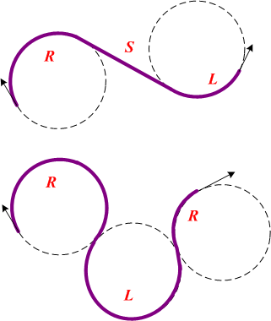
Original Dubins’ Formulation
Given u, v, U, V, R belonging to R² and R > 0 belonging to R
is called R-geodesic the path of minimal length having average curvature everywhere less than or equal to R ⁻¹
Dubins’ Result
Every planar R-geodesic is necessarily a curve which is either:
an arc of a circle of radius R, followed by a straight line segment, followed by an arc of circle of radius R
a sequence of three arcs of circles of radius R
a subpath of the previous ones
Optimal path set: { CSC, CCC, CC, CS, SC, S, C }
Markov-Dubins Problem:
an Optimal Control Approach
Pagina 2

Slide 6
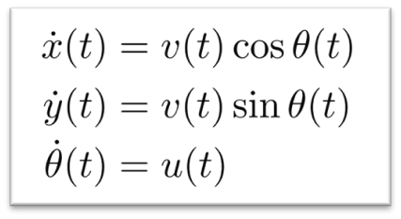
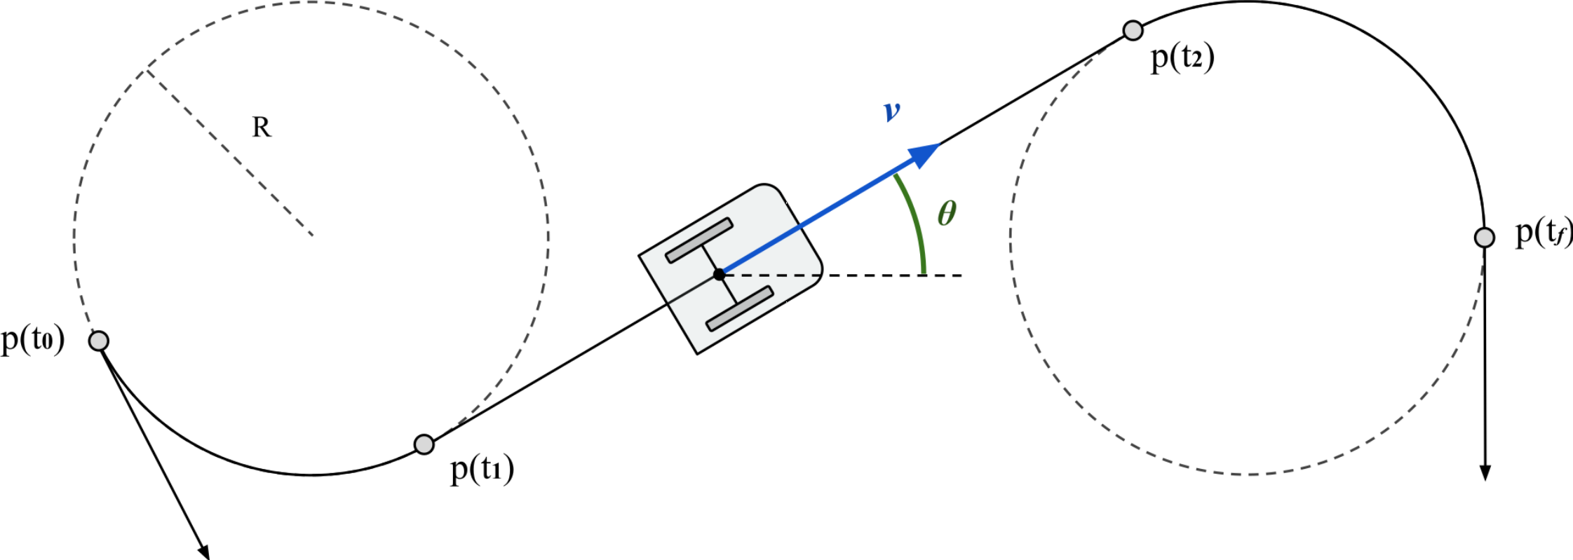
Model
Unicycle kinematic model
The unicycle robot is a nonlinear underactuated MIMO system.
Given initial and a final states, the optimal path planning problem is exactly a Markov-Dubins problem.
Control inputs v(t) and u(t) are bounded
Markov-Dubins Problem:
an Optimal Control Approach
Pagina 3

Slide 7
Optimal Control Problem
Starting from the unicycle kinametic model the optimal control formulation is straightforward:
Velocity input is fixed to the maximum value (v(t) = v_{max}=1)
Curvature input u(t) is the only input
Formulation as a minimum-time problem
Markov-Dubins Problem:
an Optimal Control Approach
Pagina 4

Slide 8
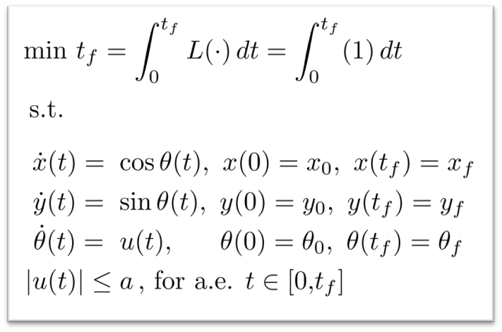
Optimal Control Problem
Starting from the unicycle kinametic model the optimal control formulation is straightforward:
Velocity input is fixed to the maximum value (v(t) = v_{max}=1)
Curvature input u(t) is the only input
Formulation as a minimum-time problem
Unicycle model:
nonlinear system
Optimization problem:
nonlinear programming
Markov-Dubins Problem:
an Optimal Control Approach
Pagina 4

Slide 9


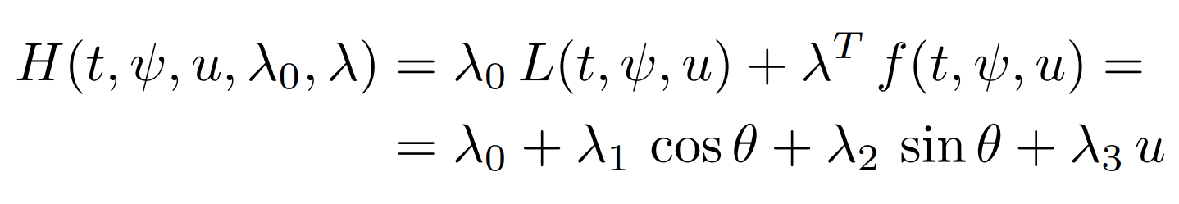
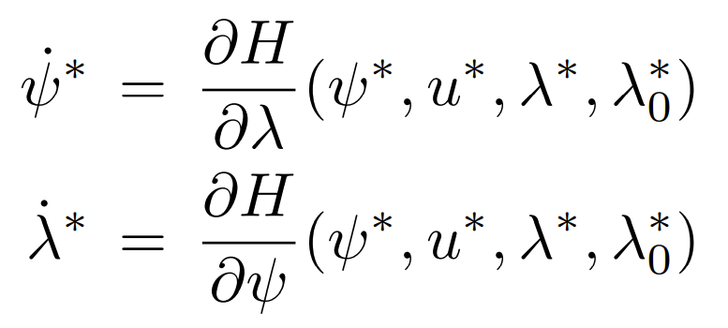
Pontryagin Maximum Principle [1]
Pontryagin's maximum principle is used to to find the best possible control for taking a dynamical system from one state to another. It states that it is necessary for any optimal control along with the optimal state trajectory to solve the so-called Hamiltonian system.
State vector
Costate vector
Hamiltonian
Hamiltonian
system
-
Markov-Dubins Problem:
an Optimal Control Approach
Pagina 5

Slide 10
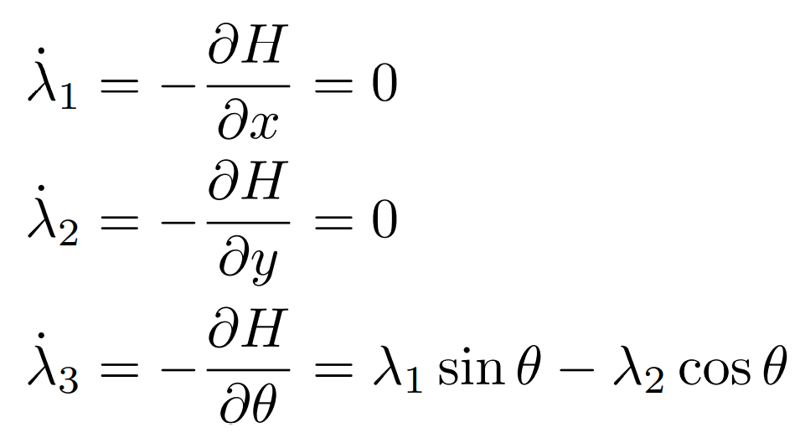
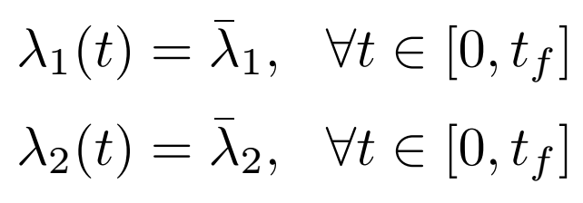
Pontryagin Maximum Principle [2]
Markov-Dubins Problem:
an Optimal Control Approach
Pagina 6

Slide 11
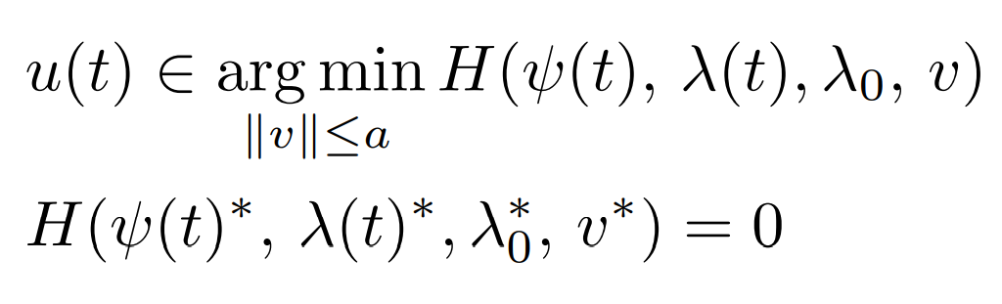
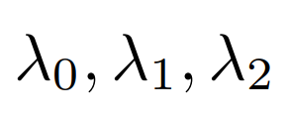
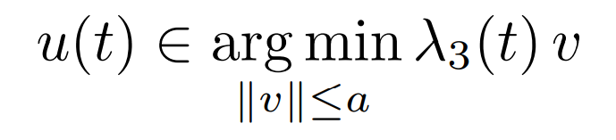
Pontryagin Maximum Principle [2]
Necessary conditions
for optimality
constant
Markov-Dubins Problem:
an Optimal Control Approach
Pagina 6

Slide 12
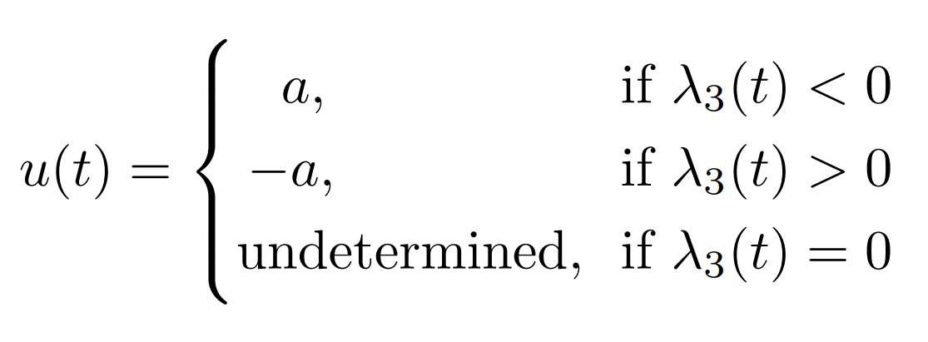
Optimal Control
Markov-Dubins Problem:
an Optimal Control Approach
Pagina 7

Slide 13

Optimal Control
Singular Control
Nonsingular Control
Markov-Dubins Problem:
an Optimal Control Approach
Pagina 7

Slide 14
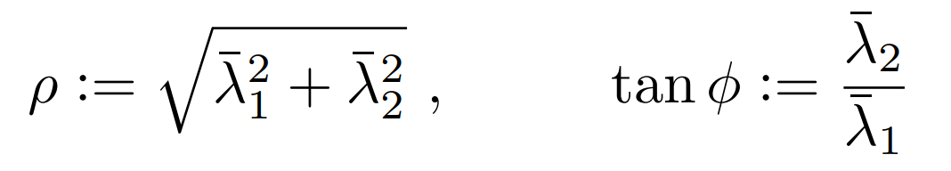
Singular Control
Define 2 new parameters:
Markov-Dubins Problem:
an Optimal Control Approach
Pagina 8

Slide 15
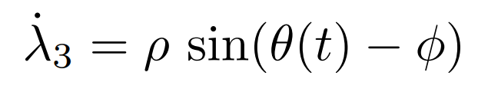
Singular Control
Define 2 new parameters:
(i)
(ii)
Markov-Dubins Problem:
an Optimal Control Approach
Pagina 8

Slide 16
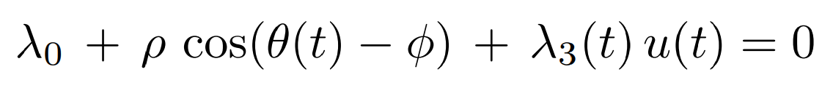
Singular Control
Define 2 new parameters:
(i)
(ii)
Necessary condition for optimality
(iii)
Markov-Dubins Problem:
an Optimal Control Approach
Pagina 8

Slide 17
Singular Control
Define 2 new parameters:
(i)
(ii)
Necessary condition for optimality
(iii)
Markov-Dubins Problem:
an Optimal Control Approach
Pagina 8

Slide 18
Singular Control
Define 2 new parameters:
(i)
(ii)
Necessary condition for optimality
(iii)
Bang-singular control
Markov-Dubins Problem:
an Optimal Control Approach
Pagina 8

Slide 19
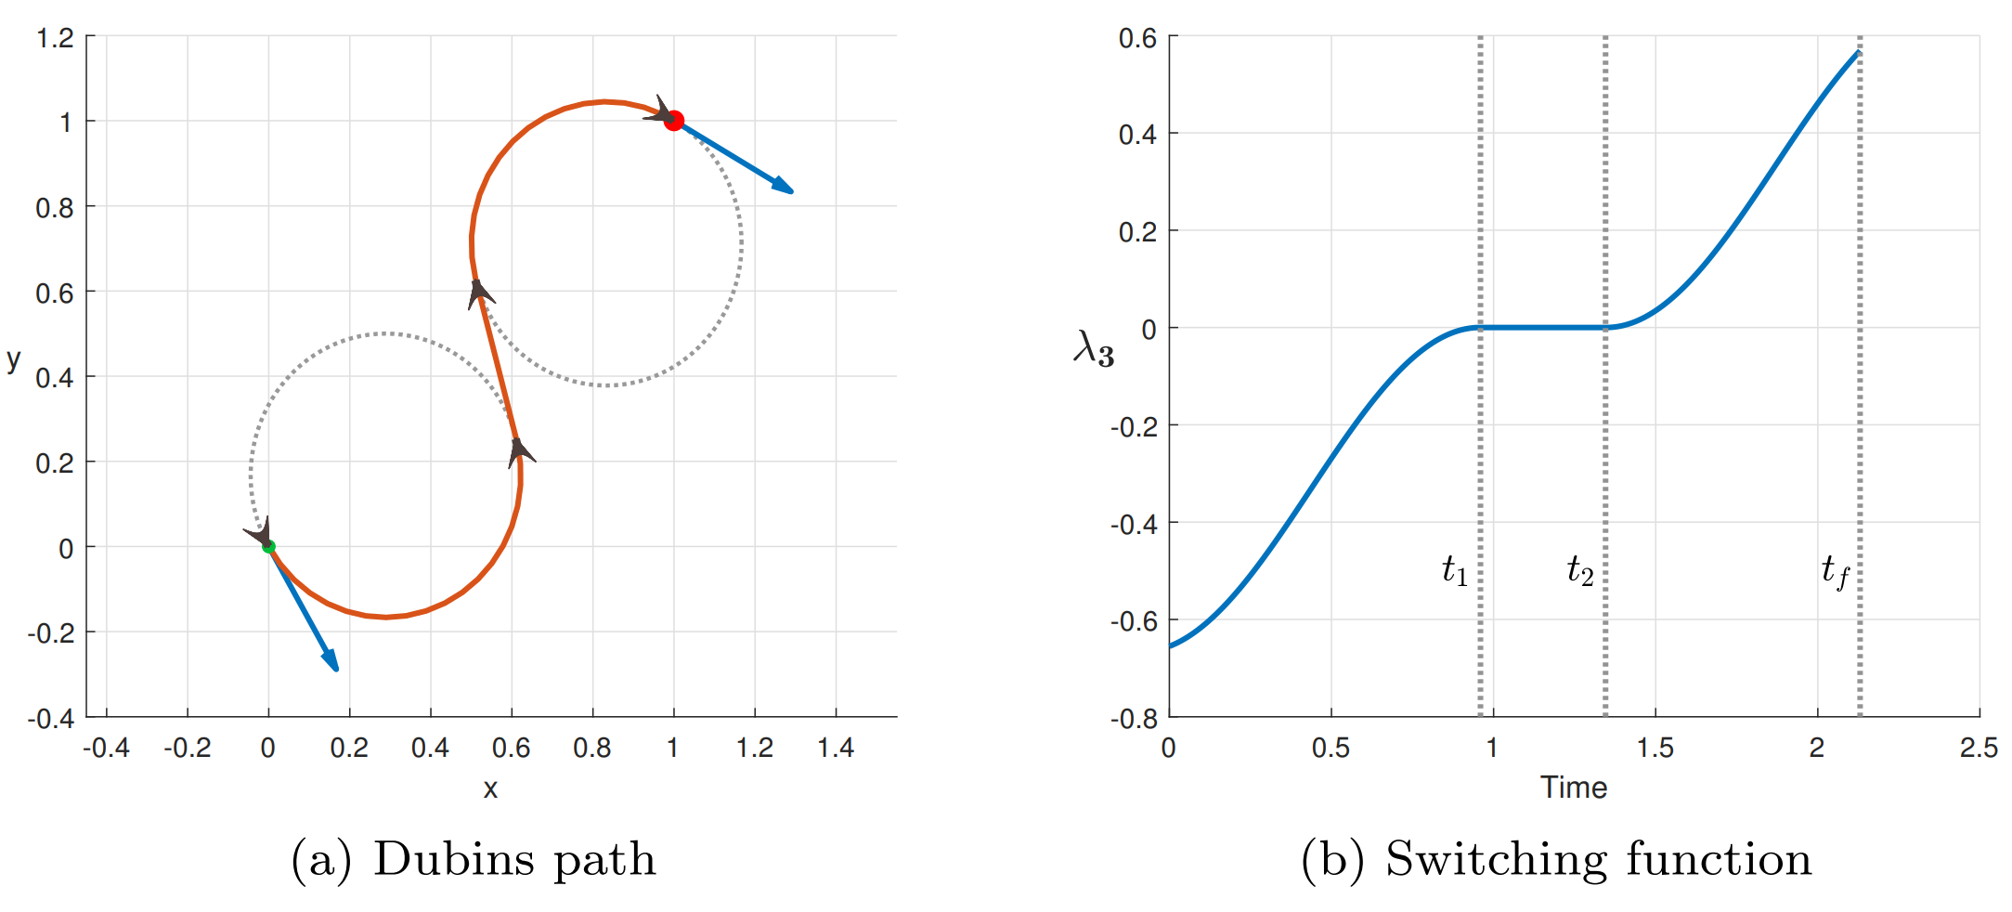
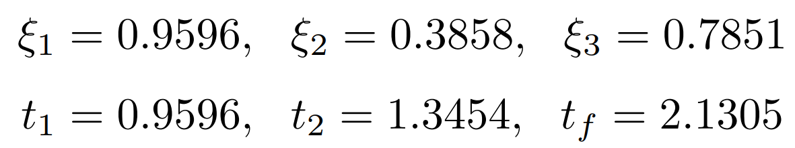
Simulation – CSC singular path
Arc lengths:
Time:
Markov-Dubins Problem:
an Optimal Control Approach
Pagina 9

Slide 20
Optimal Control
Singular Control
Nonsingular Control
Markov-Dubins Problem:
an Optimal Control Approach
Pagina 10

Slide 21

Nonsingular Control
1.
N.C. for optimality
Markov-Dubins Problem:
an Optimal Control Approach
Pagina 11

Slide 22
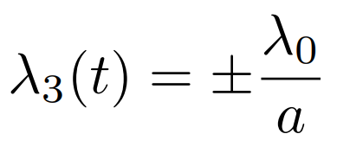
Nonsingular Control
1.
N.C. for optimality
Markov-Dubins Problem:
an Optimal Control Approach
Pagina 11

Slide 23



Nonsingular Control
1.
N.C. for optimality
2.
Then if
Markov-Dubins Problem:
an Optimal Control Approach
Pagina 11

Slide 24





Nonsingular Control
1.
N.C. for optimality
2.
3.
Then if
when
Markov-Dubins Problem:
an Optimal Control Approach
Pagina 11

Slide 25
Nonsingular Control
1.
N.C. for optimality
Bang-bang control
2.
3.
Then if
when
Markov-Dubins Problem:
an Optimal Control Approach
Pagina 11

Slide 26
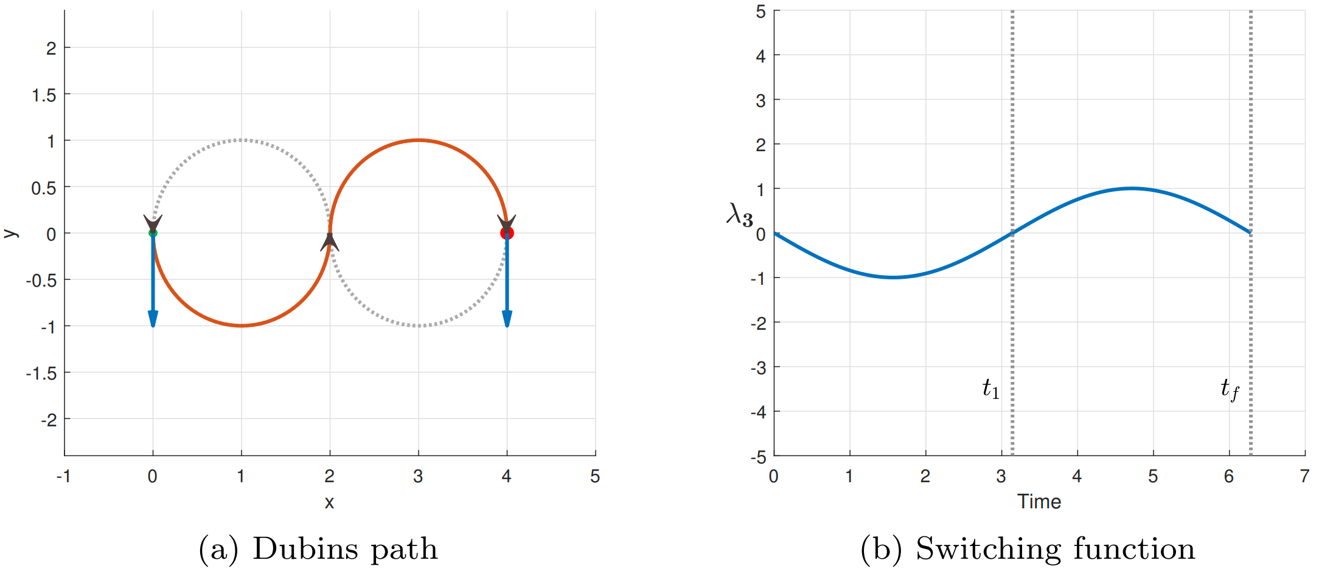
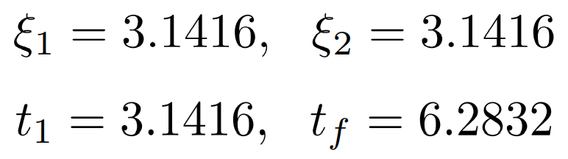
Simulation – CC nonsingular path
Arc lengths:
Time:
Markov-Dubins Problem:
an Optimal Control Approach
Pagina 12

Slide 27
Conclusions
In this work the optimal control has been found by means of Pontryagin maximum principle, and then the focus has shifted towards the characterization and classification of optimal paths. In particular:
In case of singular control the resulting path is of type always contains a straight line segment. Paths of this kind are {CSC, CS, SC, S}
In case of nonsingular control the resulting path is the composition of arcs of circle of radius R. Paths of this kind are {CCC, CC, C}
Markov-Dubins Problem:
an Optimal Control Approach
Pagina 13

Slide 28
Conclusions
In this work the optimal control has been found by means of Pontryagin maximum principle, and then the focus has shifted towards the characterization and classification of optimal paths. In particular:
In case of singular control the resulting path is of type always contains a straight line segment. Paths of this kind are {CSC, CS, SC, S}
In case of nonsingular control the resulting path is the composition of arcs of circle of radius R. Paths of this kind are {CCC, CC, C}
More in general:
The optimal control approach results to be better suited for a software implementation; the problem can be solved with the standard nonlinear/nonconvex optimization tools avaiable.
The Markov-Dubins problem addressed with the optimal control methodology offers a better understanding of the underlying structure of the optimal solutions with respect to the original Dubins approach.
Markov-Dubins Problem:
an Optimal Control Approach
Pagina 13

Slide 29
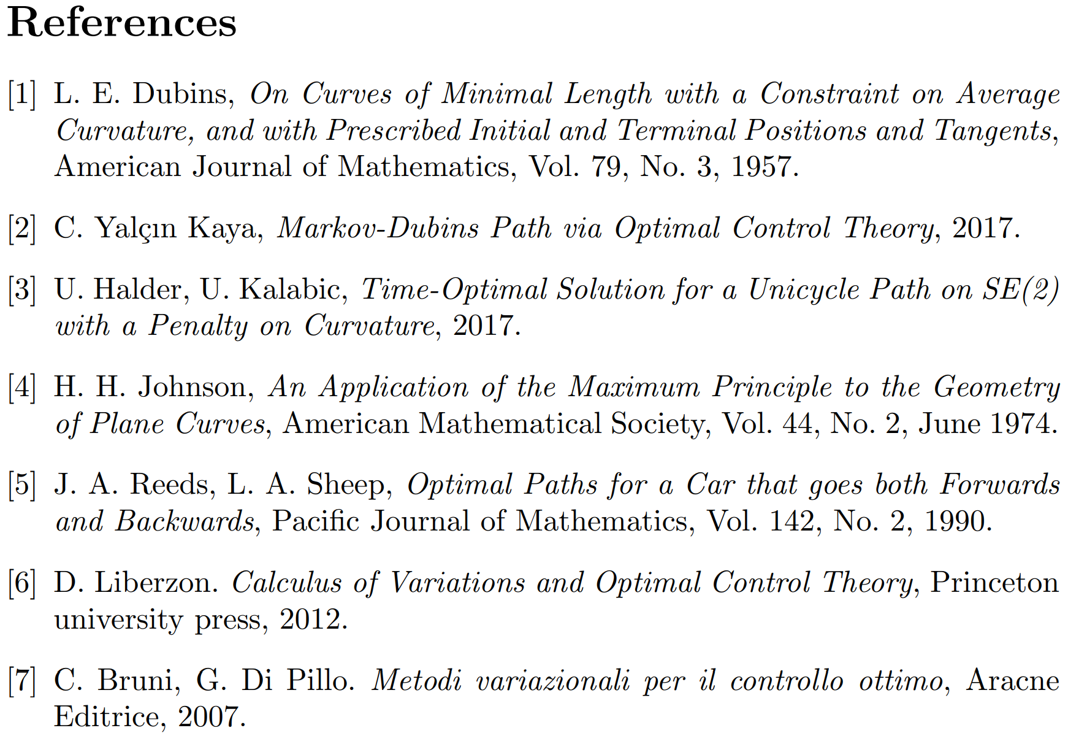
Thanks for the Your Attention
Markov-Dubins Problem:
an Optimal Control Approach
Pagina 14

