Slide 1


DOCUMENTATION ASSISTANT
Team docSquad

Slide 2
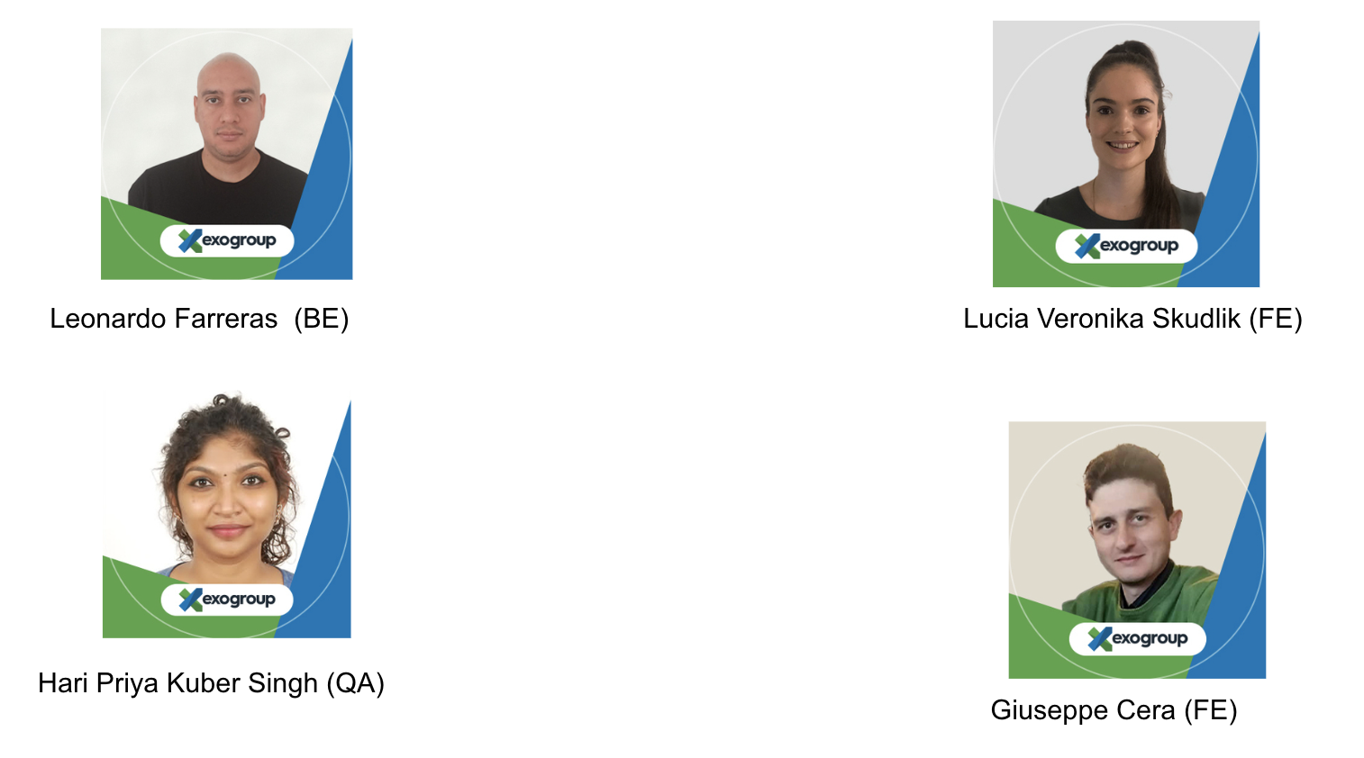

Slide 3
Agenda
Topic Covered
Technology
Process
Demo
Roadmap

Slide 4




01
TECHNOLOGY
Node JS
ChatGPT
Angular

Slide 5


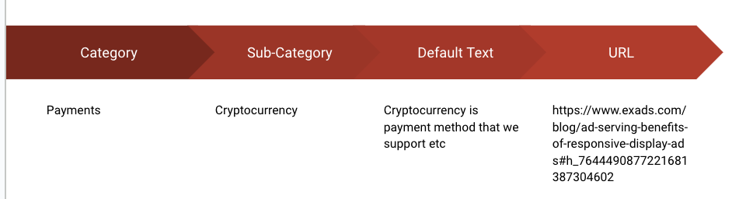


02
PROCESS
Category and Sub category
Internal and external documentation
Indexing
Knowledge
Chat GPT

Slide 6
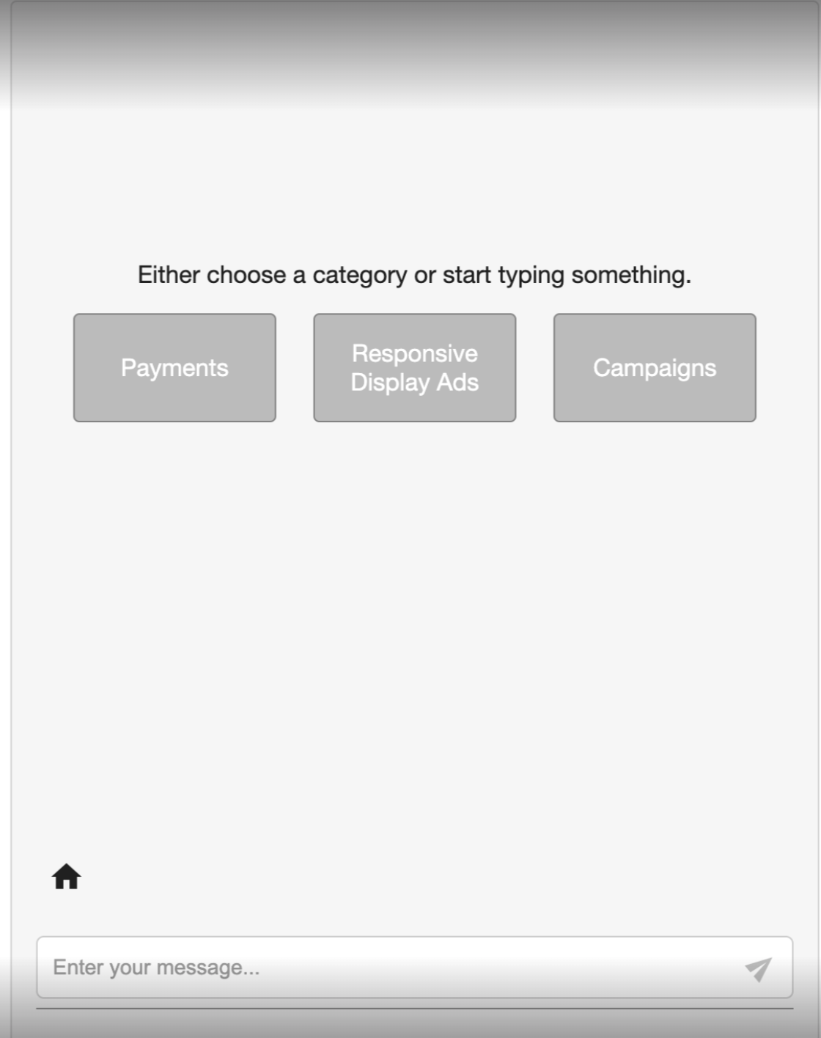
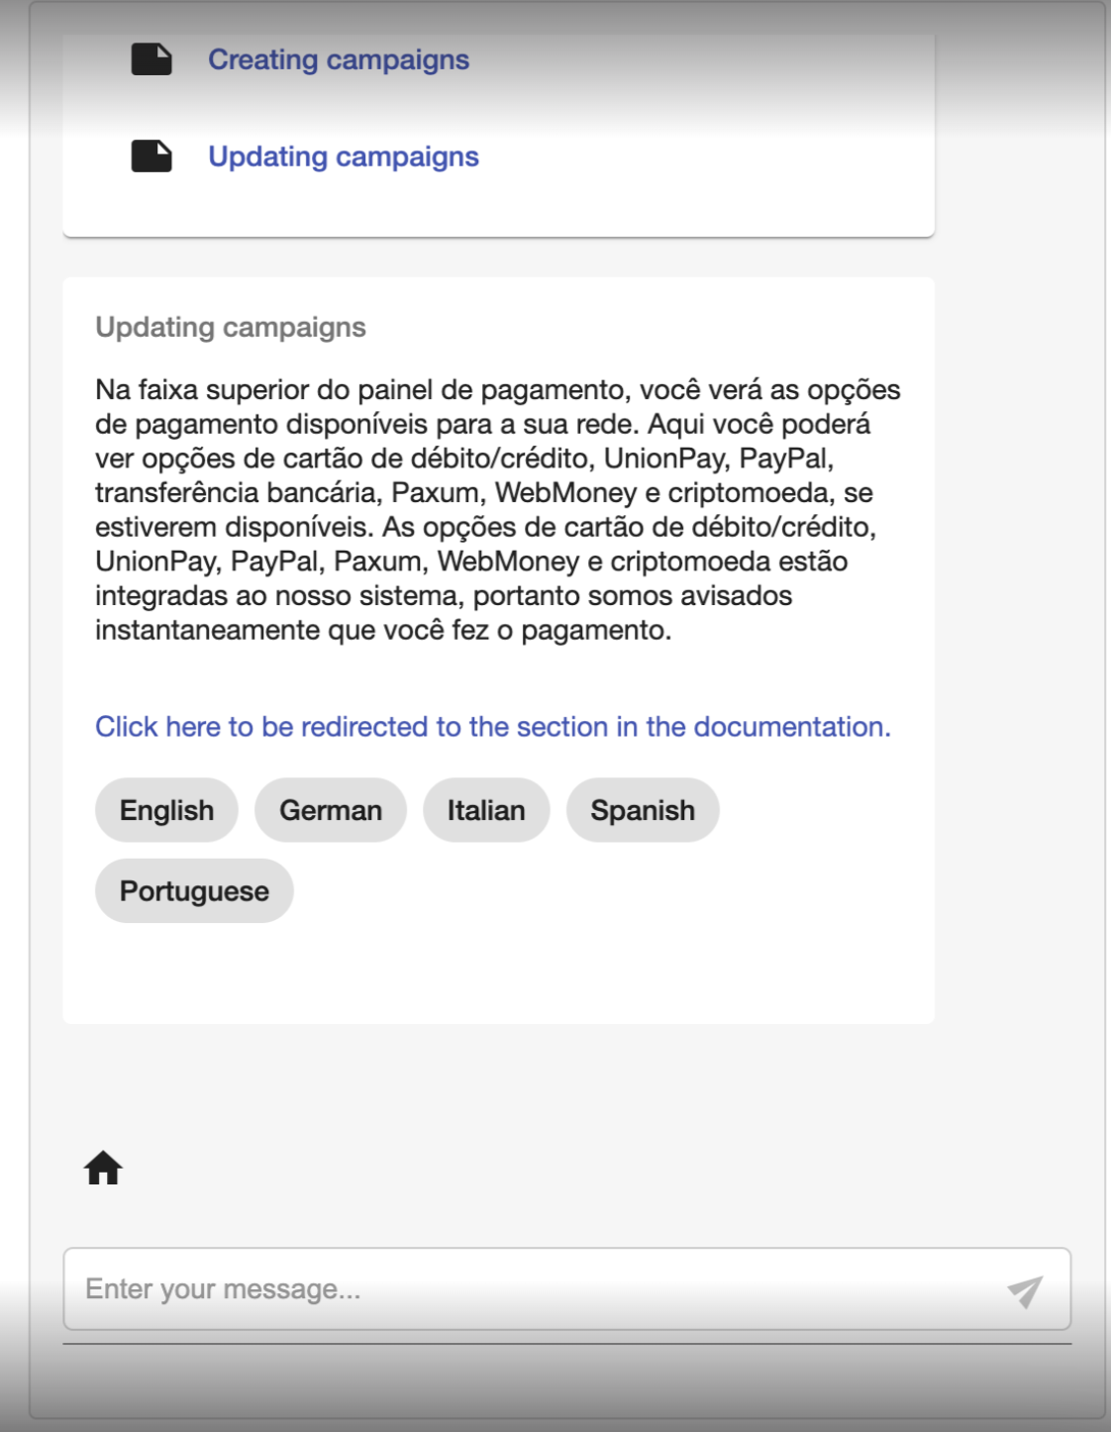
03
DEMO

Slide 7
04
ROADMAP
Effective analysis of user action
Learning from the user feedback to provide accurate information
Storing the chat history for future reference for the user
Improved UI experience by receiving feedback
UI to index the documentation
Automating the indexing of the data
Alternative or complementary process to inject the documentation through fine tuning

Slide 8
Any Questions ??

