Slide 1
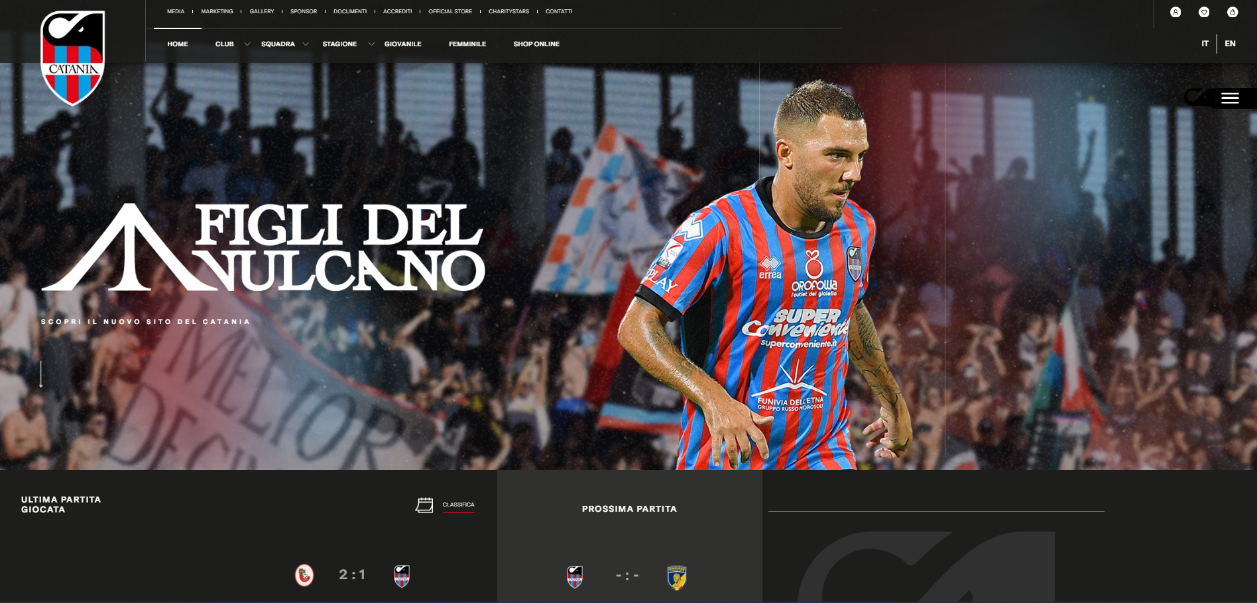
https://www.cataniafc.it/

