Slide 1

Neural Signal Analysis Project Work:
Analysis On Experimental Neural Dataset
Students: Giuseppe De Venuto, Davide Palmieri.
Professors: Gabriele Arnulfo, Michela Chiappalone.

Slide 2
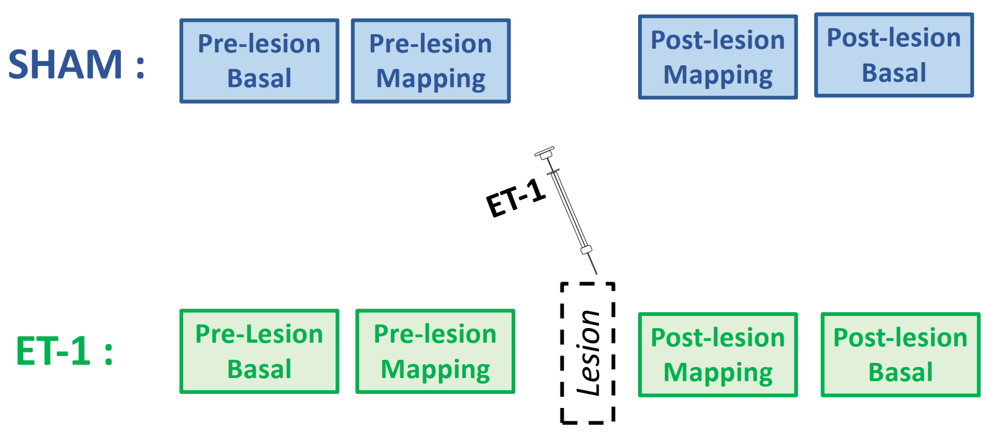
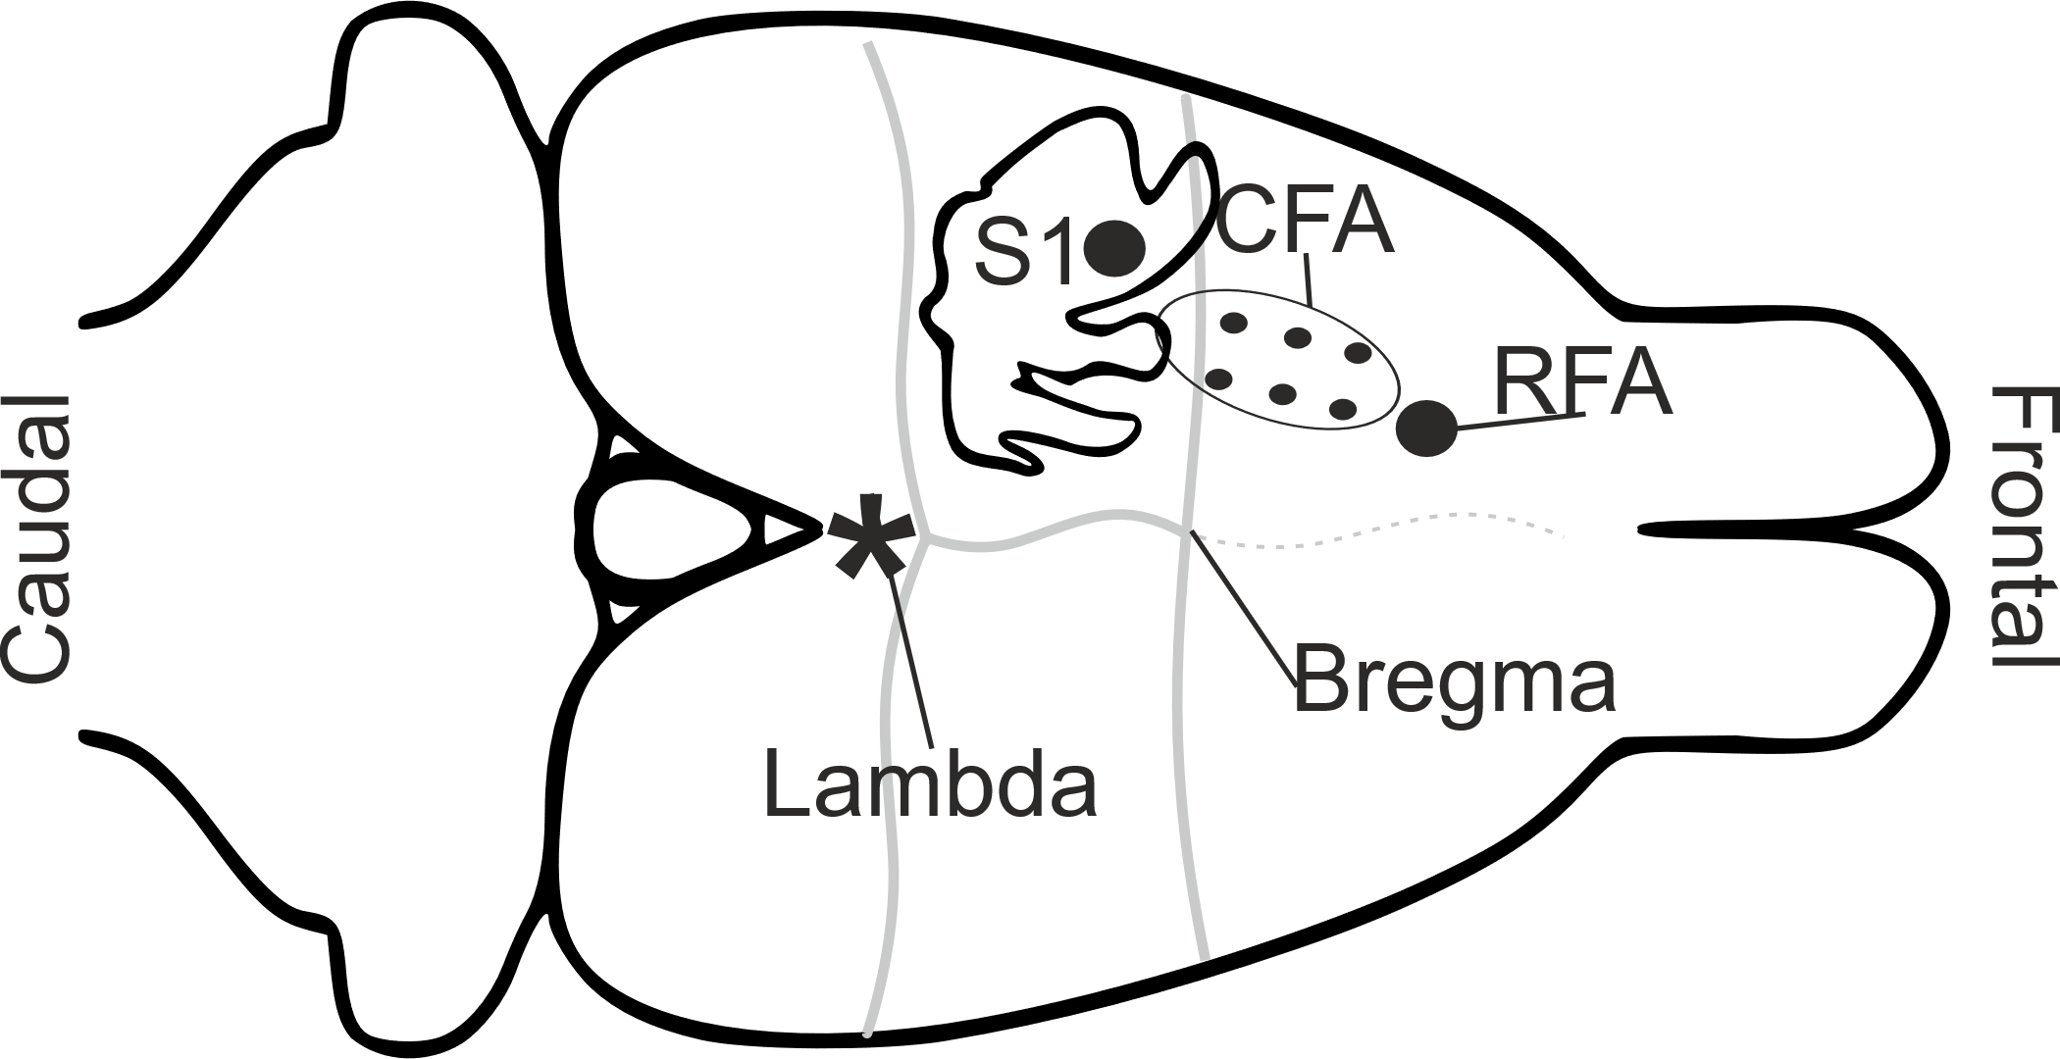
Introduction
2 groups: 3 Control Rats (no lesioned or SHAM) & 3 Injured Rats (or ET1)
Caudal Forelimb area (CFA): lesion
2 electrodes, 16 channels each in:
Primary Somatosensory area (S1 or P2): stimulation and recording
Rostral Forelimb Area (RFA or P1): recording
Pre- Post-lesion mapping (K1= first channel of stimulation, K2= second channel of stimulation):
K1
No stim
K2
3 min
30 sec
3 min
30 stimuli from each channel: 1 pulse every 5 seconds

Slide 3
Introduction
“ Does the lesion produce a decrease in neural activity? ”
Filtering
Artifact Rejection
Spike Detection
PSTH
Scatter Plot: Area Pre VS Area Post
Bar Plots: Area Pre -Area Post
Slopes T-Test
Area Differences T-Test

Slide 4
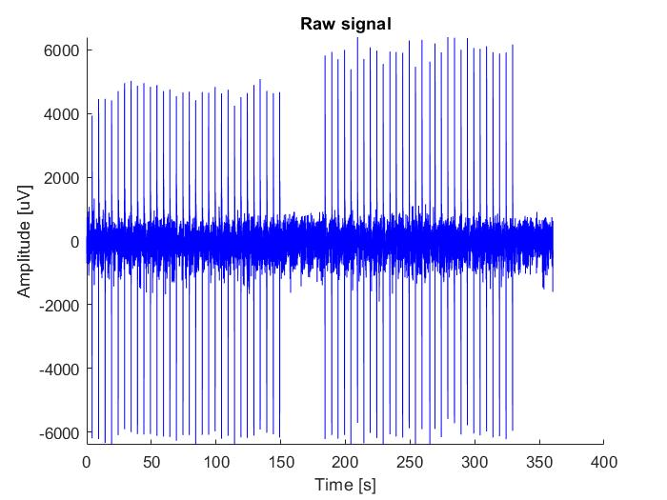
Methods

Slide 5
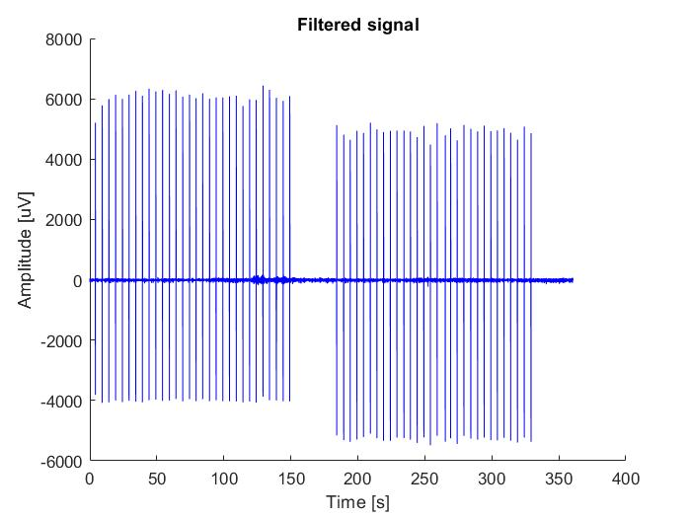
Methods
Butterworth Band Pass Filter: 300-3000 Hz

Slide 6
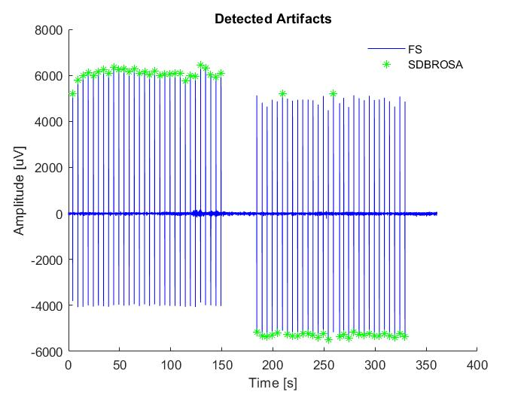
Methods
Local Maxima Detection
Threshold = 2000 µV
FS=Filtered Signal
SDBROSA=Stimuli detected before remotion of stimuli artifacts

Slide 7
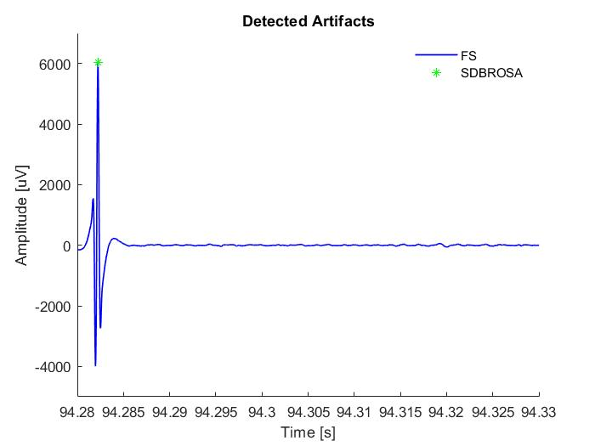
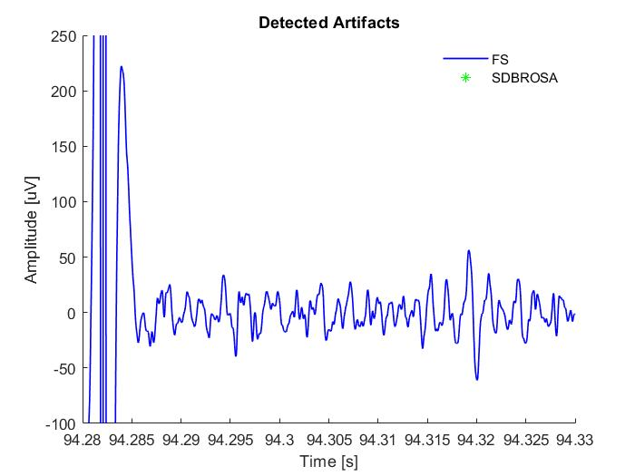
Methods

Slide 8
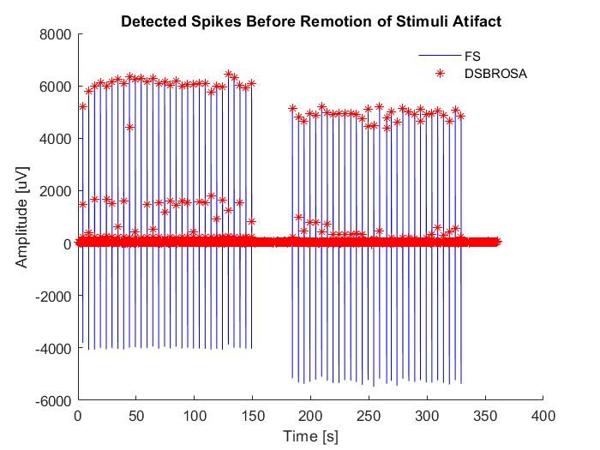
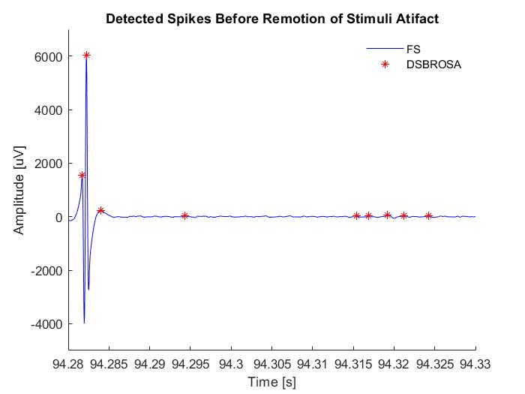
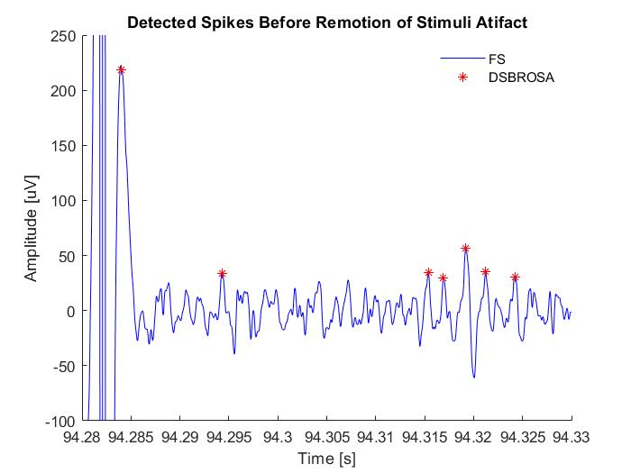
Methods

Slide 9
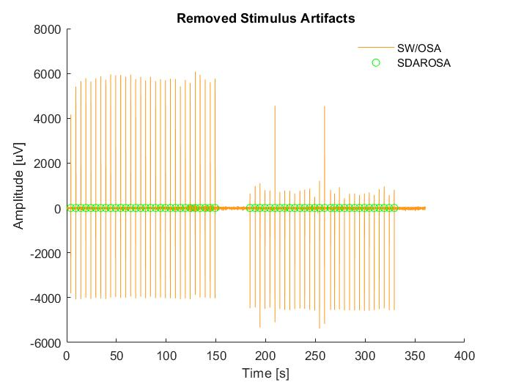
Methods
Stimulus Artifacts remotion
5ms after the detected stimulus
SW/OSA=Signal without stimuli artifacts
SDAROSA=Stimuli detected after remotion of stimuli artifacts

Slide 10
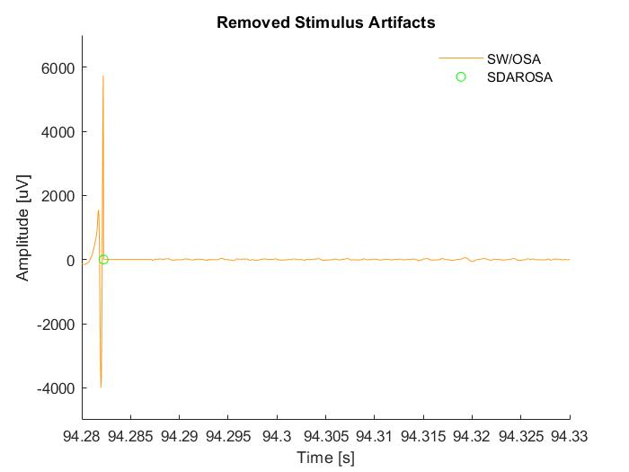
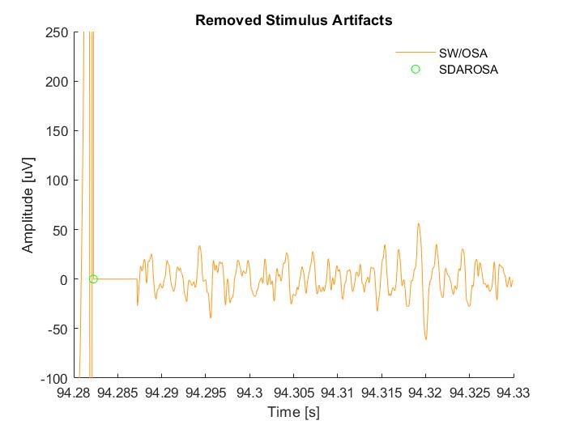
Methods

Slide 11
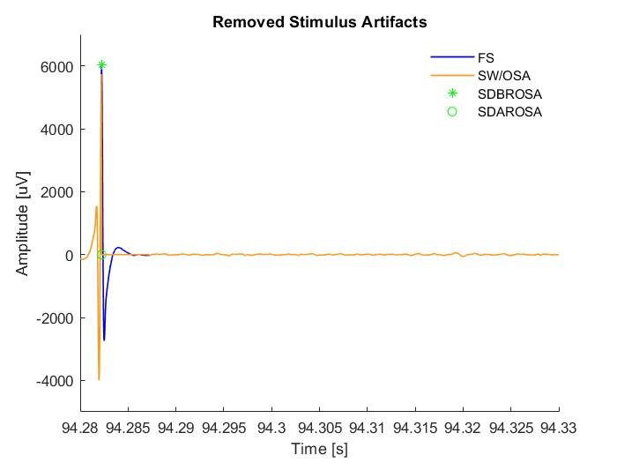
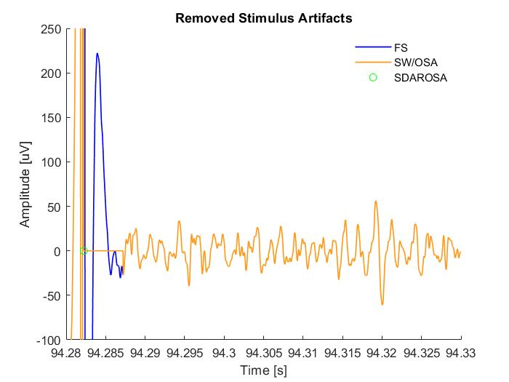
Methods

Slide 12
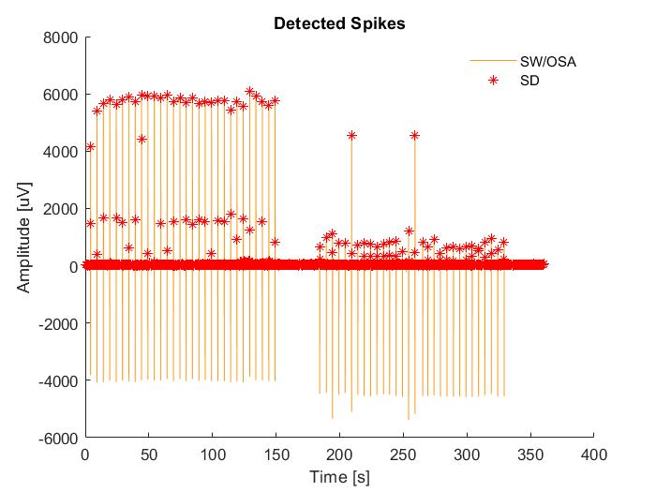
Methods
Hard Differential Threshold Algorithm
Th = 6*std
Window Size = 2 ms
SD=Spikes Detected

Slide 13
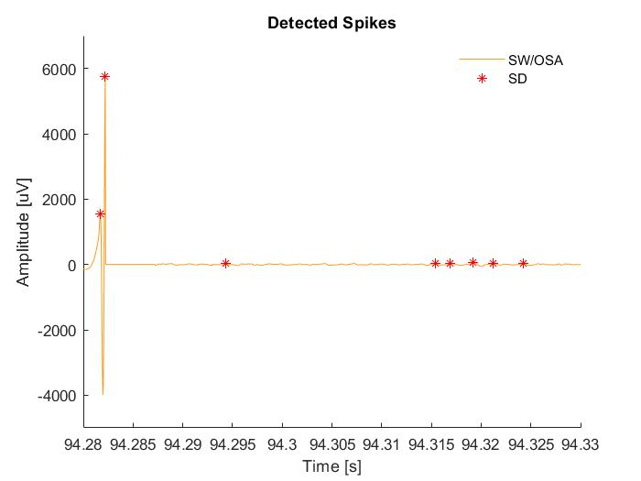
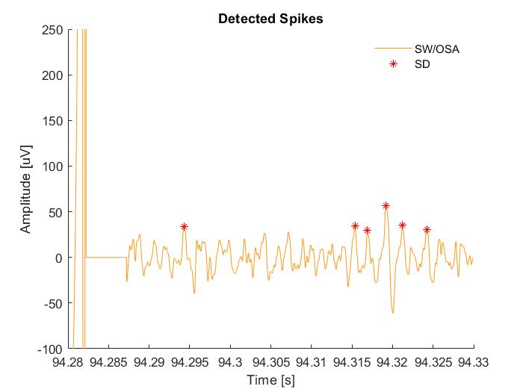
Methods

Slide 14
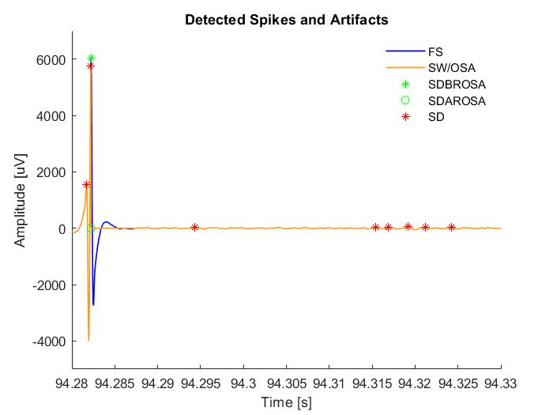
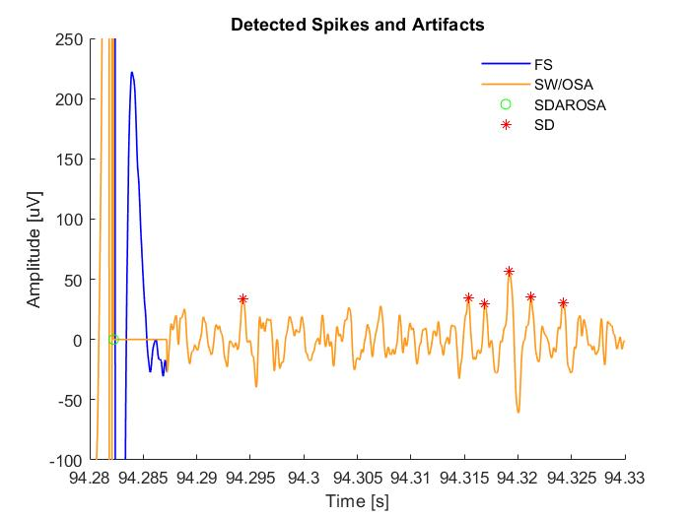
Methods

Slide 15
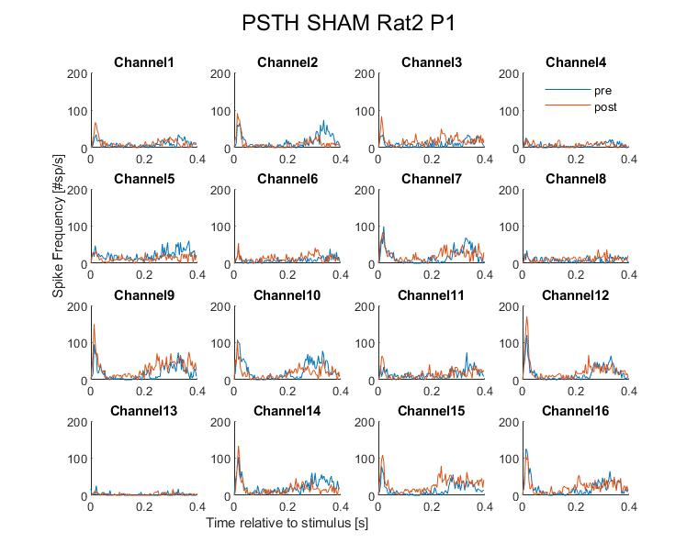
Methods
Window after stimulation = 400 ms
Bin Size = 4 ms

Slide 16
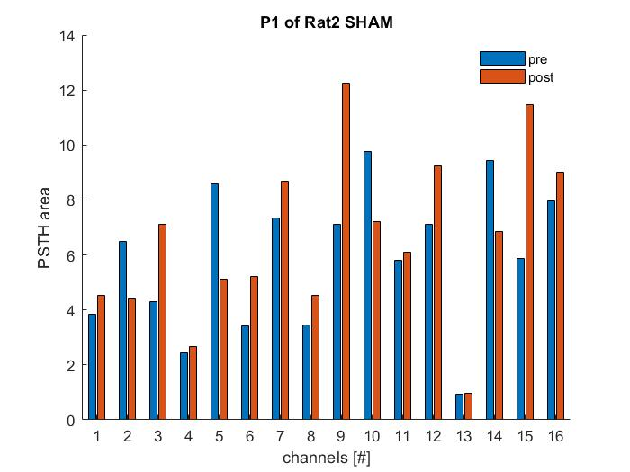
Methods

Slide 17
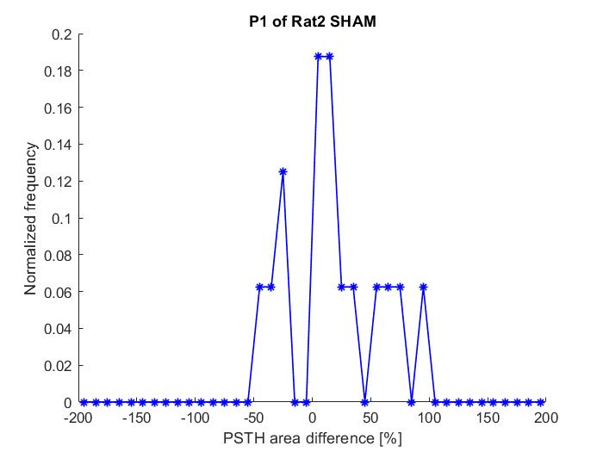
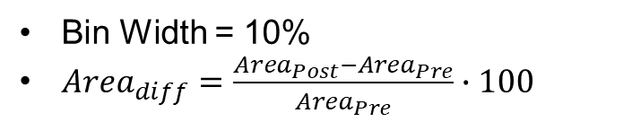
Methods
Bin Width = 10%
${Area}_{diff}=\frac{{Area}_{Post}−{Area}_{Pre}}{{Area}_{Pre}}∙100$

Slide 18
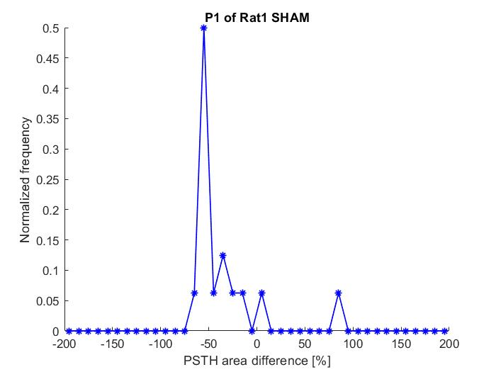
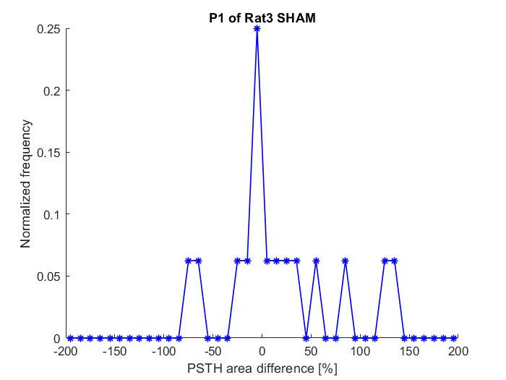
Methods

Slide 19
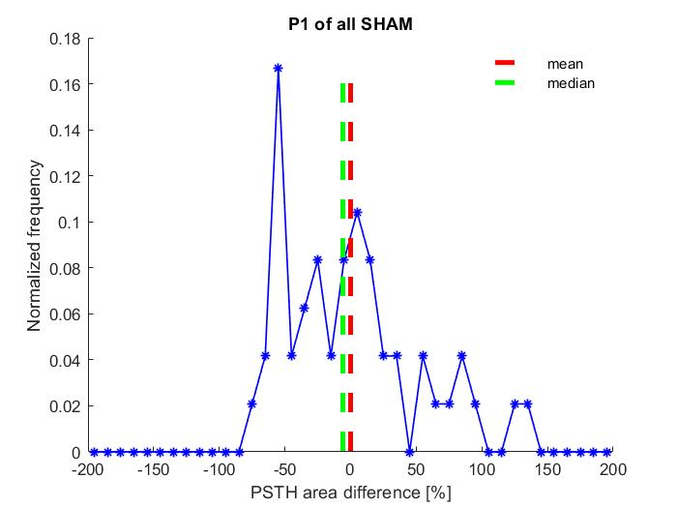
Methods

Slide 20
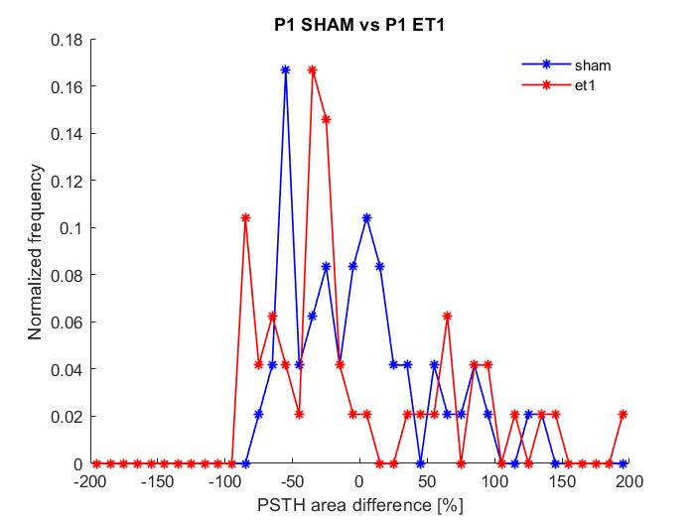
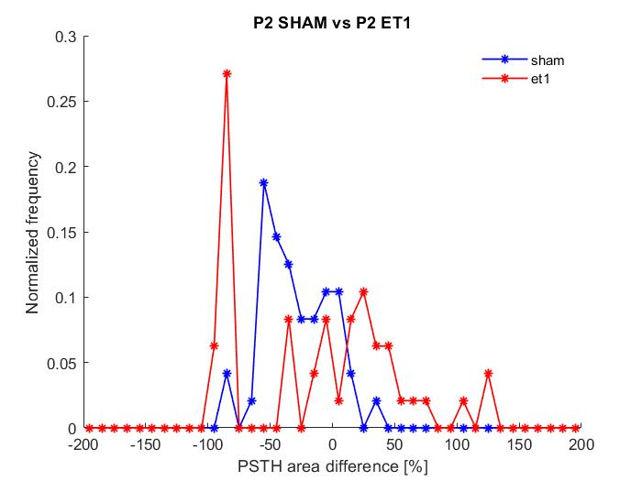
Results
p>0.05
p>0.05

Slide 21
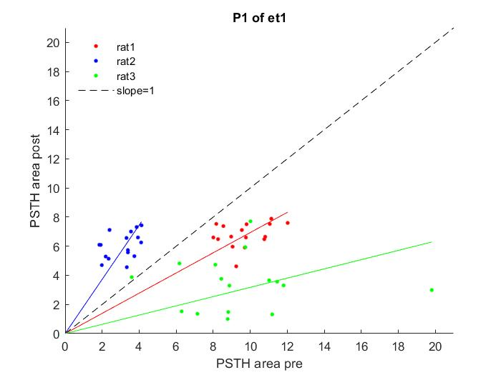
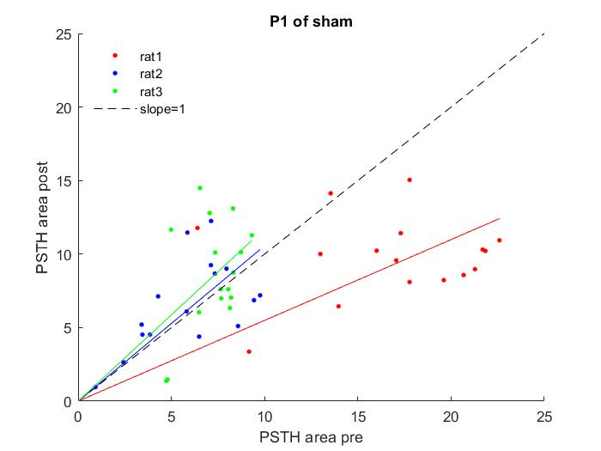
Results

Slide 22
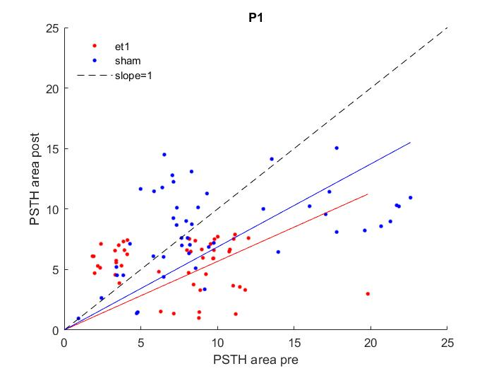
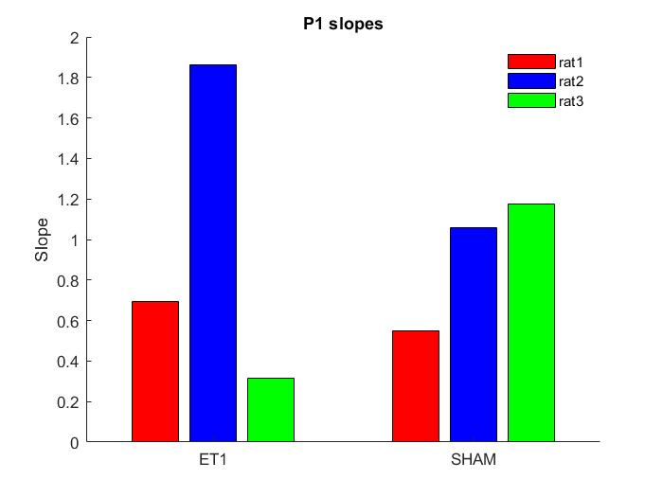
Results
p>0.05

Slide 23
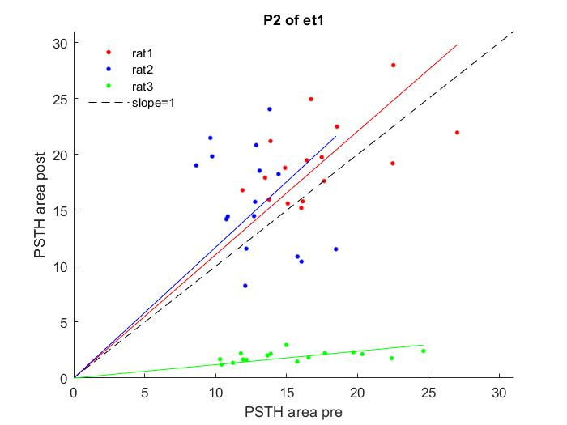
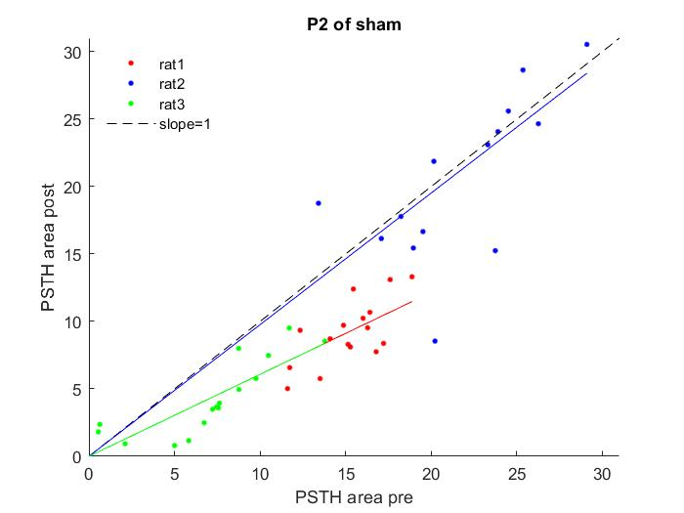
Results

Slide 24
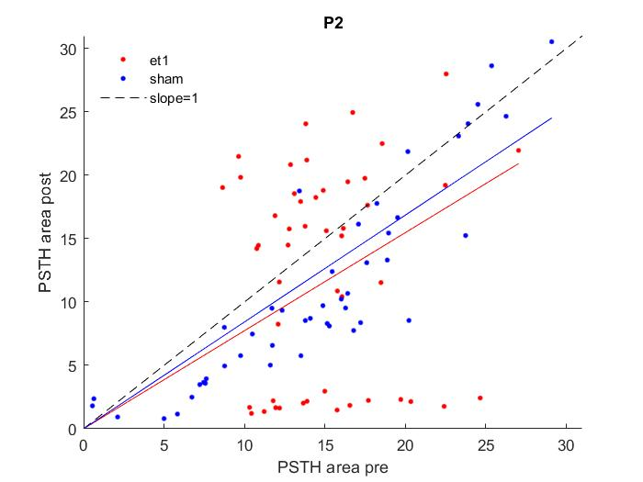
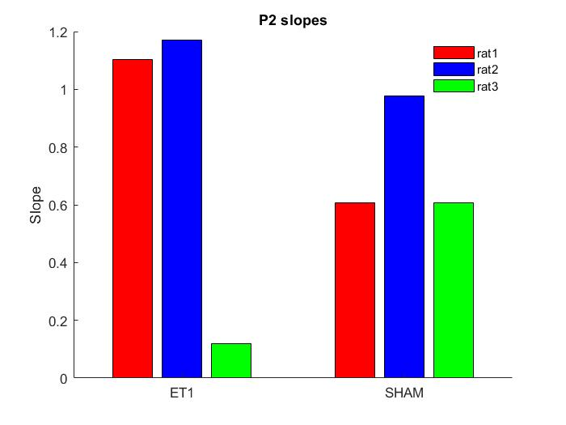
Results
p>0.05

Slide 25
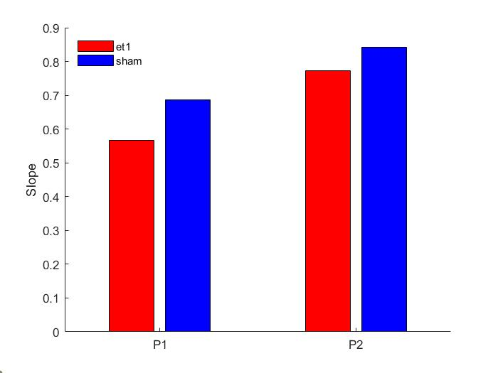
Results

Slide 26
Bibliography
Chiappalone, M., Massobrio, P. and Martinoia, S. (2008), Network plasticity in cortical assemblies. European Journal of Neuroscience, 28: 221-237. https://doi.org/10.1111/j.1460-9568.2008.06259.x

Slide 27
Thanks for the attention

