Slide 1

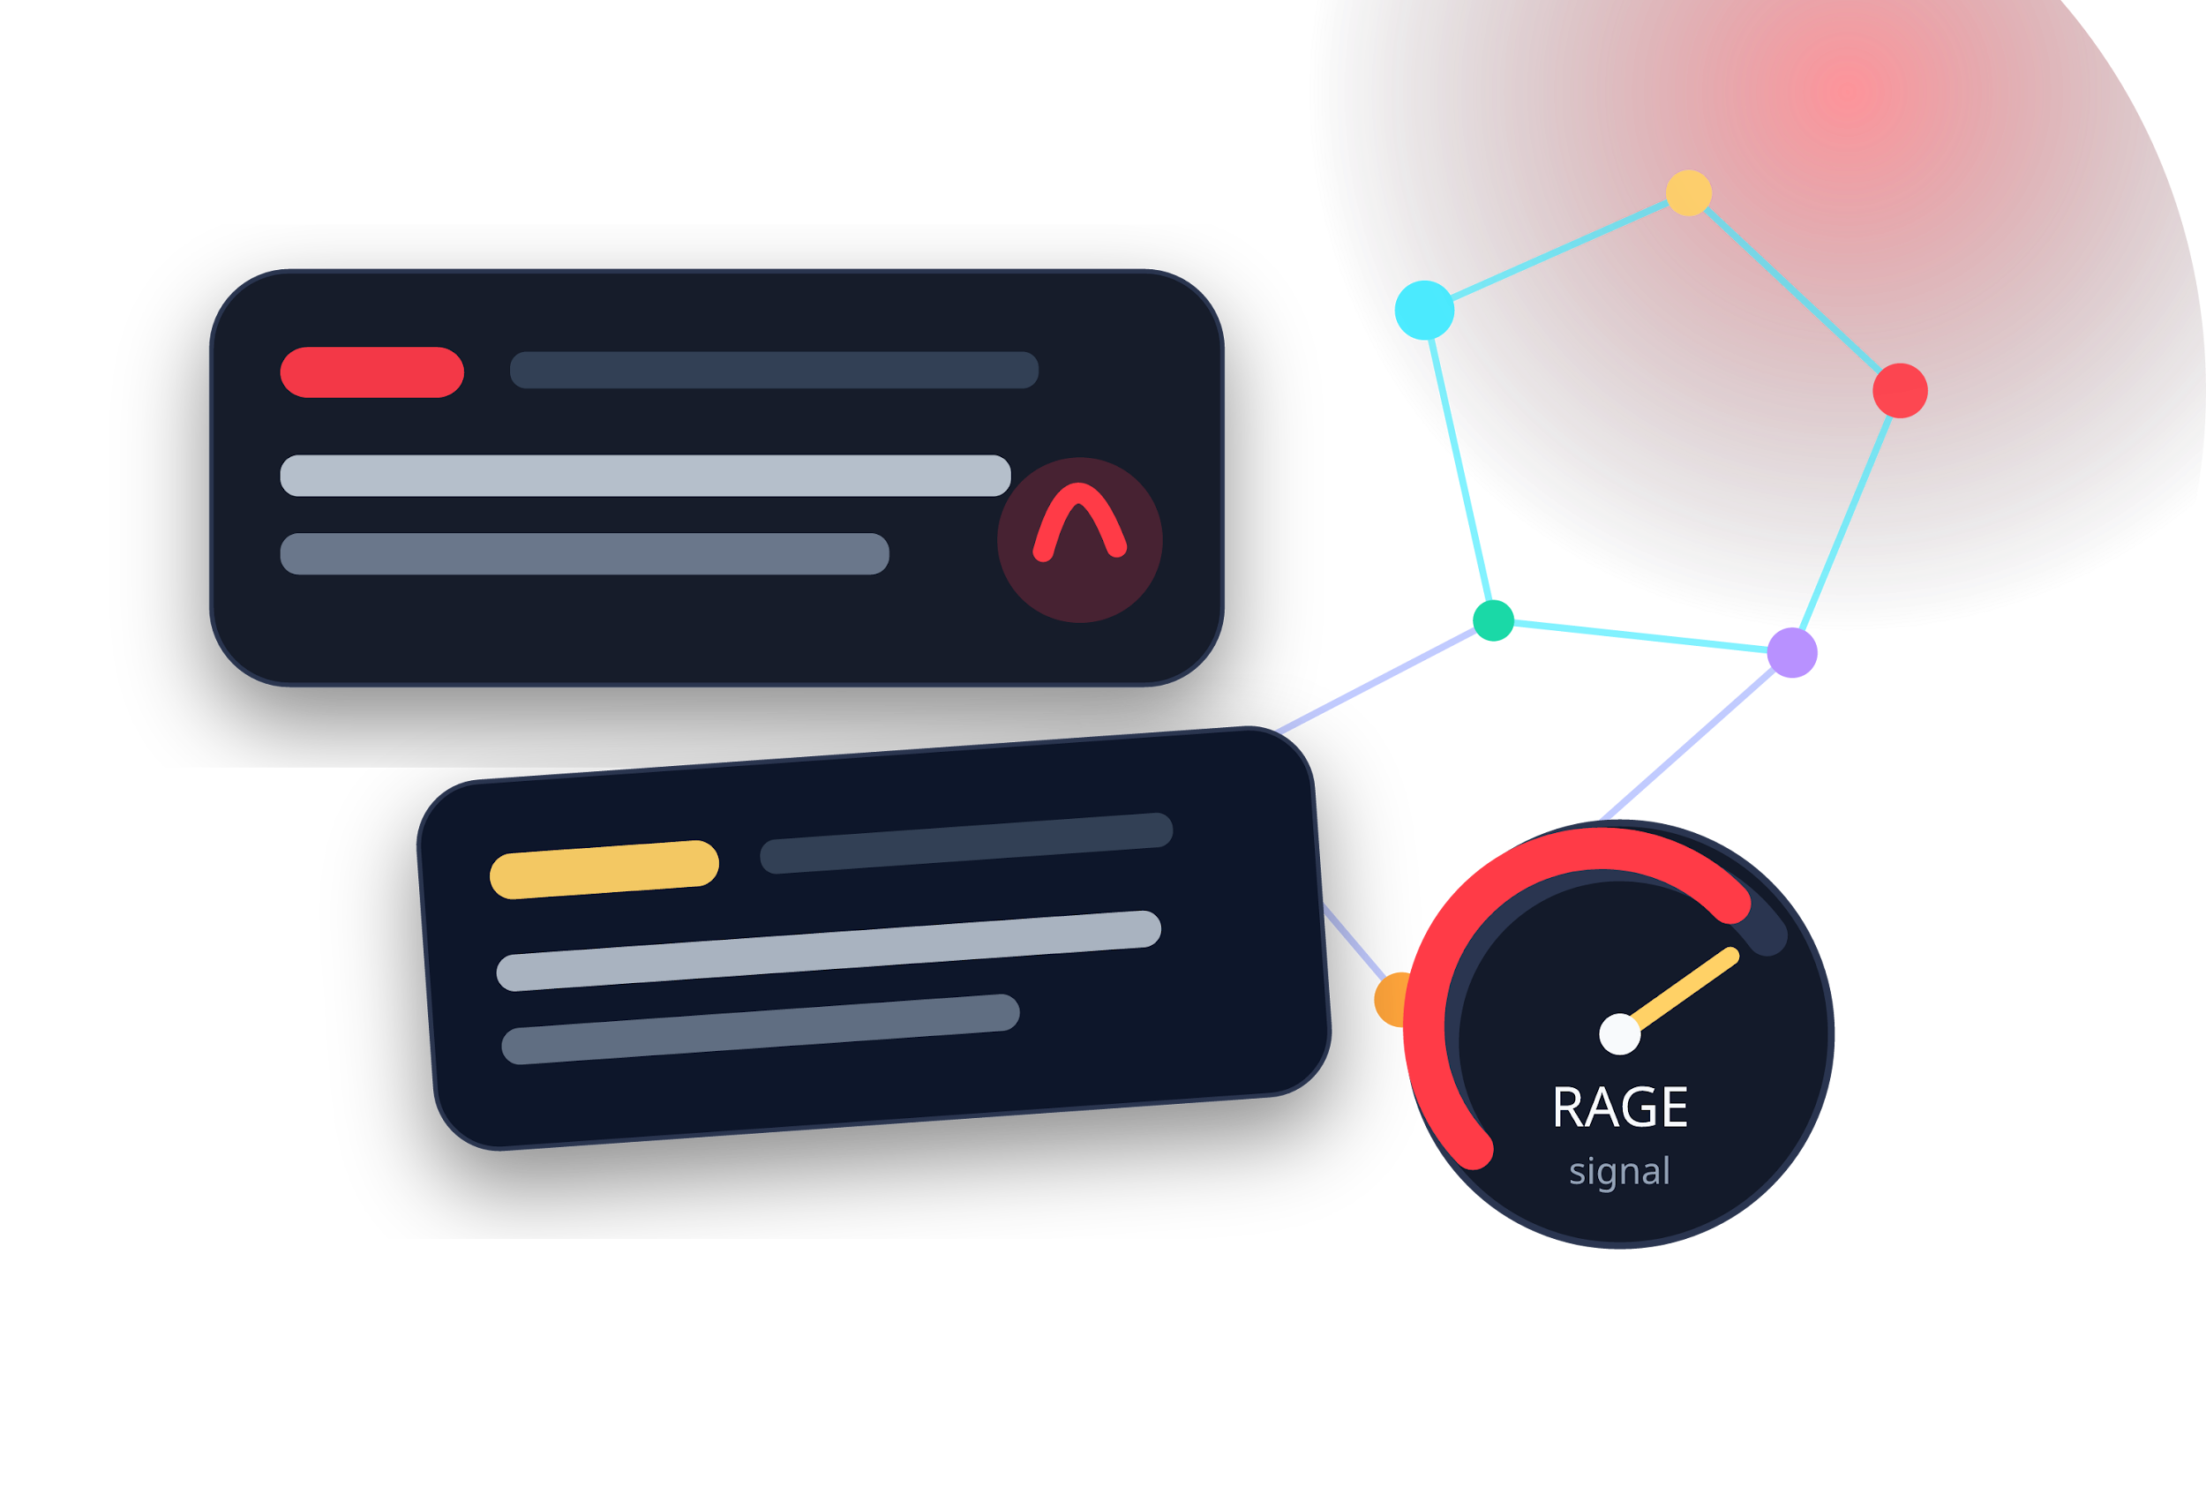
CS4375 FINAL PROJECT · GROUP 8
Ragebait
Detection
From weak-label baseline to gold-label benchmark for abusive and rage-inducing online language.
Edison Cheah · Giuseppe Galiazzi · Lawson Herger · Andrew Lin
Repository: github.com/giuseppegaliazzitx-bit/ML-Project-Ragebait
0.9229
0.6405
12,490
Binary BERT F1
Multiclass BERT Macro F1
Gold benchmark size
Best held-out detector for rage/abuse vs normal.
Nuanced 5-way task: Normal, Profanity, Trolling, Derogatory, Hate Speech.
Human-labeled posts replaced weak-label endpoint.

Slide 2
RAGEBAIT DETECTION
The real question
When do contextual transformers justify their cost over strong lexical baselines?
“
The headline is not just “BERT wins.” The stronger finding is that label quality changed what the project could validly claim.
Why ragebait is hard
Why baselines matter
Why labels matter
Short posts often mix sarcasm, insults, provocation, profanity, and targeted abuse. A bag-of-words model can catch many obvious cases, but boundary cases need intent and context.
Binary detection is already fairly easy for TF-IDF models, so the transformer has to beat a serious baseline rather than a weak strawman.
Iteration 1 tested agreement with LLM-generated labels. Iteration 2 moved the scientific claim to a human-labeled benchmark.
Core result
BERT consistently improves aggregate metrics and class-wise robustness, especially when the task expands from binary detection to overlapping abusive-language categories.
Ragebait Detection • CS4375 Final Project • Group 8
02

Slide 3
RAGEBAIT DETECTION
Project arc: weak labels → gold labels
The deck tells a pivot story: engineering baseline first, scientific benchmark second.
ITERATION 1
LLM WEAK LABELS
ARCHIVED BASELINE
PIVOT
ITERATION 2
FROZEN SPLIT
MODEL LADDER
8-source corpus
507,682 rows
binary labels
6.12% positive
SVC ≈ BERT
macro F1 ~0.87
validity >
volume
human-labeled
trolldata.csv
stratified
80/10/10
TF-IDF → FFNN
→ BERT
Before pivot
Pivot insight
After pivot
Can a model imitate LLM labels?
High scores can still be weak science.
Can models generalize on human labels?
Ragebait Detection • CS4375 Final Project • Group 8
03

Slide 4
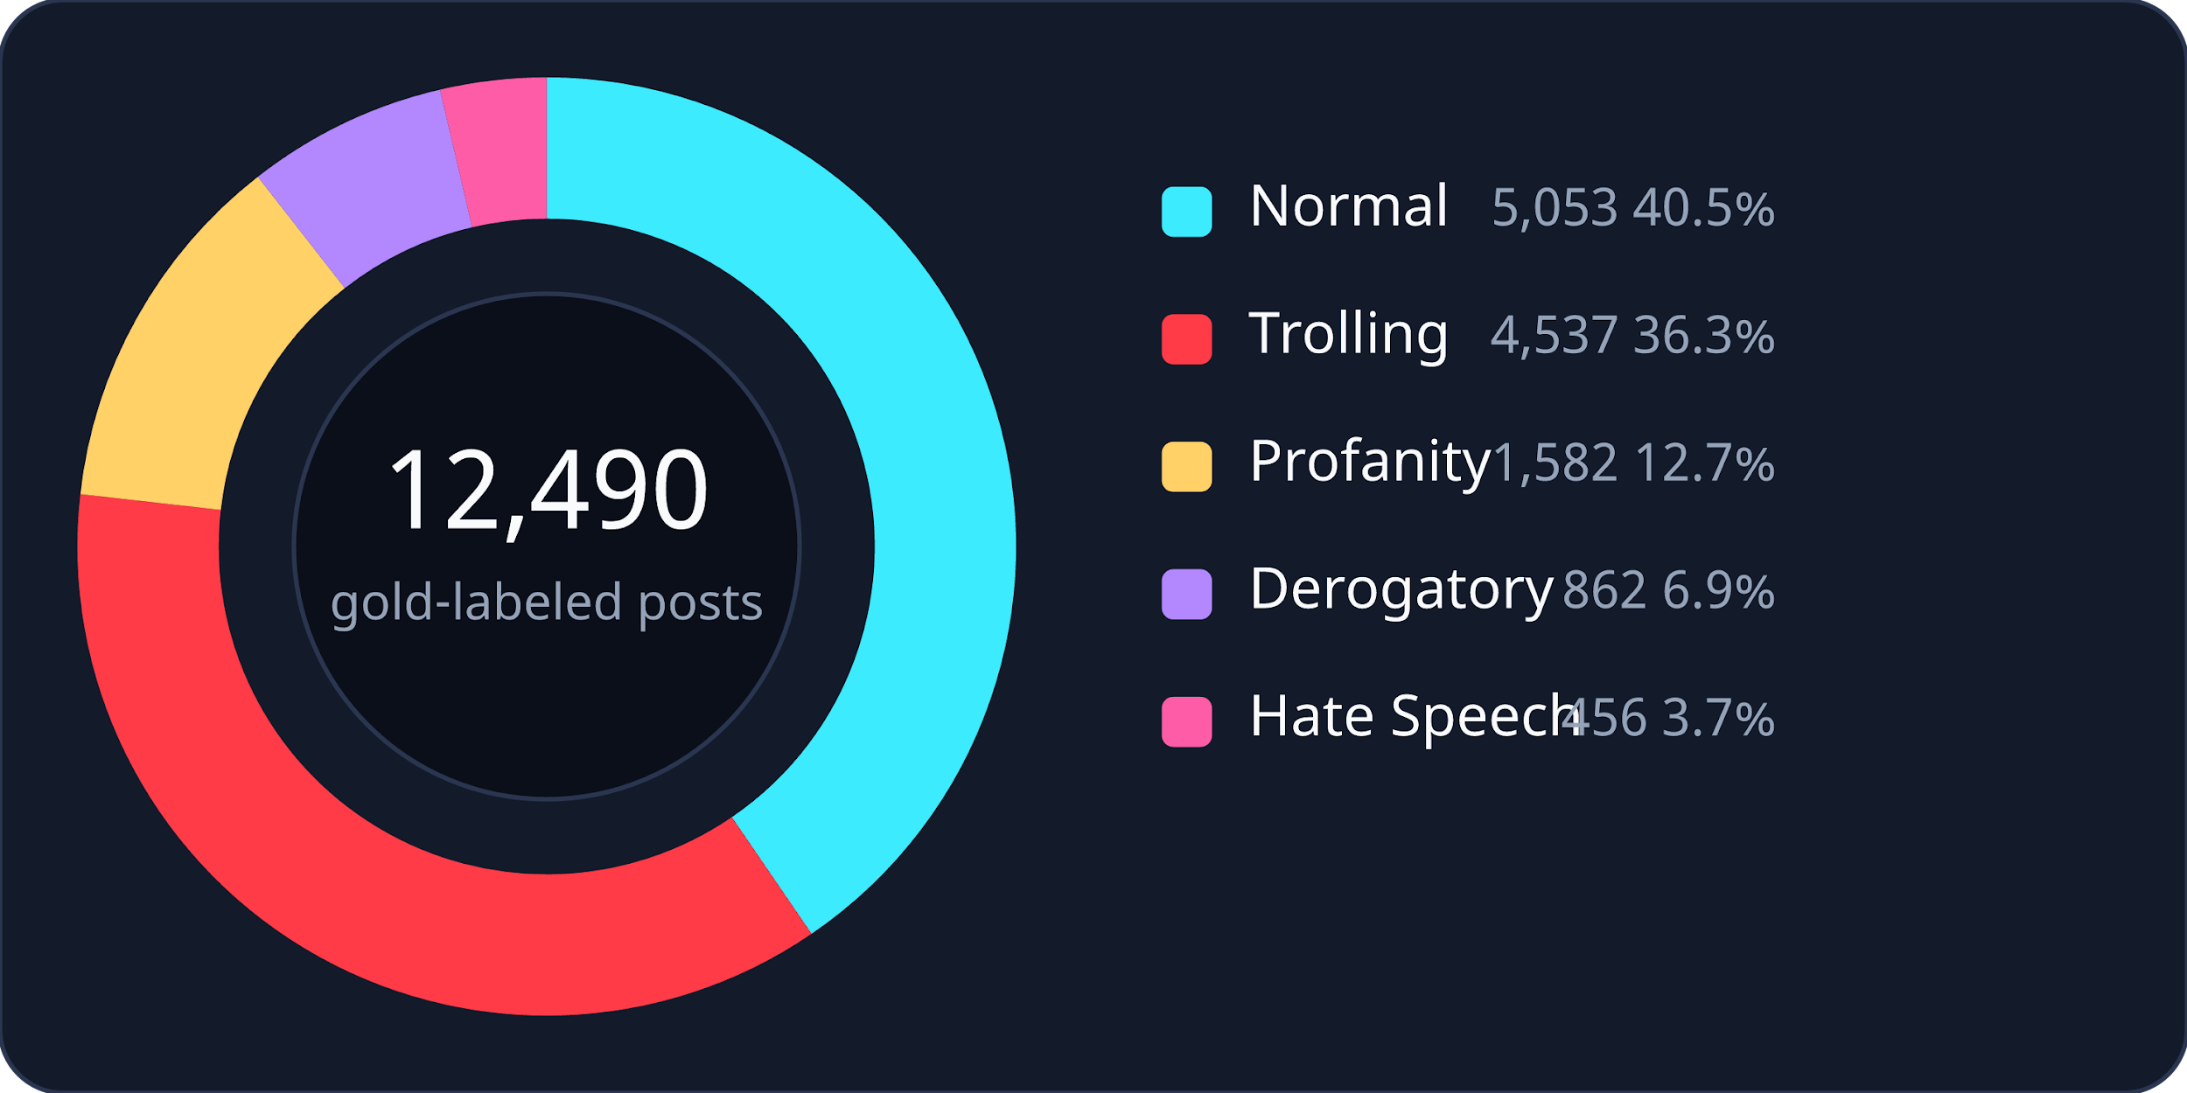
RAGEBAIT DETECTION
Data overview: volume versus trust
Iteration 2 is smaller, but it is the benchmark that supports the final claims.
Iteration 1
507,682
Unified 8-source corpus · weak binary labels · historical baseline
Iteration 2
12,490
Human 5-class labels · final benchmark · Normal→0, all others→1 for binary
five-class label set
Normal · Profanity · Trolling · Derogatory · Hate Speech
Ragebait Detection • CS4375 Final Project • Group 8
04

Slide 5
RAGEBAIT DETECTION
Task setup and experimental protocol
A single frozen split keeps the model ladder comparable.
Frozen stratified split
normal
abusive / rage-inducing
Binary metrics
Train
Accuracy · Precision · Recall · F1
9,992
4,042 normal
5,950 abusive
Validation
Multiclass metrics
506 normal
1,249
743 abusive
Accuracy · Micro F1 · Macro F1 · Weighted F1 · Class-wise scores
Test
505 normal
1,249
744 abusive
Class weighting:
Multiclass training uses inverse-frequency class weights. Largest weights: Hate Speech 5.4751 and Derogatory 2.8962.
Ragebait Detection • CS4375 Final Project • Group 8
05

Slide 6
RAGEBAIT DETECTION
Model ladder: cheap lexical → contextual transformer
The design makes BERT prove its value against strong and progressively richer baselines.
Reproducibility outputs
Transformer cost is intentional
Split manifests, label maps, checkpoints, confusion matrices, histories, and JSON summaries are saved so the comparison can be rerun.
BERT uses AdamW, warmup/decay scheduling, gradient clipping, and dynamic padding. The question is whether those costs buy measurable robustness.
TIER 3
Contextual modeling
BERT
Fine-tuned
bert-base-uncased
TIER 2
Light neural baseline
Lexical baselines
FFNN
Train-only embeddings
mean pooling
TIER 1
Logistic Regression
Linear SVC
TF-IDF 1–2 grams
max_features=20,000
Ragebait Detection • CS4375 Final Project • Group 8
06

Slide 7
RAGEBAIT DETECTION
Why Iteration 1 was not enough
Strong scores on weak labels can validate the labeling process, not the model’s relationship to ground truth.
Unified unlabeled corpus
507,682
n/a
Archived binary baseline
Raw-text Linear SVC
0.8706
macro F1
Weak-labeled corpus
507,682
6.12% positive
Tuned BERT
0.8735
macro F1
High-confidence pool ≥ 0.95
102,104
12.68% positive
“
The issue was not just model quality. Iteration 1 evaluated agreement with LLM-generated labels, so strong scores still did not establish scientific validity.
Final balanced train file
32,000
40.00% positive
Project decision:
Keep the weak-label work as an archived baseline, but move the final claim to the human-labeled Iteration 2 benchmark.
Ragebait Detection • CS4375 Final Project • Group 8
07

Slide 8
RAGEBAIT DETECTION
Experiment 1: binary classification
Lexical methods are already strong; BERT still adds a real held-out gain.
+0.0323
+0.0345
Test F1 by model
Gain over FFNN
Gain over Linear SVC
F1
BERT adds contextual value even when binary detection is easy.
Cheap lexical baseline is not enough to match BERT.
0.8854
0.8884
0.8906
0.9229
Approx. BERT confusion matrix
counts reconstructed from reported precision/recall on 1,249 test posts
predicted
Normal
Rage
Normal
BERT
446
59
LogReg
Linear SVC
FFNN
BERT
actual
Rage
56
688
Accuracy 0.9079 · Precision 0.9210 · Recall 0.9247
Ragebait Detection • CS4375 Final Project • Group 8
08

Slide 9
RAGEBAIT DETECTION
Experiment 2: multiclass classification
The five-class task is the clearest place where contextual modeling matters.
Macro F1 by model
Full result snapshot
Macro F1
0.6405
Model
Acc.
Micro
Macro
0.5524
0.5403
0.5101
LogReg
0.6645
0.6645
0.5524
Linear SVC
0.6797
0.6797
0.5403
FFNN
0.6373
0.6373
0.5101
BERT
0.7390
0.7390
0.6405
LogReg
Linear SVC
FFNN
BERT
+0.0881 macro F1 over the best non-transformer baseline
why it matters
The categories overlap semantically: a post can be profane, trolling, derogatory, or hateful depending on target, intent, and harm. BERT helps because token context matters more here than in the binary task.
Ragebait Detection • CS4375 Final Project • Group 8
09

Slide 10
RAGEBAIT DETECTION
Class-wise gains: BERT lifts every category
Minority abusive classes still remain the hardest boundary cases.
F1 by class: Logistic Regression vs BERT
Largest absolute gain
LogReg
BERT
Profanity +0.1241 F1
Hardest retained challenge
Derogatory + Hate Speech
Interpretation
Normal
Profanity
Trolling
Derog.
Hate
BERT is more robust, but the tail classes are still constrained by sparse data and annotation-boundary overlap.
Ragebait Detection • CS4375 Final Project • Group 8
10

Slide 11
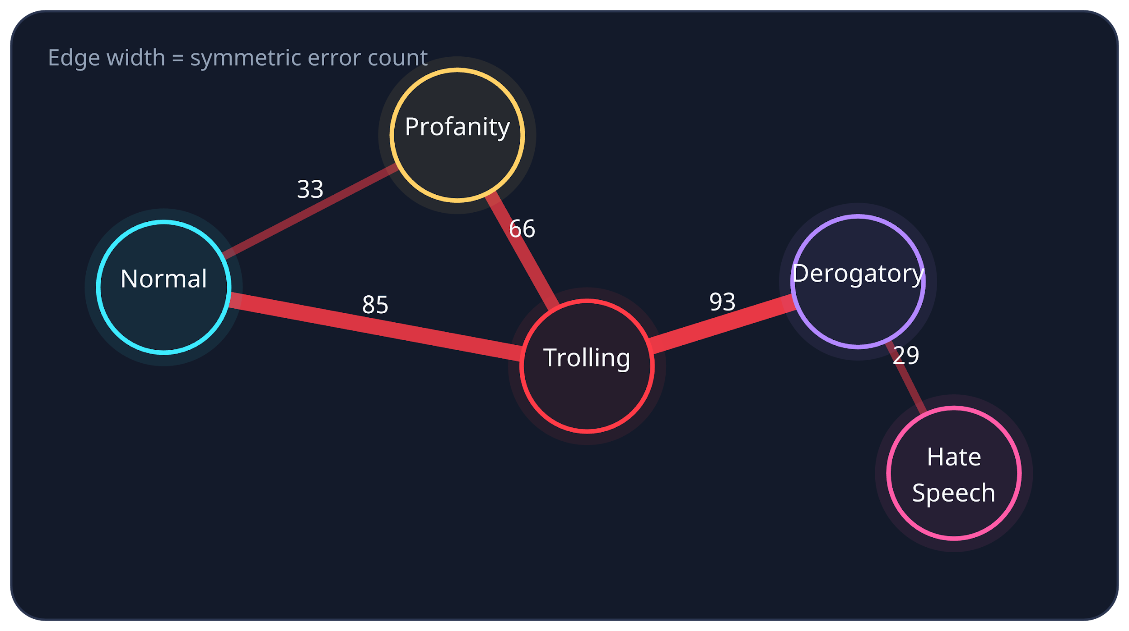
RAGEBAIT DETECTION
Confusion structure: where categories blur
Dominant errors cluster around semantic and pragmatic boundaries, not just missing words.
Top symmetric confusion pairs
Derogatory ↔ Trolling
93
Normal ↔ Trolling
85
Profanity ↔ Trolling
66
Normal ↔ Profanity
33
Derogatory ↔ Hate Speech
29
“
The model sees surface hostility, but the label often depends on target, pragmatic intent, and whether the post is insulting, baiting, or hateful.
Ragebait Detection • CS4375 Final Project • Group 8
11

Slide 12
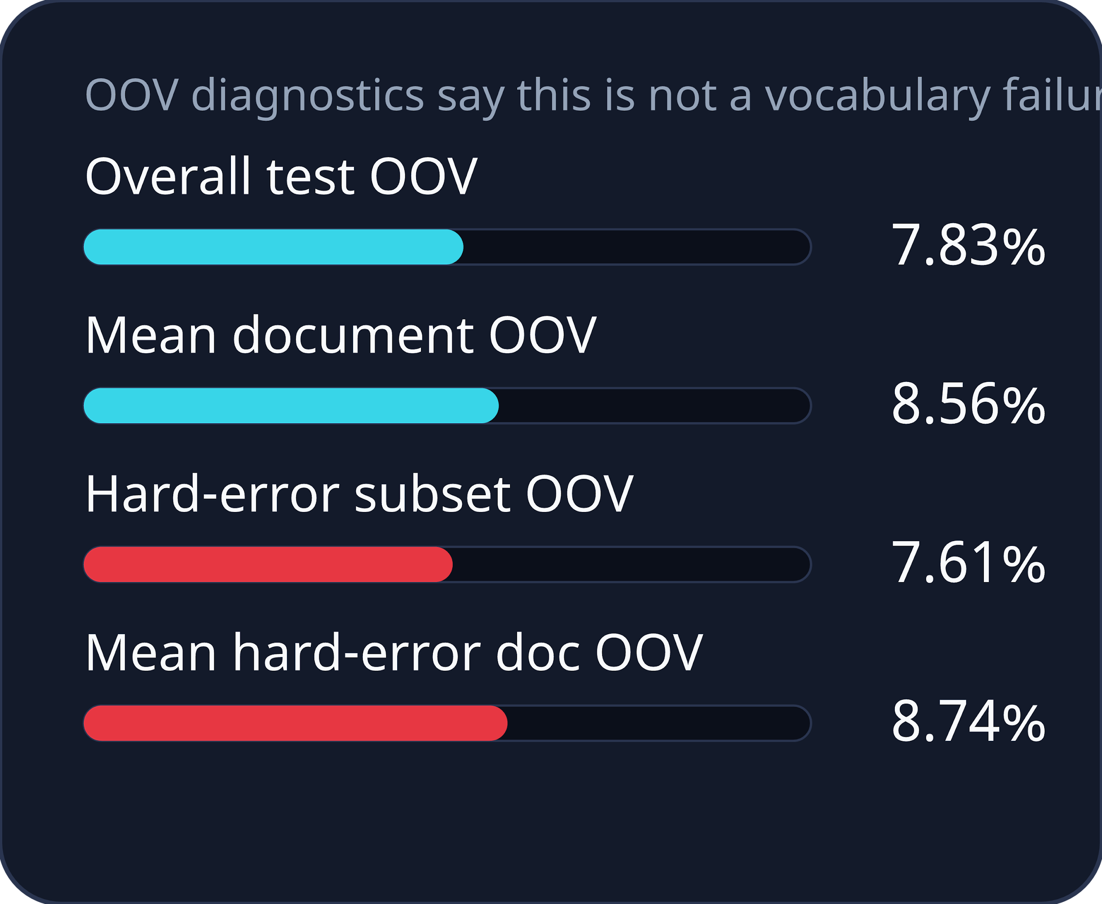
RAGEBAIT DETECTION
Error analysis: remaining failures are semantic
Hard BERT errors are not primarily out-of-vocabulary problems.
Highest-confidence miss
What this implies
Hate Speech → Profanity on a redacted wish-of-harm example. The model recognizes profanity but underestimates the harmful intent.
More model capacity alone may not solve the hardest failures. The remaining work is about richer context, better borderline guidance, and evaluation splits that prevent leakage by author/source.
Common boundary miss
Trolling → Derogatory on short insult-heavy posts. Surface hostility obscures whether the post is baiting or targeted abuse.
Reverse boundary miss
conclusion
The unresolved challenge is semantic overlap at the Trolling, Derogatory, and Hate Speech boundaries.
Derogatory → Trolling when taunting style softens clearly targeted abuse. Tone and target interact.
Ragebait Detection • CS4375 Final Project • Group 8
12

Slide 13
RAGEBAIT DETECTION
Speed and deployment tradeoff
TF-IDF models are essentially free; BERT buys quality with compute.
Multiclass train time (seconds)
Multiclass prediction time (seconds)
6.3m
9.86s
1.5m
16.31s
0.15s
0.47s
1.0ms
1.5ms
LogReg
SVC
FFNN
BERT
LogReg
SVC
FFNN
BERT
log scale
log scale
TF-IDF: deploy when speed is king.
FFNN: costs more, adds little here.
BERT: best quality, serious cost.
Ragebait Detection • CS4375 Final Project • Group 8
13

Slide 14
RAGEBAIT DETECTION
Final takeaways
The project now has a clearer scientific claim and a practical deployment story.
Report strong baselines
Label quality changed the endpoint
1
2
Classical TF-IDF methods are too strong to ignore, especially for binary detection.
Weak labels were useful engineering scaffolding, but not enough for final scientific claims.
BERT is the consistent winner
The hardest errors are semantic
3
4
It improves aggregate metrics and every class-wise F1 score.
Trolling, Derogatory, and Hate Speech boundaries remain the main pain point.
Best next steps:
grouped splits by author/source · richer context beyond one post · sharper annotation guidance for borderline categories
Ragebait Detection • CS4375 Final Project • Group 8
14

Slide 15
RAGEBAIT DETECTION
References
Trawling for Trolling: A Dataset. arXiv:2008.00525.
Devlin, Chang, Lee, and Toutanova. BERT: Pre-training of Deep Bidirectional Transformers for Language Understanding. NAACL-HLT, 2019.
Pedregosa et al. Scikit-learn: Machine Learning in Python. JMLR, 2011.
Project repository: github.com/giuseppegaliazzitx-bit/ML-Project-Ragebait
“
Backup detail slides can be added from the full markdown tables if the presentation needs a longer Q&A appendix.
Ragebait Detection • CS4375 Final Project • Group 8
15

