Slide 1
Machine Learning Ragebait Detection
A supervised NLP system for detecting abusive and rage-inducing social-media language
Group 8 - Edison Cheah, Giuseppe Galiazzi, Lawson Herger, Andrew Lin
FINAL BINARY TEST
FINAL MULTICLASS TEST
GOLD-LABEL DATASET
0.9229
0.6405
12,490
BERT F1
BERT macro F1
human-labeled posts
Final benchmark uses human labels, frozen splits, and a three-tier model ladder.
The central finding is methodological: weak-label agreement was not enough; gold-label evaluation changed the scientific story.
ML Ragebait Detection Project
1

Slide 2
Research Problem
Why this task is more than ordinary toxicity detection
Short social-media posts compress sarcasm, abuse, provocation, threats, and ordinary profanity into very little context.
A model must separate surface offensiveness from intent: trolling, derogation, hate speech, and normal speech can share vocabulary.
The practical objective is reliable classification of rage-inducing or abusive language without treating every controversial post as ragebait.
Boundary | Why it is difficult
Profanity vs. Hate Speech | Explicit words can mask stronger harm or threat intent.
Trolling vs. Derogatory | Taunting style overlaps with direct personal insult.
Normal vs. Trolling | Controversy and sarcasm are not automatically abuse.
HARDER TARGET
5 classes
Normal, Profanity, Trolling, Derogatory, Hate Speech
ML Ragebait Detection Project
2

Slide 3
Project Arc
The project intentionally preserves both the first attempt and the final system
Phase | Supervision | Key output | Main lesson
Iteration 1 | LLM weak labels | 507,682 labeled posts; balanced 32k training file | Scores measured agreement with Qwen, not human judgment.
Iteration 2 | Human labels | 12,490-row gold-label benchmark | Final claims are grounded in held-out human annotation.
The weak-label pipeline was valuable engineering practice: import, label, filter, balance, train, and evaluate.
The scientific pivot was necessary because high performance against model-generated labels does not prove real validity.
The final deck therefore emphasizes Iteration 2 while using Iteration 1 as motivation.
ARCHIVED WEAK-LABEL BERT
FINAL GOLD-LABEL BERT
FINAL MULTICLASS BERT
0.8735
0.9229
0.6405
macro F1 against LLM labels
binary F1 against human labels
macro F1 on 5 classes
ML Ragebait Detection Project
3

Slide 4
Final Dataset
Human-labeled abusive-language corpus used for all final experiments
Label | Rows | Share
Normal | 5,053 | 40.46%
Profanity | 1,582 | 12.67%
Trolling | 4,537 | 36.32%
Derogatory | 862 | 6.90%
Hate Speech | 456 | 3.65%
Binary task maps Normal to 0 and every abusive category to 1.
Multiclass task keeps all five labels: Normal, Profanity, Trolling, Derogatory, Hate Speech.
Class imbalance is substantial, especially for Hate Speech and Derogatory.
BINARY BALANCE
MINORITY CLASS
59.54%
3.65%
Dataset source: trolldata.csv, used as the final gold-label benchmark.
ragebait / abusive examples
Hate Speech examples
ML Ragebait Detection Project
4

Slide 5
Frozen Splits
Same train, validation, and test rows across all final models
Split | Rows | Normal | Ragebait / abusive
Train | 9,992 | 4,042 | 5,950
Validation | 1,249 | 506 | 743
Test | 1,249 | 505 | 744
Split policy: stratified 80/10/10 with seed 42.
Model selection used validation performance; final claims use held-out test results.
Freezing the split prevents accidental improvements from split drift.
Split | Normal | Profanity | Trolling | Derogatory | Hate Speech
Train | 4,042 | 1,265 | 3,630 | 690 | 365
Validation | 506 | 158 | 454 | 86 | 45
Test | 505 | 159 | 453 | 86 | 46
ML Ragebait Detection Project
5

Slide 6
Modeling Ladder
Three tiers test whether richer representations improve performance
Tier | Model family | Representation | Role
1 | Logistic Regression, Linear SVC | TF-IDF unigrams and bigrams | Strong lexical baselines
2 | PyTorch FFNN | Train-only embeddings with mean pooling | Compact neural baseline
3 | BERT | bert-base-uncased contextual encoder | Fine-grained intent modeling
TF-IDF establishes whether labels are mostly lexical.
FFNN tests whether learned dense interactions help beyond linear baselines.
BERT tests whether context helps separate overlapping abuse categories.
BERT setting | Binary | Multiclass
Max length | 80 | 128
Epochs | 2 | 4
Selection metric | Validation F1 | Validation macro F1
ML Ragebait Detection Project
6

Slide 7
Implementation
Final workspace is reproducible and artifact-driven
iteration2/src/data creates label maps and canonical splits.
iteration2/src/training runs TF-IDF baselines, FFNN, and BERT.
iteration2/src/evaluation saves metrics, confusion matrices, and hard-error CSV files.
Outputs include summaries, tokenizer snapshots, checkpoints, training histories, and split manifests.
weight_i = N / (K * count_i) embeddings = self.embedding(input_ids) mask = (input_ids != self.pad_index).unsqueeze(-1) pooled = (embeddings * mask).sum(dim=1) / mask.sum(dim=1).clamp(min=1) logits = self.classifier(pooled)
Two implementation details: exact class weights for imbalance and a simple mean-pooled FFNN baseline.
ML Ragebait Detection Project
7

Slide 8
Iteration 1 Results
A useful pipeline, but an insufficient endpoint
Model / run | Accuracy | Positive F1 | Macro F1 | Notes
Initial BERT | 0.4055 | 0.5770 | 0.2885 | Collapsed toward positive predictions
Raw-text Linear SVC | 0.8744 | 0.8484 | 0.8706 | Strongest exact-split classical baseline
Tuned BERT | 0.8767 | 0.8533 | 0.8735 | Best archived weak-label result
The tuned BERT barely exceeded the strongest classical baseline.
More importantly, the evaluation target was still model-generated labels.
This became the reason to pivot to a human-labeled benchmark.
WEAK-LABELED CORPUS
507,682
LLM-labeled examples
HIGH-CONFIDENCE POOL
102,104
confidence >= 0.95
ML Ragebait Detection Project
8

Slide 9
Experiment 1: Binary Classification
Held-out test results for Normal vs. ragebait / abusive
Model | Tier | Accuracy | Precision | Recall | F1
Logistic Regression | 1 | 0.8551 | 0.8371 | 0.9395 | 0.8854
Linear SVC | 1 | 0.8655 | 0.8780 | 0.8992 | 0.8884
FFNN | 2 | 0.8671 | 0.8734 | 0.9086 | 0.8906
BERT | 3 | 0.9079 | 0.9210 | 0.9247 | 0.9229
BEST MODEL
BERT
Tier 3 contextual encoder
F1 GAIN
+0.0322
over FFNN baseline
The binary task is already strong for lexical models, so BERT's gain is meaningful rather than automatic.
The FFNN only marginally improves over Linear SVC, suggesting the coarse boundary is mostly lexical.
BERT still gives the best balance of precision and recall on held-out data.
ML Ragebait Detection Project
9

Slide 10
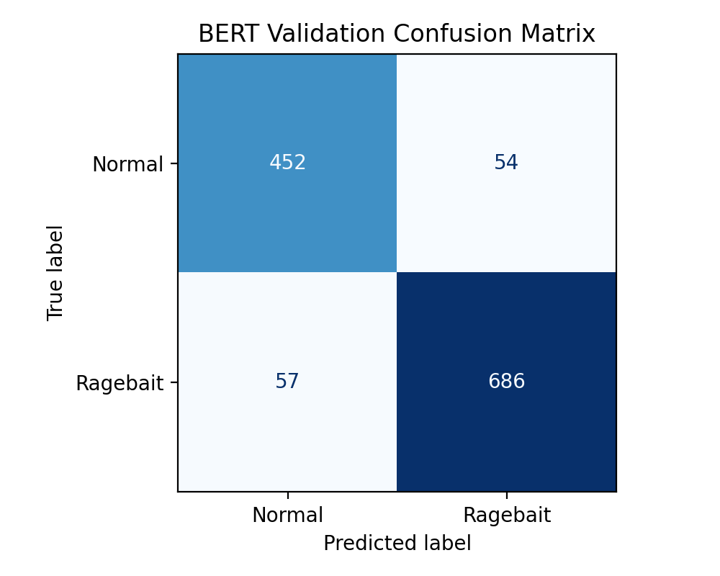
Binary Confusion Matrix
BERT reduces both false positives and false negatives on the final benchmark
BERT held-out test: 0.9079 accuracy and 0.9229 F1.
False negatives remain important because abusive posts missed by the classifier carry moderation risk.
False positives matter because controversial but non-abusive text should not be over-flagged.
PRECISION
RECALL
0.9210
0.9247
positive predictions usually correct
most abusive posts found
ML Ragebait Detection Project
10

Slide 11
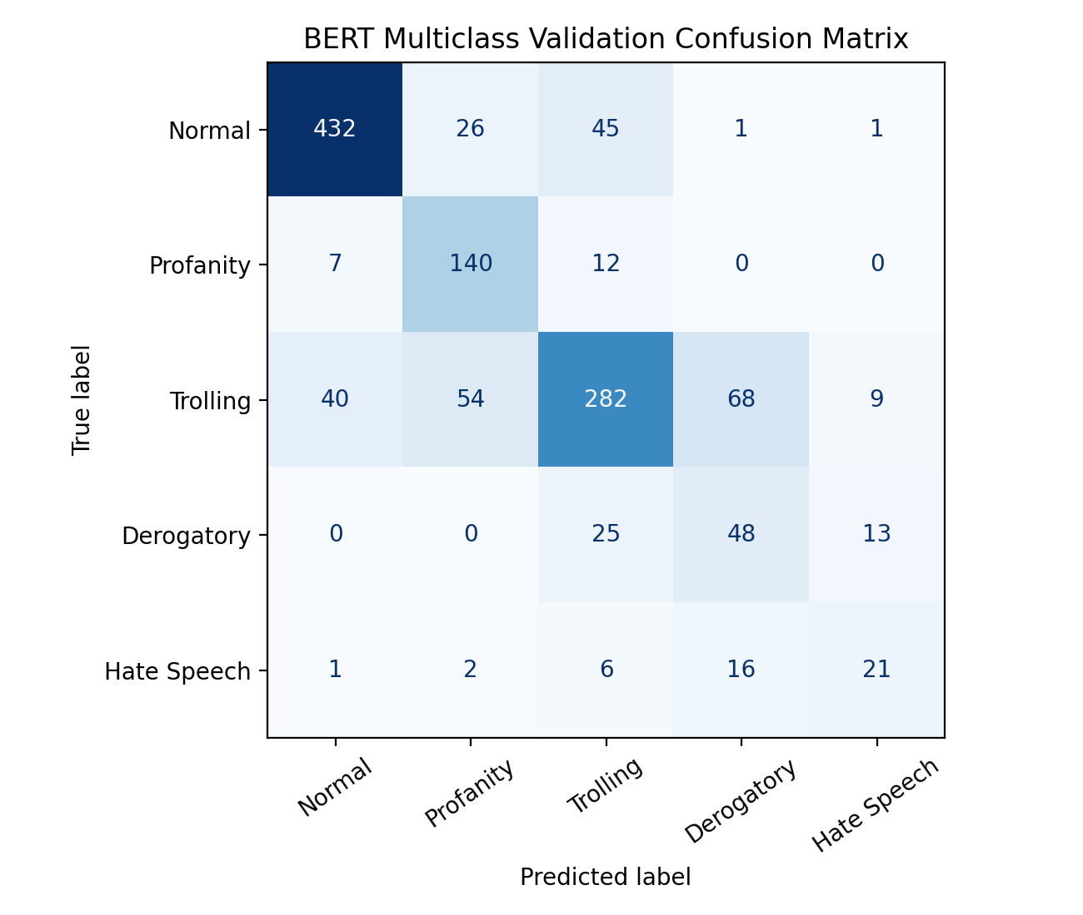
Experiment 2: Five-Class Classification
Held-out test results for the full label set
Model | Tier | Accuracy | Micro F1 | Macro F1
Logistic Regression | 1 | 0.6645 | 0.6645 | 0.5524
Linear SVC | 1 | 0.6797 | 0.6797 | 0.5403
FFNN | 2 | 0.6373 | 0.6373 | 0.5101
BERT | 3 | 0.7390 | 0.7390 | 0.6405
The five-class task exposes category-boundary ambiguity that binary detection hides.
BERT improves test macro F1 by 0.0881 over the best held-out baseline.
The remaining errors concentrate around Trolling, Derogatory, and Hate Speech.
ML Ragebait Detection Project
11

Slide 12
Class-wise Performance
BERT improves every class against the best non-transformer baseline
0.88
Class | LogReg F1 | BERT F1 | Gain
Normal | 0.8215 | 0.8772 | +0.0557
Profanity | 0.6108 | 0.7349 | +0.1241
Trolling | 0.6202 | 0.6853 | +0.0651
Derogatory | 0.3398 | 0.4384 | +0.0986
Hate Speech | 0.3696 | 0.4667 | +0.0971
0.82
0.73
0.69
0.61
0.62
0.44
0.47
0.34
0.37
Largest gains appear where surface vocabulary alone is least reliable: Profanity, Derogatory, and Hate Speech.
Normal
Profanity
Trolling
Derog.
Hate
Logistic Regression
BERT
ML Ragebait Detection Project
12

Slide 13
Error Analysis
The hardest failures are semantic and boundary-driven
Confusion pair | Symmetric errors
Derogatory <-> Trolling | 93
Normal <-> Trolling | 85
Profanity <-> Trolling | 66
Normal <-> Profanity | 33
Derogatory <-> Hate Speech | 29
Profanity can hide more severe hostile intent.
Trolling and derogatory abuse often share direct insult vocabulary.
Long rants mix sarcasm, complaint, threat, and provocation in one post.
OOV rates do not explain the hard BERT errors: hard-error OOV is 7.61%, close to the full test OOV rate of 7.83%.
TOP DIRECTIONAL ERROR
HARD-ERROR OOV
MAIN TAKEAWAY
68
7.61%
semantic
Trolling predicted as Derogatory
not a vocabulary-hole story
not just lexical
ML Ragebait Detection Project
13

Slide 14
Compute Tradeoffs
Performance gains must be weighed against training and inference cost
Model | Binary train | Binary predict | Multiclass train | Multiclass predict
Logistic Regression | 0.047 s | 0.00039 s | 16.314 s | 0.00097 s
Linear SVC | 0.032 s | 0.00045 s | 0.471 s | 0.00146 s
FFNN | 25.388 s | 0.01973 s | 87.860 s | 0.1501 s
BERT | 4893.595 s | 64.869 s | 376.786 s | 9.860 s
TF-IDF models are effectively free and remain valuable baselines.
BERT is the only model with a serious compute cost, but GPU training makes the multiclass run practical.
Operationally, BERT is most justified when category distinction matters, not merely when coarse binary screening is enough.
BINARY BERT
MULTICLASS BERT
PRACTICAL USE
81.6 min
6.3 min
batch
CPU training run
CUDA training run
offline moderation scoring
ML Ragebait Detection Project
14

Slide 15
Conclusion
Final results and next steps
FINAL BINARY BERT
FINAL MULTICLASS BERT
BEST BASELINE GAP
0.9229
0.6405
+0.0881
held-out test F1
held-out test macro F1
multiclass macro F1
Classical lexical baselines are strong and should always be reported.
The FFNN adds little on binary detection and underperforms the best linear model on multiclass macro F1.
BERT is the only model that consistently improves aggregate scores and class-wise robustness.
The remaining research problem is better handling of overlapping abusive categories, not simply more parameters.
Promising next step | Reason
Grouped splits by author/source | Reduce leakage and test real generalization.
More context per post | Resolve sarcasm, threat, and reply-chain ambiguity.
Sharper annotation guidance | Clarify Trolling vs. Derogatory vs. Hate Speech.
ML Ragebait Detection Project
15

Slide 16
References
Core sources used by the project
Trawling for Trolling: A Dataset. arXiv:2008.00525.
Devlin, Chang, Lee, and Toutanova. BERT: Pre-training of Deep Bidirectional Transformers for Language Understanding. NAACL-HLT, 2019.
Pedregosa et al. Scikit-learn: Machine Learning in Python. Journal of Machine Learning Research, 2011.
Project repository: github.com/giuseppegaliazzitx-bit/ML-Project-Ragebait
End
ML Ragebait Detection Project
16

