Slide 1
P1906.1 reference code
Giuseppe Piro, Ph.D.
Telematics Research Group (Politecnico di Bari) - giuseppe.piro@poliba.it telematics.poliba.it/piro

Slide 2
Main details
Availability: https://code.google.com/p/ieee-p1906-1-reference-code/
Main features: core, em example, molecular example
Number of classes: 27
Lines of code: 11800
Number of files: 57
Giuseppe Piro, Ph.D.
Telematics Research Group (Politecnico di Bari) - giuseppe.piro@poliba.it telematics.poliba.it/piro

Slide 3
Core of the module
Components belonging to the P1906.1 framework:
MessageCarrier, Motion, Field, Perturbation, Specificity
Entities belonging to the P1906.1 framework:
Medium, Message
Additional entities:
NetDevice, CommunicationInterface, TransmitterCommunicationInterface, ReceiverCommunicationInterface
Giuseppe Piro, Ph.D.
Telematics Research Group (Politecnico di Bari) - giuseppe.piro@poliba.it telematics.poliba.it/piro

Slide 4
Components/entities interaction
The NetDevice receives a message from upper layers. The message is delivered to the Transmitter Communication Interface
The Perturbation component is used to create the Message Carrier
The Transmitter Communication Interface triggers the propagation in the medium by passing MessageCarrier, Perturbation, and Field components
The Motion component modify properties of the Message Carrier (i.e., propagation loss, delay)
The Message Carrier is delivered to the receiver and the Specificity component verifies the compatibility
In case of compatibility, the message is delivered to upper layers
The message is received by upper layers
Giuseppe Piro, Ph.D.
Telematics Research Group (Politecnico di Bari) - giuseppe.piro@poliba.it telematics.poliba.it/piro

Slide 5
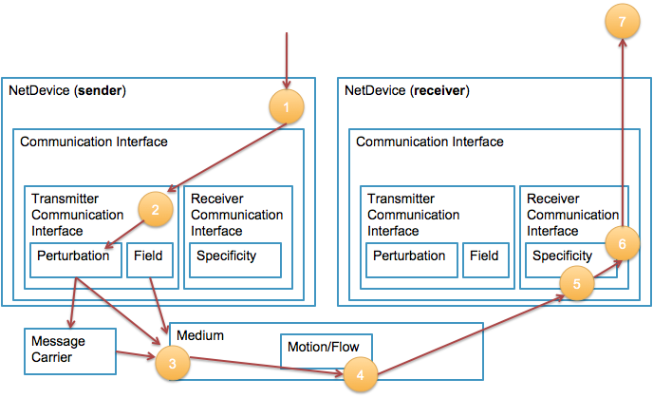
Components/entities interaction (2)
Giuseppe Piro, Ph.D.
Telematics Research Group (Politecnico di Bari) - giuseppe.piro@poliba.it telematics.poliba.it/piro

Slide 6
Install and use the tool
download and install the simulator
https://code.google.com/p/ieee-p1906-1-reference-code
https://code.google.com/p/ieee-p1906-1-reference-code/source/browse/README
run the simple example through command line (idea communication)
cp ns-3-dev/p1906/example/first-example.cc scratch
./waf --run scratch/first-example
Giuseppe Piro, Ph.D.
Telematics Research Group (Politecnico di Bari) - giuseppe.piro@poliba.it telematics.poliba.it/piro

Slide 7
EM example - Main description
Electromagnetic based communication
Single transmitter / receiver pair
THz channel communication
Reference papers:
Ke Yang, Akram Alomainy and Yang Hao, "In-vivo Characterisation and Numerical Analysis of the THz Radio Channel for Nanoscale Body-Centric Wireless Networks", IEEE APS/USNC-URSI 2013, Orlando, Florida, USA, 7-13 July 2013
Ke Yang, Alice Pellegrini, Alessio Brizzi, Akram Alomainy, Yang Hao, "Numerical Analysis of the Communication Channel Path Loss at the THz Band inside the Fat Tissue", IEEE IMWS-Bio 2013, Singapore, 9-11 December 2013
Jornet, J.M.; Akyildiz, IF., "Channel Modeling and Capacity Analysis for Electromagnetic Wireless Nanonetworks in the Terahertz Band," Wireless Communications, IEEE Transactions on , vol.10, no.10, pp.3211-3221, Oct. 2011
Giuseppe Piro, Ph.D.
Telematics Research Group (Politecnico di Bari) - giuseppe.piro@poliba.it telematics.poliba.it/piro

Slide 8
EM example - Message Carrier
EM wave transmitted in the THz channel [0.45-1.55] THz
List of parameters:
Number of subchannels, Bandwidth size, Central frequency, Pulse duration, Pulse interval, Starting time, Duration, Spectrum Values (i.e., Power Spectral Density), Message to transmit (packet)
All the parameters are set by the perturbation component before the physical transmission
Giuseppe Piro, Ph.D.
Telematics Research Group (Politecnico di Bari) - giuseppe.piro@poliba.it telematics.poliba.it/piro

Slide 9
EM example - Field
Ability of wave to be directed in particular direction
Assumption: omnidirectional antenna
Giuseppe Piro, Ph.D.
Telematics Research Group (Politecnico di Bari) - giuseppe.piro@poliba.it telematics.poliba.it/piro

Slide 10
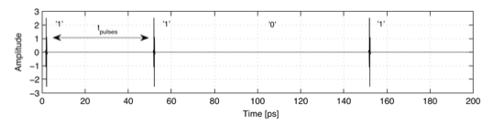
EM example - Perturbation
TS-OOK Modulation
List of parameters:
Power transmission, Number of subchannels, Bandwidth size, Central frequency, Pulse duration, Pulse interval
Giuseppe Piro, Ph.D.
Telematics Research Group (Politecnico di Bari) - giuseppe.piro@poliba.it telematics.poliba.it/piro

Slide 11
EM example - Motion
Propagation model of EM waves
List of parameters:
Path loss model as a function of the frequency and the distance (Akram’s team contribution)
Giuseppe Piro, Ph.D.
Telematics Research Group (Politecnico di Bari) - giuseppe.piro@poliba.it telematics.poliba.it/piro

Slide 12

EM example - Specificity
Ability for receiving the EM wave
The signal is received only if:
transmitter and received use the same channel configuration (bandwidth and central frequency)
the channel capacity (Shannon bound) is higher or equal to the transmission physical data rate
A and N represents the pathloss and the molecular noise, respectively (provided by Akram’s team)
Giuseppe Piro, Ph.D.
Telematics Research Group (Politecnico di Bari) - giuseppe.piro@poliba.it telematics.poliba.it/piro

Slide 13
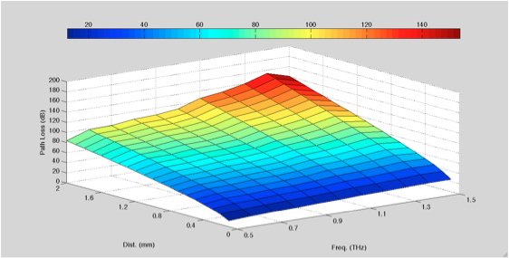
EM example - Path loss model
Provided by Akram’s team and integrated within the Motion compoment
Giuseppe Piro, Ph.D.
Telematics Research Group (Politecnico di Bari) - giuseppe.piro@poliba.it telematics.poliba.it/piro

Slide 14
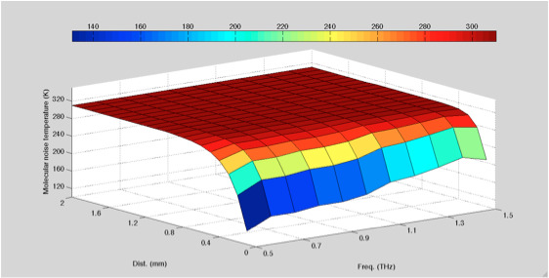
EM example - Molecular noise model
Provided by Akram’s team and integrated within the Specificity component
Giuseppe Piro, Ph.D.
Telematics Research Group (Politecnico di Bari) - giuseppe.piro@poliba.it telematics.poliba.it/piro

Slide 15
Run the EM example
Default settings:
distance among devices = 0.001 m
energy pulse = 500 pJ
pulse duration = 100 fs
pulse interval = 100 ps
subchannel size = 0.1 THz
bandwidth [0.45-1.55] THz
Line commands
cp ns-3-dev/p1906/example/em-example.cc scratch/
./waf --run scratch/em-example
Giuseppe Piro, Ph.D.
Telematics Research Group (Politecnico di Bari) - giuseppe.piro@poliba.it telematics.poliba.it/piro

Slide 16
Molecular example - Main description
Molecular based communication
Single transmitter / receiver pair
Diffusion-based propagation (Fick’s law)
Reference paper:
I Llatser, A Cabellos-Aparicio, M Pierobon, E Alarcón, “Detection Techniques for Diffusion-based Molecular Communication”, Selected Areas in Communications, IEEE Journal on 31 (12), 726-734
Giuseppe Piro, Ph.D.
Telematics Research Group (Politecnico di Bari) - giuseppe.piro@poliba.it telematics.poliba.it/piro

Slide 17

Molecular example - Fick’s law
If the transmitter releases Q molecules at the time instant t = 0, the molecula concentration at any point in space is given by (D is the diffusion coefficient, r is the distance)
Giuseppe Piro, Ph.D.
Telematics Research Group (Politecnico di Bari) - giuseppe.piro@poliba.it telematics.poliba.it/piro

Slide 18
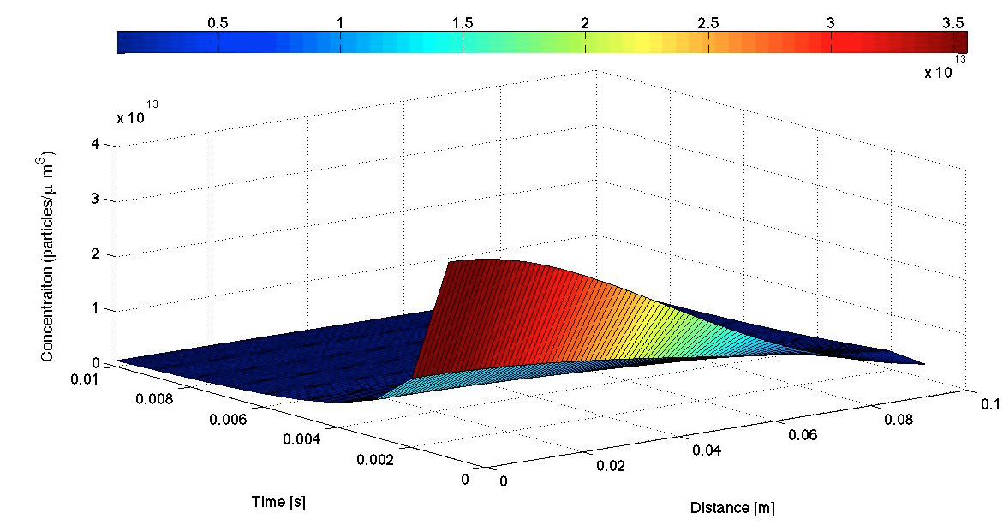
Molecular example - Fick’s law (2)
Giuseppe Piro, Ph.D.
Telematics Research Group (Politecnico di Bari) - giuseppe.piro@poliba.it telematics.poliba.it/piro

Slide 19


Molecular example - Fick’s law (3)
Assuming to have an Amplitude detection scheme, the propagation delay (t_{d}) and the minimum allowable pulse width (t_{w}) are:
Giuseppe Piro, Ph.D.
Telematics Research Group (Politecnico di Bari) - giuseppe.piro@poliba.it telematics.poliba.it/piro

Slide 20
Molecular example - Message Carrier
Molecules transmitted by the sender
List of parameters:
Number of molecules, Pulse interval, Starting time, Duration, Message to transmit (packet)
All the parameters are set by the perturbation component before the physical transmission
Giuseppe Piro, Ph.D.
Telematics Research Group (Politecnico di Bari) - giuseppe.piro@poliba.it telematics.poliba.it/piro

Slide 21
Molecular example - Field
Ability of molecules to be directed in particular direction
Assumption: omnidirectional transmission
Giuseppe Piro, Ph.D.
Telematics Research Group (Politecnico di Bari) - giuseppe.piro@poliba.it telematics.poliba.it/piro

Slide 22
Molecular example - Perturbation
OOK Modulation
List of parameters:
Number of molecules, Pulse interval
Giuseppe Piro, Ph.D.
Telematics Research Group (Politecnico di Bari) - giuseppe.piro@poliba.it telematics.poliba.it/piro

Slide 23
Molecular example - Motion
Propagation model of molecules
List of parameters:
Diffusion coefficient
Giuseppe Piro, Ph.D.
Telematics Research Group (Politecnico di Bari) - giuseppe.piro@poliba.it telematics.poliba.it/piro

Slide 24
Molecules example - Specificity
Ability of detecting molecules
The signal is received only if:
the channel capacity (Fick’s bound) is higher or equal to the transmission physical data rate
Giuseppe Piro, Ph.D.
Telematics Research Group (Politecnico di Bari) - giuseppe.piro@poliba.it telematics.poliba.it/piro

Slide 25
Run the Molecular example
Default settings:
distance among devices = 0.001 m
molecules per pulse = 50000
pulse interval = 1 ms
diffusion coefficient = 1 nm²/ns
Line commands
cp ns-3-dev/p1906/example/mol-example.cc scratch/
./waf --run scratch/mol-example
Giuseppe Piro, Ph.D.
Telematics Research Group (Politecnico di Bari) - giuseppe.piro@poliba.it telematics.poliba.it/piro

Slide 26
Customize simulation parameters
EM example:
./waf --run “scratch/em-example --nodeDistance=0.01 --energyPulse=500 --pulseDuration=100 --pulseInterval=100”
Molecular example:
./waf --run “scratch/mol-example --nodeDistance=0.01 --nbOfMoleculas=50000 --pulseInterval=100 --diffusionCoefficient=1”
Giuseppe Piro, Ph.D.
Telematics Research Group (Politecnico di Bari) - giuseppe.piro@poliba.it telematics.poliba.it/piro

Slide 27
EM vs Molecular communication
Goal: evaluate the channel capacity as a function of the distance
EM parameters:
energy per pulse = 500 pJ
pulse duration = 100 fs
pulse interval = 100 ps
node distance = [0 - 0.1] m
Molecular parameters:
molecules per pulse = 50000
diffusion coefficient = 1 nm²/ns
pulse interval = 100 ps
node distance = [0 - 0.1] m
Giuseppe Piro, Ph.D.
Telematics Research Group (Politecnico di Bari) - giuseppe.piro@poliba.it telematics.poliba.it/piro

Slide 28
EM vs Molecular communication (2)
run simulations
cp ns-3-dev/p1906/example/_RUN_EM_CHANNEL_CAPACITY_.sh .
cp ns-3-dev/p1906/example/_RUN_MOL_CHANNEL_CAPACITY_.sh .
sh _RUN_EM_CHANNEL_CAPACITY_.sh
sh _RUN_MOL_CHANNEL_CAPACITY_.sh
Giuseppe Piro, Ph.D.
Telematics Research Group (Politecnico di Bari) - giuseppe.piro@poliba.it telematics.poliba.it/piro

Slide 29
EM vs Molecular communication (3)
read outputs
RES_EM contains channel capacity computed for the EM example
RES_MOL contains channel capacity computed for the Molecular example
two columns
distance
channel capacity
create graphs
matlab, excel, and so on
a matlab script is available into the src/p1906/example folder
Giuseppe Piro, Ph.D.
Telematics Research Group (Politecnico di Bari) - giuseppe.piro@poliba.it telematics.poliba.it/piro

Slide 30
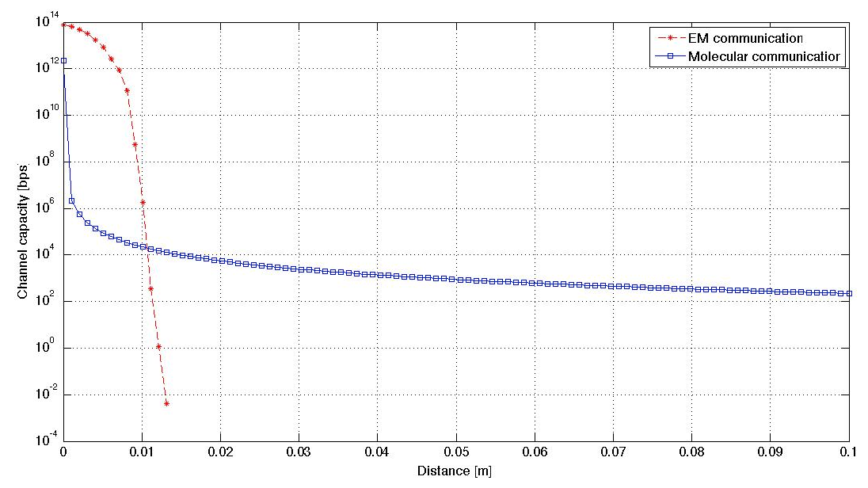
EM vs Molecular communication (4)
Giuseppe Piro, Ph.D.
Telematics Research Group (Politecnico di Bari) - giuseppe.piro@poliba.it telematics.poliba.it/piro

