Slide 1

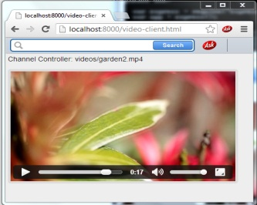
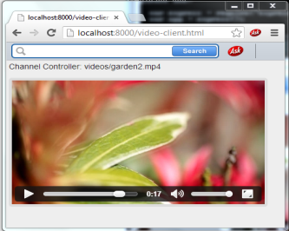
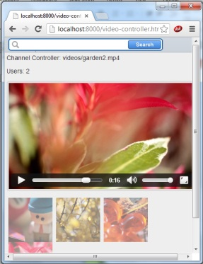

HTML Source Server
Keep hand stay on button
Swipe left
Open hand as a sign of pause
Send Hold gesture
Send swipeleft gesture
Send pause gesture
Send canPlay
Send userCount
Send isAllReady
Send userCount
Send isAllReady
Send Timestamp
Send pause
Send controlling
video name
Send Timestamp
Send pause
Send canPlay
Send controlling
video name
Websocket Server
Process Msg

