Slide 1
SFM Learner Practice
Hyunyoung Jung
gusdud1500@gmail.com
Computing and Memory Architecture Lab
Seoul National University

Slide 2
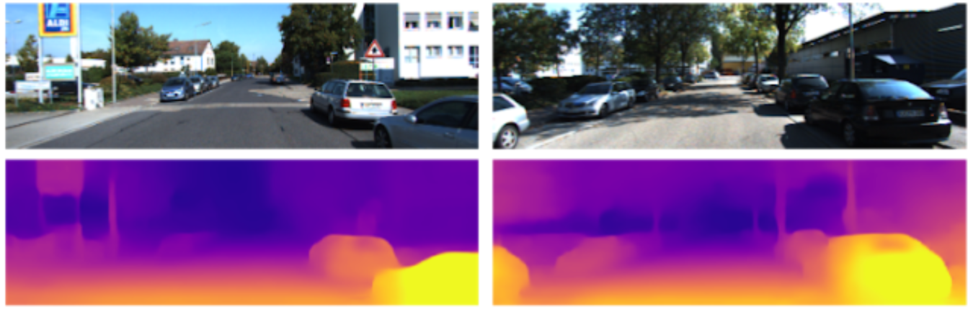
Monocular depth estimation

Slide 3
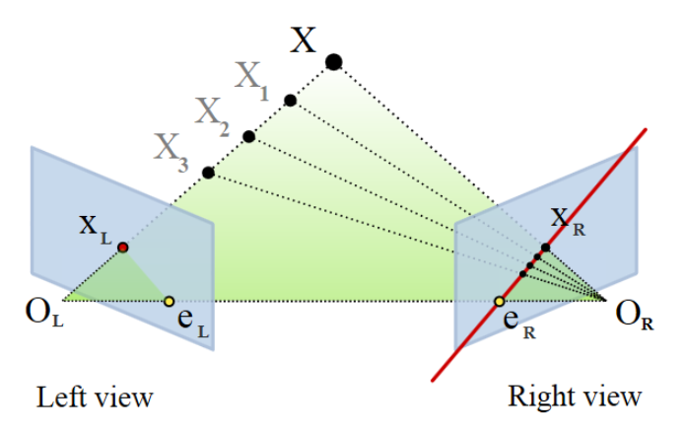
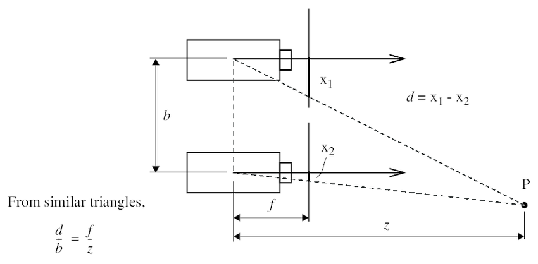
Basics
Disparity the difference in image location of the same 3D point when projected under perspective to two different cameras
Depth ∝ 1 / Disparity

Slide 4
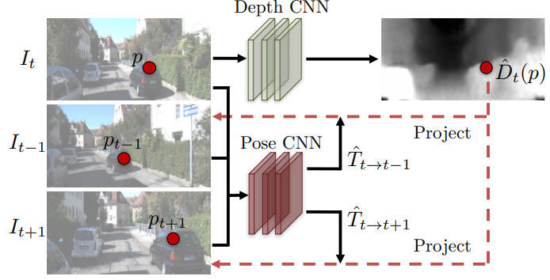
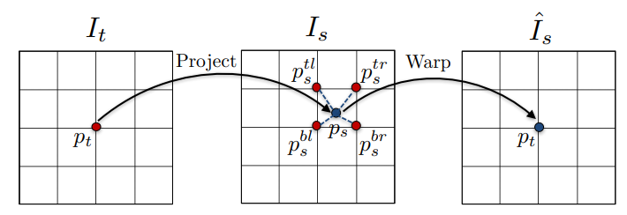

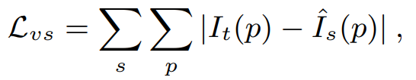
Unsupervised training using monocular images
T. Zhou, Unsupervised Learning of Depth and Ego-Motion from Video, 2017
Two consecutive frames

Slide 5
Goal
Jointly train Depth & Pose networks in an unsupervised way
Analyze and resolve the problems existing in current frameworks

Slide 6
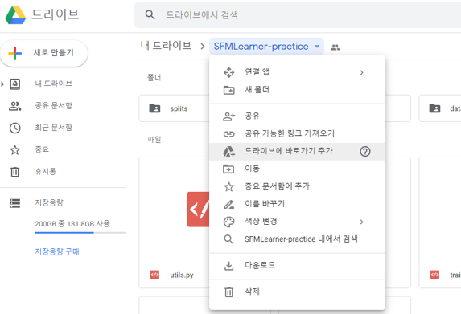
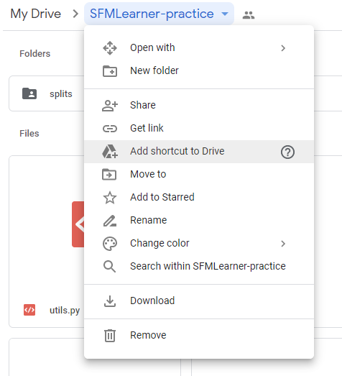
Practice
1. Save code&data to your own Google Drive
https://drive.google.com/drive/folders/1P5Vz3hIWUw3l0OapLlrfLx99E60lN7vJ?usp=sharing

Slide 7
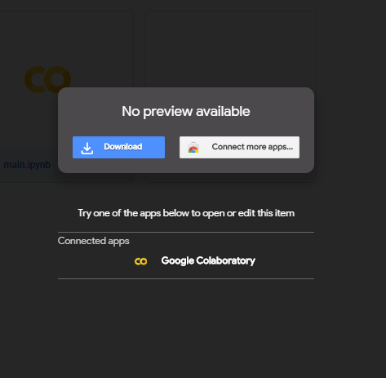
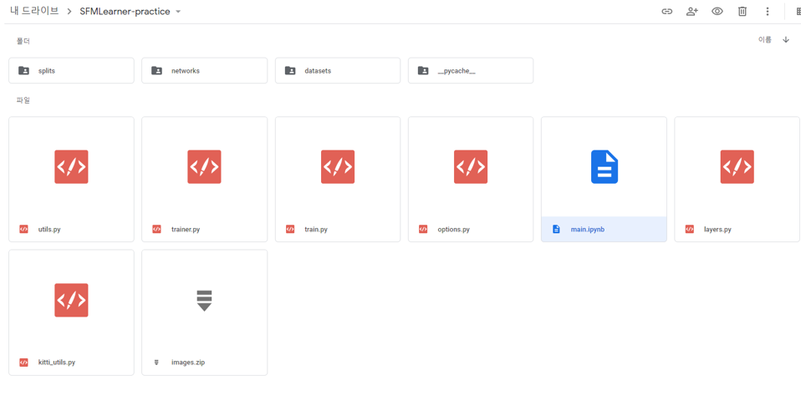
Practice
2. Open main.ipynb in Google Colaboratory

Slide 8
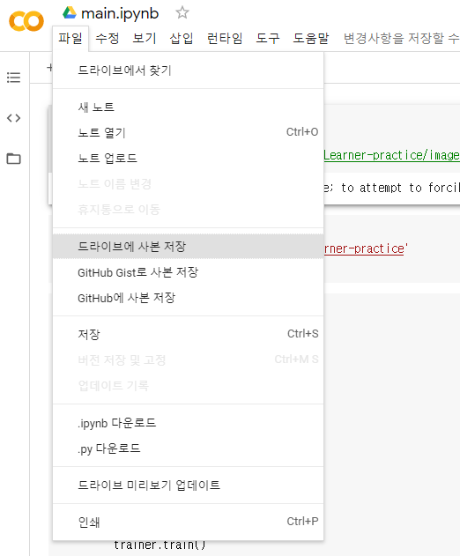
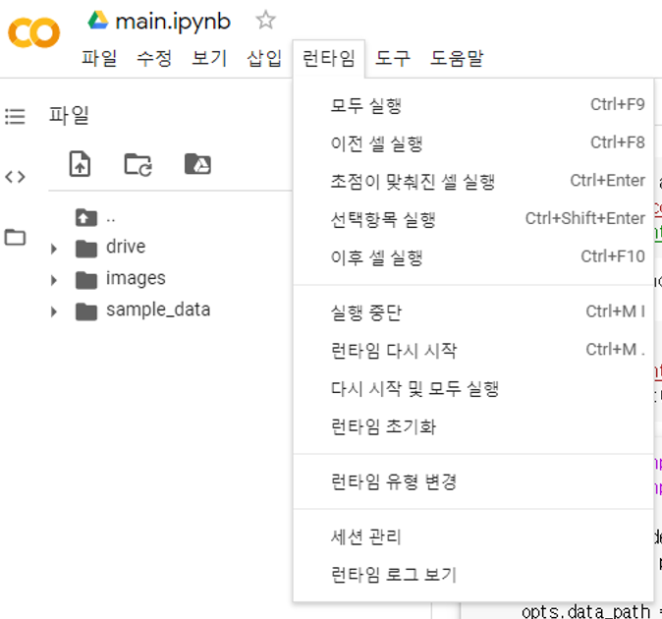
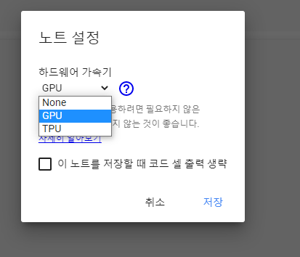
Practice
3. Save a copy to google drive, and change the runtime to enable GPU

Slide 9
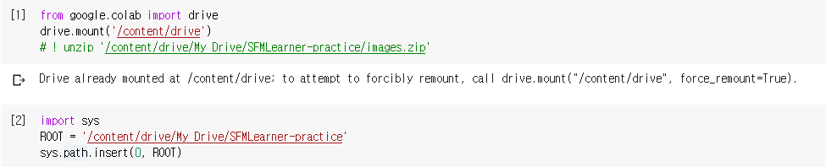
Practice
4. Mount google drive on your current session, configure your path

Slide 10
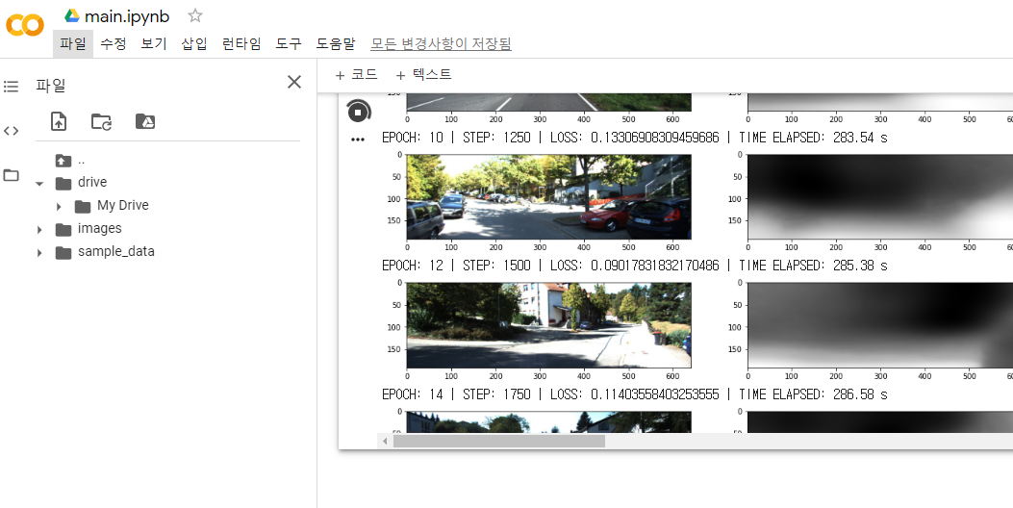
Practice
5. Check if it’s properly mounted
Properly mounted

Slide 11
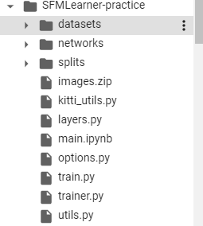
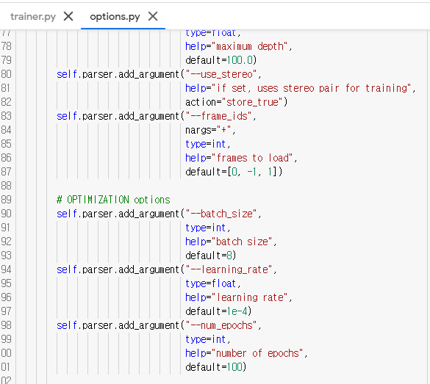
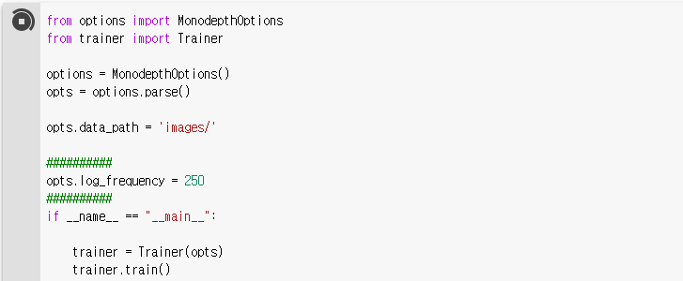
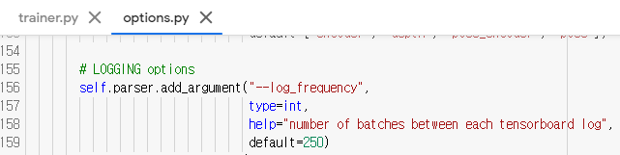
Practice
Start training
You can change training options

Slide 12
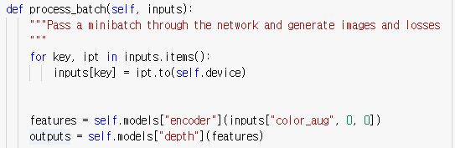
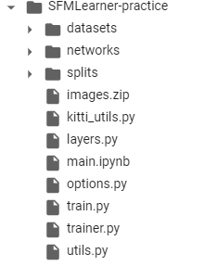
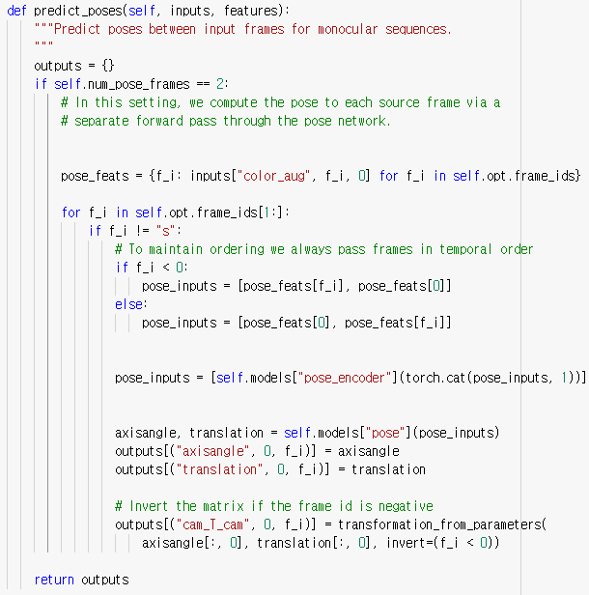
Practice
Predict depth
trainer.py contains main algorithm
Predict pose

Slide 13

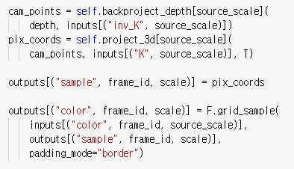
Practice

Slide 14
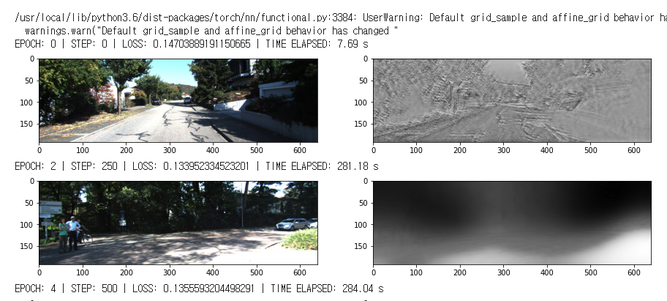
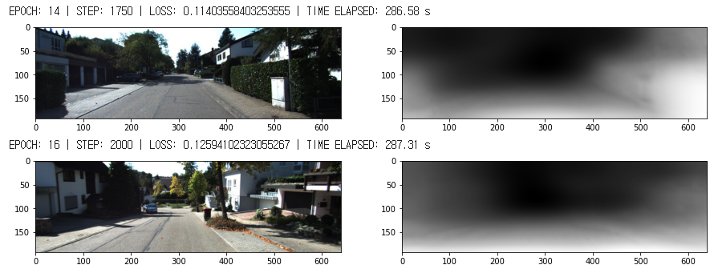
Practice

Slide 15
Homework
Due date: Oct. 12th 11:59 pm
Report file format: .pdf
File name: <YOUR_STUDENT_ID>_<YOUR_NAME>_Practice_2
ex) 2020-12345_XXX_Practice_2.pdf
No requirement on report template
If you have any question, please send an e-mail to gusdud1500@gmail.com

Slide 16
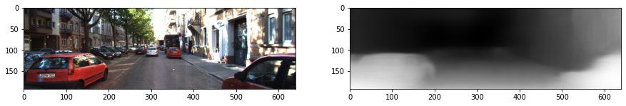
Homework
a. In the paper, there exist three assumptions to train the monocular depth estimation network (Section 3.3). Briefly explain these three cases. (3 pts)
b. Provide an example of one of these cases that the assumptions are violated. (1 pt)
e.g. )
case A

Slide 17
Homework
c. Provide the visual result after training the network for 6000 steps. (4 pts)
d. The function compute_losses in trainer.py is now computing the reprojection loss by averaging the ones from two reference frames. Change the code to select minimum value between the losses from two frames. (2 pts)
e. Explain the expected effects of choosing the minimum value between losses two reference frames. You can refer to another paper, section 3.2. (2 pts)

Slide 18
Term project examples
Build a SFM-learner enabled training at test time, given a long sequence of images. You should implement one or more methods presented in the paper list of the last slide.
Build a visual localization pipeline using NAVER LABS localization dataset

Slide 19
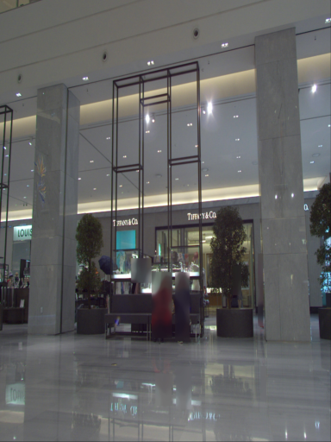
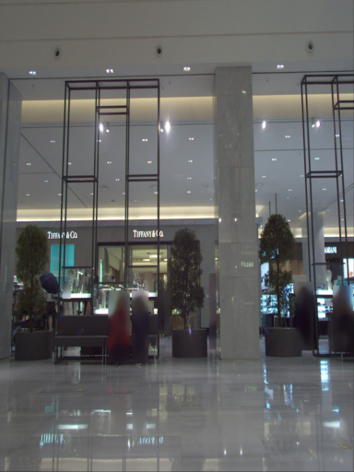
Term project examples
Visual localization pipeline
Image Retrieval
ㅇ
DB cluster
Database
Global
Descriptor
Query
Pose Estimation
Lidar Projection & 2D-3D matching
ㅇ
Feature Matching & Re-ranking
$$R, T$$
ㅇ
$$X$$
$$score_{i}$$
$$score_{j}$$
$$score_{k}$$
.
.
$$x$$

Slide 20
Challenge paper list
A. Tonioni. Real-time self-adaptive deep stereo. 2018
Update only partial layers of target network to reduce computation
Z. Zhang. Online adaptation through meta-learning for stereo depth estimation. 2019
mixed BN params with target domain to avoid domain shift issue
Pretrained target model by meta-learning to make adaptation fast
A. Tonioni. Learning to adapt for stereo. 2019
- Pretrained target model by MAML to make adaptation fast
Used additional confidence network to increase training stability
JW. Bian. Unsupervised scale-consistent depth and ego-motion learning from monocular video. 2019
- Proposed loss function to train monocular depth estimation in an unsupervised way

