Slide 1
Practice 1
- Course Information

Slide 2
Lecture Goal and Organization
Understanding hardware/software system design issues/methods with a real system design example
Tuesday lecture for N^{th} week
50min lecture + N-2th week practice quiz + explaining N-1th practice answer + N^{th} practice introduction (two video recordings, detailed instruction + intro lecture, are provided)
One practice class
TUE 18:30-20:20
Hardware practice room, 302-310-2
Zoom online meeting room during March
Real system design example
Image recognition application running on Zynq FPGA
Hardware/software co-design
Hardware: matrix-vector (MV) multiplication accelerator
Software: neural network code running on ARM communicating with hardware MV accelerator

Slide 3
Course Information
Course board
http://etl.snu.ac.kr
Practice materials will be uploaded on eTL
Please check the eTL board very often
Lab computer account
TBD
Contact
Email: ta.hsd@cmalab.snu.ac.kr -> If you mail here, it will be forwarded to TA
Namwoo Lee, namwoo.lee@cmalab.snu.ac.kr
Hanbyul Kim, hanbyul.kim@cmalab.snu.ac.kr

Slide 4
Course Information
Grading
Mid-term exam 20%
Final exam 20%
Lab 30%
Term project 20%
Attendance 10%

Slide 5
Course Information
Attendance
Will be checked on every lecture/practice class
You need to confirm your attendance by yourself
2 late arrivals → 1 absence
Practice
Max. 2 students/team
1 report/team (before on-site lab, 1 report/individual)
In case of absence without notice before the practice class
10% penalty out of final score
If you have important affairs on practice time,
→ You should contact TA or the professor BEFORE the class begins

Slide 6
Course Information
Assignment
Either in Korean of in English
# of pages does not matter
Due: 23:59 pm, next Monday
No Late submission
1 report/team (before on-site lab, 1 report/individual)
Example: On 3rd practice (3/31)
Your work has to be checked before next Tuesday
Due: 11:59 pm 4/6 Monday
No late submission

Slide 7
Course Information
Quiz
No quiz in this semester because of online lecture

Slide 8
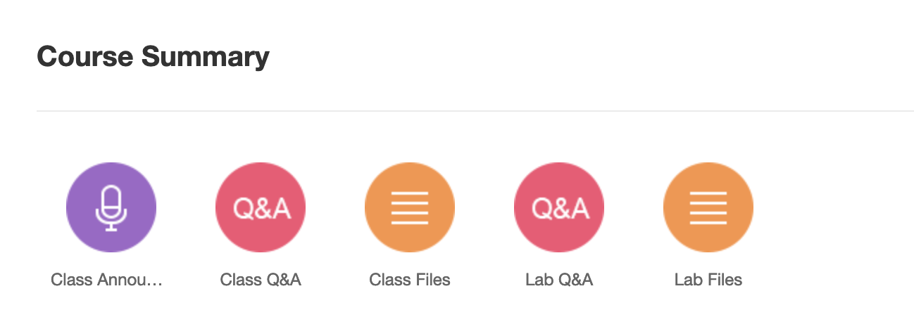
Course Information
Use eTL question board!
Do not send public questions via email
Upload it to eTL [Lab Q&A] board
Please specify the lab number first
Ex) [Lab 02] Your Question Title
If you have any question, please search Q&A board first
Can answer other students’ question if you know about the issue
If the problem is private (core part of your practice, have to open your source code a lot…), use online 1:1 lab session or send email to TA
TA will answer your questions in Tuesday, Thursday, and Friday
At the end of the semester, TA will give extra points (maybe 2.5% of total score) to 5 students who answer well in Q&A board
Criteria: total answers – low quality answers

Slide 9
Question

