Slide 1
Illumination and Shading
Jehee Lee
Seoul National University

Slide 2
Photorealism in Computer Graphics
Photorealism in computer graphics involves
  Accurate representations of surface properties, and
  Good physical descriptions of the lighting effects
Modeling the lighting effects that we see on an object is a complex process, involving principles of both physics and psychology
Physical illumination models involve
  Material properties, object position relative to light sources and other objects, the features of the light sources, and so on

Slide 3
Illumination and Rendering
An illumination model in computer graphics
  also called a lighting model or a shading model
  used to calculate the color of an illuminated position on the surface of an object
  Approximations of the physical laws
A surface-rendering method determine the pixel colors for all projected positions in a scene

Slide 4
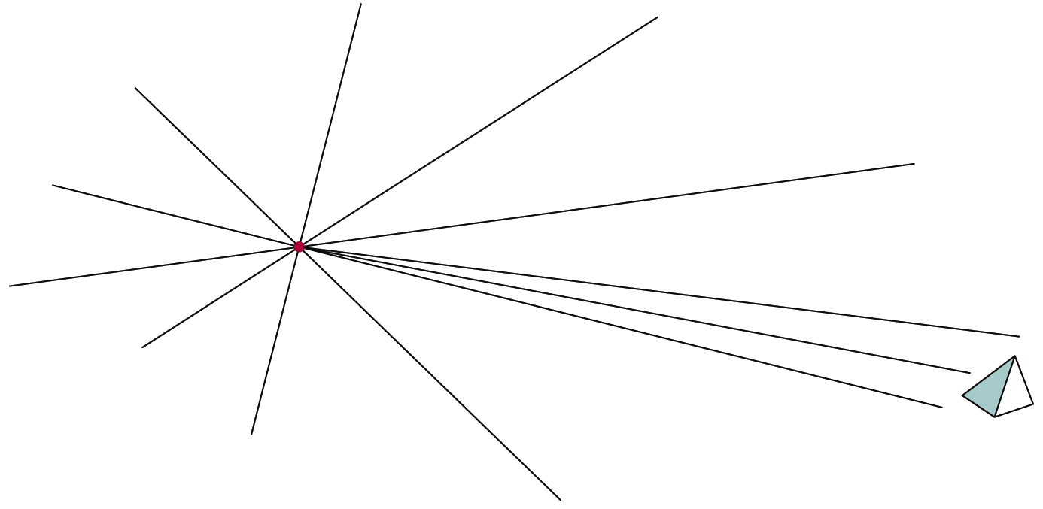
Light Sources
Point light sources
  Emitting radiant energy at a single point
  Specified with its position and the color of the emitted light
Infinitely distant light sources
  A large light source, such as sun, that is very far from a scene
  Little variation in its directional effects
  Specified with its color value and a fixed direction for the light rays

Slide 5
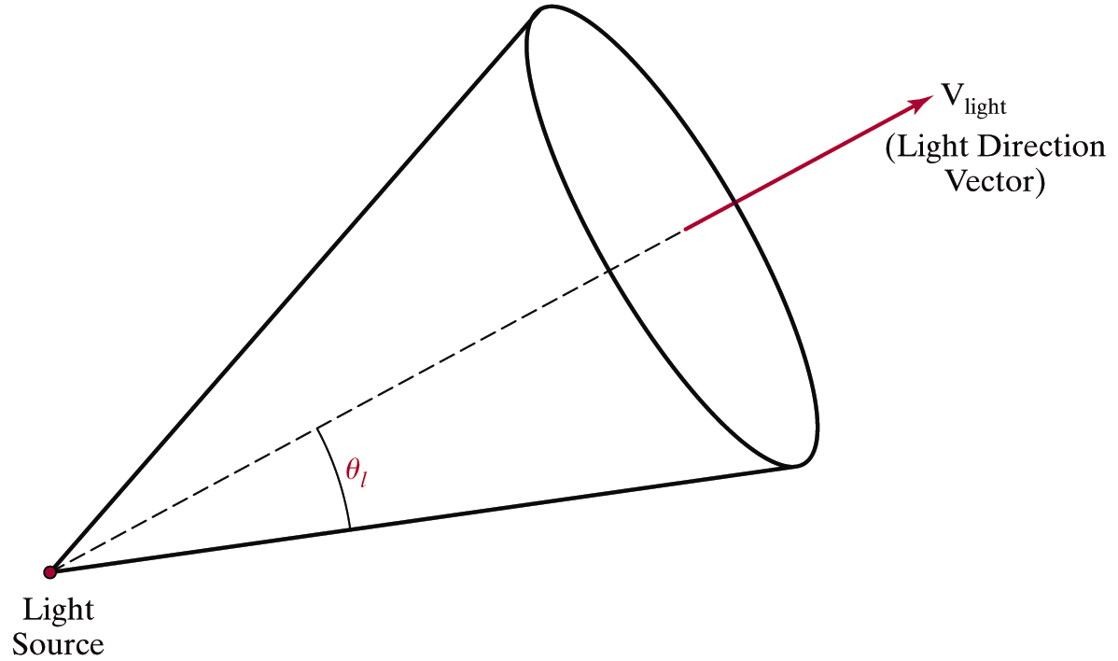
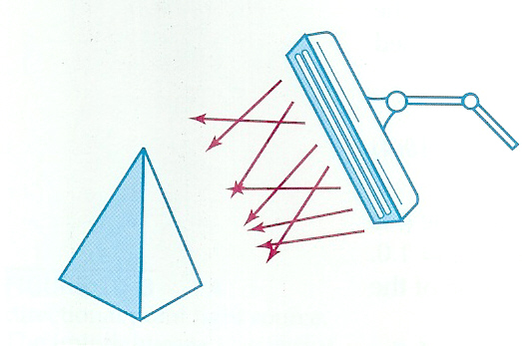
Light Sources
Directional light sources
  Produces a directional beam of light
  Spotlight effects
Area light sources

Slide 6

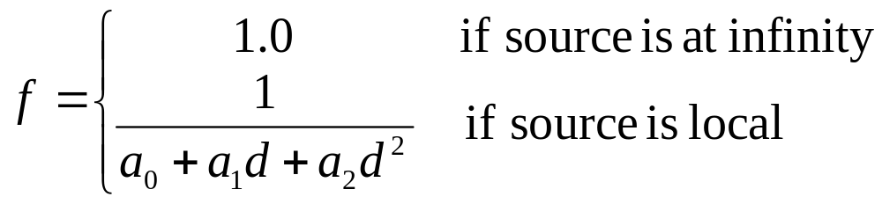
Light Sources
Radial intensity attenuation
  As radiant energy travels, its amplitude is attenuated by the factor
  Sometimes, more realistic attenuation effects can be obtained with an inverse quadratic function of distance
  The intensity attenuation is not applied to light sources at infinity because all points in the scene are at a nearly equal distance from a far-off source

Slide 7
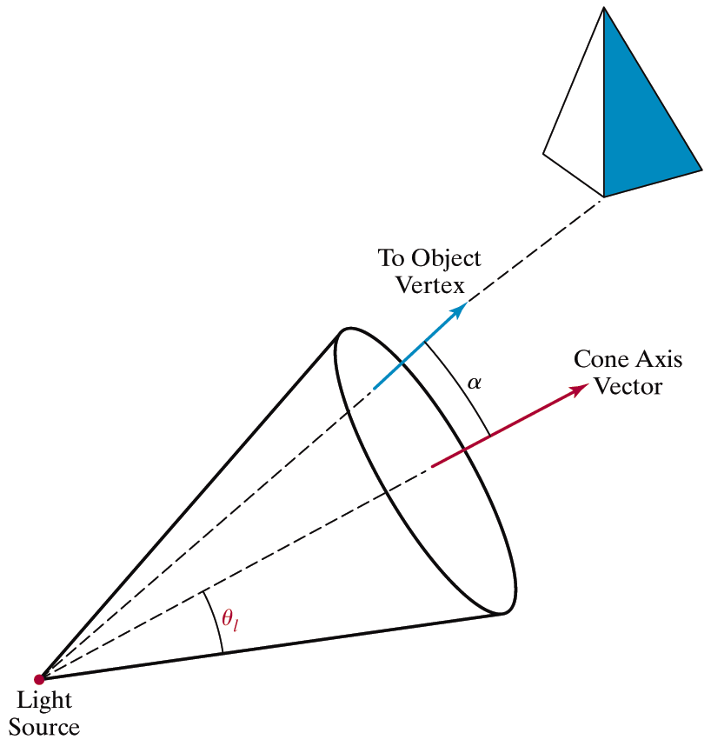
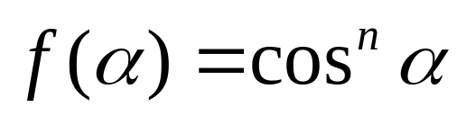
Light Sources
Angular intensity attenuation
  For a directional light, we can attenuate the light intensity angularly as well as radially

Slide 8
Surface Lighting Effects
An illumination model computes the lighting effects for a surface using the various optical properties
  Degree of transparency, color reflectance, surface texture
The reflection (phong illumination) model describes the way incident light reflects from an opaque surface
  Diffuse, ambient, specular reflections
  Simple approximation of actual physical models

Slide 9
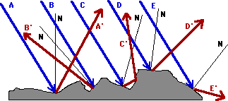
Diffuse Reflection
Incident light is scattered with equal intensity in all directions
Such surfaces are called ideal diffuse reflectors (also referred to as Lambertian reflectors)

Slide 10
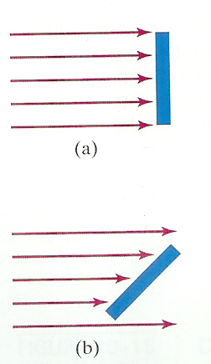
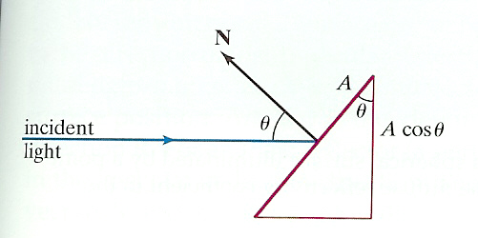
Diffuse Reflection
Light intensity is independent of angle of reflection
Light intensity depends on angle of incidence

Slide 11
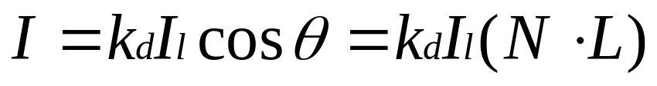
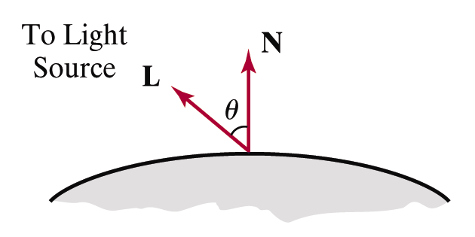




Diffuse Reflection
: the intensity of the light source
: diffuse reflection coefficient,
: the surface normal (unit vector)
: the direction of light source, (unit vector)

Slide 12



Ambient Light
Multiple reflection of nearby (light-reflecting) objects yields a uniform illumination
A form of diffuse reflection independent of he viewing direction and the spatial orientation of a surface
Ambient illumination is constant for an object
    : the incident ambient intensity
    : ambient reflection coefficient, the proportion reflected away from the surface

Slide 13
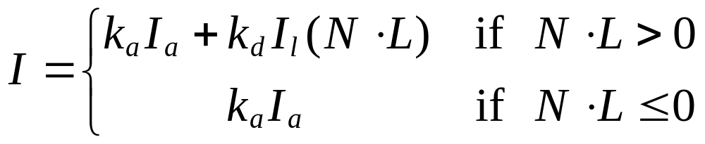
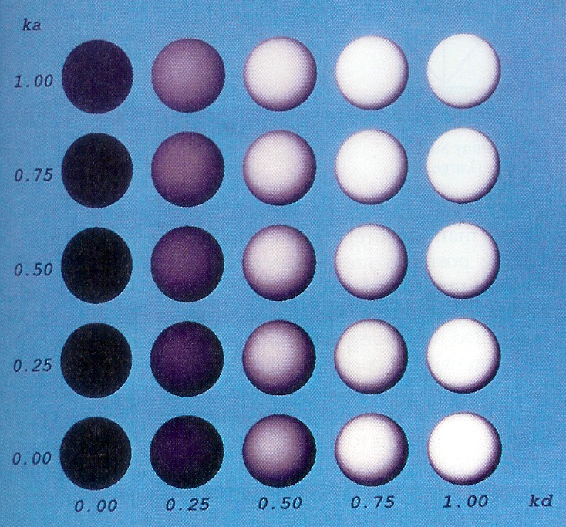
Ambient + Diffuse

Slide 14
Specular Reflection
Perfect reflector (mirror) reflects all lights to the direction where angle of reflection is identical to the angle of incidence
It accounts for the highlight
Near total reflector reflects most of light over a range of positions close to the direction

Slide 15
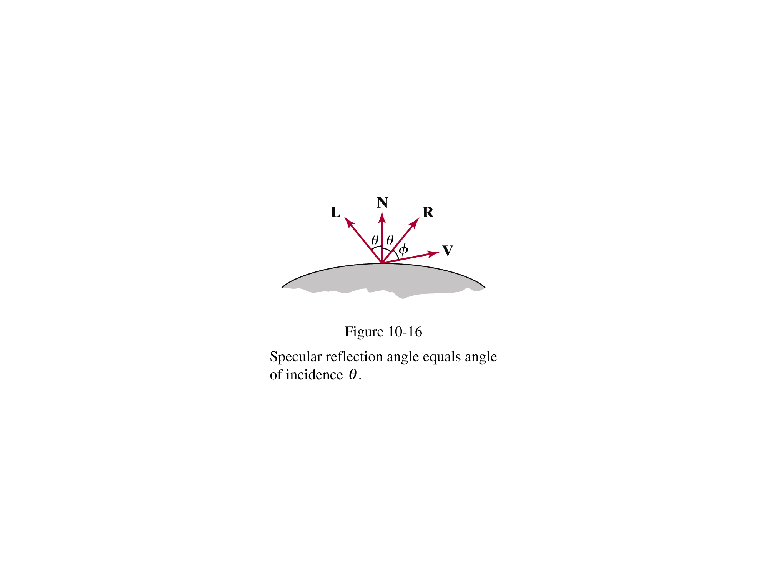
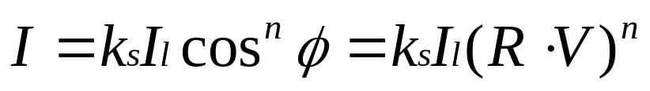


Specular Reflection
Phong specular-reflection model
  Note that N, L, and R are coplanar, but V may not be coplanar to the others
: intensity of the incident light
: color-independent specular coefficient
: the gloss of the surface

Slide 16
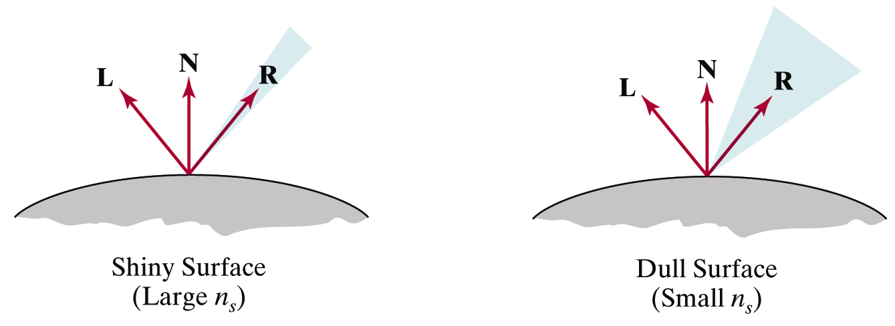
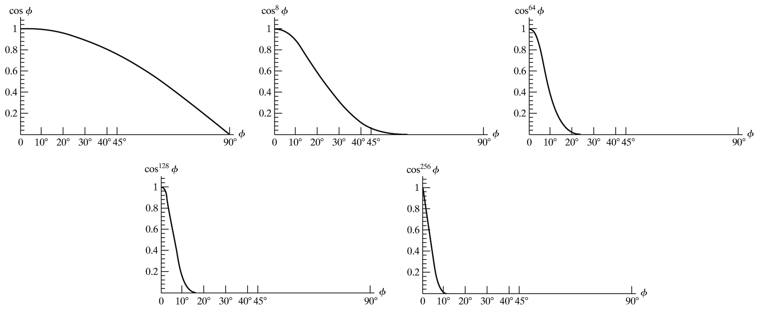
Specular Reflection
Glossiness of surfaces

Slide 17
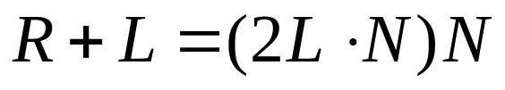
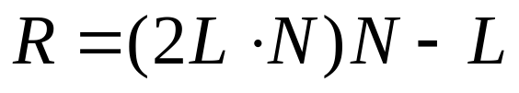
Specular Reflection
Specular-reflection coefficient ks is a material property
  For some material, ks varies depending on θ
  ks =1 if θ =90°
Calcularing the reflection vector R

Slide 18
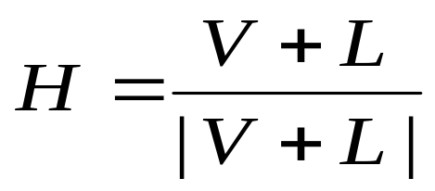
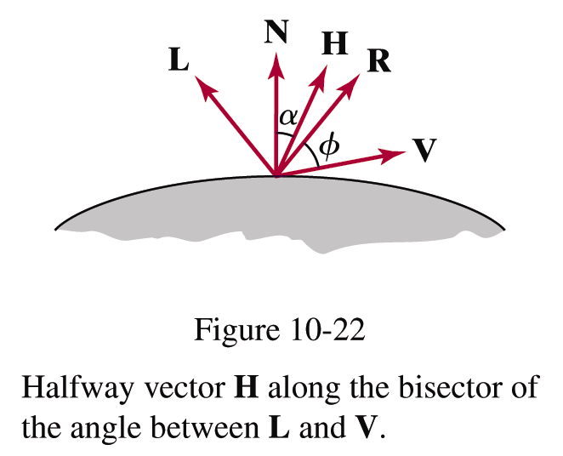
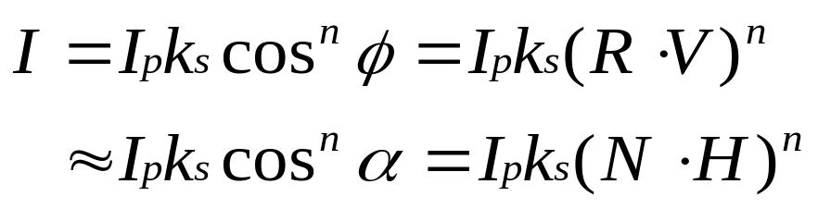
Specular Reflection
Simplified Phong model using halfway vector
  H is constant if both viewer and the light source are sufficiently far from the surface

Slide 19
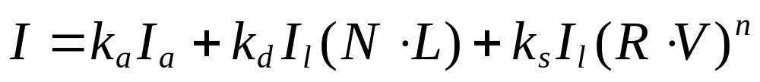
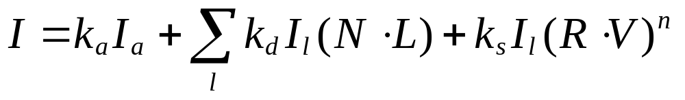
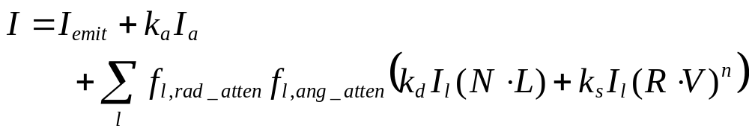
Ambient+Diffuse+Specular Reflections
Single light source
Multiple light source
Emission and attenuation

Slide 20
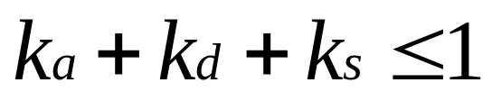
Parameter Choosing Tips
For a RGB color description, each intensity and reflectance specification is a three-element vector
The sum of reflectance coefficients is usually smaller than one
Try n in the range [0, 100]
Use a small ka (~0.1)
Example
  Metal: n=90, ka=0.1, kd=0.2, ks=0.5

Slide 21
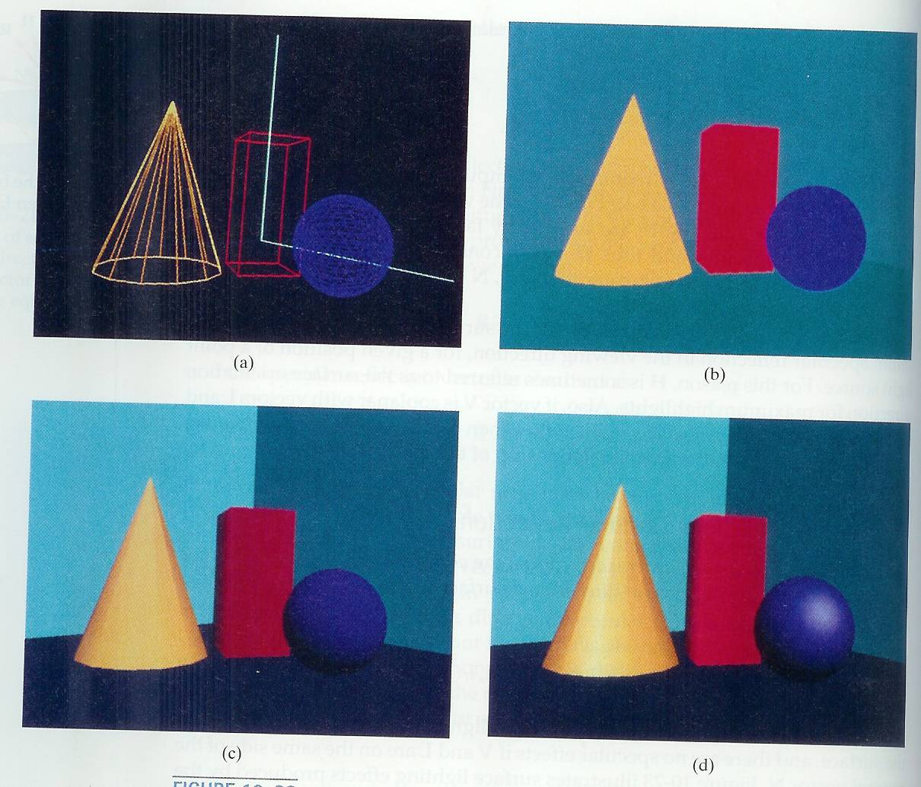

Slide 22
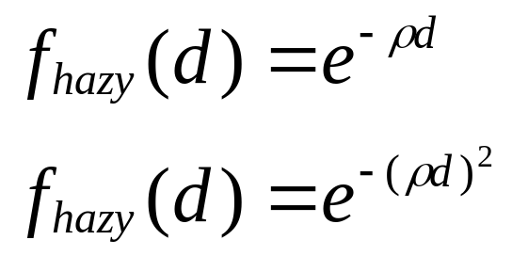
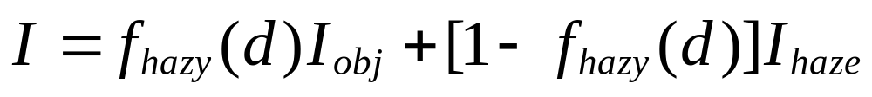
Atmospheric Effects
A hazy atmosphere makes colors fade and objects appear dimmer
Hazy-atmosphere effect is often simulated with an exponential attenuation function such as
Higher values for ρ produce a denser atmosphere

Slide 23
Polygon Rendering Methods
We could use an illumination model to determine the surface intensity at every projected pixel position
Or, we could apply the illumination model to a few selected points and approximate the intensity at the other surface positions
Curved surfaces are often approximated by polygonal surfaces
So, polygonal (piecewise planar) surfaces often need to be rendered as if they are smooth

Slide 24
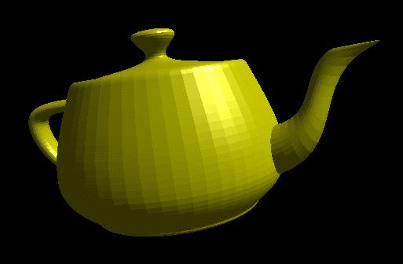

Constant-Intensity Surface Rendering
Constant (flat) shading
  Each polygon is one face of a polyhedron and is not a section of a curved-surface approximation mesh

Slide 25
Intensity-Interpolation Surface Rendering
Gouraud shading
  Rendering a curved surface that is approximated with a polygon mesh
  Interpolate intensities at polygon vertices
Procedure
Determine the average unit normal vector at each vertex
Apply an illumination model at each polygon vertex to obtain the light intensity at that position
Linearly interpolate the vertex intensities over the projected area of the polygon

Slide 26
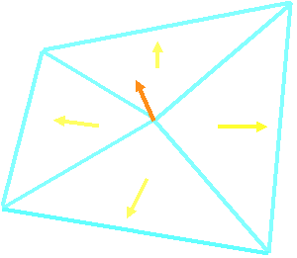





Intensity-Interpolation Surface Rendering
Normal vectors at vertices
  Averaging the normal vectors for each polygon sharing that vertex
(
N
+
N
+
N
+
N
)
N
=
1
2
3
4
v
N
+
N
+
N
+
N
1
2
3
4

Slide 27
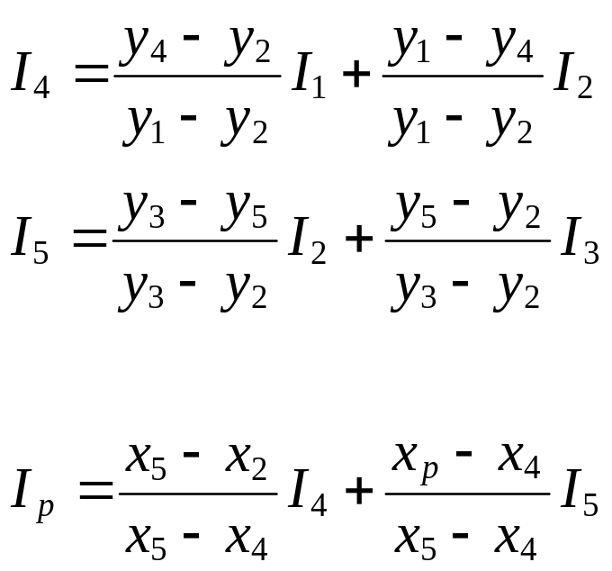
Intensity-Interpolation Surface Rendering
Intensity interpolation along scan lines
  I4 and I5 are interpolated along y-axis, and then
  Ip is interpolated along x-axis
Incremental calculation is also possible
y
3
1
p
scan line
4
5
2
x

Slide 28
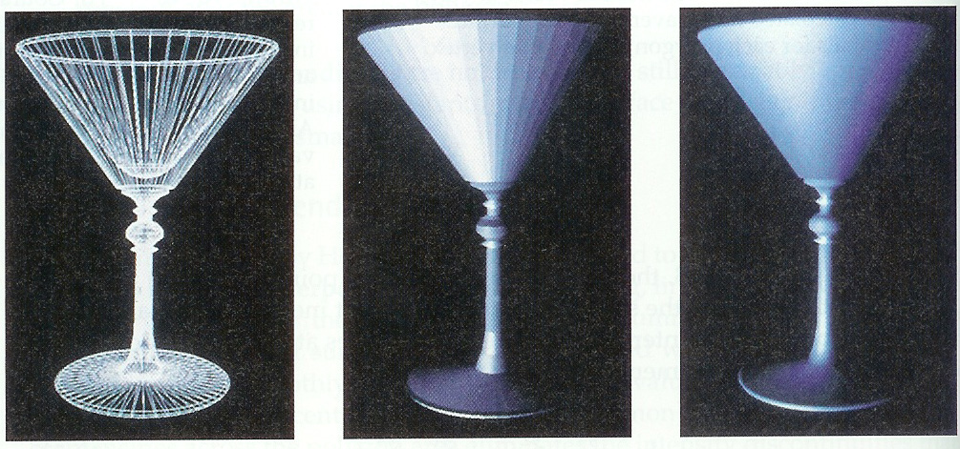
Intensity-Interpolation Surface Rendering

Slide 29

Gouraud Shading Problems
Lighting in the polygon interior is inaccurate
Mach band effect
  Optical illusion

Slide 30
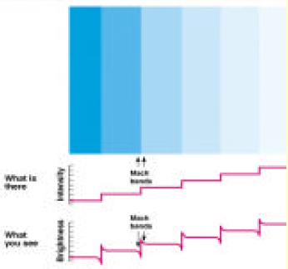
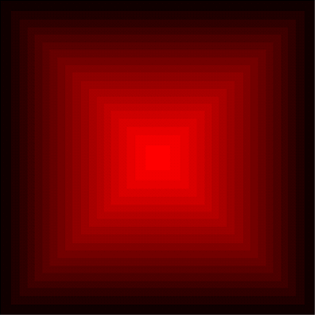
Mach Band Effect
These “Mach Bands” are not physically there. Instead, they are illusions due to excitation and inhibition in our neural processing
The bright bands at 45 degrees (and 135 degrees) are illusory.
The intensity of each square is the same.

Slide 31
Normal-Vector Interpolation
Surface Rendering
Phong shading
  Interpolate normal vectors at polygon vertices
Procedure
Determine the average unit normal vector at each vertex
Linearly interpolate the vertex normals over the projected area of the polygon
Apply an illumination model at positions along scan lines to calculate pixel intensities
n1
n2
n3

Slide 32
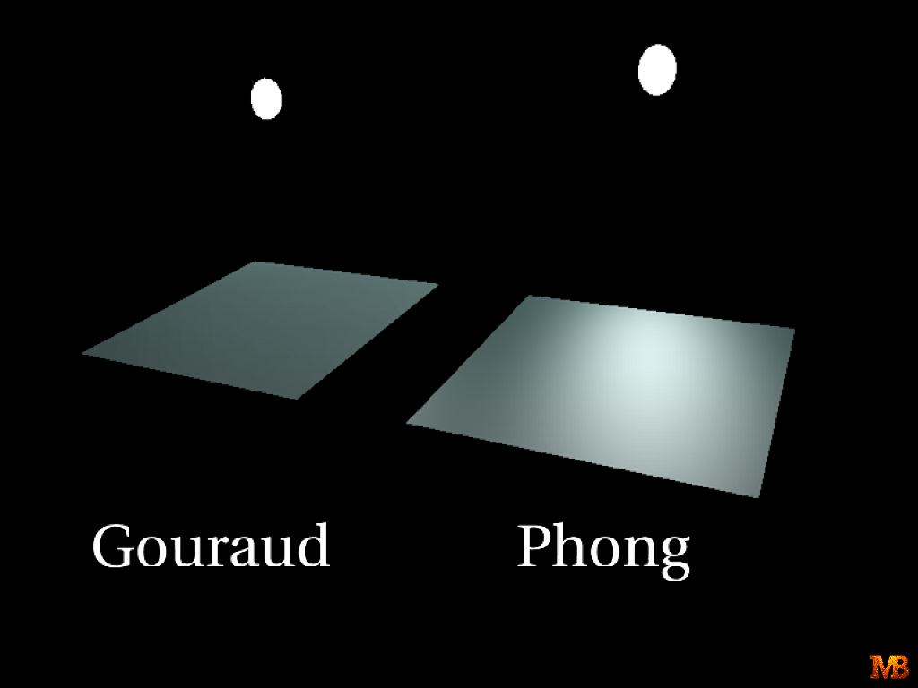
Gouraud versus Phong Shading
Gouraud shading is faster than Phong shading
  OpenGL supports Gouraud shading
Phong shading is more accurate

Slide 33



Problems with Interpolated Shading
Polygon silhouette
Perspective distortion
Orientation dependence
Shared edges

