Slide 1
React 화면
2팀 MotiveOn

Slide 2
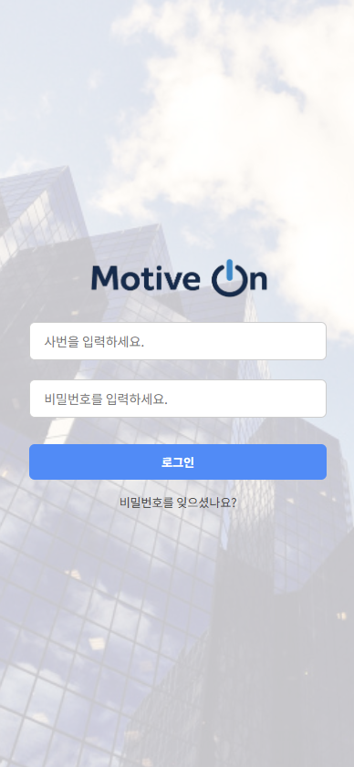
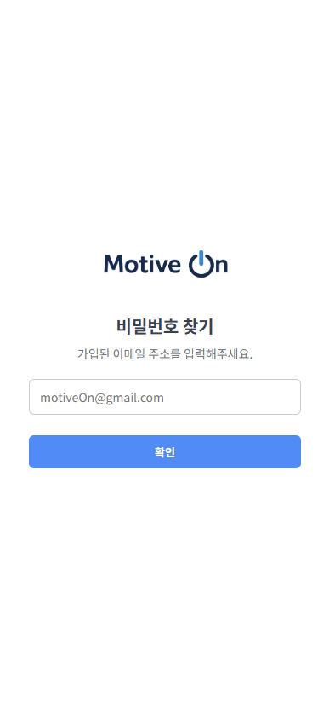
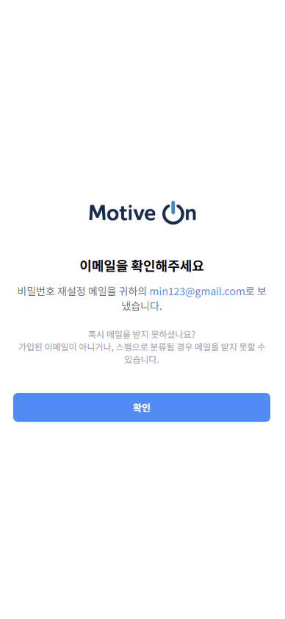
로그인
./components/Login/LoginForm
./components/Login/PasswordComfirm
./components/Login/PasswordFind

Slide 3
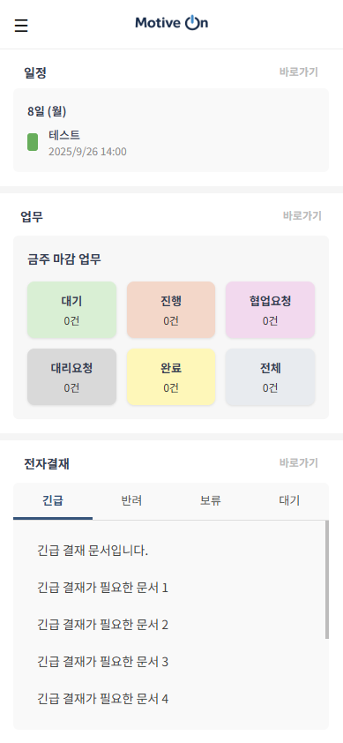
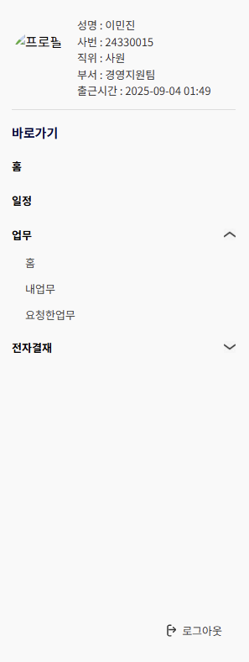

홈 대시보드
./components/Home/HomePage
./components/common/Layout

Slide 4
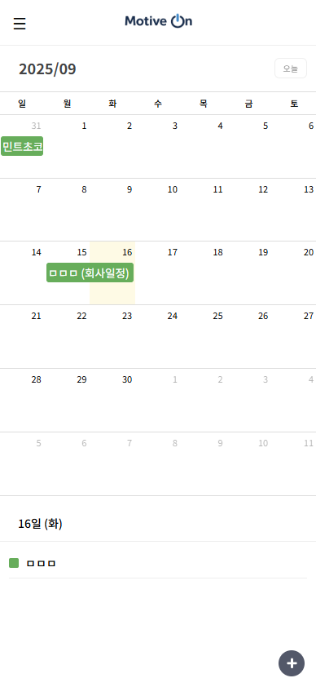
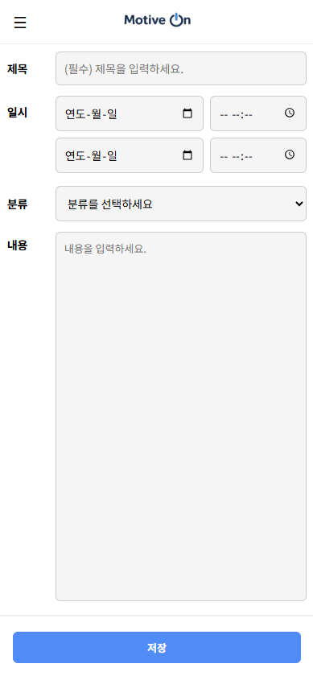
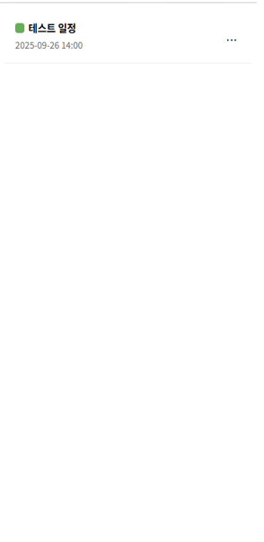
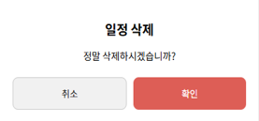
일정
./components/Calendar/CalendarPage
./components/Calendar/CalendarRegist
./components/Calendar/CalendarDetail
./components/Calendar/CalendarDelete

Slide 5
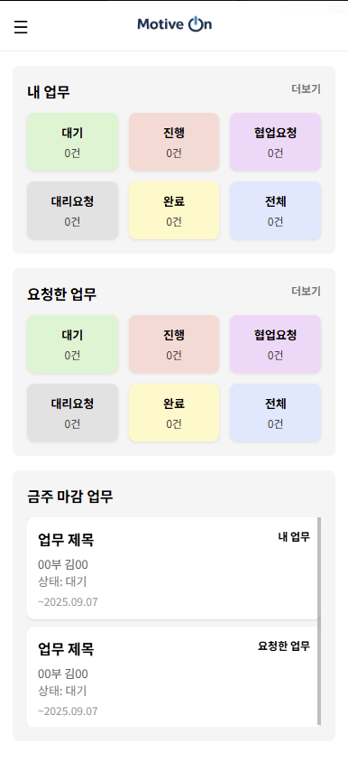
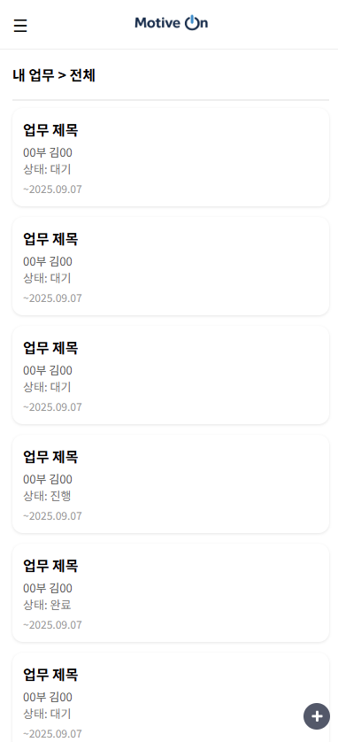
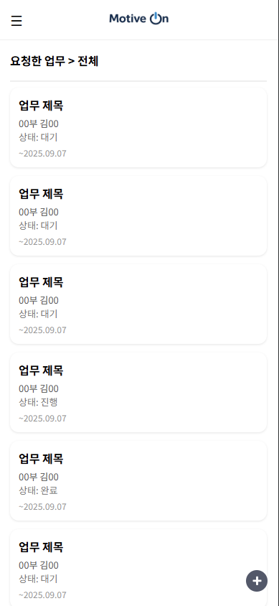
업무
./components/Work/WorkPage
./components/Work/MyWorkPage
./components/Work/RequestedWorkPage

Slide 6
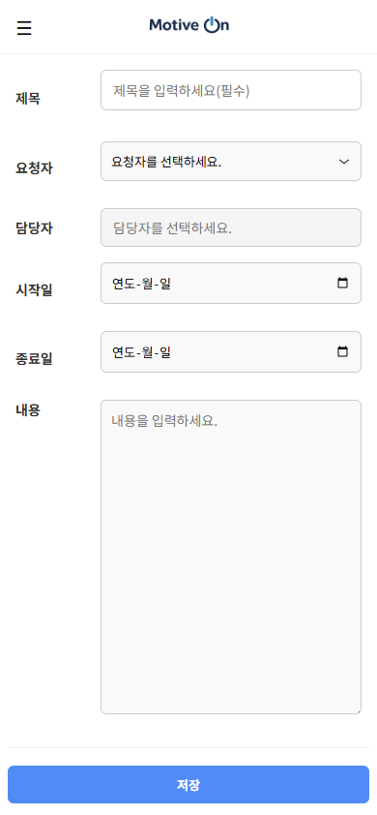
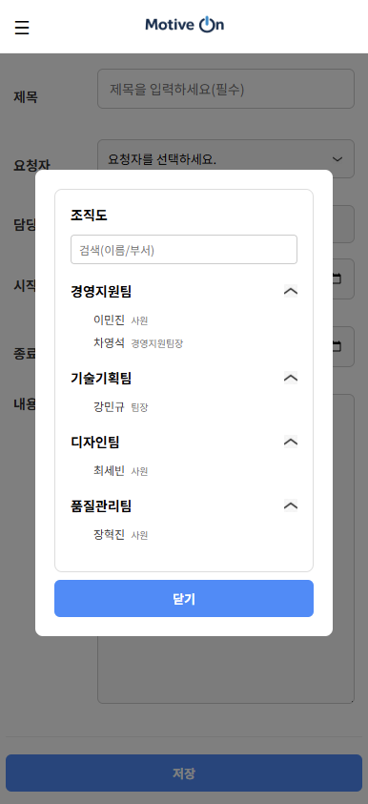
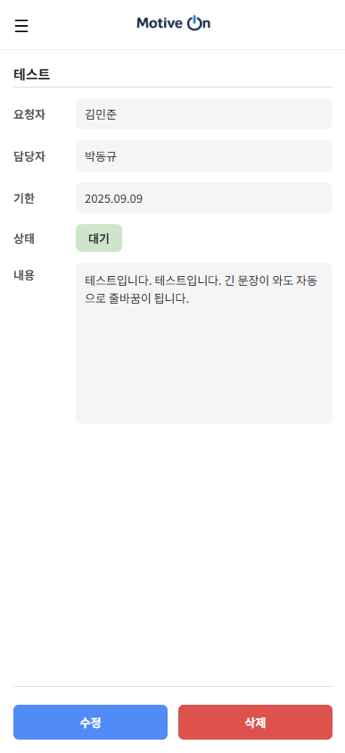
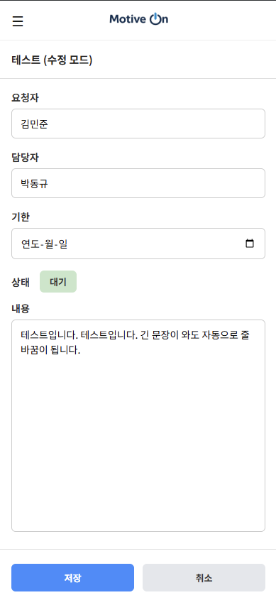
업무
./components/Work/WorkRegist
./components/Work/WorkRegist
./components/Work/WorkDetailEdit
./components/Work/WorkDetail

Slide 7
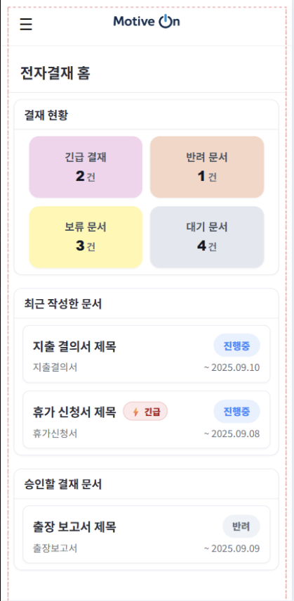
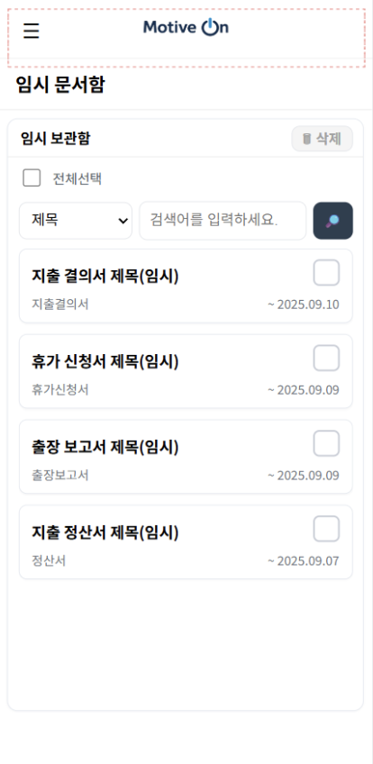
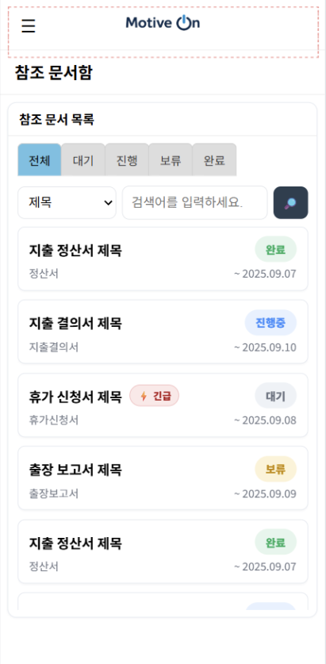
전자결재
./components/Approval/ApprovalPage
./components/Approval/TempApprovalPage
./components/Approval/RefenceApprovalPage

Slide 8
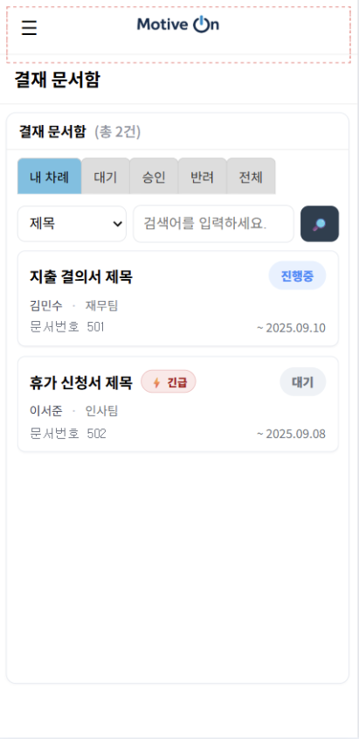
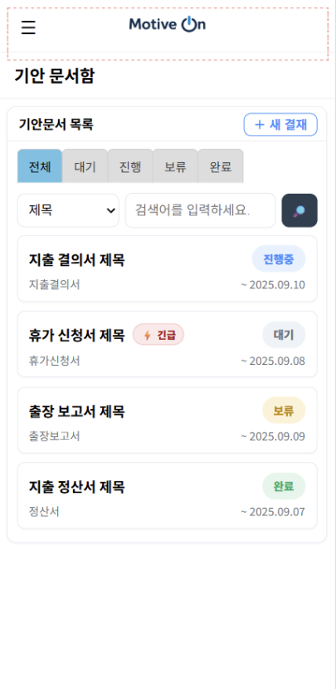
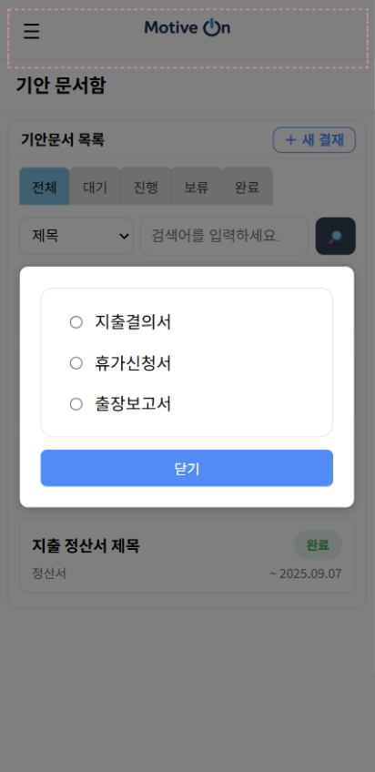
전자결재
./components/Approval/CompleteApprovalPage
./components/Approval/DraftApprovalPage

