Slide 1
Flight
Satisfaction
Jakub Gazda
Aleksander Wieliński
419 272 420 272

Slide 2
Starting Point: What to Expect
Intro
Value
Data
To explore relation between passengers characteristic and flight satisfaction one has to have an insightful, thorough and interactive visualizations…
Take- away
Demo

Slide 3






Unlocking Business Value
To define strategic value one has to consider benefits that initiative brings to the business. Understanding passengers satisfaction provides deep insight to several key areas we want outline…
Intro
Value
Data
Take- away
Demo

Slide 4
Understanding the Data
Different Airlines reflecting whole market
130k individuals surveyed
23 variables total…
… with 14 areas of satisfaction
To unravel the intricacies of the issue one has to have an interesting dataset. A helping hand can be provided through a treasure trove of insight - Kaggle - and more specifically Airlines Customer satisfaction…
Intro
Value
Data
Take- away
Demo

Slide 5
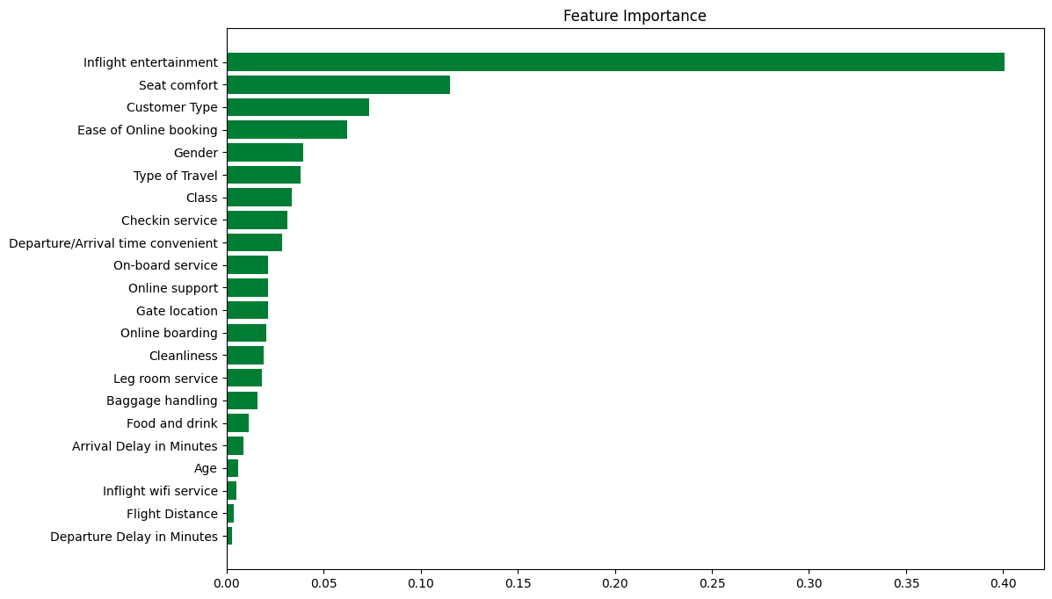
Modeling the Data
Confusion Matrix of XGBoost on test sample (20% of total)
TN 11256
FP 456
Intro
FN 662
TP 13151
Value
Data
Accuracy of 96%!
Take- away
Demo

Slide 6
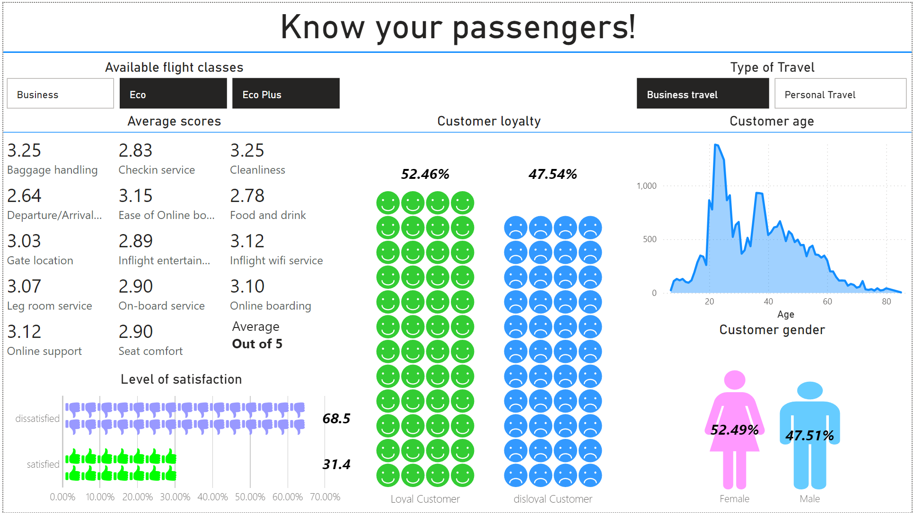
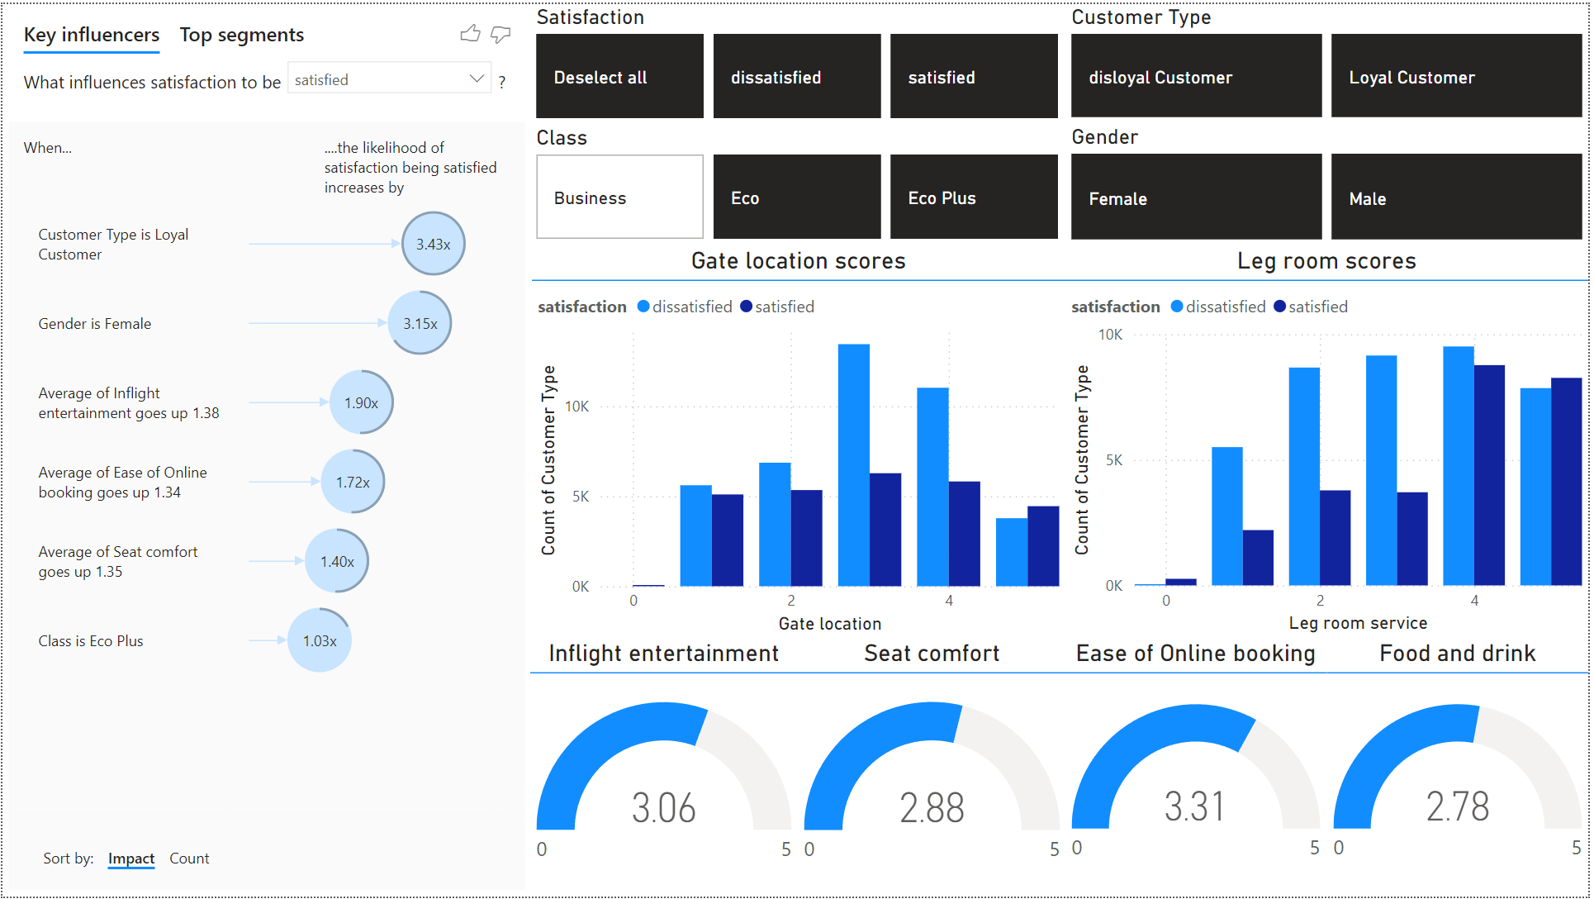
Intro
Value
Data
Take- away
Demo

Slide 7
DEMO
And it’s finally time for…

