Slide 1
Analysis Report on Kagglers’ Job Satisfaction Level and Building a Machine Learning Model SABANCI UNIVERSITY Course-DA514 Group 7 Gizem Güneş, Esra Akarçay, Ayda Gizem Kumkumoğlu

Slide 2
CONTENTS
01 Statistics About Kagglers
02 Model Building

Slide 3
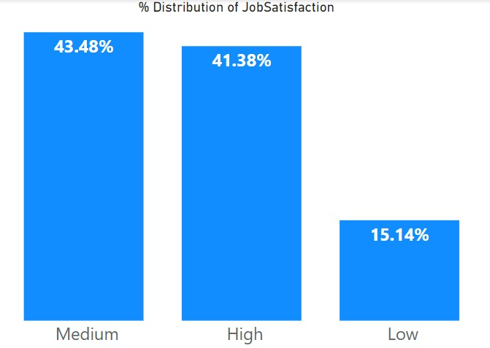
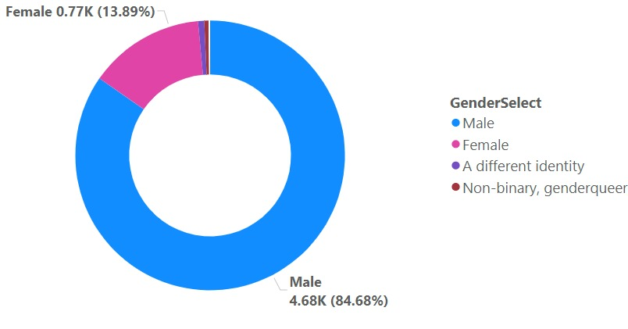
Statistics About Kagglers
Project data set is an imbalanced data set consist of 43.48% Medium, 41.38% High and 15.14% Low labels
Exploratory data analysis findings show that 85% of Kagglers are male and 14% are female. Female Kagglers have low job satisfaction with 16% which is 2 point greater than Male Kagglers’ low job satisfaction ratio

Slide 4
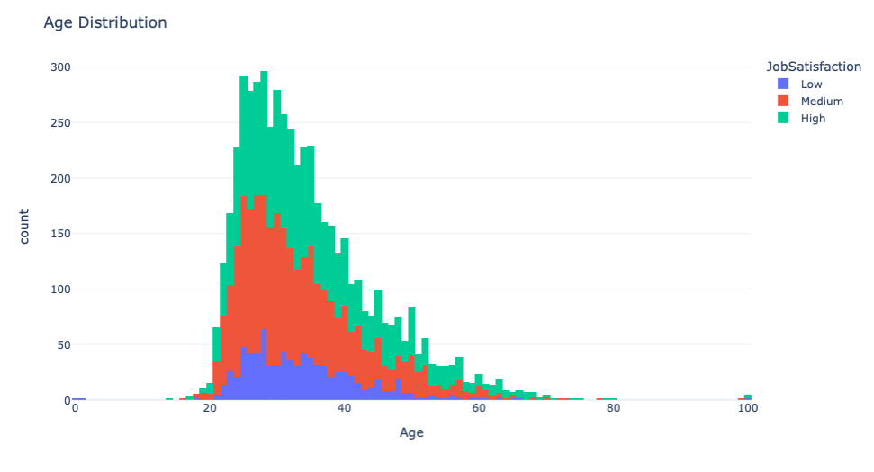
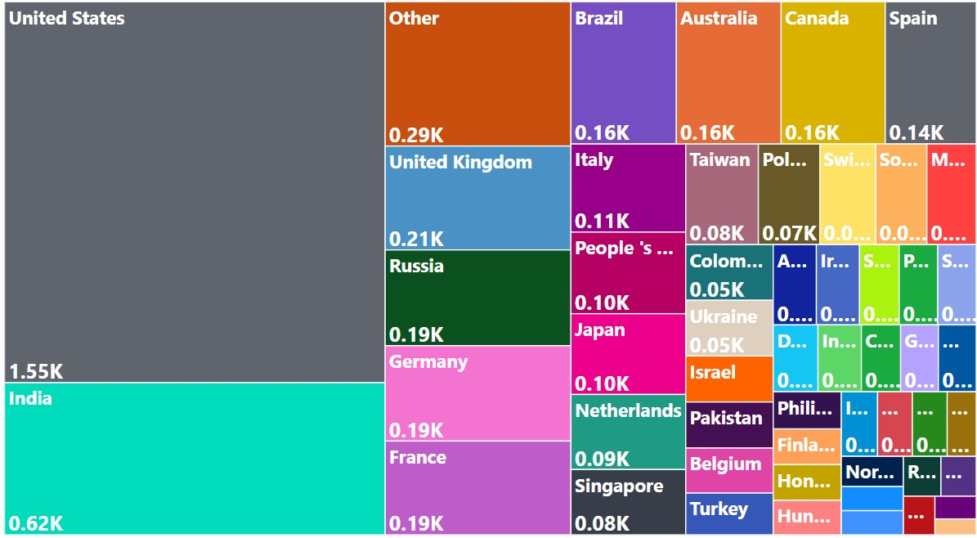
Statistics About Kagglers
Kagglers’ age has a skewed distribution with the mean age of 35
approximately
Kagglers are mostly located in the USA, Asia and West Europe while the rest is located in other regions

Slide 5
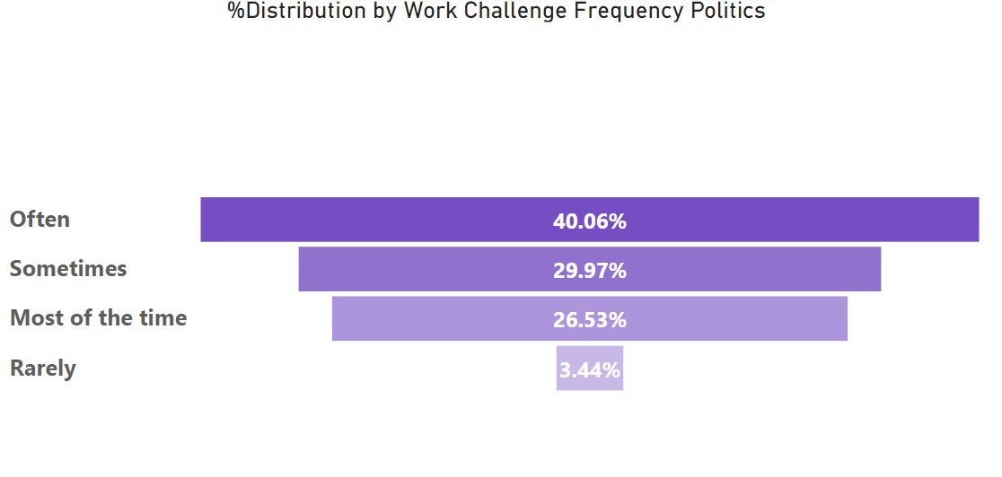
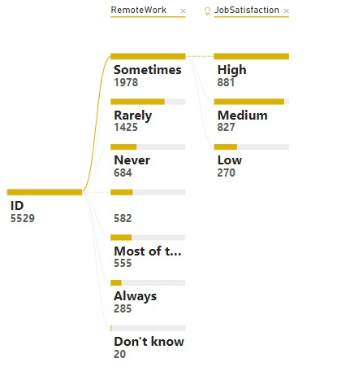
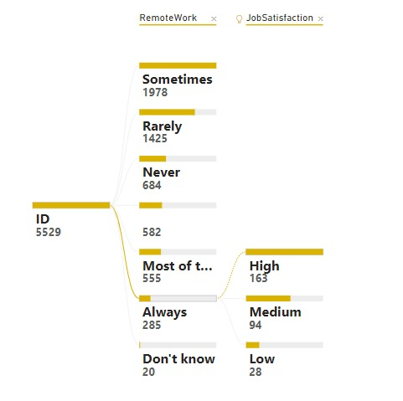
Statistics About Kagglers
Kagglers who face challenges challenges like company politics, lack of
management and financial support for a data science team most of the
time in their working environment have the lowest job satisfaction level.
Kagglers who always work remotely have higher job satisfaction.

Slide 6
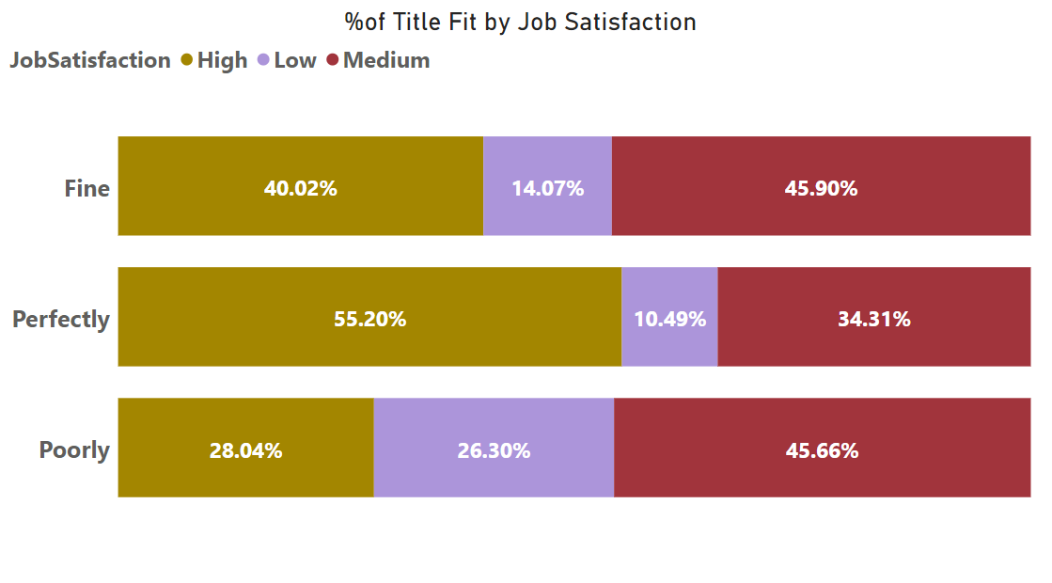
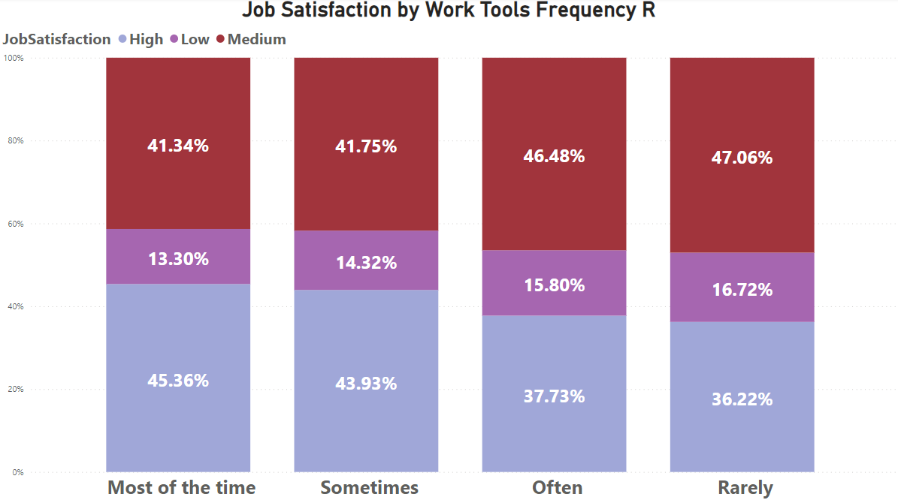
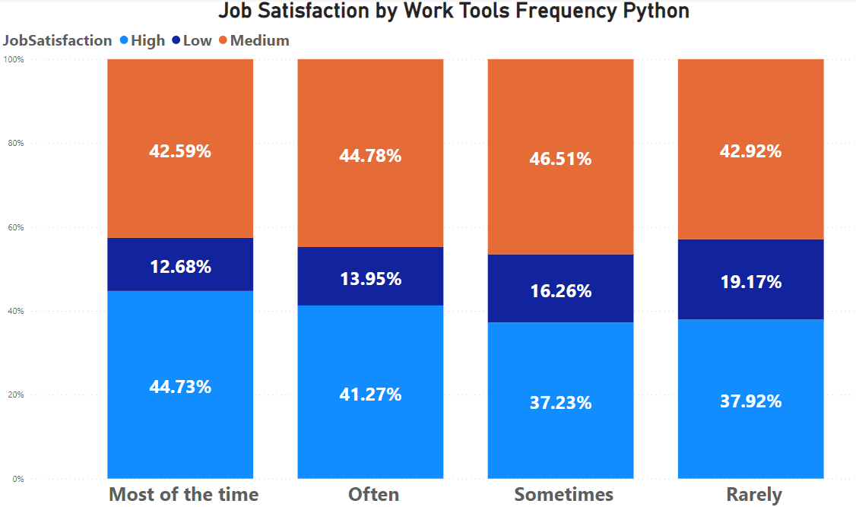
Statistics About Kagglers
Kagglers who have claimed that they are perfectly fit to their title are
more satisfied (55%) with their jobs than others who claim that they are
fine or poorly fit to their title.
Python and R users indicate higher satisfaction levels if they use these tools most of the time or often.

Slide 7
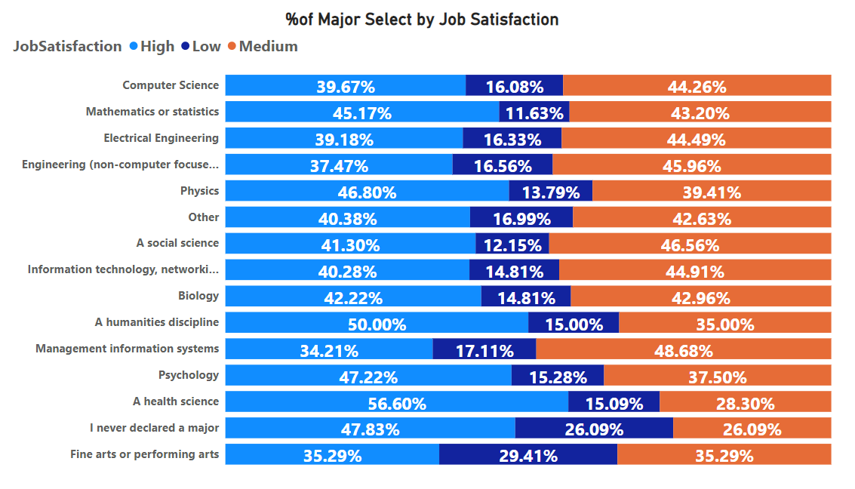
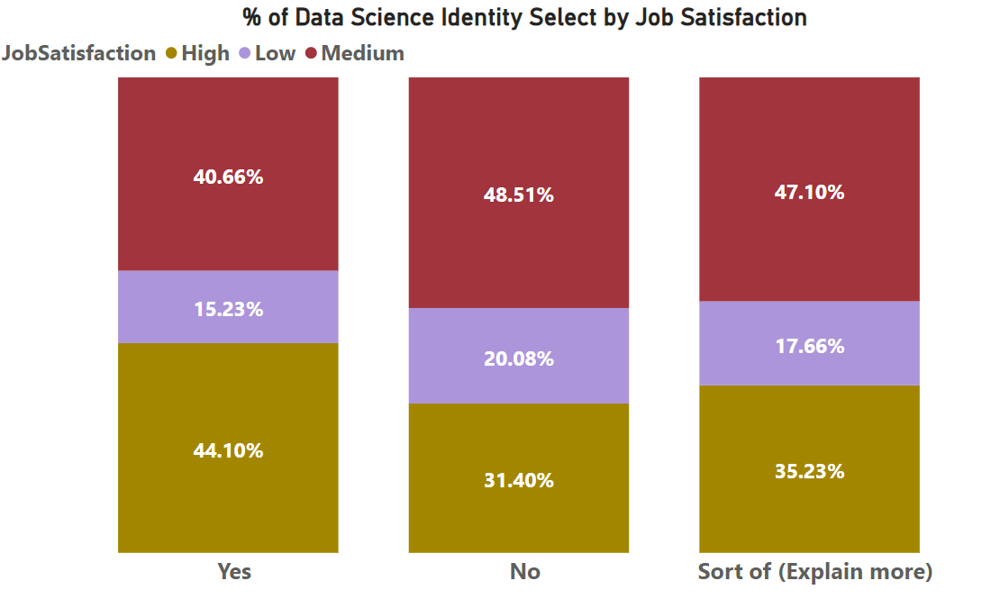
Statistics About Kagglers
Kagglers mostly have Bachelor Degrees from Computer Science, Mathematics-Statistics and Engineering (Non-computer Focus) majors and their mostly employed in the academic and technology fields
Kagglers specified several current job titles and Data Scientist title is the most
frequent one. Also, Kagglers who identified themselves as Data Scientist are dominant in the data set.

Slide 8
Model Selection
FEN:
Originally an Arabic Word that means Art, but in Turkish it means Science
Like Machine Learning…

Slide 9
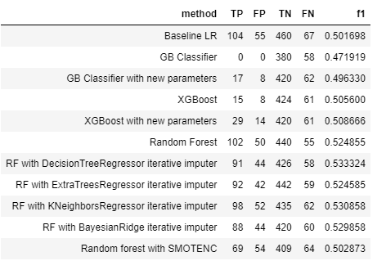
Model Building
Score Table
In this part of the project, there have been built 11 models based on different approaches including Logistic Regression, Random Forest, Gradient Boosting Classification and XGBoost algorithms.
As this dataset consists of imbalanced multiclass labels, it was expected to have better F1 scores with algorithms including weighted class distribution
The best performing model was found as RF with Decision Tree Regressor Iterative Imputer with 53.3% F1 score
F1 score improvement 50% → 53.3%

Slide 10
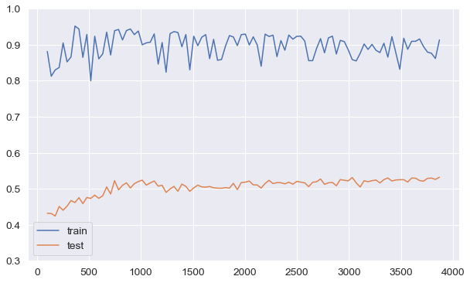
Model Results
Learning Curve for RF model with Decision Tree Regressor Iterative Imputer
Classification Report
When the class related F1-score is checked, it was found that Low class has
the worst performance meaning that, the model has poorly performed
classifying Low class compared to High and Medium classes.
It can be observed that there is overfitting with this model since there is a gap between train and test trend. However, we may say that they can converge closer if more data added.

Slide 11
THANK YOU

