Slide 1

Data Driven Application Deployment with Chef
Steven Gonzales

Slide 2
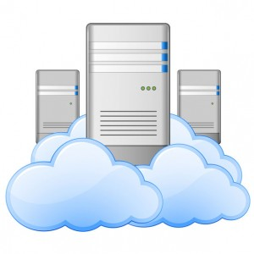
Why Automation?

Slide 3
My use case
Dev Environment = 8 nodes
Test Environment = 8 nodes
PreProd Environment = 20 to 40 nodes
This is small, and will continue to grow!

Slide 4
Doing it by hand sucks!
Expected to deploy new code frequently
Every installation and configuration should be defined, and performed exactly the same on every node.
Good luck making changes to all your nodes!
My application is written in python and uses ElasticSearch, MongoDB, RabbitMQ, ZeroMQ, and has 7 different pieces!

Slide 5

I’ll just learn how to Chef!

Slide 6
Tell me how it works!
Ruby
Cookbooks
Recipes
Roles
Environments
Chef-Client
Chef-Server
Knife
Attribute Precedence
Phases of Chef Run
Providers and LWR

Slide 7

Wut!

Slide 8
Node Objects
Attributes that hold data about the state of the node:
Was (Last Run)
Is
Should Be (End of Run)
Defined by:
Cookbooks
Roles
Environments

Slide 9
Cookbooks
Cookbooks are data driven instructions for your application
Installation
Required Libraries or Applications
Config Files
Programmatic Configurations (adding users or creating tables)

Slide 10
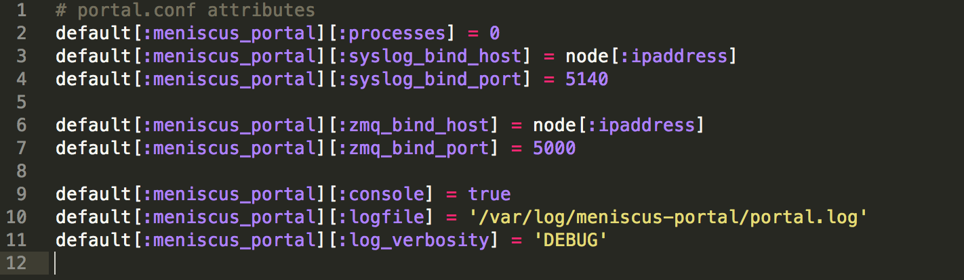
Cookbooks - Attributes

Slide 11
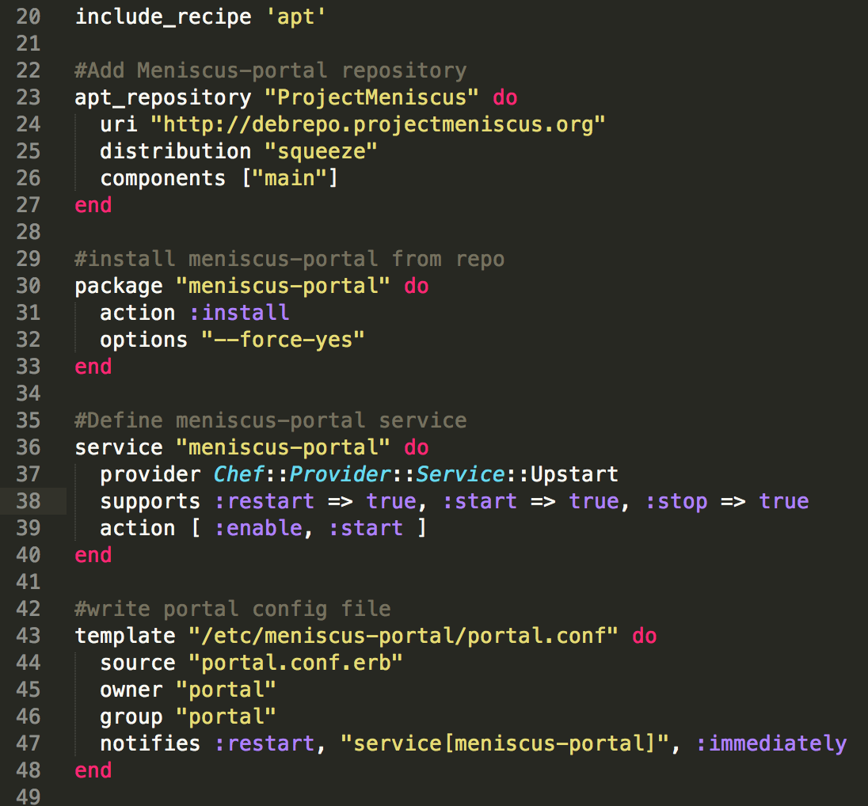

Slide 12
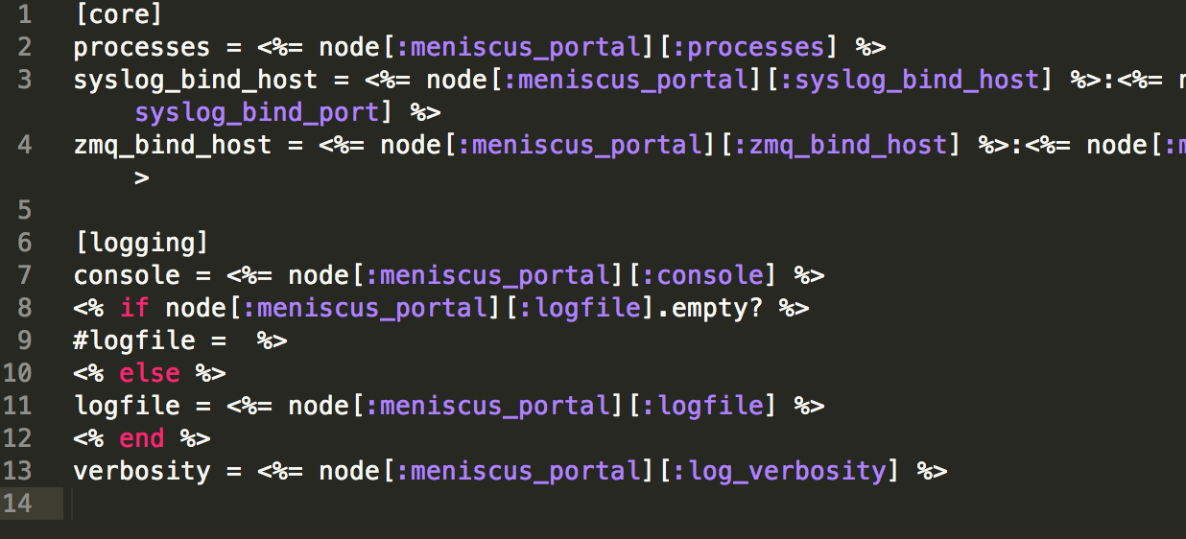
Cookbooks-Templates

Slide 13
Roles
Can layer a grouping of recipes to run on a node
Can also specify attributes that will override attributes set in a cookbook

Slide 14
Environments
Specify node attributes that override cookbooks and roles
Version control Cookbooks run in an environment

Slide 15
Chef-client
Chef-client is installed locally on your node.
The client can simply run once when node is bootstrapped
Client can run as a service and update on an interval
Chef Run – Ohai + Cookbooks

Slide 16
Chef Server
Chef Server is a central repository for cookbooks, roles, and environments
Chef Server is also a datastore for Node objects!
Node Data is available to the client, or you, through an API

Slide 17
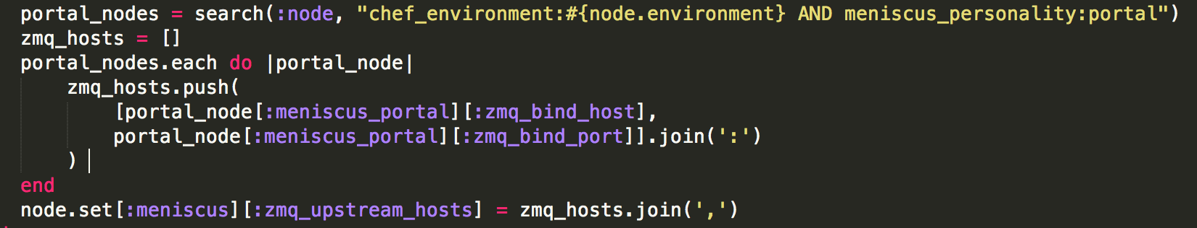
What About Clusters?!?!?
Chef is just Ruby
When using Chef Server, you can search for other nodes

Slide 18
Knife
Command Line tool for chef
Really useful for bootstrapping nodes
Plugins for most cloud providers
knife rackspace server create!

Slide 19
Community
Chef is Open Source
A lot of publicly available chef cookbooks for your favorite applications!
Many are maintained by Opscode
Lots of documentation and How To

Slide 20
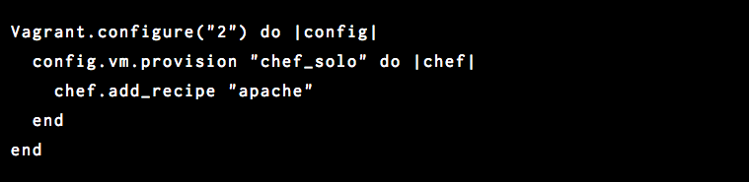
Chef with Vagrant!

Slide 21
For Another Day
Setting up a Chef Repo
Using Berkshelf
Layering cookbooks/recipes
Wrapper cookbooks instead of Roles
Complex clustering! (Mongo Replica Sets)

Slide 22
Questions?
Ask me!

