Slide 1
Puppet
SA Web Developer Meetup
By Nathan Shirlberg 11/21/2013

Slide 2
Agenda
Configuration Management
Puppet overview
Intro to using Puppet
Demo!

Slide 3
Configuration Management
Infrastructure configuration as code
Maintain history of infrastructure changes
Manage many servers at once
Ensure development matches production, etc

Slide 4
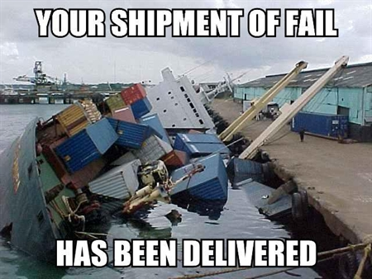
Don’t manage servers by hand

Slide 5

Configuration Management
Tools

Slide 6
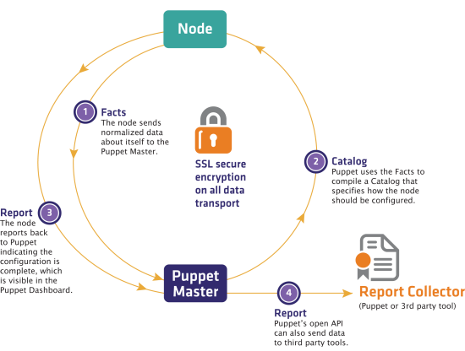
Puppet

Slide 7
Puppet Ecosystem
Puppet Open Source vs Enterprise (Puppet Labs)
Facter
Hiera
Puppet Dashboard
MCollective
Puppet Forge
Notes:
http://puppetlabs.com/facter
http://puppetlabs.com/mcollective
https://puppetlabs.com/community/overview

Slide 8
Facter
Facter is an independent, cross-platform Ruby library designed to gather information on all the nodes you will be managing with Puppet. It is available on all platforms that Puppet is available. -- http://puppetlabs.com/facter

Slide 9
MCollective
MCollective is a framework to build server orchestration or parallel job execution systems. -- http://puppetlabs.com/mcollective

Slide 10
Puppet DSL
Describes how the server should behave
MongoDB service should be running
service { "MongoDB" :
ensure => 'running',
}
Puppet takes care of the rest
If MongoDB service is not running: Puppet starts it.
If MongoDB service is running: Puppet does nothing.

Slide 11
Basics
Resources
Classes
Manifests

Slide 12
Tips
Use Open-Source Modules
Puppet Forge
Github
Create O/S packages
MSI installers for Windows
RPM for Redhat, etc

Slide 13
Demo

