Slide 1

There is

Slide 2
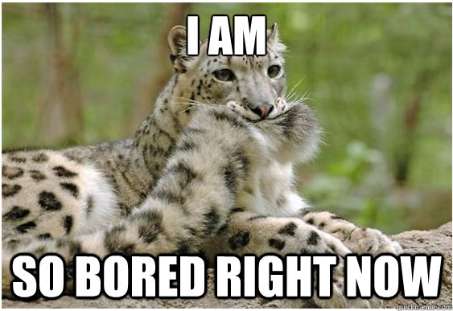

Slide 3
Unless…

Slide 4
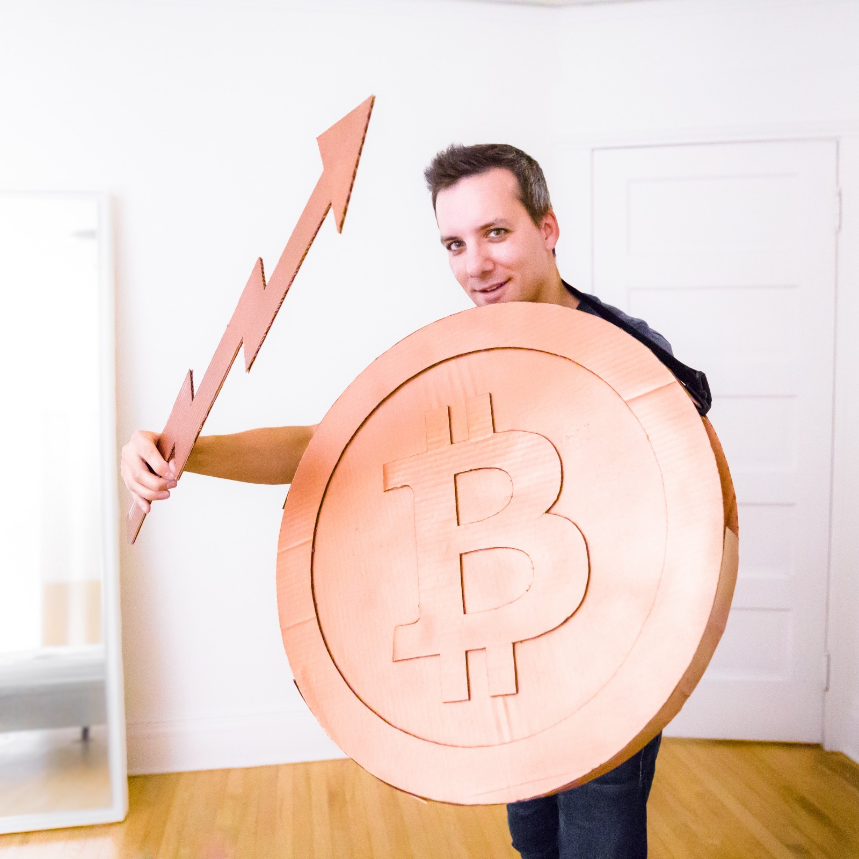
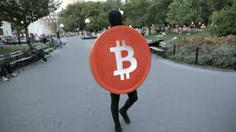
… bitcoin cosplay?

Slide 5
So, what else is out there?

Slide 6



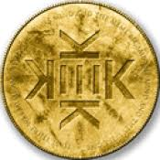
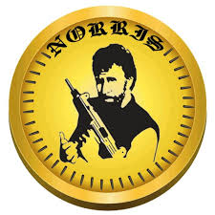
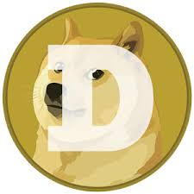
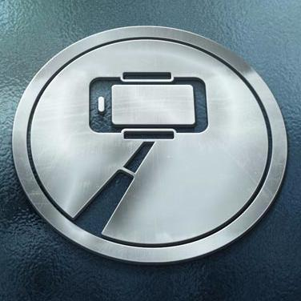
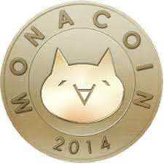
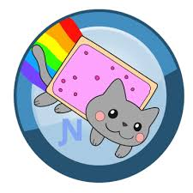

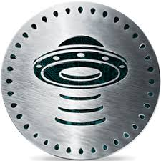




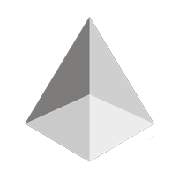
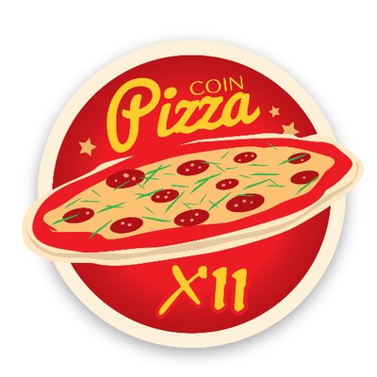


Slide 7

Ponzicoin
Fonziecoin
Ethereum Coin
Jesus Coin
Putin Coin
Titticoin
Potcoin
Monacoin
…
Nyancoin
Norriscoin
Dogecoin
Pizzacoin
Selfiecoin
Deeponion Coin
FUCKToken
GarlicCoin
…

Slide 8
Why those weird branding choices?

Slide 9
Online videos
Games
Wikis
E-Commerce
Memes
Internet forums
Social networks
Chat
Blog
Virtual worlds
Peer-to-peer file sharing

Slide 10
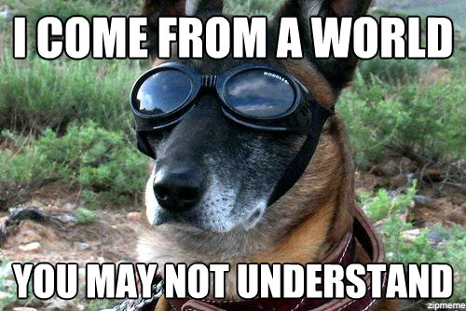

Slide 11


Slide 12



Wow, doge means dog
Blog > Shiba Inu
Internet forums > Reddit | 4chan

Slide 13
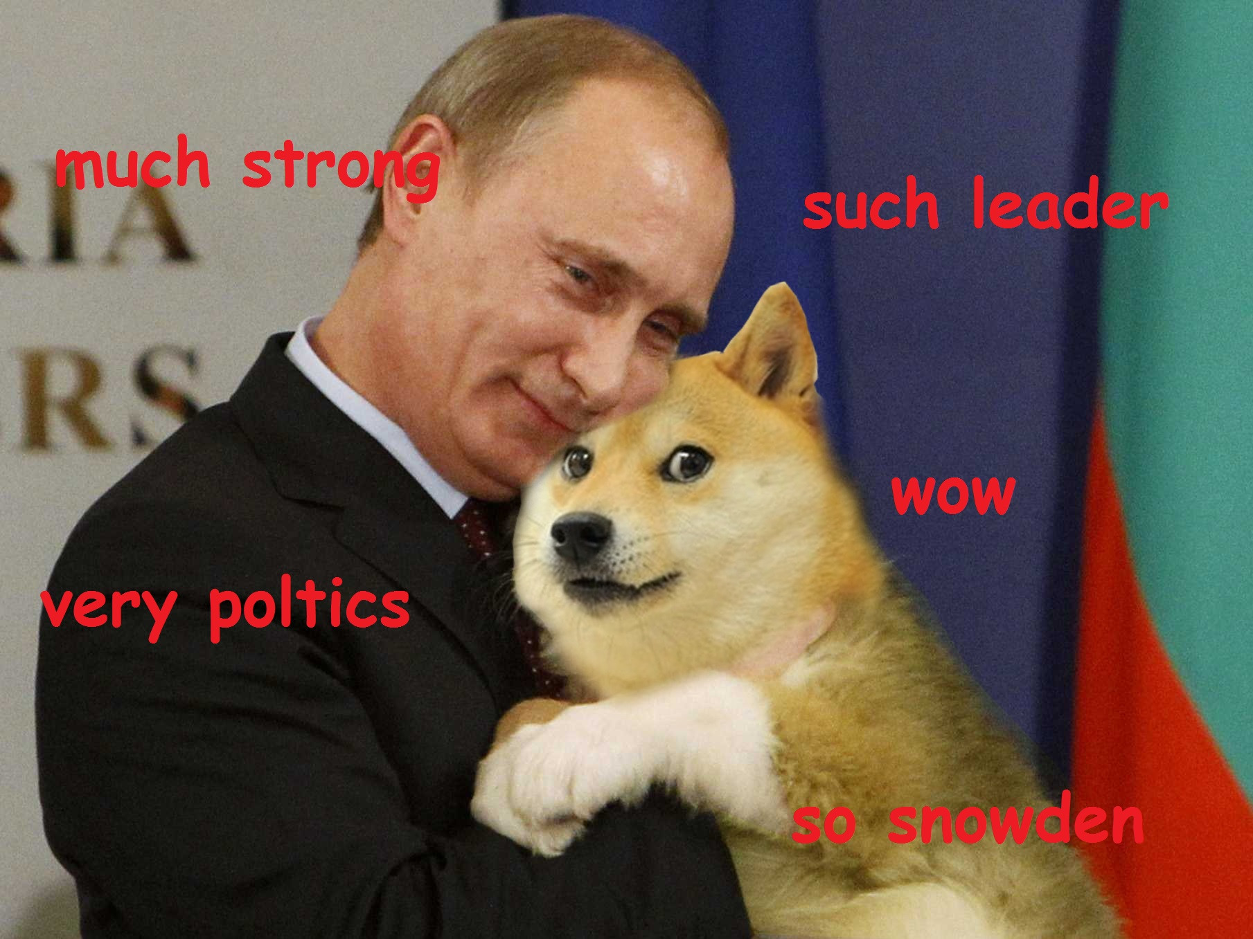

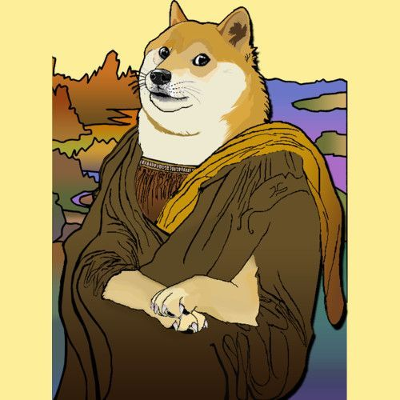
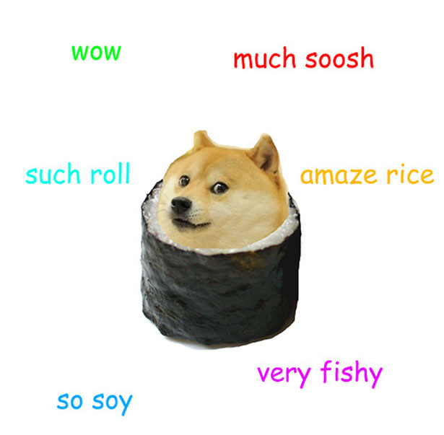
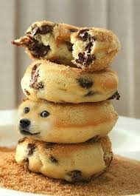
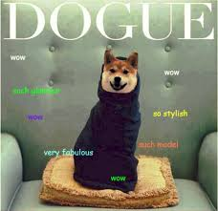
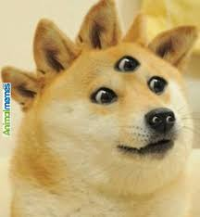

Memes

Slide 14
Dogecoin

Slide 15


Slide 16
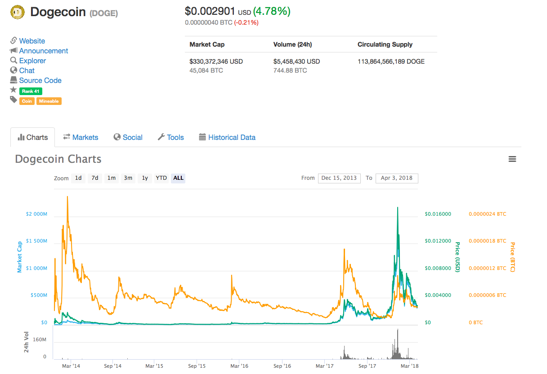

Slide 17
Nyancoin

Slide 18



April 2, 2011 gif by prguitarman
Published in LOL-COMICS
Utauloid Momo Momone
“Nyanyanyanyanyan…”
From April 5, 2018 Nyan Cat on
YouTube
Facebook, Tumblr, Memebase, Buzzfeed etc

Slide 20
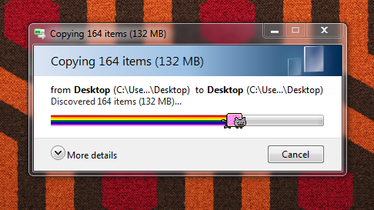

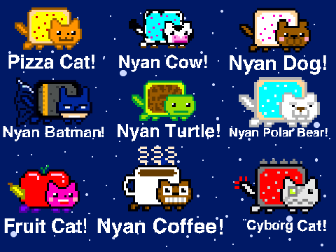
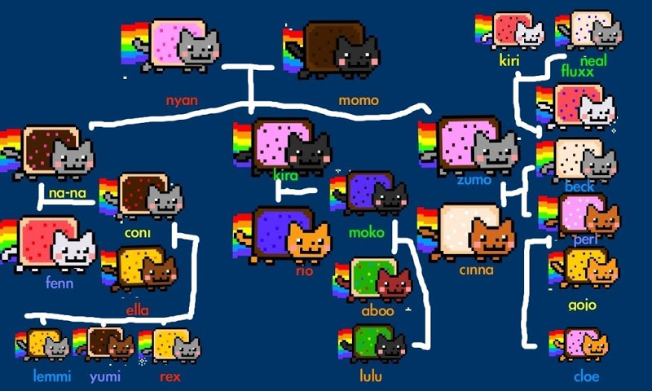

Slide 21
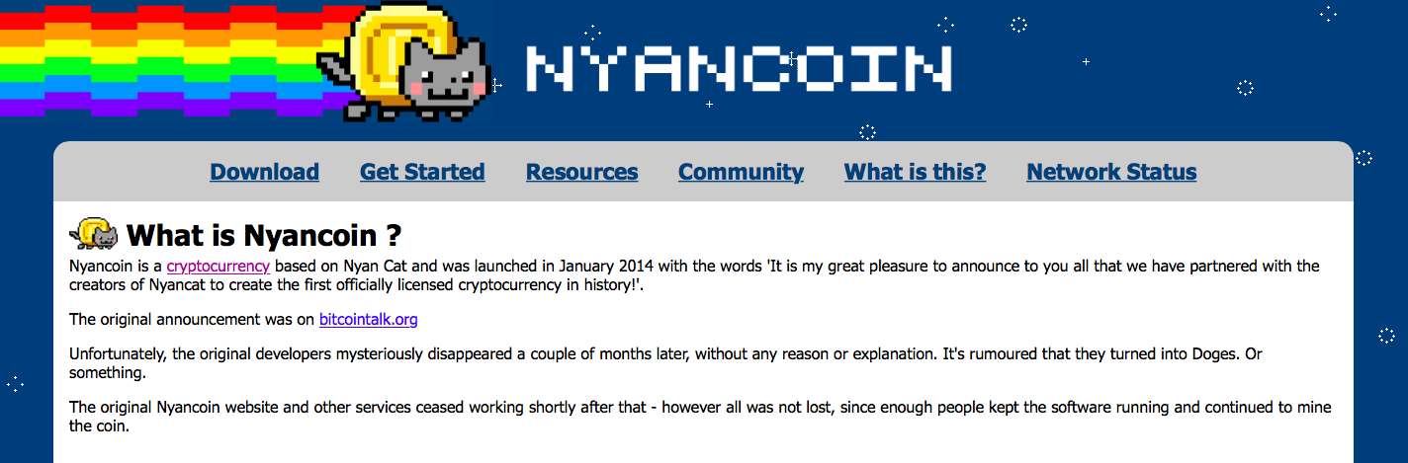

Slide 22
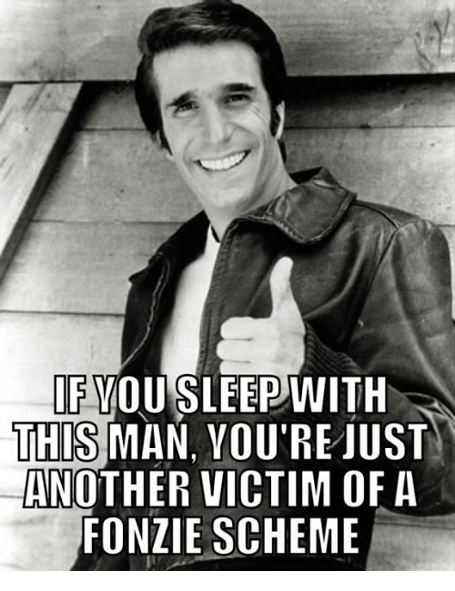
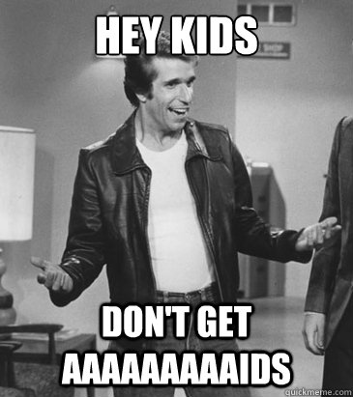


Slide 23
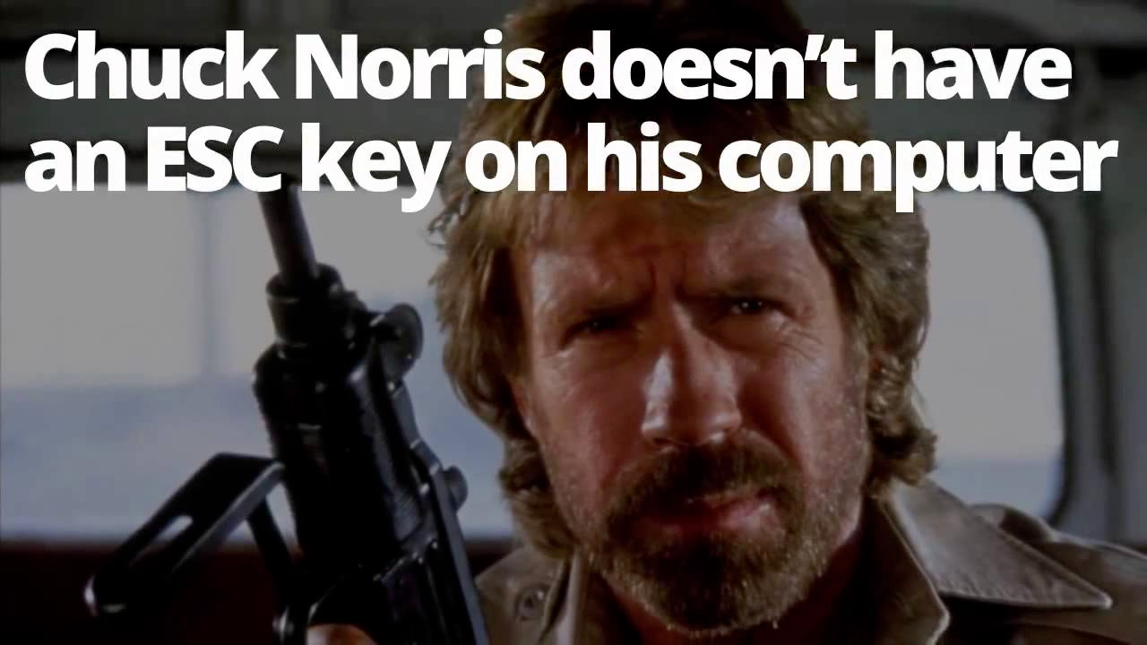
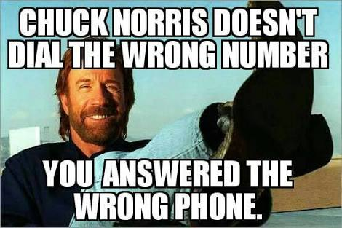
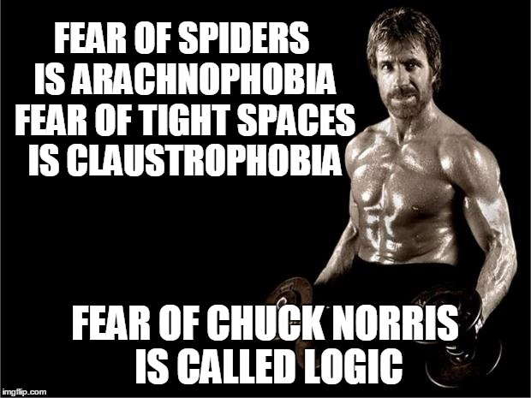

Slide 24
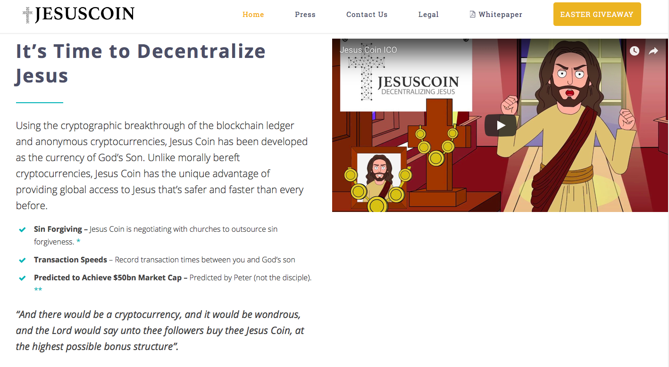

Slide 26


