Slide 1
Term and Semester Overview

Slide 2
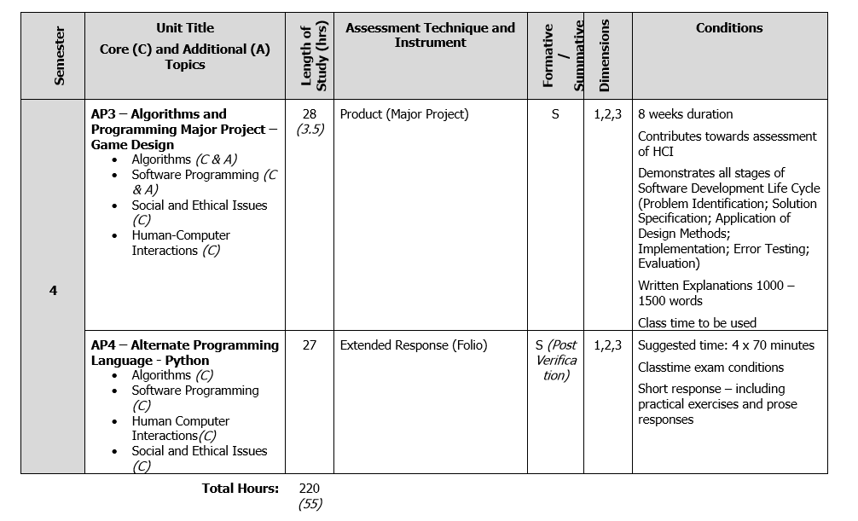

Slide 3
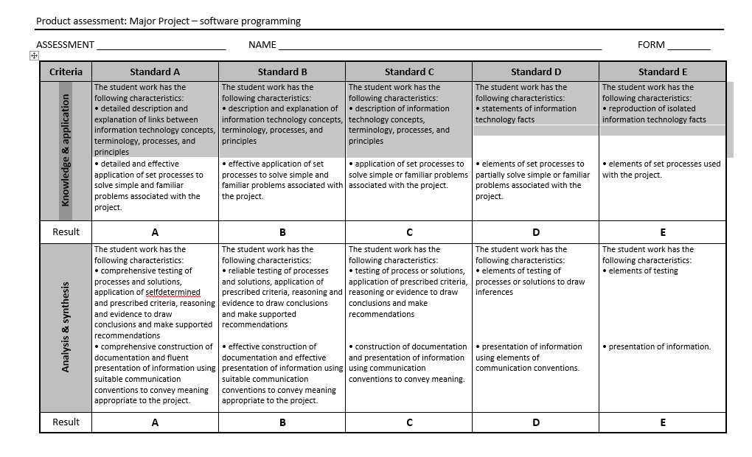

Slide 4
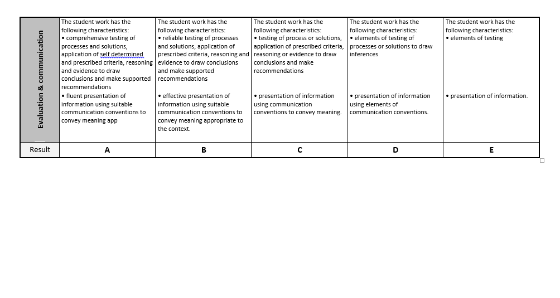

Slide 5
For your Major Project you will be marked on
Knowledge and Application
What you know about programming and that you can apply it
For instance, iterative statements while() for(), Boolean statements if( a > b)
Input and Output and processing if data.
Analysis and Synthesis
You can analyse the requirements of your problem and break it down into a design and synthesize this into an application
Evaluation and Communication
You should provide evidence of testing and communicate this in your project.
Communication should also ocur in the analysis and design of your project.

Slide 6
The Software development Cycle, for The production of a software solution
Problem Identification
Solution Specification
Design Implementation
Testing
Evaluation
Documentation

Slide 7
For your analysis you should use paragraphs which mirror the Software Development Cycle
Problem Identification
This may not be too large for you as assignments usually are fairly well scoped, but you should still do this step for your analysis/communication (Analysis and Synthesis) and (K&A)
Solution Specification (Analysis and Synthesis) and (Knowledge and Application)
This documentation step reflects your preparation for the design (Analysis and Synthesis)
Design Implementation
This is your coding (Knowledge and Application) IE Coding knowledge
Testing
Present evident of testing of your code, some small tests as well as complete final tests, some tests even for parts of your project. (Evaluation and Communication)
Evaluation (Evaluation and Communication)
Present evidence of the evaluation of your project, this could be final testing, along with reflection on improvments.
Documentation

Slide 8
Your Major project will be over 8 weeks
Uses your time wisely
Create a time line
Plan to finish early so you have time spare
Stick to your time line
Ask for help early, not in the last week
I will give some lessons on Solution specification early on to help you get started

