Slide 1
SUMMER INTERNSHIP REPORT
Estimating How Monopiles Affect Turbulence in Ocean Models
From Cylinder Validation to Monopile Turbulence Parameterization
Gloria Wang Bedford Institute of Oceanography Supervised by Dr. Yongsheng Wu and Dr. Yongxing Ma June 4 – August 26, 2026

Slide 2
PART ONE
Life at BIO

Slide 3
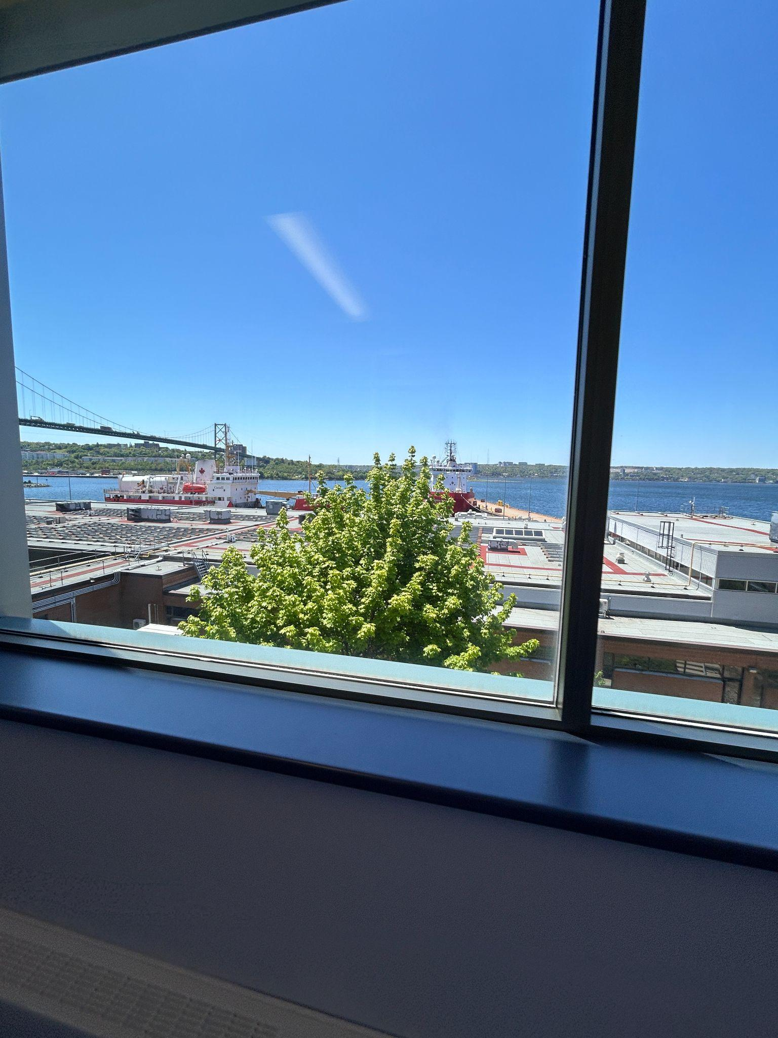
LIFE AT BIO
12 Weeks at BIO
Bedford Institute of Oceanography sits on the Bedford Basin in Halifax, Nova Scotia. It is Canada's largest ocean research centre on the Atlantic coast. I spent 12 weeks with the offshore wind farm group, running simulations and calculating metrics to help estimate the oceanographic impact of monopile construction in Halifax Harbour.
Bedford Institute of Oceanography · Gloria Wang
Life · 1/2

Slide 4
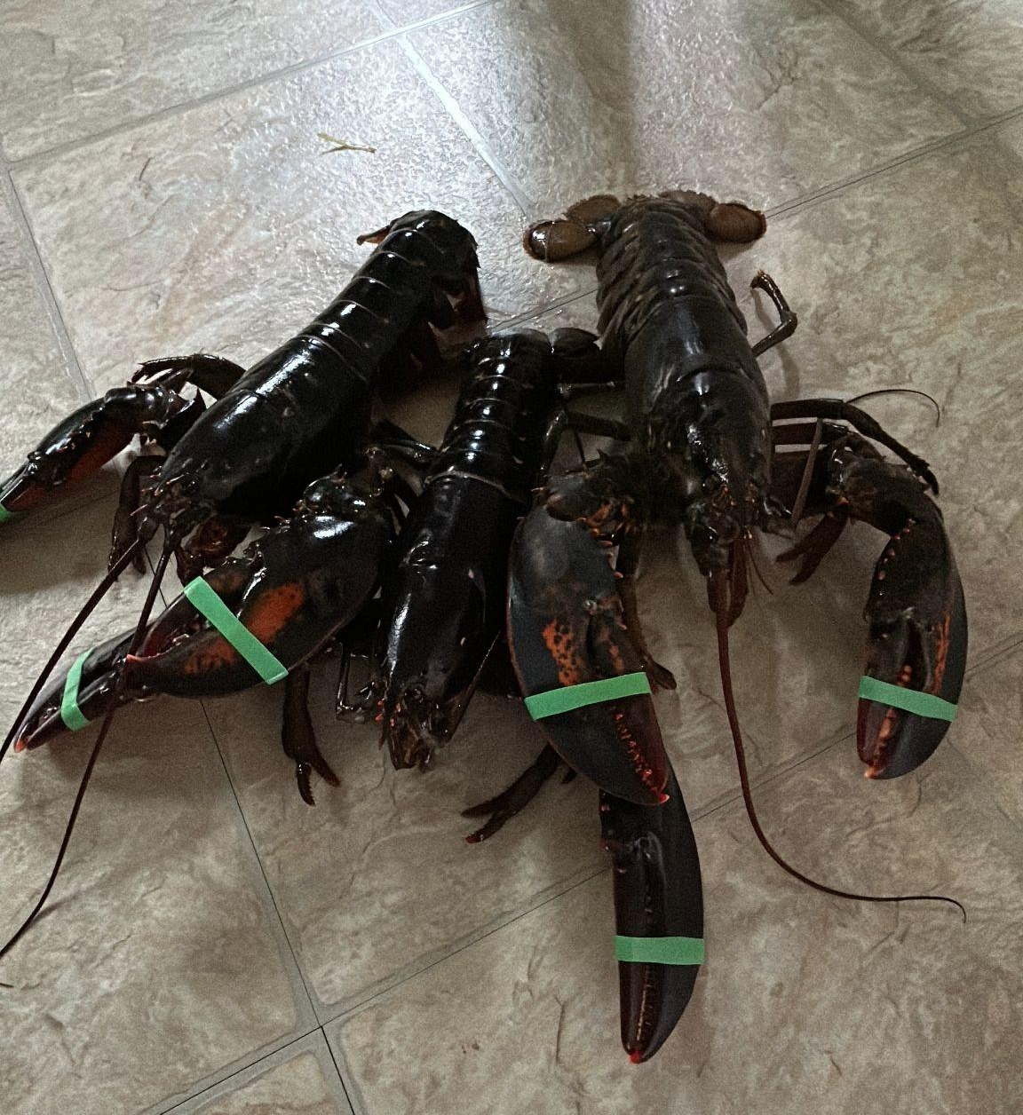
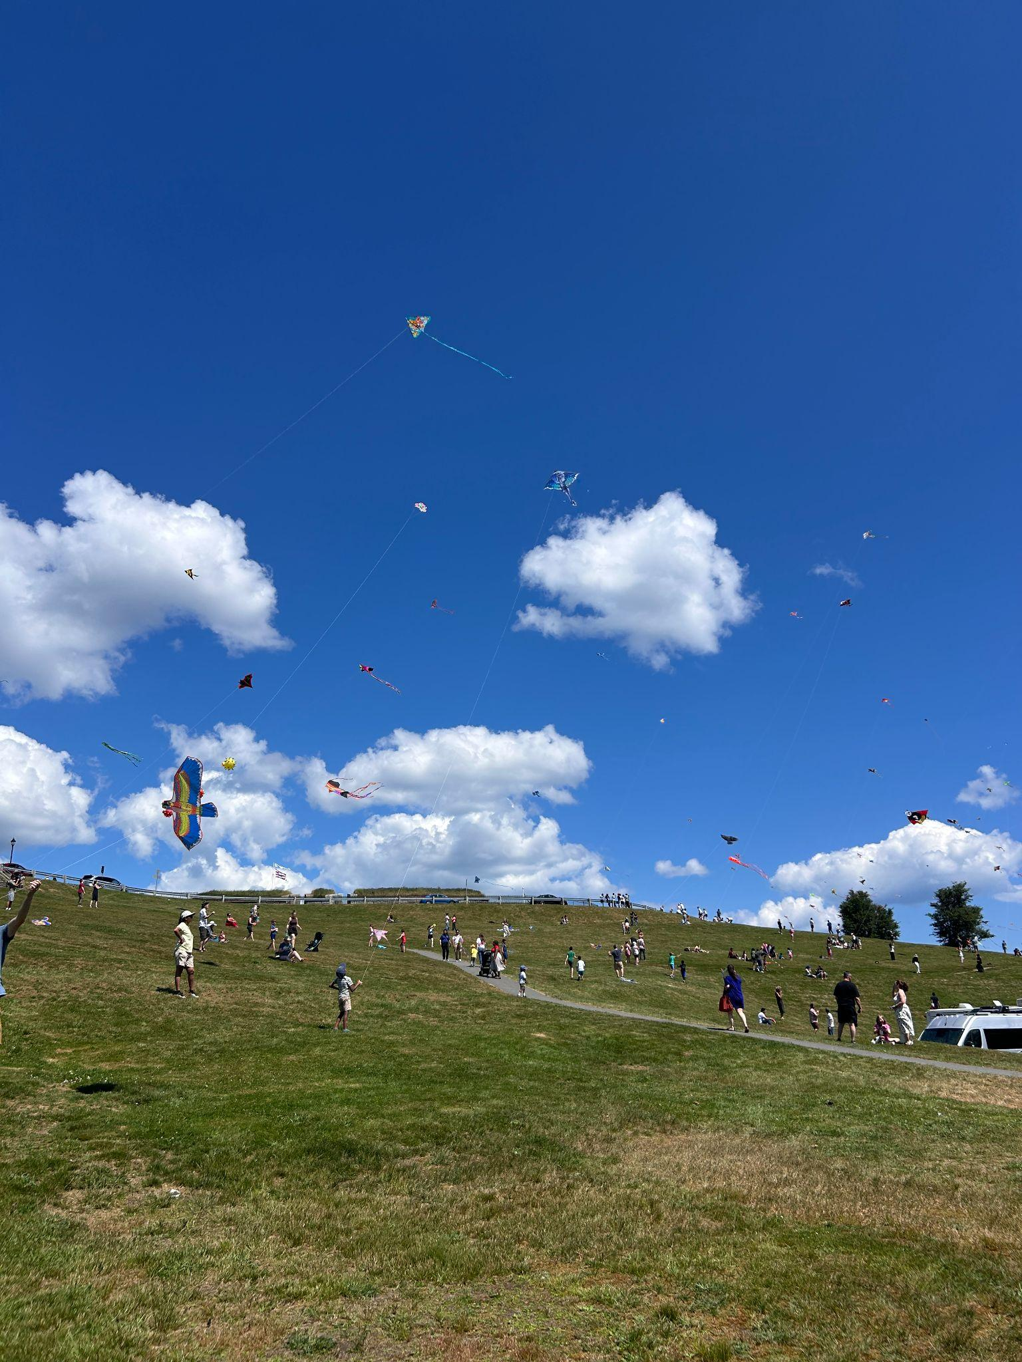
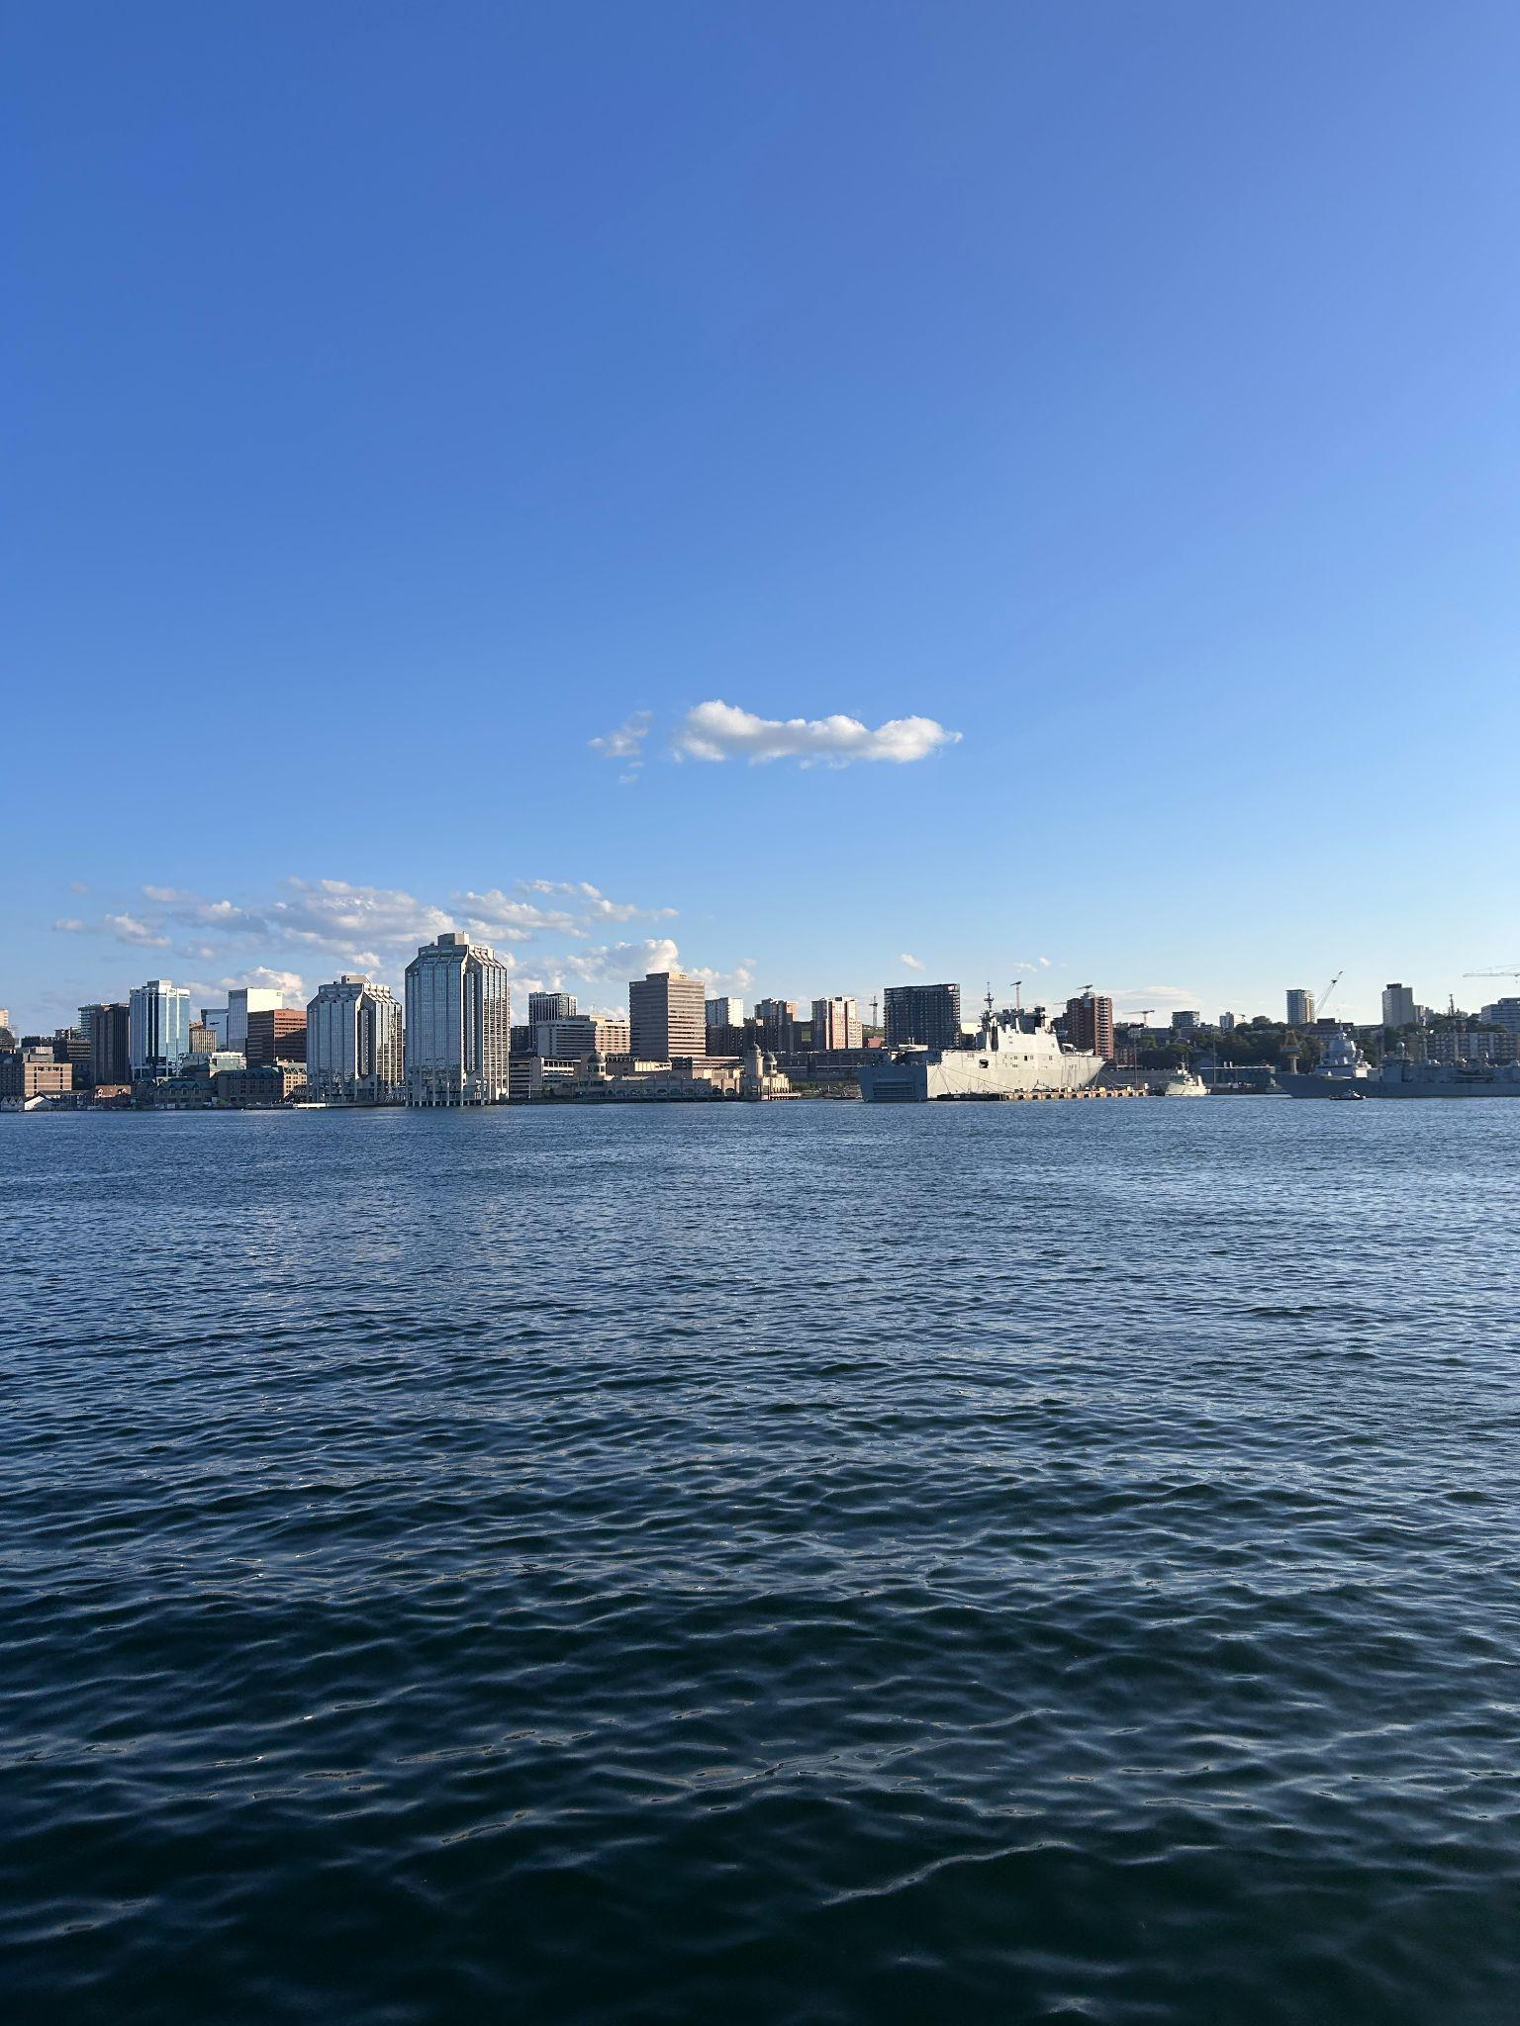
LIFE AT BIO
Halifax Life
Outside the lab, Halifax offered a coastline to explore and a city small enough to feel like home. Weekends were split between the waterfront, downtown, and getting to know the Maritimes 🐳
Bedford Institute of Oceanography · Gloria Wang
Life · 2/2

Slide 5
PART TWO
The Work

Slide 6
THE WORK
Outline
1
Introduction
2
Method
3
Results
4
Conclusion
5
Acknowledgements
Bedford Institute of Oceanography · Gloria Wang
Work · Outline

Slide 7
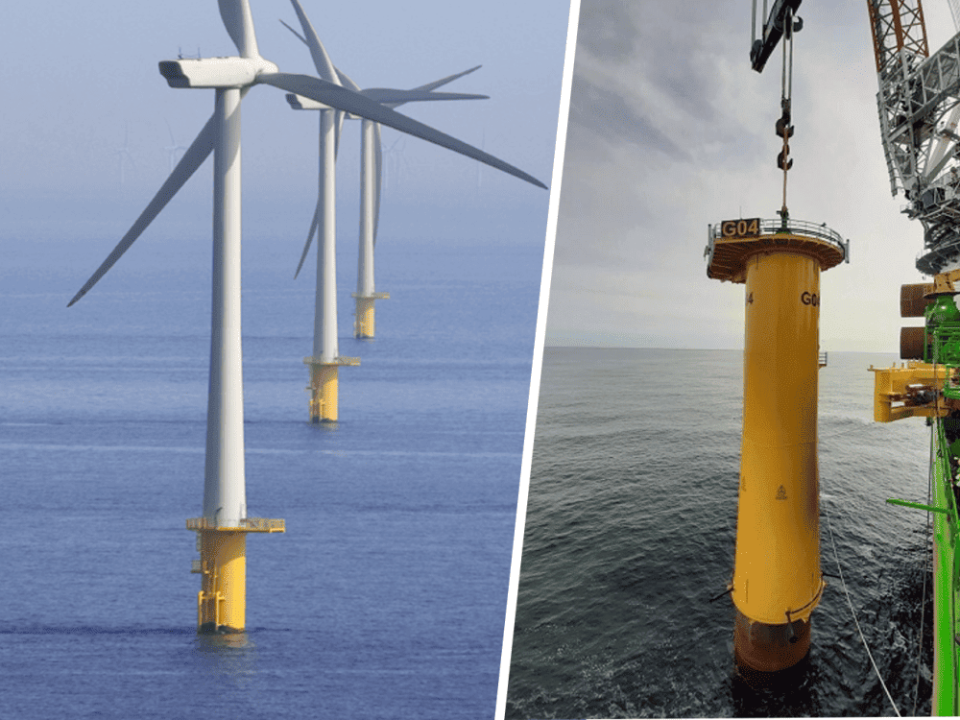
INTRODUCTION
The Monopile Problem
Monopiles are commonly used as foundations for offshore wind turbines. Despite enabling the generation of large amounts of renewable energy, their presence disturbs the surrounding water flow, potentially affecting nearby physical and biological ocean processes. Monopiles can also alter water column stratification, which is the vertical layering that influences mixing, oxygen transport, and nutrient exchange.
Bedford Institute of Oceanography · Gloria Wang
Introduction · 1/2

Slide 8
INTRODUCTION
My Tasks
My work estimates the impact that installing offshore wind farm monopiles has on Halifax Harbour. It is consisted of two studies. The first is a validation study that calculates drag, pressure, and wake data for flow past a cylinder. The second is an LES-based study that quantifies monopile-generated turbulence .
Study 1 — Flow Past Cylinder Validation
Study 2 — Turbulence Parameterization
Does the simulation reproduce known drag, shedding, and separation behaviour for flow past a cylinder?
How much turbulence does a monopile create, and what are αᵏ and c₄, the two numbers that describe it?
Both studies simulate the same 8 m cylinder in cross-flow at Re = 4×10⁶, water depth 40 m, inflow velocity 0.5 m/s.
Bedford Institute of Oceanography · Gloria Wang
Introduction · 2/2

Slide 9
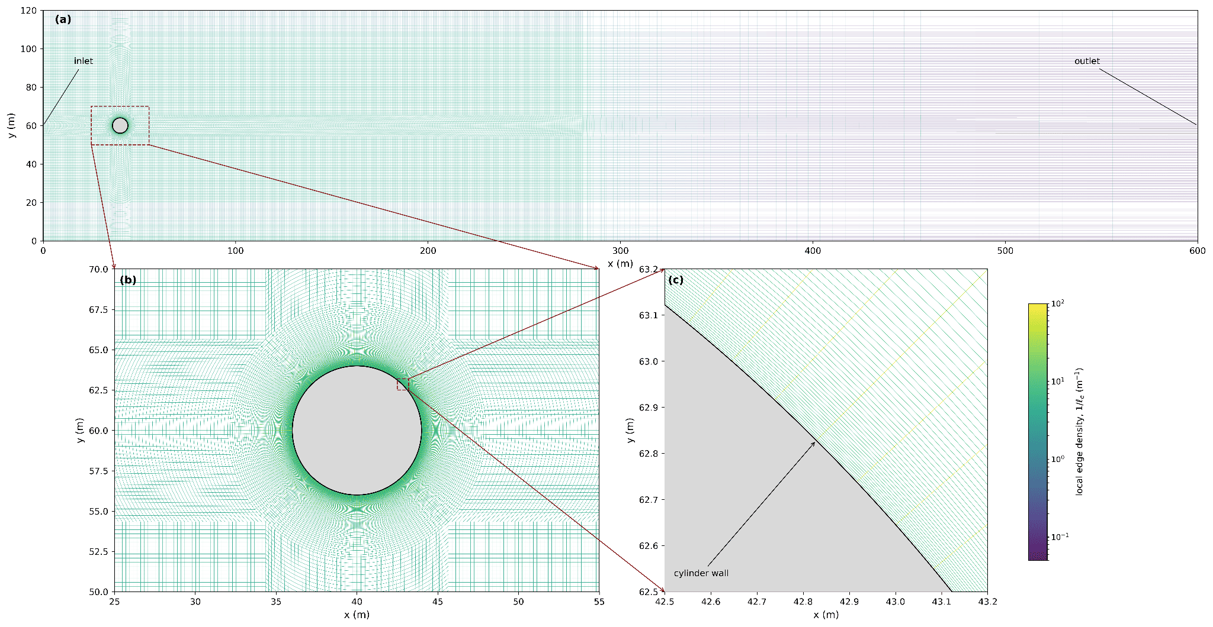
METHOD
Simulation Setup & Tools
Reynolds Number | 4 × 10⁶
Turbulence model | Spalart–Allmaras DDES / LES
Mesh | ~43M cells, 256 processors
Kinematic viscosity | 1.0 × 10⁻⁶ m²/s
Post-processing | ParaView 5.7.0, connected via MobaXterm/ThinLinc remote HPC access
Analysis | Python 3.8, NumPy & Matplotlib for FFT and plotting
Bedford Institute of Oceanography · Gloria Wang
Method · 1/2

Slide 10
METHOD
Equations Used
Flow Past Cylinder
Turbulence Parameterization
Equation | Description
Cd = Fd / (0.5·ρ·U∞²·D) | Drag coefficient
Cpb = (Pb − P∞) / (0.5·ρ·U∞²) | Base pressure coefficient
St = f·D / U∞ | Strouhal number
Lr / D | Recirculation length (normalized)
Re = ρ·U∞·D / μ | Reynolds number
Equation | Description
kRes = ½(u′² + v′² + w′²) | Resolved turbulent kinetic energy
εRes = 2ν·s′ij·s′ij | Resolved dissipation rate
εLES = εRES + εSGS | Overall dissipation rate
Pwake = −u′i u′j (∂ūi/∂xj) | Wake-generated TKE production
Sk,LES = ⟨Pwake⟩·Vc | Volume-averaged TKE source
S^pile_k = α^k · ½·CD,eff·(D/Acell)·|uh|³ | Ocean-model TKE source term
S^pile_ε = c4 · (ε/k) · S^pile_k | Ocean-model dissipation source term
These five quantities validate the simulation against known drag, shedding, and separation behaviour for flow past a cylinder at Re = 4×10⁶.
A standard k–ε ocean-model closure represents the unresolved monopile as a quadratic drag force; αᵏ and c₄ are the two parameters this study estimates from LES.
Bedford Institute of Oceanography · Gloria Wang
Method · 2/2

Slide 11
RESULTS
Everything Solved For
Validation Study
LES Turbulence
Quantity | Description
Cpb = −0.451 | Mean back-pressure coefficient
St = 0.505 | Strouhal number (shedding frequency)
Lr/D = 1.214 | Recirculation length
θsep = 117° | Mean separation angle
Quantity | Description
kRes ≈ 2.90×10⁻⁴ m²/s² | Resolved TKE (volume-avg)
εLES ≈ 1.66×10⁻⁶ m²/s³ | Dissipation terms
Sk,LES ≈ 2.15×10⁻⁶ m²/s³ | Wake TKE production
Cd,eff = 0.404 | Effective drag coefficient
Pdrag ≈ 4.83×10⁻⁶ m²/s³ | Drag power per unit mass
αᵏ = 0.445 | Fraction of drag power becoming TKE
c4 = 1.478 | Dissipation-equation closure parameter
Bedford Institute of Oceanography · Gloria Wang
Results · 1/9

Slide 12
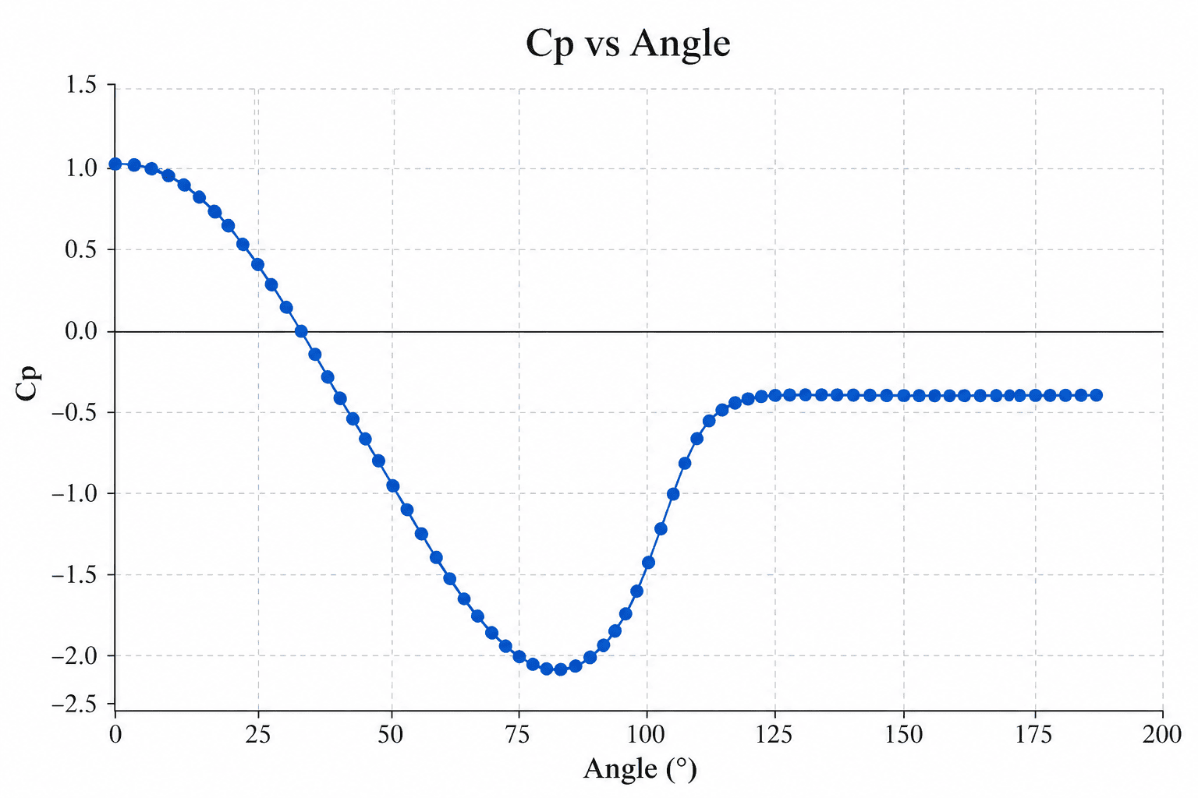
RESULTS
Drag, Pressure & Wake Geometry
0.404
−0.451
1.214
117°
Cd — Drag Coefficient
Cpb — Back-Pressure Coefficient
Lr/D — Recirculation Length
Mean Separation Angle
Cd falls within the expected 0.2–0.5 range for post-critical flow (Re ≈ 4×10⁶); Cpb, Lr/D, and separation angle all sit within reported experimental ranges for this regime.
Bedford Institute of Oceanography · Gloria Wang
Results · 2/9

Slide 13
RESULTS
Benchmarked Against Published Literature
Quantity | This Study | Miralles & Koobus | Yeon et al. | Roshko | Catalano et al.
Re | 4×10⁶ | 1×10⁶ | 7.6×10⁵ | 3.5–1×10⁷ | 1×10⁶
Mean Cd | 0.404 | 0.289 | 0.23 | 0.70 | 0.31
Mean Cpb | −0.451 | −0.25 | −0.24 | −0.86 | −0.32
St | 0.505 | 0.50 | 0.46 | 0.27 | 0.35
Sep. Angle | 117° | 128° | 135° | — | 110°
Lr/D | 1.214 | — | — | — | 1.04
Results are broadly consistent with values reported in high-Reynolds-number cylinder-flow literature.
Bedford Institute of Oceanography · Gloria Wang
Results · 3/9

Slide 14
RESULTS
The Turbulence Parameters
kRes
εLES​
Pwake
2.90×10⁻⁴ m²/s²
volume averaged
1.66×10⁻⁶ m²/s³
volume averaged
2.15×10⁻⁶ m²/s³
volume averaged
kRes = ½(u′²+v′²+w′²), built from the fluctuating velocity field.
εLES = εRes + εSGS, combining resolved and subgrid-scale contributions.
Pwake = −u′ᵢu′ⱼ(∂ūᵢ/∂xⱼ), driven by the wake's mean velocity gradients.
Bedford Institute of Oceanography · Gloria Wang
Results · 4/9

Slide 15
RESULTS
Ocean-Model Parameters
The effective drag coefficient sets the wake's available drag power; αᵏ is the fraction of available drag power contributing to wake TKE production. c₄ then links resolved dissipation back to the source term, giving Sᵖⁱˡᵉ_k and Sᵖⁱˡᵉ_ε . These are the two terms a regional ocean model plugs in directly as unresolved monopile turbulence.
0.445
1.478
αᵏ
c₄
c₄ (1.478) sits below the standard k–ε constant Cε2 (1.92).
Bedford Institute of Oceanography · Gloria Wang
Results · 5/9

Slide 16
RESULTS
Flow Visualizations
Three short clips and a map capture the wake at Re = 4×10⁶: Vorticity contours reveal alternating vortex shedding behind the cylinder and the wake’s downstream transition into increasingly complex turbulent structures.
Bedford Institute of Oceanography · Gloria Wang
Results · 6/9

Slide 17
RESULTS
Flow Visualizations
Speed: reveal a low-velocity wake behind the cylinder and its gradual recovery as the flow moves downstream.
Bedford Institute of Oceanography · Gloria Wang
Results 7/9·

Slide 18
RESULTS
Flow Visualizations
Viscosity: highlight regions of enhanced modeled turbulent mixing as vortices form and evolve throughout the wake.
Bedford Institute of Oceanography · Gloria Wang
Results · 8/9

Slide 19
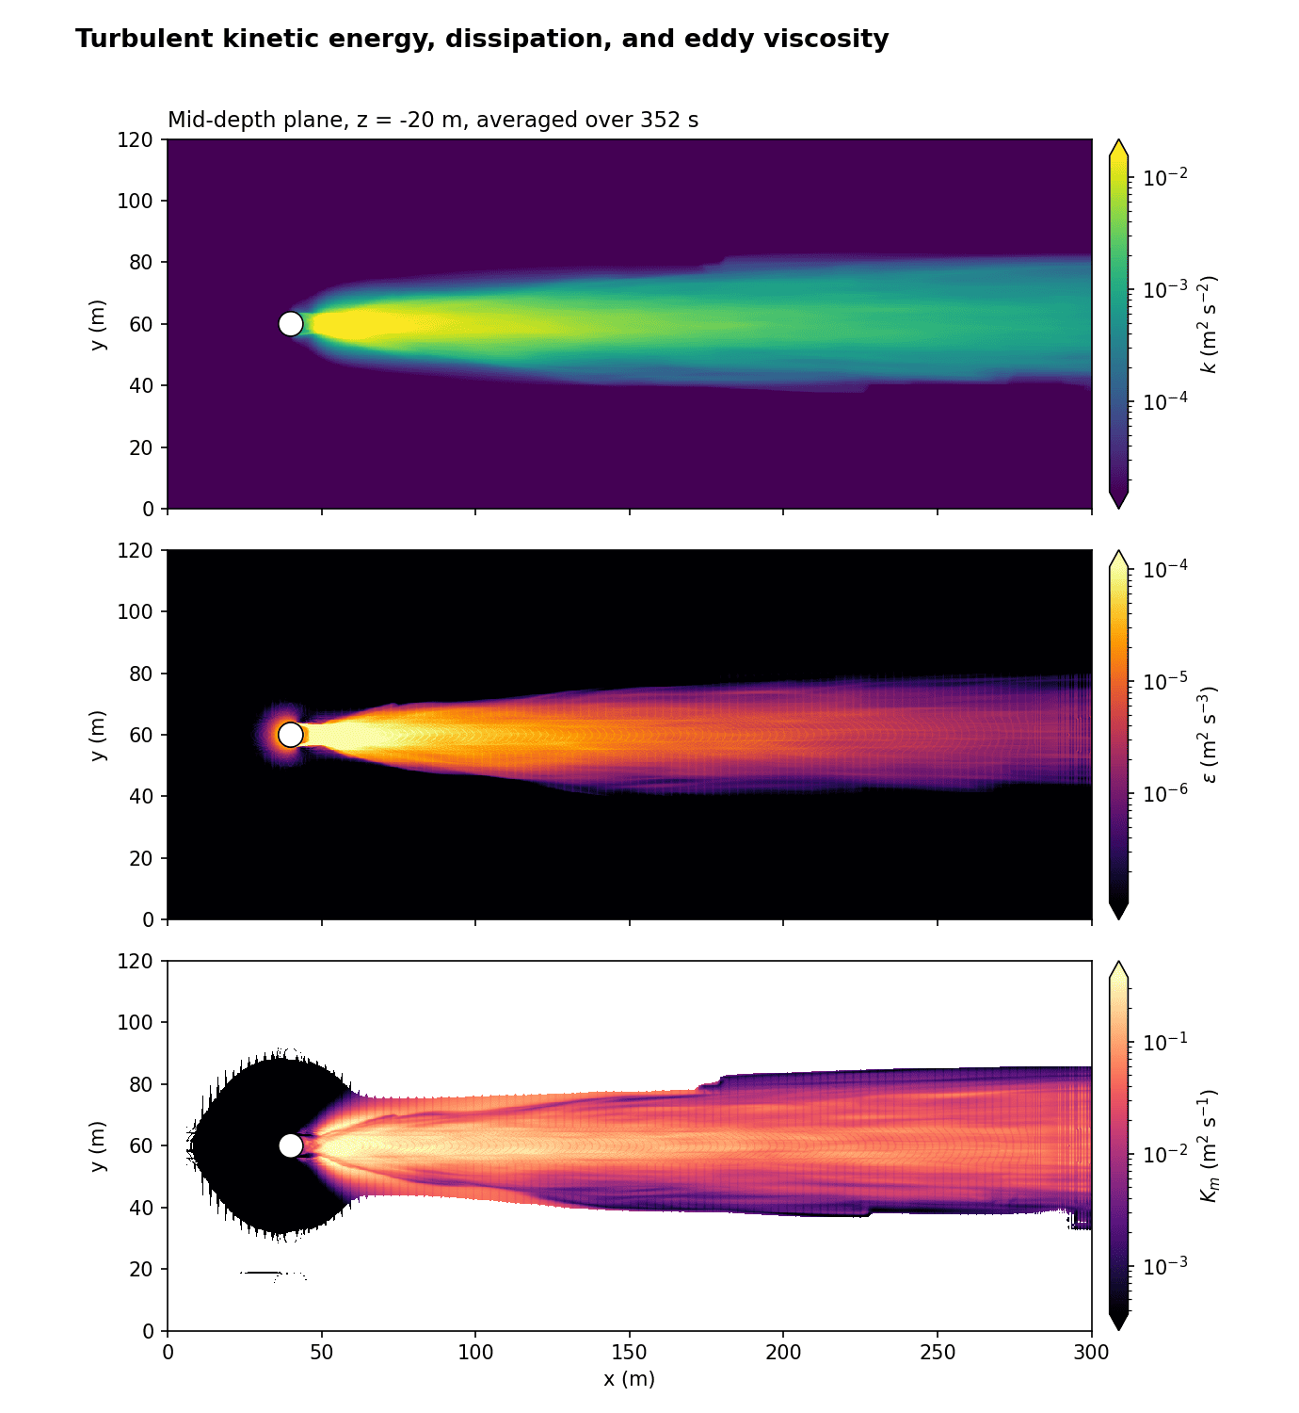
RESULTS
Flow Visualizations
Time-averaged turbulence maps show where kinetic energy, dissipation, and modeled mixing are concentrated within the cylinder’s wake.
Bedford Institute of Oceanography · Gloria Wang
Results · 9/9

Slide 20
CONCLUSION
Summary
The validation study confirms the simulation reproduces published drag, pressure, shedding, and separation behaviour for post-critical cylinder flow (Re = 4×10⁶).
The LES-based analysis estimates αᵏ = 0.445 and c₄ = 1.478, indicating that wake TKE production corresponds to approximately 44.5% of the available drag power, below the common assumption of αᵏ = 1.
Together, these provide an LES-informed parameterization for implementation in a regional ocean model’s k–ε closure: Skpile​ and Sεpile​.
Key limitations: SGS kinetic energy is currently neglected in k but included in ε; c₄ assumes local equilibrium in the near wake; offline calibration against the model is still pending, and can give more accurate results.
Bedford Institute of Oceanography · Gloria Wang
Conclusion

Slide 21
CONCLUSION
Acknowledgements
Thank You to Those Who Made This Summer Possible
Dr. Marc Skinner
Dr. Yongsheng Wu & Dr. Yongxing Ma
Sharon Young
Andy He
For a smooth hiring process that made this term possible.
For supervision and guidance on OpenFOAM, ParaView, and turbulence-closure theory throughout the term.
For HR support that made onboarding smooth.
For always being willing to help and for making lunch breaks much more fun.
Thank you all for your time!
Bedford Institute of Oceanography · Gloria Wang
Acknowledgements

