Slide 1
Blackjack
By: Madison Dodd, Greg Jacobus, Matt King, Austin Jordan
Description, this needs to be replaced

Slide 2
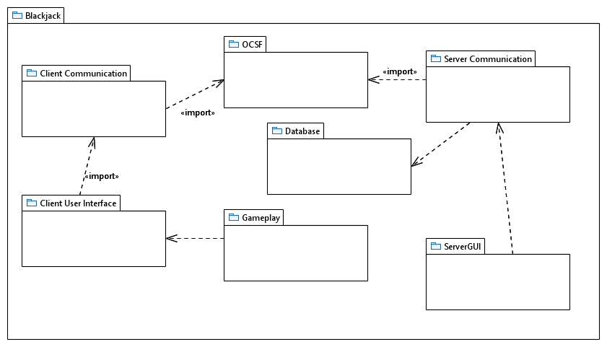
Package diagram

Slide 3
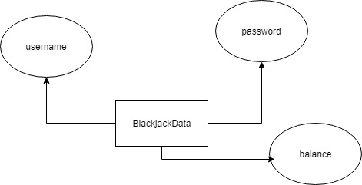
Database design diagram

Slide 4
Functional requirement example

Slide 5
Use case description example

Slide 6
Class diagram example

