Slide 1
Blackjack
By: Madison Dodd, Greg Jacobus, Matt King, Austin Jordan
This “Bare Bones” Blackjack game will simulate the casino experience without the pressure of losing real money.

Slide 2
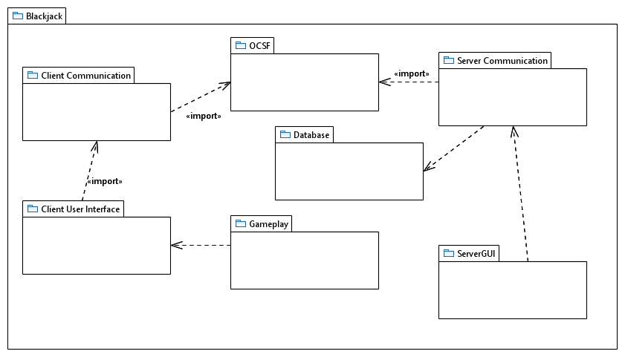
Package diagram

Slide 3
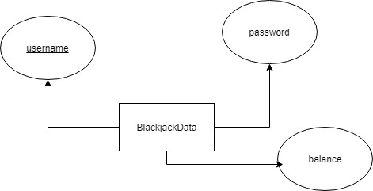
Database design diagram

Slide 4
Functional requirement example
Starting with the player left of the dealer, each player gets to repeatedly hit (get another card) until they choose to stay (end turn) or bust (go over 21) (PlayHand)

Slide 5
Use case description example

Slide 6
Class diagram example

