Slide 1
DEEP LEARNING PROJECT | ICT-4442
Comparative Evaluation of Deep Learning Models for Binary Sentiment Classification
MLP vs TextCNN vs BiLSTM-Attention vs DistilBERT on the IMDB Movie Review Dataset
Arnav Kumar | 230911308
School of Computer Engineering, Manipal Institute of Technology
+
–
Notes:
20 seconds. I compared four deep learning architectures for positive versus negative movie-review classification. The aim is to compare accuracy and compute cost under one evaluation protocol.

Slide 2
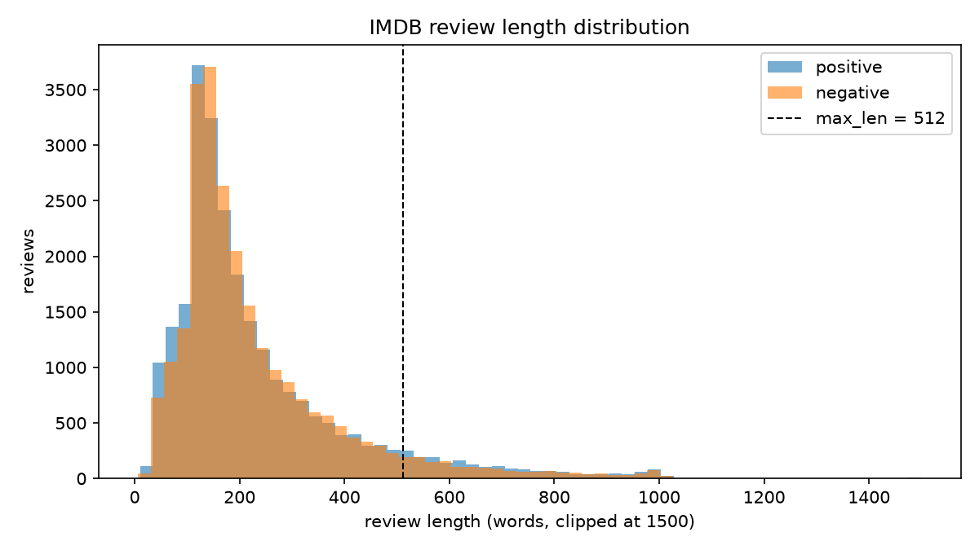
Dataset: IMDB Large Movie Review Dataset
35,000 / 7,500 / 7,500
train / val / test
231 words
mean length (median 173)
7.4%
reviews > 512 tokens
94.4%
tokens covered by 10k vocab
Source: Stanford AI Lab, via HuggingFace stanfordnlp/imdb
IMDB Sentiment: Comparative Evaluation | ICT-4442 | Arnav Kumar
2
Notes:
40 seconds. The dataset has 50,000 labelled reviews. I pooled and stratified it into 35,000 training, 7,500 validation and 7,500 test reviews. Vocabulary and TF-IDF fitting use training data only. This is a custom split, and duplicate texts across splits are a limitation.

Slide 3
Four architectures for sentiment classification
1
MLP + TF-IDF
2
TextCNN
CLASSICAL BASELINE
CONVOLUTIONAL
Dense 512-128 net over a 10k TF-IDF vector. Ignores word order: the performance floor.
GloVe-300 + 1D convolutions, kernels 2/3/4 (100 filters each), max-over-time pooling.
3
BiLSTM + Attention
4
DistilBERT
RECURRENT
PRE-TRAINED TRANSFORMER
2-layer BiLSTM (128/dir) over GloVe-300; additive attention weights sentiment words.
distilbert-base-uncased, 6 layers, fine-tuned end to end with a single-logit head.
IMDB Sentiment: Comparative Evaluation | ICT-4442 | Arnav Kumar
3
Notes:
60 seconds. MLP uses TF-IDF word features. TextCNN detects local phrases using GloVe embeddings. BiLSTM reads both directions and uses attention pooling. DistilBERT transfers pretrained contextual language knowledge and is fine-tuned on the reviews.

Slide 4
Training setup
Model | LR | Batch | Epoch cap | Patience | Selected
MLP (TF-IDF BoW) | 0.0003 | 64 | 3 | 3 | best epoch 1
TextCNN | 0.001 | 64 | 3 | 3 | best epoch 3
BiLSTM + Attention | 0.001 | 64 | 3 | 3 | best epoch 3
DistilBERT | 2e-05 | 8 x 2 | 3 | 2 | best epoch 3
Shared
AdamW optimiser
Binary cross-entropy, one logit
fp16 mixed precision
Gradient clipping at 1.0
Early stopping on val F1
Seed 42 everywhere
RTX 4060 Laptop GPU, 8 GB
IMDB Sentiment: Comparative Evaluation | ICT-4442 | Arnav Kumar
4
Notes:
35 seconds. I tried two learning rates per model with a three-epoch cap. I selected the learning rate and checkpoint by validation F1, then evaluated the selected models once on the test set. DistilBERT uses batch eight with two gradient accumulation steps.

Slide 5
Results on the test split
Model | Accuracy (%) | Precision (%) | Recall (%) | F1 (%) | Params | Train time (min) | Latency (ms/review)
MLP (TF-IDF BoW) | 89.63 | 91.35 | 87.55 | 89.41 | 5.19M | 0.4 | 0.43
TextCNN | 89.68 | 88.99 | 90.56 | 89.77 | 3.27M | 0.7 | 14.65
BiLSTM + Attention | 91.52 | 90.91 | 92.27 | 91.58 | 3.87M | 14.0 | 76.73
DistilBERT | 93.29 | 93.26 | 93.33 | 93.30 | 66.95M | 27.2 | 5.53
7,500 test reviews; pretokenized latency. Custom split: not an official leaderboard score.
IMDB Sentiment: Comparative Evaluation | ICT-4442 | Arnav Kumar
5
Notes:
50 seconds. DistilBERT achieved 93.29 percent accuracy and 93.30 percent F1. BiLSTM achieved 91.52 percent accuracy, while MLP and TextCNN were around 89.6 percent. These are measured scores from saved predictions on 7,500 reviews.

Slide 6
Conclusion and future work
DistilBERT led this experiment at 93.29% test accuracy.
The MLP offers a low compute baseline; the BiLSTM is the strongest non-transformer in this run.
One training seed and duplicate reviews across splits limit the conclusions. A grouped split and repeated seeds are needed to assess robustness.
Next steps
Multi-seed runs with confidence intervals
Head + tail truncation for long reviews
RoBERTa / DeBERTa and LoRA fine-tuning
Distil DistilBERT into TextCNN for on-device use
Visualise BiLSTM attention weights
IMDB Sentiment: Comparative Evaluation | ICT-4442 | Arnav Kumar
6
Notes:
35 seconds. DistilBERT was best on this experiment, while MLP used much less compute. Limitations are one seed, limited tuning, truncation and duplicate texts across splits. Next I will show live predictions using the saved model weights.

