Slide 1


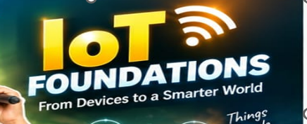
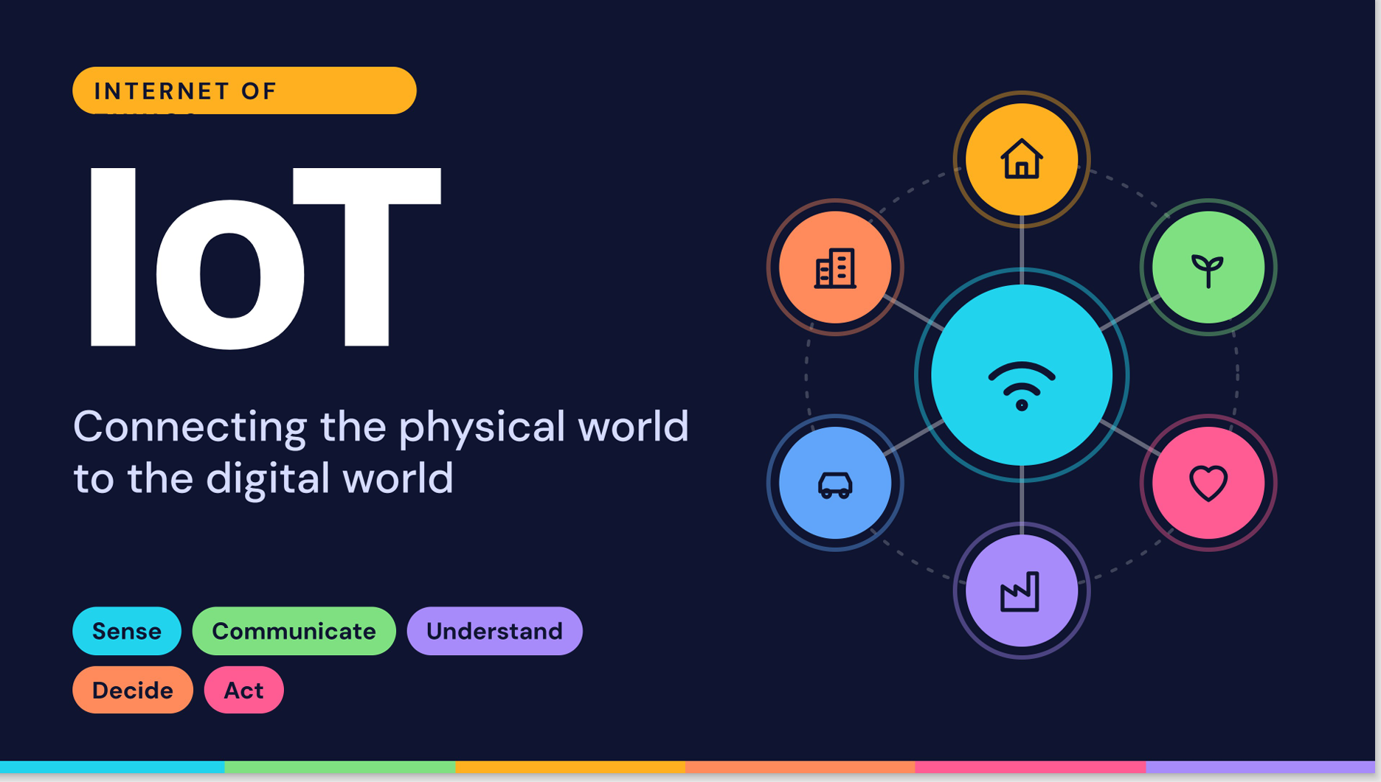

Slide 2
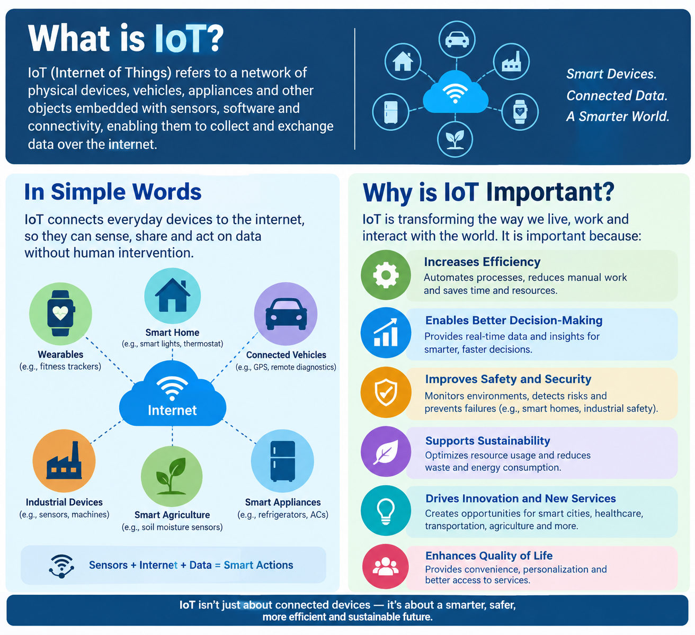

Slide 3
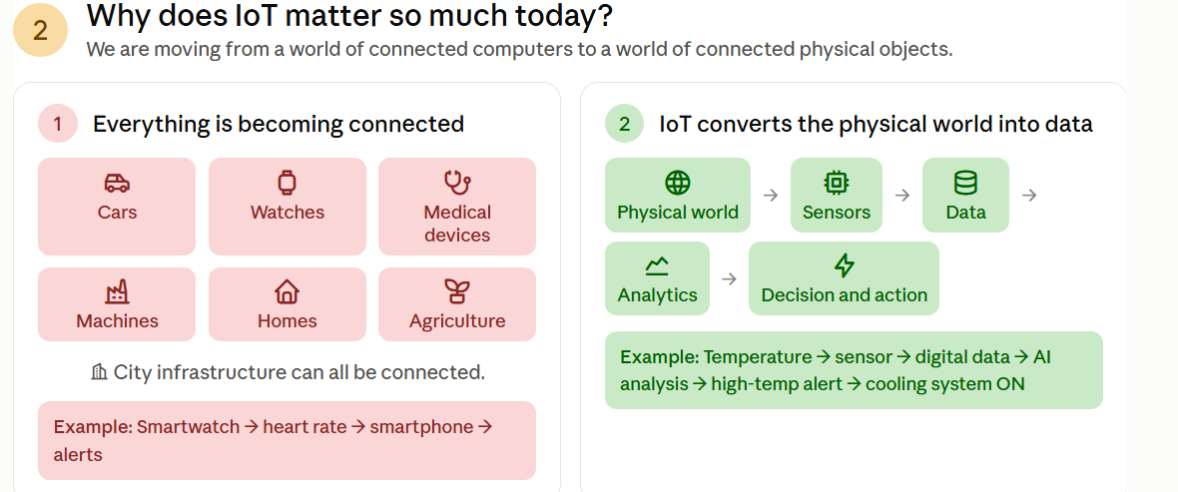

Slide 4
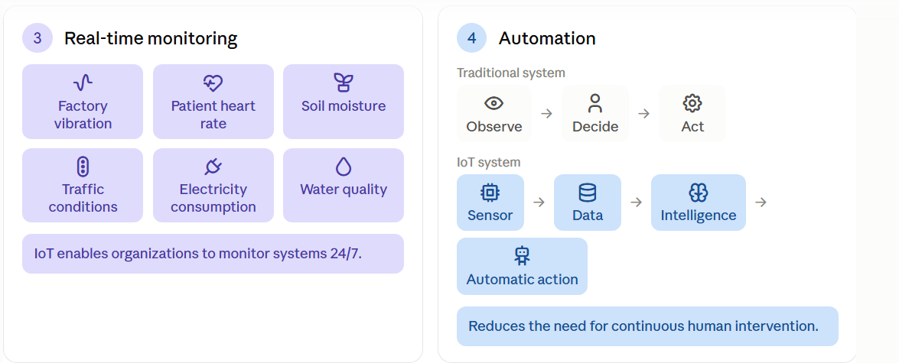

Slide 5
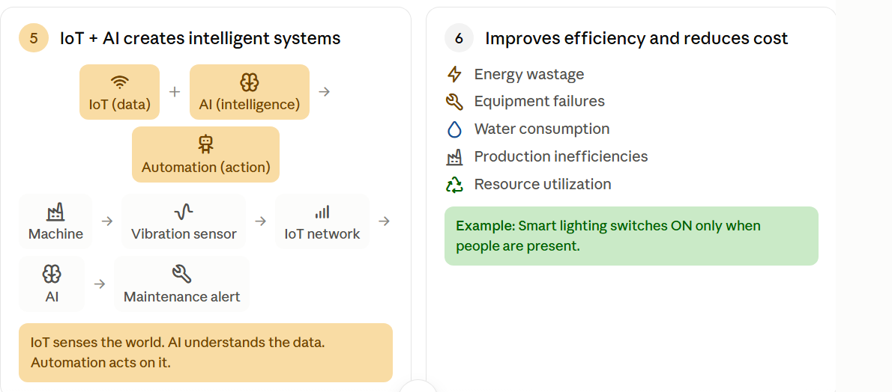

Slide 6
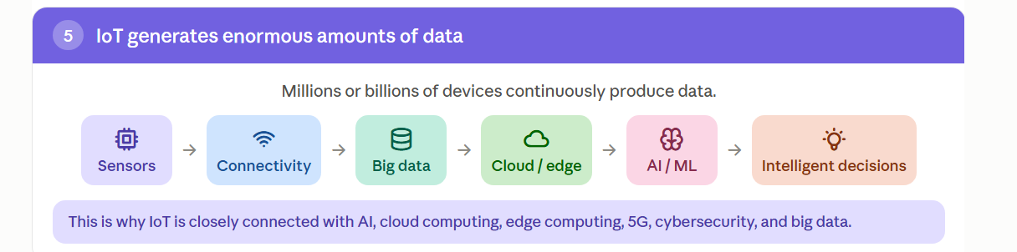

Slide 7
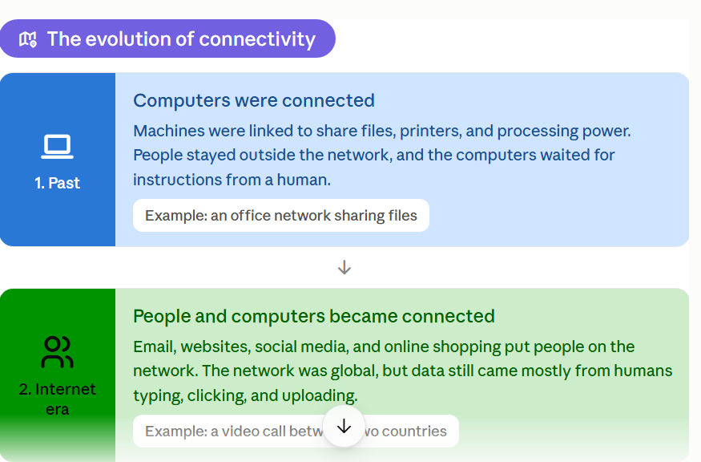

Slide 8
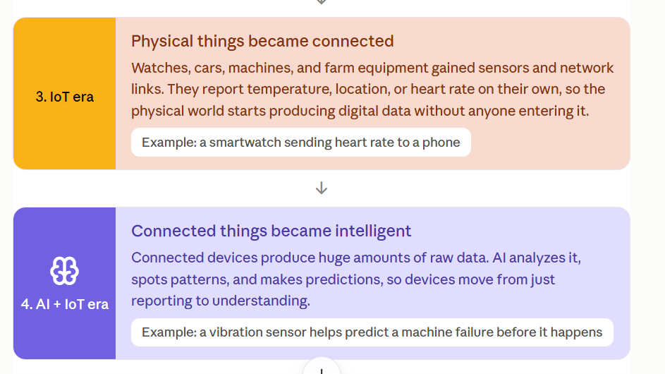

Slide 9
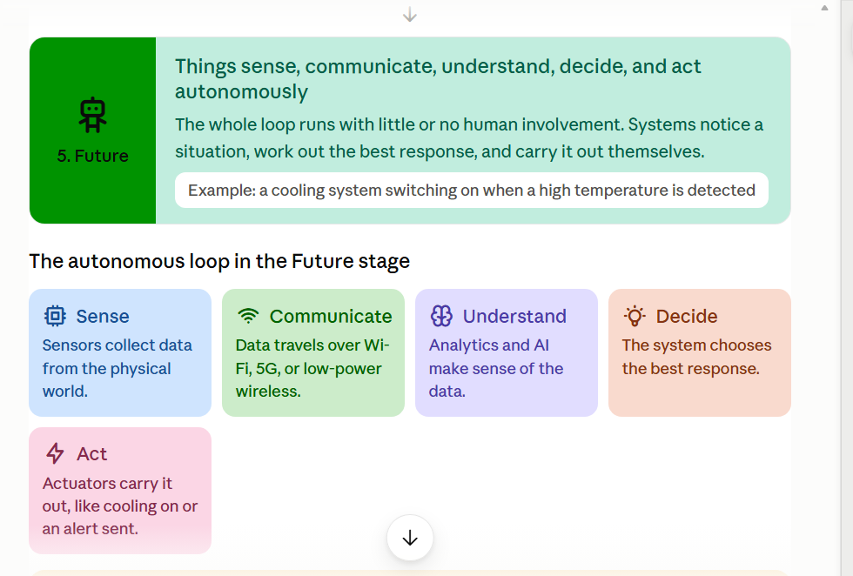
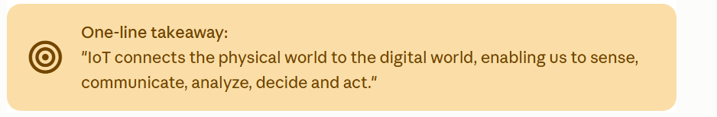

Slide 10
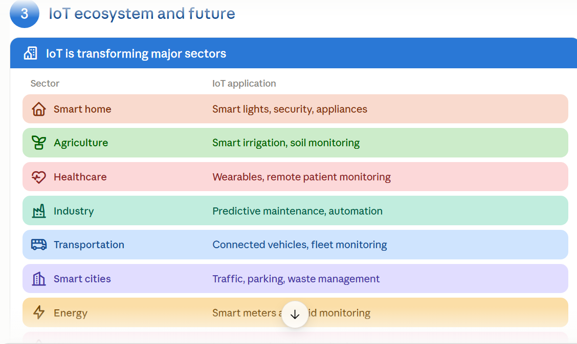

Slide 11
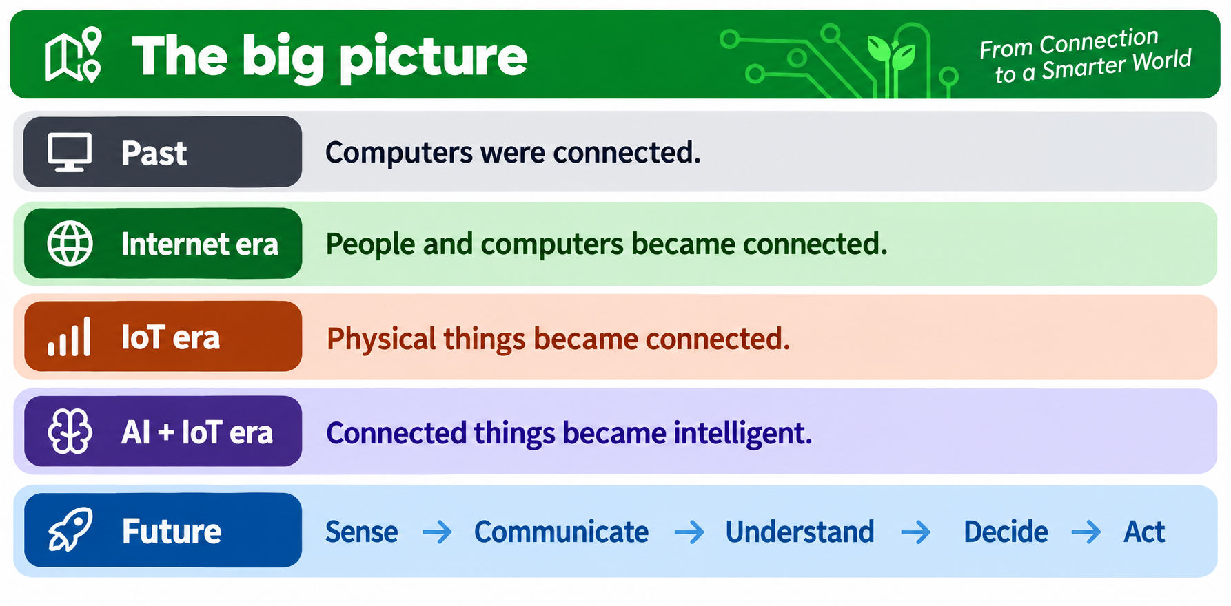

Slide 12
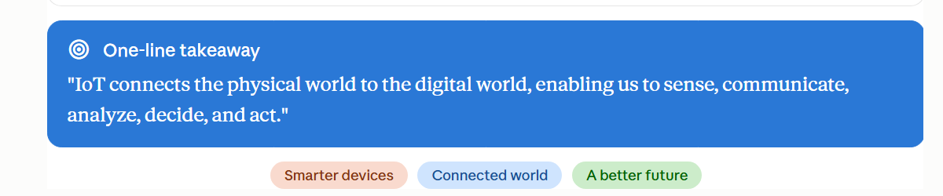

Slide 13








IoT vs Related Concepts
IoT is often confused with the Internet, M2M and Cyber-Physical Systems (CPS). They overlap and share technology, but each has a different focus and purpose.
Internet
M2M
IoT
CPS
Related. Overlapping. Not identical.
In Simple Words
How Is IoT Different?
The Internet connects people and information. M2M links machines directly. CPS uses computing to control physical processes. IoT connects everyday things to the Internet so they can sense, share and act on data.
IoT overlaps with each concept, but adds something more:
IoT vs Internet
The Internet is the network. IoT is the system of things, data and services that runs on it.
IoT vs M2M
M2M links machines directly. IoT connects many devices to shared cloud platforms and analytics.
Internet
people and information
IoT
M2M
machine to machine
CPS
computing controls the physical world
IoT vs CPS
CPS focuses on real-time control of physical processes. IoT focuses on connectivity and data.
IoT overlaps with all three, but it is the one that links everyday things to the Internet, data and intelligence.

Slide 14






1
Why do these terms get confused?
They share the same technology, but they answer different questions.
1
They share the same building blocks
2
But each one asks a different question
Internet
How do we connect people and information?
Sensors
Connectivity
Software
M2M
How can machines exchange data on their own?
Data
Actuators
Computing
IoT
How can connected things share data and act smartly?
Each concept uses some mix of these ingredients.
Example: a smart thermostat has sensors, a network link, software and an actuator, so it touches all four ideas.
CPS
How can computing safely control physical processes?
Different questions, overlapping technology.

Slide 15

2
IoT vs Internet
The Internet connects people and information. IoT connects physical things.
Internet
IoT
the global network
the network of things
CONNECTS
CONNECTS
Computers, phones and people worldwide
Physical things with sensors and software
DATA COMES FROM
vs
DATA COMES FROM
Humans: typing, clicking, uploading
Sensors and devices, automatically
MAIN PURPOSE
MAIN PURPOSE
Communication and access to information
Monitor, analyse and act on the physical world
EXAMPLE
EXAMPLE
A video call between two countries
A smart thermostat adjusting room temperature
Key idea: the Internet is the network; IoT is a system of things, data and services that runs on it.

Slide 16





2
How the Internet and IoT work together
IoT needs connectivity, and the Internet gives it global reach.
Thing
Local link
Internet
Cloud
App
Sensor in a field
Wi-Fi, Bluetooth, cellular
Global connectivity
Stores and analyses data
Shows the result
Only the blue step is the Internet. The rest of the chain is what makes it IoT.
The Internet enables IoT
IoT goes beyond the Internet
It gives devices global reach, so things can be monitored and controlled from anywhere.
It adds sensors, actuators, analytics and automation on top of connectivity.
Example: checking soil moisture on your phone from the city
Example: a smart farm that also opens valves automatically
Note: not every IoT system needs the public Internet. Some run on local or private networks, such as a home hub linking Zigbee devices.

Slide 17







3
IoT vs M2M
M2M links machines directly. IoT connects many devices through the Internet and the cloud.
M2M
vs
IoT
Machine-to-Machine
Internet of Things
Sensor
Dashboard
Direct link
Wearable
Analytics
Vending machine
cellular or wired
Supplier server
Cloud platform
Machine
Mobile app
Machines exchange data directly, no human needed
Usually point-to-point and single-purpose
Often closed or proprietary systems
Devices connect via the Internet to shared platforms
Many devices can serve many applications
Data feeds analytics, dashboards and AI
Example: a vending machine reports low stock to a supplier's server
Example: a smart building's lights, HVAC and sensors feed one cloud platform

Slide 18
3
IoT vs M2M: side by side
M2M is often described as a building block, or predecessor, of IoT.
M2M
IoT
Communication
Direct, point-to-point
Many-to-many via the Internet and cloud
Network
Cellular, wired or proprietary links
IP-based: Wi-Fi, cellular, LPWAN and more
Scope
Closed, single-purpose solutions
Open ecosystems, many applications
Data use
Basic monitoring and control
Analytics, AI and smart decisions
Scale
Small, fixed deployments
Highly scalable, up to millions of devices
Human role
Little or none
Users interact through apps and dashboards
Key idea: IoT takes the machine-to-machine link and adds Internet-scale integration, cloud and intelligence.

Slide 19





4
IoT vs Cyber-Physical Systems (CPS)
CPS tightly couples computing with physical processes. IoT connects things to share data and services.
CPS
vs
IoT
Cyber-Physical Systems
Internet of Things
Physical process
Sensors
Things
Network
Cloud
Services
Actuators
Control software
Data flows from things to analytics and services
A real-time feedback loop
Computers monitor and control physical processes
Focus on real-time control, safety, reliability
Need not use the public Internet
Things sense, connect and share data over networks
Focus on connectivity, data and services
Some systems only monitor and never control
Example: a pacemaker senses heart rhythm and corrects it in real time
Example: a weather sensor sends readings to a cloud dashboard

Slide 20


4
IoT vs CPS: where they overlap
Many real systems are both. What matters is whether they connect, control, or do both.
A quick test
1. Is there a control loop?
Sensors feed computing, which drives actuators that change the physical process. If yes, it behaves like a CPS.
BOTH
Connected and controlling
Smart grid
Connected vehicles
Industrial IoT
CPS
Controls a physical process in a real-time loop
e.g. pacemaker, autopilot
IoT
Connects things and shares their data
e.g. weather sensor
2. Is it networked?
Devices share data with the cloud, other systems or users. If yes, it behaves like IoT.
Yes to both?
Then the system is both IoT and CPS, for example a smart grid balancing supply and demand.

Slide 21

Comparison at a glance
Internet
M2M
IoT
CPS
Connects
People, computers and information
Machines with other machines
Everyday things to the Internet
Computing with physical processes
Data comes from
Humans: typing, clicking, uploading
Machines, automatically
Sensors and devices, automatically
Sensors in the physical process
Main focus
Communication and information access
Automated data exchange between machines
Data, analytics and smart services
Real-time control, safety, reliability
Network
Global, IP-based
Point-to-point: cellular or wired
Internet-based and cloud-connected
Varies: embedded buses to the Internet
Example
A video call
Vending machine to supplier server
Smart thermostat or smart farm
Pacemaker or aircraft autopilot

Slide 22


The big picture
Internet
Connected people and information.
M2M
Connected machines, directly.
IoT
Connected everyday things, using the Internet, data and intelligence.
CPS
Computing tightly tied to physical processes for real-time control.
Remember
Internet = network · M2M = direct link · IoT = things + data · CPS = control

Slide 23

One-line takeaway
“The Internet connects people, M2M connects machines, CPS controls physical processes, and IoT connects everyday things to data and intelligence.”
Connected people
Connected machines
Connected things
Controlled processes
Up next: Building Blocks of IoT

Slide 24









Building Blocks of IoT
Every IoT system, from a smart bulb to a smart factory, is assembled from the same four components and powered by five enabling technologies.
Devices
Connectivity
Processing
Interface
Four blocks. One working system.
In Simple Words
Two Ways to Study Them
An IoT system is a chain of four jobs. Devices sense the world, connectivity carries the data, data processing turns it into insight, and the user interface lets people see and act.
We look at the same system through two lenses:
Components
What the system is made of: devices, connectivity, data processing and user interface.
Enabling technologies
What makes each block possible today: sensors, connectivity, cloud, big data and AI.
Devices
senses
Connectivity
carries
Processing
decides
Interface
shows
Why it matters
With these blocks in mind you can read any IoT architecture, from a smart bulb to a smart city.
Feedback: commands flow back down to the devices.
Four building blocks, five enabling technologies: one connected system.

Slide 25

1
Why break IoT into building blocks?
Every IoT system, big or small, does the same four jobs.
1
Think of IoT as a living body
2
Two lenses on the same system
Devices
Senses and muscles
See, hear, touch and move.
Part A: Components
What is an IoT system made of?
Connectivity
Nerves
Carry signals to and from the brain.
Devices
Connectivity
Data processing
User interface
Processing
Brain
Makes sense of signals and decides.
Part B: Enabling technologies
What makes each block possible today?
Interface
Voice and face
How we see and talk to the system.
Sensors
Connectivity
Cloud
Big data
AI

Slide 26

1
The four components of an IoT system
Data flows up from the physical world, and commands flow back down.
Devices
Connectivity
Data processing
User interface
Sense and act
Carry the data
Turn data into insight
Show and control
Feedback: commands flow back to the devices
Follow the data: smart irrigation on a farm
1
Sense
2
Carry
3
Decide
4
Show and act
A soil-moisture sensor measures the field: 28%.
A LoRaWAN radio sends the reading to a gateway, which forwards it online.
The cloud compares 28% with a target of 40% and flags the field as too dry.
The farmer's app shows an alert. One tap, or an automatic rule, opens the valve.
Note: Small systems can merge blocks. A smart bulb and its phone app may talk directly, but all four jobs still happen.

Slide 27



2
Devices: the things that touch the physical world
Sensors read the world, actuators change it, and a small computer runs them.
Sensors
Microcontroller
Actuators
the input: they sense
the brain of the device
the output: they act
JOB
JOB
JOB
Measure something in the physical world and turn it into an electrical signal.
Reads the sensors, runs the device program and prepares data to send.
Take a command and make something happen in the physical world.
EXAMPLES
EXAMPLES
EXAMPLES
Temperature, humidity, motion, light, soil moisture, GPS
ESP32, Arduino, NodeMCU
Relay, motor, valve, buzzer, smart lock, LED
SENDS
OFTEN INCLUDES
RECEIVES
Readings to the microcontroller
A radio such as Wi-Fi or Bluetooth to connect
Commands from the microcontroller or the cloud
Key idea: devices are the only block that touches the physical world. Everything else works on data.

Slide 28


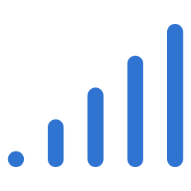

2
Connectivity: how the data travels
The right link depends on distance, power and how much data you send.
Short range
Long range, low power
Long range, high speed
A few cm to about 100 m
Kilometres
Wide-area network coverage
Bluetooth LE
Zigbee
Wi-Fi
NFC
LoRaWAN
NB-IoT
LTE-M
4G
5G
BEST FOR
BEST FOR
BEST FOR
Homes, wearables and smart buildings
Farms, meters and remote sensors on small batteries
Vehicles, cameras and devices that send a lot of data
TRADE-OFF
TRADE-OFF
TRADE-OFF
Limited range, so it usually needs a gateway to reach the Internet.
Low data rate: small messages, sent occasionally.
Higher power use and data plan costs.
Shorter range
Longer range
Gateways bridge the gap. A gateway collects data from local links such as Bluetooth and Zigbee and forwards it to the Internet.

Slide 29



2
Data processing: from raw readings to decisions
Somewhere between the sensor and the screen, data must be stored, analysed and acted on.
Collect
Store
Analyse
Act
Readings arrive from many devices.
Kept as time-stamped records.
Rules and AI find patterns and problems.
Send alerts, update dashboards, trigger actuators.
Near the device (edge)
In the cloud
on the device or a local gateway
on powerful remote servers
Fast response: no round trip to the cloud
Keeps working when the connection drops
Sends only useful data, saving bandwidth
Huge storage and computing power on demand
Combines data from many devices and sites
Trains and runs AI models on long histories
+
Example: a camera detects motion on the spot
Example: the cloud spots pump vibration rising for weeks
Key idea: most real systems use both: the edge for speed, the cloud for scale.

Slide 30


3
Enabling technologies: why IoT works now
Five advances made connected devices cheap, reliable and useful at scale.
Sensors
Connectivity
Cloud
Big data
AI
WHAT CHANGED
WHAT CHANGED
WHAT CHANGED
WHAT CHANGED
WHAT CHANGED
Tiny, cheap, accurate and low-power sensors can now go almost anywhere.
Wi-Fi, Bluetooth LE, LPWAN and 5G give devices low-power links at many ranges.
On-demand storage and computing that grows with the number of devices.
Tools that store and process fast, never-ending streams of readings.
Machine learning finds patterns in data and turns them into predictions.
EXAMPLE
EXAMPLE
EXAMPLE
EXAMPLE
EXAMPLE
A phone accelerometer or a soil probe
A LoRaWAN water meter
A platform storing readings from thousands of sensors
Years of vibration logs from every machine in a plant
Predicting a bearing failure before it happens
Key idea: no single technology is IoT. Each one removes a barrier, and together they make connected things practical.

Slide 31
3
Which technology powers which block?
Each enabling technology strengthens one or more components.
Enabling technology
Devices
Connectivity
Data processing
User interface
Sensors
Measure the physical world
Connectivity
Radio chip inside the device
Wi-Fi, BLE, LPWAN, 5G links
Cloud
Storage and computing on demand
Hosts apps and dashboards
Big data
Handles huge, fast streams
AI
Edge AI on the device
Finds patterns and predicts
Voice assistants
Main role
Also helps

Slide 32

Comparison at a glance
Devices
Connectivity
Data processing
User interface
Main job
Sense the world and act on it
Carry data between devices, gateways and the cloud
Store, analyse and turn data into decisions
Show results and let people control the system
Typical tools
Sensors, actuators, microcontrollers
Wi-Fi, Bluetooth LE, Zigbee, LoRaWAN, NB-IoT, 5G
Edge gateways, cloud platforms, analytics, AI models
Dashboards, mobile apps, voice assistants, alerts
Example
A soil-moisture sensor and a valve
A LoRaWAN link from field to gateway
The cloud flags a field as too dry
The farmer's app shows 28% and opens the valve
If it is missing
No data comes in and nothing happens
Data stays trapped on the device
Only raw numbers, no insight
Nobody can see or control the system

Slide 33
The big picture
Devices
Sense the physical world and act on it.
Connectivity
Carry data between things, gateways and the cloud.
Data processing
Store, analyse and turn data into decisions.
User interface
Show results and let people monitor and control.
Remember
Devices sense · Connectivity carries · Processing decides · Interface shows

Slide 34
One-line takeaway
“Devices sense, connectivity carries, data processing decides, and the user interface shows, all made possible by sensors, connectivity, cloud, big data and AI.”
Devices sense
Connectivity carries
Processing decides
Interface shows
Up next: IoT Architecture

Slide 35





IoT Reference Architecture
A layered way of describing an IoT system, so heterogeneous devices, sprawling networks and diverse applications can work together as one organized whole.
Sense it. Move it. Use it.
In Simple Words
Why do we need an architecture?
An IoT system is a stack of layers. Each layer has one job, and data flows up from the physical world to the person who uses it.
Real IoT systems mix devices, networks and applications. A layered model keeps that manageable:
Tames complexity
Application
Splits a big system into layers, one clear job each.
Use it: dashboards, alerts, actions
Handles heterogeneity
Many devices, networks and apps fit the same frame.
Network
Move it: carry data where it is needed
Works at any scale
From one smart apartment to a national power grid.
Perception
Gives a common map
Sense it: sensors and actuators
Any IoT system can be mapped onto the same layers.
Perception + Network + Application = a working system
Shows where processing lives
Device, gateway or cloud becomes a design choice.
Architecture is the skeleton of every IoT system: learn it once, use it everywhere.

Slide 36







1
Two ways to describe an IoT system
Two reference architectures are in common use: a simple one and a more precise one.
3
Three-layer model
5
Five-layer model
The simple view
The more precise view
Perception
Network
Application
Perception
Network
Processing
Sense it → Move it → Use it
Easy to hold in your head. It captures the core idea without unnecessary complexity.
Application
Business
Same bottom two layers. The old Application layer is split into Processing, Application and Business.
Same system, two levels of detail: three layers show the shape of the data flow; five layers show what “use” really breaks down into.

Slide 37

The three-layer model
Data flows up the stack, from the physical world to the end user.
Sensors and actuators perceive the environment
Sensors perceive the surroundings, actuators act on them. Raw data collection happens here.
1. Perception
Example: a soil-moisture sensor buried at root depth
Data is carried to where it needs to go
Carries the collected data onward using communication technologies and gateways (see Unit II).
2. Network
Example: an ESP32 sending readings over Wi-Fi
The service is delivered to the end user
A dashboard, an alert or an automated action: where collected data is finally put to use.
3. Application
Example: a mobile app showing live soil moisture
Perception, Network, Application. Sense it, move it, use it.

Slide 38





3
Why a five-layer model?
In practice, the third layer quietly does an enormous amount of hidden work.
Stores, analyzes and pre-processes the incoming data. Also called the middleware layer.
Application layer
in the three-layer model
Processing
Storage
Analytics
Delivers processed information to user-facing services, such as apps and dashboards.
Business logic
User interface
Application
splits into
Turns collected data into high-level business decisions and judges whether the system is succeeding.
One overloaded box doing everything.
Business
Perception and Network stay exactly the same. Only the top layer is pulled apart.

Slide 39
3
The five-layer model
The full stack, mapped onto the three-layer view.
5 · Business
Turns data into high-level decisions and judges whether the deployment is succeeding.
4 · Application
Delivers processed information to end-user services such as apps and dashboards.
Application
in the 3-layer model
3 · Processing
Stores, analyzes and pre-processes the incoming stream (edge and cloud).
2 · Network
Transmits the collected data to wherever it is processed.
Network
in the 3-layer model
1 · Perception
Sensors and actuators perceive, and act on, the physical world.
Perception
in the 3-layer model
Data flows up: sense → move → process → apply → decide

Slide 40






Layer 1 · Perception
A closer look at the physical layer.
Sheer diversity
Passive and active
A fifty-cent mass-produced temperature sensor can sit beside a several-hundred-dollar precision vibration sensor in one deployment.
Passive sensors simply measure and report. Actuators physically change something about the world.
Perception Layer
Where raw data collection happens, at the literal, physical point of sensing.
Harsh constraints
Exposed to the world
Most of a system's physical limits live here: battery life, durability against weather and vibration, size and unit cost.
These are the devices out in a field, worn on a wrist, or bolted onto a running industrial machine.
Sensors + Actuators
The system’s window onto the physical world: diverse, exposed and tightly constrained.

Slide 41
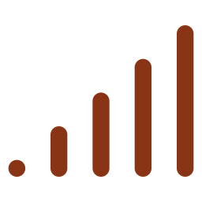



Layer 2 · Network
Moves data reliably from where it is sensed to where it is processed.
short-range or long-range link
onward link
Devices
Gateway
Cloud / processing
What makes this layer hard
Unreliable links
Limited power
Huge distances
Data often travels over inherently unreliable wireless links.
Devices frequently run on extremely limited battery power.
Data sometimes has to cross genuinely large geographic areas.
One of the hardest engineering problems in IoT, which is why Unit II is dedicated to it.

Slide 42






Layers 4 & 5 · Application and Business
Application Layer
Business Layer
Where a person, or another automated system, gets real value from everything below.
Looks at the whole system and its business model, not at any single sensor reading.
A clear, uncluttered dashboard
Analyzes collected data to inform high-level business decisions
A perfectly timed, relevant alert
Manages overall system operation strategically
A simple, reliable automated action
Evaluates whether a deployment is succeeding or failing
How successful a deployment feels to users depends on how thoughtfully this layer is designed, even when every layer beneath it is technically flawless.
Easy to overlook from a purely technical background, but it absolutely matters in real deployments.

Slide 43
5
Where does the processing happen?
A central theme of both models: edge, fog or cloud.
Closer to the device
Farther from the device
Edge computing
Fog computing
Cloud-centric
WHERE
WHERE
WHERE
On, or very near, the device that generated the data.
An intermediate tier on a local gateway or modest on-premises server.
A distant, centralized data center.
WHAT IT DOES
WHAT IT DOES
WHAT IT DOES
Runs a lightweight check, such as anomaly detection, on the microcontroller itself.
Aggregates data from many edge devices, then sends a smaller, filtered volume onward.
Every raw reading is shipped wholesale for central processing.
IMPACT
IMPACT
IMPACT
Lowest latency and less network bandwidth used.
A local “middle manager” that spares the cloud the raw firehose.
Stops scaling gracefully with thousands or millions of devices.
One of the most important design decisions in practical IoT. We go much deeper in Unit III.

Slide 44




6
Worked example: mapping a real system
Smart irrigation on a working farm, placed onto the five layers.
Smart irrigation deployment
Layer
What it looks like on the farm
Perception
Soil-moisture sensors buried at root depth
Network
An ESP32 microcontroller sending readings over local Wi-Fi
Processing
A cloud service that filters and stores every incoming reading
Application
A mobile app showing the farm manager live soil moisture
Business
Monthly report review: should irrigation expand to more acreage?
Once this clicks, you can run the same five-second mental exercise on any IoT system you meet.

Slide 45
The big picture
3 layers
Perception, Network, Application: sense it, move it, use it.
5 layers
Application splits into Processing, Application and Business.
Any system
Every real IoT system maps cleanly onto these layers.
Edge · Fog · Cloud
Where processing happens is a key design decision.
Up next
The devices that live in the Perception Layer.

Slide 46
One-line takeaway
“IoT is organized in layers: sense it, move it, process it, use it, and decide what it means for the business.”
Perception
Network
Processing
Application
Business

Slide 47




IoT Devices Explained
The real hardware of the Perception Layer: the sensors, actuators and small computers you will personally wire up and program in the Unit III labs.
Sense it. Compute it. Act on it.
In Simple Words
The five device families
Every IoT device does some mix of three jobs: it senses the world, thinks locally, and acts back on it.
This topic tours each family in turn, from a single sensor to a finished smart product:
Sensors
Sensor
Turn physical quantities into readable signals.
The eyes and ears of the system
Actuators
Turn digital commands into physical action.
Microcontroller
The local brain, right beside the hardware
Microcontrollers
Provide local, on-site computation.
Actuator
RFID, NFC and GPS
The hands of the system
Give a device its identity and location.
Sense + Compute + Act = an IoT device
Smart devices
Finished products that bundle it all together.
Small hardware details carry very real consequences for how a system performs in the field.

Slide 48
1
Sensors and actuators: a two-way interface
Together they give an IoT system its full connection to the physical world.
measures
electrical signal
digital command
acts on
Physical world
Sensor
Microcontroller
Actuator
Physical world
Sensor
Actuator
The system’s eyes and ears
The system’s hands
Converts a physical quantity in the real world into an electrical signal a computer can read.
Does the exact reverse: converts a digital command from software into real physical action.
Temperature
Light level
Motion
Gas
Open a valve
Switch a relay
Spin a motor
Sensors let the system perceive its surroundings; actuators let it act on those same surroundings.

Slide 49





2
Sensors: a guided tour
Four sensors you will see constantly in the course and its lab series.
Common IoT sensors
Sensor
Measures
How it works
DHT11 / DHT22
Temperature and humidity
Extremely common and inexpensive: in nearly every beginner IoT project ever built.
LDR
Ambient light intensity
A light-dependent resistor: its resistance changes with how much light hits it.
HC-SR04
Distance (ultrasonic)
Sends a pulse of sound and times the returning echo, like a bat navigating in the dark.
PIR sensor
Motion
Passive infrared: senses changes in infrared (body heat) moving across its view.
You will wire these up yourself in the Unit III labs.

Slide 50




3
Actuators: the system’s hands
The reverse of a sensor: a digital command becomes physical change.
Relay
Servo motor
LED
Physically switches a circuit on or off.
Turns a command into controlled motion.
Changes its state to show what is going on.
Example: switching a water pump on
Example: opening a ventilation vent
Example: signaling a status
Sensor perceives
Microcontroller decides
Actuator acts
Sensors and actuators together give an IoT system its full two-way interface with the world.

Slide 51



Microcontrollers and embedded systems
Embedded system
One chip, three jobs
Any computing system built directly into a device to perform a small, dedicated set of functions.
Reads your sensors
Takes readings from the sensors connected to it.
Microcontroller-based IoT node
A small, self-contained computer on a single chip
Runs your control logic
Executes whatever logic the application needs.
Processor core
Working memory
Input and output pins
Drives your actuators
Switches connected actuators in response.
All in one tight package.
A microcontroller-based IoT node is one especially common example of a broader embedded system.

Slide 52


Three platforms you will build with
Hands-on projects in Unit III.
Arduino
ESP32
Raspberry Pi
WHAT IT IS
Simple, robust development boards
Adds built-in Wi-Fi and Bluetooth right on the chip
A genuine general-purpose computer running a full Linux OS
STANDOUT
Genuinely beginner-friendly
Probably the most popular platform for networked IoT
Considerably more powerful, but more power-hungry and complex
BEST FOR
Learning the basics
Networked IoT projects
Heavier, general-purpose jobs
Do not memorize the differences yet. We compare them feature by feature in Unit III.

Slide 53




5
Identity and location: RFID, NFC and GPS
Without an identity, a device cannot really be a “thing” on the network.
A reader wirelessly reads a unique ID from a tag
No line of sight needed. Passive tags have no power source: they draw it from the reader’s signal.
RFID
Example: asset tracking, secure access badges
RFID’s short-range cousin
Works over a few centimeters at most. That short range is a feature: it keeps contactless payment secure.
NFC
Example: contactless payment
A device reports its own precise location
Triangulates radio signals from a constellation of orbiting satellites.
GPS
Example: fleet tracking, “your delivery is nearby”
Identification and location are prerequisites for treating an object as something addressable on a network.

Slide 54





6
Smart devices: everything in one product
The catch-all name for a finished product with sensing, software and connectivity built in.
Sensing
Software
Communication
Smart device
Examples
Smart thermostat
Smart refrigerator
Smart streetlight
Senses temperature, runs control logic and connects to an app.
A household appliance with sensing, computing and connectivity built in.
Stands on a city corner and can dim automatically at night.
The same three-part combination from Topic 2, wrapped into one consumer or industrial product.

Slide 55


How the devices fit together
One product, the same building blocks.
A smart device
signal
command
Sensors
Microcontroller
Actuators
DHT · LDR · HC-SR04 · PIR
Arduino · ESP32 · Raspberry Pi
Relay · servo motor · LED
RFID · NFC · GPS
Identity and location awareness
Whatever the product, it is the same small set of device types combined in different ways.

Slide 56





Worked example · Battery life
How long will one battery last?
80 mA
One 600-second cycle
while transmitting, for 2 s per reading
2 s transmitting at 80 mA
598 s idle at 0.5 mA
0.5 mA
(transmit slice enlarged for visibility)
while idle between readings
1
Average current
(2 s × 80 mA + 598 s × 0.5 mA) ÷ 600 s
10 min
between readings (a 600 s cycle)
Work it out
2
(160 + 299) ÷ 600 ≈ 0.765 mA
2,000 mAh
battery capacity
3
Runtime
2,000 mAh ÷ 0.765 mA ≈ 2,600 hours
The node is idle for 598 of every 600 seconds.

Slide 57
The big picture
Sensors
Turn the physical world into usable digital data.
Actuators
Turn digital data back into real physical action.
Microcontrollers
Provide the local computational brains that tie it together.
RFID · NFC · GPS
Give devices their own identity and location awareness.
Smart devices
Finished products that bundle all of this into one package.

Slide 58
One-line takeaway
“Sensors perceive, actuators act, microcontrollers think, and small device-level details have very real consequences in the field.”
Sensors
Actuators
Microcontrollers
RFID · NFC · GPS
Smart devices
Up next: following one piece of data from sensor to dashboard.

Slide 59





The IoT Data Journey
The path one reading takes from a raw physical measurement to a meaningful decision or action, in five stages.
Measure. Move. Store. Analyze. Act.
In Simple Words
Why treat it as one pipeline?
Think of one sensor reading as a traveler. It starts in the physical world and passes through five stages until a person, or a machine, acts on it.
A weakness at any one stage undermines everything downstream of it:
Sampling sets the ceiling
1
Acquire
The sensor samples the world
Analytics cannot recover what was never captured.
Dropped readings leave gaps
2
Transmit
The reading moves onward
Unreliable transmission quietly corrupts the data.
Gaps mislead analytics
3
Store
Timestamped and persisted
A time series with holes can point to wrong answers.
Analyze
Insight is extracted
Clutter hides value
4
A confusing dashboard wastes all earlier engineering.
5
Monitor
Results reach people or machines
One connected whole
Design the pipeline together, not as five boxes.
Every application in Unit V builds on this same five-stage backbone.

Slide 60





1
The five-stage pipeline
One reading, five stages, from the physical world to a real decision.
1
2
3
4
5
Acquisition
Transmission
Storage
Analytics
Monitoring
A sensor samples the physical world, producing a raw digital reading.
The reading moves across the network, via a gateway or straight to the cloud.
Timestamped readings are kept in a time-series database.
Stored data is processed for insight, from simple thresholds to machine learning.
Results reach a person on a dashboard, or an actuator, closing the loop.
Perception layer
Network layer
Processing layer
Processing layer
Application layer
Where each stage lives in the five-layer architecture from Topic 5
The same pipeline recurs, in specialized form, across every application in Unit V.

Slide 61







Stage 1 · Data acquisition
A sensor samples the physical world.
A physical quantity
Sampled at a chosen rate
One raw digital reading
Sample far too rarely
The sweet spot
Sample far too often
You risk missing important, fleeting events entirely.
A real trade-off between data fidelity and power and bandwidth cost. Getting the balance right is a genuine engineering skill.
You needlessly burn battery life and network bandwidth for very little extra benefit.
The sampling rate is a design decision in its own right, not an afterthought.

Slide 62




Stage 2 · Data transmission
The reading physically moves.
via a gateway
Gateway (optional)
Device
or directly to the cloud, with no gateway
Cloud
Network-layer technology
Gateway or direct
The subject of Unit II
The reading crosses whichever technology was chosen for the deployment.
It heads onward to a gateway, or sometimes travels straight to the cloud.
This entire stage is, essentially, the whole subject of Unit II.
If transmission silently drops readings, every stage after it inherits the gaps.

Slide 63



Stage 3 · Data storage
Readings are persisted for later use.
Timestamped readings
Built for one recurring pattern
Timestamp
Sensor
Value
Huge volumes
09:00:00
node-12
24.1 °C
Absolutely huge volumes of sequential, timestamped records.
09:05:00
node-12
24.3 °C
Constantly written
09:10:00
node-12
24.2 °C
New records keep arriving, written in real time.
09:15:00
node-12
24.6 °C
Illustrative readings
Occasionally queried
A time-series database
Read back now and then over a specific range of time.
Timestamped readings must be reliably persisted somewhere for later use.

Slide 64


Stage 5 · Real-time monitoring
Results finally reach someone or something.
A person, through a dashboard
Results are presented to a human operator on a dashboard or mobile app.
Example: a farm manager checking live soil moisture
A machine, through an actuator
Results are fed back automatically to an actuator, closing the loop between sensing and acting.
Fully processed results
Example: a soil sensor triggering automated irrigation
The loop closes
Physical world
Five-stage pipeline
Actuator
Physical world
The loop between sensing and acting that we first met in Topic 2.

Slide 65





Worked example · Data volume
A smart-city air-quality network.
500
Readings per sensor per day
1
air-quality sensors across a metropolitan area
24 × 60 = 1,440 min ÷ 5 = 288 readings
200 bytes
in each reading
Data per sensor per day
2
288 × 200 B = 57,600 B ≈ 56 KB
5 min
between readings, continuously
Whole deployment per day
How much?
3
500 × 56.25 KB ≈ 28,000 KB ≈ 27.5 MB
total data generated in one full day
About 27.5 MB a day sounds modest: less than one high-resolution smartphone photo.

Slide 66




2
Why every stage matters together
A weakness at any one stage undermines everything downstream of it.
1 · Acquisition
2 · Transmission
3 · Storage
4 · Analytics
5 · Monitoring
Stage 1
Stage 2
Stage 5
A poorly chosen sampling rate
Transmission that silently drops readings
A cluttered, confusing dashboard
No clever analytics in stage 4 can recover information that was never captured.
Stage 3 ends up with gaps in its time series that quietly mislead the analytics.
All the careful engineering in the first four stages can still fail the person who needed to see it.
Treat the pipeline as one connected whole, not five boxes optimized in isolation.

Slide 67

3
The same backbone in Unit V
Two applications, one five-stage pipeline (illustrative sketches).
From sensor to action
Smart irrigation
Wearable patient monitor
Acquisition
Soil-moisture reading
Blood-oxygen reading
Transmission
ESP32 over local Wi-Fi
Wireless link to the hospital network
Storage
Timestamped readings in a time-series database
Timestamped readings, kept per patient
Analytics
Is the soil too dry?
Has blood oxygen dropped?
Monitoring
Dashboard, then automated irrigation
Urgent alert to the nurse
The full applications, with far more detail, arrive in Unit V.

Slide 68
The big picture
1 · Acquisition
A sensor samples the world at a chosen rate.
2 · Transmission
The reading travels via a gateway or straight to the cloud.
3 · Storage
Timestamped readings are persisted in a time-series database.
4 · Analytics
Stored data is analyzed, from thresholds to machine learning.
5 · Monitoring
Dashboards, or actuators, put the results to use.

Slide 69
One-line takeaway
“Every reading travels the same five stages, from acquisition to monitoring, and a weakness in any one undermines everything after it.”
Acquisition
Transmission
Storage
Analytics
Monitoring
Up next: a Unit I recap and a five-question self-check.

Slide 70






Unit I Recap & Self-Assessment
Pull the whole unit together in a rapid recap, then check your own understanding with five short questions.
Recap it. Test it. Move on.
Unit I in Five Questions
How the self-check works
By now you can answer the big questions that frame the whole field:
Five questions, one at a time, with a pause after each:
1
What is IoT?
Objects that sense, share and act
Read the question
One at a time
2
How is it different?
From the Internet, M2M and CPS
Pause for about five seconds
Resist the urge to peek
3
What is it made of?
Sensors, actuators, gateways, cloud
Answer on your own
Out loud, or in writing
4
How is it organized?
Layers, plus edge, fog and cloud
Reveal the answer
Check it against yours
5
How does data flow?
Five stages, sensor to dashboard
Revisit what was tricky
Every question maps to a topic
You will retain far more by testing yourself than by passively nodding along.

Slide 71

1
Recap: what IoT is, and is not
Topics 2 and 3.
Physical objects embedded with sensing, software and communication hardware, exchanging data over a network and very often acting back on the world.
It is clearly distinguished from three related ideas
The Internet
M2M
Cyber-physical systems
IoT focuses on physical objects that operate under severe power and processing constraints.
IoT uses shared, internet-based infrastructure rather than fixed, proprietary, point-to-point links.
IoT generally does not require the same tight, hard real-time control loop.
IoT is best seen as the broad, network-centric umbrella that connects physical devices at massive scale.

Slide 72





2
Recap: the building blocks
Topic 4: the same recurring parts in every IoT system.
Every IoT system is built from
Made possible by five enabling technologies
Identification technologies
Sensors
Actuators
Microcontrollers
Communication technologies
Computation platforms
Connectivity
Gateways
Cloud platforms
Cloud and edge computing
The same skeleton, whatever the domain.
AI-driven analytics
Enabling technologies had to mature and become affordable before IoT at scale was possible.

Slide 73

3
Recap: the reference architecture
Topic 5: two views of the same layered system.
5 · Business
Business-level decisions; is the deployment succeeding?
4 · Application
User-facing services: apps and dashboards.
Application
in the 3-layer model
3 · Processing
Stores, analyzes and pre-processes the data.
2 · Network
Transmits data to where it is processed.
Network
in the 3-layer model
1 · Perception
Sensors and actuators at the point of sensing.
Perception
in the 3-layer model
Edge and fog computing decide where processing happens: on the device, at the fog, or in the cloud.

Slide 74


4
Recap: the data journey
Topic 7: the backbone under every Unit V application.
1
2
3
4
5
Acquisition
Transmission
Storage
Analytics
Monitoring
A sensor samples at a chosen rate.
The reading moves via a gateway or straight to the cloud.
Timestamped readings go into a time-series database.
From simple thresholds to machine learning.
Dashboards, or actuators, put results to use.
Sampling rate is a design choice
Data volume scales linearly
Too rarely misses fleeting events; too often burns battery and bandwidth.
500 sensors made about 27.5 MB a day; 50,000 would make nearly 3 GB.
The exact same backbone every application in Unit V will build on.

Slide 75


Q1
Self-assessment: question 1 of 5
Tests: Related concepts (Topic 3)
What is the single biggest architectural difference between classic M2M communication and genuine IoT?
Pause the video
about 5 seconds
Try to answer on your own first. You retain far more by testing yourself.
5
4
3
2
1
The answer is on the next slide. No peeking!

Slide 76



Q1
Question 1: the answer
Tests: Related concepts (Topic 3)
What is the single biggest architectural difference between classic M2M communication and genuine IoT?
M2M relies on fixed, proprietary, point-to-point links to exactly one counterpart, while IoT uses shared, internet-based infrastructure and joins a much broader platform ecosystem.
Classic M2M
Genuine IoT
A fixed, proprietary, point-to-point link to one counterpart.
Shared, internet-based infrastructure and a broader platform ecosystem.
If this was tricky, revisit Topic 3: IoT versus related concepts.

Slide 77
Q2
Self-assessment: question 2 of 5
Tests: IoT architecture (Topic 5)
Name the three layers of the simple three-layer IoT architecture, in their correct order.
Pause the video
about 5 seconds
Try to answer on your own first. You retain far more by testing yourself.
5
4
3
2
1
The answer is on the next slide. No peeking!

Slide 78

Q2
Question 2: the answer
Tests: IoT architecture (Topic 5)
Name the three layers of the simple three-layer IoT architecture, in their correct order.
Perception, Network and Application.
Perception
Network
Application
Sense it
Move it
Use it
If this was tricky, revisit Topic 5: IoT architecture.

Slide 79
Q3
Self-assessment: question 3 of 5
Tests: IoT architecture (Topic 5)
In the more detailed five-layer model, which layer from the original three gets split apart, and what are the three resulting layers called?
Pause the video
about 5 seconds
Try to answer on your own first. You retain far more by testing yourself.
5
4
3
2
1
The answer is on the next slide. No peeking!

Slide 80
Q3
Question 3: the answer
Tests: IoT architecture (Topic 5)
In the more detailed five-layer model, which layer from the original three gets split apart, and what are the three resulting layers called?
The Application Layer is split into the Processing Layer, the Application Layer and the Business Layer.
Application layer
in the three-layer model
Processing
Application
Business
If this was tricky, revisit Topic 5: IoT architecture.

Slide 81
Q4
Self-assessment: question 4 of 5
Tests: Devices and components (Topics 4 and 6)
What is the key functional difference between a sensor and an actuator?
Pause the video
about 5 seconds
Try to answer on your own first. You retain far more by testing yourself.
5
4
3
2
1
The answer is on the next slide. No peeking!

Slide 82

Q4
Question 4: the answer
Tests: Devices and components (Topics 4 and 6)
What is the key functional difference between a sensor and an actuator?
A sensor converts a physical quantity into an electrical signal: it perceives the world. An actuator converts a digital command into physical action: it acts on the world.
Sensor
It perceives
Actuator
It acts
Physical quantity → electrical signal
Digital command → physical action
If this was tricky, revisit Topic 6: IoT devices explained.

Slide 83

Q5
Self-assessment: question 5 of 5
Tests: Data journey (Topic 7)
Name all five stages of the complete IoT data journey, in their correct order.
Pause the video
about 5 seconds
Try to answer on your own first. You retain far more by testing yourself.
5
4
3
2
1
The answer is on the next slide. No peeking!

Slide 84

Q5
Question 5: the answer
Tests: Data journey (Topic 7)
Name all five stages of the complete IoT data journey, in their correct order.
Data acquisition, data transmission, data storage, data analytics and real-time monitoring, typically delivered through dashboards.
1 · Acquisition
2 · Transmission
3 · Storage
4 · Analytics
5 · Monitoring
If this was tricky, revisit Topic 7: the IoT data journey.

Slide 85


How did you do?
Missed a few? Revisit the matching topic
Q1
M2M versus IoT
Topic 3 · IoT versus related concepts
Got most of them right?
Q2 · Q3
Three- and five-layer models
If you answered most of the five without peeking at the answers, you have properly internalized Unit I.
Topic 5 · IoT architecture
Q4
Sensors and actuators
Topics 4 and 6 · Building blocks and devices
You are ready for Unit II
Q5
The five data stages
Topic 7 · The IoT data journey
Actively testing yourself beats passively nodding along.

Slide 86





Preview of Unit II
IoT Communication and Networking
UNIT I
UNIT II
What an IoT system is made of, and how it is organized into layers.
How do all these separate pieces actually talk to each other, over the air?
Short-range options
Long-range options
Bluetooth and Zigbee.
LoRaWAN and cellular IoT.
Application protocols
Wider networking
MQTT structures the actual messages that are sent.
IPv6 and wireless sensor networks tie it together at scale.
Next: how physically separate devices communicate, reliably and at scale.

Slide 87
One-line takeaway
“Every IoT system uses the same parts, the same layers and the same five-stage data journey. Learn that skeleton and the rest follows.”
Definition
Related concepts
Building blocks
Architecture
Data journey
See you in Unit II: IoT Communication and Networking.

