Slide 1
PCp³: A C Front End for
Preprocessor Analysis and Transformation
Greg J. Badros
23 October 1997
Qualifying Exam Presentation
University of Washington
Department of Computer Science
and Engineering

Slide 2
Simple C program
#include <stdio.h>
int main(int argc, char *argv[]) {
printf("Hello world\n");
return 0;
}
Uses preprocessor
Outputs nothing if compiled with:
gcc -Dprintf(x)= hello.c -o hello
C language requires preprocessor
Notes:
Even the simplest of C programs uses the preprocessor
Header files, command line directives
cpp is inseparable -- must get preprocessed
-D may be slightly contrived here, but it's a common
usage, especially from Makefiles
Also, C relies on cpp for
* file inclusion
* symbolic constants
* configuration control
* pseudo-inline functions

Slide 3
What...
you see
is not what
the compiler gets
if (STREQ (&(argv[arg_index][1]),
long_args[i].name))
...
else {
#if defined (HISTORY)
# if defined (BANG_HISTORY)
history_expansion = 0;
# endif
remember_on_history = 0;
#endif /* HISTORY */
interactive_shell =
startup_state =
interactive = 0;
no_line_editing = 1;
#if defined (JOB_CONTROL)
job_control = 0;
#endif /* JOB_CONTROL */
}
if ((( &(argv[arg_index][1]) )[0] ==
(long_args[i].name )[0] &&
strcmp( &(argv[arg_index][1]),
long_args[i].name ) == 0) )
...
else {
remember_on_history = 0;
interactive_shell =
startup_state =
interactive = 0;
no_line_editing = 1;
job_control = 0;
}
cpp
Eliminates useful abstractions
Removes preprocessor directives
Restricts artifact to a single version configuration
Notes:
Abstractions have already been eliminated: STREQ
RED = Transformed
GREEN = Removed
Lose preprocessor directives
Lose abstractions provided by macros
Lose conditionally un-included code that may be
essential for different versions, platforms, etc.
Also note: preprocessor operates on tokens...
nothing prevents #ifdef-s from conditionally excluding
individual identifiers, operators, etc., and little
constrains the bodies of macros (do not have to
be syntactically correct, etc.)
Difficult for programmer and for tools

Slide 4
Outline
Problems with C preprocessor
Common approaches
PCp³ approach
  integrate parser and preprocessor
  mapping between unprocessed and preprocessed source
Automating transformation of
preprocessor uses to language
features
Future Work
Summary
Notes:
Just discussed the problem
Take a look at two main approaches existing tools use
when analyzing C code
Mix those approaches to try to get the best of both
worlds by a tool enabling us to see both views
as we need.
The less difference there is in the views, the better
off all approaches are, so consider ways we can
replace cpp constructs with language features,
especially those provided by C++ since it provides
a reasonable upgrade path
Shortcomings of the approach and areas where
it could be extended

Slide 5
Common approaches
C source
code
C source
code
Cpp
analysis
tool
analysis
tool
✓
✓
Precise analysis
Reuses existing front-end
Handles non-syntactic programs
Processes entire source code
Analyzes same view as engineer
✓
✓
✓
Notes:
Left side:
Preprocess first
We get to use a parser so we can accurately recognize
the language, build a parse tree, etc.
But the source needs to preprocess: missing header
files could be a problem
Sees only one version
Has the view that the compiler has
--abstractions already removed
Right side:
Continuum: can choose to completely ignore cpp
directives and hope for the best, or try to
simulate the preprocessor to the extent required
Can deal with missing header files
Get to see the whole code (all versions)
Same view as software engineer
-- better for program understanding
-- better for source->source translation
We'll see that pcp3 is an extreme instance of this approach
TRANSITION:
Maybe the problem isn't so bad... maybe C preprocessor
is not used that much and the views are not all that
different.... so we looked to see

Slide 6
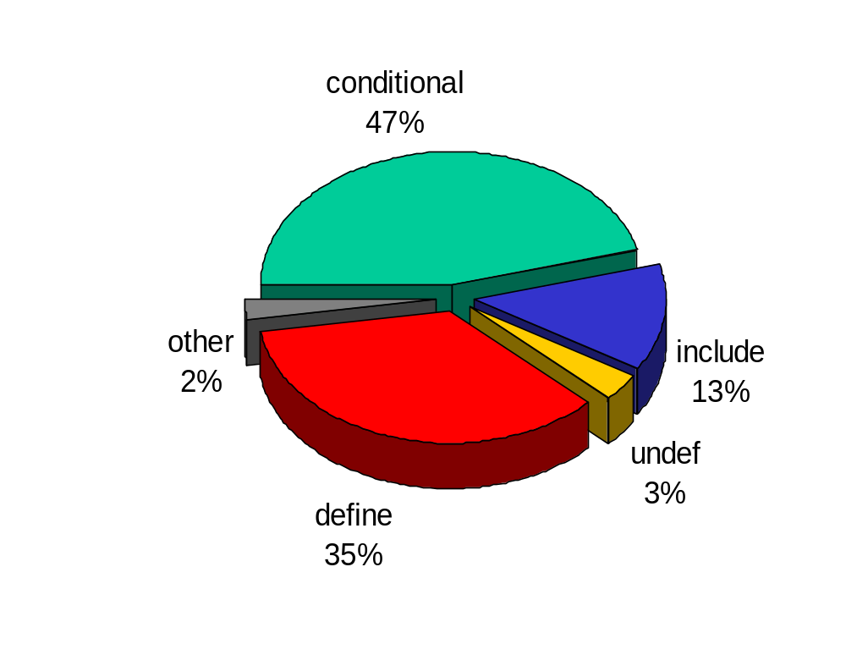
How pervasive is
C preprocessor use?
10% of lines contain a preprocesor directive
28% of lines must expand at least one macro
40% of lines have some cpp dependence
Notes:
This slide is joint work with Michael Ernst and David Notkin
NCNB lines over 30 freely available C packages (emacs, bash, plan, remind, etc.)
This is a *lot* of use; programmer can only be sure what’s there with 60% of NCNB lines
Most definitions were pretty simple, some were difficult,
and each difficult one could have cause problems
for tools looking at unprocessed code
Lots of these simple uses have analogues in language
features, especially of more modern languages like C++

Slide 7
The PCp³ Approach
Parser + Cpp + Perl = PCppP = PCp³
Allow views of both unprocessed and preprocessed code
Control source code processing
so the analysis does not have to
Provide powerful scripting language for easy development and refinement of analyses
Notes:
Make analysis framework easy for the analysis
The analysis really needs to be able to see
both un- and pre-processed code as the tool needs
them.
Don't make the analysis deal with technicalities,
just tell it what it cares about
Provide high level language to write analyses in.
New approach, really an instance of the set of
tools that work on the unprocessed code,
taken to an extreme.
TRANSITION:
So what does this framework give us???

Slide 8
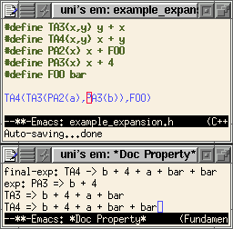
Visualizing the mapping
Analysis output Emacs lisp code to mark-up
the source code with arbitrary annotations
doc-property-mode lets programmer interact with the source and its annotations.
Notes:
Interactive tool to show software engineer
both views at the same time (she's an analysis,
too, and it's useful for the software engineer
as well as for programmed analyses)
Annotations are arbitrary, output by the Perl hooks to write Elisp code
Conventions dictate meaning to and interaction with Elisp code to perform the transformations

Slide 9
The PCp³ Infrastructure
Preprocessor
ANSI C parser
Scripting language for writing analyses
Emacs environment
for interactive exploration
and transformations
Notes:
Leverage existing reliable components
Arrows are interfaces between the components
Preprocessor grew 7k to 8k NCNBL
-- from GCC
Parser is 5,000 NCNBL
-- from CTree
-- gives us AST
Perl glue is 1800 NCNBL
Emacs is 200 lines of ELisp
40 action events,
26 backcalls
(incomplete, but sufficient for useful analyses)

Slide 10
Event hooks
Preprocessor announces
  directives
  definitions
  expansions
  ... and more
Parser announces
  typedefs
  declarations
  function calls
  ... and more
Notes:
40 events
Different levels of abstraction
Pick and choose what details your analysis needs to
focus on
Need not control main execution -- hides details
of file processing

Slide 11
Backcalls
Expose data structures
  preprocessor’s name table
  parser’s symbol table, AST
  current processing position
Control processing
  add code to be processed
  (e.g., otherwise unseen branches)
  alter the parser’s state
  introduce and exit scopes
Notes:
26 backcalls
Gets around the problem of having the preprocessor
mimic exactly -- then hooks would only get
called for code in the version selected by macro
definitions; we need to be able to see all the code
TRANSITION:
so what does an analysis look like?

Slide 12
Example PCp³ analysis
use pcp3;
AddHook("TYPEDEF",\&Typedef);
AddHook("EXIT",\&Exit);
sub Typedef { my ($name) = @_;
push @typedefs, $name;
$num_typedefs{pcp3::Fname()}++;
}
sub Exit { my ($return_value) = @_;
print "Typedefs:\n",
join("\n",sort @typedefs), "\n\n";
print "Number per file:\n";
foreach my $fname (sort keys %num_typedefs) {
print $fname, " had ",
$num_typedefs{$fname}, " typedefs\n";
}
}
Notes:
Not too long
This analysis lists all user-defined types
and the number defined in each file that was
included
(This example makes no use of the mapping)
TRANSITION:
Exposing preprocessor directives lets
us reason about how it is being used
Really preprocessing lets us be sure we get
it right.
This combination is essential for preserving
semantics which is what we want to do
when we do source->source transformations

Slide 13
C++ Language Features to replace uses of Cpp
Constants (improved over C’s)
Reference parameters
Inline functions
Templates (generic code)
Boolean type
Enumerations
Name spaces
Notes:
Most preprocessor use is regular and disciplined
Much of that maps to language features of C++
Perfect migration language because it still has cpp,
we know some uses (#include) can not be replaced
Using the language features reduces the difference
between un- and pre-processed views, adds type
safety, exposes symbols to the debugger, permits
higher-level compiler optimizations, and generally
mitigates the problem discussed earlier
Focus on a seemingly simple example that illustrates
many of the same problems. Just one small,
manageable piece of the problem.

Slide 14
Replacing macros with language-proper constants
#include <stdio.h>
#define CCD2
#ifdef CCD1
# define FOO 1
#endif
#ifdef CCD2
# define FOO 2
#endif
#define FUD 3
#define BAR 4
#define BAZ 5
#define BING 6
int
main(char **argv, int argc) {
int fud = FUD;
int BONG = -1;
int rgi[BING];
printf("%d, %d, %d, %d, %d, %d\n",
FOO,FUD,BAR,BAZ,BING,BONG);
#define BAR -2
#define BONG 7
printf("%d, %d, %d, %d, %d, %d\n",
FOO,FUD,BAR,BAZ,BING,BONG);
return 0;
}
#undef FUD
1
1
2
3
4
2
4
Notes:
Numbers mark possible issues
1. Two definitions of FOO may not be mutually exclusive
2. BAR is redefined
3. BING is used in an array bounds specifier
4. BONG is used as a variable before being #define-d

Slide 15
PCp³ analysis will notice
1
Two definitions of FOO may
not be mutually exclusive
2
BAR is redefined,
second definition location is
inappropriate for a variable definition
3
BING is used as an array bounds specifier
4
BONG is used as a variable identifier before later being defined as a macro
Notes:
Essential to preserving semantics
This issues influence whether if and how we
want to change the source code.

Slide 16
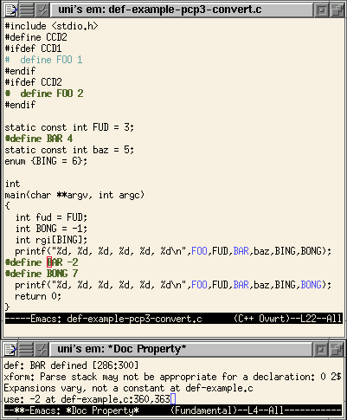
Transformed code
Notes:
Another view of doc-property-mode; general mechanism
Note that BAZ has been renamed to baz
-> follows naming conventions
Also note that FUD has not been renamed to fud
do to a name conflict
Important what things were *not* changed
Over 40% of macro definitions are just constants,
so this has the potential to make lots of changes
Other transformations might do more to help other
tools

Slide 17
How PCp³ compares
C source
code
C source
code
C source
code
Cpp
analysis
tool
analysis
tool
Parser Cpp Perl
PCp³
✓
✓
✓
✓
✓
PCp³
✓
✓
✓
✓
✓
Precise analysis
Reuses existing front-end
Handles non-syntactic programs
Processes entire source code
Analyzes same view as engineer
Notes:
PCp3 really just an instance of type on the right
Gives us precision and simplicity by reusing tools
Lets us control handling of mis-parses, parsing
of otherwise-unseen branches
Lets us see both views at the same time

Slide 18
Future work
Complete hooks/backcalls interfaces
Exploit AST better
  avoid single-pass problems
  permit more sophisticated analyses
Generalized tables for better
versioning support
Multiple translation units
Convert more preprocessor uses
Convert to Java
Notes:
Interaces developed to support the analysis
illustrated... lots missing
AST is largely unused
Still a distinguished version
--- slide on this
Multiple translation units
--- summaries exist, but are combined by emacs,
could use CIA++-like database mechanism
Only covered first bullet of C++ features, lots
more to be done
-- Siff & Reps w/ Templates
Java another interesting target language

Slide 19
Summary
C preprocessor limits program understanding and tools
PCp³ flexible analysis framework
  integrates preprocessor and parser
  hooks interface for simplifying analyses
Interactive view of mapping between un- and pre-processed views
Transforming C preprocessor use into language features
Notes:
Cpp hurts software engineer and tools
PCp3 makes analyses easy
Two uses:
interactive tool for exploring the mapping between views
convert simple uses of cpp into language feature

Slide 20
Extra slides.....

Slide 21
The C Preprocessor
File inclusion
  #include
Conditional inclusion
  #if, #ifdef, #ifndef
  #else, #elif
  #endif
Textual (token-based) macros
  User-defined via #define
  Pre-defined
    e.g., __STDC__, __FILE__
Stringization, pasting operators
  #, ##
Notes:
Everything is text-based; no interaction with C syntax
Has been used for other text-processing, X resources w/ rdb, Imakefile-s
Other macro preprocessors are more powerful, e.g.,
cpp can’t have macro expand to include a newline

Slide 22
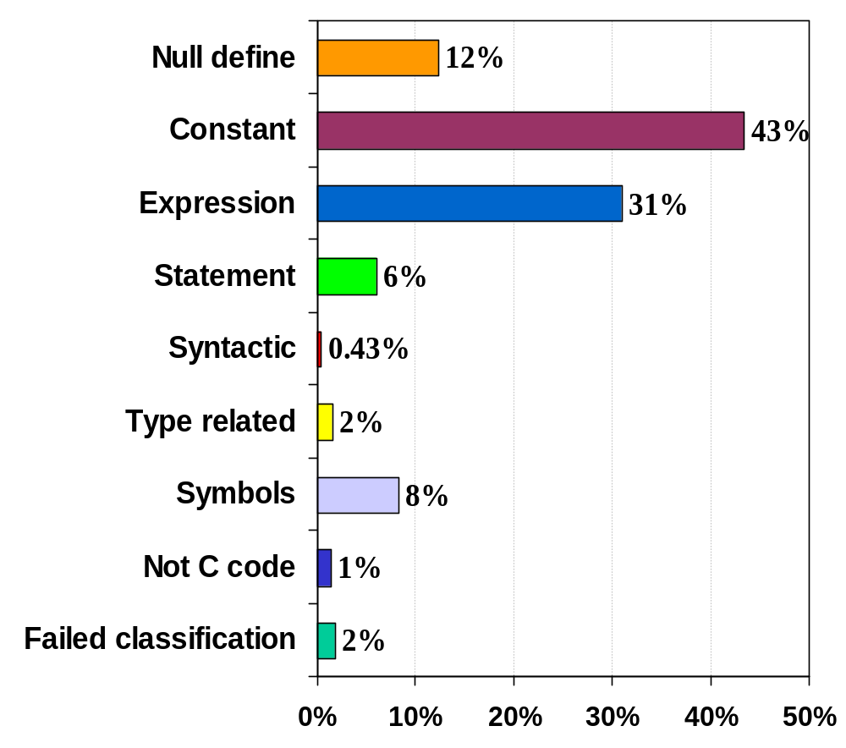
Most definitions are simple
Percent of macro definitions by category
Notes:
Bottom categories are the biggest problem, and fewer macro definitions do things
that are hard to handle
But, how often are those difficult ones expanded? A macro definition that is not used
is not so bad
Unfortunately....

Slide 23
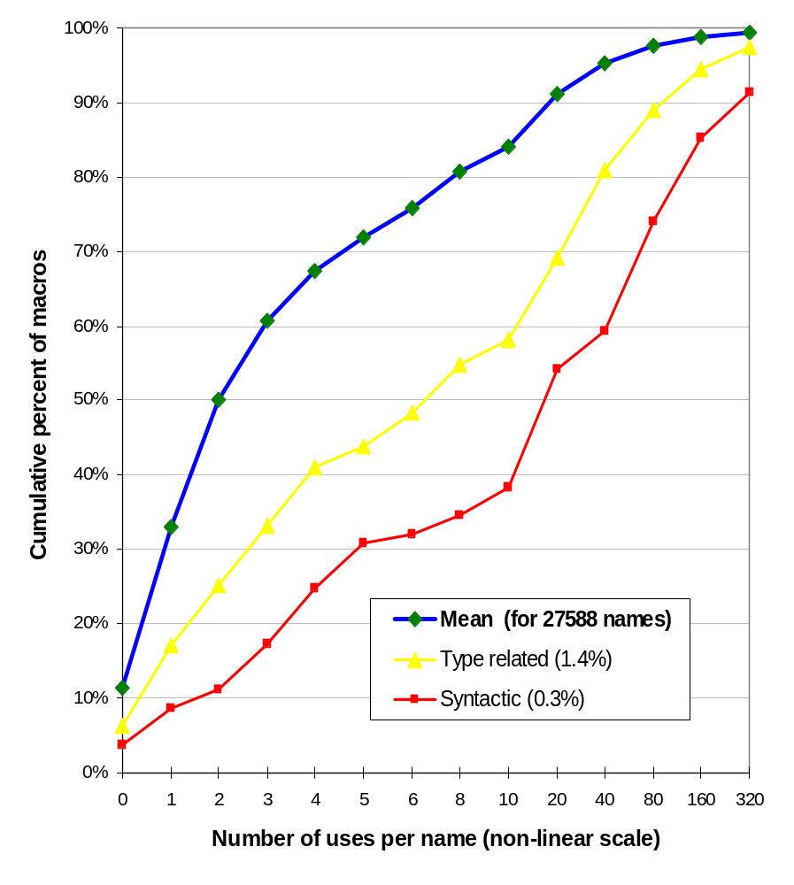
Difficult macros are used more than simple ones
more uses
Notes:
Trickier uses have more expansions (though they are often used in regular ways)
Note 11% of macro names that are defined are never expanded
Each expansion of a syntactic macro can cause a missed feature in a lexical tool,
or an erroneous parser when approximately parsing;
so the approximate parse/lexical approach is far from perfect,
but we can’t throw away preprocessor directives and abstractions if we’re hoping
to translate to C++--- what do we really want????

Slide 24
Syntactic macros hinder lexical tools
#define START_PARAMS (
#define END_PARAMS )
#define START_CALL (
#define END_CALL )
#define BEGIN {
#define END }
#define ARRAY []
#define NL ;
#define POINTER *
#define COMMA ,
#define STRING(x) #x
#include <stdio.h>
int main START_PARAMS int argc COMMA
char POINTER argv ARRAY END_PARAMS
BEGIN
printf START_CALL STRING(Hello world\n)
END_CALL NL
return 0 NL
END
Notes:
Lexical tool is looking for a function call is out of luck
Difficult for a human software engineer to parse some of these constructs
Representative of actual abuses, but, as it turns out, C programmers tend to be
more merciful in their use of cpp, as empirical analysis shows

Slide 25
Expansion mechanism
#define TA3(x,y) y + x
#define TA4(x,y) x + y
#define PA2(x) x + FOO
#define PA3(x) x + 4
#define FOO bar
note the order of arg. use
TA4(TA3(PA2(a),PA3(b)),FOO)
11
x
y
12
TA3(PA2(a),PA3(b))
7
FOO
9
y
x
8
10
PA3(b)
1
PA2(a)
3
Hooks called
2
expand
FOO
*
4
5
cleanup
6
Notes:
Post-order traversal of the tree
Blue are expansions, Green are cleanups

Slide 26
Nested macro expansion
#define TA3(x,y) y + x
#define TA4(x,y) x + y
#define PA2(x) x + FOO
#define PA3(x) x + 4
#define FOO bar
TA4(TA3(PA2(a),PA3(b)),FOO)
note the order of arg. use
1
expansion & cleanup of PA3
2
time
expansion of PA2
3
*
4
expansion & cleanup of FOO
5
6
cleanup of PA2
7
expansion & cleanup of TA3
8
9
10
11
Hooks called
12
expand
cleanup
Notes:
Another way to look at it
RED is consideration of the source text (no hooks)
Expansions of *arguments* takes place in the
order they are used, not left->right order at the call site

Slide 27
Intentional programming group’s approach (MS)
1. Convert conditional inclusion directives into (C++) parse-able stylized declarations:
#if !defined(NDEBUG)
int __cpp_if = !defined(NDEBUG);
2. Expand all macros and annotate the resulting tokens. Store those derivations in the AST
3. Encapsulate variant expansion as an implicit argument at all call sites.
#define errmsg(x) \
fprintf(stderr,x ", line %d", __LINE__)
errmsg("Missing filename",563)
4. “Enzymes” then process the AST and try to recognize known abstractions (intentions)
convert inclusion directives
add arguments to call sites

Slide 28
Griswold & Atkinson’s approach for TAWK
Attempt to parse macro
definition as extended expressions
(permit types as arguments)
success
failure
Encode in AST as special
macro-expansion node
Expand in-line at all
invocation sites

Slide 29
Multiple translation units
system and library header files
main.c
compute.c
compute.h
PCp³
PCp³
PCp³
ELisp
annotations
. . . . . . . . . . . . . . . . . . . . . . .. . . .. . . . .
Emacs
environment
Notes:
Annotations appended to by multiple analysis runs,
each generating a summary
Offloads to emacs the chore of combining summaries
and doing the right thing
CIA++ database approach would be better

Slide 30
Details of processing entire source
use pcp3;
AddHook("DO_XIFDEF",\&do_xifdef);
AddHook("POP_PERL_BUFFER",\&pop_perl_buffer);
AddHook("HANDLE_DIRECTIVE",\&handle_directive);
sub do_xifdef {
my ($s_start,$s_end,$kind,$conditional,$trailer,
$skipped_text,$fSkipping,
$s_branch_start) = @_;
if ($fSkipping) {
handle_unincluded_block($s_branch_start,
$skipped,$kind,$conditional);
}
}
sub handle_unincluded_block {
my ($s_branch_start,$s_branch_end,$skipped) = @_;
$skipped =~ s/^\s*\#\s*include .*$//mg;
pcp3::YYPushStackState();
pcp3::EnterScope();
pcp3::PushHashTab();
pcp3::PushBuffer($skipped,$s_branch_start);
}
sub pop_perl_buffer {
pcp3::ExitScope();
pcp3::PopHashTab();
pcp3::YYPopAndRestoreStackState();
}
sub handle_directive {
$cDirectives++;
}
Notes:
Hooks and backcalls give us the power to see all the source code.
EnterScope, ExitScope for the parser’s symbol table
YY{Push,Pop}StackState for the parser’s configuration
{Push,Pop}HashTab for cpp’s name table
We'd like finer control

Slide 31
Processing all the source code
#ifndef COMPUTE_H__
#define COMPUTE_H__
#include <stdio.h>
#ifdef PROFILE
#define PROFILE_OUTPUT(x) \
fprintf(stderr,"%d\n",x)
#endif
...
#ifdef PROFILE
int ccalls = 0;
#endif
....
#ifdef PROFILE
ccalls++;
PROFILE_OUTPUT(ccalls);
#endif
...
#endif /* COMPUTE_H__ */
DO_XIFDEF hook
gets text skipped
by cpp as argument
Call PushBuffer()
on skipped code
Other backcalls can save
parser configuration
symbol table
preprocessor name table
PCp³
Notes:
EnterScope, ExitScope for the parser’s symbol table
YY{Push,Pop}StackState for the parser’s configuration
{Push,Pop}HashTab for cpp’s name table
Perl component provides this rudimentary functionality

