Slide 1
JavaML:
An XML Markup Language for Java Source Code
Greg J. Badros
<badros@cs.washington.edu>
University of Washington
Department of Computer Science & Engineering
16 May 2000

Slide 2
Example of the problem
import java.applet.*;
import java.awt.*;
public class FirstApplet extends Applet {
public void paint(Graphics g) {
g.drawString("FirstApplet", 25, 50);
}
}
Notes:
Want to find class “FirstApplet”

Slide 3
Simple tools are commonly used…
% grep FirstApplet < FirstApplet.java
public class FirstApplet extends Applet {
g.drawString("FirstApplet", 25, 50);
Notes:
So what’s wrong with this?

Slide 4
Lexical tools fall short
No distinction between FirstApplet the class, and "FirstApplet", the literal string
Line-based results instead of a meaningful code fragment
Some interesting constructs are difficult to match using regular expressions
(e.g., type cast expressions)
Notes:
Results are imprecise– we had a false positive in the second line
Type casts– C++ introduce funky syntax to make them easier to find…

Slide 5
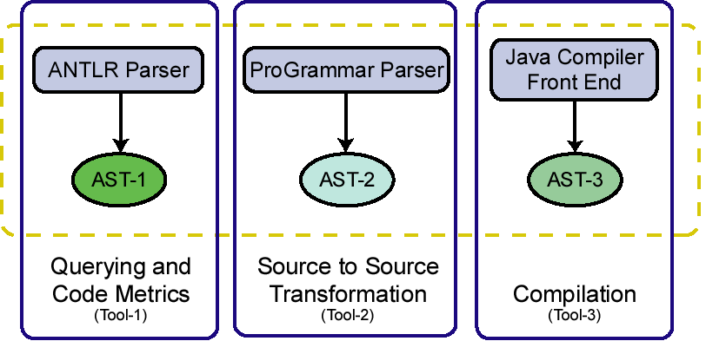
Just say no to regular expressions
Java source code
Duplicated
functionality,
wasted effort
complicates
communication
among tools
Notes:
Tools do better when they operate on ASTs so that they get a more semantically-meaningful view
Note that the ASTs are different – they are subject to artifacts resulting from the underlying grammar

Slide 6
What we need
A canonical, ubiquitous, open,
easy-to-exchange format capable of representing the structure of programs

Slide 7
Simple answer:
XML
Similar to HTML, but the element tags are defined specifically for the data to be represented
Document Type Definition (DTD) describes how elements can nest, and what the attributes of each element may be
eXtensible Markup Language
Notes:
As you probably know, XML is a simplified version of SGML…
Define the Document Type Defintion for JavaML
Convert to JavaML from ordinary source representation, and back

Slide 8
Simple XML example
<email>
<head>…</head>
<body encrypted="no">
…
</body>
</email>
element tag
attribute, value
<!-- email DTD -->
<!ELEMENT email (head,body)>
<!ELEMENT head (to+,from,subject?)>
<!ATTLIST body encrypted (yes|no) #IMPLIED>
……
Notes:
So now we’ve decided to use XML, but that’s the easy part

Slide 9
Devil is in the details
Lots of possible representations of Java source code in XML
Representation has profound impact on ease of performing various analyses

Slide 10
Approach 1:
Dump raw AST as XML
<compilation-unit>
<ImportDeclarationsopt>
<ImportDeclarations>
<ImportDeclaration>
<TypeImportOnDemandDeclaration>
import
<Name>
<QualifiedName>
<Name>
<SimpleName>java</SimpleName>
</Name>
.
<Name>
<SimpleName>applet</SimpleName>
</Name>
<QualifiedName>
</Name>
import java.
– Excessively verbose
– Exposes grammar
– Unnatural, hard to read
+ Very easy to generate
Notes:
ANTLR (Java parser generator --- another tool for language recognition) has an XML serialization feature that does basically this.

Slide 11
Approach 2:
Mark-up source code directly
import java.applet.*;
import java.awt.*;
public class FirstApplet
extends Applet {
…
<java-source-program>
<import-declaration>import java.applet.*;
</import-declaration>
<import-declaration>import java.awt.*;
</import-declaration>
<class-declaration>
<modifiers>public</modifiers> class
<class-name>FirstApplet</class-name>
extends
<superclass>Applet</superclass> {
<method-definition> …
+ More concise
+ Easy to convert back
– Still need to do some
lightweight parsing
– Exposes Java syntax

Slide 12
The chosen approach
<java-class-file name="FirstApplet.java">
<import module="java.applet.*"/>
<import module="java.awt.*"/>
<class name="FirstApplet" visibility="public">
<superclass name="Applet"/>
<method name="paint" visibility="public">
<type name="void" primitive="true"/>
<formal-args>
<formal-arg name="g" id="frmarg-13">
<type name="Graphics"/></formal-arg>
</formal-args>
……
Notes:
Notice:
all information is in the elements and their attributes (none in text inside the elements)
arguments are given id-s that then are referenced via idref when the variable is used

Slide 13
JavaML representation
An isomorphic, complementary representation better suited for tools
(programmers still edit ordinary source code)
Program structure is reflected in the nesting of the elements
References to variables point back to the definition of the variable using ID/IDREFs
(i.e., representation is a graph, not a tree)

Slide 14
Perspectives on JavaML
Canonical representation of the Abstract Syntax Tree (AST) of Java programs
Database of source code
Document describing program
Enabling technology to build a bridge between software-engineering, languages, database, web, and documents communities

Slide 15
The Big Win
Leverage and build on existing expertise, tools, technologies, and experience of the software engineering, languages, databases, web, and documents.
(Instead of having to re-invent lots of wheels.)

Slide 16
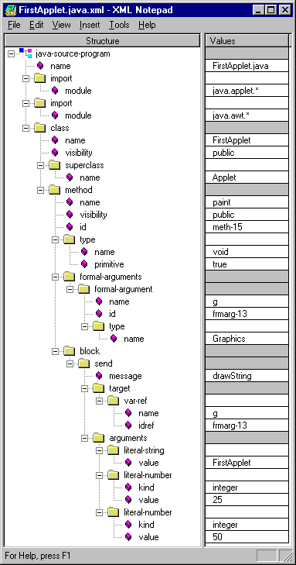
Visualization
XML Notepad
(from Microsoft)

Slide 17
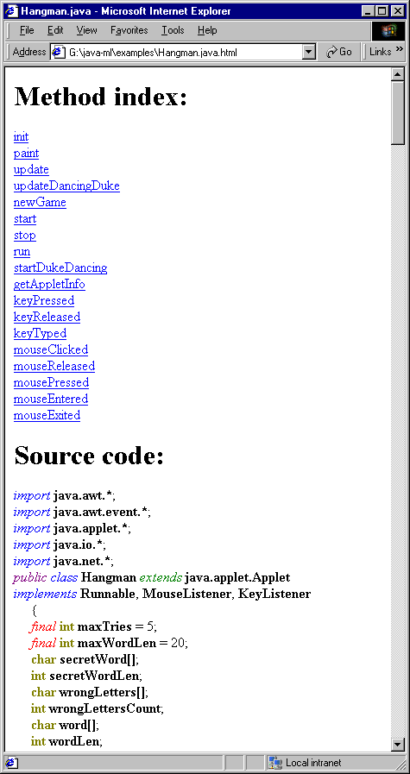
Browsing
HTML Pretty-printed
using XSLT
(displayed in IE 5)

Slide 18
Code metrics
% sgcount FirstApplet.java.xml
literal-number 2
method 1
block 1
formal-argument 1
target 1
arguments 1
import 2
send 1
type 2
var-ref 1
literal-string 1

Slide 19
Semantic analyses
Are there any classes that are not declared abstract that need to be because they contain an abstract method?
% sggrep –q '.*/class[abstract!=true]/\
method[abstract=true]'

Slide 20
Other examples
Find all sends of the message setFont
Find all methods that contain a send of the message setFont
Rename a method, along with all sends of that message name
Instrument methods for tracing
Canonicalize source for comparing versions, committing to CVS repository

Slide 21
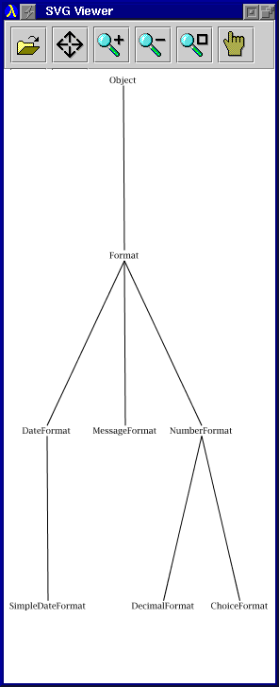
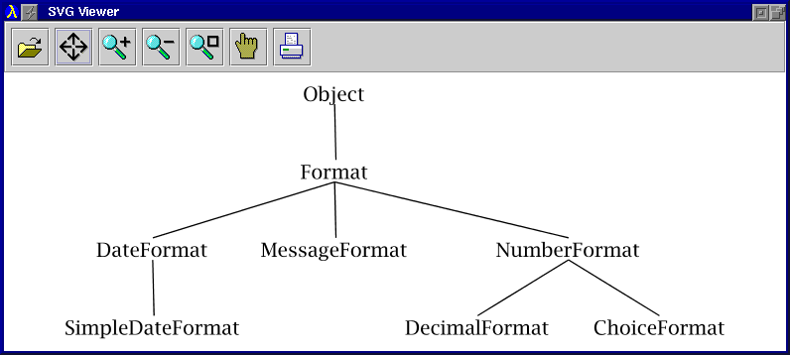
JavaML + CSVG
Constraint extensions to
Scalable Vector Graphics

Slide 22
Implementation
JavaML Document Type Definition (DTD)
Robust, complete implementation using Jikes Java compiler
(open-sourced compiler originally from IBM)
XSLT stylesheets to view JavaML as classical source code, or as pretty-printed HTML
Example queries, transformations, tools

Slide 23
Interpreting query results
Problem:
We want to be able to find the location in the original source code of elements that we find in the JavaML representation.
Notes:
Consider the semantic analysis I just mentioned…
suppose the query is successful –
that indicates that there is a class that needs to be declared abstract
HOW DO WE FIND OUT WHERE IT IS TO FIX THE PROBLEM?

Slide 24
Source-code positions
Problem:
We want to be able to find the location in the original source code of elements that we find in the JavaML representation.
Solution:
Converter can optionally include attributes line, col, end-line, end-col on elements class, method, block, etc., to specify source-code positions.
(less of a problem when representation is integrated with editor)
Notes:
Consider the semantic analysis I just mentioned…
suppose the query is successful –
that indicates that there is a class that needs to be declared abstract
HOW DO WE FIND OUT WHERE IT IS TO FIX THE PROBLEM?

Slide 25
Dealing with comments
Problem:
Comments are discarded early in lexical analysis, but are an essential part of the software artifact.
Notes:
Really need to do inference to see what element the comment refers to, but that’s a lot harder.
Many other simple heuristics that could be very effective.

Slide 26
Comment attribute
Problem:
Comments are discarded early in lexical analysis, but are an essential part of the software artifact.
Solution:
Use a comment attribute on various elements and queue up the comments until we output one of those elements.
Notes:
Really need to do inference to see what element the comment refers to, but that’s a lot harder.
Many other simple heuristics that could be very effective.

Slide 27
Multiple-file projects
cat-javaml script merges multiple JavaML files into one proper XML document:
<java-source-program>
<java-class-file name="File1.java">…</>
<java-class-file name="File1.java">…</>
……
</java-source-program>

Slide 28
Summary
Java source code is not great for tools
JavaML provides an isomorphic, complementary representation of Java source code better suited for tools
Leveraging existing and forthcoming XML/SGML tools is a big win!
http://www.cs.washington.edu/homes/gjb/JavaML/

Slide 29
Web technologies
SGML Standard Generalized Markup Language
XML eXtensible Markup Language
DTD Document Type Definition
XSLT eXt. Style Lang. for Transformations
SAX Simple API for XML
DOM Document Object Model

Slide 30
FirstApplet.java.xml (1 of 2)
<?xml version="1.0" encoding="UTF-8"?>
<!DOCTYPE java-class-file SYSTEM "java-ml.dtd">
<java-class-file name="FirstApplet.java">
<import module="java.applet.*"/>
<import module="java.awt.*"/>
<class name="FirstApplet" visibility="public">
<superclass name="Applet"/>
<method name="paint" visibility="public"> <type name="void" primitive="true"/>
<formal-arguments>
<formal-argument name="g" id="frmarg-13">
<type name="Graphics"/></formal-argument>
</formal-arguments>
……
Notes:
Yes, it’s verbose
No, programmers won’t write the XML directly
It’s a complementary representation well-suited for numerous tools

Slide 31
FirstApplet.java.xml (2 of 2)
……
<block>
<send message="drawString">
<target><var-ref name="g" idref="frmarg-13"/></target>
<arguments>
<literal-string value="FirstApplet"/>
<literal-number kind="integer" value="25"/>
<literal-number kind="integer" value="50"/>
</arguments>
</send>
</block>
</method>
</class>
</java-class-file>

