Slide 1
JavaML:
An XML Markup Language for Java Source Code
Greg J. Badros
<badros@cs.washington.edu>
University of Washington
Department of Computer Science & Engineering
24-Feb-2000

Slide 2
Example of the problem
import java.applet.*;
import java.awt.*;
public class FirstApplet extends Applet {
public void paint(Graphics g) {
g.drawString("FirstApplet", 25, 50);
}
}

Slide 3
Simple tools are commonly used…
% grep FirstApplet < FirstApplet.java
public class FirstApplet extends Applet {
g.drawString("FirstApplet", 25, 50);

Slide 4
Lexical tools fall short
No distinction between FirstApplet the class, and "FirstApplet", the literal string
Line-based results instead of a meaningful code fragment
Some interesting constructs are difficult to match using regular expressions
(e.g., type cast expressions)

Slide 5
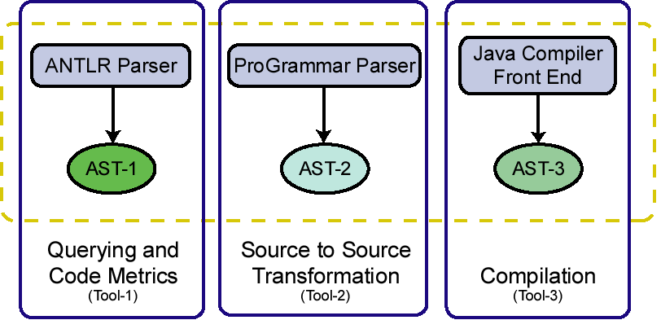
Just say no to regular expressions
Java source code
Duplicated
functionality,
wasted effort
complicates
communication
among tools

Slide 6
What we need
A canonical, ubiquitous, open,
easy-to-exchange format capable of representing the structure of programs

Slide 7
FirstApplet.java.xml (1 of 2)
<?xml version="1.0" encoding="UTF-8"?>
<!DOCTYPE java-class-file SYSTEM "java-ml.dtd">
<java-class-file name="FirstApplet.java">
<import module="java.applet.*"/>
<import module="java.awt.*"/>
<class name="FirstApplet" visibility="public">
<superclass name="Applet"/>
<method name="paint" visibility="public"> <type name="void" primitive="true"/>
<formal-arguments>
<formal-argument name="g" id="frmarg-13">
<type name="Graphics"/></formal-argument>
</formal-arguments>
……
Notes:
Yes, it’s verbose
No, programmers won’t write the XML directly
It’s a complementary representation well-suited for numerous tools

Slide 8
FirstApplet.java.xml (2 of 2)
……
<block>
<send message="drawString">
<target><var-ref name="g" idref="frmarg-13"/></target>
<arguments>
<literal-string value="FirstApplet"/>
<literal-number kind="integer" value="25"/>
<literal-number kind="integer" value="50"/>
</arguments>
</send>
</block>
</method>
</class>
</java-class-file>

Slide 9
Perspectives on JavaML
Canonical representation of the Abstract Syntax Tree (AST) of Java programs
Database of source code
Enabling technology to build a bridge between software-engineering, languages, database, web, and documents communities

Slide 10
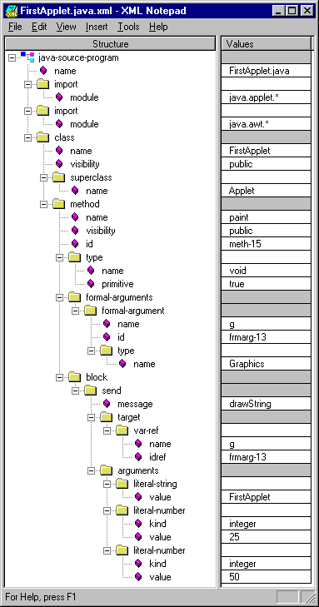
Visualization
XML Notepad
(from Microsoft)

Slide 11
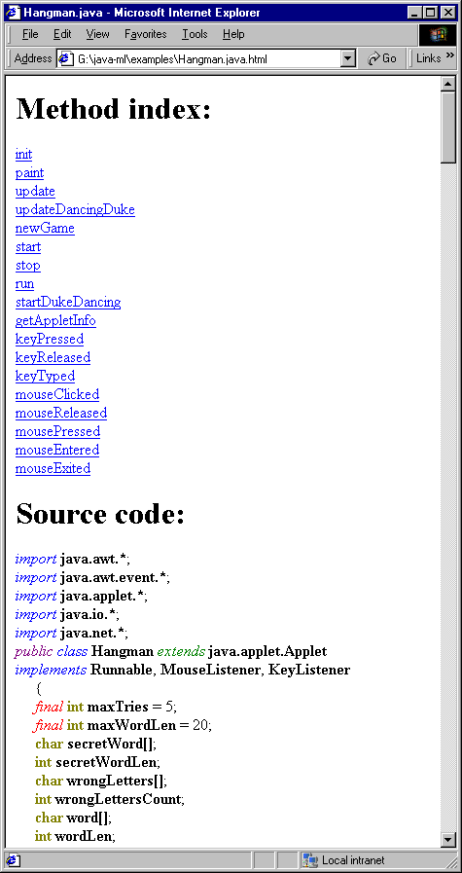
Browsing
HTML Pretty-printed
using XSLT
(displayed in IE 5)

Slide 12
Code metrics
% sgcount FirstApplet.java.xml
literal-number 2
method 1
block 1
formal-argument 1
target 1
arguments 1
import 2
send 1
type 2
var-ref 1
literal-string 1

Slide 13
Semantic analyses
Are there any classes that are not declared abstract that need to be because they contain an abstract method?
% sggrep –q '.*/class[abstract!=true]/\
method[abstract=true]'

Slide 14
Other examples
Find all sends of the message setFont
Find all methods that contain a send of the message setFont
Rename a method, along with all sends of that message name
Instrument methods for tracing
See my WWW9 paper.
Available
at poster 49

Slide 15
Implementation
JavaML Document Type Definition (DTD)
Robust, complete implementation using Jikes Java compiler
(open-sourced compiler originally from IBM)
XSLT stylesheets to view JavaML as classical source code, or as pretty-printed HTML
Example queries, transformations, tools
http://www.cs.washington.edu/homes/gjb/JavaML

Slide 16
Summary
Java source code is not great for tools
JavaML provides an isomorphic, complementary representation of Java source code better suited for tools
Leveraging existing and forthcoming XML/SGML tools is a big win!

Slide 17
Web technologies
SGML Standard Generalized Markup Language
XML eXtensible Markup Language
DTD Document Type Definition
XSLT eXt. Style Lang. for Transformations
SAX Simple API for XML
DOM Document Object Model

