Slide 1

Github Activity Data Analysis System
PPT模板 http://www.1ppt.com/moban/
MSBD5003
Presented by :
Yuan Yingzhe Guo Jong

Slide 2
TABLE OF CONTENT
contents
1
Task Overview
2
Data Set
3
System Architecture
4
Result Obtained
5
Benefits of Big Data Technologies

Slide 3
Task Overview
1
Task
Huge number of activities happen every time on the GitHub.
Push, PullRequest, Watch, Fork…
Tracking on these data and making analysis of it can get more information about the environment of the programing(…)
Our aim is:
1. Get data from GitHub constantly.
2. Cleaning the data and store it well-structured in the HDFS.
3. Using method of dimensional modeling to build the data warehouse.
4. Make offline and real-time analysis of the data and show Visualization Display of the results.

Slide 4
Datasets
2
Two of Data Source
Using the dataset from GitHub, there are two kinds of dataset:
1. User activity data: -- pseudo-off-line
-- Real time user activity data, mixture of all kinds of activity from GH Archive.
-- Contains useful information like activity type, time, executor with many other useless information.
-- json.gz file, compressed by GH Archive Servers, including the almost all data from 2015,
-- The latest data is only a few hours from now.
2.User and Repo detail data – online, real-time
-- Data of users and repos, contains the detail information like name, location
-- Got by calling Github Open API.

Slide 5
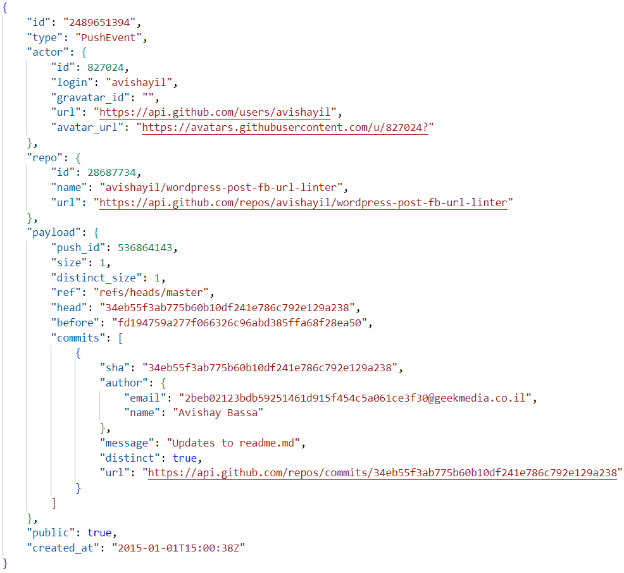
Datasets
2
Data Type
All the data are JSON type.
The JSON data has complicated structure.
Useful information is deeply wrapped inside each records.

Slide 6
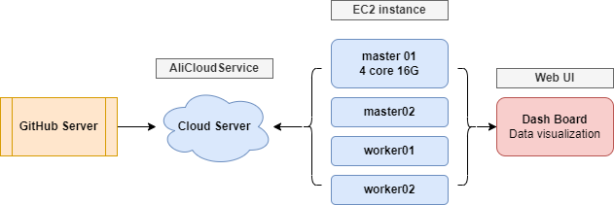
System Architecture
3
Cloud Service

Slide 7
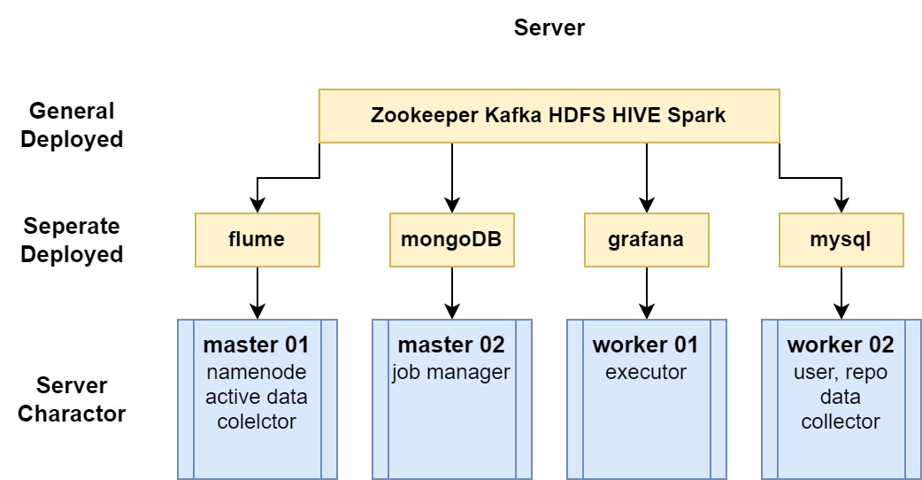
System Architecture
3
Cluster Service Deployed

Slide 8
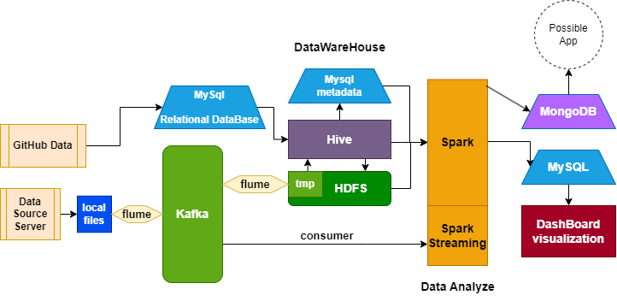
System Architecture
3
Data Flow

Slide 9
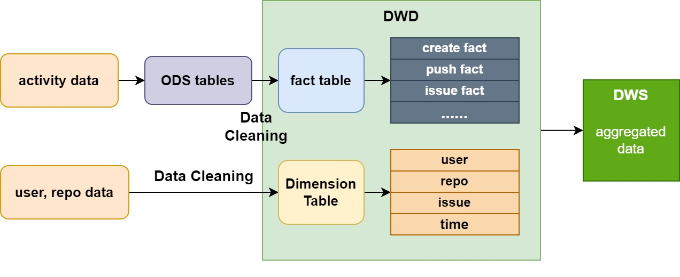
System Architecture
3
Datawarehouse

Slide 10
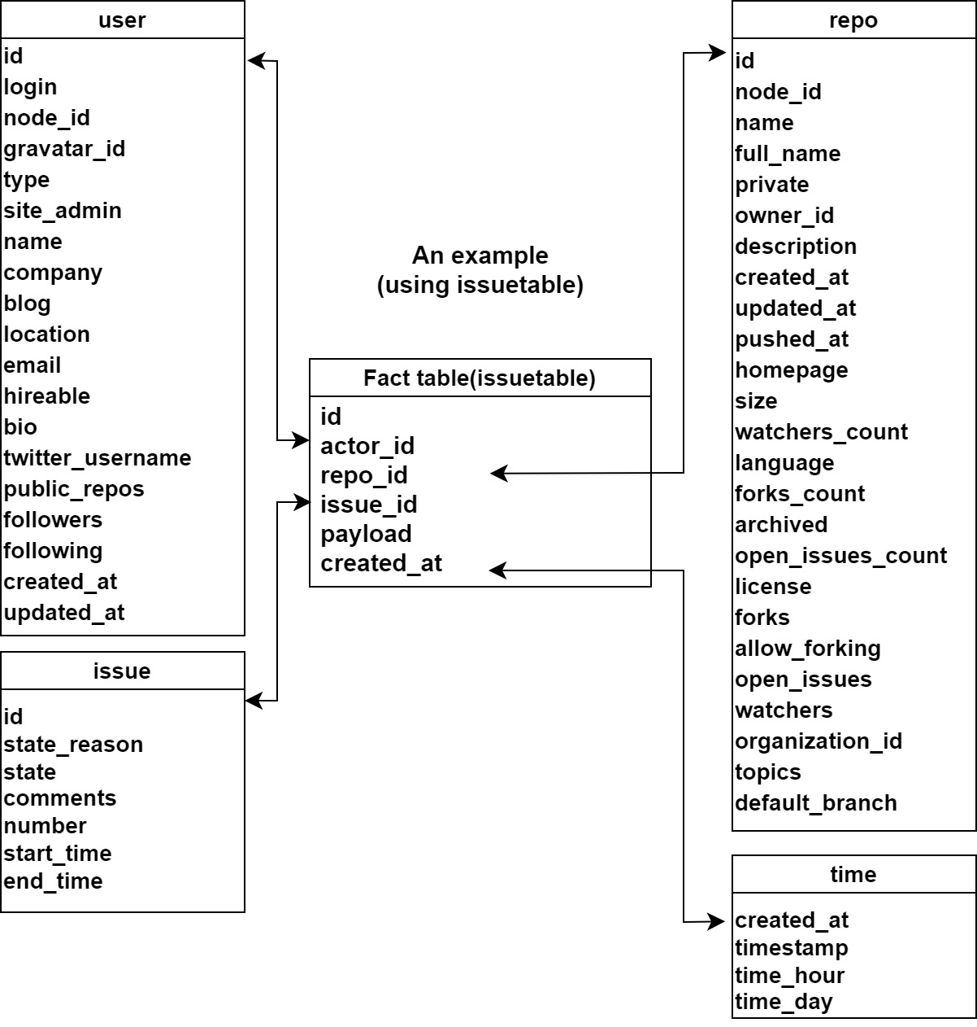
System Architecture
3
DWD Schema examples
Star-schema

Slide 11
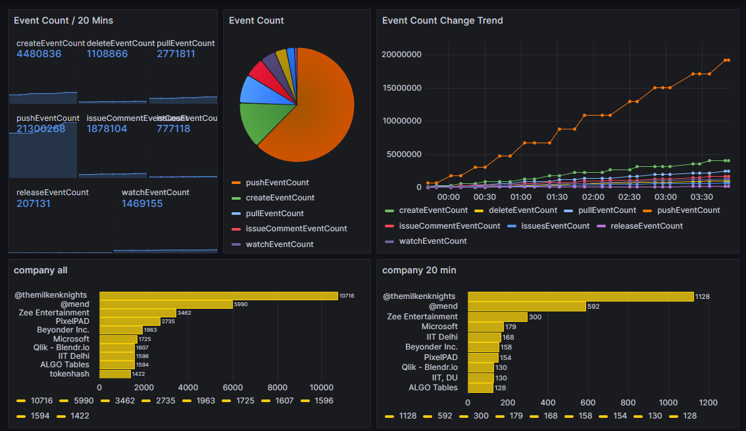
Result Obtained
4

Slide 12
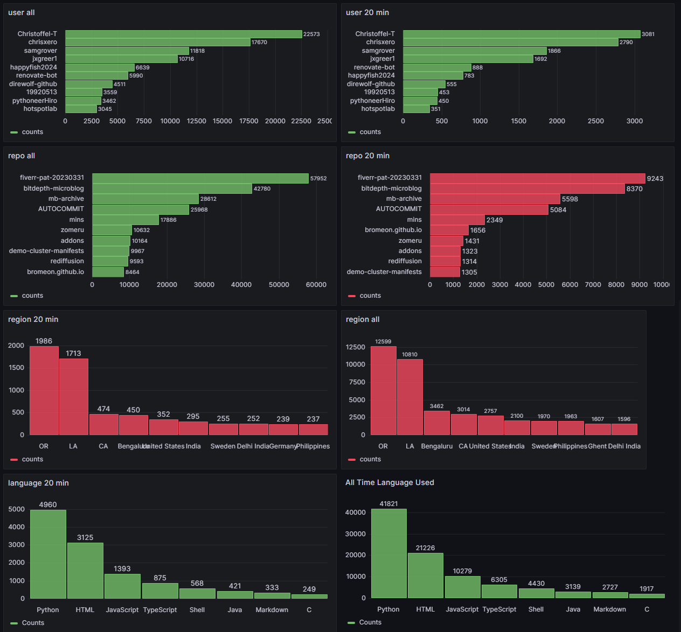
Result Obtained
4
Deploy Grafana on Servers.
Visualize data results stored in the MySQL database.
Including statistics of event, users, companies…
5003 - Dashboards - Grafana

Slide 13
Benefits of Big data technologies
5
Benefits
1.Storage
Clusters can accept more data flows by multiple servers, which means high bandwidth.
Distributed storage (duplicated files) makes it safer for large storage
Server suffered from attacks consistently, need recovery methods and security method
2.Process
Separate the operation of relational database (MySQL) and huge data analyze.
Release the pressure of relational database.
3.Analyze
History data stored make it more flexible for different layers of analyze.

