Slide 1
CS 5600 Computer Systems
Lecture 12: Authorization and
Access Control

Slide 2
Authentication
Access Control
Mandatory Access Control

Slide 3
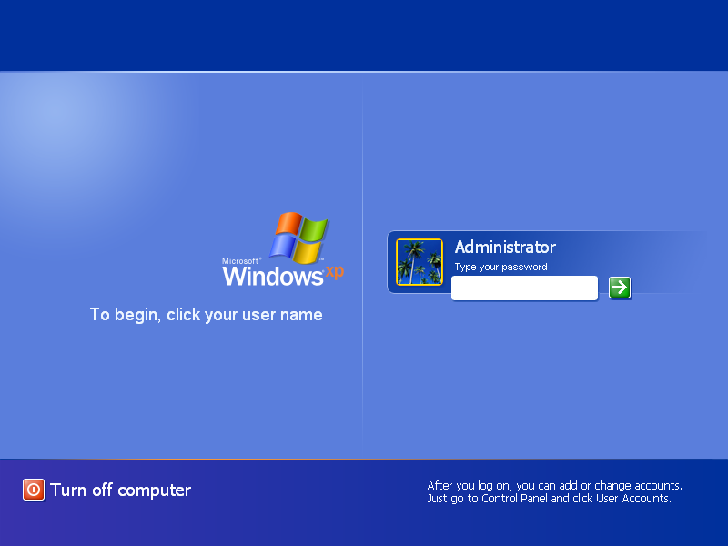

Slide 4
Authentication
Authentication is the process of verifying an actor’s identity
Critical for security of systems
Permissions, capabilities, and access control are all contingent upon knowing the identity of the actor
Typically parameterized as a username and a secret
The secret attempts to limit unauthorized access

Slide 5
Types of Secrets
Actors provide their secret to log-in to a system
Three classes of secrets:
Something you know
Example: a password
Something you have
Examples: a smart card or smart phone
Something you are
Examples: fingerprint, voice scan, iris scan

Slide 6
Checking Passwords
The system must validate passwords provided by users
Thus, passwords must be stored somewhere
Basic storage: plain text
password.txt
cbw p4ssw0rd
sandi i heart doggies
amislove 93Gd9#jv*0x3N
bob security

Slide 7
Problem: Password File Theft
Attackers often compromise systems
They may be able to steal the password file
Linux: /etc/shadow
Windows: c:\windows\system32\config\sam
If the passwords are plain text, what happens?
The attacker can now log-in as any user, including root/administrator
Passwords should never be stored in plain text

Slide 8
Hashed Passwords
Key idea: store encrypted versions of passwords
Use one-way cryptographic hash functions
Examples: md5, sha1, sha256, sha512
Cryptographic hash function transform input data into scrambled output data
Deterministic: hash(A) = hash(A)
High entropy:
md5(‘security’) = e91e6348157868de9dd8b25c81aebfb9
md5(‘security1’) = 8632c375e9eba096df51844a5a43ae93
md5(‘Security’) = 2fae32629d4ef4fc6341f1751b405e45
Collision resistant
Locating A’ such that hash(A) = hash(A’) takes a long time
Example: 2²¹ tries for md5

Slide 9


Hashed Password Example
md5(‘p4ssw0rd’) = 2a9d119df47ff993b662a8ef36f9ea20
User: cbw
md5(‘2a9d119df47ff993b662a8ef36f9ea20’) = b35596ed3f0d5134739292faa04f7ca3
hashed_password.txt
cbw 2a9d119df47ff993b662a8ef36f9ea20
sandi 23eb06699da16a3ee5003e5f4636e79f
amislove 98bd0ebb3c3ec3fbe21269a8d840127c
bob e91e6348157868de9dd8b25c81aebfb9

Slide 10
Attacking Password Hashes
Recall: cryptographic hashes are collision resistant
Locating A’ such that hash(A) = hash(A’) takes a very long time
Are hashed password secure from cracking?
No!
Problem: users choose poor passwords
Most common passwords: 123456, password
Username: cbw, Password: cbw
Weak passwords enable dictionary attacks

Slide 11


Dictionary Attacks
hash()
List of possible password hashes
hashed_
password.txt
English
Dictionary
hash()
Common
Passwords
Common for 60-70% of hashed passwords to be cracked in <24 hours

Slide 12
Hardening Password Hashes
Key problem: cryptographic hashes are deterministic
hash(‘p4ssw0rd’) = hash(‘p4ssw0rd’)
This enables attackers to build lists of hashes
Solution: make each password hash unique
Add a salt to each password before hashing
hash(salt + password) = password hash
Each user has a unique, random salt
Salts can be stores in plain text

Slide 13
Example Salted Hashes
hashed_password.txt
cbw 2a9d119df47ff993b662a8ef36f9ea20
sandi 23eb06699da16a3ee5003e5f4636e79f
amislove 98bd0ebb3c3ec3fbe21269a8d840127c
bob e91e6348157868de9dd8b25c81aebfb9
hashed_and_salted_password.txt
cbw a8 af19c842f0c781ad726de7aba439b033
sandi 0X 67710c2c2797441efb8501f063d42fb6
amislove hz 9d03e1f28d39ab373c59c7bb338d0095
bob K@ 479a6d9e59707af4bb2c618fed89c245

Slide 14
Password Storage on Linux
/etc/passwd
username:x:UID:GID:full_name:home_directory:shell
cbw:x:1001:1000:Christo Wilson:/home/cbw/:/bin/bash
amislove:1002:2000:Alan Mislove:/home/amislove/:/bin/sh
First two characters are the salt
/etc/shadow
username:password:last:may:must:warn:expire:disable:reserved
cbw:a8ge08pfz4wuk:9479:0:10000::::
amislove:hz560s9vnalh1:8172:0:10000::::

Slide 15
Attacking Salted Passwords
No matches
List of possible password hashes
hashed_
and_salted_
password.txt
hash()
cbw a8
sandi 0X
amislove hz
bob K@
List of possible password hashes w/ salt a8
List of possible password hashes w/ salt 0X
hash(‘a8’ + word)
cbw XXXX
hash(‘0X’ + word)
sandi YYYY

Slide 16
Breaking Hashed Passwords
Stored passwords should always be salted
Forces the attacker to brute-force each password individually
Problem: it is now possible to compute cryptographic hashes very quickly
GPU computing: hundreds of small CPU cores
nVidia GeForce GTX Titan Z: 5,760 cores
GPUs can be rented from the cloud very cheaply
2x GPUs for $0.65 per hour (2014 prices)

Slide 17
Examples of Hashing Speed
A modern x86 server can hash all possible 6 character long passwords in 3.5 hours
Upper and lowercase letters, numbers, symbols
(26+26+10+32)⁶ = 690 billion combinations
A modern GPU can do the same thing in 16 minutes
Most users use (slightly permuted) dictionary words, no symbols
Predictability makes cracking much faster
Lowercase + numbers → (26+10)⁶ = 2B combinations

Slide 18
Hardening Salted Passwords
Problem: typical hashing algorithms are too fast
Enables GPUs to brute-force passwords
Solution: use hash functions that are designed to be slow
Examples: bcrypt, scrypt, PBKDF2
These algorithms include a work factor that increases the time complexity of the calculation
scrypt also requires a large amount of memory to compute, further complicating brute-force attacks

Slide 19
bcrypt Example
Python example; install the bcrypt package
[cbw@ativ9 ~] python
>>> import bcrypt
>>> password = “my super secret password”
>>> fast_hashed = bcrypt.hashpw(password, bcrypt.gensalt(0))
>>> slow_hashed = bcrypt.hashpw(password, bcrypt.gensalt(12))
>>> pw_from_user = raw_input(“Enter your password:”)
>>> if bcrypt.hashpw(pw_from_user, slow_hashed) == slow_hashed:
… print “It matches! You may enter the system”
… else:
… print “No match. You may not proceed”
Work factor

Slide 20
Password Storage Summary
Never store passwords in plain text
Always salt and hash passwords before storing them
Use hash functions with a high work factor
These rules apply to any system that needs to authenticate users
Operating systems, websites, etc.

Slide 21
Password Recovery/Reset
Problem: hashed passwords cannot be recovered
“Hi… I forgot my password. Can you email me a copy? Kthxbye”
This is why systems typically implement password reset
Use out-of-band info to authenticate the user
Overwrite hash(old_pw) with hash(new_pw)
Be careful: its possible to crack password reset

Slide 22
Authentication
Access Control
Mandatory Access Control

Slide 23
Status Check
At this point, we can authenticate users
And we are securely storing their password
How do we control what users can do, and what they can access?

Slide 24
Simple Access Control
Basic security in an OS is based on access control
Simple policies can be written as an access control matrix
Specifies actions that actors can take on objects
Unix actions: read, write and execute
For directories, x → traverse
 | file 1 | file 2 | dir 1 | file 3
user 1 | --- | r-- | --- | rw-
user 2 | r-- | r-- | rwx | r--
user 3 | r-- | r-- | --- | ---
user 4 | rw- | rwx | --- | ---

Slide 25
Users and Groups on Unix
Actors are users, each user has a unique ID
Users also belong to >=1 groups
/etc/passwd
cbw:x:13273:65100:Christo Wilson:/home/cbw/:/bin/bash
[cbw@finalfight ~] id cbw
uid=13273(cbw) gid=65100(faculty) groups=65100(faculty), 1314(cs5700f13),1316(cs5750f13),1328(cs5600sp13)

Slide 26
File Permissions on Unix
Files and directories have an owner and a group
Three sets of permissions:
For the owner
For members of the group
For everybody else (other)
[cbw@finalfight ~] ls -lh
-rw-r--r-- 1 cbw faculty 244K Mar 2 13:01 pintos.tar.gz
drwxr-xr-- 3 cbw faculty 4.0K Mar 2 13:01 pintos
Owner
Group
Global permissions
Group permissions
Owner permissions
File or directory?

Slide 27
Permission Examples
[cbw@finalfight ~] ls -lh
-rw-r--r-- 1 cbw faculty 244K Mar 2 13:01 pintos.tar.gz
drwxr-xr-- 3 cbw faculty 4.0K Mar 2 13:01 pintos
cbw:faculty
amislove:faculty
bob:student
May read both objects
May modify the file
May not execute the file
May enter the directory
May add files to the directory
May modify the permissions of both objects
May read both objects
May not modify the file
May not execute the file
May enter the directory
May not add files to the directory
May not modify permissions
May read both objects
May not modify the file
May not execute the file
May not enter the directory
May not add files to the directory
May not modify permissions

Slide 28
Encoding the Access Control Matrix
 | file 1 | file 2 | dir 1 | file 3
user 1 | --- | r-- | --- | rw-
user 2 | r-- | r-- | rwx | r--
user 3 | r-- | r-- | --- | ---
user 4 | rw- | rwx | --- | ---
group 1 = {user 2, user 3, user 4}
group 2 = {user 1, user 2}
file 1 – owner = user 4, group = group 1, rw-r-----
file 2 – owner = user 4, group = group 1, rwx---r--
dir 1 – owner = user 2, group = group 1, rwx------
file 3 – owner = user 1, group = group 2, rw-r-----

Slide 29
Modifying Permissions
u – user
g – group
o - other
+ add permissions
- remove permissions
= set permissions
r – read
w – write
x - executable
Users may only modify the permissions of files they own
[cbw@finalfight ~] ls -lh
-rw------- 1 amislove faculty 5.1K Jan 23 11:25 alans_file
-rw------- 4 cbw faculty 3.5K Jan 23 11:25 christos_file
[cbw@finalfight ~] chmod ugo+rw alans_file
chmod: changing permissions of `alans_file': Operation not permitted
[cbw@finalfight ~] chmod go+r christos_file
[cbw@finalfight ~] chmod u+w christos_file
[cbw@finalfight ~] chmod u-r christos_file
[cbw@finalfight ~] ls -lh
-rw------- 1 amislove faculty 5.1K Jan 23 11:25 alans_file
--wxr--r-- 4 cbw faculty 3.5K Jan 23 11:25 christos_file

Slide 30
Advanced chmod
Sometimes you’ll see chmod commands in numerical format
[cbw@finalfight ~] chmod 755 christos_file
What do the numbers mean?
Permissions (rwx) are stored in binary (000)
Example: rw- is 110, or 6
Three permission groups, hence three number
Examples:
777 | rwxrwxrwx
755 | rwxr-x-r-x
644 | rw-r--r--
655 | rw-r-xr-x

Slide 31
Modifying Users and Groups
[cbw@finalfight ~] id cbw
uid=13273(cbw) gid=65100(faculty) groups=65100(faculty), 1314(cs5700f13),1316(cs5750f13),1328(cs5600sp13)
[cbw@finalfight ~] ls -lh
-rw------- 4 cbw faculty 3.5K Jan 23 11:25 christos_file
[cbw@finalfight ~] chown cbw:cs5600sp13 christos_file
[cbw@finalfight ~] ls -lh
-rw------- 4 cbw cs5600sp13 3.5K Jan 23 11:25 christos_file
Users may not change the owner of a file*
Even if they own it
Users may only change to a group they belong to
* unless you are root

Slide 32
Permissions of Processes
Processes also have permissions
They have to, since they read files, etc.
What is the user:group of a process?
The user:group of the executable file?
The user:group of the user running the process?
Processes inherit the credentials of the user who runs them
Child processes inherit their parents credentials
*
* except when the program is setuid

Slide 33
Privileged Operations
Other aspects of the OS may also require special privileges
Fortunately, on Unix most aspects of the system are represented as files
E.g. /dev contains devices like disks
Formatting a disk requires permissions to /dev/sd*
Processes may only signal other processes with the same user ID*
Otherwise, you could send SIGKILL to other user’s processes
* unless the process is root

Slide 34
The Exception to Every Rule
On Unix, the root user (ID=0) can do whatever it wants
Access any file
Change any permission
On Windows, called the Administrator account
Your everyday user account should never be Admin/root

Slide 35
Ways to Access Root
Suppose you need to run a privileged command
Example: $ apt-get install python
How can you get root privileges?
Log in as root
$ ssh root@mymachine.ccs.neu.edu
The Switch User command (su)
$ su
Opens a new shell with as root:root
The Switch User Do Command (sudo)
$ sudo apt-get install python
Runs the given command as root:root

Slide 36
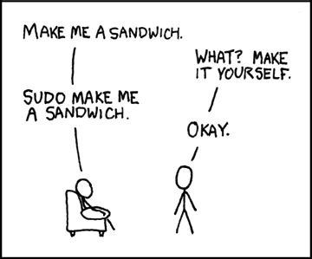

Slide 37
Set Effective User ID
In some cases, you may need a program to run as the file owner, not the invoking user
Imagine a command-line guessing game
Users may input numbers as guesses
The user should not be able to read the file with the correct answers
Program must check if guesses are correct
The program must be able to read the file with correct answers

Slide 38
setuid example
Game executable is setuid
[cbw@finalfight game] ls -lh
-rw------- 1 amislove faculty 180 Jan 23 11:25 secrets.txt
-rwsr-sr-x 4 amislove faculty 8.5K Jan 23 11:25 guessinggame
[cbw@finalfight game] cat secrets.txt
cat: secrets.txt: Permission denied
[cbw@finalfight game] ./guessinggame 4 8 15 16 23 42
Sorry, none of those number are correct :(
[cbw@finalfight game] ./guessinggame 37
Correct, 37 is one of the hidden numbers!

Slide 39
How to setuid
[cbw@finalfight tmp] gcc –o my_program my_program.c
[cbw@finalfight tmp] ls -lh
-rwxr-xr-x 1 cbw faculty 2.3K Jan 23 11:25 my_program
[cbw@finalfight tmp] chmod u+s my_program
[cbw@finalfight tmp] ls -lh
-rwsr-xr-x 1 cbw faculty 2.3K Jan 23 11:25 my_program
Be very careful with setuid
You are giving other users the ability to run a program as you, with your privileges
Programs that are setuid=root should drop privileges
Google “setuid demystified” for more info

Slide 40
setuid and scripts
This is known as a TOCTOU vulnerability:
Time-Of-Check, Time-of-Use
[cbw@finalfight tmp] ls -lh
-rwsr-xr-x 1 cbw faculty 2.3K Jan 23 11:25 server.py
[cbw@finalfight tmp] ./server.py
Steps to run a setuid script
Kernel checks setuid bit of the script
Kernel loads the interpreter (i.e. python) with setuid permissions
Interpreter executes the script
Never set a script as setuid
Replace server.py with modified, evil script

Slide 41
Limitations of the Unix Model
The Unix model is very simple
Users and groups, read/write/execute
Not all possible policies can be encoded
 | file 1 | file 2
user 1 | --- | rw-
user 2 | r-- | r--
user 3 | rw- | rwx
user 4 | rw- | ---
file 1: two users have high privileges
If user 3 and user 4 are in a group, how to give user 2 read and user 1 nothing?
file 2: four distinct privilege levels
Maximum of three levels (user, group, other)

Slide 42
Access Control Lists
ACLs are explicit rules that grant or deny permissions to users and groups
Typically associated with files as meta-data
 | file 1 | file 2
user 1 | --- | rw-
user 2 | r-- | r--
user 3 | rw- | rwx
user 4 | rw- | ---
file 1: owner = user 4, group = {user 4, user 3}
owner: rw- group: rw-
user 2: r-- other: ---
file 2: owner = user 3, group = {user 3, user 1}
owner: rwx group: rw-
user 2: r-- other: ---

Slide 43
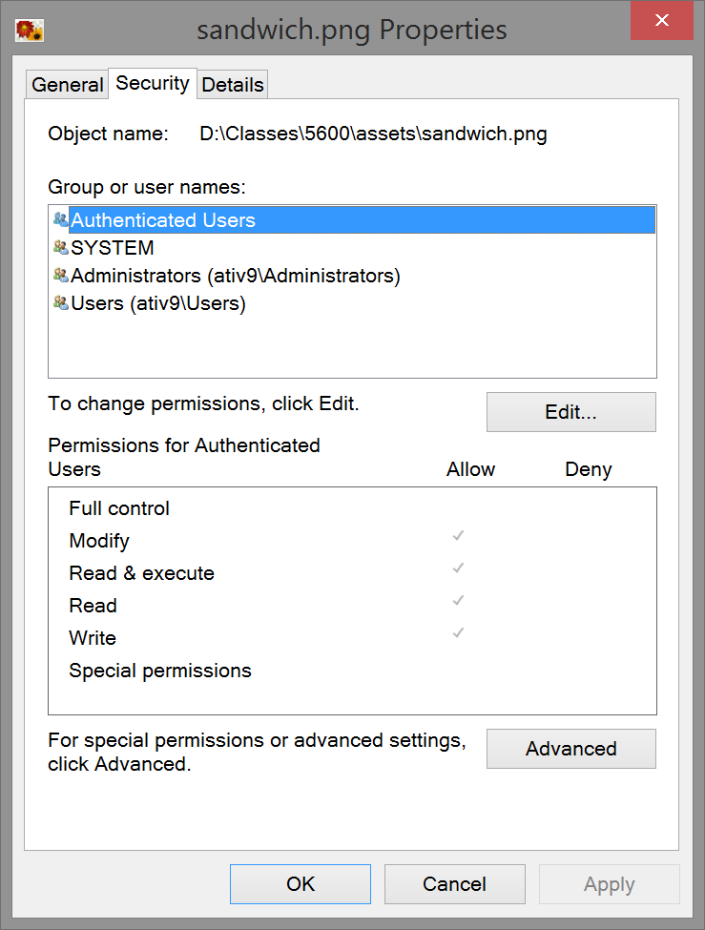
More ACLs
OSX and some versions of Linux also support ACLs

Slide 44
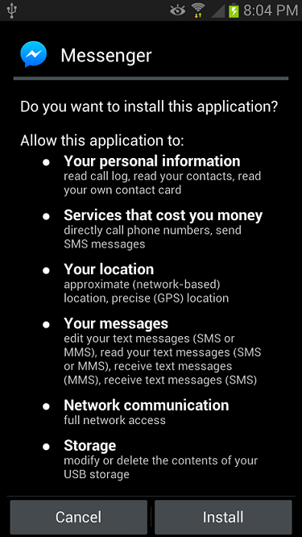
API Permissions
On Android, apps need permission to access some sensitive API calls
Android is based on Linux
Behind the scenes, each app is given its own user and group
Kernel enforces permission checks when system calls are made

Slide 45
Authentication
Access Control
Mandatory Access Control

