Slide 1
CS 5600 Computer Systems
Lecture 3: Hardware, CPUs, and a Basic Operating System

Slide 2
What is an Operating System?
An OS is any and all software that sits between a user program and the hardware
Hardware (e.g., mouse, keyboard)
Operating System
User Program
OS is a resource manager and allocator
Decides between conflicting requests for hardware access
Attempts to be efficient and fair
OS is a control program
Controls execution of user programs
Prevents errors and improper use

Slide 3







GUI
Command Line Shell
Text Editor
Operating System
Hardware (e.g., mouse, keyboard)

Slide 4
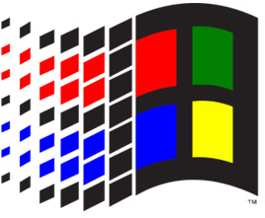


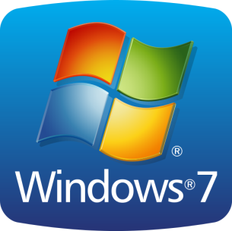











Many Different OSes
Windows
Linux
BSD

Slide 5
Goals for Today
By the end of class, we will build a very, very simple command line OS
But to get there, we need to understand the hardware platform we are building on
Basics of PC architecture
How devices and the CPU communicate
What is the basic functionality of the CPU
How do we boot into an OS

Slide 6
Hardware Basics
PC Bootup Sequence
A Simple OS Example
Kernels

Slide 7
Basic Computer Architecture
Architecture determines many properties of the OS
How does the OS load and take control?
How does the OS interacts with devices?
How does the OS manage CPU and memory?
This discussion will focus on the IBM PC architecture
Until recently, most computers could still run MS-DOS based programs from the 80’s and 90’s
Remains the most popular architecture
But not for long…
Alternatives: Amiga, Macintosh, PowerPC, etc.

Slide 8
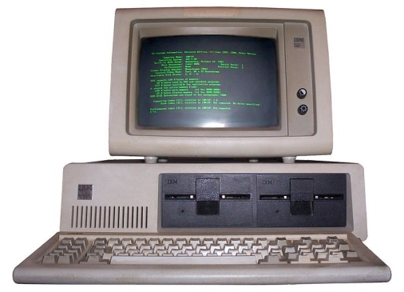
Some History
1981: IBM releases a Personal Computer (PC) to compete with Apple
Basic Input/Output System (BIOS) for low-level control
Three high-level OSes, including MS-DOS
Developers were asked to write software for DOS or BIOS, not bare-metal hardware
1982: Compaq and others release IBM-compatible PCs
Different hardware implementations (except 808x CPU)
Reverse engineered and reimplemented BIOS
Relied on customized version of MS-DOS

Slide 9


Slide 10
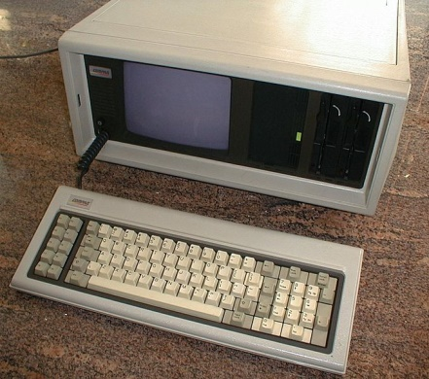
IBM Loses Control
1985: IBM clones dominated computer sales
Used the same underlying CPUs and hardware chips
Close to 100% BIOS compatibility
MS-DOS was ubiquitous
Thus, IBM PC hardware became the de-facto standard
1986: Compaq introduces 80386-based PC
1990’s: Industry is dominated by “WinTel”
Intel x86 CPU architectures (Pentium 1, 2, and 3)
Windows 3.1, NT, 95 software compatibility

Slide 11
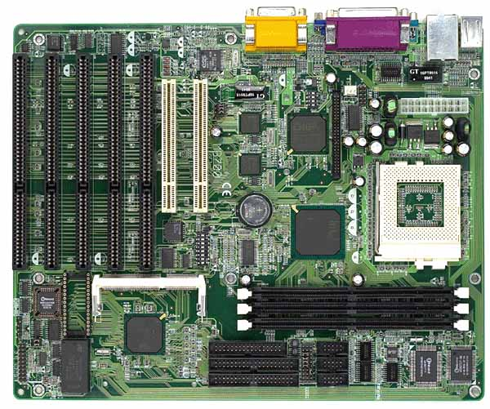
CPU Socket
Many different physical socket standards
This a Pentium 1 socket
Physical standard is less important than Instruction Set Architecture (ISA)
IBM PCs are Intel 80836 compatible
Original x86 design
Intel, AMD, VIA
Today’s dominant ISA: x86-64, developed by AMD

Slide 12
Slots for random access memory (RAM)
Pre-1993: DRAM (Dynamic RAM)
Post-1993: SDRAM (Synchronous DRAM)
Current standard: Double data rate SDRAM (DDR SDRAM)
North Bridge
Coordinates access to main memory

Slide 13
I/O device slots
Attached to the south-bridge bus
Very old standard: ISA slots
Built in I/O also on the PCI/ISA bus
South-bridge
Facilitates I/O between devices, the CPU, and main memory
Slightly less old standard: PCI slots
Other types:
AGP slots
PCI-X slots

Slide 14
Storage connectors
Also controlled by the South Bridge
Old standard: Parallel ATA (P-ATA)
AT Attachment Packet Interface (ATAPI)
Evolution of the Integrated Drive Electronics (IDE) standard
Other standards
Small Computer System Interface (SCSI)
Serial ATA (SATA)

Slide 15
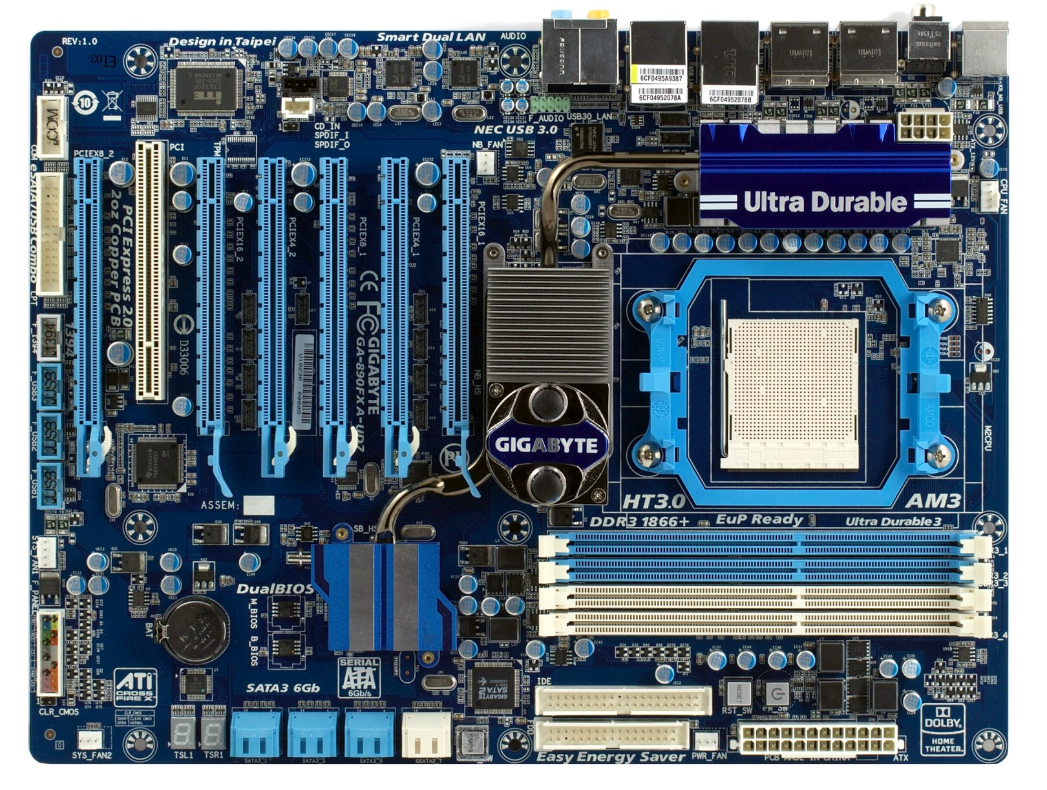
PCI slot
PCI-x16 slots
USB Headers
North Bridge
CPU socket
South Bridge
RAM Slots
SATA Plugs
PATA Connectors

Slide 16
L1, L2, L3 Cache
CPU(s)
All devices compete for access to memory
North/South Bridge
Memory
Graphics
Graphics Memory
…
I/O
I/O
I/O

Slide 17
x86 History
1978: Intel 8086 – 16 bit
1982: Intel 80286 – introduces protected mode and memory paging
1985: Intel 80386 – 32 bit
1989: Intel 80486 – integrates x87 FPU and cache
1993: Pentium and Pentium MMX
1997, 1999: Pentium II and III
2003, 2004: AMD Athlon 64 and Pentium 4
AMD pioneers the move to 64 bit x86-64

Slide 18
Basic CPU Layout
Main Memory
System Bus
L1 (and L2, L3) Cache
Instruction Fetch
Floating Point (FPU)
Arithmetic and Logic (ALU)
Arithmetic and Logic (ALU)
Registers
Decode
Control Unit

Slide 19
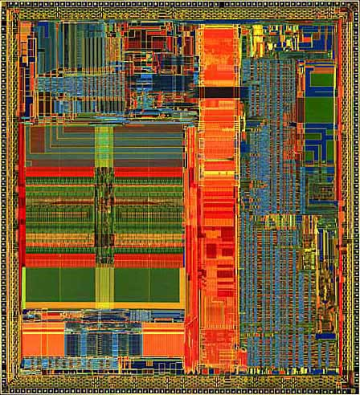

Slide 20
Registers
Storage built in to the CPU
Can hold values or pointers
Instructions operate directly on registers
Things from memory can be loaded into registers…
… or things in registers can be moved to memory
Some registers have special functions
Pointing to the current instruction in memory
Pointing to the top of the stack
Configuring low-level CPU features
Etc.

Slide 21
Storage Hierarchy
Smaller / Faster
CPU Registers
1KB
CPU L1/L2/L3 Cache
1 - 32MB
Main Memory (RAM)
4 - 256GB
Solid State Drive (SSD)
32 GB – 1 TB
Hard Drive
512 GB – 4 TB
Tape Drive
1 – 8 TB
Larger / Slower

Slide 22
x86 Registers (32 bit)
General purpose registers
EAX, EBX, ECX, EDX
Used for pretty much anything
Stack registers
ESP: Points to the top of the stack
The stack grows down, so this is the lowest address
EBP: Points to the bottom of the current stack frame
Not strictly necessary, may be used as a general purpose register
Other registers
EIP: Points to the currently executing instruction
EFLAGS: Bit vector of flags
Stores things like carry (after addition), equals zero (after a comparison), etc.

Slide 23
Register Layout
x86 has gone through 16, 32, and 64 bit versions
Registers can be addressed in whole or in part
RAX
64 bits
EAX
32 bits
AX
16 bits
AH
AL
8 bit high and low

Slide 24
x86 Assembly Examples
mov eax, 0x00ABCDE ; move 32-bit value to EAX
mov ax, 0xABCD ; move 16-bit value to AX
mov ah, 0xAB
mov al, 0xCD ; 3) + 4) are equivalent to 2)
add eax, ebx ; result stored in EAX
mov edx, [esp] ; dereference the pointer in ESP, move the value to EDX

Slide 25
Important x86 Instructions
In Intel assembly syntax, [] means dereference (e.g. *ptr in C)
Instructions | Description | Examples
mov | Move data from one place to another | mov eax, 7 mov edx, [0xF0FF] mov [ebx], eax
add / sub | Add / subtract values in registers | add eax, ebx
inc / dec | Increment / decrement the value in a register | inc eax
call | Push EIP onto the stack and jump to a function | call 0x80FE4C
ret | Pop the top of the stack into EIP | ret
push / pop | Add or remove items to the stack | push eax
int | Execute the given interrupt handler | int 0x80
jmp | Load the given value into EIP | jmp 0x80FE4C
cmp | Compare the value of two registers and store the value in the flags register | cmp ebx, edx
jxx | Load the given value into EIP if the condition is met | jz 0x80FE4C jnz 0x80FE4C
Basics
Func.
Stack
Control Flow

Slide 26
Typical Memory Layout
Top
0xFFFF
Example: 64KB of memory
2¹⁶ bytes
Addresses from 0 to 65535
Not all memory is free
Specific ranges get used by devices, system services, the BIOS, etc.
Memory mapped devices
0xF000
Free Memory
0x0DFF
BIOS Code
0x00FF
Interrupt Vector
Bottom
0x0000

Slide 27
Memory Addressing
Memory can be addressed as:
Individual bytes
Multi-byte words, double words, quad words, etc.
Address | Value
0xC7 | 0x00
0xC6 | 0x00
0xC5 | 0x10
0xC4 | 0x05
0xC3 | 0x00
0xC2 | ‘c’
0xC1 | ‘b’
0xC0 | ‘a’
mov ax, [0xC4] ; AX = 0x0510
mov ah, [0xC0] ; AH = ‘a’

Slide 28
Communicating with Devices
CPU and devices execute concurrently
How do CPU and devices communicate?
I/O Ports
I/O-only memory space shared by the CPU and a device
Memory mapping
Regions of RAM that are shared by the CPU and a device
Interrupts
Signal from a device to the CPU
Interrupt causes the OS to switch to handler code

Slide 29
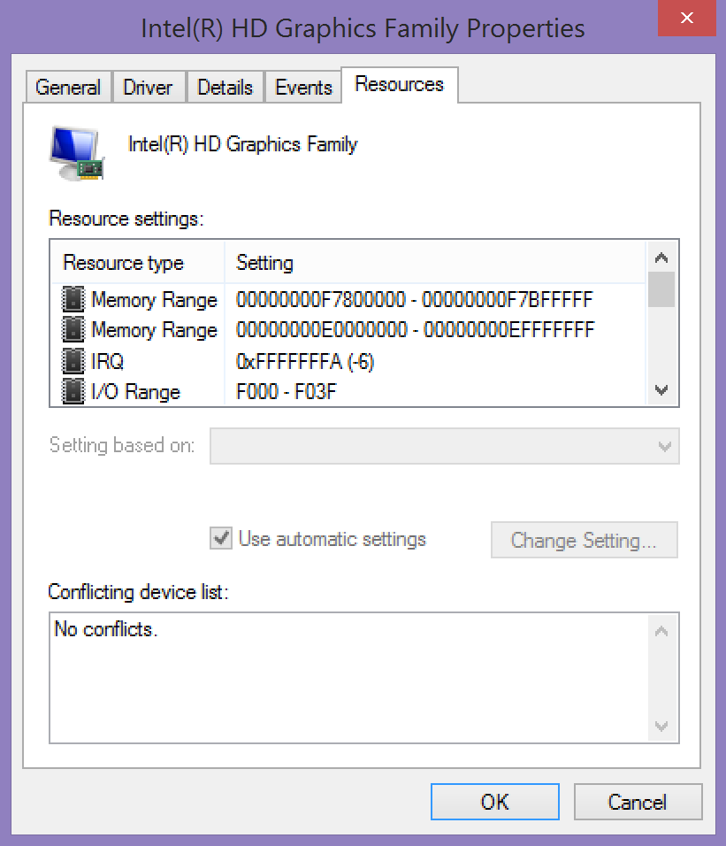
Shared Memory
Interrupt
I/O Ports

Slide 30
I/O Ports
Oldest method of interacting with devices
CPU and devices share a virtual 16-bit memory space
Each device is assigned some portion of the address space
E.g. 0xF000 – 0xF03F
CPU and device communicate by reading/writing to the virtual memory space

Slide 31
I/O Port Example
Assume there is a serial port attached to port 0x3F8
Output
Input
mov eax, 1
mov dx, 0x3F8
start: out dx, al
inc eax
cmp eax, 32
jne start
…
mov ebx, 0
mov dx, 0x3F8
start: in dx, ax
mov [esp + ebx], ax
inc ebx
cmp ebx, 31
jle start
…

Slide 32
Problem With I/O Ports
CPU must mediate all transfers
Suppose you want to move data from disk to memory…
CPU must copy each 16-bit value from the I/O port to memory
All I/O must be synchronous
Suppose the disk wants to send data…
… but the CPU isn’t reading the I/O port with in
Bottom line: I/O ports are slow

Slide 33
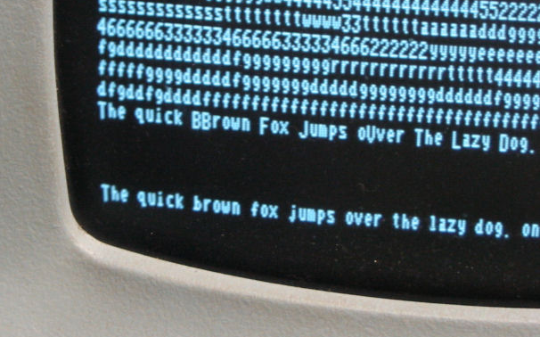
Memory Mapped Devices
RAM shared by the CPU and a device
Example: Console frame buffer
Address range of 1920 bytes
Corresponds to 24 lines of text, 80 characters wide
CPU writes characters into the memory range…
… Video hardware displays them on the screen
Address | Value
0xC2 | ‘e’
0xC1 | ‘h’
0xC0 | ‘T’

Slide 34
Example Keyboard Controller
Simple, memory mapped keyboard interface
2 bytes: keycode byte and status byte
When a key is pressed:
The keycode byte is set to the character
The status byte is set to 1
When the key is read:
CPU sets the status byte to 0
Address | Purpose
0xF801 | keycode
0xF800 | status

Slide 35
Direct Memory Access (DMA)
Enables devices to transfer blocks of data directly to memory
Interrupt generated when transfer is completed
Much faster than the alternative method
Interrupt generated after each byte is transferred

Slide 36
DMA in Action
CPU(s)
Memory
(Instructions and Data)
Instructions
Data
Data via
I/O Ports
Interrupts
Device
Data via DMA

Slide 37
Interrupts
Interrupts transfer control from the running code to an interrupt handler
Each interrupt is assigned a number
Number acts as an index into the Interrupt Vector Table
Table maps interrupt numbers to handlers
Interrupts cause a context switch
State of the CPU must be saved before the switch…
… and restored after the handler completes
Main Memory
0xFFFF
0x01 Handler
0xA146
0x00FF
Interrupt Number | Pointer to Handler
0x02 | 0x0000
0x01 | 0xA146
Interrupt Vector
0x0000

Slide 38
Interrupt Timeline
file.read();
Context Switch
file.read();
User Process
CPU
Interrupts are an example of asynchronous messaging
Interrupts enable the CPU and devices to work in parallel
Interrupt Handler
Idle
I/O Device
Transferring
Time
Read done, raise interrupt
Read done, raise interrupt

Slide 39
Today’s Servers/Desktops
Much greater homogeneity/compatibility
Apple and PC use the same internals
Powerful industry groups ratify strict standards for hardware compatibility
Joint Electron Device Engineering Council (JEDEC)
PCI Special Interest Group (PCI SIG)
USB Implementors Forum (USB-IF)
No longer IBM-PC compatible
x86-64
Unified Extensible Firmware Interface (UEFI) instead of Basic Input/Output System (BIOS)

Slide 40
Hardware Basics
PC Bootup Sequence
A Simple OS Example
Kernels

Slide 41

What Happens After You Push Power?
A lot happens in between
Pushing power…
… And arriving at the desktop
Basic steps
Start the BIOS
Load settings from CMOS
Initializing devices
Run POST
Initiate the bootstrap sequence

Slide 42
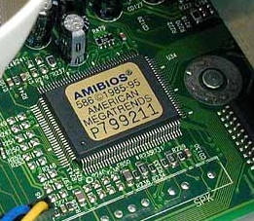
Starting the BIOS
Basic Input/Output System (BIOS)
A mini-OS burned onto a chip
Begins executing a soon as a PC powers on
Code from the BIOS chip gets copied to RAM at a low address (e.g. 0xFF)
jmp 0xFF (16 bits) written to RAM at 0xFFFF0 (2²⁰-16)
x86 CPUs always start with 0xFFFF0 in the EIP register
Essential goals of the BIOS
Check hardware to make sure its functional
Install simple, low-level device drivers
Scan storage media for a Master Boot Record (MBR)
Load the boot record into RAM
Tells the CPU to execute the loaded code

Slide 43
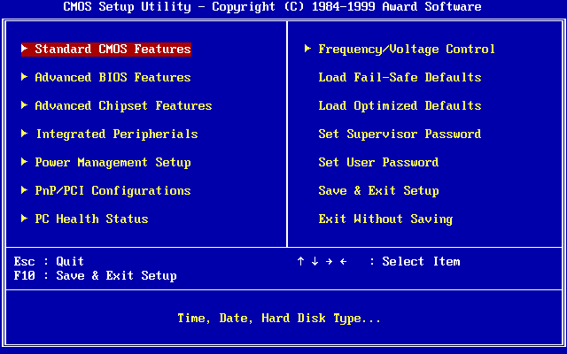
Loading Settings from CMOS
BIOS often has configurable options
Values stored in battery-backed CMOS memory

Slide 44
Initialize Devices
Scans and initializes hardware
CPU and memory
Keyboard and mouse
Video
Bootable storage devices
Installs interrupt handlers in memory
Builds the Interrupt Vector Table
Runs additional BIOSes on expansion cards
Video cards and SCSI cards often have their own BIOS
Runs POST test
Check RAM by read/write to each address

Slide 45
Bootstrapping
Problem: we need to find and load a real OS
BIOS identifies all potentially bootable devices
Tries to locate Master Boot Record (MBR) on each device
Order in which devices are tried is configurable
MBR has code that can load the actual OS
Code is known as a bootloader
Example bootable devices:
Hard drive, SSD, floppy disk, CD/DVD/Bluray, USB flash drive, network interface card

Slide 46
The Master Boot Record (MBR)
Special 512 byte file written to sector 1 (address 0) of a storage device
Contains
446 bytes of executable code
Entries for 4 partitions
Address |  | Description | Size (Bytes)
Hex | Dec.
0x000 | 0 | Bootstrap code area | 446
0x1BE | 446 | Partition Entry #1 | 16
0x1CE | 462 | Partition Entry #2 | 16
0x1DE | 478 | Partition Entry #3 | 16
0x1EE | 494 | Partition Entry #4 | 16
0x1FE | 510 | Magic Number | 2
 |  | Total: | 512
Too small to hold an entire OS
Starts a sequence of chain-loading

Slide 47
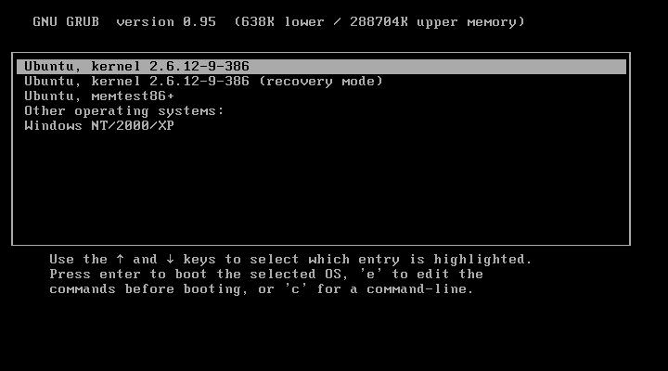
Example Bootloader: GRUB
Grand Unified Bootloader
Used with Unix, Linux, Solaris, etc.

Slide 48
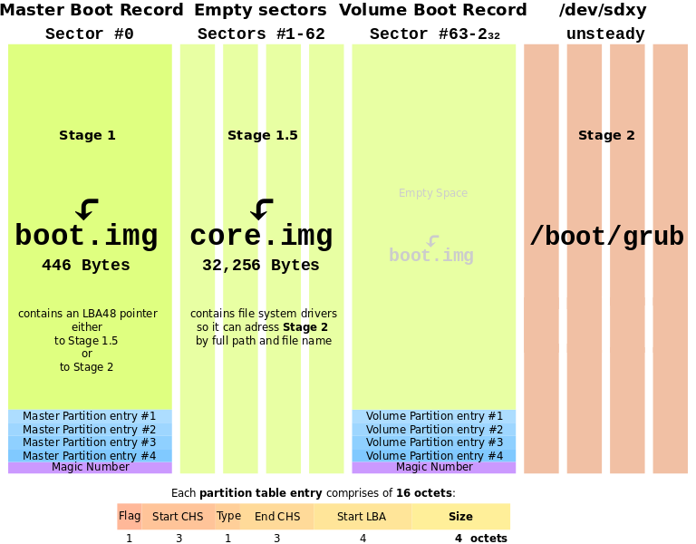

Slide 49
Hardware Basics
PC Bootup Sequence
A Simple OS Example
Kernels

Slide 50
Status Check
At this point we understand:
The basic building blocks of device I/O
How memory is laid out
Basic x86 instructions
How the BIOS locates and executes a bootloader
What’s next?
Let’s build a tiny OS for the bootloader to load

Slide 51
Goals of Our Simple OS
APIs for device access
Read from the keyboard
Read and write to a simple disk
Display text to the screen
Ability to run a simple user program
A basic command line for running programs

Slide 52
Sample Program 1 – Hello World
Writes “Hello World” to the frame buffer
Then loops forever
H
He
Hel
Hell
Hello
Hello W
Hello Wo
Hello Wor
Hello Worl
Hello World
fbuf = 0xF000
str: 'Hello World'
begin: mov eax, str
mov ebx, 11
mov ecx, 0xF000
loop: mov edx, byte [eax]
inc eax
mov [ecx], byte edx
inc ecx
sub ebx, 1
jnz_loop done: jmp done
H
e
l
o
W
o
r
l
d
EDX
0xF000
ECX
0xF001
0xF001
0xF002
0xF003
0xF004
0xF005
0xF006
0xF007
0xF008
0xF009
0xF00A
0xF00B
11
10
9
8
7
6
5
4
3
2
1
0
EBX
EAX
H
e
l
l
o
W
o
r
l
d

Slide 53
Sample Program 1 – Hello World
In this program, there is no OS
Program interacts directly with hardware
This approach might be used for highly-constrained, low-cost environments
Example: simple embedded devices
In a system like this, the program is usually written into read-only-memory (ROM) at the factory

Slide 54
Sample Program 2 – Keyboard to Screen
Reads input from the keyboard and writes it to the frame buffer
framebuf = 0xF000
status = 0xF800
keycode = 0xF801
begin: mov eax, 0xF000
loop: mov ebx, byte [0xF800]
cmp ebx, 0
jz loop
mov ebx, byte [0xF801]
mov [eax], byte ebx
inc eax
mov [0xF800], 0
jmp loop
How can we turn this functionality into an API?

Slide 55
The x86 Stack
Memory
x86 CPU uses ESP register to implement a push down stack
Examples:
push 0x01
pop eax ; EAX = 1
ESP
0xCAFE | 0xAE
0x01 | 0xAA
 | 0xA6
 | 0xA2
 | 0x9E
 | 0x9A
 | 0x96
 | 0x92
 | 0x8E
 | 0x8A
 | 0x86

Slide 56
Function Calls and the Stack
The stack is used to implement function calls
call addr: call a function
Calculates a return address (the address of the instruction following call)
Pushes the return address on to the stack
Jumps to addr (EIP = addr)
ret: return from a function
Pops the return address from the stack
Jumps to the return address

Slide 57
Function Call Example
Suppose we have code that calls
i = add(1, 2);
…
10. push 2
11. push 1
12. call add
13. mov ecx, eax
…
20. add: mov eax, [esp + 4]
21. mov ebx, [esp + 8]
22. add eax, ebx
23. ret
EIP
Memory
ESP
0xCAFE | 0xAE
0x02 | 0xAA
0x01 | 0xA6
13 | 0xA2
 | 0x9E

Slide 58
Argument Ordering and Return Values
Function arguments are always pushed in reverse order
Why?
To support functions with a variable number of arguments
Example: printf(“%i %f %s”, a, pi, str);
Argument 1 tells you how many more arguments there are on the stack
By convention, return values are always placed in EAX
This is why (typical) functions may only return one value

Slide 59
Pop Quiz
What does the stack look like after calling f(7, 10)?
…
27. call f
…
59. f: mov eax, [esp + 4]
…
Memory
10 | 0xAE
7 | 0xAA
28 | 0xA6
 | 0xA2
 | 0x9E

Slide 60
A Minimal Operating System
We’ll now write a simple OS that can:
Read keyboard input
Write it to the frame buffer
getkey()
Loops until a key has been pressed
Loads the key into EAX
getkey: mov edx, byte [status]
cmp edx, 0
jz getkey
mov [status], 0
mov eax, byte [keycode]
ret

Slide 61
putchar()
putchar()
Writes the 2 byte function argument to the frame buffer
Maintains the frame buffer cursor
bufptr: variable holding a pointer to the frame buffer
putchar: mov eax, word [esp+ 4] mov ebx, dword [bufptr] mov [ebx], word eax add ebx, 1 mov [bufptr], ebx ret

Slide 62
Using getkey() and putchar()
We can now rewrite Sample Program 2 using our simple OS
Old Code
New Code
framebuf = 0xF000
status = 0xF800
keycode = 0xF801
begin: mov eax, 0xF000
loop: mov ebx, byte [0xF800]
cmp ebx, 0
jz loop
mov ebx, byte [0xF801]
mov [eax], byte ebx
inc eax
jmp loop
loop: call getkey push eax call putchar pop eax jmp loop

Slide 63
Why Do We Care?
Reusability
Many programs can use getchar() and putchar()
Abstraction
Programs don’t need to know details of the keyboard and frame buffer interfaces
Portability
Program could run on another OS that supports getchar() and putchar()…
… even if the hardware interface has changes

Slide 64
Let’s Build a Basic Shell
Almost all OSes include a shell
A program that takes commands from the user
Earliest (and best) shells were command lines
Modern shells are GUIs
Let’s build a shell into our OS
Read a command line from the keyboard
Read the associated program from the disk
Load the program into memory and execute it

Slide 65
Basic Program Loading
Memory regions are reserved
Memory mapped hardware
OS code
IVT
Etc…
To load and run a program:
Read the program from disk into the program region of memory
Use call to jump to the first instruction of the program
Called the entry point
Main Memory
0xFFFF
Hardware
OS Code
getchar()
putchar()
User Program Region
IVT
0x0000

Slide 66
Example Disk Controller
Disk drive interface
Reads and writes occur in 512-byte blocks
Block numbers start at 0
To write to block B
Copy the data into range 0xF900 – 0xFAFF
Write B to 0xF822
Write ‘W’ to 0xF820
Tells the drive to write the buffer
Drive will write 0 to 0xF820 when the transfer is complete
Address | Purpose
0xFAFF | 512-byte buffer
…
0xF900
0xF822 | block address
0xF820 | cmd/status

Slide 67
Example Disk Controller (cont.)
To read from block B
Write B to 0xF822
Write ‘R’ to 0xF820
Tells the drive to read data from the disk into the buffer
Drive will write 0 to 0xF820 when the transfer is complete
Data from B is now available in 0xF900 – 0xFAFF
Address | Purpose
0xFAFF | 512-byte buffer
…
0xF900
0xF822 | block address
0xF820 | cmd/status

Slide 68
Additional OS APIs
Assume we have already implemented some functions
read_disk_block() reads a block from the disk to some address in memory
getline() reads a line from the keyboard and stores it into a buffer

Slide 69
Basic File System
Assume the disk is divided into blocks
We introduce a trivial file system
Block 0 is the directory mapping of the file system
Other blocks are program data blocks
Block 0 (directory)
Valid? | Name | Addr | len
1 | “file1.txt” | 1 | 2
0
1 | “program.com” | 3 | 3
Blocks 1 and 2
file1.txt
Blocks 3, 4 and 5
program.com

Slide 70
File System Structures
Block 0 (directory)
Valid? | Name | Addr | len
1 | “file1.txt” | 1 | 2
0
1 | “program.com” | 3 | 3
struct dirent {
bool valid;
char name[16]; int start; int len;
};
struct dirent directory[BLK_SIZ/sizeof(struct dirent)]
read_disk_block(/*blk #*/ 0, /*destination*/ directory);
Blocks 1 and 2
file1.txt
Blocks 3, 4 and 5
program.com

Slide 71
Basic Command Line
We can now write a very simple command line:
char buffer[80]; struct dirent directory[NDIR];
int i, start, count;
void *program_base = …; /* probably 0x100 or so */
while (1) {
getline(buffer);
read_disk_block(DIR_SECTOR, directory);
for (i = 0; i < NDIR; i++) {
if (strcmp(buffer,directory[i].name)== 0 && directory[i].valid) {
for (j = 0; j < directory[i].len; j++)
read_disk_block(/* block # */ directory[i].start + j, /* destination*/ program_base + j * 512);
break;
}
}
asm(“call program_base”);
/* returns here when program is done */
}

Slide 72
Limitations of Our OS
Main Memory
Crashes if it can’t find the specified program
If the program crashes, the whole OS needs to be restarted
Programs may not run if the OS is upgraded
Why?
Programs access OS APIs directly
What if the addresses change?
0xFFFF
Hardware
OS Code
getchar()
putchar()
User Program
IVT
0x0000

Slide 73
System Call Interface
System call table
Layer of indirection to abstract the OS APIs
Table is always located at a fixed position
Each OS API is given a specific index in the table
Programs access APIs via the table, instead of hard coding the function address

Slide 74
Traps: Software Interrupts
Software can also generate interrupts
Traps and exceptions are software interrupts
Example:
mov eax, 1 ; system call number goes in EAX, exit() = 1
xor ebx, ebx ; exit() takes one parameter
int 0x80 ; transfer control to the Linux kernel

Slide 75
(Simplified) System Call Example
Software executes int 0x80, pushes EIP
CPU looks up handler in the IVT
CPU transfers control to the OS handler
Handler looks up EAX in the syscall table
Jump to the API code
Main Memory
0xFFFF
OS Code
0xC0F4
printf()
EAX | Pointer to API
1 | 0xC0F4
0xA146
0x80 Handler
Syscall Table
EIP
mov eax, 1
xor ebx, ebx
int 0x80
User Program
Interrupt Number | Pointer to Handler
0x80 | 0xA146
IVT
0x0000

Slide 76
CPU Support for System Calls
Many CPUs provide instruction support for invoking system calls
On x86, system calls are initiated via an interrupt
Example: Linux system calls
On x86, int 0x80 is the system call interrupt
EAX holds the table index of the desired API
EAX | Function
1 | sys_exit
2 | sys_fork
3 | sys_read
4 | sys_write

Slide 77
Our OS So Far
Almost at the level of MS-DOS 1.0
Current features:
Interface to frame buffer
Interface to keyboard controller
Interface to disk controller
Command line
Ability to load and execute simple programs
Uses interrupts to make system calls

Slide 78
Similarities with MS-DOS 1.0
Main Memory
Separate OS and program spaces
System call table accessed via interrupt
Command line is part of OS
Similar keyboard controller, frame buffer, and disk controller
Top
User Program Region
MS-DOS
BIOS
IVT
0x0000

Slide 79
Hardware Basics
PC Bootup Sequence
A Simple OS Example
Kernels

Slide 80
Towards a Kernel
“The one program running at all times on the computer” is the kernel
Typically loaded by the bootloader
Questions:
What are the features that kernels should implement?
How should we architect the kernel to support these features?

Slide 81
Kernel Features
Device management
Required: CPU and memory
Optional: disks, keyboards, mice, video, etc.
Loading and executing programs
System calls and APIs
Protection and fault tolerance
E.g. a program crash shouldn’t crash the computer
Security
E.g. only authorized users should be able to login

Slide 82
Architecting Kernels
Three basic approaches
Monolithic kernels
All functionality is compiled together
All code runs in privileged kernel-space
Microkernels
Only essential functionality is compiled into the kernel
All other functionality runs in unprivileged user space
Hybrid kernels
Most functionality is compiled into the kernel
Some functions are loaded dynamically
Typically, all functionality runs in kernel-space

Slide 83
Monolithic Kernel
Kernel Space
User Space
Monolithic Kernel Code
CPU Scheduling
Program Loader
Memory Manager
User Program
Error Handling
System APIs
Security Policies
File Systems
Device Drivers

Slide 84
Hybrid Kernel
Kernel Space
User Space
Kernel Code
Third-Party Code
Memory Manager
CPU Scheduling
Device Driver
Security Policies
Error Handling
Device Driver
File Systems
System APIs
File System
Program Loader
User Program

Slide 85
Microkernel
Kernel Space
User Space
File System
Disk Driver
Kernel Code
Memory Manager
Networking Service
Network Card Driver
CPU Scheduling
User Program 1
Interprocess Communication
User Program 2

Slide 86



Research Kernels:
Mach
L4
GNU Hurd
Kernels for Embedded System:
QNX
Microkernels:
Small code base,
Few features
Hybrid Kernels:
Pretty large code base,
Some features delegated
Monolithic Kernels:
Huge code base,
Many features

Slide 87
Pros/Cons of Monolithic Kernels
Advantages
Single code base eases kernel development
Robust APIs for application developers
No need to find separate device drivers
Fast performance due to tight coupling
Disadvantages
Large code base, hard to check for correctness
Bugs crash the entire kernel (and thus, the machine)

Slide 88
Pros/Cons of Microkernels
Advantages
Small code base, easy to check for correctness
Excellent for high-security systems
Extremely modular and configurable
Choose only the pieces you need for embedded systems
Easy to add new functionality (e.g. a new file system)
Services may crash, but the system will remain stable
Disadvantages
Performance is slower: many context switches
No stable APIs, more difficult to write applications

