Slide 1
Running your own LLMs
Geert Jan Bex (geertjan.bex@uhasselt.be)
License: this presentation is released under the Creative Commons CC BY 4.0, see https://creativecommons.org/licenses/by/4.0/deed.ast

Slide 2
http://bit.ly/2RYQvSX

Slide 3


Slide 4
Overview
Why LLMs?
What are LLMs?
How can I use LLMs?
Can I run an LLM on my laptop?
Can I chat with my data?
Fine-tuning models
Computing on the edge: quantization
Can I start from scratch?
Conclusions

Slide 5
Why LLMs?

Slide 6
What are LLMs?

Slide 7
How can I use LLMs?

Slide 8
Steps
Get your data: ingestion
Index your data: embeddings
Query a model
Use LlamaIndex

Slide 9
Data ingestion
Simple: SimpleDirectoryReader
More specific from LlamaHub
BeautifulSoupWebReader: scrape web pages
DatabaseReader: query relational database
OneDriveReader: load documents form Microsoft OneDrive
WikipediaReader: read Wikipedia articles
…
Create Document on the fly
Many sources for data ingestion

Slide 10
Indexing
Index = data structure of documents to query by LLM
Types
Vector Store Index
Documents split into nodes
Embedding computed for every node
Summary Index
Knowledge Graph Index

Slide 11
Querying Vector Storage Index
To query
Compute embedding from query text
Do top-K similarity search over Vector Store Index
Send query + top-K + prompt to LLM for answer synthesis
Retrieval-Augmentation
Generation

Slide 12
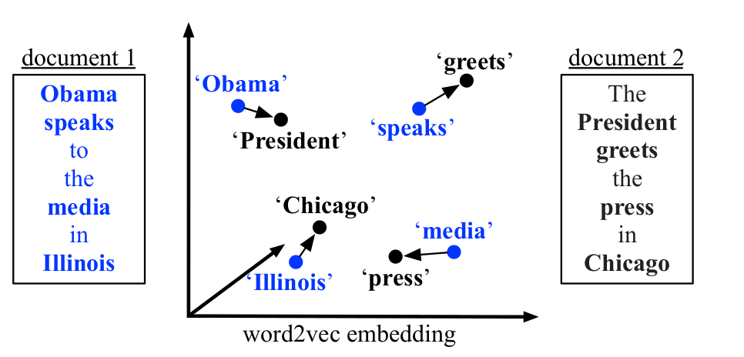
Word embeddings
Represent words as one-hot vectors length = vocabulary size
Issues
Unwieldy
No semantics
Word embeddings
dense vector
vector distance ≈ semantic distance
Training
use context
discover relations with surrounding words

Slide 13
Can I run an LLM on my laptop?

Slide 14
Yes... well, maybe
Depends on
Hardware
CPU
RAM
GPU
Task
Inference
Training
For serious work, use HPC system

Slide 15

Running local LLMs
Use Ollama
Llama 3.2
Phi 3
Mistral
Gemma 2
...
Headstrong install script ⇒ run in container

