Slide 1
Running your own LLMs
Geert Jan Bex (geertjan.bex@uhasselt.be)
License: this presentation is released under the Creative Commons CC BY 4.0, see https://creativecommons.org/licenses/by/4.0/deed.ast

Slide 2
http://bit.ly/2RYQvSX

Slide 3


Slide 4
Overview
Why LLMs?
What are LLMs?
How can I use LLMs?
Can I run an LLM on my laptop?
Can I chat with my data?
Fine-tuning models
Computing on the edge: quantization
Can I start from scratch?
Conclusions

Slide 5
Why LLMs?

Slide 6
What are LLMs?

Slide 7
How can I use LLMs?

Slide 8
Use cases
Information retrieval

Slide 9
How can I use LLMs?
Retrieval-Augmented Generation (RAG)

Slide 10

Steps
Get your data: ingestion
Index your data: embeddings
Query a model
Use LlamaIndex

Slide 11
Data ingestion
Simple: SimpleDirectoryReader
More specific from LlamaHub
BeautifulSoupWebReader: scrape web pages
DatabaseReader: query relational database
OneDriveReader: load documents form Microsoft OneDrive
WikipediaReader: read Wikipedia articles
…
Create Document on the fly
Many sources for data ingestion

Slide 12
Indexing
Index = data structure of documents to query by LLM
Types
Vector Store Index
Documents split into nodes
Embedding computed for every node
Summary Index
Knowledge Graph Index

Slide 13
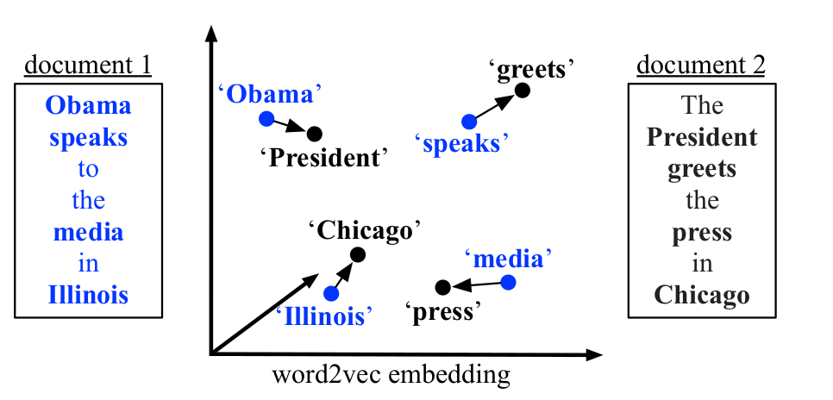
Word embeddings
Represent words as one-hot vectors length = vocabulary size
Issues
Unwieldy
No semantics
Word embeddings
dense vector
vector distance ≈ semantic distance
Training
use context
discover relations with surrounding words

Slide 14
Data ingestion & indexing code
from llama_index.core import VectorStoreIndex, SimpleDirectoryReader, Settings
from llama_index.embeddings.huggingface import HuggingFaceEmbedding
...
# Local text documents to index (.rst files)
documents = SimpleDirectoryReader("texts/").load_data()
# Embeddings model
Settings.embed_model = HuggingFaceEmbedding(model_name="BAAI/bge-base-en-v1.5")
# Create index
index = VectorStoreIndex.from_documents(documents)
...
Ingest documents
Set embedding
Create index
Modelfile-marvin

Slide 15
Querying Vector Storage Index
To query
Compute embedding from query text
Do top-K similarity search over Vector Store Index
Send query + top-K + prompt to LLM for answer synthesis
Retrieval-Augmentation
Generation

Slide 16
Querying code
...
from llama_index.llms.ollama import Ollama
# Language model
Settings.llm = Ollama(model="llama3.2", request_timeout=360.0)
# Create RAG query engine based on index
query_engine = index.as_query_engine()
...
# Perform a query
response = query_engine.query(query_text)
...
Set LLM to use
Create query engine from vector store index
Query LLM using index
Modelfile-marvin

Slide 17
Can I run an LLM on my laptop?

Slide 18
Yes... well, maybe
Depends on
Hardware?
CPU
RAM
GPU
Task?
Inference
Training
For serious work, use HPC system

Slide 19

Running local LLMs
Use Ollama
Llama 3.2
Phi 3
Mistral
Gemma 2
...
Headstrong install script ⇒ run in container

Slide 20
How to chat with Ollama models
Start server
(Pull,) launch model, e.g., llama3.2 & start client
$ ollama serve
$ ollama run llama3.2
>>>

Slide 21
How to manage models
List installed models
Install model, e.g., codellama
Show information about model, e.g., codellama
Remove model, e.g., codellama
$ ollama list
$ ollama pull codellama
$ ollama show codellama
$ ollama rm codellama

Slide 22
How to run Ollama models
Start a model, e.g., llama3.2
List all running models
Stop a running model, e.g., llama3.2
$ ollama run llama3.2
$ ollama ps
$ ollama stop llama3.2

Slide 23
Don't byte of more than you can chew
Model | Nr. Parameters (B) | Download size (GB) | Memory size (GB)
Llama 3.2 | 3 | 2.0 | 4.0
Llama 3.2 | 1 | 1.3 | 2.7
Code Llama | 7 | 3.8 | 5.7
LLaVa | 7 | 4.5

Slide 24
Marvin the helpdesk guy
Create a model file, e.g.,
Create model marvin
FROM llama3.2
PARAMETER temperature 1.5
# set the system message
SYSTEM """
You are Marvin, the paranoid robot from the Hitchhiker's guide to the galaxy.
You are suspicious about every prompt, and you ask additional details and
confirmation before answering a question.
"""
Modelfile-marvin
$ ollama create marvin --file Modelfile-marvin

