Slide 1
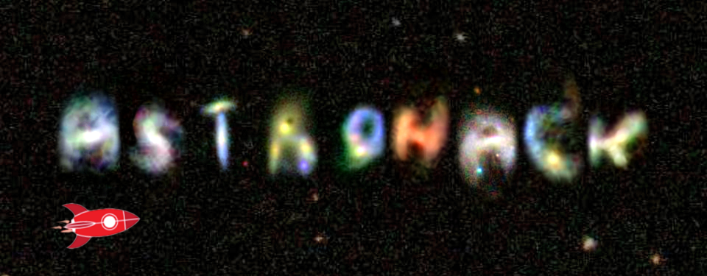





DATA SCIENCE
GHENT

Slide 2





Program and practical information
Contact information: gertdegeyter@gmail.com or +32478305240
@DSGhent @DeGeyterGert
#ASTROHACK
This event is for fun!
Two locations:
Start is at Volksterrenwacht Armand Pien
Later we move to S5 building at the Sterre
Everyone is free to come and go as they see fit!
Ends at 2AM start again at 10AM
Team size is 4 people but let’s vote on this
You can look for team members during the reception (add the tool you will use, your experience, …)
When you have your team MAIL me with everyone in cc I will send the data labels to start in reply ☺
DATA SCIENCE GHENT

Slide 3
Program and practical information
Friday 28/04
Location: Sterrenwacht Armand Pien
(No dinner – make sure to eat before)
19:00 – Tensorflow certificates by Datatonic
19:30 – Talk by Prof. Dr. Maarten Baes on the hackathon data
19:50 – Vlaamse supercomputer centrum introduction
20:10 – Hackathon introduction: Sample + goal
20:30 – Opening reception and guided tour in Volksterrenwacht Armand Pien
22:00 – Move to Hackathon location S5, De Sterre
02:00 – End of Day
DATA SCIENCE GHENT

Slide 4
Program and practical information
Saturday 29/04
Location: S5, De Sterre
10:00 – Start with breakfast
13:00 – Small lunch
14:00 – Start of model tests! (we’ll send more info tomorrow how to submit)
19:00 – Dinner is served!
02:00 – End of day
Sunday 30/04
Location: S5, De Sterre
10:00 – Start with breakfast
14:00 – Submission deadline
DATA SCIENCE GHENT

Slide 5
Program and practical information
The submitted slides will be reviewed by a jury (see site)
Presented at the closing meetup (most likely 11/05)
The winners are chosen by these jury members who will keep in mind a number of arguments like the model accuracy, performance, data exploration phase, visuals, relevance etc.
The winning team will be invited to write a scientific A1 paper on their winning solutions together with the organizers and partners of the hackathon.
DATA SCIENCE GHENT

Slide 6
VSC login and sample data
There will be 2 people present from the Vlaamse supercomputer centrum
Create an account on VSC instructions: https://github.com/gjbex/Astrohack
Requested to limit to 1-2 accounts per team
SOFTWARE:
We have installed TensorFlow on both the GPU and CPU nodes and tested it.
Python and R also available
If there will be any other software used by the participants, it will be better if we know upfront. This way we can test it. Otherwise we will not able to guarantee that it will work. (see google form)
We have access to 13 GPU nodes (8 K20xm and 5 K40c) and 40 CPU nodes
DATA SCIENCE GHENT

Slide 7


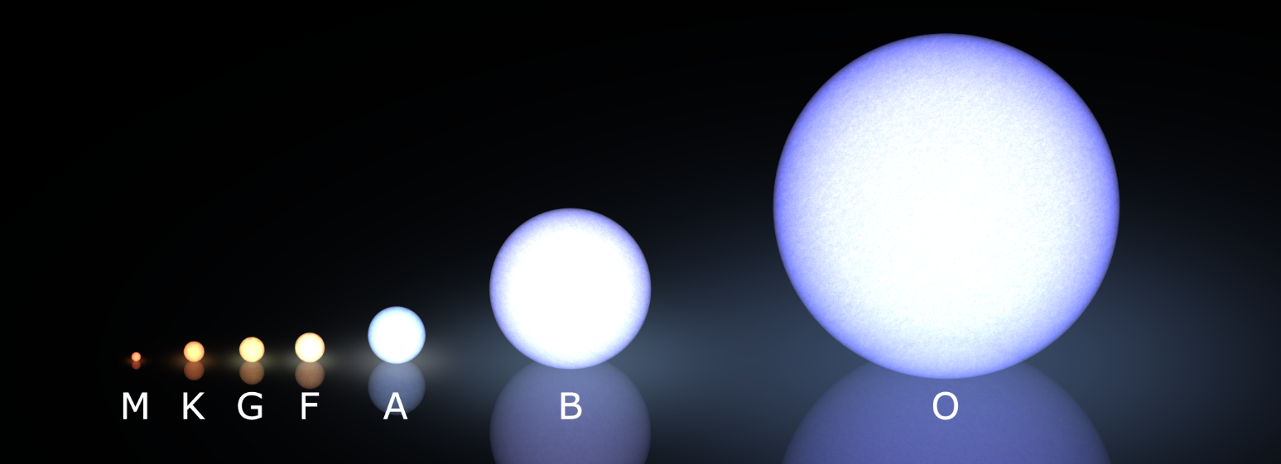
Astrohack: Goal
In collaboration with the UGent Astronomy department
Dataset consists out of 75000 images of galaxies
Additional 8500 will be used for testing the models
Can we determine the stellar mass of galaxies?
This is usually done by combining total fluxes corresponding to at least two different wavelengths for example blue and red light
What if we don’t have this information?
Available on VSC already (apart from labels) and on USB stick
DON’T DOWNLOAD IT PLS! (+- 18gb)
DATA SCIENCE GHENT

Slide 8
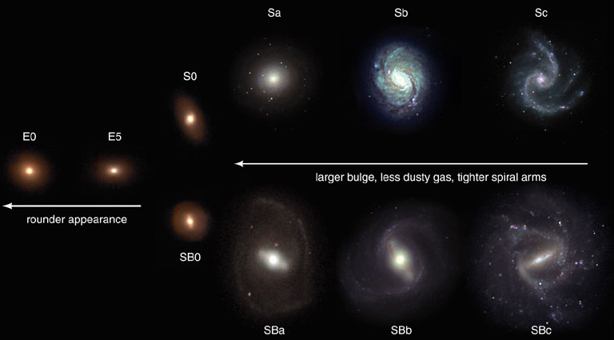
Astrohack: Goal
Can morphology make up for the lack of wavelength information?
DATA SCIENCE GHENT

Slide 9
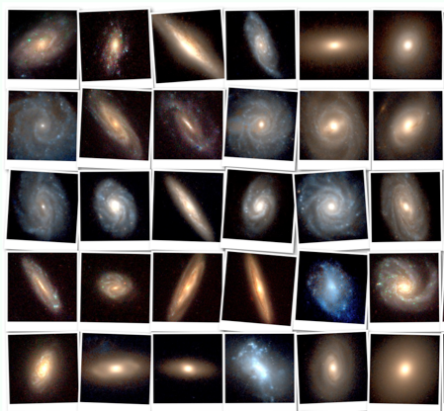
Astrohack: Goal
g and i-band images taken by SDSS will be used
In addition a subset is provided with stellar masses and distances
In the first part the images at both wavelengths can be used
In the second part only g-band images can be used
DATA SCIENCE GHENT

Slide 10
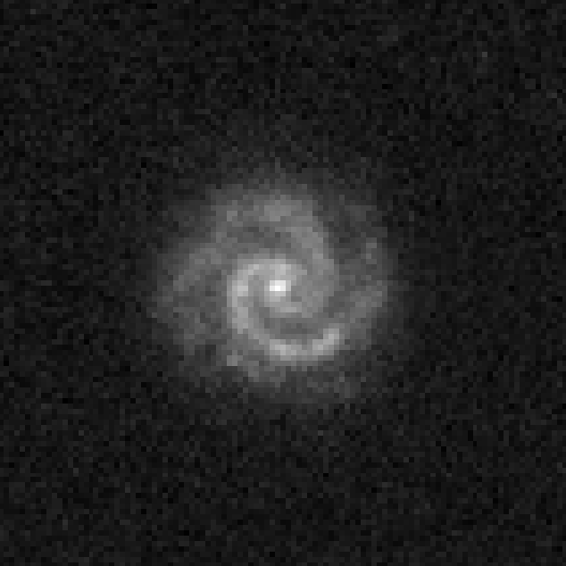
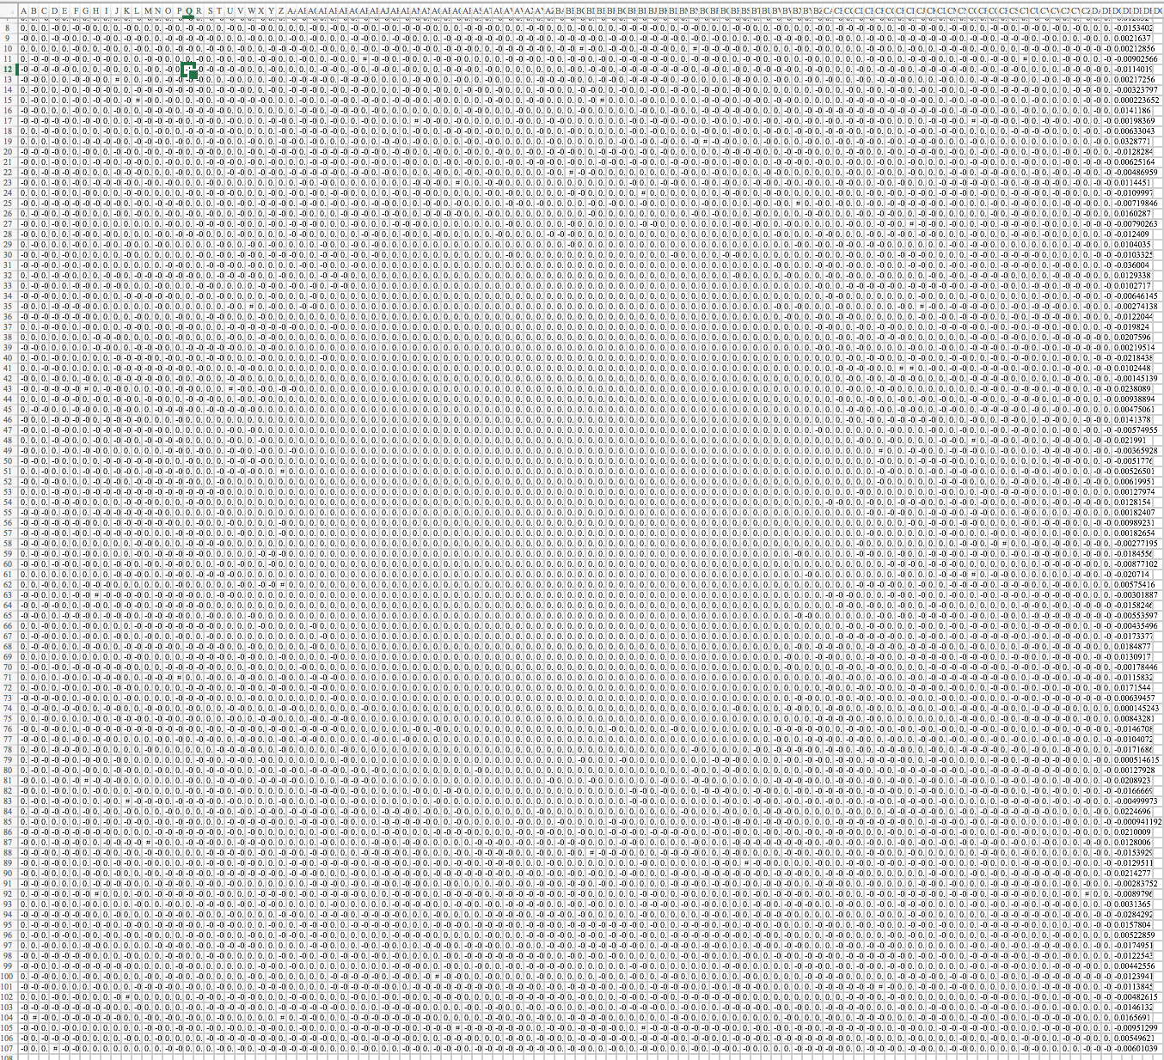
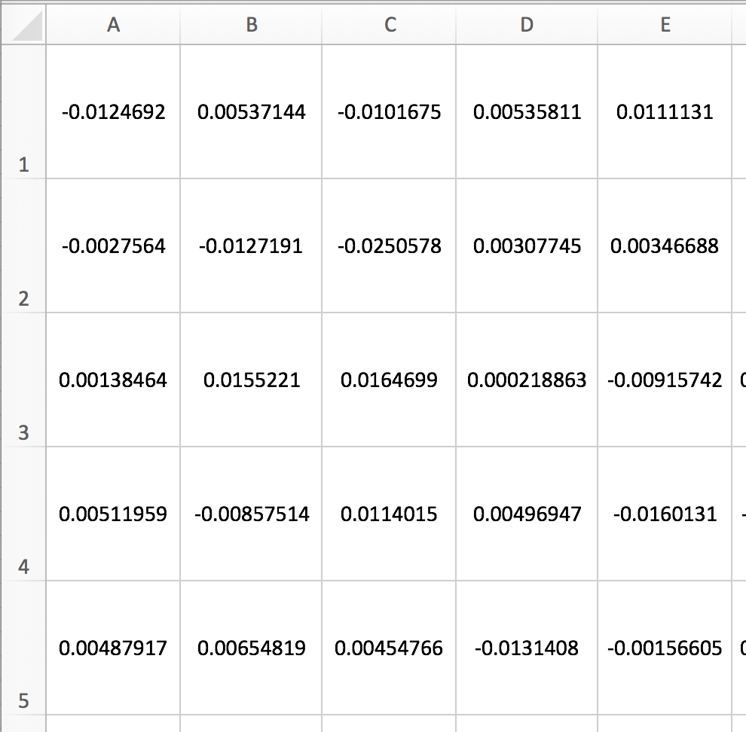
Astrohack: Goal
Images are converted
Final set is large set of csv files
Small sample set available on https://github.com/gjbex/Astrohack
Easy to read
Start small and simple!
DATA SCIENCE GHENT

Slide 11
Astrohack: Example
Schematic overview of one very very basic to start solving the problem
Given an image and some characteristics
Step1: extract features from the image to expand characteristics table
Step2: solve regression problem
SDSS_ID | Distance | LogMstar | Err_LogMstar
This is the ID of the galaxy | The distance (translated from redshift) given in megaparsec | The estimated stellar mass given in logarithm of solar mass | The error on estimated stellar mass
DATA SCIENCE GHENT

Slide 12
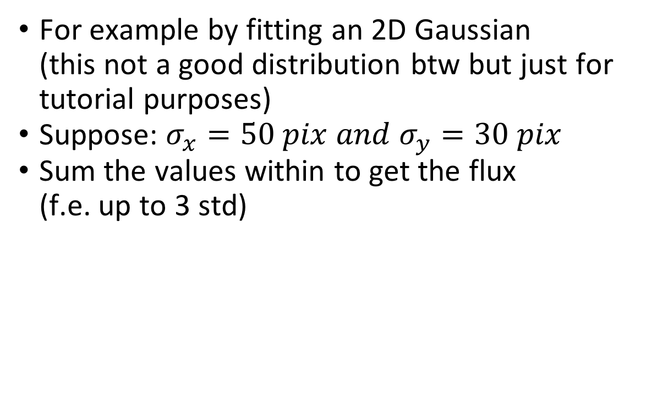
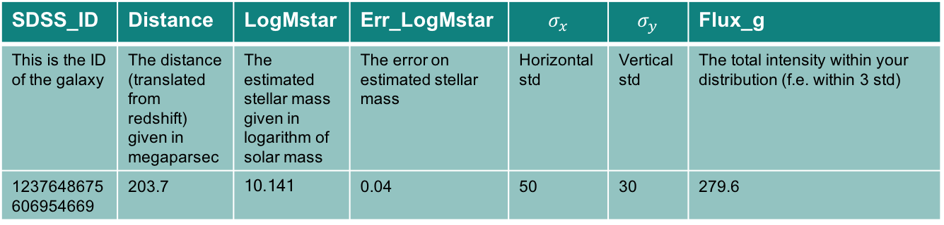
Astrohack: Example
For example by fitting an 2D Gaussian (this not a good distribution btw but just for tutorial purposes)
Suppose: $σ_{x}=50 pix and{ σ}_{y}=30 pix$
Sum the values within to get the flux (f.e. up to 3 std)
SDSS_ID | Distance | LogMstar | Err_LogMstar | $$σ_{x}$$ | $$σ_{y}$$ | Flux_g
This is the ID of the galaxy | The distance (translated from redshift) given in megaparsec | The estimated stellar mass given in logarithm of solar mass | The error on estimated stellar mass | Horizontal std | Vertical std | The total intensity within your distribution (f.e. within 3 std)
1237648675606954669 | 203.7 | 10.141 | 0.04 | 50 | 30 | 279.6
DATA SCIENCE GHENT

Slide 13
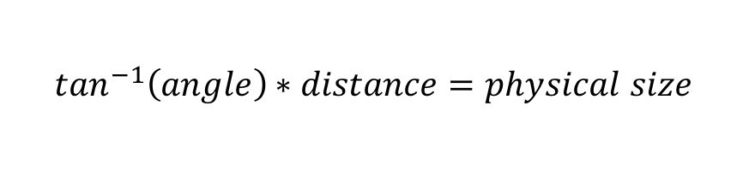
Astrohack: Distance
Images are in angular units 0.396”/pixel
Depending on how far your object is this might result in different physical sizes
It’s the physical size that will determine your stellar mass
Luckily this is an easy conversion (basic trigonometry)
(For tensorflow it might be necessary to preprocess images to physical distances)
size
angle
distance
$$\tan^{−1}\left(angle\right)∗distance=physical size$$
DATA SCIENCE GHENT

Slide 14

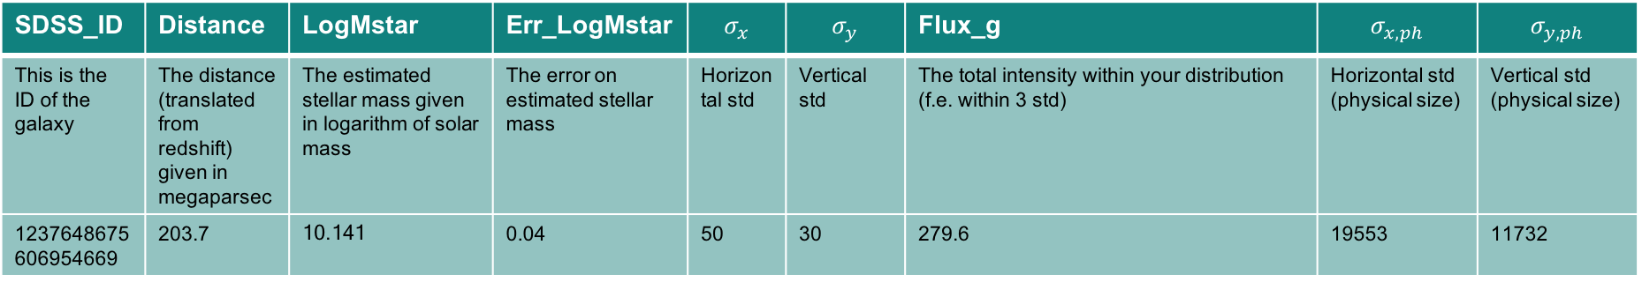
Astrohack: Example
$σ_{x}=50 pix ∗\frac{0.396 ”}{pix}$ = 19.8” = 9.6e-5 rad
$\tan^{−1}\left(\text{9.6}\text{e}\text{−5}\right)∗203.7e6 pc=$ 19553 pc
$σ_{y}=30 pix ∗\frac{0.396 ”}{pix}$ = 11.9” = 5.76e-5 rad
$\tan^{−1}\left(\text{5.76}\text{e}\text{−5 }\text{rad} \right)∗203.7e6 pc=$ 11732 pc
SDSS_ID | Distance | LogMstar | Err_LogMstar | $$σ_{x}$$ | $$σ_{y}$$ | Flux_g | $$σ_{x, ph}$$ | $$σ_{y, ph}$$
This is the ID of the galaxy | The distance (translated from redshift) given in megaparsec | The estimated stellar mass given in logarithm of solar mass | The error on estimated stellar mass | Horizontal std | Vertical std | The total intensity within your distribution (f.e. within 3 std) | Horizontal std (physical size) | Vertical std (physical size)
1237648675606954669 | 203.7 | 10.141 | 0.04 | 50 | 30 | 279.6 | 19553 | 11732
DATA SCIENCE GHENT

Slide 15
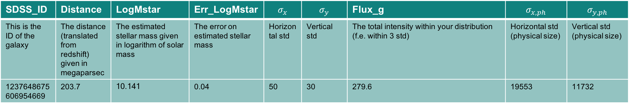
Astrohack: Example
You can now repeat this process for all galaxies
Note the above example is a very basic case as it does not take into account potential issues such as Projection of the galaxy on 2D, spiral structure, star in front acting as noise in image, etc.
SDSS_ID | Distance | LogMstar | Err_LogMstar | $$σ_{x}$$ | $$σ_{y}$$ | Flux_g | $$σ_{x, ph}$$ | $$σ_{y, ph}$$
This is the ID of the galaxy | The distance (translated from redshift) given in megaparsec | The estimated stellar mass given in logarithm of solar mass | The error on estimated stellar mass | Horizontal std | Vertical std | The total intensity within your distribution (f.e. within 3 std) | Horizontal std (physical size) | Vertical std (physical size)
1237648675606954669 | 203.7 | 10.141 | 0.04 | 50 | 30 | 279.6 | 19553 | 11732
DATA SCIENCE GHENT

Slide 16
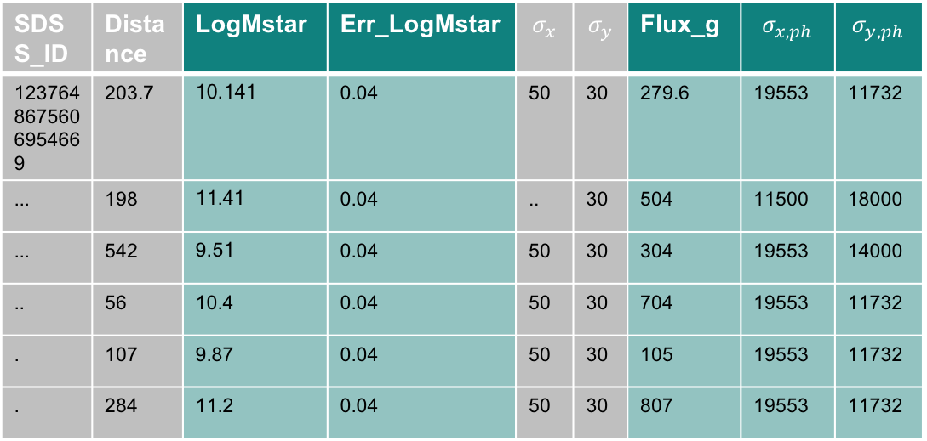
Astrohack: Example
This you can now use to solve as a standard regression problem
Again note that this is just to show you how to split up the problem
Up to you to extract optimal features and choose how to solve the regression problem
SDSS_ID | Distance | LogMstar | Err_LogMstar | $$σ_{x}$$ | $$σ_{y}$$ | Flux_g | $$σ_{x, ph}$$ | $$σ_{y, ph}$$
1237648675606954669 | 203.7 | 10.141 | 0.04 | 50 | 30 | 279.6 | 19553 | 11732
... | 198 | 11.41 | 0.04 | .. | 30 | 504 | 11500 | 18000
... | 542 | 9.51 | 0.04 | 50 | 30 | 304 | 19553 | 14000
.. | 56 | 10.4 | 0.04 | 50 | 30 | 704 | 19553 | 11732
. | 107 | 9.87 | 0.04 | 50 | 30 | 105 | 19553 | 11732
. | 284 | 11.2 | 0.04 | 50 | 30 | 807 | 19553 | 11732
DATA SCIENCE GHENT

Slide 17
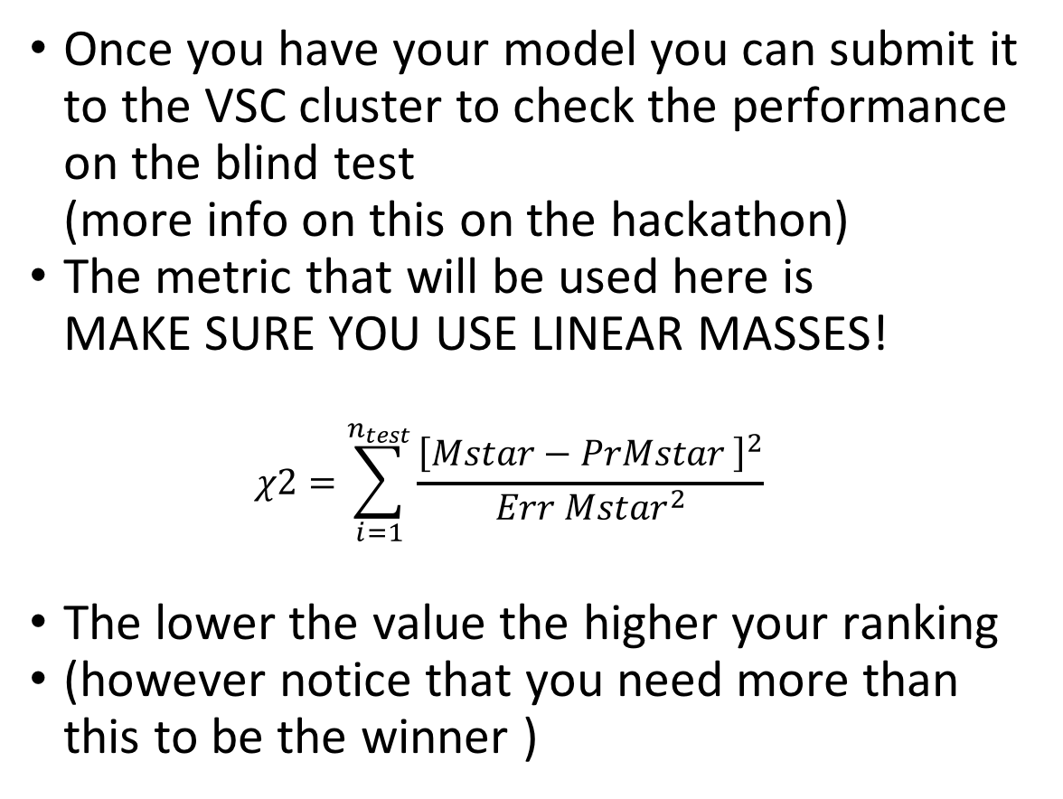
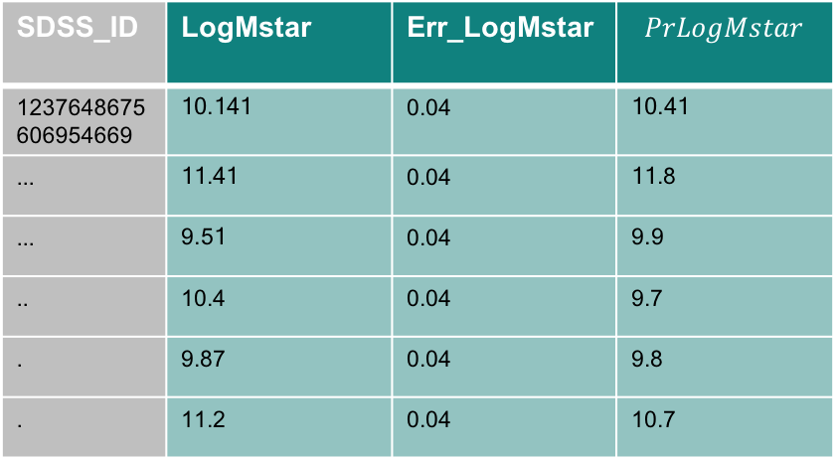
Astrohack: Example
Once you have your model you can submit it to the VSC cluster to check the performance on the blind test (more info on this on the hackathon)
The metric that will be used here is MAKE SURE YOU USE LINEAR MASSES! $χ2=\sum_{i=1}^{n_{test}}{\frac{{\left[Mstar−PrMstar \right]}^{2}}{{Err Mstar}^{2}}}$
The lower the value the higher your ranking
(however notice that you need more than this to be the winner )
SDSS_ID | LogMstar | Err_LogMstar | $$PrLogMstar$$
1237648675606954669 | 10.141 | 0.04 | 10.41
... | 11.41 | 0.04 | 11.8
... | 9.51 | 0.04 | 9.9
.. | 10.4 | 0.04 | 9.7
. | 9.87 | 0.04 | 9.8
. | 11.2 | 0.04 | 10.7
DATA SCIENCE GHENT

Slide 18
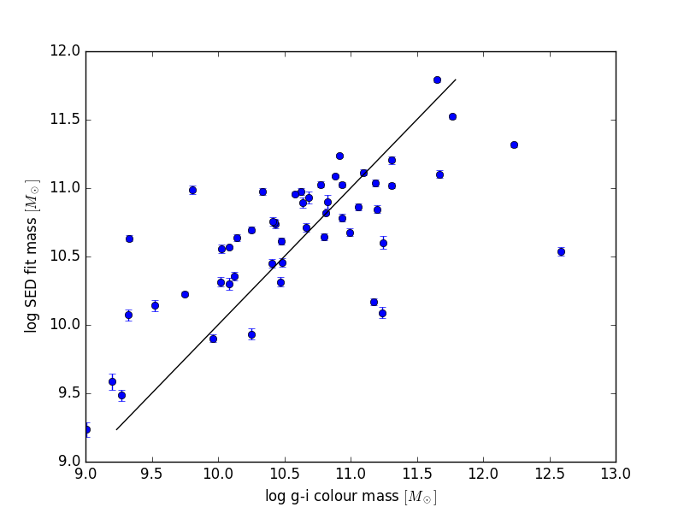
Astrohack: g-i band stellar mass
There is an example script on the github page
Visualize an image
Calculate the g-i band stellar mass using the Zibetti et al 2009 approach
This is using the entire image as a flux
So you model should not perform worse!
DATA SCIENCE GHENT

Slide 19
Astrohack: g-i band stellar mass
According to Zibetti et al. 2009 (ArXiv: 0904.4252)
1. Obtain mass-to-light ratio
g and i fluxes of a galaxy are in nanomaggies (SDSS linear flux units).
g-i colour = col_gi = -2.5*log10(flux_g / flux_i)
Zibetti2009, table B1, Appendix B:
log10(M/L) = a + b * col_gi
for the g-band:
log10(Mg/Lg) = -1.197 + 1.431 * col_gi
Mg/Lg = 10^log10(Mg/Lg)
DATA SCIENCE GHENT

Slide 20
Astrohack: g-i band stellar mass
According to Zibetti et al. 2009 (ArXiv: 0904.4252)
1. Obtain mass-to-light ratio
g and i fluxes of a galaxy are in nanomaggies (SDSS linear flux units).
g-i colour = col_gi = -2.5*log10(flux_g / flux_i)
Zibetti2009, table B1, Appendix B:
log10(M/L) = a + b * col_gi
for the g-band:
log10(Mg/Lg) = -1.197 + 1.431 * col_gi
Mg/Lg = 10^log10(Mg/Lg)
DATA SCIENCE GHENT

Slide 21
Astrohack: g-i band stellar mass
In the g band, convert g band flux to g band absolute luminosity in Lsun
Lsun = 3.846e26 Watt
1 nanomaggy = 3.631e-6 Jy
flux_g_Jy = flux_g * 3.631e-6
Distance from redshift
given 3.086e+22 meter per Mpc
D = z * c / H0 * 3.086e22
D = z * 3e5 / 70 * 3.086e22
g band central wavelength = 0.469 micron
Lg = flux_g_Jy * 1.e-26 * 4.*pi*D*^2 * 3.e8 / (0.469*1.e-6) / Lsun
Finally, apply the mass-to-light ratio:
Mass g band = Mg = Mg/Lg * Lg in solar masses.
DATA SCIENCE GHENT

Slide 22
Astrohack:FAQ: units
The images are in nanomaggies. A strange unit which you don’t really have to worry about too much (but it’s good to know it’s they are linear)
Converting them to jansky is possible Jy = nanomaggies * 3.631e-6
Megaparsec is a linear distance unit 1 Mpc = 3.086e22 m
DATA SCIENCE GHENT

Slide 23
Astrohack:FAQ: units
The images are in nanomaggies. A strange unit which you don’t really have to worry about too much (but it’s good to know it’s they are linear)
Converting them to jansky is possible Jy = nanomaggies * 3.631e-6
Megaparsec is a linear distance unit 1 Mpc = 3.086e22 m
DATA SCIENCE GHENT

Slide 24
Astrohack: FAQ: Why negative values?
When observing galaxies from earth we not only observe light coming from the galaxy
We also observe the atmosphere itself (which is not 100% dark).
The images you received have been pre-processed and sky-substracted
However the sky-background fluctuates resulting in some negative values in pixels More info here: http://casu.ast.cam.ac.uk/surveys-projects/wfcam/technical/sky-subtraction
DATA SCIENCE GHENT

Slide 25
Astrohack: Submission and presentation
The submission deadline is Sunday 14:00 for the presentation and the final model
Make sure your explain both the g-i band models and the g-band alone models
We will let you decide on whether or not you are allowed to modify the presentations (not the model of course) before presenting on the award meetup. We will vote on this on the final day of the hackathon
All participants will receive a certificate of participation
The winners will receive a winner certificate an more information on writing the paper
The winners will be posted on the site as well as all participating teams and presentations (if given permission)
DATA SCIENCE GHENT

Slide 26
ENJOY #ASTROHACK
DATA SCIENCE
GHENT

