Slide 1


Best practices for data science on HPC
Geert Jan Bex
(geertjan.bex@uhasselt.be)
License: this presentation is released under the Creative Commons CC BY 4.0, see https://creativecommons.org/licenses/by/4.0/deed.ast

Slide 2

https://shorturl.at/Rb4Ni

Slide 3


Slide 4
Typographical conventions I
Inline code fragments and file names are rendered as, e.g., hello_world.py
Longer code fragments are rendered as
Data files are rendered as
#!/usr/bin/env python
…
if __name__ == '__main__':
print('hello world!')
case dim temp
1 1 -0.5
2 1 0.0
3 1 0.5
4 2 -0.5
…
fragment not shown

Slide 5





Typographical conventions II
Shell commands are rendered as
Do not type $, it represents your shell prompt!
Good practice:
Bad practice:
(Potential) hazards/bugs:
Performance issue:
Warning:
$ python –m doctest data_parsing.py

Slide 6
Introduction

Slide 7



Motivation: why use HPC?
Computation takes a lot of time
Large data set, not enough memory
Many different scenarios to compute
Or some
combination

Slide 8
Is it hard?
There is a learning curve
There are pitfalls
Extensive training catalog
Support is here to help
It's not rocket science either!

Slide 9
Set up your environment

Slide 10



Data science software stack
Mainly
Python
R
Packages… many packages … more packages
Not exactly
HPC-ready
HPC-friendly
CRAN

Slide 11
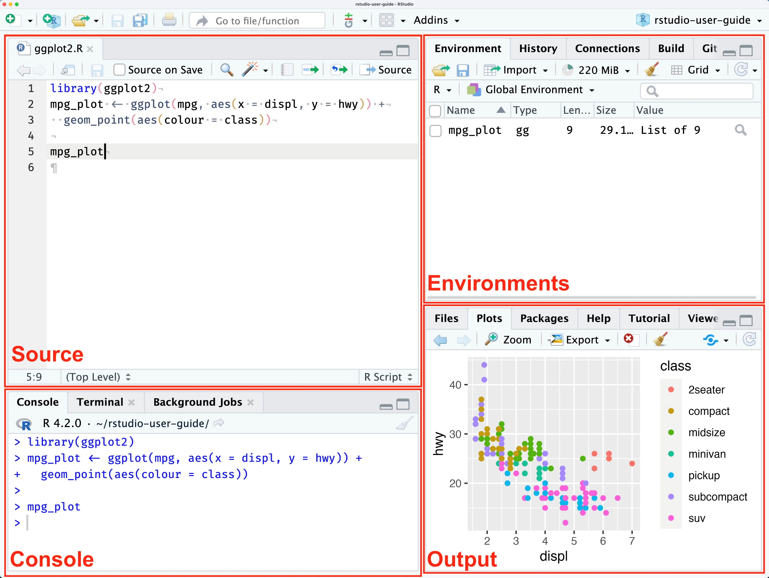
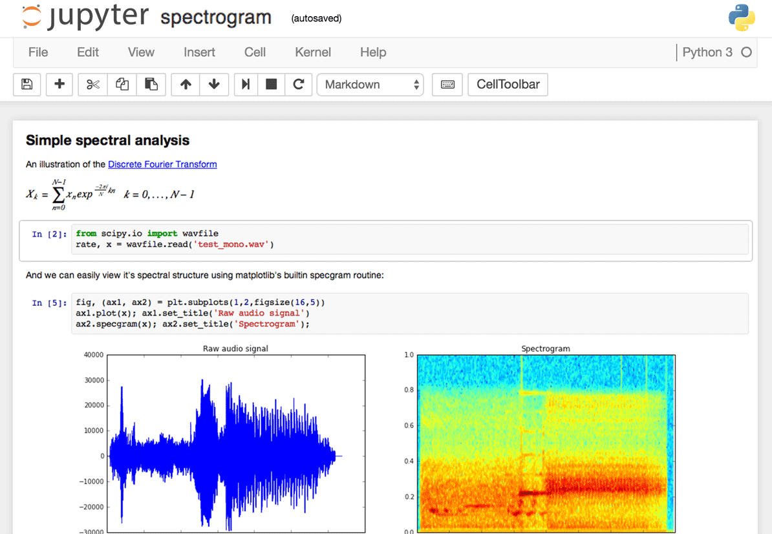
Modus operandi
$ python data_parsing.py
$ Rscript data_parsing.R
Transition from GUI/interactive to command line/batch

Slide 12
How to transition?
No absolute paths!
Values changed interactively → command line arguments
Python: use argparse/click
R: optparse
Choose/create your environment
"C:\Users\..."

Slide 13
Command line arguments

Slide 14
Python: argparse
…
Import argparse
…
parser = argparse.ArgumentParser(description='Compute cosine values.')
parser.add_argument('-n', '--num-points', type=int, default=100,
help='Number of points to compute')
parser.add_argument('-A', '--amplitude', type=float, default=1.0,
help='Amplitude of the cosine function')
parser.add_argument('-f', '--frequency', type=float, default=1.0,
help='Frequency of the cosine function')
…
args = parser.parse_args()
…
x, y = compute_cosine(args.num_points, args.amplitude, args.frequency)
…
cosine.py
Declare options
Handle options
Use option values
$ python cosine.py -n 100 --amplitude 2.5 …

Slide 15
R: optparse
…
library(optparse)
…
option_list <- list(
make_option(c("-c", "--city"), type = "character", help = "Name of the city to analyze weather data for"),
make_option(c("-q", "--quantity"), type = "character", default = "temp",
help = "Name of the quantity to analyze"),
make_option(c("-o", "--output"), type = "character",
help = "Path to the output CSV file")
)
opt <- parse_args(OptionParser(option_list = option_list))
if (dirname(opt$output) != ".") {
dir.create(dirname(opt$output), showWarnings = FALSE, recursive = TRUE)
}
…
weather_analysis.R
Declare options
Handle options
Use option values
$ Rscript weather_analysis.R -c London --output data_out.csv …

Slide 16
Environments

Slide 17
Options
Pre-installed modules
Install your own packages
Use containers
Not in scope: see https://gjbex.github.io/Containers-for-HPC/

Slide 18
Environment: modules

Slide 19
Modules
Use installed modules, when possible, e.g.,
R/4.4.0-gfbf-2023a
Python/3.12.3-GCCcore-13.3.0
Use package bundles, e.g.,
R-bundle-CRAN/2023.12-foss-2023a
SciPy-bundle/2024.05-gfbf-2024a
Use additional modules, e.g.,
TensorFlow/2.15.1-foss-2023a-CUDA-12.1.1
matplotlib/3.9.2-gfbf-2024a
Much, but likely not all

Slide 20
Job script & modules: best practices
#!/usr/bin/env -S bash -l
#SBATCH --account=<your_account>
#SBATCH --cluster=<your_cluster>
#SBATCH --time=00:02:00
…
# first clean up your environment
module purge &> /dev/null
# load only the modules you need
module load R-bundle-CRAN/2023.12-foss-2023a
…
jobscript.slurm
Reduces side effects
Ensures reproducability
Similar for Python

Slide 21
Python environments

Slide 22
Conda environments
Install conda
Create environment with numpy, matplotlib
Activate environment
Install additional packages
Update
$ wget https://repo.continuum.io/miniconda/Miniconda3-latest-Linux-x86_64.sh
$ bash Miniconda3-latest-Linux-x86_64.sh -b -p $VSC_DATA/miniconda3
$ source ~/.bashrc
$ conda create -n my_env numpy matplotlib
$ conda activate my_env
$ conda install pandas
$ conda update --all

Slide 23
Using conda environment
#!/usr/bin/env -S bash -l
#SBATCH --account=<your_account>
#SBATCH --cluster=<your_cluster>
#SBATCH --time=00:05:00
conda activate my_env
python cosine.py -n 100 -o result_${SLURM_JOB_ID}.txt \
-p plot_${SLURM_JOB_ID}.png
cosine.slurm
Activate environment

Slide 24
Conda
Best practices
Lean, single purpose environments
Keep under version control: reproducible
Keep laptop and HPC in sync: portability
Pitfall: installation directory, see documentation https://docs.vscentrum.be/compute/software/python_package_management.html
For performance on CPU, use Intel OneAPI distribution
$ conda list --explicit > environment_spec.txt
$ conda env export --from-history > environment.yml
$ conda create -n my_env -c intel intelpython3_full

Slide 25
R environments

Slide 26
R packages considerations
Packages built hardware-specific!
Install & use on same hardware
Installation on compute nodes
Packages built per R major release
Pure R packages: easy
Packages with library dependencies: not so easy
Use modules
Ask help if necessary

Slide 27
Interactive install: setup
Use OnDemand: interactive shell, or
From login node, submit interactive job
Load module
$ srun --account=<your-account> --time=00:30:00 \
--cluster=wice --partition=batch_sapphirerapids \
--pty /bin/bash -l
Hardware architecture
node $ module load R-bundle-CRAN/2023.12-foss-2023a

Slide 28
Interactive install: setup & install
Define installation location
Create the directory
Start R and install package(s)
node$ export R_LIBS_USER=$VSC_DATA/R/$VSC_OS_LOCAL/$VSC_ARCH_LOCAL/$EBVERSIONR
node $ mkdir -p $R_LIBS_USER
node $ R_LIBS_USER=$R_LIBS_USER R
> install.packages("dplyr")

Slide 29
Install in batch job
Do not underestimate walltime
#!/usr/bin/env -S bash -l
#SBATCH --account=<your_account>
#SBATCH --time=00:30:00
#SBATCH --cpus-per-task=4
module purge &> /dev/null
module load R-bundle-CRAN/2023.12-foss-2023a
export R_LIBS_USER="${VSC_DATA}/R/${VSC_OS_LOCAL}/${VSC_ARCH_LOCAL}/${EBVERSIONR}"
LOG_FILE="install_${VSC_OS_LOCAL}_${VSC_ARCH_LOCAL}_${EBVERSIONR}.log"
mkdir -p $R_LIBS_USER
R_LIBS_USER=$R_LIBS_USER R --no-save &> $LOG_FILE <<EOI
options(repos = c(CRAN = "https://cloud.r-project.org"))
install.packages("dplyr")
EOI
install_r_packages.slurm
Load R module
Create directory if necessary
List of packages to install
$ sbatch --cluster=wice --partition=batch_sapphirerapids install_r_packages.slurm

Slide 30
Using R environment
#!/usr/bin/env -S bash -l
#SBATCH --account=<your_account>
#SBATCH --cluster=<your_cluster>
#SBATCH --time=00:05:00
module purge &> /dev/null
module load R-bundle-CRAN/2023.12-foss-2023a
export R_LIBS_USER="${VSC_DATA}/R/${VSC_OS_LOCAL}/${VSC_ARCH_LOCAL}/${EBVERSIONR}"
R_LIBS_USER=$R_LIBS_USER Rscript hello_world_cla.R
cosine.slurm
Ensures right environment

Slide 31
Walltime & runtime?

Slide 32
How much time do you need?
Specify --time=d-HH:MM:SS
How much?
Don't underestimate!
Don't (massively) overestimate!
Experiment: benchmark
Start with "small" problem
Increase problem size gradually
Extrapolate to real problem
time
Clock frequencies compute node < laptop
size

Slide 33

Running example
R script dgemm.R
Arguments $N$and $p$
Generates random matrix $A∈ℝ^{N×N}$
Computes $A^{p}$
Determines minimum/maximum diagonal element
$ Rscript dgemm.R --size 1000 --power 15

Slide 34
Benchmark job script
#!/usr/bin/env -S bash -l
#SBATCH --account=<your_account>
#SBATCH --cluster=<your_cluster>
#SBATCH --partition=<your_partition>
#SBATCH --ntasks=1
#SBATCH --cpus-per-task=1
#SBATCH --time=00:05:00
module purge &> /dev/null
module load R-bundle-CRAN/2023.12-foss-2023a
export R_LIBS_USER="${VSC_DATA}/R/${VSC_OS_LOCAL}/${VSC_ARCH_LOCAL}/${EBVERSIONR}"
R_LIBS_USER=$R_LIBS_USER Rscript dgemm.R --size $SIZE --power $POWER
memory_and_walltime.slurm
Parameters to vary

Slide 35
Running benchmark
Submit benchmark jobs
Get resources used
$ sbatch --export=ALL,SIZE=5000,POWER=10 memory_and_walltime.slurm
$ sbatch --export=ALL,SIZE=5000,POWER=20 memory_and_walltime.slurm
$ sbatch --export=ALL,SIZE=5000,POWER=40 memory_and_walltime.slurm
$ sbatch --export=ALL,SIZE=10000,POWER=10 memory_and_walltime.slurm
$ sbatch --export=ALL,SIZE=10000,POWER=20 memory_and_walltime.slurm
…
$ sacct --cluster=<your_cluster> --jobs=<your_job_id>.batch \
--format=jobid,elapsed,maxrss,maxvmsize
…

Slide 36

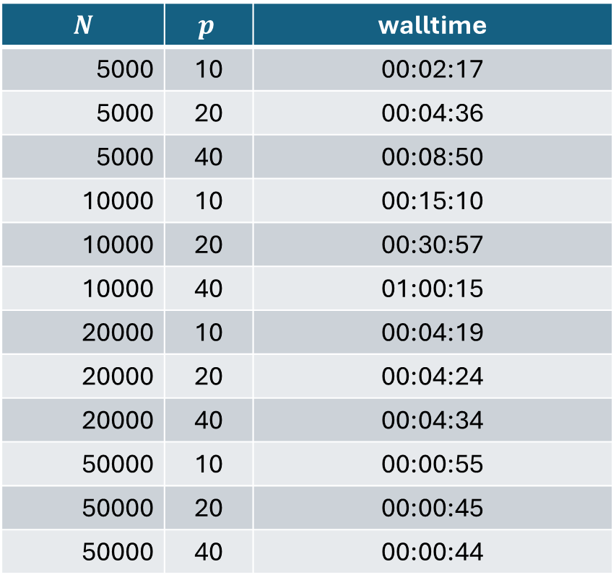
Walltime benchmark results
$$N$$ | $$p$$ | walltime
5000 | 10 | 00:02:17
5000 | 20 | 00:04:36
5000 | 40 | 00:08:50
10000 | 10 | 00:15:10
10000 | 20 | 00:30:57
10000 | 40 | 01:00:15
20000 | 10 | 00:04:19
20000 | 20 | 00:04:24
20000 | 40 | 00:04:34
50000 | 10 | 00:00:55
50000 | 20 | 00:00:45
50000 | 40 | 00:00:44
Scaling
$T\left(N, p\right)∝p$
$T\left(N, p\right)∝N^{3}$
What happened?
What happened?

Slide 37
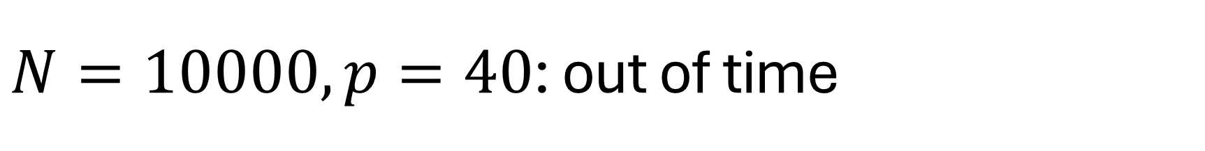
$N=10000, p=40$: out of time
Inspect job output
…
Walltime: 00-01:00:00
========================================================================
…
slurmstepd: error: *** JOB 62199209 ON q16c03n1 CANCELLED
AT 2024-08-13T18:28:16 DUE TO TIME LIMIT ***
slurm-62199209.out
No output, 1 hour of computations lost!

Slide 38
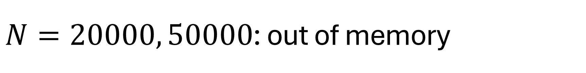
$N=20000, 50000$: out of memory
Inspect job output
…
Walltime: 00-01:00:00
========================================================================
…
slurmstepd: error: Detected 1 oom_kill event in StepId=62199210.batch.
Some of the step tasks have been OOM Killed.
slurm-62199210.out

Slide 39
Specify memory requirements
Check available memory/node (typically 256 GB RAM) https://docs.vscentrum.be/compute/tier2.html
Total memory per job: --mem mem < RAM - 8 GB
Memory per core: --mem-per-cpu ntasks × cpus-per-task × mem-per-cpu < RAM - 8 GB
Units: K, M, G, T
…
#SBATCH --mem=15G
…

Slide 40
How much memory do you need?
Specify --mem
How much?
Don't underestimate!
Don't (massively) overestimate!
Experiment: benchmark
Start with "small" problem
Increase problem size gradually
Extrapolate to real problem
memory
size

Slide 41

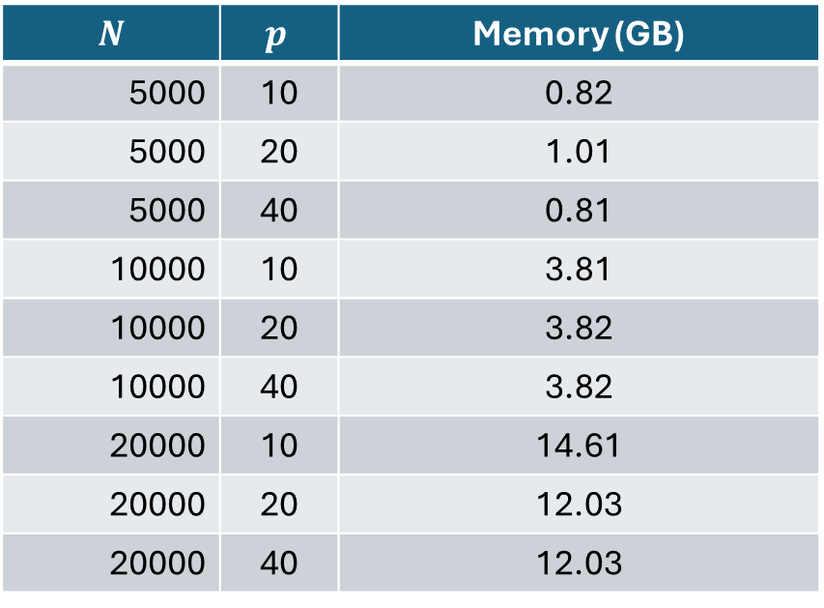
Memory benchmark results
$$N$$ | $$p$$ | Memory (GB)
5000 | 10 | 0.82
5000 | 20 | 1.01
5000 | 40 | 0.81
10000 | 10 | 3.81
10000 | 20 | 3.82
10000 | 40 | 3.82
20000 | 10 | 14.61
20000 | 20 | 12.03
20000 | 40 | 12.03
Scaling
$memory\left(N, p\right)$ constant in $p$
$memory\left(N, p\right)∝N^{2}$

Slide 42
Walltime & memory: conclusions
Do not underestimate: waste of resources
Do not overestimate (too much): inefficient
Only benchmark when relevant
Long walltimes
Lots of memory
Many runs

Slide 43
Efficiency

Slide 44
Implicit parallelism
Parallelism "under the hood"
Some R functions/operations, e.g.,
Some Python libraries, e.g.,
Numpy
How to know?
Check documentation
Measure
…
A <- matrix(rnorm(25), nrow=5)
result <- A
for (i in 1:(power-1)) {
result <- result %*% A
}
…

Slide 45

Benchmark environment
Sapphire Rapids node
2 Intel Xeon Platinum 8468 48-core CPUs
256 GB RAM
Environment: R/4.4.0-gfbf-2023a

Slide 46
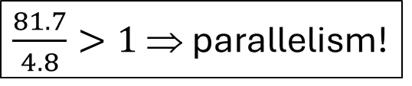
Parallel or not?
Time R script execution
…
#SBATCH --cpus-per-task=16
…
export R_LIBS_USER="${VSC_DATA}/R/${VSC_OS_LOCAL}/${VSC_ARCH_LOCAL}/${EBVERSIONR}"
time R_LIBS_USER=$R_LIBS_USER Rscript dgemm.R --size 5000 --power 20
memory_and_walltime.slurm
…
real 0m4.791s
user 1m21.693s
sys 0m31.345s
…
slurm-….out
$\frac{81.7}{4.8}>1$ ⇒ parallelism!

Slide 47
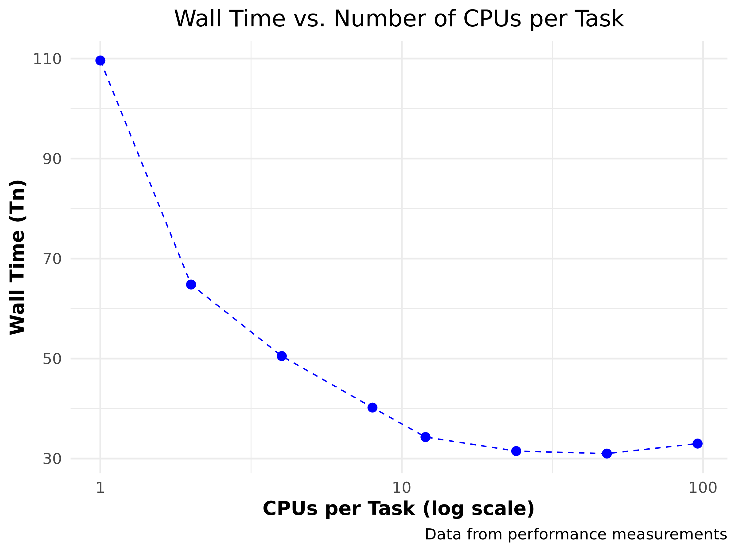

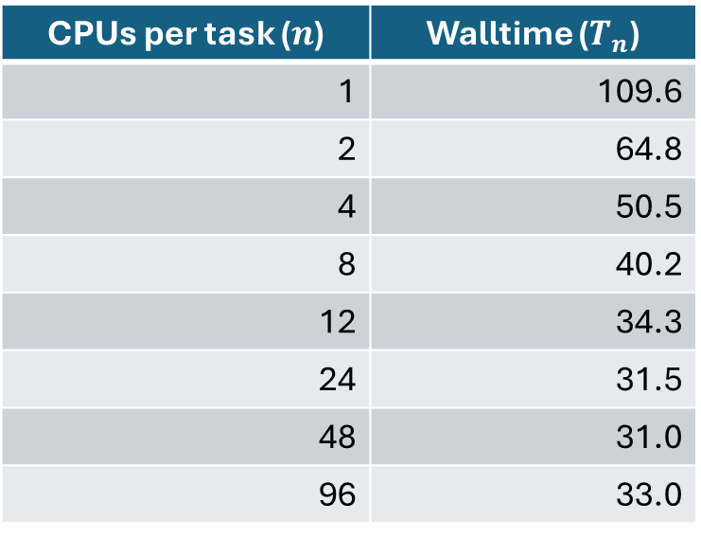
How to exploit?
Use --cpus-per-task 1 ≤ cpus-per-task ≤ number of cores
CPUs per task ($n$) | Walltime ($T_{n}$)
1 | 109.6
2 | 64.8
4 | 50.5
8 | 40.2
12 | 34.3
24 | 31.5
48 | 31.0
96 | 33.0

Slide 48
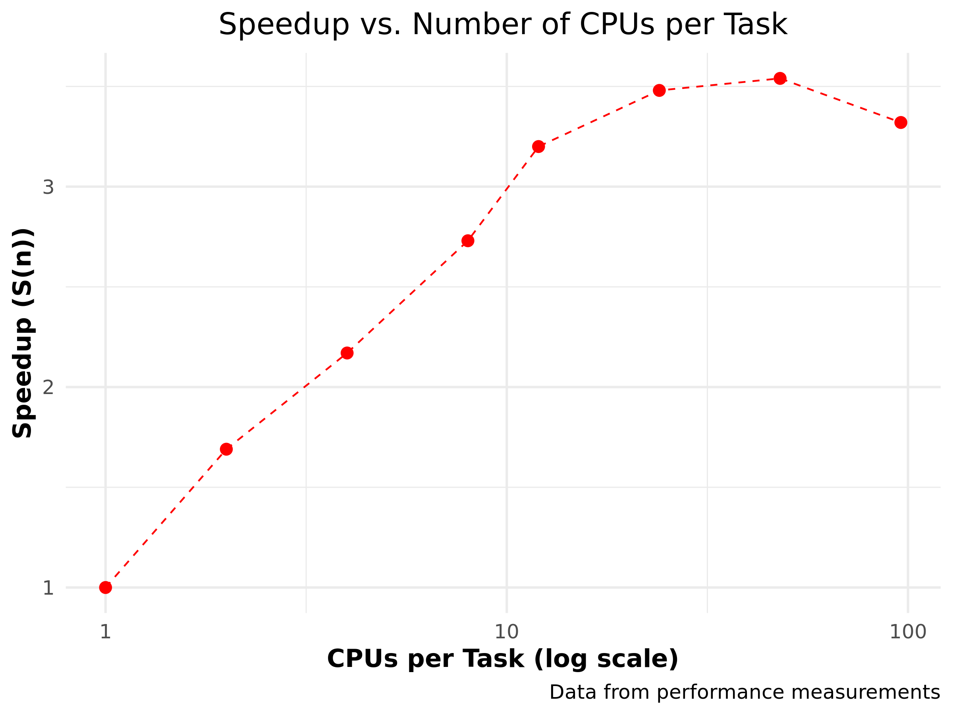

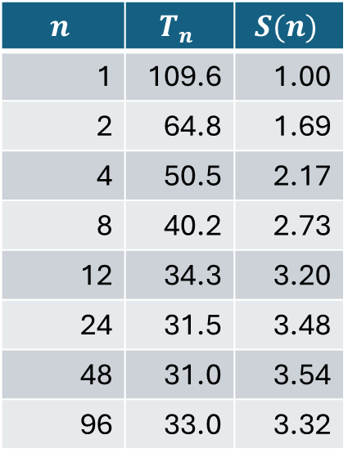
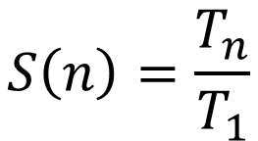
Speedup
$$S\left(n\right)=\frac{T_{n}}{T_{1}}$$
$$n$$ | $$T_{n}$$ | $$S(n)$$
1 | 109.6 | 1.00
2 | 64.8 | 1.69
4 | 50.5 | 2.17
8 | 40.2 | 2.73
12 | 34.3 | 3.20
24 | 31.5 | 3.48
48 | 31.0 | 3.54
96 | 33.0 | 3.32

Slide 49
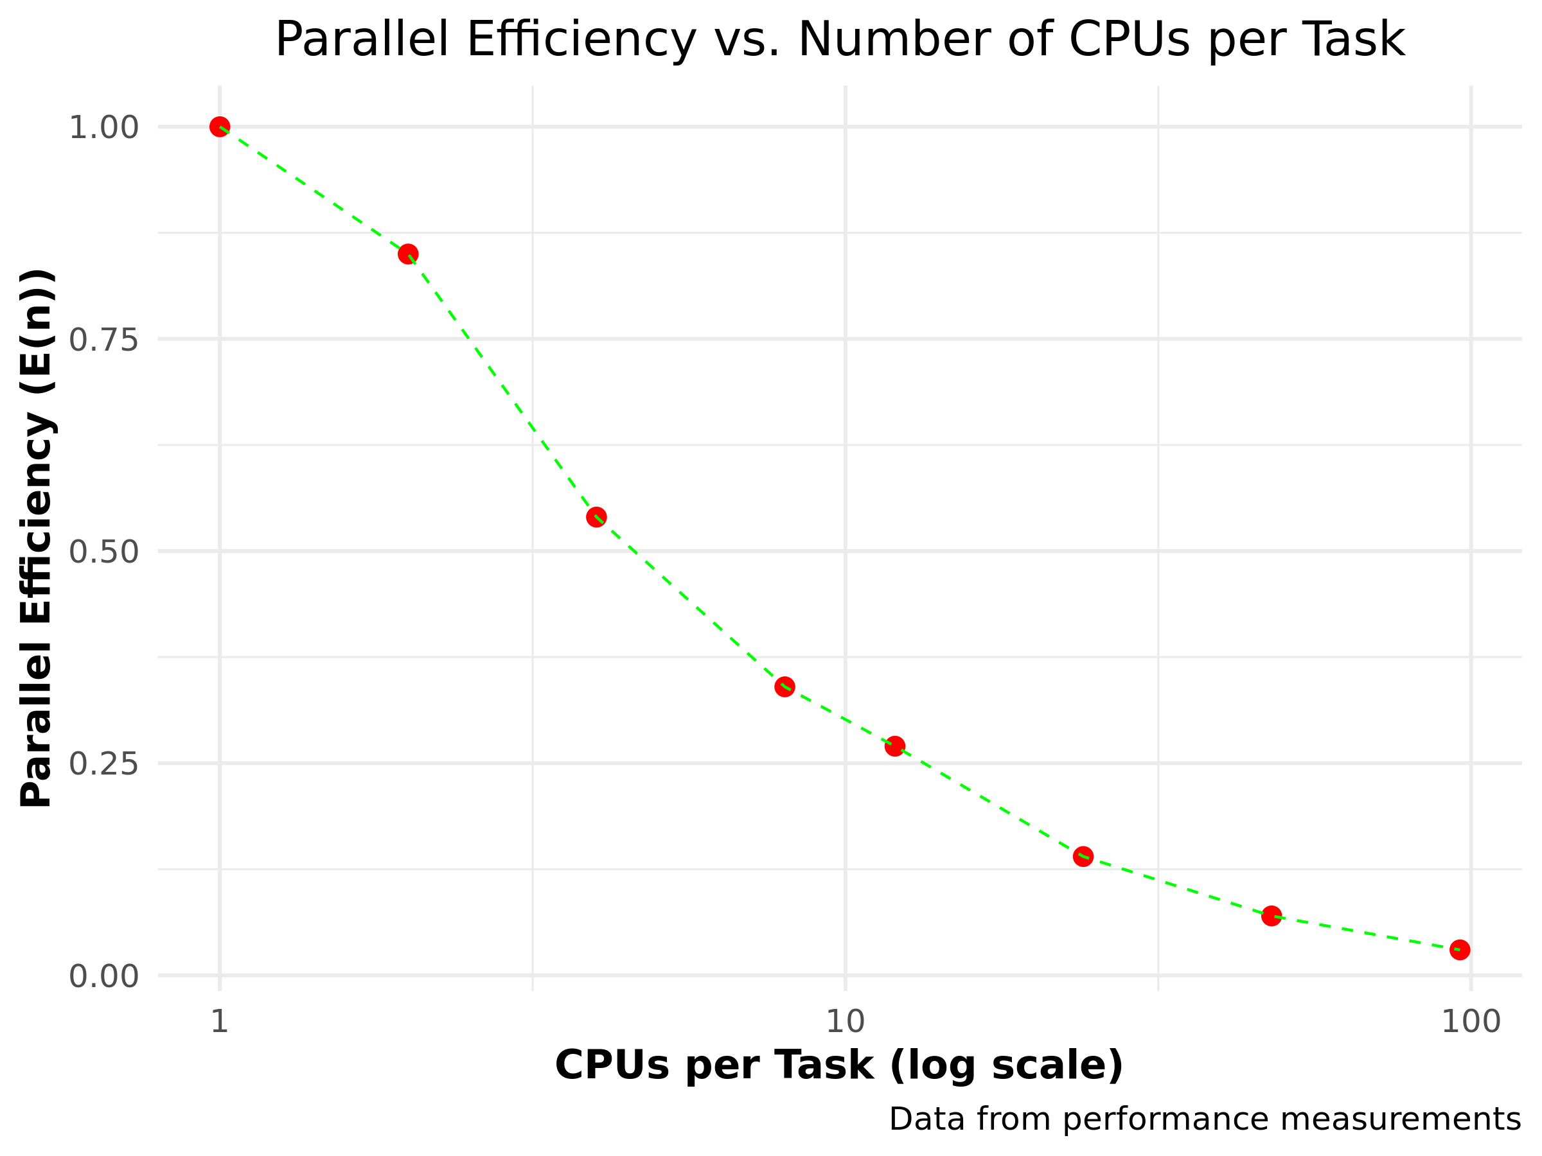

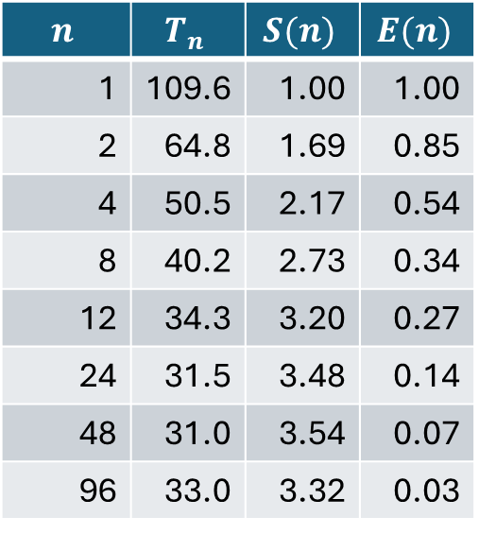
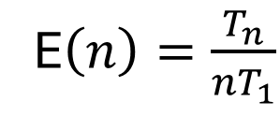
Parallel efficiency
E$\left(n\right)=\frac{T_{n}}{{nT}_{1}}$
$$n$$ | $$T_{n}$$ | $$S(n)$$ | $$E(n)$$
1 | 109.6 | 1.00 | 1.00
2 | 64.8 | 1.69 | 0.85
4 | 50.5 | 2.17 | 0.54
8 | 40.2 | 2.73 | 0.34
12 | 34.3 | 3.20 | 0.27
24 | 31.5 | 3.48 | 0.14
48 | 31.0 | 3.54 | 0.07
96 | 33.0 | 3.32 | 0.03

Slide 50
Parallel scaling

Slide 51
Dimensions for scaling
Scaling considered in two dimensions
solve same problem faster by using more resources
solve larger problem by using more resources
Strong scaling
Weak scaling

Slide 52
What you hope/expect for…
strong scaling
weak scaling
execution time
nr. processes
Is this going
to happen?
system size
execution time ∼
nr. processes

Slide 53





Definitions
Parallel speedup $S(n)$ for $n$ processes:
Ideally,
Parallel efficiency $E(n)$ for $n$ processes:
Ideally,
$$S(n)=\frac{T_{1}}{T_{n}}$$
$$S(n)=n$$
$$E(n)=\frac{T_{1}}{nT_{n}}$$
$$E(n)=1$$

Slide 54
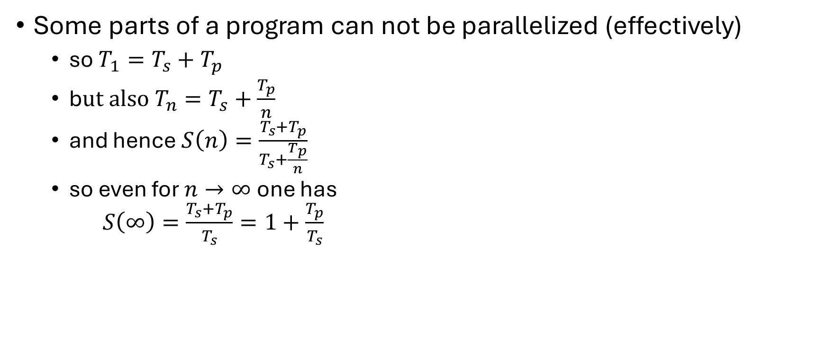
Strong scaling: oops!?!
Some parts of a program can not be parallelized (effectively)
so $T_{1}=T_{s}+T_{p}$
b$ut also T_{n}=T_{s}+\frac{T_{p}}{n}$
and hence $S\left(n\right)=\frac{T_{s}+T_{p}}{T_{s}+\frac{T_{p}}{n}}$
so even for $n→∞$ one has $S\left(∞\right)=\frac{T_{s}+T_{p}}{T_{s}}=1+\frac{T_{p}}{T_{s}}$
Hard limit on speedup due to serial part: Amdahl's law

Slide 55
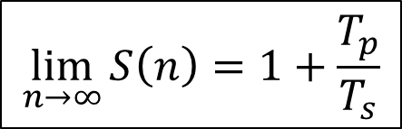

Amdahl's law
speedup
nr. processes
$$\lim_{n→∞}{S\left(n\right)=1+\frac{T_{p}}{T_{s}}}$$
$$\lim_{n→∞}{E\left(n\right)=0}$$

Slide 56
It gets worse…
Overhead!
communication takes time
finite bandwidth
non-zero latency
resource contention
memory subsystem: L3 cache, RAM, QPI
network access
speedup
nr. processes

Slide 57
Picking the sweet spot
sweet spot
speedup
sweet spot
nr. processes
efficiency
nr. processes

Slide 58
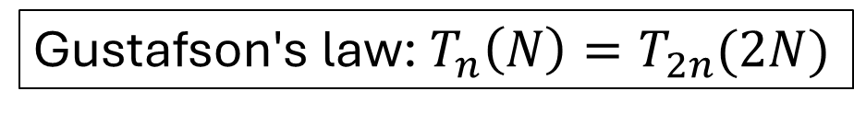
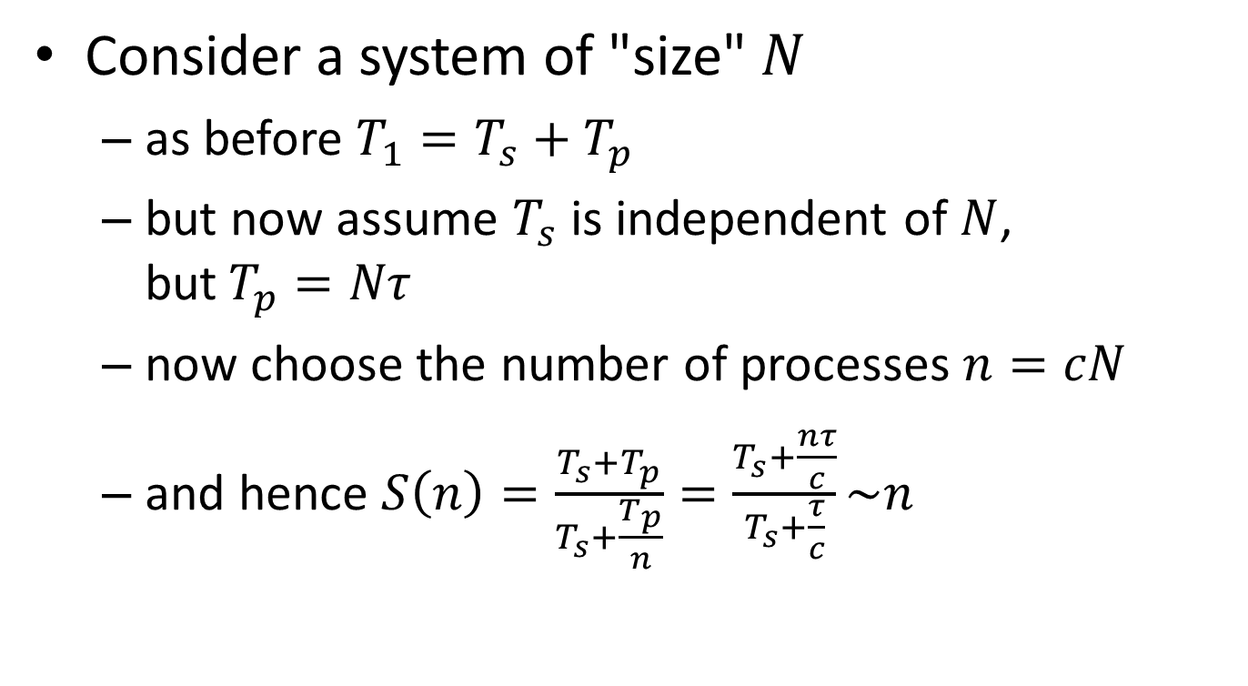
Weak scaling
Consider a system of "size" $N$
as before $T_{1}=T_{s}+T_{p}$
but now assume $T_{s}$ is independent of $N$, but$T_{p}=Nτ$
now choose the number of processes $n=cN$
and hence $S\left(n\right)=\frac{T_{s}+T_{p}}{T_{s}+\frac{T_{p}}{n}}=\frac{T_{s}+\frac{nτ}{c}}{T_{s}+\frac{τ}{c}}\sim n$
Nice for scientists!
Gustafson's law: $T_{n}\left(N\right)=T_{2n}(2N)$

Slide 59
We love Gustafson
Scientist are interested in
studying larger systems/bigger data sets
increasing precision/resolution
more complex phenomena
…

Slide 60
Throughput computing
N independent tasks
Total number of cores n << N
Execution time single task, 1 thread: t₁
Execution time single task, n threads: t_{n}
Multithreading or not?
However: memory?

