Slide 1


Best practices for data science on HPC
Geert Jan Bex
(geertjan.bex@uhasselt.be)
License: this presentation is released under the Creative Commons CC BY 4.0, see https://creativecommons.org/licenses/by/4.0/deed.ast

Slide 2

https://shorturl.at/Rb4Ni

Slide 3


Slide 4
Typographical conventions I
Inline code fragments and file names are rendered as, e.g., hello_world.py
Longer code fragments are rendered as
Data files are rendered as
#!/usr/bin/env python
…
if __name__ == '__main__':
print('hello world!')
case dim temp
1 1 -0.5
2 1 0.0
3 1 0.5
4 2 -0.5
…
fragment not shown

Slide 5





Typographical conventions II
Shell commands are rendered as
Do not type $, it represents your shell prompt!
Good practice:
Bad practice:
(Potential) hazards/bugs:
Performance issue:
Warning:
$ python –m doctest data_parsing.py

Slide 6
Introduction

Slide 7



Motivation: why use HPC?
Computation takes a lot of time
Large data set, not enough memory
Many different scenarios to compute
Or some
combination

Slide 8
Is it hard?
There is a learning curve
There are pitfalls
Extensive training catalog
Support is here to help
It's not rocket science either!

Slide 9
Set up your environment

Slide 10



Data science software stack
Mainly
Python
R
Packages… many packages … more packages
Not exactly
HPC-ready
HPC-friendly
CRAN

Slide 11
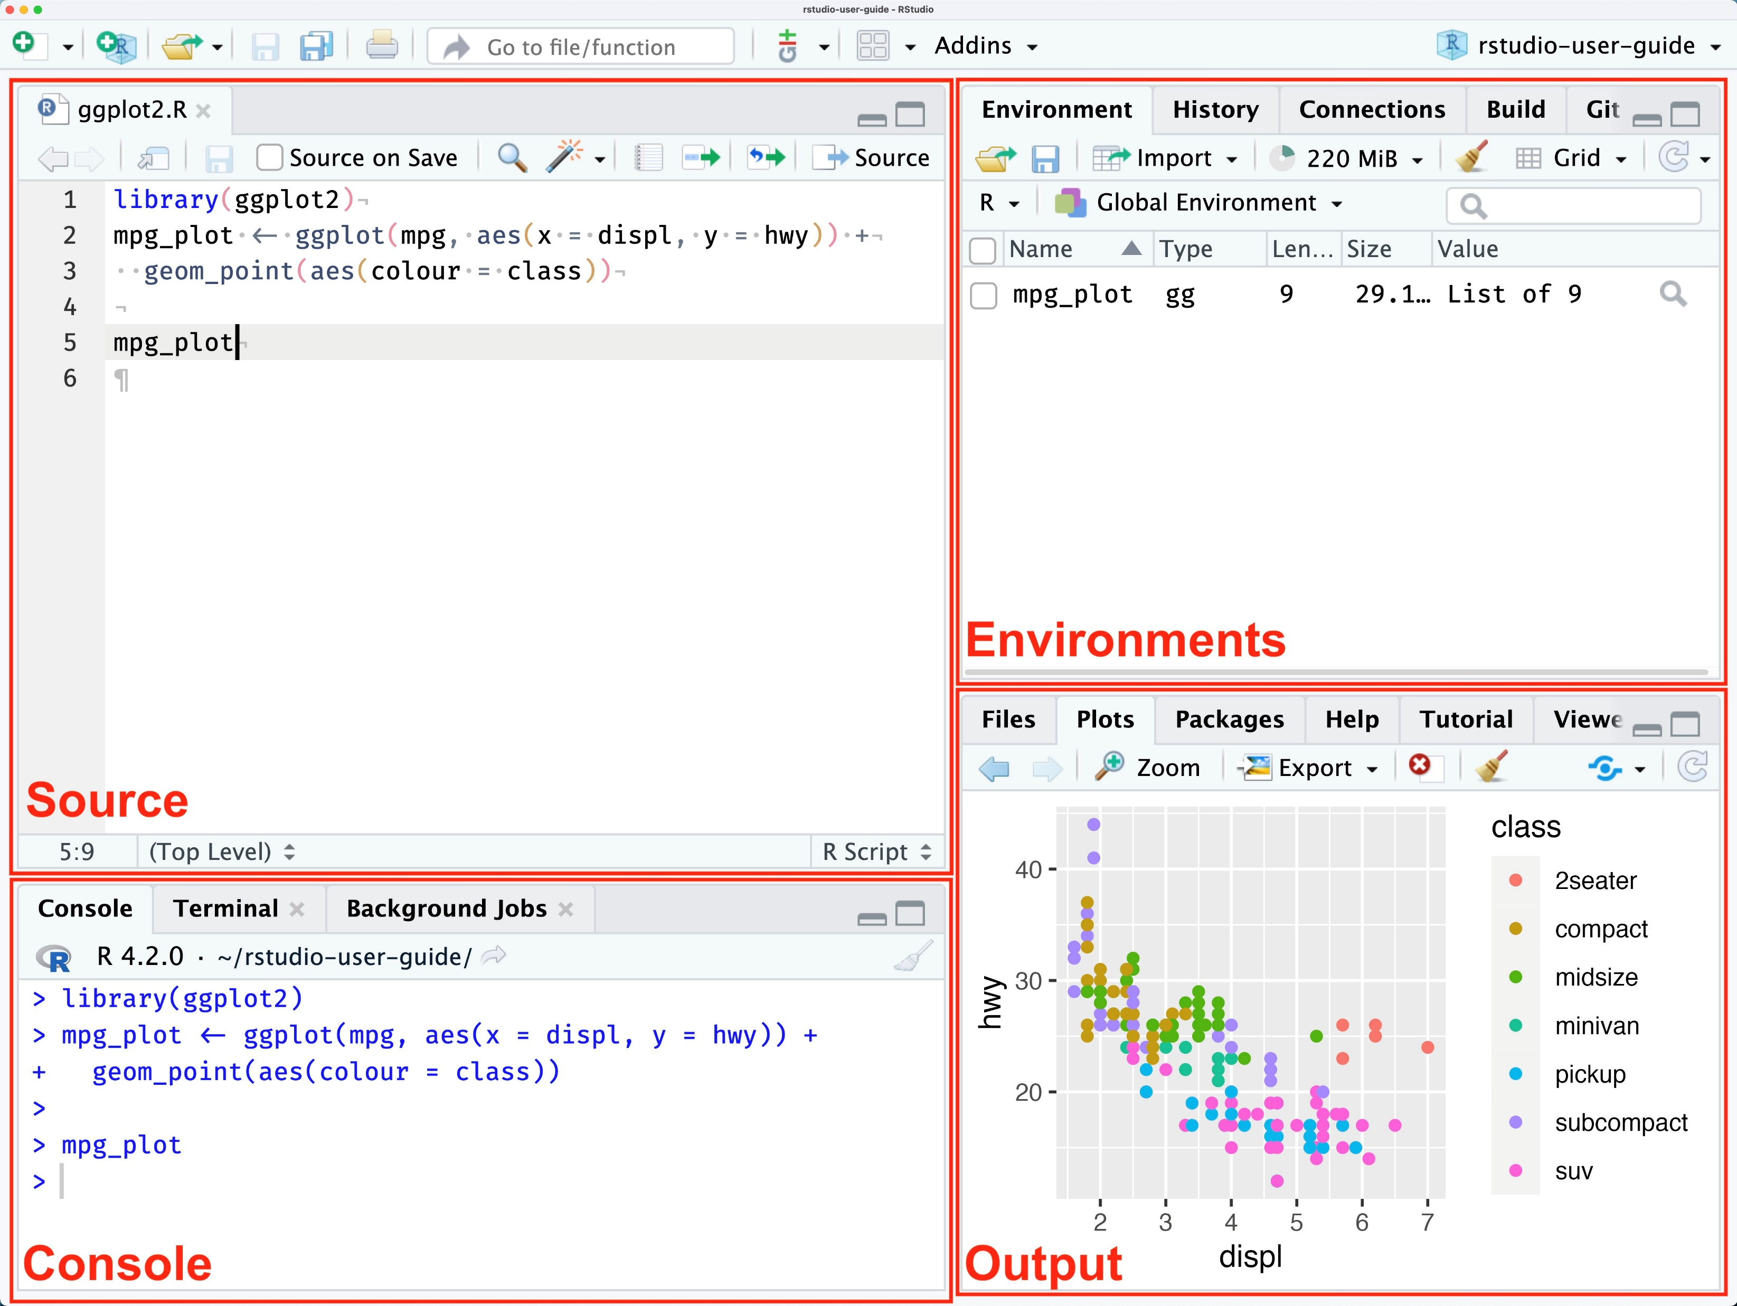
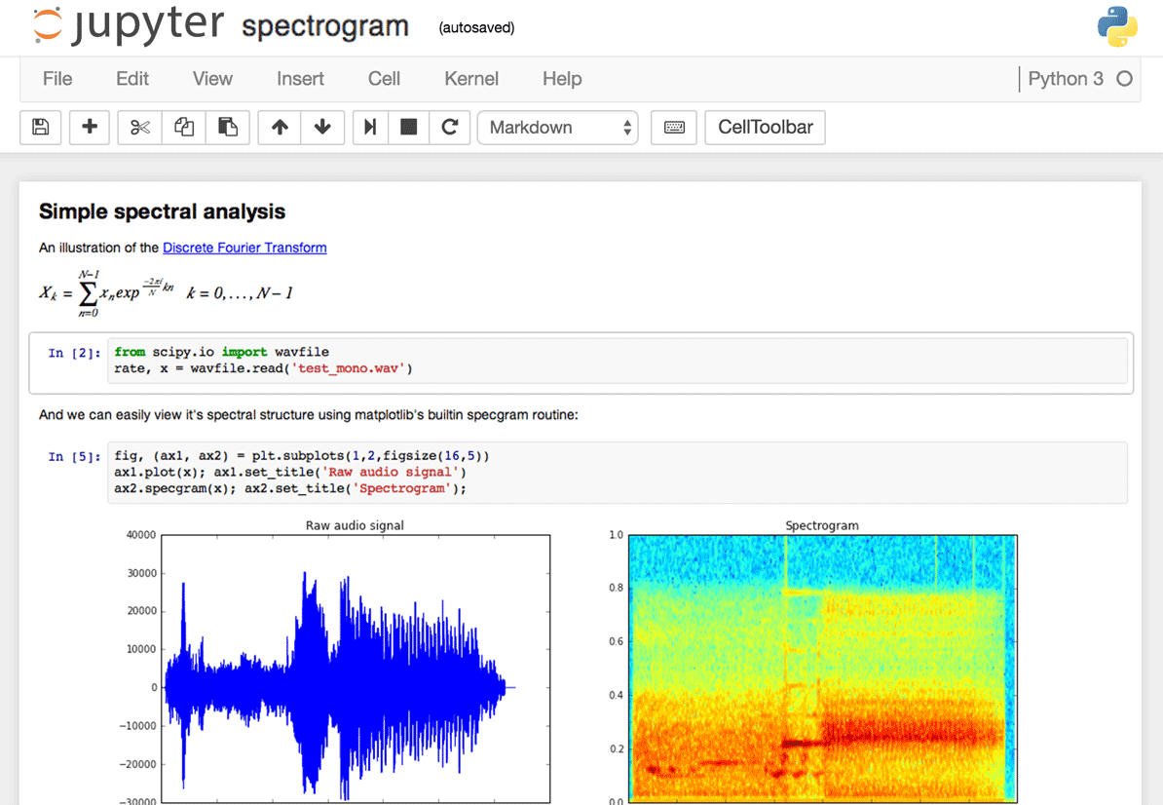
Modus operandi
$ python data_parsing.py
$ Rscript data_parsing.R
Transition from GUI/interactive to command line/batch

Slide 12
How to transition?
No absolute paths!
Values changed interactively → command line arguments
Python: use argparse/click
R: optparse
Choose/create your environment
"C:\Users\..."

Slide 13
Command line arguments

Slide 14
Python: argparse
…
Import argparse
…
parser = argparse.ArgumentParser(description='Compute cosine values.')
parser.add_argument('-n', '--num-points', type=int, default=100,
help='Number of points to compute')
parser.add_argument('-A', '--amplitude', type=float, default=1.0,
help='Amplitude of the cosine function')
parser.add_argument('-f', '--frequency', type=float, default=1.0,
help='Frequency of the cosine function')
…
args = parser.parse_args()
…
x, y = compute_cosine(args.num_points, args.amplitude, args.frequency)
…
cosine.py
Declare options
Handle options
Use option values
$ python cosine.py -n 100 --amplitude 2.5 …

Slide 15
R: optparse
…
library(optparse)
…
option_list <- list(
make_option(c("-c", "--city"), type = "character", help = "Name of the city to analyze weather data for"),
make_option(c("-q", "--quantity"), type = "character", default = "temp",
help = "Name of the quantity to analyze"),
make_option(c("-o", "--output"), type = "character",
help = "Path to the output CSV file")
)
opt <- parse_args(OptionParser(option_list = option_list))
if (dirname(opt$output) != ".") {
dir.create(dirname(opt$output), showWarnings = FALSE, recursive = TRUE)
}
…
weather_analysis.R
Declare options
Handle options
Use option values
$ Rscript weather_analysis.R -c London --output data_out.csv …

Slide 16
Environments

Slide 17
Options
Pre-installed modules
Install your own packages
Use containers
Not in scope: see https://gjbex.github.io/Containers-for-HPC/

Slide 18
Environment: modules

Slide 19
Modules
Use installed modules, when possible, e.g.,
R/4.4.0-gfbf-2023a
Python/3.12.3-GCCcore-13.3.0
Use package bundles, e.g.,
R-bundle-CRAN/2023.12-foss-2023a
SciPy-bundle/2024.05-gfbf-2024a
Use additional modules, e.g.,
TensorFlow/2.15.1-foss-2023a-CUDA-12.1.1
matplotlib/3.9.2-gfbf-2024a
Much, but likely not all

Slide 20
Job script & modules: best practices
#!/usr/bin/env -S bash -l
#SBATCH --account=<your_account>
#SBATCH --cluster=<your_cluster>
#SBATCH --time=00:02:00
…
# first clean up your environment
module purge &> /dev/null
# load only the modules you need
module load R-bundle-CRAN/2023.12-foss-2023a
…
jobscript.slurm
Reduces side effects
Ensures reproducability
Similar for Python

Slide 21
Python environments

Slide 22
Conda environments
Install conda
Create environment with numpy, matplotlib
Activate environment
Install additional packages
Update
$ wget https://repo.continuum.io/miniconda/Miniconda3-latest-Linux-x86_64.sh
$ bash Miniconda3-latest-Linux-x86_64.sh -b -p $VSC_DATA/miniconda3
$ source ~/.bashrc
$ conda create -n my_env numpy matplotlib
$ conda activate my_env
$ conda install pandas
$ conda update --all

Slide 23
Using conda environment
#!/usr/bin/env -S bash -l
#SBATCH --account=<your_account>
#SBATCH --cluster=<your_cluster>
#SBATCH --time=00:05:00
conda activate my_env
python cosine.py -n 100 -o result_${SLURM_JOB_ID}.txt \
-p plot_${SLURM_JOB_ID}.png
cosine.slurm
Activate environment

Slide 24
Conda
Best practices
Lean, single purpose environments
Keep under version control: reproducible
Keep laptop and HPC in sync: portability
Pitfall: installation directory, see documentation https://docs.vscentrum.be/compute/software/python_package_management.html
For performance on CPU, use Intel OneAPI distribution
$ conda list --explicit > environment_spec.txt
$ conda env export --from-history > environment.yml
$ conda create -n my_env -c intel intelpython3_full

Slide 25
R environments

Slide 26
R packages considerations
Packages built hardware-specific!
Install & use on same hardware
Installation on compute nodes
Packages built per R major release
Pure R packages: easy
Packages with library dependencies: not so easy
Use modules
Ask help if necessary

Slide 27
Interactive install: setup
Use OnDemand: interactive shell, or
From login node, submit interactive job
Load module
$ srun --account=<your-account> --time=00:30:00 \
--cluster=wice --partition=batch_sapphirerapids \
--pty /bin/bash -l
Hardware architecture
node $ module load R-bundle-CRAN/2023.12-foss-2023a

Slide 28
Interactive install: setup & install
Define installation location
Create the directory
Start R and install package(s)
node$ export R_LIBS_USER=$VSC_DATA/R/$VSC_OS_LOCAL/$VSC_ARCH_LOCAL/$EBVERSIONR
node $ mkdir -p $R_LIBS_USER
node $ R_LIBS_USER=$R_LIBS_USER R
> install.packages("dplyr")

Slide 29
Install in batch job
Do not underestimate walltime
#!/usr/bin/env -S bash -l
#SBATCH --account=<your_account>
#SBATCH --time=00:30:00
#SBATCH --cpus-per-task=4
module purge &> /dev/null
module load R-bundle-CRAN/2023.12-foss-2023a
export R_LIBS_USER="${VSC_DATA}/R/${VSC_OS_LOCAL}/${VSC_ARCH_LOCAL}/${EBVERSIONR}"
LOG_FILE="install_${VSC_OS_LOCAL}_${VSC_ARCH_LOCAL}_${EBVERSIONR}.log"
mkdir -p $R_LIBS_USER
R_LIBS_USER=$R_LIBS_USER R --no-save &> $LOG_FILE <<EOI
options(repos = c(CRAN = "https://cloud.r-project.org"))
install.packages("dplyr")
EOI
install_r_packages.slurm
Load R module
Create directory if necessary
List of packages to install
$ sbatch --cluster=wice --partition=batch_sapphirerapids install_r_packages.slurm

Slide 30
Using R environment
#!/usr/bin/env -S bash -l
#SBATCH --account=<your_account>
#SBATCH --cluster=<your_cluster>
#SBATCH --time=00:05:00
module purge &> /dev/null
module load R-bundle-CRAN/2023.12-foss-2023a
export R_LIBS_USER="${VSC_DATA}/R/${VSC_OS_LOCAL}/${VSC_ARCH_LOCAL}/${EBVERSIONR}"
R_LIBS_USER=$R_LIBS_USER Rscript hello_world_cla.R
cosine.slurm
Ensures right environment

Slide 31
Walltime & runtime?

Slide 32
How much time do you need?
Specify --time=d-HH:MM:SS
How much?
Don't underestimate!
Don't (massively) overestimate!
Experiment: benchmark
Start with "small" problem
Increase problem size gradually
Extrapolate to real problem
time
Clock frequencies compute node < laptop
size

Slide 33

Running example
R script dgemm.R
Arguments $N$and $p$
Generates random matrix $A∈ℝ^{N×N}$
Computes $A^{p}$
Determines minimum/maximum diagonal element
$ Rscript dgemm.R --size 1000 --power 15

Slide 34
Benchmark job script
#!/usr/bin/env -S bash -l
#SBATCH --account=<your_account>
#SBATCH --cluster=<your_cluster>
#SBATCH --partition=<your_partition>
#SBATCH --ntasks=1
#SBATCH --cpus-per-task=1
#SBATCH --time=00:05:00
module purge &> /dev/null
module load R-bundle-CRAN/2023.12-foss-2023a
export R_LIBS_USER="${VSC_DATA}/R/${VSC_OS_LOCAL}/${VSC_ARCH_LOCAL}/${EBVERSIONR}"
R_LIBS_USER=$R_LIBS_USER Rscript dgemm.R --size $SIZE --power $POWER
memory_and_walltime.slurm
Parameters to vary

Slide 35
Running benchmark
Submit benchmark jobs
Get resources used
$ sbatch --export=ALL,SIZE=5000,POWER=10 memory_and_walltime.slurm
$ sbatch --export=ALL,SIZE=5000,POWER=20 memory_and_walltime.slurm
$ sbatch --export=ALL,SIZE=5000,POWER=40 memory_and_walltime.slurm
$ sbatch --export=ALL,SIZE=10000,POWER=10 memory_and_walltime.slurm
$ sbatch --export=ALL,SIZE=10000,POWER=20 memory_and_walltime.slurm
…
$ sacct --cluster=<your_cluster> --jobs=<your_job_id>.batch \
--format=jobid,elapsed,maxrss,maxvmsize
…

Slide 36

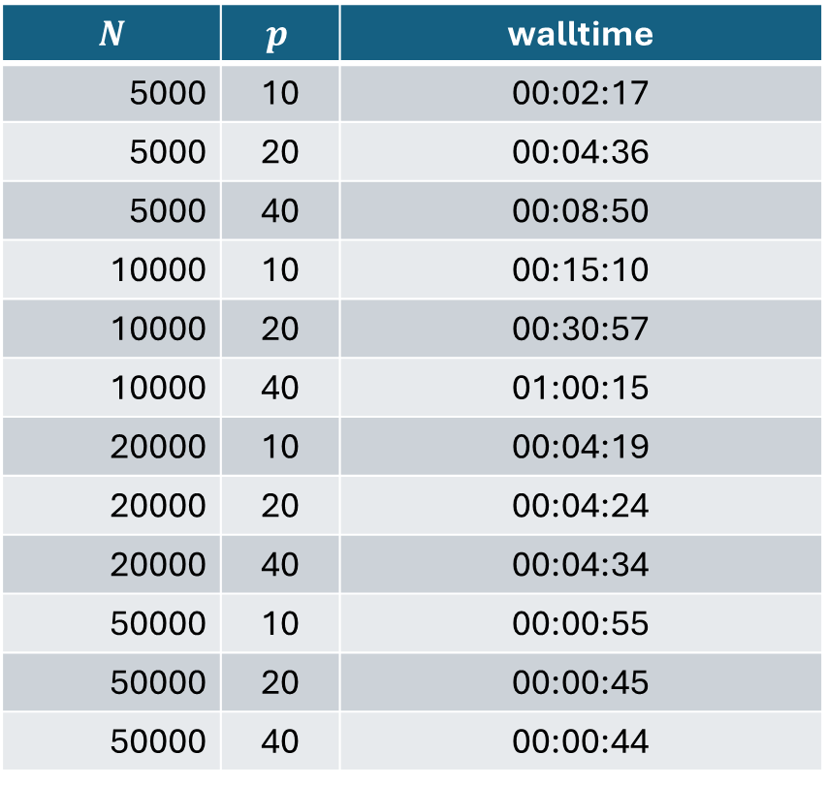
Walltime benchmark results
$$N$$ | $$p$$ | walltime
5000 | 10 | 00:02:17
5000 | 20 | 00:04:36
5000 | 40 | 00:08:50
10000 | 10 | 00:15:10
10000 | 20 | 00:30:57
10000 | 40 | 01:00:15
20000 | 10 | 00:04:19
20000 | 20 | 00:04:24
20000 | 40 | 00:04:34
50000 | 10 | 00:00:55
50000 | 20 | 00:00:45
50000 | 40 | 00:00:44
Scaling
$T\left(N, p\right)∝p$
$T\left(N, p\right)∝N^{3}$
What happened?
What happened?

Slide 37

$N=10000, p=40$: out of time
Inspect job output
…
Walltime: 00-01:00:00
========================================================================
…
slurmstepd: error: *** JOB 62199209 ON q16c03n1 CANCELLED
AT 2024-08-13T18:28:16 DUE TO TIME LIMIT ***
slurm-62199209.out
No output, 1 hour of computations lost!

Slide 38
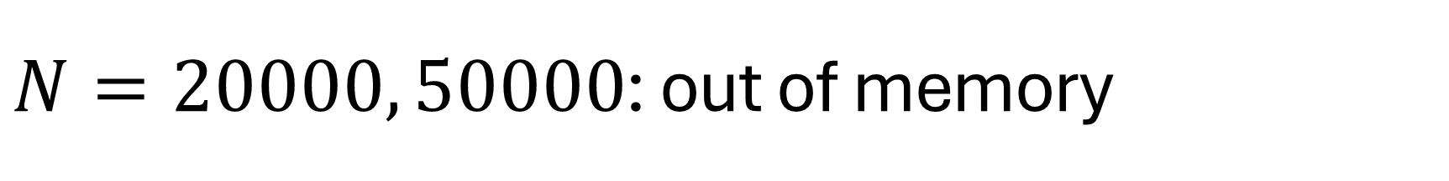
$N=20000, 50000$: out of memory
Inspect job output
…
Walltime: 00-01:00:00
========================================================================
…
slurmstepd: error: Detected 1 oom_kill event in StepId=62199210.batch.
Some of the step tasks have been OOM Killed.
slurm-62199210.out

Slide 39
Specify memory requirements
Check available memory/node (typically 256 GB RAM) https://docs.vscentrum.be/compute/tier2.html
Total memory per job: --mem mem < RAM - 8 GB
Memory per core: --mem-per-cpu ntasks × cpus-per-task × mem-per-cpu < RAM - 8 GB
Units: K, M, G, T
…
#SBATCH --mem=15G
…

Slide 40
How much memory do you need?
Specify --mem
How much?
Don't underestimate!
Don't (massively) overestimate!
Experiment: benchmark
Start with "small" problem
Increase problem size gradually
Extrapolate to real problem
memory
size

Slide 41

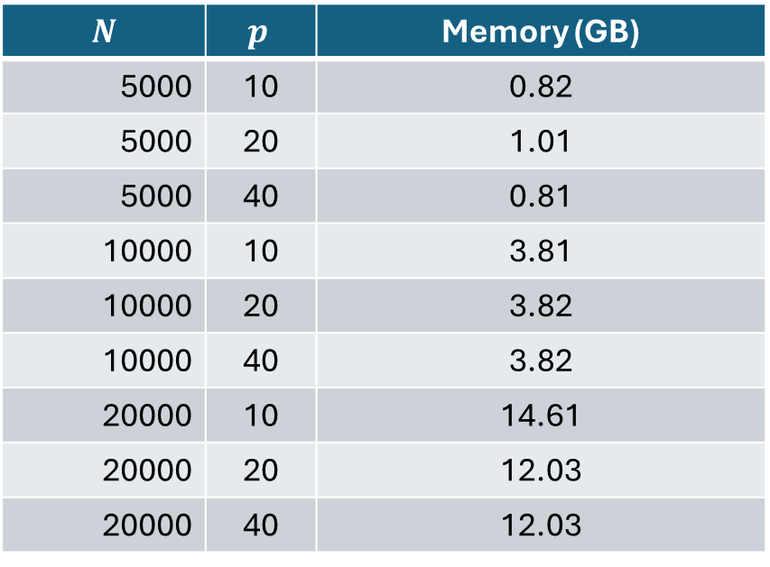
Memory benchmark results
$$N$$ | $$p$$ | Memory (GB)
5000 | 10 | 0.82
5000 | 20 | 1.01
5000 | 40 | 0.81
10000 | 10 | 3.81
10000 | 20 | 3.82
10000 | 40 | 3.82
20000 | 10 | 14.61
20000 | 20 | 12.03
20000 | 40 | 12.03
Scaling
$memory\left(N, p\right)$ constant in $p$
$memory\left(N, p\right)∝N^{2}$

Slide 42
Walltime & memory: conclusions
Do not underestimate: waste of resources
Do not overestimate (too much): inefficient
Only benchmark when relevant
Long walltimes
Lots of memory
Many runs

Slide 43
Efficiency

Slide 44
Implicit parallelism
Parallelism "under the hood"
Some R functions/operations, e.g.,
Some Python libraries, e.g.,
Numpy
How to know?
Check documentation
Measure
…
A <- matrix(rnorm(25), nrow=5)
result <- A
for (i in 1:(power-1)) {
result <- result %*% A
}
…

Slide 45

Benchmark environment
Sapphire Rapids node
2 Intel Xeon Platinum 8468 48-core CPUs
256 GB RAM
Environment: R/4.4.0-gfbf-2023a

Slide 46
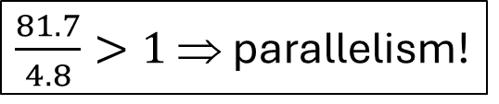
Parallel or not?
Time R script execution
…
#SBATCH --cpus-per-task=16
…
export R_LIBS_USER="${VSC_DATA}/R/${VSC_OS_LOCAL}/${VSC_ARCH_LOCAL}/${EBVERSIONR}"
time R_LIBS_USER=$R_LIBS_USER Rscript dgemm.R --size 5000 --power 20
memory_and_walltime.slurm
…
real 0m4.791s
user 1m21.693s
sys 0m31.345s
…
slurm-….out
$\frac{81.7}{4.8}>1$ ⇒ parallelism!

Slide 47
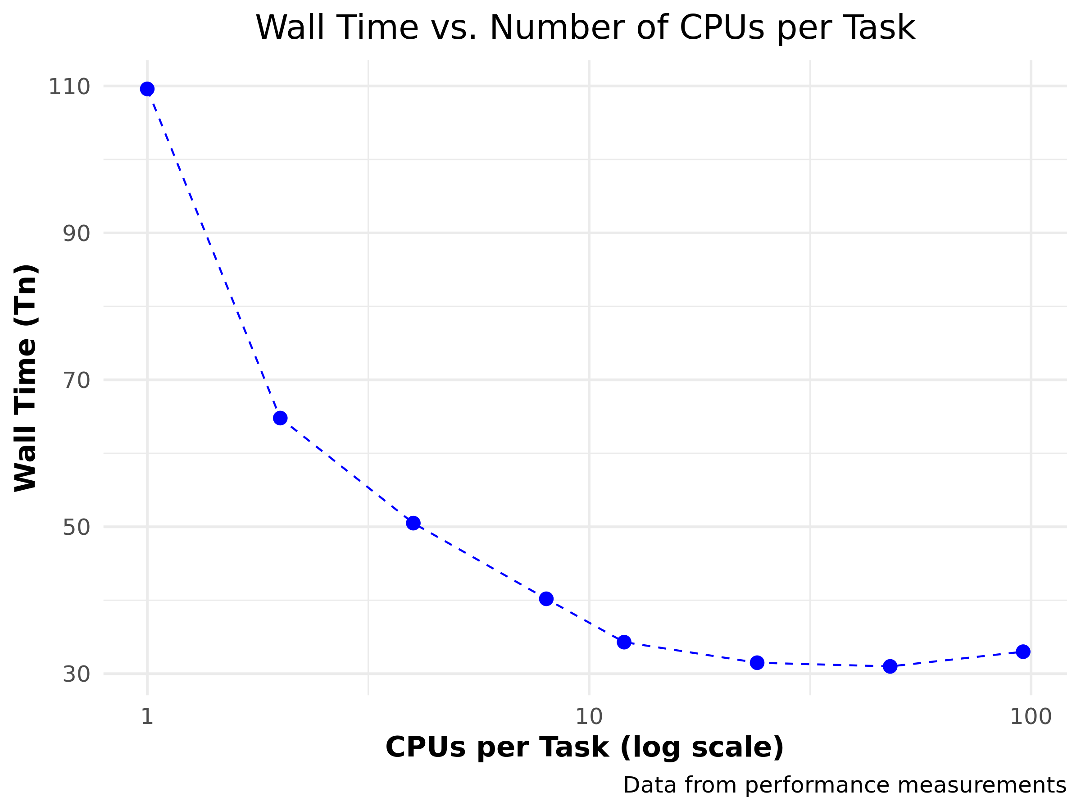

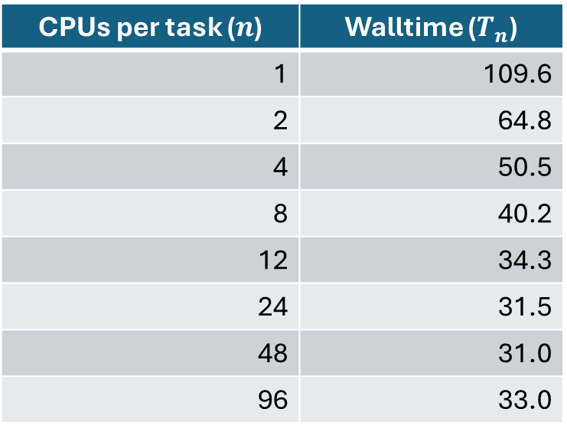
How to exploit?
Use --cpus-per-task 1 ≤ cpus-per-task ≤ number of cores
CPUs per task ($n$) | Walltime ($T_{n}$)
1 | 109.6
2 | 64.8
4 | 50.5
8 | 40.2
12 | 34.3
24 | 31.5
48 | 31.0
96 | 33.0

Slide 48
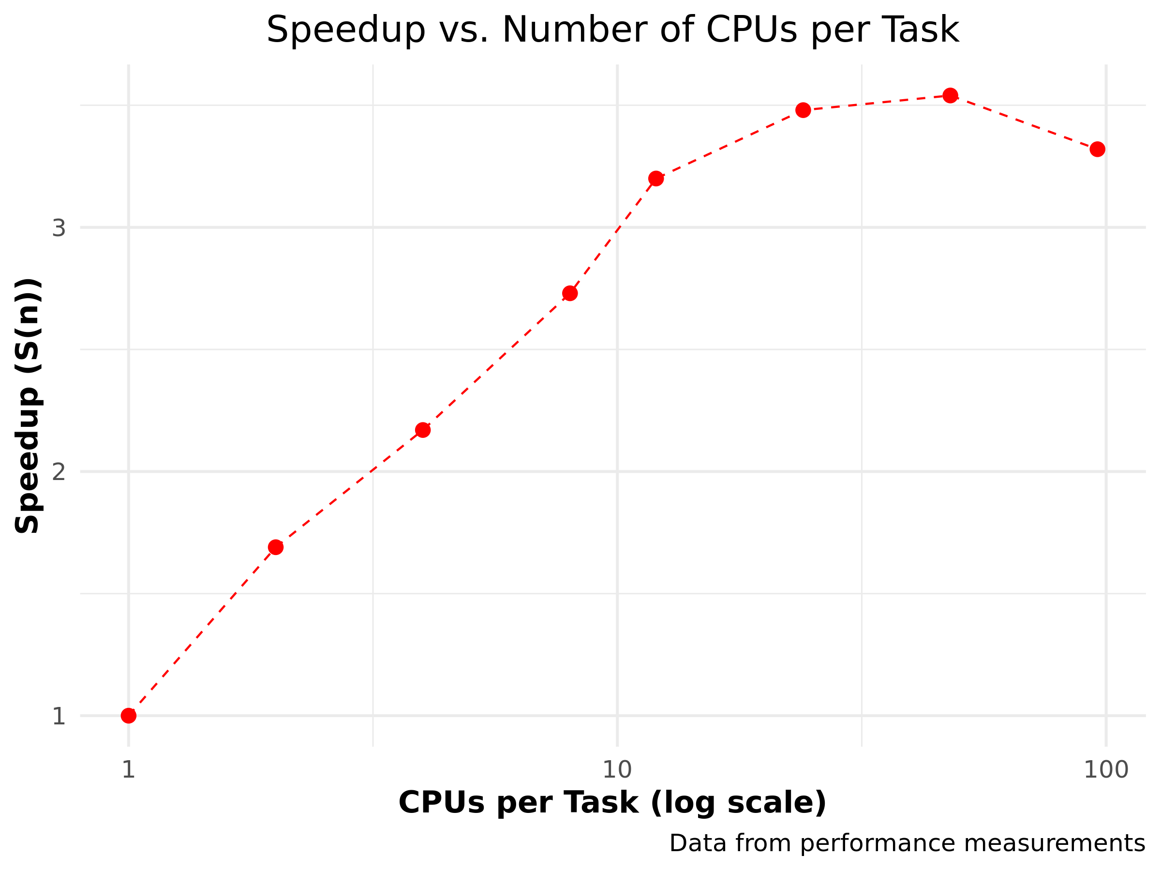

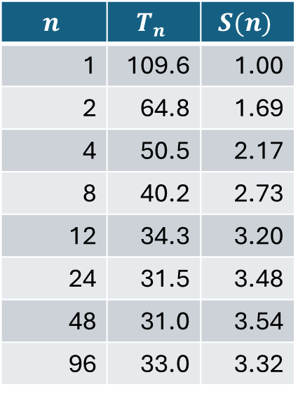
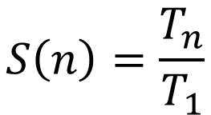
Speedup
$$S\left(n\right)=\frac{T_{n}}{T_{1}}$$
$$n$$ | $$T_{n}$$ | $$S(n)$$
1 | 109.6 | 1.00
2 | 64.8 | 1.69
4 | 50.5 | 2.17
8 | 40.2 | 2.73
12 | 34.3 | 3.20
24 | 31.5 | 3.48
48 | 31.0 | 3.54
96 | 33.0 | 3.32

Slide 49
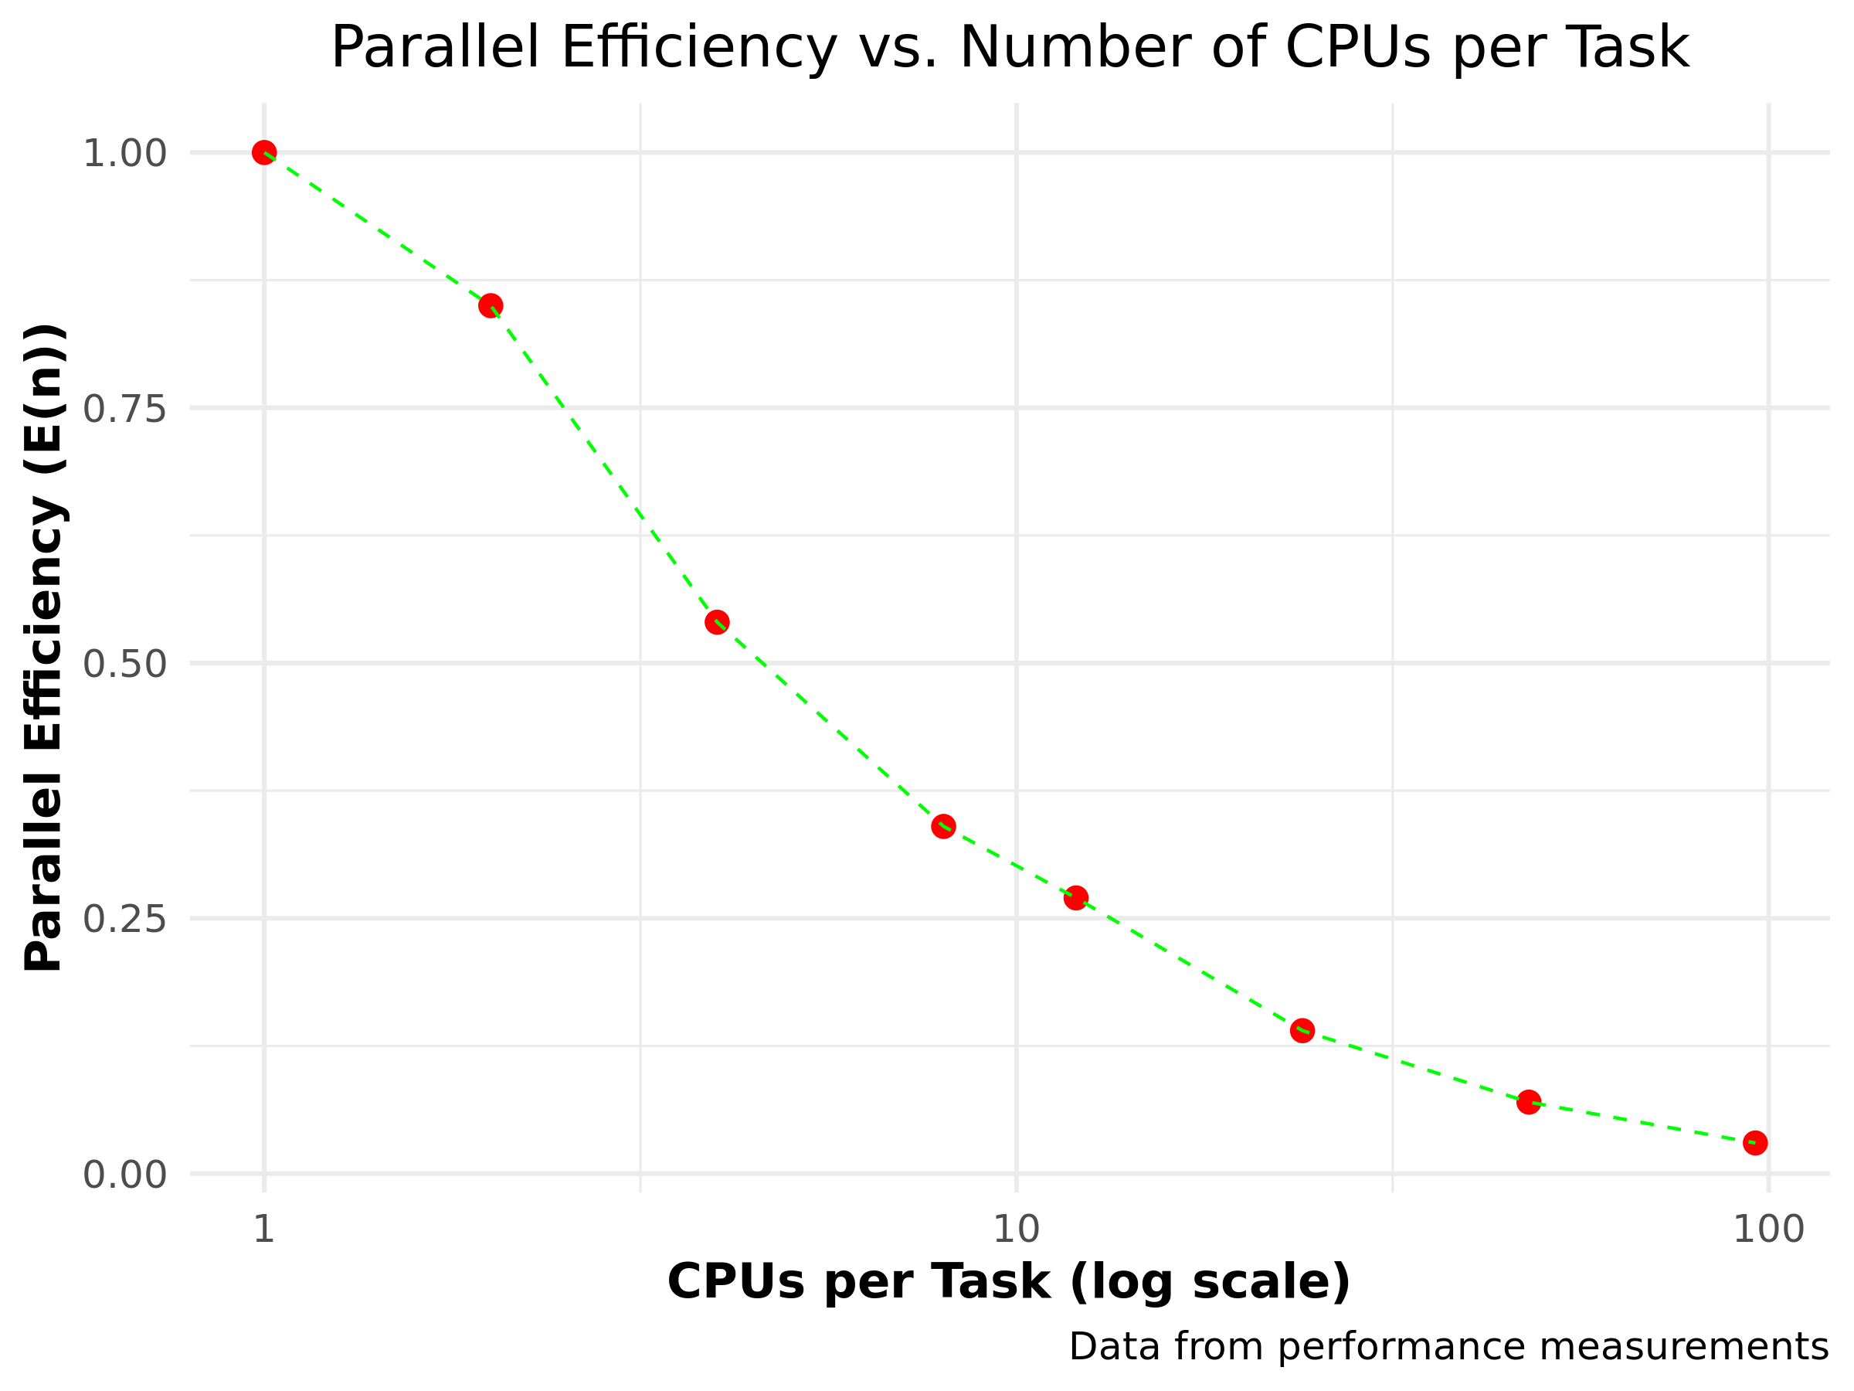

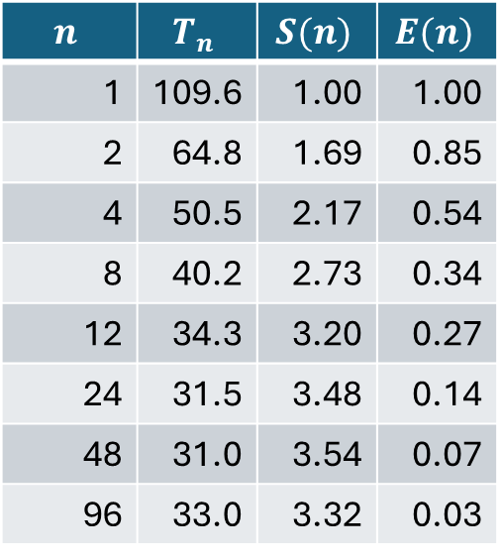
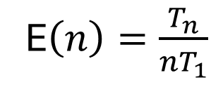
Parallel efficiency
E$\left(n\right)=\frac{T_{n}}{{nT}_{1}}$
$$n$$ | $$T_{n}$$ | $$S(n)$$ | $$E(n)$$
1 | 109.6 | 1.00 | 1.00
2 | 64.8 | 1.69 | 0.85
4 | 50.5 | 2.17 | 0.54
8 | 40.2 | 2.73 | 0.34
12 | 34.3 | 3.20 | 0.27
24 | 31.5 | 3.48 | 0.14
48 | 31.0 | 3.54 | 0.07
96 | 33.0 | 3.32 | 0.03

