Slide 1


C++ software engineering
Geert Jan Bex
(geertjan.bex@uhasselt.be)
License: this presentation is released under the Creative Commons CC BY 4.0, see https://creativecommons.org/licenses/by/4.0/deed.ast

Slide 2

https://bit.ly/3ywlOx0

Slide 3


Slide 4
Typographical conventions: code
Inline code fragments and file names are rendered as, e.g., hello_world.cpp
Longer code fragments are rendered as
Data or CMake files are rendered as
#include <iostream>
…
Int main(int argc, char* argv[]) {
case dim temp
1 1 -0.5
2 1 0.0
3 1 0.5
4 2 -0.5
…
fragment not shown

Slide 5
Typographical conventions: shell
Shell commands are rendered as
Do not type $, it represents your shell prompt!
$ cmake -B build/ -S .

Slide 6
Best practices

Slide 7
Code style matters
Readability
Coding conventions
Exception handling
Code organization
Documentation
Testing
Code must be maintained
Over long periods of time
By multiple people

Slide 8
Coding == story telling
Names should be descriptive
Variables are nouns
Functions are verbs
Boolean functions are questions
Avoid long functions
Should fit on screen
Don’t try to be too clever
Others should understand it (including your future self)
Add comments and documentation
C++ can be easy to read,
make it so!

Slide 9
Coding conventions
Be consistent!
Many conventions, choose one, stick to it
Use tools, e.g., clang-tidy/clang-format
C++ core guidelines https://isocpp.github.io/CppCoreGuidelines/CppCoreGuidelines
Google C++ style guide https://google.github.io/styleguide/cppguide.html
MISRA C++2023 https://misra.org.uk/

Slide 10
Use (modern) language idioms
Don’t
Do
std::vector<double> v;
…
for (int i = 0; I < v.size(); ++i)
std::cout << v[i] << " ";
std::vector<double> v;
…
double su₼{0.0};
For (auto value: v)
sum += value;
std::vector<double> v;
…
for (auto value: v)
std::cout << values << " ";
#include <numeric>
…
std::vector<double> v;
…
double su₼{std::accumulate(v.cbegin(),
v.cend(), 0.0)};

Slide 11
Further reading
Robert C. Martin (2008) Clean code: a handbook of agile software craftsmanship, Pearson

Slide 12
Building with CMake

Slide 13
What is CMake?
Build system generator
Declarative
Generates build files for, e.g., make, ninja,…
Basic steps
Write a CMakeLists.txt file
Create build files
Build the project
Install the project
$ cmake -B build/ -S .
$ cmake --build build/
$ cmake --install build/

Slide 14
Basic CMakeLists.txt file
CMake version
cmake_minimum_required(VERSION 3.20)
project (hello LANGUAGES CXX)
set(CMAKE_CXX_STANDARD 17)
set(CMAKE_CXX_STANDARD_REQUIRED ON)
set(CMAKE_CXX_EXTENSIONS OFF)
add_executable(hello.exe hello_world.cpp)
Project name & language(s)
Language properties
Build artifact

Slide 15
Generate build files
Specify installation directory
Specify build type, e.g., Debug, RelWithDebInfo, Release
Specify a compiler
$ cmake … -DCMAKE_INSTALL_PREFIX=some_directory
$ cmake … -DCMAKE_BUILD_TYPE=Release
$ CXX=ipcx cmake …

Slide 16
Building & installing
Build project
Build, but clean first
Install
Clean
$ cmake --build build/
$ cmake --build build/ --clean-first
$ cmake --install build/
$ cmake --build build/ --target clean

Slide 17
More complex examples
Building a library: library
Using GNU GSL: external-library
Using Boost: boost
Using BLAS/Lapack: blas-lapack
Installing executables and scripts: mixed-code-and-scripts-install
Doing a static build: static-build
Compiling OpenMP: openmp
Using TBB: tbb
See https://github.com/gjbex/C-plus-plus-software-engineering/tree/main/source-code/cmake

Slide 18
Further reading
CMake documentation & community https://cmake.org/documentation/
Dominik Berner and Mustafa Kemal Gilor (2022) CMake Best Practices: Discover proven techniques for creating and maintaining programming projects with Cmake, Packt
Better CMake https://www.youtube.com/playlist?list=PL8i3OhJb4FNV10aIZ8oF0AA46HgA2ed8g
Pablo Arias (2018) It's time to do CMake right https://pabloariasal.github.io/2018/02/19/its-time-to-do-cmake-right/
Daniel Pfeifer's Effective CMake https://youtu.be/rLopVhns4Zs?si=iu9i97KpIIldR41D

Slide 19
Static code analysis

Slide 20
What is it?
Search for known
buggy code patterns
performance issues
deprecated coding style
...
Various implementations
clang-tidy
cppcheck
See
https://github.com/gjbex/C-plus-plus-software-engineering/tree/main/source-code/static-analysis

Slide 21
Further reading
clang-tidy documentation https://clang.llvm.org/extra/clang-tidy/
cppcheck documentation https://cppcheck.sourceforge.io/#documentation

Slide 22
Testing

Slide 23
Types of testing
Unit testing
API level
Various frameworks
Catch2
Google Test
cppunit
Google FuzzyTest
Functional testing
Application level
Various frameworks
CTest
Shunit2
Google FuzzyTest
...

Slide 24
Unit testing
Key concepts
Implementation tested through API
Testing should be easy
Tests are independent of one another
Find problems early/fast
Facilitates change
Make small change, run tests
TDD: Test Driven Development
Write tests first, then implement
Programming framework, e.g., Catch2
"How to test?" is a question that
cannot be answered in general.
"When to test?" however, does have
a general answer: as early and as
often as possible.
— Bjarne Stroustrup
See
https://github.com/gjbex/C-plus-plus-software-engineering/tree/main/source-code/testing/catch2

Slide 25
Functional testing
Run application and test results
See
https://github.com/gjbex/C-plus-plus-software-engineering/tree/main/source-code/testing/ctest

Slide 26
Further reading
Catch2 tutorial https://github.com/catchorg/Catch2/blob/devel/docs/tutorial.md#top
Google Test primer https://google.github.io/googletest/primer.html
cppunit https://www.freedesktop.org/wiki/Software/cppunit/
CTest https://cmake.org/cmake/help/latest/module/CTest.html
Google FuzzTest https://github.com/google/fuzztest
shunit2 https://github.com/kward/shunit2

Slide 27
Dependency management

Slide 28
Package managers
Conan
Wide range of software packages
Mature
vcpkg
Microsoft-backed
Wide range of software packages
CPM
CMake centric
Pure Cmake, (almost) zero install
Relies on CMakeLists.txt of software packages
Can pull GitHub repositories

Slide 29
Conan basic usage
Set up
Write project requirement conanfile.txt
Install dependencies
Change to build directory
Generate build files
Build project
$ pip install conan && conan profile detect --force
$ conan install . --output-folder=build/ --build=missing
$ cd build/
$ cmake .. -DCMAKE_TOOLCHAIN_FILE=conan_toolchain.cmake \
-DCMAKE_BUILD_TYPE=Release
$ cmake --build .

Slide 30
Conan conanfile.txt
[requires]
blaze/3.8.2@
[generators]
CMakeDeps
CMakeToolchain
Dependencies
Build generator
See
https://github.com/gjbex/C-plus-plus-software-engineering/tree/main/source-code/dependency-management/conan

Slide 31
vcpkg
Install vcpkg
Install packages, e.g., blaze
Build your software
$ git clone https://github.com/microsoft/vcpkg
$ ./vcpkg/bootstrap-vcpkg.sh
$ export VCPKG_DIR=$(pwdd)/vcpkg
$ $VCPKG_DIR/vcpkg install blaze
$ cmake -S . -B build/ \
-DCMAKE_TOOLCHAIN_FILE=$VCPKG_DIR/scripts/buildsystems/vcpkg .cmake
$ cmake --build build/

Slide 32
CPM
Install via CMakeLists.txt
…
set(CPM_DOWNLOAD_VERSION 0.38.1)
if(CPM_SOURCE_CACHE)
set(CPM_DOWNLOAD_LOCATION "${CPM_SOURCE_CACHE}/cpm/CPM_${CPM_DOWNLOAD_VERSION}.cmake")
elseif(DEFINED ENV{CPM_SOURCE_CACHE})
set(CPM_DOWNLOAD_LOCATION "$ENV{CPM_SOURCE_CACHE}/cpm/CPM_${CPM_DOWNLOAD_VERSION}.cmake")
else()
set(CPM_DOWNLOAD_LOCATION "${CMAKE_BINARY_DIR}/cmake/CPM_${CPM_DOWNLOAD_VERSION}.cmake")
endif()
if(NOT (EXISTS ${CPM_DOWNLOAD_LOCATION}))
message(STATUS "Downloading CPM.cmake to ${CPM_DOWNLOAD_LOCATION}")
file(DOWNLOAD
https://github.com/TheLartians/CPM.cmake/releases/download/v${CPM_DOWNLOAD_VERSION}/CPM.cmake
${CPM_DOWNLOAD_LOCATION}
)
endif()
include(${CPM_DOWNLOAD_LOCATION})
…

Slide 33
CPM
Install software packages
Download and build of dependencies done by CMake
…
CPMAddPackage("gh:fmtlib/fmt#9.1.0")
…
See
https://github.com/gjbex/C-plus-plus-software-engineering/tree/main/source-code/dependency-management/cpm

Slide 34
Further reading
Conan documentation https://docs.conan.io/2/
vcpkg documentation https://learn.microsoft.com/en-us/vcpkg/
CPM site https://github.com/cpm-cmake/CPM.cmake

Slide 35
Design principles

Slide 36
Write SOLID code
S: Single Responsibility Principle (SRP)
O: Open-Closed Principle (OCP)
L: Lishkov's Substitution Principle (LSP)
I: Interface Segregation Principle (ISP)
D: Dependency Inversion Principle (DIP)
See
https://github.com/gjbex/Scientific-C-plus-plus/tree/master/source-code/DesignPatterns/CellularAutomata

Slide 37
Single Responsibility Principle (SRP)
Class or function should have
only one reason to change
Single responsibility
Aims
Improve maintainability
Improve clarity
Reduce coupling
Enable better testing
Support reusability

Slide 38
Open-Closed Principle (OCP)
Classes, modules, functions should be
Open to extension
Closed to modification
Aims
Promote extensibility (Open)
Improve maintainability, existing code not affected by changes (Closed)
Support reusability and scaling (extension)
Encourage use of abstraction
Facilitate cleaner architecture

Slide 39
Lishkov Substitution Principle (LSP)
Derived class can be used wherever base class is used
Aims
Properly model "is-a" relationships, behavioral consistency
Preserve code correctness
Enable safe polymorphism
Improve reusability and maintainability
“If a piece of code works with the parent class,
it should also work with any subclass, without
knowing the difference.”

Slide 40
Interface Segregation Principle (ISP)
Do not force to depend on irrelevant interfaces
Aims
Reduce coupling, unnecessary dependencies
Improve code maintainability
Improve flexibility and reusability
Minimize impact of changes
Encourage cleaner architecture
“Favor multiple small interfaces"

Slide 41
Dependency Inversion Principle (DIP)
High-level code should not depend on low-level details
Aims
Promote decoupling
Enhance flexibility and scalability (extensions)
Improve maintainability and testability
Encourage layered architecture
Facilitate reuse and "plug-and-play" components
“Depend on abstractions, not concretions"

Slide 42
Law of Demeter
Modules should not "know" about the internal details of the objects they interacts with
Law of Demeter helps enforce SOLID
Helps enforce Single Responsibility Principle
Reduces ripple effect of change (open-closed principle)
Encourages smaller interfaces (Interface segregation principle)
"Only talk to your immediate friends"
See
https://github.com/gjbex/Scientific-C-plus-plus/tree/master/source-code/DesignPatterns/CellularAutomata

Slide 43
Further reading
Robert C. Martin (2008) Clean Code: A Handbook of Agile Software Craftsmanship, Pearson

Slide 44
Design patterns

Slide 45
Motivation
Observation: patterns in problems to solve
Design pattern = recipe for software design
Don’t reinvent the wheel

Slide 46
Design patterns
Quite a lot (23 originally)
Creational patterns
E.g., builder, factory
Structural patterns
E.g., decorator
Behavioral patterns
E.g., state, strategy
Parallel patterns
See
https://github.com/gjbex/C-plus-plus-software-engineering/tree/main/source-code/design-patterns

Slide 47
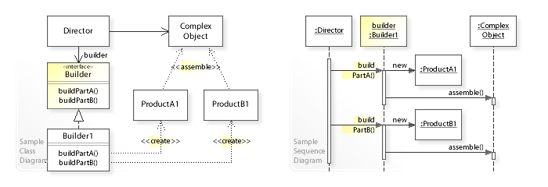
Builder design pattern
See
https://github.com/gjbex/Scientific-C-plus-plus/tree/master/source-code/DesignPatterns/BuilderPattern

Slide 48
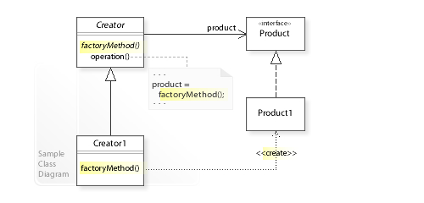
Factory design pattern
See
https://github.com/gjbex/Scientific-C-plus-plus/tree/master/source-code/DesignPatterns/FactoryPattern https://github.com/gjbex/Scientific-C-plus-plus/tree/master/source-code/DesignPatterns/CellularAutomata

Slide 49
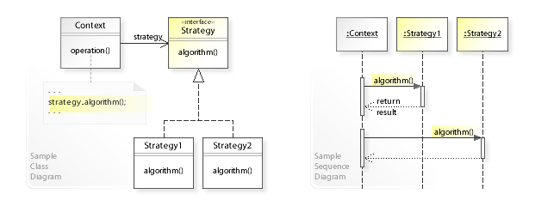
Strategy design pattern
See https://github.com/gjbex/Scientific-C-plus-plus/tree/master/source-code/DesignPatterns/StrategyPattern
https://github.com/gjbex/Scientific-C-plus-plus/tree/master/source-code/DesignPatterns/CellularAutomata

Slide 50
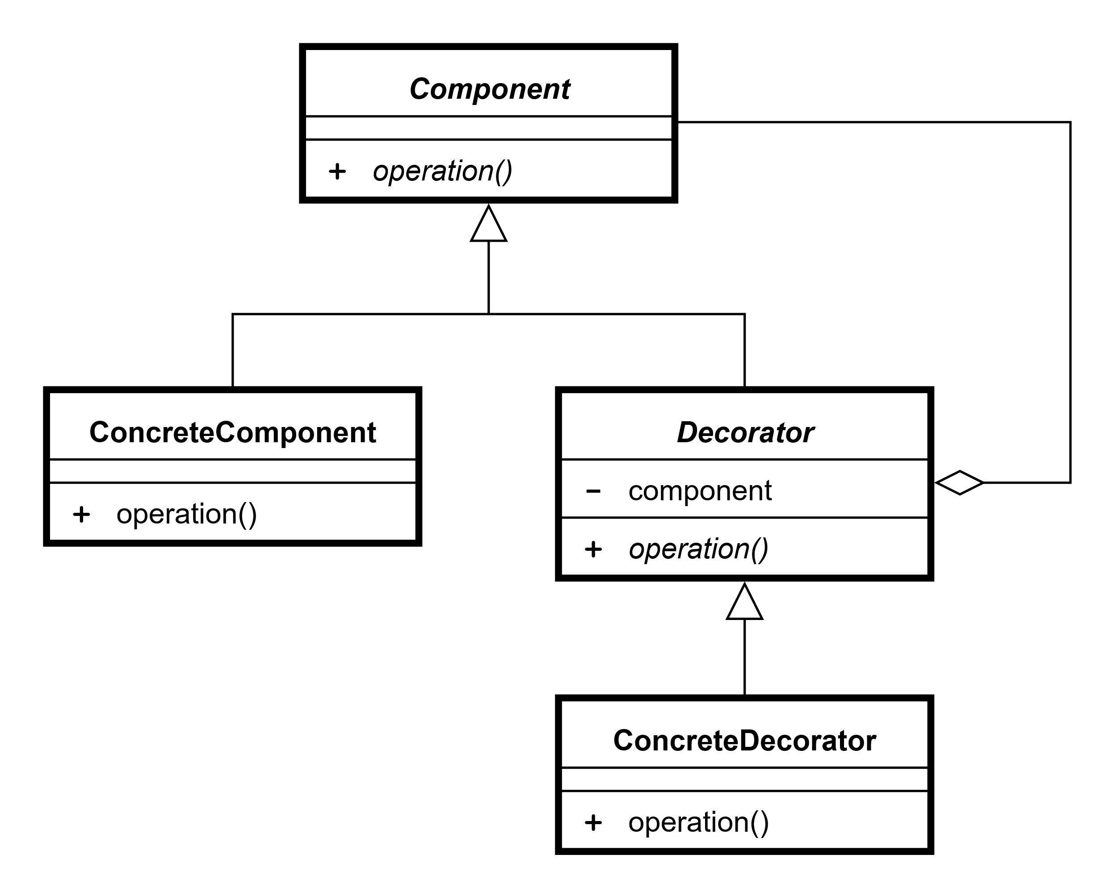
Decorator pattern
See https://github.com/gjbex/Scientific-C-plus-plus/tree/master/source-code/DesignPatterns/CellularAutomata

Slide 51
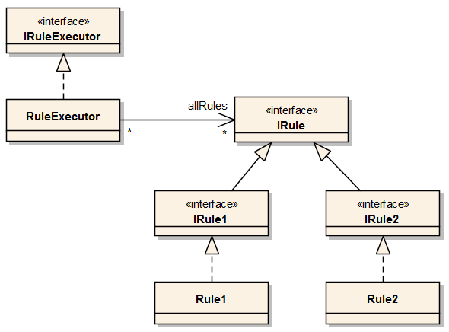
Dependency injection
Supports dependency inversion principle
See https://github.com/gjbex/Scientific-C-plus-plus/tree/master/source-code/DesignPatterns/CellularAutomata

Slide 52
C++ specific patterns
Curiously Repeating Template Pattern (CRTP)
Type erasure
Pointer to IMPLementation idiom (PIMPL)
Resource Acquisition Is Initialization (RAII)

Slide 53
Curiously, Repeating Template Pattern (CRTP)
Avoid virtual function overhead
Enforce compile time interface constraints
Code reuse without dynamic polymorphism
Static polymorphism
See
https://github.com/gjbex/C-plus-plus-software-engineering/tree/main/source-code/design-patterns

Slide 54
CRTP: base class
template<class Derived>
struct Simulation {
protected:
…
public:
…
void step() {
if (is_verbose_) std::cout << "start step " << current_step_ << '\n';
static_cast<Derived*>(this)->step_implementation();
if (is_verbose_) std::cout << "end step " << current_step_ << '\n';
current_step_++;
}
void run(const std::size_t max_nr_steps) {
for (size_t step_nr = 0; step_nr < max_nr_steps; ++step_nr) step();
}
…
simulation.h

Slide 55
CRTP: first derived class
…
#include "simulation.h"
struct DiceSimulation : public Simulation<DiceSimulation> {
protected:
std::mt19937_64 engine_;
std::uniform_int_distribution<int> distr_ {1, 6};
public:
void seed(const std::size_t seed_value) { engine_.seed(seed_value); }
void step_implementation() { std::cout << distr_(engine_) << '\n'; };
};
dice_simulation.h

Slide 56
CRTP: second derived class
…
#include "simulation.h"
using Distribution = std::array<std::size_t, 6>;
struct DiceAvgSimulation : public Simulation<DiceAvgSimulation> {
protected:
std::mt19937_64 engine_;
std::uniform_int_distribution<int> distr_ {1, 6};
Distribution throw_distr_ = {0};
public:
void seed(const std::size_t seed_value) { engine_.seed(seed_value); }
void step_implementation() {
throw_distr_[distr_(engine_) - 1]++;
};
const Distribution& distribution() const { return throw_distr_; }
};
dice_avg_simulation.h

Slide 57
CRTP: usage
…
#include "dice_simulation.h"
int main() {
DiceSimulation simulation;
simulation.seed(1234);
simulation.run(10);
return 0;
}
main_dice.cpp

Slide 58
Pointer to IMPLementation idiom (PIMPL)
Interface holds pointer to implementation
Advantages
Decouple interface and implementation
Easy to replace implementation
Reduces compile times (only implementation needs to be recompiled)
See https://github.com/gjbex/Scientific-C-plus-plus/tree/master/source-code/DesignPatterns/PIMPL

Slide 59
Resource Acquisition Is Intialization (RAII)
Resources
acquire in constructor
Release in destructor
Advantage
No leaks
No dangling resources
Example
C++ smart pointers (std::unique_ptr/std::shared_ptr)

Slide 60
Further reading
Erich Gamma, Richard Helm, Ralph Johnson and John Vlissides (1994) Design patterns: elements of reusable object-oriented software, Addison-Wesley
Klaus Iglberger (2022) C++ software design, O'Reilly Media

Slide 61
Functional approach

Slide 62
Functional features in C++
Lambda functions
STL algorithms
STL ranges/views
STL generators
See
https://github.com/gjbex/Scientific-C-plus-plus/tree/master/source-code/Functional
https://github.com/gjbex/Scientific-C-plus-plus/tree/master/source-code/Algorithms
https://github.com/gjbex/Scientific-C-plus-plus/tree/master/source-code/Ranges

