Slide 1
Inversions
Geert Jan Bex
(geertjan.bex@uhasselt.be)

Slide 2
Definition
maps point x_{o} outside a circle with radius r onto a point x_{i} inside of it
and vice versa
r
x_{o}
x_{i}
r
x_{o}
x_{i}

Slide 3

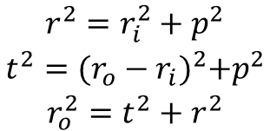



Formulas in polar coordinates
$$\begin{matrix}x_{o}=(r_{o},θ_{o}) \\ x_{i}=(r_{i},θ_{i})\end{matrix}$$
t
p
r
$$\begin{matrix}r^{2}=r_{i}^{2}+p^{2} \\ t^{2}={(r_{o}−r_{i})}^{2}+p^{2} \\ r_{o}^{2}=t^{2}+r^{2}\end{matrix}$$
$$r_{i}=\frac{r^{2}}{r_{o}}$$
$$⇒$$
x_{o}
x_{i}
$$θ_{i}=θ_{o}$$

Slide 4
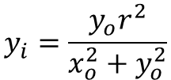

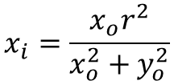



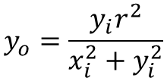

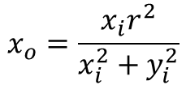
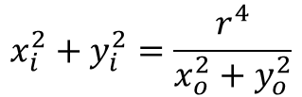

Formulas in Cartesian coordinates
$$r_{i}=\frac{r^{2}}{r_{o}}$$
$$x_{i}^{2}+y_{i}^{2}=\frac{r^{4}}{x_{o}^{2}+y_{o}^{2}}$$
$$x_{i}=\frac{x_{o}r^{2}}{x_{o}^{2}+y_{o}^{2}}$$
$$⇒$$
$$⇒$$
$$\frac{y_{i}}{x_{i}}=\frac{y_{o}}{x_{o}}$$
$$y_{i}=\frac{y_{o}r^{2}}{x_{o}^{2}+y_{o}^{2}}$$
$$θ_{i}=θ_{o}$$
$$x_{o}=\frac{x_{i}r^{2}}{x_{i}^{2}+y_{i}^{2}}$$
$$⇒$$
$$y_{o}=\frac{y_{i}r^{2}}{x_{i}^{2}+y_{i}^{2}}$$

